Slide 1
Basic Level of Production Metrics
2026-W36 · the three numbers this deck reports, and what each one is for
1. Capacity
How many units we are producing
171 units through 4 steps this week, across 221 runs.
It sets the schedule: a station cannot ship what it cannot test.
2. Yield
How many percentage we can ship vs total production
First pass 40.0% at MLT and 78.9% at HTT — — rolled across the two.
It sets how many units must be started to ship one.
3. Retest
How stable is the test
16.7% of MLT units and 11.9% of HTT units had to be run again — 15 and 8 units.
It is where yield loss turns into lost capacity.
Why it is broken out by test step: a line ships at the rate of its worst step, not its average — so the only useful version of these three numbers is one per step, in the order a unit travels.

Slide 2
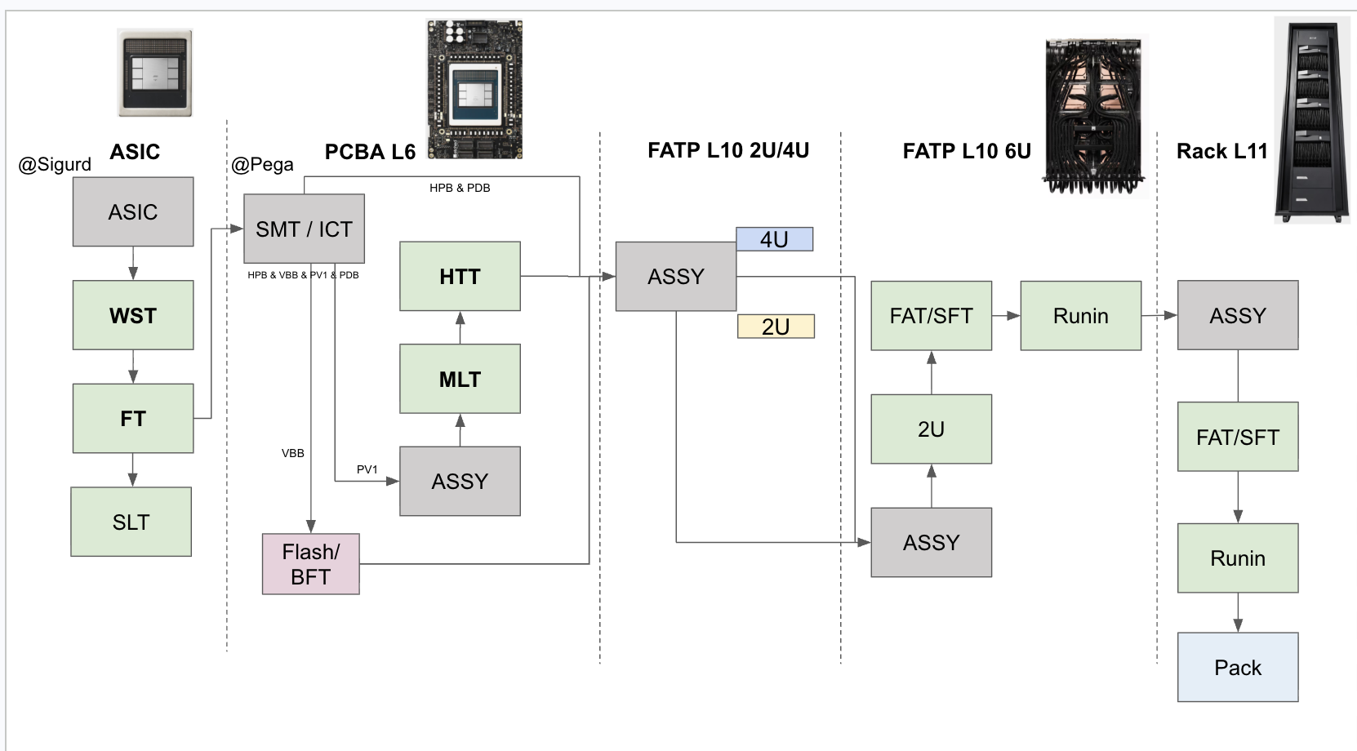
Production test flow — yield and quantity
2026-W36 · 2026-08-31 to 2026-09-06, week still running · UTC · first-pass yield and units, under each step
L6 combined (MLT × HTT)
—
MLT 40.0% · HTT 78.9%
a module's chance of clearing both first time
Through the line
171 units
221 runs across 4 steps
67 units few units
32.5% reported
Reading the numbers
A percentage is a first-pass yield: units that passed at their first attempt that week.
A count means no yield is reported. None are chassis and rack level and in bring-up — a percentage over three units swings 33 points on one of them.
Too few units this week: TIM, MLT, HTT, L11 Provision. WST and FT are reported by Sigurd. VBB is drawn for the flow and left out of the yield view.
Source: pega2, pega6, pega3, pega4, pega5 (ESVM), one row per unit.
90 units few units
— reported
at Sigurd — not collected here
VBB — outside the yield view
counted with FAT / SFT

Slide 3
Every step, with the retest rate
2026-W36 · retest rate is the share of units that had to be run again
Test step
Units
Runs
First pass
After retest
Retest rate
Top failure
WST reported
32.5%
Sigurd, as of 2026-08-21
FT reported
—
Sigurd, as of 2026-08-14
TIM pega6
11
11
not enough units
90.9%
0.0%
0 of 11 units re-run
validate_coldplate_temperature
MLT pega3
90
106
not enough units
63.3%
16.7%
15 of 90 units re-run
SohuPmbistTestCase
HTT pega3
67
75
not enough units
85.1%
11.9%
8 of 67 units re-run
SohuLlamaForwardIteratedTestCase
L11 Provision pega5
3
29
not enough units
100.0%
100.0%
3 of 3 units re-run
ProvisionComputeServer
Rolled first-pass across no step: —
Steps under 20 first-time units report counts only. Full unit-level source data, every serial and release with a link to its run: 32x-production.i.etched.com/week.html#week=2026-W36

Slide 4
What's next
two actions, each against a target and where 2026-W36 finished
a
Improve the yield / stability of L6 test
L6 is the only level with the volume to be measured against a target at all, and it is where the line loses most of its units.
Yield target
85%
today 40.0% at MLT, 78.9% at HTT
Stability
< 10% retest
today 16.7% at MLT, 11.9% at HTT
b
Speed up development of multiple L10 test units
Gate: only 1–2 units onsite
Not to improve the L10 yield — to make one exist. On single digits there is nothing to read, which is why every L10 box on this deck says quantity only.
Target
3 to 10 units
assembled for test development
Coverage
full coverage
today 0 units across four steps
The ordering is the point. Coverage, then stability, then efficiency — a station clears one gate before the next is worth measuring. L6 is at the first gate with the volume to prove it; L10 is not yet at a gate at all.

Slide 5
Appendix — where the data comes from
every figure on this deck traces to one of these; the first one lists the units behind it
This week, unit by unit
Source data for 2026-W36 — every DUT serial, software release, verdict and a link to its run
32x-production.i.etched.com/week.html#week=2026-W36
Every week since collection began, one row each
32x-production.i.etched.com/weekly.html
The rest of the dashboard
Daily tracker — the line's own MLT/HTT tabs, rebuilt from pega3
32x-production.i.etched.com/dailyexcel.html
L10 daily tracker — FAT, SFT, RIN, 2U from pega4
32x-production.i.etched.com/l10.html
Station yield, from the controllers
32x-production.i.etched.com/direct.html
Station yield, from OCP Logs — and the measured gap between them
32x-production.i.etched.com/index.html
Run drill-down, any serial or test name
32x-production.i.etched.com/runs.html
Production test flow, with coverage
32x-production.i.etched.com/flow.html
Upstream of the dashboard
The controllers themselves — ESVM login admin / admin
pega2:3000 · pega3:3000 · pega4:3000 · pega5:3000
OCP Logs / EOS, the other side of the discrepancy
ocplogs.core.etched.com
WST and FT — Sigurd's STDF and SPLM, asked for weekly in #production-test-eng
strata6.sv9.i.etched.com:8235 · splm.i.etched.com
This deck, the pipeline that built it, and every archived week
github.com/etched-ai/factory_data_analysis · weekly/2026-W36/
All addresses are on the factory network. The dashboard rebuilds hourly; the archived copy of 2026-W36 under weekly/ does not change.

