Slide 1
Basic Level of Production Metrics
2026-W33 · the three numbers this deck reports, and what each one is for
1. Capacity
How many units we are producing
407 units through 7 steps this week, across 573 runs.
It sets the schedule: a station cannot ship what it cannot test.
2. Yield
How many percentage we can ship vs total production
First pass 65.5% at MLT and 54.3% at HTT — 35.6% rolled across the two.
It sets how many units must be started to ship one.
3. Retest
How stable is the test
19.7% of MLT units and 27.6% of HTT units had to be run again — 45 and 47 units.
It is where yield loss turns into lost capacity.
Why it is broken out by test step: a line ships at the rate of its worst step, not its average — so the only useful version of these three numbers is one per step, in the order a unit travels.

Slide 2
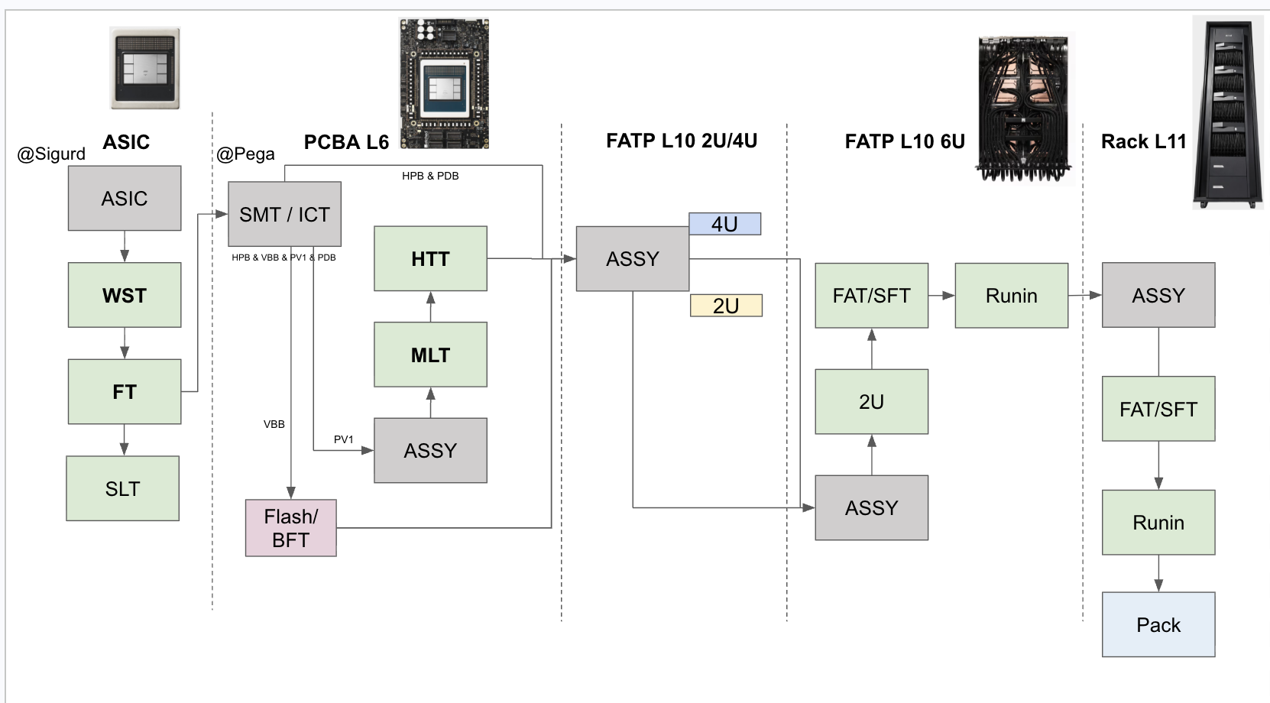
Production test flow — yield and quantity
2026-W33 · 2026-08-10 to 2026-08-16, week still running · UTC · first-pass yield and units, under each step
Rolled first-pass
35.6%
MLT × HTT
Through the line
407 units
573 runs across 7 steps
54.3% 170 units
Reading the numbers
A percentage is a first-pass yield: units that passed at their first attempt that week.
A count means no yield is reported. L10 FAT, L10 SFT, L10 RIN, L10 2U, L11 Test are chassis and rack level and in bring-up — a percentage over three units swings 33 points on one of them.
WST and FT are reported by Sigurd. VBB is drawn for the flow and left out of the yield view.
Source: pega2 – pega5 (ESVM), one row per unit.
35.3% reported
FAT 2u · SFT 1u quantity only
1 unit quantity only
65.5% 228 units
84.3% reported
3 units quantity only
2 units quantity only
at Sigurd — not collected here
VBB — outside the yield view
counted with FAT / SFT

Slide 3
Every step, with the retest rate
2026-W33 · retest rate is the share of units that had to be run again
Test step
Units
Runs
First pass
After retest
Retest rate
Top failure
WST reported
35.3%
Sigurd, as of 2026-08-14
FT reported
84.3%
Sigurd, as of 2026-08-14
MLT pega3
228
279
65.5%
74.6%
19.7%
45 of 228 units re-run
SohuPowerVirusTestCase
HTT pega3
170
234
54.3%
68.8%
27.6%
47 of 170 units re-run
SohuRdqsSweepTrainingTestCase
L10 FAT pega4
2
15
quantity only
—
—
chassis and rack level, in bring-up — quantity only
SohuHostRebootTestCase
L10 SFT pega4
1
6
quantity only
—
—
chassis and rack level, in bring-up — quantity only
SohuLlama70bHp8ForwardIteratedTestCase
L10 RIN pega4
1
4
quantity only
—
—
chassis and rack level, in bring-up — quantity only
RunInStress
L10 2U pega4
3
19
quantity only
—
—
chassis and rack level, in bring-up — quantity only
BmcCheck
L11 Test pega5
2
16
quantity only
—
—
chassis and rack level, in bring-up — quantity only
CheckSohuServerNoErrorLogTestCase
Rolled first-pass across MLT × HTT: 35.6%
Steps under 20 first-time units report counts only. Full unit-level source data, every serial and release with a link to its run: 32x-production.i.etched.com/week.html#week=2026-W33

Slide 4
What's next
two actions, each against a target and where 2026-W33 finished
a
Improve the yield / stability of L6 test
L6 is the only level with the volume to be measured against a target at all, and it is where the line loses most of its units.
Yield target
85%
today 65.5% at MLT, 54.3% at HTT
Stability
< 10% retest
today 19.7% at MLT, 27.6% at HTT
b
Speed up development of multiple L10 test units
Gate: only 1–2 units onsite
Not to improve the L10 yield — to make one exist. On single digits there is nothing to read, which is why every L10 box on this deck says quantity only.
Target
3 to 10 units
assembled for test development
Coverage
full coverage
today 7 units across four steps
The ordering is the point. Coverage, then stability, then efficiency — a station clears one gate before the next is worth measuring. L6 is at the first gate with the volume to prove it; L10 is not yet at a gate at all.

Slide 5
Appendix — where the data comes from
every figure on this deck traces to one of these; the first one lists the units behind it
This week, unit by unit
Source data for 2026-W33 — every DUT serial, software release, verdict and a link to its run
32x-production.i.etched.com/week.html#week=2026-W33
Every week since collection began, one row each
32x-production.i.etched.com/weekly.html
The rest of the dashboard
Daily tracker — the line's own MLT/HTT tabs, rebuilt from pega3
32x-production.i.etched.com/dailyexcel.html
L10 daily tracker — FAT, SFT, RIN, 2U from pega4
32x-production.i.etched.com/l10.html
Station yield, from the controllers
32x-production.i.etched.com/direct.html
Station yield, from OCP Logs — and the measured gap between them
32x-production.i.etched.com/index.html
Run drill-down, any serial or test name
32x-production.i.etched.com/runs.html
Production test flow, with coverage
32x-production.i.etched.com/flow.html
Upstream of the dashboard
The controllers themselves — ESVM login admin / admin
pega2:3000 · pega3:3000 · pega4:3000 · pega5:3000
OCP Logs / EOS, the other side of the discrepancy
ocplogs.core.etched.com
WST and FT — Sigurd's STDF and SPLM, asked for weekly in #production-test-eng
strata6.sv9.i.etched.com:8235 · splm.i.etched.com
This deck, the pipeline that built it, and every archived week
github.com/etched-ai/factory_data_analysis · weekly/2026-W33/
All addresses are on the factory network. The dashboard rebuilds hourly; the archived copy of 2026-W33 under weekly/ does not change.

