Slide 1

Board Support Package (BSP)
Ra fsp investigation
Feb 9, 2023
Canh phan
Software development department
Ra fsp group
Renesas Electronics Corporation

Slide 2
Agenda
What is BSP?
BSP modules
BSP I/O access
Common Error Codes
MCU Board Support Package
Summary

Slide 3
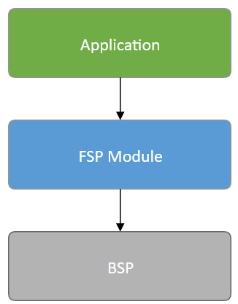
What is BSP?
The Board Support Package (BSP) is the foundation for FSP modules, providing functionality to determine the MCU used as well as configuring clocks, interrupts and pins.

Slide 4
Bsp modules
BSP I/O access
Common Error Codes
MCU Board Support Package

Slide 5
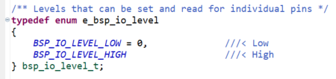
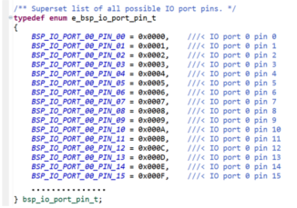
Bsp i/o access
This module provides basic read/write access to port pins
enum | Description
bsp_io_level_t | Levels that can be set and read for individual pins
bsp_io_direction_t | Direction of individual pins
bsp_io_port_t | Superset list of all possible IO ports.
bsp_io_port_pin_t | Superset list of all possible IO port pins.

Slide 6
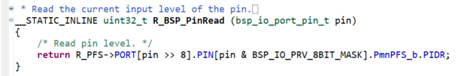
Bsp i/o access
Function | Description
R_BSP_PinRead() | Read the current input level of the pin.
R_BSP_PinWrite() | Set a pin to output and set the output level to the level provided. If PFS protection is enabled, disable PFS protection using R_BSP_PinAccessEnable() before calling this function.
R_BSP_PinCfg() | Configure a pin. If PFS protection is enabled, disable PFS protection using R_BSP_PinAccessEnable() before calling this function.
R_BSP_PinAccessEnable() | Enable access to the PFS registers. Uses a reference counter to protect against interrupts that could occur via multiple threads or an ISR re-entering this code.
R_BSP_PinAccessDisable() | Disable access to the PFS registers. Uses a reference counter to protect against interrupts that could occur via multiple threads or an ISR re-entering this code.

Slide 7
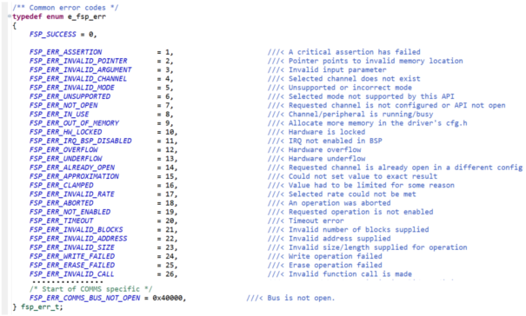
Common Error Codes
All FSP modules share these common error codes.

Slide 8
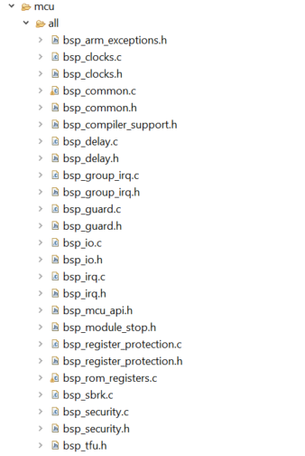
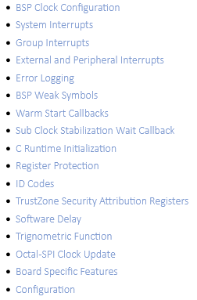
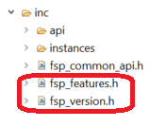
MCU Board Support Package
The BSP is responsible for getting the MCU from reset to the user's application. Before reaching the user's application, the BSP sets up the stacks, heap, clocks, interrupts, C runtime environment, and stack monitor.

Slide 9
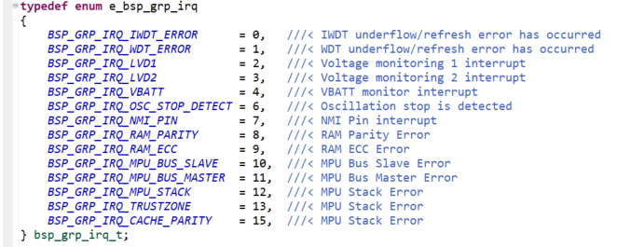
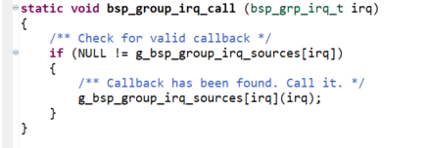
MCU Board Support Package bsp_group_irq
Group interrupt is the term used to describe the 12 sources that can trigger the Non-Maskable Interrupt (NMI).
Enum | Description
bsp_grp_irq_t | Which interrupts can have callbacks registered.
Function | Description
bsp_group_irq_call() | Calls the callback function for an interrupt if a callback has been registered.
R_BSP_GroupIrqWrite() | Register a callback function for supported interrupts.
NMI_Handler() | Non-maskable interrupt handler.

Slide 10
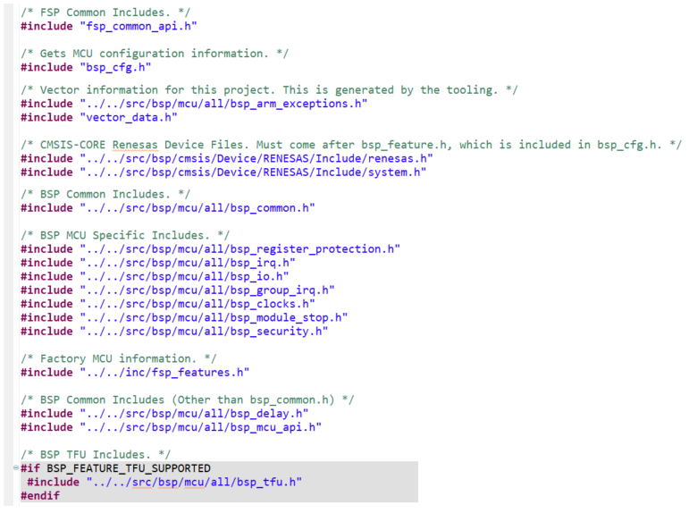
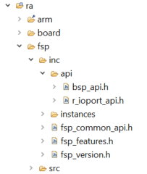
Bsp summary
Common Error Codes
BSP I/O access

Slide 11
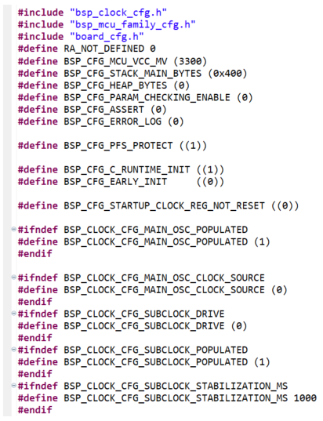
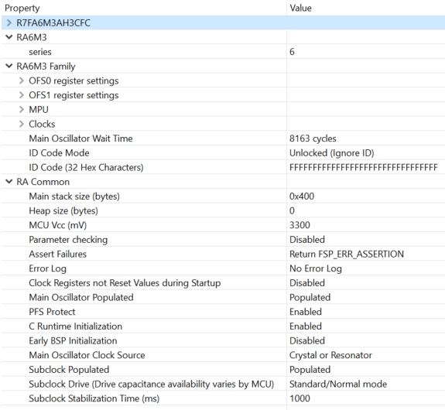
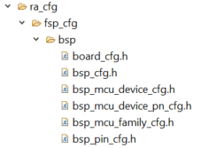
Bsp summary
Configuration

Slide 12
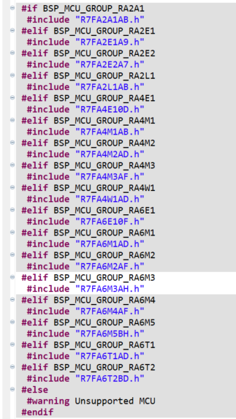
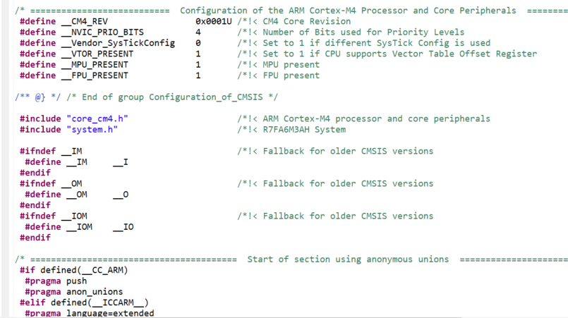
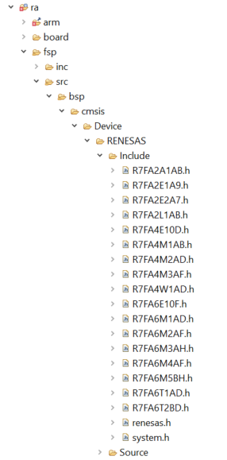
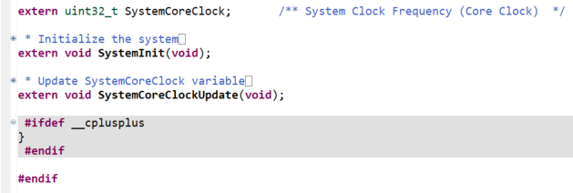
Bsp summary
CMSIS-CORE

Slide 13
reference
RA Flexible Software Package Documentation https://renesas.github.io/fsp/
FSP Architecture FSP Architecture | Renesas RA Wiki.js

Slide 14
Renesas.com

