Slide 1

Clock Generation Circuit (cgc) module
Ra fsp investigation report
Feb 9, 2023
The Nguyen
Software development department
Ra fsp group
Renesas Electronics Corporation

Slide 2
Agenda
overview Page 03
Module Configuration Page 11
Register Descriptions Page 15
CGC Interface Page 19
CGC API Page 21
EXAMPLES Page 32

Slide 3
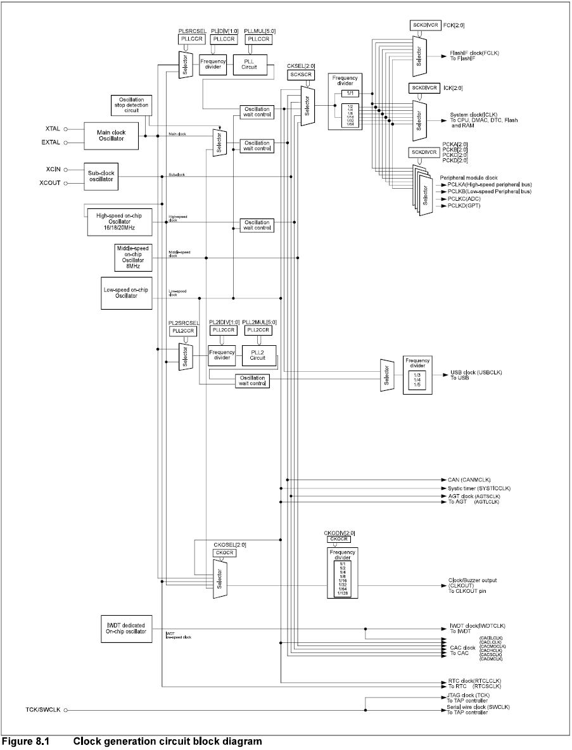
overview what is “cgc”?
CGC is driver for the Clock Generation Circuit peripheral on RA MCUs. This module implements the CGC Interface.
The CGC module supports runtime modifications of clock settings. Key features include the following:
Supports changing the system clock source.
When the system core clock frequency changes, update some new information for: CMSIS standard global variable, wait states for ROM and RAM, the operating power control mode.
Supports starting or stopping any of the system clock sources.
Supports changing dividers for the internal clocks.
Supports the oscillation stop detection feature.

Slide 4
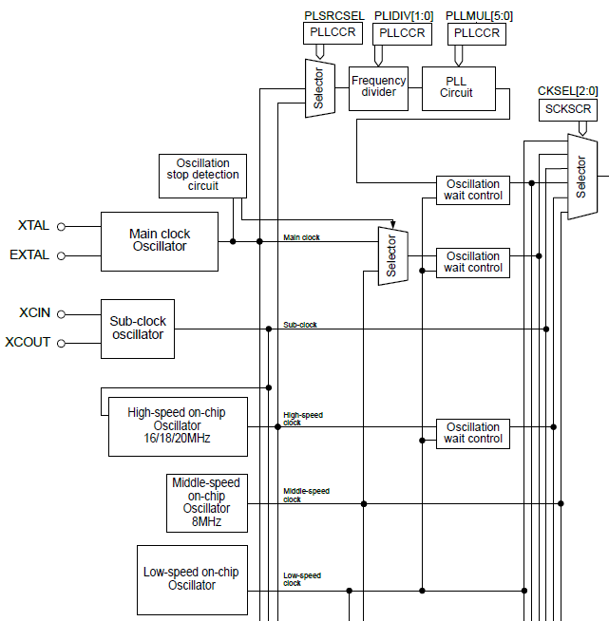
overview clock source support
On-chip oscillator: refer RA4M3 User‘s Hardware Manual
Clock source | Description | Specification
High-speed on-chip oscillator (HOCO) | Oscillation frequency | 16/18/20 MHz
 | FLL function * | Available
 | User trimming | Available
Middle-speed on-chip oscillator (MOCO) | Oscillation frequency | 8 MHz
 | User trimming | Available
Low-speed on-chip oscillator (LOCO) | Oscillation frequency | 32.768 kHz
 | User trimming | Available
IWDT-dedicated on-chip oscillator (IWDTLOCO) | Oscillation frequency | 15 kHz
 | User trimming | Unavailable
*FLL: Frequency Locked Loop

Slide 5
overview clock source support
External oscillator: refer RA4M3 User‘s Hardware Manual
Clock source | Description | Specification
Main clock oscillator (MOSC) | Resonator frequency | 8 MHz to 24 MHz
 | External clock input frequency | Up to 24 MHz
 | External resonator or additional circuit | ceramic resonator, crystal
 | Drive capability switching | Available
 | Oscillation stop detection function | Available
Sub-clock oscillator (SOSC) | Resonator frequency | 32.768 kHz
 | External resonator or additional circuit | crystal resonator
 | Drive capability switching | Available

Slide 6
overview clock source support
Phase-Locked-Loop: refer RA4M3 User‘s Hardware Manual
Clock source | Description | Specification
PLL circuit | Input clock source | MOSC, HOCO
 | Input frequency | 8 MHz to 24 MHz
 | PLL Output frequency | 100 MHz to 200 MHz
PLL2 circuit | Input clock source | MOSC, HOCO
 | Input frequency | 8 MHz to 24 MHz
 | PLL Output frequency | 120 MHz to 240 MHz
 | PLL2-LDO stop function | Unavailable

Slide 7
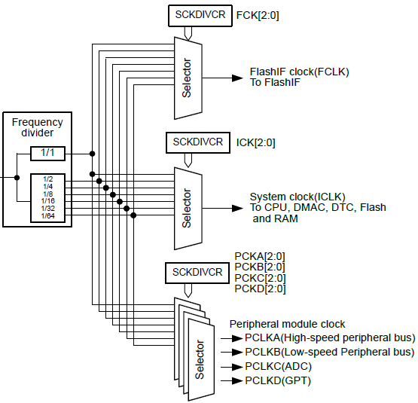
overview Internal Clocks
The RA microcontrollers have up to seven internal clocks:
System clock (ICLK): core clock used for CPU, flash, internal SRAM, DTC, and DMAC
PCLKA/PCLKB/PCLKC/PCLKD: Peripheral clocks
FCLK: Clock source for reading data flash and for programming/erasure of both code and data flash.
BCLK: External bus clock
Internal clocks Block Diagram

Slide 8
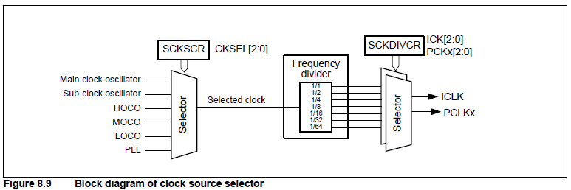
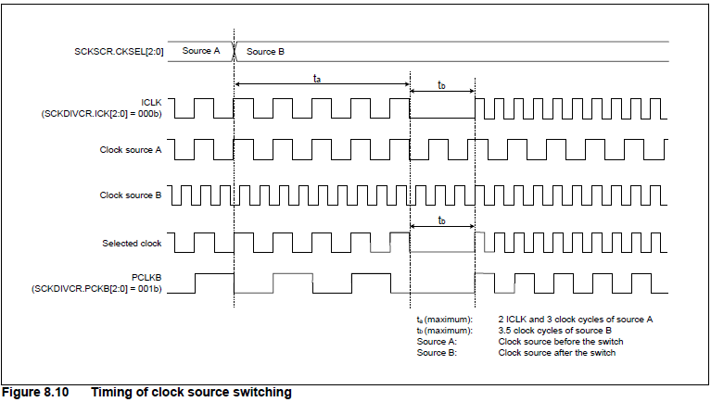
overview system Clocks
The system clock (ICLK) is the operating clock of the CPU, DMAC, DTC, Flash, and SRAM.
The ICLK frequency is specified by the ICK[2:0] bits in SCKDIVCR, the CKSEL[2:0] bits in SCKSCR, the PLLMUL[5:0] bits and PLIDIV[1:0] bits in PLLCCR, and the HOCOFRQ0[1:0] bits in OFS1.
When the ICLK clock source is switched, the duration of the ICLK clock cycle becomes longer during the clock source transition period. See Figure 8.9 and Figure 8.10.

Slide 9
Overview Oscillation Stop Detection Function
The oscillation stop detection function detects the main clock oscillator stop. When oscillation stop is detected, the system clock switches as follows:
If an oscillation stop is detected with SCKSCR.CKSEL[2:0] = 011b (system clock source = MOSC), the system clock source switches to the MOCO clock.
If an oscillation stop is detected with PLLCCR.PLSRCSEL = 0 (PLL source clock = MOSC) and SCKSCR.CKSEL[2:0] = 101b (system clock source = PLL), PLL clock remains the system clock source. However, the frequency becomes a free-running oscillation frequency.
An oscillation stop detection interrupt request can be generated when an oscillation stop is detected. In addition, the General PWM Timer (GPT) output can be forced to a high-impedance state on detection.

Slide 10
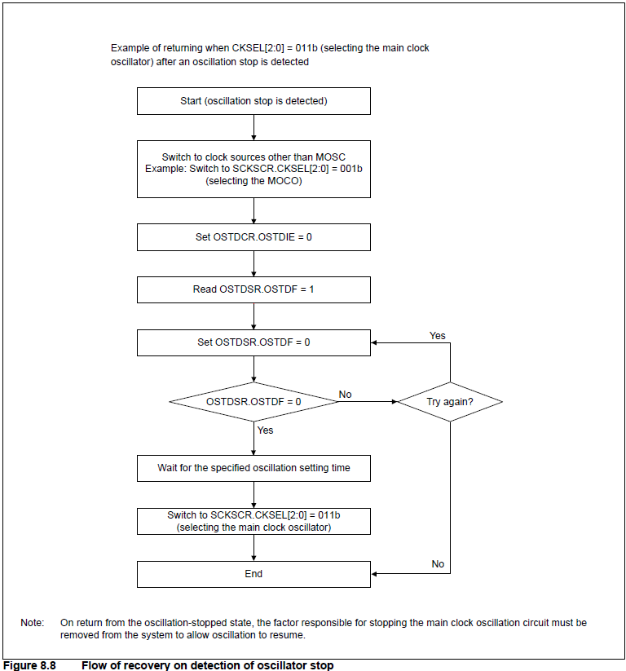
Overview Oscillation Stop Detection Function
Switching between the main clock oscillator and the MOCO clock or between the PLL clock and PLL free-running clock is controlled by the Oscillation Stop Detection Flag (OSTDSR.OSTDF).
To switch the clock source to the main clock or PLL clock again after the oscillation stop detection, follow step of flow of recovery on detection of oscillator stop (Fig 8.8)

Slide 11
Module Configuration
Configuration
Build Time Configurations
Parameter Checking:
- Default (BSP)
- Enabled
- Disabled
Configurations for System > Clock Generation Circuit
Module name:
- Name must be a valid C symbol.
- Default: g_cgc0.
NMI Callback:
- Name must be a valid C symbol.
- Default: NULL
Clock Configuration
Used to configure the system clocks.
There are no module specific clock configurations required to use it.
Pin Configuration
Controls the output of the CLOCKOUT signal.
If an external oscillator is used the XTAL and EXTAL pins must be configured accordingly.

Slide 12
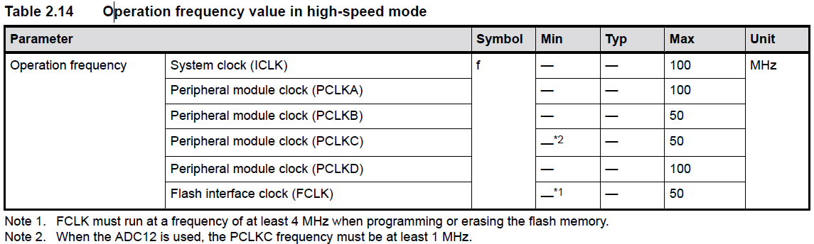
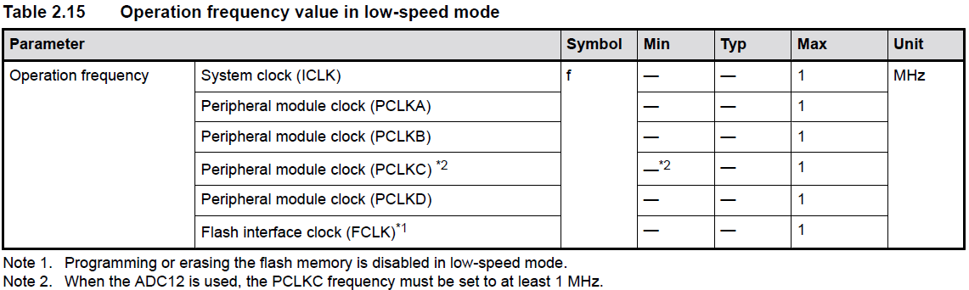
Module Configuration usage notes
Frequency of clocks must lower than max value (Table 2.14 and table 2.15 - RA4M3 Group: Datasheet)

Slide 13
Module Configuration usage notes
If "Use Low Voltage Mode" is enabled, no other power modes are considered. The following conditions must be met for the MCU to run in low voltage mode:
Requires HOCO to be running, so HOCO cannot be stopped in low voltage mode
Requires PLL to be stopped, so PLL APIs are not available in low voltage mode
Requires ICLK <= 4 MHz
If oscillation stop detection is used, dividers of 1 or 2 cannot be used for any clock

Slide 14
Module Configuration usage notes
If "Use Low Voltage Mode" is not enabled, the MCU applies the lowest power mode by searching through the following list in order and applying the first power mode that is supported under the current conditions:
Subosc-speed mode (lowest power)
Requires system clock to be LOCO or subclock
Requires MOCO, HOCO, main oscillator, and PLL (if present) to be stopped
Requires ICLK and FCLK dividers to be 1
Low-speed mode
Requires PLL to be stopped
Requires ICLK <= 1 MHz
If oscillation stop detection is used, dividers of 1, 2, 4, or 8 cannot be used for any clock
Middle-speed mode (not supported on all MCUs)
Requires ICLK <= 8 MHz
High-speed mode
Default mode if no other operating mode is supported

Slide 15
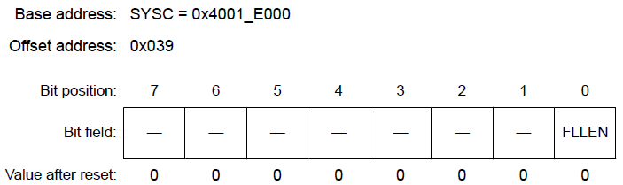
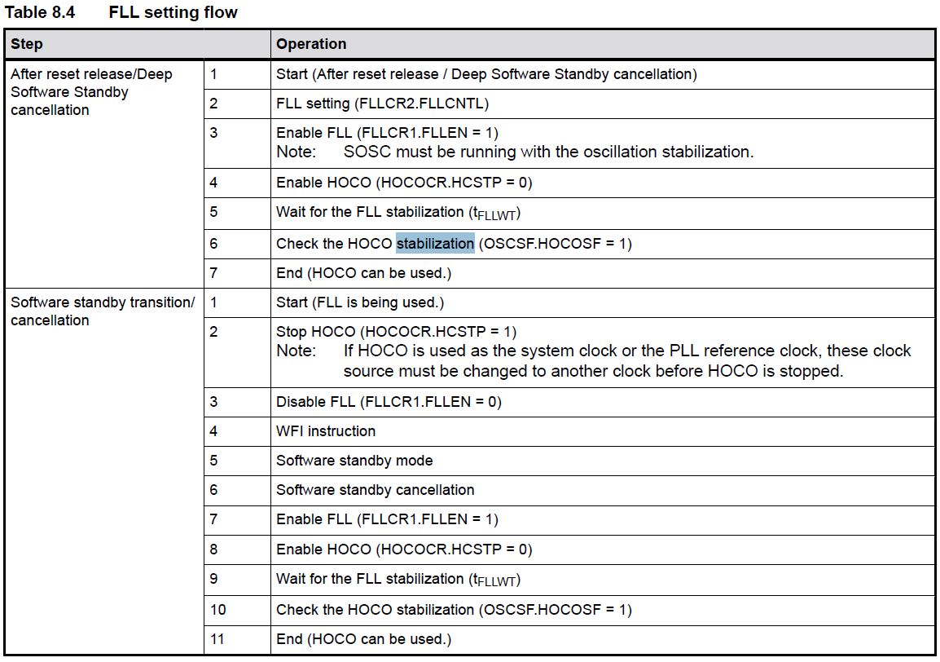
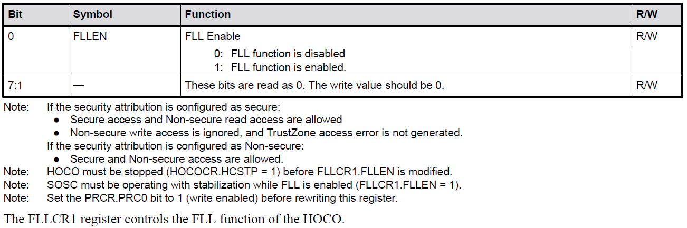
Register Descriptions
Refer 8.2.13 FLLCR1 : FLL Control Register1 (RA4M3 Group - User’s Manual: Hardware)

Slide 16
Register Descriptions
Register | Base address | Offset address | Number of bit | Description | Refer
CGFSAR | 0x4001_E000 | 0x3C0 | 32 | CGFSAR register controls the secure attribute of Clock Generation Function registers | 8.2.1 CGFSAR : Clock Generation Function Security Attribute Register (RA4M3 Group - User’s Manual: Hardware)
SCKDIVCR | 0x4001_E000 | 0x020 | 32 | SCKDIVCR selects the frequencies of the system clock (ICLK), peripheral module clock (PCLKA, PCLKB, PCLKC, PCLKD), FlashIF clock (FCLK) | 8.2.2 SCKDIVCR : System Clock Division Control Register (RA4M3 Group - User’s Manual: Hardware)
SCKSCR | 0x4001_E000 | 0x026 | 8 | The SCKSCR register selects the clock source for the system clock | 8.2.3 SCKSCR : System Clock Source Control Register (RA4M3 Group - User’s Manual: Hardware)
PLLCCR | 0x4001_E000 | 0x028 | 16 | The PLLCCR register sets the operation of the PLL circuit | 8.2.4 PLLCCR : PLL Clock Control Register (RA4M3 Group - User’s Manual: Hardware)
PLLCR | 0x4001_E000 | 0x02A | 8 | The PLLCR register controls the operation of the PLL circuit. | 8.2.5 PLLCR : PLL Control Register (RA4M3 Group - User’s Manual: Hardware)
PLL2CCR | 0x4001_E000 | 0x048 | 16 | The PLL2CCR register sets the operation of the PLL2 circuit. | 8.2.6 PLL2CCR : PLL2 Clock Control Register (RA4M3 Group - User’s Manual: Hardware)
PLL2CR | 0x4001_E000 | 0x04A | 8 | The PLL2CR register controls the operation of the PLL2 circuit | 8.2.7 PLL2CR : PLL2 Control Register (RA4M3 Group - User’s Manual: Hardware)
MOSCCR | 0x4001_E000 | 0x032 | 8 | The MOSCCR register controls the main clock oscillator | 8.2.8 MOSCCR : Main Clock Oscillator Control Register (RA4M3 Group - User’s Manual: Hardware)

Slide 17
Register Descriptions
Register | Base address | Offset address | Number of bit | Description | Refer
SOSCCR | 0x4001_E000 | 0x480 | 8 | The SOSCCR register controls the sub-clock oscillator | 8.2.9 SOSCCR : Sub-Clock Oscillator Control Register (RA4M3 Group - User’s Manual: Hardware)
LOCOCR | 0x4001_E000 | 0x490 | 8 | The LOCOCR register controls the LOCO clock | 8.2.10 LOCOCR : Low-Speed On-Chip Oscillator Control Register (RA4M3 Group - User’s Manual: Hardware)
HOCOCR | 0x4001_E000 | 0x036 | 8 | The HOCOCR register controls the HOCO clock | 8.2.11 HOCOCR : High-Speed On-Chip Oscillator Control Register (RA4M3 Group - User’s Manual: Hardware)
MOCOCR | 0x4001_E000 | 0x038 | 8 | The MOCOCR register controls the MOCO clock | 8.2.12 MOCOCR : Middle-Speed On-Chip Oscillator Control Register (RA4M3 Group - User’s Manual: Hardware)
FLLCR1 | 0x4001_E000 | 0x039 | 8 | The FLLCR1 register controls the FLL function of the HOCO. | 8.2.13 FLLCR1 : FLL Control Register1 (RA4M3 Group - User’s Manual: Hardware)
FLLCR2 | 0x4001_E000 | 0x03A | 16 | The FLLCR2 register controls the FLL function of the HOCO | 8.2.14 FLLCR2 : FLL Control Register2 (RA4M3 Group - User’s Manual: Hardware)
OSCSF | 0x4001_E000 | 0x03C | 8 | The OSCSF register contains flags to indicate the operating status of the counters in the oscillation stabilization wait circuits for the individual oscillators. | 8.2.15 OSCSF : Oscillation Stabilization Flag Register (RA4M3 Group - User’s Manual: Hardware)
OSTDCR | 0x4001_E000 | 0x040 | 8 | The OSTDCR register controls the oscillation stop detection function | 8.2.16 OSTDCR : Oscillation Stop Detection Control Register (RA4M3 Group - User’s Manual: Hardware)

Slide 18
Register Descriptions
Register | Base address | Offset address | Number of bit | Description | Refer
OSTDSR | 0x4001_E000 | 0x041 | 8 | The OSTDSR register indicates the stop detection status of the main clock oscillator | 8.2.17 OSTDSR : Oscillation Stop Detection Status Register (RA4M3 Group - User’s Manual: Hardware)
MOSCWTCR | 0x4001_E000 | 0x0A2 | 8 | Set the main clock oscillation stabilization time to a period longer than or equal to the stabilization time recommended by the oscillator manufacturer. | 8.2.18 MOSCWTCR : Main Clock Oscillator Wait Control Register (RA4M3 Group - User’s Manual: Hardware)
MOMCR | 0x4001_E000 | 0x413 | 8 | Mode controll for main clock oscillation | 8.2.19 MOMCR : Main Clock Oscillator Mode Oscillation Control Register (RA4M3 Group - User’s Manual: Hardware)
SOMCR | 0x4001_E000 | 0x481 | 8 | Mode controll for sub-clock oscillation | 8.2.20 SOMCR : Sub-Clock Oscillator Mode Control Register (RA4M3 Group - User’s Manual: Hardware)
CKOCR | 0x4001_E000 | 0x03E | 8 | Clock out controll register | 8.2.21 CKOCR : Clock Out Control Register (RA4M3 Group - User’s Manual: Hardware)
LOCOUTCR | 0x4001_E000 | 0x492 | 8 | The LOCOUTCR register is added to the original LOCO trimming data. | 8.2.22 LOCOUTCR : LOCO User Trimming Control Register (RA4M3 Group - User’s Manual: Hardware)
MOCOUTCR | 0x4001_E000 | 0x061 | 8 | The MOCOUTCR register is added to the original MOCO trimming data. | 8.2.23 MOCOUTCR : MOCO User Trimming Control Register (RA4M3 Group - User’s Manual: Hardware)
HOCOUTCR | 0x4001_E000 | 0x062 | 8 | The HOCOUTCR register is added to the original HOCO trimming data. | 8.2.24 HOCOUTCR : HOCO User Trimming Control Register (RA4M3 Group - User’s Manual: Hardware)
USBCKDIVCR | 0x4001_E000 | 0x06C | 8 | The USBCKDIVCR register controls the USB clock. | 8.2.25 USBCKDIVCR : USB Clock Division Control Register (RA4M3 Group - User’s Manual: Hardware)
USBCKCR | 0x4001_E000 | 0x074 | 8 | The USBCKCR register controls the USB clock | 8.2.26 USBCKCR : USB Clock Control Register (RA4M3 Group - User’s Manual: Hardware)
TRCKCR | 0x4001_E000 | 0x03F | 8 | Trace Clock Control Register controls switching the trace clock. | 8.2.27 TRCKCR : Trace Clock Control Register (RA4M3 Group - User’s Manual: Hardware)

Slide 19
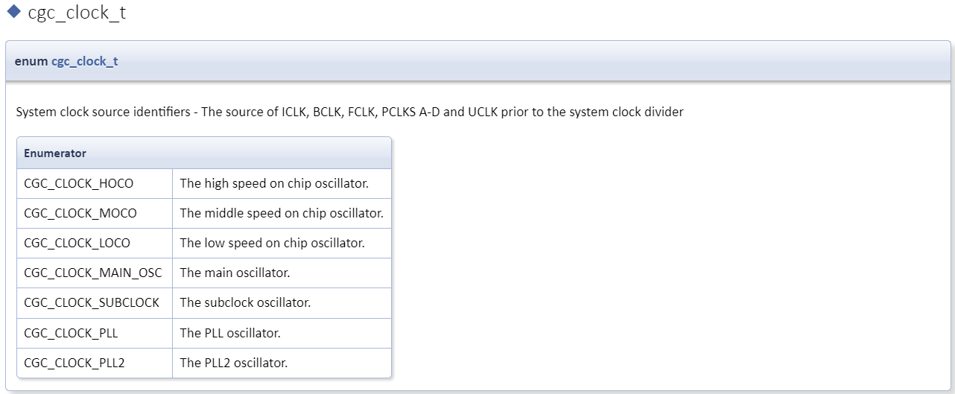
CGC fsp Interface Typedef/Enumeration Type Documentation
Use as config parameter/return value of CGC API.
Refer to RA Flexible Software Package Documentation: CGC Interface (renesas.github.io):
CGC Interface → Typedef Documentation
CGC Interface → Enumeration Type Documentation
Information about cgc_clock_t enum from RA FSP Documentation

Slide 20
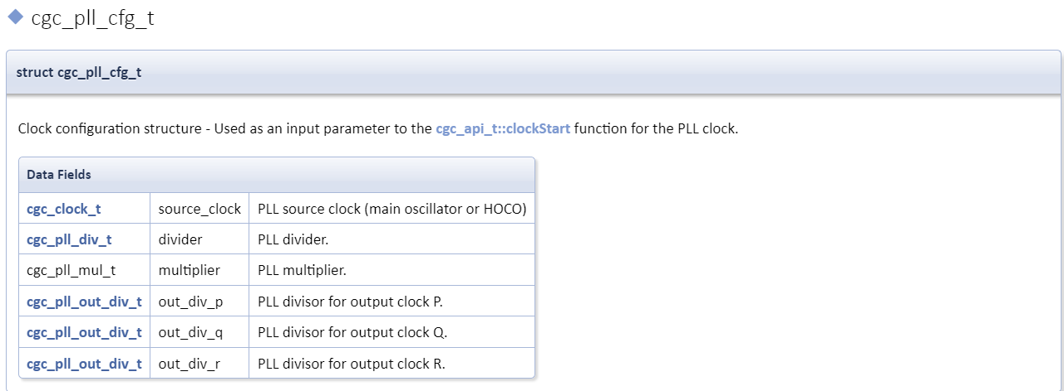
CGC fsp Interface Data Structures
Use to save module data/module config or pass in API as parameters
Refer to RA Flexible Software Package Documentation: CGC Interface (renesas.github.io):
CGC Interface → Data Structure Documentation
Information about cgc_pll_cfg_t structure from RA FSP Documentation

Slide 21
CGC api open
fsp_err_t(* cgc_api_t::open) (cgc_ctrl_t *const p_ctrl, cgc_cfg_t const *const p_cfg) Initial configuration Implemented as R_CGC_Open() Parameters [in] p_ctrl Pointer to instance control block [in] p_cfg Pointer to configuration

Slide 22
CGC api clocksCfg
fsp_err_t(* cgc_api_t::clocksCfg) (cgc_ctrl_t *const p_ctrl, cgc_clocks_cfg_t const *const p_clock_cfg) Configure all system clocks. Implemented as R_CGC_ClocksCfg() Parameters [in] p_ctrl Pointer to instance control block [in] p_clock_cfg Pointer to desired configuration of system clocks

Slide 23
CGC api clockStart
fsp_err_t(* cgc_api_t::clockStart) (cgc_ctrl_t *const p_ctrl, cgc_clock_t clock_source, cgc_pll_cfg_t const *const p_pll_cfg) Start a clock. Implemented as R_CGC_ClockStart() Parameters [in] p_ctrl Pointer to instance control block [in] clock_source Clock source to start [in] p_pll_cfg Pointer to PLL configuration, can be NULL if clock_source is not CGC_CLOCK_PLL or CGC_CLOCK_PLL2

Slide 24
CGC api clockStop
fsp_err_t(* cgc_api_t::clockStop) (cgc_ctrl_t *const p_ctrl, cgc_clock_t clock_source)
Stop a clock. Implemented as R_CGC_ClockStop() Parameters [in] p_ctrl Pointer to instance control block [in] clock_source The clock source to stop

Slide 25
CGC api clockCheck
fsp_err_t(* cgc_api_t::clockCheck) (cgc_ctrl_t *const p_ctrl, cgc_clock_t clock_source) Check the stability of the selected clock. Implemented as R_CGC_ClockCheck() Parameters [in] p_ctrl Pointer to instance control block [in] clock_source Which clock source to check for stability

Slide 26
CGC api systemClockSet
fsp_err_t(* cgc_api_t::systemClockSet) (cgc_ctrl_t *const p_ctrl, cgc_clock_t clock_source, cgc_divider_cfg_t const *const p_divider_cfg) Set the system clock. Implemented as R_CGC_SystemClockSet() Parameters [in] p_ctrl Pointer to instance control block [in] clock_source Clock source to set as system clock [in] p_divider_cfg Pointer to the clock divider configuration

Slide 27
CGC api oscStopDetectEnable
fsp_err_t(* cgc_api_t::oscStopDetectEnable) (cgc_ctrl_t *const p_ctrl) Enable and optionally register a callback for Main Oscillator stop detection. Implemented as R_CGC_OscStopDetectEnable() Parameters [in] p_ctrl Pointer to instance control block [in] p_callback Callback function that will be called by the NMI interrupt when an oscillation stop is detected. If the second argument is "false", then this argument can be NULL. [in] enable Enable/disable Oscillation Stop Detection

Slide 28
CGC api oscStopDetectDisable
fsp_err_t(* cgc_api_t::oscStopDetectDisable) (cgc_ctrl_t *const p_ctrl) Disable Main Oscillator stop detection. Implemented as R_CGC_OscStopDetectDisable() Parameters [in] p_ctrl Pointer to instance control block

Slide 29
CGC api oscStopStatusClear
fsp_err_t(* cgc_api_t::oscStopStatusClear) (cgc_ctrl_t *const p_ctrl) Clear the oscillator stop detection flag. Implemented as R_CGC_OscStopStatusClear() Parameters [in] p_ctrl Pointer to instance control block

Slide 30
CGC api callbackSet
fsp_err_t(* cgc_api_t::callbackSet) (cgc_ctrl_t *const p_ctrl, void(*p_callback)(cgc_callback_args_t *), void const *const p_context, cgc_callback_args_t *const p_callback_memory) Specify callback function and optional context pointer and working memory pointer. Implemented as R_CGC_CallbackSet() Parameters [in] p_ctrl Pointer to the CGC control block. [in] p_callback Callback function [in] p_context Pointer to send to callback function [in] p_working_memory Pointer to volatile memory where callback structure can be allocated. Callback arguments allocated here are only valid during the callback.

Slide 31
CGC api close
fsp_err_t(* cgc_api_t::close) (cgc_ctrl_t *const p_ctrl) Close the CGC driver. Implemented as R_CGC_Close() Parameters [in] p_ctrl Pointer to instance control block

Slide 32
Examples minimal use of the CGC in an application
void cgc_basic_example(void)
{
fsp_err_t err = FSP_SUCCESS;
/* Initializes the CGC module. */
err = R_CGC_Open(&g_cgc0_ctrl, &g_cgc0_cfg);
/* Handle any errors. This function should be defined by the user. */
assert(FSP_SUCCESS == err);
/* Change the system clock to LOCO for power saving. */
/* Start the LOCO. */
err = R_CGC_ClockStart(&g_cgc0_ctrl, CGC_CLOCK_LOCO, NULL);
assert(FSP_SUCCESS == err);
/* Wait for the LOCO stabilization wait time. */
R_BSP_SoftwareDelay(BSP_FEATURE_CGC_LOCO_STABILIZATION_MAX_US, BSP_DELAY_UNITS_MICROSECONDS);
/* Set divisors. Divisors for clocks that don't exist on the MCU are ignored. */
cgc_divider_cfg_t dividers =
{
/* PCLKB is not used in this application, so select the maximum divisor for lowest power. */
.sckdivcr_b.pclkb_div = CGC_SYS_CLOCK_DIV_64,
/* PCLKD is not used in this application, so select the maximum divisor for lowest power. */
.sckdivcr_b.pclkd_div = CGC_SYS_CLOCK_DIV_64,
/* ICLK is the MCU clock, allow it to run as fast as the LOCO is capable. */
.sckdivcr_b.iclk_div = CGC_SYS_CLOCK_DIV_1,
/* These clocks do not exist on some devices. If any clocks don't exist, set the divider to 1. */
.sckdivcr_b.pclka_div = CGC_SYS_CLOCK_DIV_1,
.sckdivcr_b.pclkc_div = CGC_SYS_CLOCK_DIV_1,
.sckdivcr_b.fclk_div = CGC_SYS_CLOCK_DIV_1,
.sckdivcr_b.bclk_div = CGC_SYS_CLOCK_DIV_1,
};
/* Switch the system clock to LOCO. */
err = R_CGC_SystemClockSet(&g_cgc0_ctrl, CGC_CLOCK_LOCO, &dividers);
assert(FSP_SUCCESS == err);
}

Slide 33
Examples Configuring Multiple Clocks
void cgc_clocks_cfg_example(void)
{
fsp_err_t err = FSP_SUCCESS;
/* Initializes the CGC module. */
err = R_CGC_Open(&g_cgc0_ctrl, &g_cgc0_cfg);
/* Handle any errors. This function should be defined by the user. */
assert(FSP_SUCCESS == err);
/* Change the system clock to PLL running from the main oscillator. */
/* Assuming the system clock is MOCO, switch to HOCO. */
cgc_clocks_cfg_t clocks_cfg;
clocks_cfg.system_clock = CGC_CLOCK_PLL;
clocks_cfg.pll_state = CGC_CLOCK_CHANGE_NONE;
clocks_cfg.pll_cfg.source_clock = CGC_CLOCK_MAIN_OSC; // unused
clocks_cfg.pll_cfg.multiplier = CGC_PLL_MUL_10_0; // unused
clocks_cfg.pll_cfg.divider = CGC_PLL_DIV_2; // unused
clocks_cfg.divider_cfg.sckdivcr_b.iclk_div = CGC_SYS_CLOCK_DIV_1;
clocks_cfg.divider_cfg.sckdivcr_b.pclka_div = CGC_SYS_CLOCK_DIV_4;
clocks_cfg.divider_cfg.sckdivcr_b.pclkb_div = CGC_SYS_CLOCK_DIV_4;
clocks_cfg.divider_cfg.sckdivcr_b.pclkc_div = CGC_SYS_CLOCK_DIV_4;
clocks_cfg.divider_cfg.sckdivcr_b.pclkd_div = CGC_SYS_CLOCK_DIV_4;
clocks_cfg.divider_cfg.sckdivcr_b.bclk_div = CGC_SYS_CLOCK_DIV_4;
clocks_cfg.divider_cfg.sckdivcr_b.fclk_div = CGC_SYS_CLOCK_DIV_4;
clocks_cfg.mainosc_state = CGC_CLOCK_CHANGE_NONE;
clocks_cfg.hoco_state = CGC_CLOCK_CHANGE_START;
clocks_cfg.moco_state = CGC_CLOCK_CHANGE_STOP;
clocks_cfg.loco_state = CGC_CLOCK_CHANGE_NONE;
err = R_CGC_ClocksCfg(&g_cgc0_ctrl, &clocks_cfg);
assert(FSP_SUCCESS == err);
#if BSP_FEATURE_CGC_HAS_PLL
/* Assuming the system clock is HOCO, switch to PLL running from main oscillator and stop MOCO. */
clocks_cfg.system_clock = CGC_CLOCK_PLL;
clocks_cfg.pll_state = CGC_CLOCK_CHANGE_START;
clocks_cfg.pll_cfg.source_clock = CGC_CLOCK_MAIN_OSC;
clocks_cfg.pll_cfg.multiplier = (cgc_pll_mul_t)BSP_CFG_PLL_MUL;
clocks_cfg.pll_cfg.divider = (cgc_pll_div_t)BSP_CFG_PLL_DIV;
clocks_cfg.divider_cfg.sckdivcr_b.iclk_div = CGC_SYS_CLOCK_DIV_1;
clocks_cfg.divider_cfg.sckdivcr_b.pclka_div = CGC_SYS_CLOCK_DIV_4;
clocks_cfg.divider_cfg.sckdivcr_b.pclkb_div = CGC_SYS_CLOCK_DIV_4;
clocks_cfg.divider_cfg.sckdivcr_b.pclkc_div = CGC_SYS_CLOCK_DIV_4;
clocks_cfg.divider_cfg.sckdivcr_b.pclkd_div = CGC_SYS_CLOCK_DIV_4;
clocks_cfg.divider_cfg.sckdivcr_b.bclk_div = CGC_SYS_CLOCK_DIV_4;
clocks_cfg.divider_cfg.sckdivcr_b.fclk_div = CGC_SYS_CLOCK_DIV_4;
clocks_cfg.mainosc_state = CGC_CLOCK_CHANGE_START;
clocks_cfg.hoco_state = CGC_CLOCK_CHANGE_STOP;
clocks_cfg.moco_state = CGC_CLOCK_CHANGE_NONE;
clocks_cfg.loco_state = CGC_CLOCK_CHANGE_NONE;
err = R_CGC_ClocksCfg(&g_cgc0_ctrl, &clocks_cfg);
assert(FSP_SUCCESS == err);
#endif
}

Slide 34
Examples Oscillation Stop Detection
Refer to RA Flexible Software Package Documentation: Clock Generation Circuit (r_cgc) (renesas.github.io):
API Reference → Module → System → Example → Oscillation Stop Detection

Slide 35
Reference
RA Flexible Software Package Documentation: RA Flexible Software Package Documentation: Introduction (renesas.github.io)
RA4M3 Group Datasheet: RA4M3 Group Datasheet (renesas.com)
RA4M3 Group User's Manual: Hardware: RA4M3 Group User's Manual: Hardware (renesas.com)

Slide 36
Renesas.com

