Slide 1

How to add new isr
Date: Mar 16
Name: the nguyen
Fsp1 section
Ra fsp group
Renesas Electronics Corporation

Slide 2
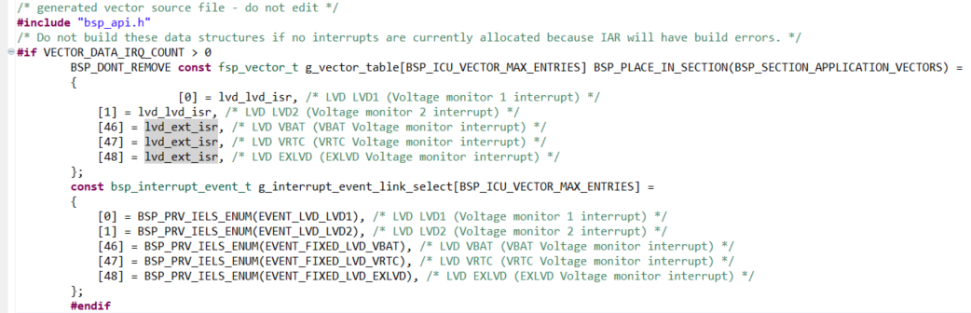
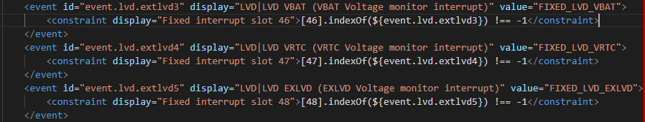
Interrupt configurations Nvic directly
Add ISR in corresponding vector table slot (ra_gen/vector_data.c)
→ Refer RA interrupt event allocation to IRQ slots - e2 studio Project - Confluence ASR [Live] (renesas.eu) to update MDF file

Slide 3
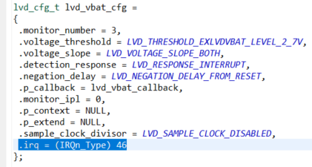
Interrupt configurations Nvic directly
In config structure, declare .irq corresponding IRQ number (Table 13.3 Interrupt vector table/HWM)
→ Update MDF file to generate correct config structure.

Slide 4

Interrupt configurations Nvic directly
In .open() implement, call those 2 API to configure NVIC recognize interrupts
Refer to 13.6 Non-Maskable Interrupt Operation (HWM)

Slide 5
Renesas.com

