Slide 1
CONFIGURE TZ BOUNDARIES AND DEBUG
Date
Name: hang nguyen
Position, Department,
Unit
Renesas Electronics Corporation

Slide 2

Configure tz boundaries
TrustZone tests assume that code flash, data flash, and SRAM memory regions are split 50/50 between secure and non-secure applications. The last 2KiB of secure memory should be configured as non-secure callable.
Example:
RA4M3 has 1MB code flash, 8KB data flash, 128KB SRAM
Code flash:
Secure: 510KB
Non-secure callable: 2KB
Non-secure: 512KB
Data flash:
Secure: 4KB
Non-secure: 4KB
SRAM:
Secure: 62KB
Non-secure callable: 2KB
Non-secure: 64KB
* Note: RA8x1 devices only support setting the code flash and data flash partitions (Read more at Configure trustzone boundaries)

Slide 3
Configure tz boundaries

Slide 4
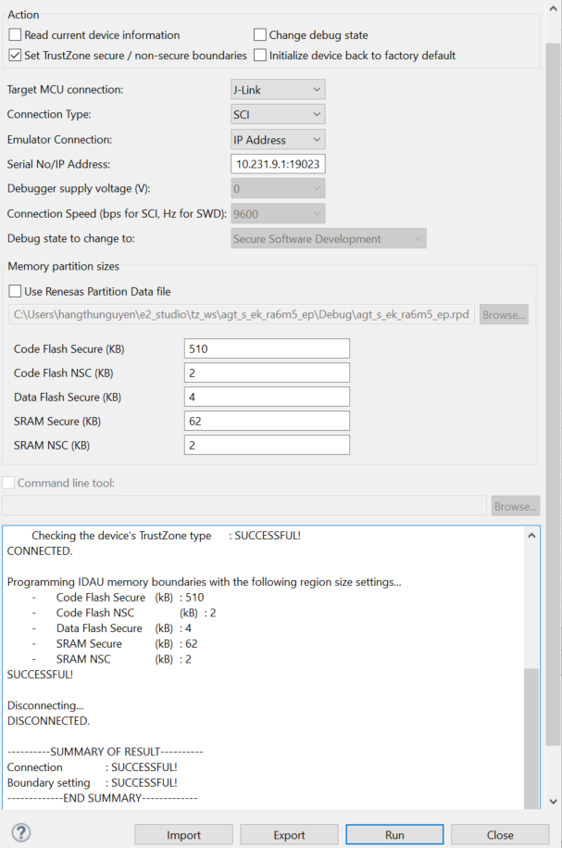
If the result is FAIL => Initialize and try again

Slide 5
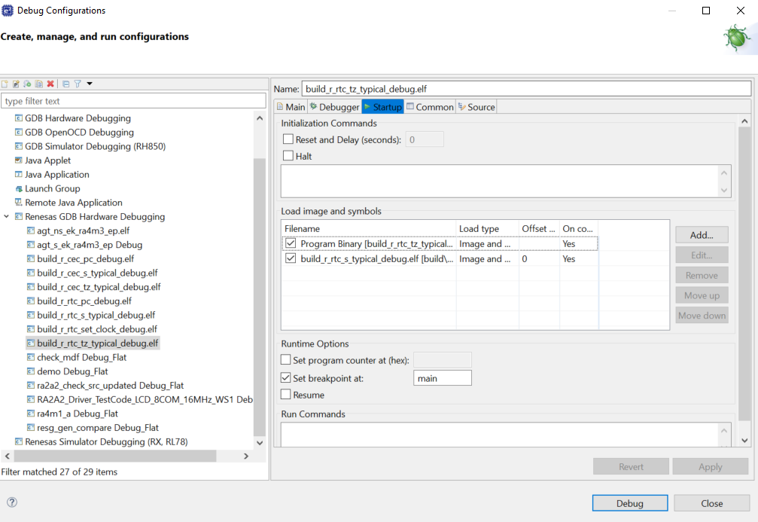
DEBUG
Build project
Open Debug Configurations
Add *.elf of secure projects in the Non-Secure project to allow downloading of both Secure and Non-Secure projects at once
Debug

Slide 6
Renesas.com

