Slide 1
Data Transfer Control (DTC)

Slide 2
Overview
DTC is a peripheral that provides a simple, but extremely flexible mechanism to transfer data between peripheral and memory or memory and a peripheral.
DTC is the same as DMA (Direct Memory Access), but it provides us with much higher level of flexibility in its operation compared to using a DMAC
It is activated by an interrupt request
Set-up information is held in SRAM not in a fixed set of on chip registers like in a DMA controller
DTC could be created more than 10 or 20 channels, or more.
The main disadvantage of this mechanism is that for each transfer a few cycles must be taken to read the configuration data before each transfer takes place

Slide 3
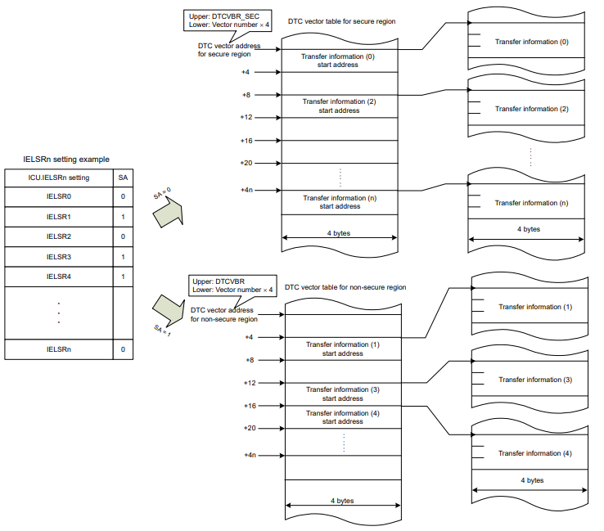
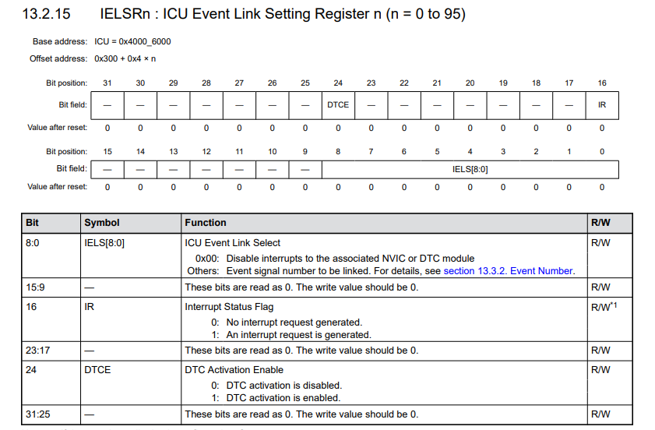
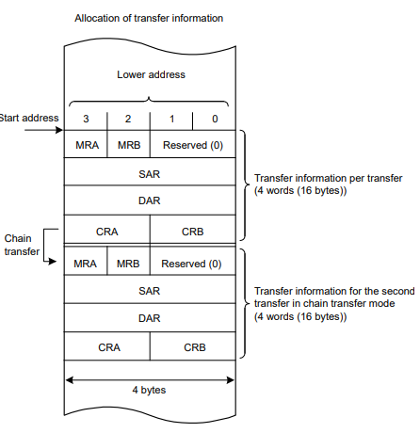
Activation Sources & Allocating Transfer Information
DTC is activated by an interrupt request. Setting the ICU.IELSRn.DTCE bit to 1 enables activation of the DTC by the associated interrupt.
The specific DTC interrupt source associated with each interrupt vector number n is selected in ICU.IELSRn.IELS[8:0] in the interrupt vector ICU.IELSRn where n from 0 to 95. The smaller interrupt vector number has higher priority.
The interrupt vector number is equivalent to the DTC vector table number.
DTC has two tables, non-secure side or secure side.

Slide 4
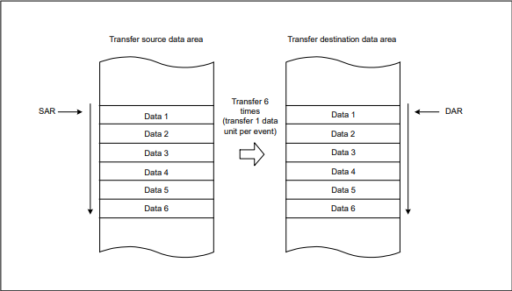
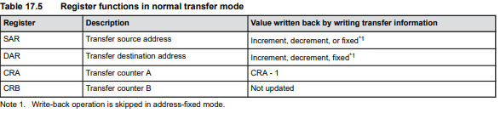
Normal Transfer Mode
The normal transfer mode allows a 1-byte (8 bit), 1-halfword (16 bit), 1-word (32 bit) data transfer on a single activation source. The transfer count can be set from 1 to 65536.
Transfer source and destination addresses can be independently set to increment, decrement, or fixed.
This mode enables an interrupt request to the CPU to be generated at the end of a specified count transfer

Slide 5
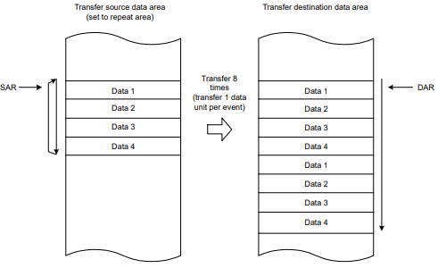
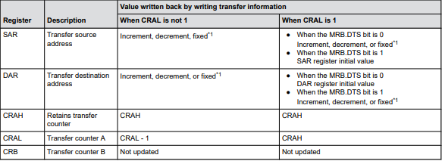
Repeat Transfer Mode
The repeat transfer mode allows a 1-byte (8 bit), 1-halfword (16 bit), 1-word (32 bit) data transfer on a single activation source
Transfer source or transfer destination for the repeat area must be specified in the MRB.DTS bit. The transfer count can be set from 1 to 256.
When the specified transfer count is complete, the initial value of the address register specified in the repeat area is restored, the initial value of the transfer counter is restored, and the transfer is repeated. The other address register is incremented or decremented continuously or remains unchanged
When the transfer counter CRAL decrements to 0x00 in repeat transfer mode, the CRAL value is updated to the value set in the CRAH register. As a result, the transfer counter does not clear to 0x00, which disables interrupt requests to the CPU when the MRB.DISEL bit is set to 0.

Slide 6
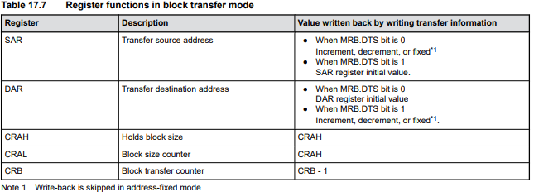
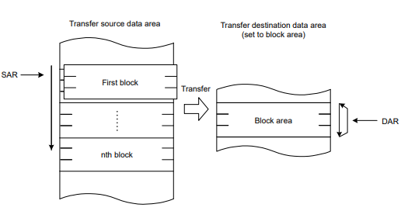
Block Transfer Mode
The block transfer mode allows single-block data transfer on a single activation source.
Transfer source or transfer destination for the block area must be specified in the MRB.DTS bit. The block size can be set from 256 x data size (byte, half-word, word).
When transfer of the specified block completes, the initial values of the block size counter CRAL and the address register specified in the block area are restored. The other address register is incremented or decremented continuously or remains unchanged.
The transfer count (block count) can be set from 1 to 65536. This mode enables an interrupt request to the CPU to be generated at the end of the specified-count block transfer.

Slide 7
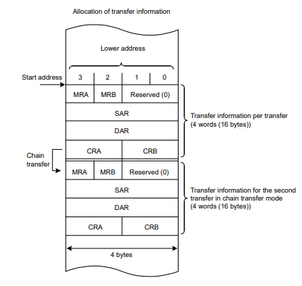
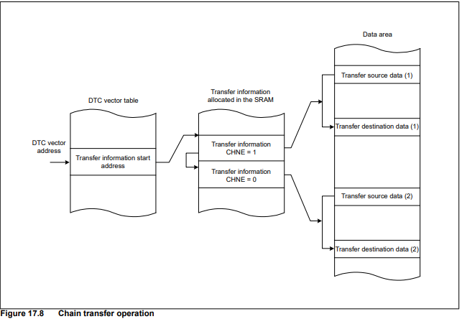
Chain Transfer Mode
Setting the MRB.CHNE bit to 1 allows chain transfer to be performed continuously on a single activation source.
If the MRB.CHNE is set to 1 and CHNS to 0, an interrupt request to the CPU is not generated on completion of the specified number of rounds of transfer or by setting the MRB.DISEL bit to 1. An interrupt request is sent to the CPU each time DTC data transfer is performed
Writing 1 to MRB.CHNE and CHNS bits enables chain transfer to be performed only after the completion of the specified data transfer.

Slide 8
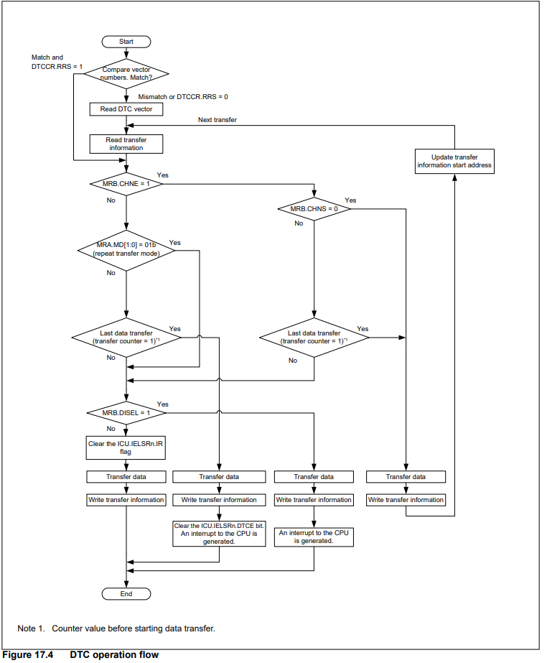
DTC Operation Flow Overview

Slide 9
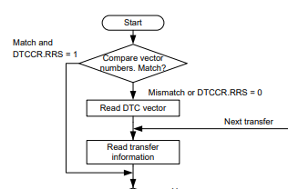
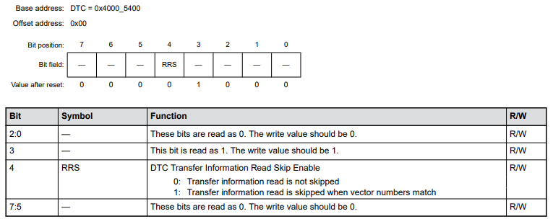
DTC Operation Beginning
The RRS bit enables skipping of transfer information reads when vector numbers match.
The DTC vector number is compared with the vector number in the previous process. When these vector numbers match and the RRS bit is set to 1, DTC data transfer is performed without reading the transfer information. However, when the previous transfer is a chain transfer, the transfer information is read regardless of the RRS bit.
When the transfer counter (CRA register) becomes 0 during the previous normal transfer and when the transfer counter (CRB register) becomes 0 during the previous block transfer, the transfer information is read regardless of the RRS bit value.

Slide 10
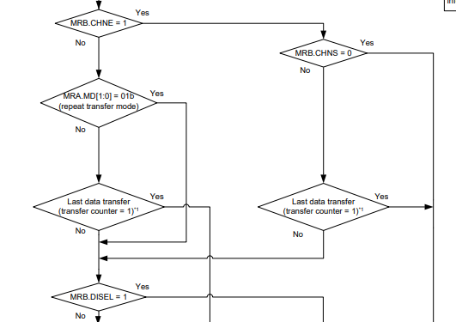
DTC Interurpt Configuration
MRB.CHNE selects Chain Transfer enable or not
MRB.CHNS sets 0 when Chain Transfer is continuous. When it sets to 1, chain transfer occurs only when then transfer counter changes from 1 to 0 or 1 to CRAH
MRA.MD are two bits selecting Transfer Mode
MRB.DISEL is an interrupt selection bit

Slide 11
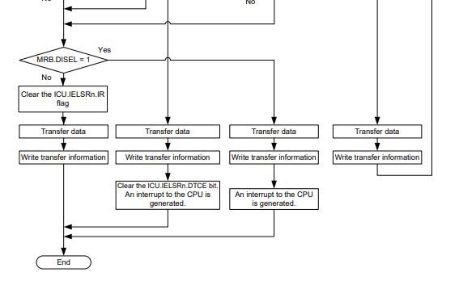
DTC Mode Handlers
DTC reads start address of the transfer information from the vector table, DTC has two vector tables, non-secure side or secure side.
The DTC is activated by an interrupt request. Setting ICU.IELSRn.DTCE bit to 1 enables activation of DTC by the associated interrupt, where n is from 0 to 95.
On the completion of specified round of data transfer, the ICU.IELSRn.DTCE bit is set to 0, and an interrupt request is sent to the CPU
MRB.DISEL bit is 1, an interrupt request is sent to the CPU on completion of a data transfer
For other transfers, the ICU.IELSRn.IR flag of the activation source is set to 0 at the start of data transfer

Slide 12
Inter-integrated Circuit (IIC – I2C)

Slide 13
Overview
The I2C bus interface has 2 channels.
Communications format: I2C-bus format or SMBus format, Master or slave mode selectable, and automatic securing of the setup times, hold times, and bus-free times for the transfer rate
Slave address: Configurable for up to three different slave addresses, 7-bit and 10-bit address formats supported, including simultaneous use, and general call addresses, device ID addresses, and SMBus host addresses detectable
Interrupt sources:
Transfer error or event occurrence (arbitration-lost, NACK, timeout, start or restart condition, or stop condition)
Receive data full
Transmit data empty
Transmit end
Address matching during wakeup function
IIC operating modes: master transmit, master receive, slave transmit, and slave receive.
Module-stop function: module-stop state can be set

Slide 14
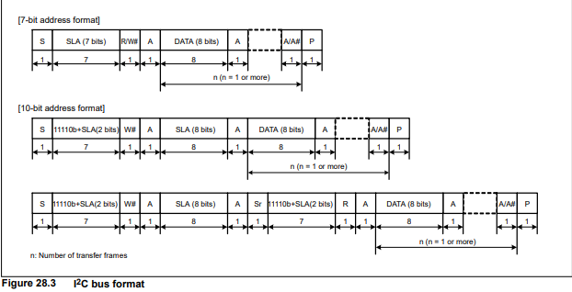
IIC Data Format

Slide 15
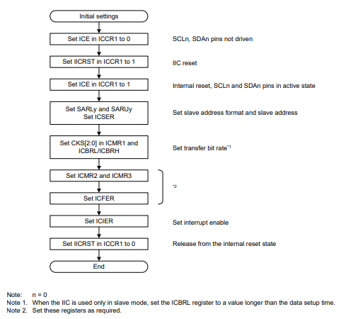
IIC Initialization Flow
ICCR1.ICE: IIC Interface Enable.
1: Enable (SCL and SDA pin in active state)
0: Disable (SCL and SDA pin in inactive state)
ICCR1.IICRST: IIC Bus interface internal reset.
1: Initiate IIC reset or internal reset
0: release IIC rest or internal reset
ICSER: IIC Bus Status Enable Register. ICSER.SARx is used to enable slave address register x.
when ICSER.SAR bit is set to 1, the slave address set in SARLy and SARUy is enabled and is compared with the received slave address. If this bit is set to 0, the slave address set in SARLy and SARUy is disabled and is ignored even if it matches the received slave address.

Slide 16
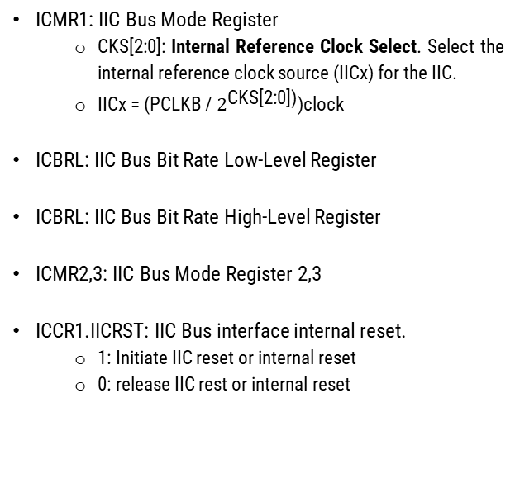
IIC Initialization Flow
ICMR1: IIC Bus Mode Register
CKS[2:0]: Internal Reference Clock Select. Select the internal reference clock source (IICx) for the IIC.
IICx = (PCLKB / $2^{\text{CKS}\text{[2:0])}}$)clock
ICBRL: IIC Bus Bit Rate Low-Level Register
ICBRL: IIC Bus Bit Rate High-Level Register
ICMR2,3: IIC Bus Mode Register 2,3
ICCR1.IICRST: IIC Bus interface internal reset.
1: Initiate IIC reset or internal reset
0: release IIC rest or internal reset

Slide 17
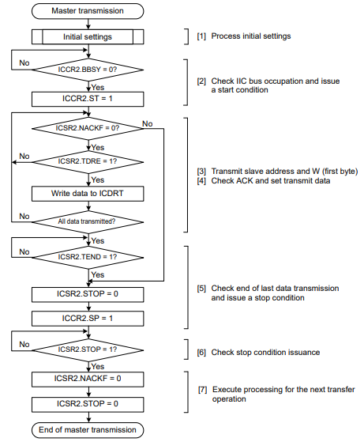
Master Transmission Flow
ICCR2: I2C Bus control register
BBSY: Bus busy detection flag
ST: Start condition Issuance Request. This bit requests transition to master mode and triggers a start condition.
SP: issuing a stop condition. This bit setting to 1 will request a stop condition.
ICSR2: IIC Bus Status Register 2
NACKF: NACK Detection Flag. This bit being 1 indicates that no slave device recognized the address or there was an error in communications
TDRE: indicates whether the ICDRT contains transmit data. 0: ICDRT contains transmit data, 1: ICDRT contains no transmit data.
STOP: a flag shows stop condition was detected
ICDRT: IIC Bus Transmit Data Register

Slide 18
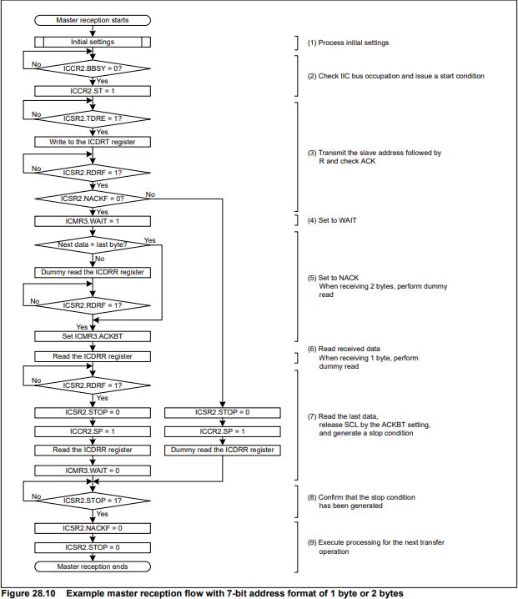
Master Reception Flow
ICCR2: I2C Bus control register
BBSY: Bus busy detection flag
ST: Start condition Issuance Request. This bit requests transition to master mode and triggers a start condition.
TRS: Transmit/Receive mode. 0 is received mode, 1 is transmit mode
ICSR2: IIC Bus Status Register 2
TDRE: indicates whether the ICDRT contains transmit data. 0: ICDRT contains transmit data, 1: ICDRT contains no transmit data.
RDRF: Receive Data Full Flag (check ACK)
NACKF: NACK Detection Flag. This bit being 1 indicates that no slave device recognized the address or there was an error in communications
ICMR3: I2C Bus Mode Register 3
ACKBT: Transmit Acknowledgement. Being 0 means received as the acknowledge bit (ACK reception). Setting to 1 indicates (NACK transmission).
WAIT: 0 is no wait, 1 is wait (SCL is held low during the period between the 9th clock cycle and 1st clock cycle)
ICDRR: IIC Bus Receive Data Register

Slide 19
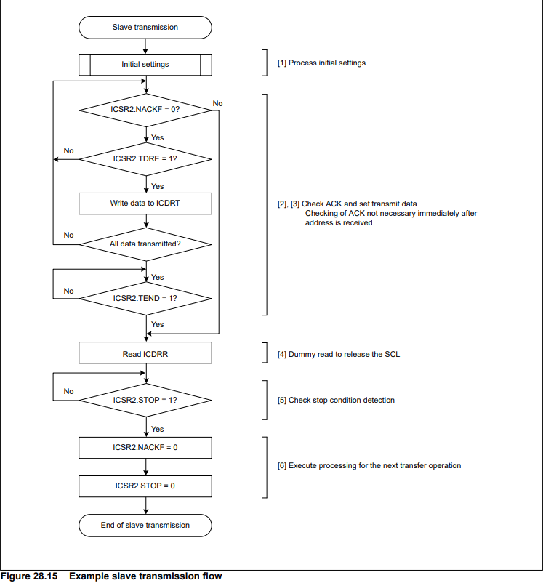
Slave Transmit Flow
ICSR2: IIC Bus Status Register 2
NACKF: NACK Detection Flag. This bit being 1 indicates that no slave device recognized the address or there was an error in communications
TDRE: indicates whether the ICDRT contains transmit data. 0: ICDRT contains transmit data, 1: ICDRT contains no transmit data.
TEND: Transmit End Flag. 1: Data transmit complete, 0: Data being transmitted
STOP: a flag shows stop condition was detected
ICDRT: IIC Bus Transmit Data Register
ICDRR: IIC Bus Receive Data Register

Slide 20
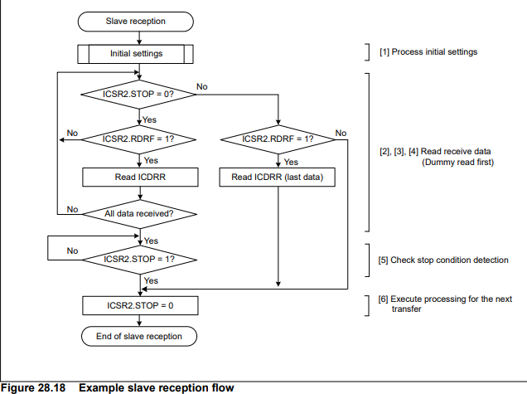
Slave Receive Flow
ICSR2: IIC Bus Status Register 2
RDRF: Receive Data Full Flag (check ACK)
STOP: a flag shows stop condition was detected
ICDRR: IIC Bus Receive Data Register

Slide 21
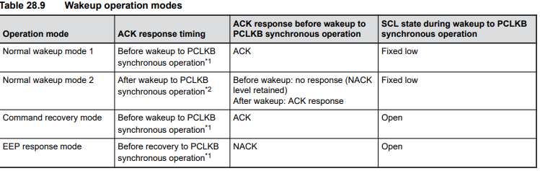
Wakeup Function
IIC provides a wakeup function that causes the MCU transition from Software Standby mode or Snooze mode to normal operation.
The wakeup function enables the reception of data when the system clock (PLCKB) is stopped and generates a wakeup interrupt signal on a match of slave address of the received data.
After the wakeup interrupt occurs, switch the IIC to PCLKB synchronous operation so that communication can continue
The following can be selected as wakeup interrupt sources:
Host address detection
General call address detection
Slave address 0, 1, 2 detection

Slide 22
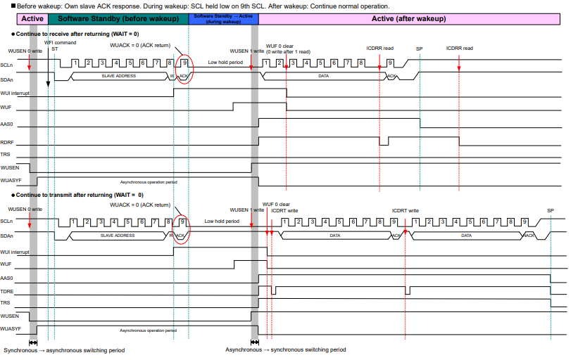
Normal Wakeup Mode 1
A wakeup interrupt trigger by the match of the slave address initiates the transition to normal operation
Before wakeup: ACK is sent in response to the data received with its own slave address of the IIC
During wakeup: ACK response is made on the 9th clock cycle of SCL
After wakeup: normal operation continues.

Slide 23
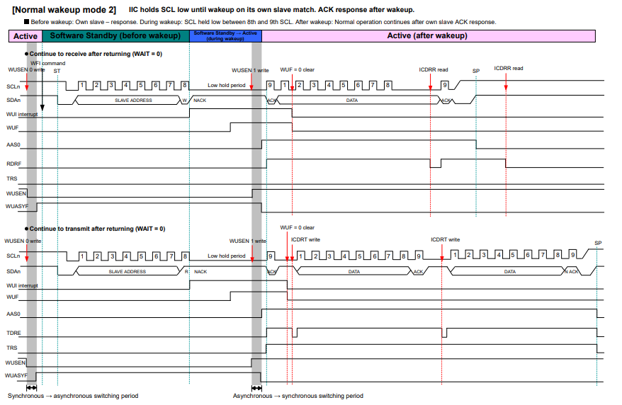
Normal Wakeup Mode 2
A wakeup interrupt trigger by the match of the slave address initiates the transition to normal operation
Before wakeup: No response to data received with its own slave address until of the 8th SCL cycle
During wakeup: SCL line held low during the 8th and 9th clock cycles
After wakeup: ACK returns on the 9th clock cycle of SCL, and normal operation continues.

Slide 24
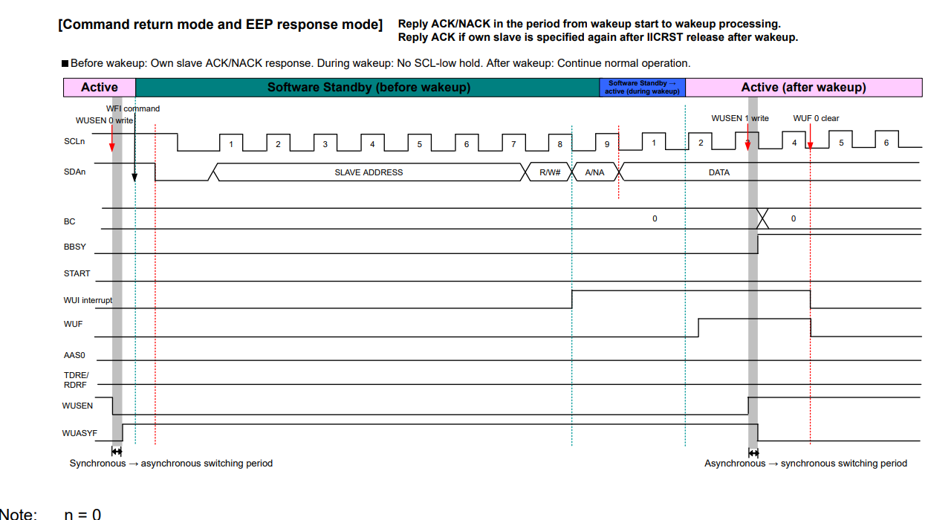
Command return mode and EEP response mode
A wakeup interrupt trigger by the match of the slave address initiates the transition to normal operation
Before wakeup: In response to the data received with its own slave address, the IIC returns ACK (command recovery mode) or NACK (EEP response mode)
During wakeup: The SCL line is not held low
After wakeup: Normal operation continues after IIC initialization

Slide 25
SMBus (System Management Bus) Overview
The IIC supports data communication conforming to the SMBus Specification.
SMBus is based on the I2C protocol and use I2C as a physical layer, it uses a two-wire interface and device addressing to communicate; each device has a unique address and may be addressed by any other device on the network
There are some differences between the I2C bus and the SMBus:
Timeout for transfers
Packet Error checking
SMBUS Host Notification Protocol

Slide 26
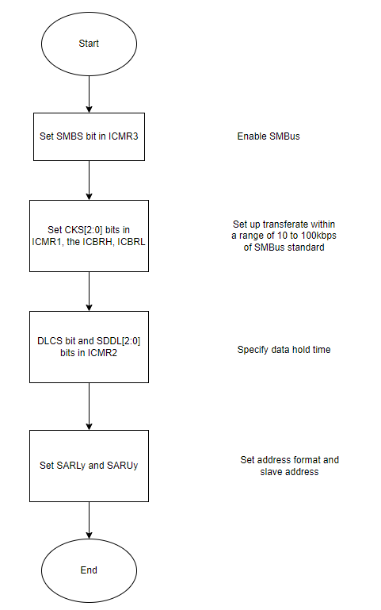
SMBus Initialization Flow

Slide 27
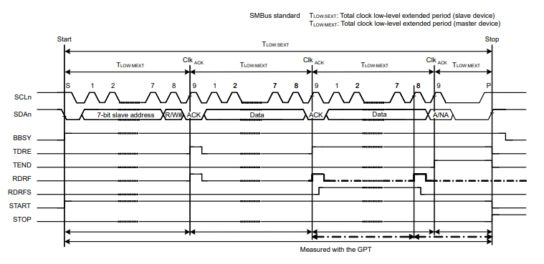

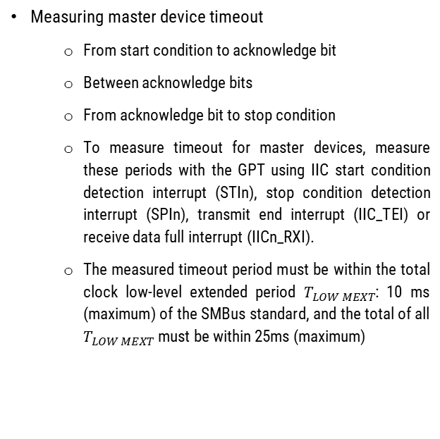
SMBus Timeout Measurement
Mearsuring slave device timeout
From start condition to stop condition, which use the GPT to measure timeout between start condition detection interrupt (STIn) and stop condition detection interrupt (SPIn).
The measured timeout could not exceed $T_{LOW SEXT}$: 25ms (maximum). If it exceeds, the device will release the bus by writing 1 to IICRST bit in ICCR1 to issue an internal reset of the IIC.
Measuring master device timeout
From start condition to acknowledge bit
Between acknowledge bits
From acknowledge bit to stop condition
To measure timeout for master devices, measure these periods with the GPT using IIC start condition detection interrupt (STIn), stop condition detection interrupt (SPIn), transmit end interrupt (IIC_TEI) or receive data full interrupt (IICn_RXI).
The measured timeout period must be within the total clock low-level extended period $T_{LOW MEXT}$: 10 ms (maximum) of the SMBus standard, and the total of all $T_{LOW MEXT}$must be within 25ms (maximum)

Slide 28
Packet Error Code
The MCU provides a CRC calculator that allows checking of the received data in SMBus data communication for the IIC.
In master transmit mode, the PEC data can be generated by writing all transmit data to the CRC Data Input Register (CRCDIR) in the CRC calculator
In master receive mode, the PEC data can be checked by writing all received data to CRCDIR and comparing CRCRDIR with CRCCDOR (CRC Data Output Register).
To send ACK or NACK based on the match or mismatch result when the final byte is received as a result of the PEC code check, modify RDRFS bit in ICMR3.

Slide 29
SMBUS Host Notification Protocol (Notify ARP Master Command)
In communicating over an SMBus, a slave device can temporarily act as master device to notify the SMBus host (or ARP master) of its own address, or to request its own slave address from the SMBus host.
To detect the host address as a slave address, set the SMBS bit in ICMR3 and the HOAE bit in ICSER to 1.

Slide 30
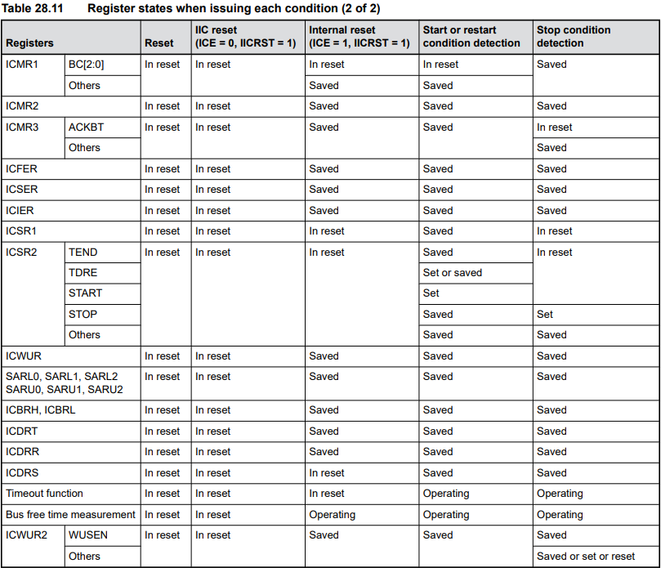
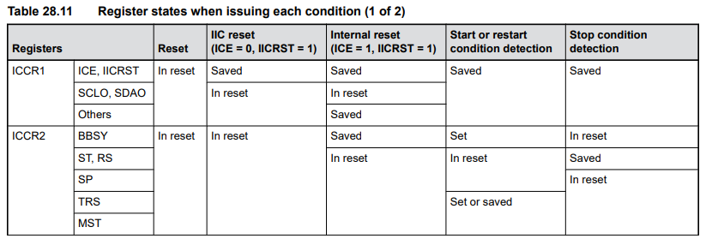
State of Register When Issuing Each Condition

