Slide 1

Docker investigate
Aug. 23
Bao Nguyen
Ra fsp, fsp1,
Renesas Electronics Corporation

Slide 2
Agenda
What is Docker Page 03
Docker Engine and Docker Desktop Page 04
Docker architect Page 06
Dockerfile reference Page 10
Docker command Page 16

Slide 3
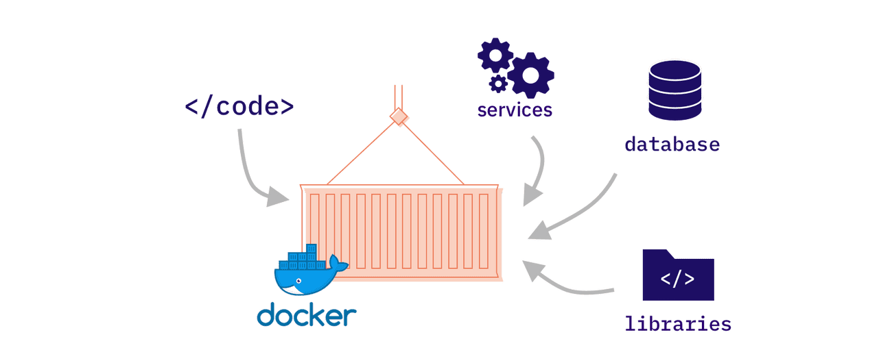
What is docker?
Docker is an open platform for developing, shipping, and running applications. Docker enables you to separate your applications from your infrastructure so you can deliver software quickly.
Docker provides the ability to package and run an application in a loosely isolated environment called a container. The isolation and security allows you to run many containers simultaneously on a given host. Containers are lightweight and contain everything needed to run the application, so you do not need to rely on what is currently installed on the host. You can easily share containers while you work and be sure that everyone you share with gets the same container that works in the same way.

Slide 4
Docker engine and docker desktop
Docker Engine is an open-source containerization technology for building and containerizing your applications. Docker Engine acts as a client-server application with:
A server with a long-running daemon process dockerd.
APIs which specify interfaces that programs can use to talk to and instruct the Docker daemon.
A command line interface (CLI) client docker.

Slide 5
Docker engine and docker desktop
Docker Desktop is a one-click-install application for your Mac, Linux, or Windows environment that lets you build, share, and run containerized applications and microservices.
It provides a straightforward GUI (Graphical User Interface) that lets you manage your containers, applications, and images directly from your machine. Docker Desktop can be used either on its own or as a complementary tool to the CLI.
Docker Desktop included:
- Docker Engine - Docker CLI client - Docker Buildx - Docker Extensions - Docker Compose | - Docker Scout - Docker Content Trust - Kubernetes - Credential Helper

Slide 6
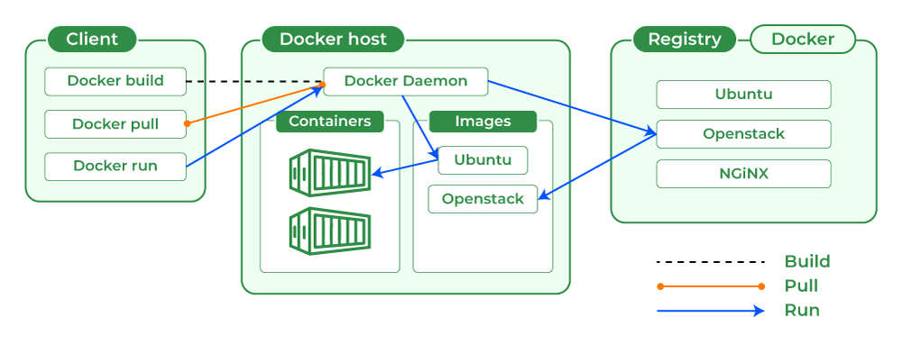
Docker architecture
Docker uses a client-server architecture. The Docker client talks to the Docker daemon, which does the heavy lifting of building, running, and distributing your Docker containers. The Docker client and daemon can run on the same system, or you can connect a Docker client to a remote Docker daemon. The Docker client and daemon communicate using a REST API, over UNIX sockets or a network interface. Another Docker client is Docker Compose, that lets you work with applications consisting of a set of containers.

Slide 7
Docker architecture
Docker Client
With the help of the docker client, the docker users can interact with the docker. The docker command uses the Docker API. The Docker client can communicate with multiple daemons. When a docker client runs any docker command on the docker terminal then the terminal sends instructions to the daemon.
Docker Host
Docker Host provides a complete environment to execute and run applications. It comprises of the Docker daemon, Images, Containers, Networks, and Storage.
Docker Daemon
Docker daemon manages all the services by communicating with other daemons. It manages docker objects such as images, containers, networks, and volumes with the help of the API requests of Docker.

Slide 8
Docker architecture
Docker Objects:
Images
Container
Storage
Networking
Docker Registry
All the docker images are stored in the docker registry. There is a public registry which is known as a docker hub that can be used by anyone. We can run our private registry also. With the help of docker run or docker pull commands, we can pull the required images from our configured registry. Images are pushed into configured registry with the help of the docker push command.

Slide 9
Image and container
Images
An image is a read-only template with instructions for creating a Docker container. Often, an image is based on another image, with some additional customization. A running container uses an isolated filesystem. This isolated filesystem is provided by an image, and the image must contain everything needed to run an application - all dependencies, configurations, scripts, binaries, etc. The image also contains other configurations for the container, such as environment variables, a default command to run, and other metadata.
Container
A container is a sandboxed process running on a host machine that is isolated from all other processes running on that host machine.
Is a runnable instance of an image.
Can be run on local machines, virtual machines, or deployed to the cloud.
Is portable (and can be run on any OS).
Is isolated from other containers and runs its own software, binaries, configurations, etc.

Slide 10
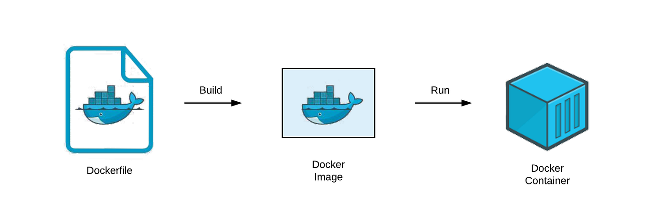
What is dockerfile
Docker can build images automatically by reading the instructions from a Dockerfile. A Dockerfile is a text document that contains all the commands a user could call on the command line to assemble an image.

Slide 11
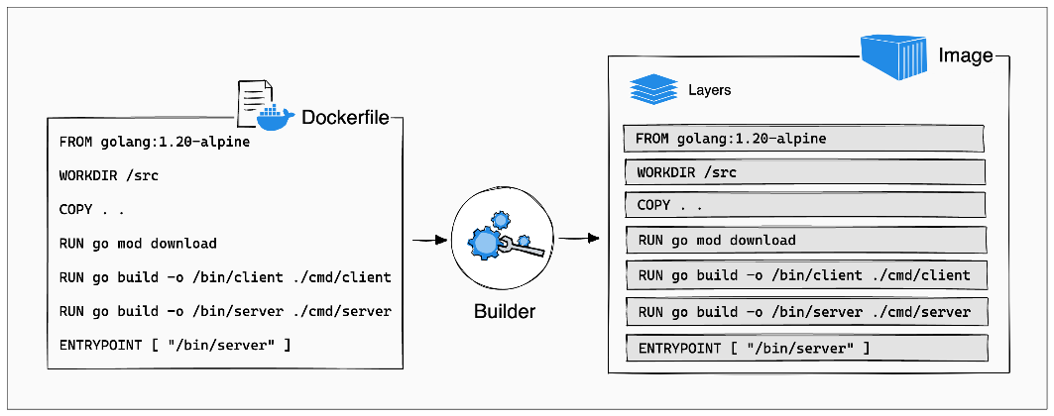
Docker file reference
A Dockerfile is a text document in which you define the build steps for your application. You write the Dockerfile in a domain-specific language, called the Dockerfile syntax.
Format of the Dockerfile:
# Comment
INSTRUCTION arguments
A Dockerfile must begin with a FROM instruction.
The order of Dockerfile instructions matters. A Docker build consists of a series of ordered build instructions. Each instruction in a Dockerfile roughly translates to an image layer.

Slide 12
Docker file reference
FROM
The FROM instruction initializes a new build stage and sets the Base Image for subsequent instructions. As such, a valid Dockerfile must start with a FROM instruction. ARG is the only instruction that may precede FROM in the Dockerfile.
RUN
The RUN instruction will execute any commands in a new layer on top of the current image and commit the results. The resulting committed image will be used for the next step in the Dockerfile.
CMD
The main purpose of a CMD is to provide defaults for an executing container. These defaults can include an executable, or they can omit the executable, in which case you must specify an ENTRYPOINT instruction as well.
LABEL
The LABEL instruction adds metadata to an image. A LABEL is a key-value pair. To include spaces within a LABEL value, use quotes and backslashes as you would in command-line parsing.

Slide 13
Docker file reference
MAINTAINER
The MAINTAINER instruction sets the Author field of the generated images.
EXPOSE
The EXPOSE instruction informs Docker that the container listens on the specified network ports at runtime. You can specify whether the port listens on TCP or UDP, and the default is TCP if the protocol is not specified.
ENV
The ENV instruction sets the environment variable <key> to the value <value>.
ADD
The ADD instruction copies new files, directories or remote file URLs from <src> and adds them to the filesystem of the image at the path <dest>.
COPY
The COPY instruction copies new files or directories from <src> and adds them to the filesystem of the container at the path <dest>.
.

Slide 14
Docker file reference
ENTRYPOINT
An ENTRYPOINT allows you to configure a container that will run as an executable.
WORKDIR
The WORKDIR instruction sets the working directory for any RUN, CMD, ENTRYPOINT, COPY and ADD instructions that follow it in the Dockerfile. If the WORKDIR doesn’t exist, it will be created even if it’s not used in any subsequent Dockerfile instruction.
USER
The USER instruction sets the username (or UID) and optionally the user group (or GID) to use as the default user and group for the remainder of the current stage.
ARG
The ARG instruction defines a variable that users can pass at build-time to the builder with the docker build command using the --build-arg <varname>=<value> flag. If a user specifies a build argument that was not defined in the Dockerfile, the build outputs a warning

Slide 15
Docker file reference
VOLUME
The VOLUME instruction creates a mount point with the specified name and marks it as holding externally mounted volumes from native host or other containers.
ONBUILD
The ONBUILD instruction adds to the image a trigger instruction to be executed at a later time, when the image is used as the base for another build. The trigger will be executed in the context of the downstream build, as if it had been inserted immediately after the FROM instruction in the downstream Dockerfile.
STOPSIGNAL
The STOPSIGNAL instruction sets the system call signal that will be sent to the container to exit. This signal can be a signal name in the format SIG<NAME>, for instance SIGKILL, or an unsigned number that matches a position in the kernel’s syscall table, for instance 9. The default is SIGTERM if not defined.
HEALTHCHECK
The HEALTHCHECK instruction tells Docker how to test a container to check that it is still working. This can detect cases such as a web server that is stuck in an infinite loop and unable to handle new connections, even though the server process is still running.

Slide 16
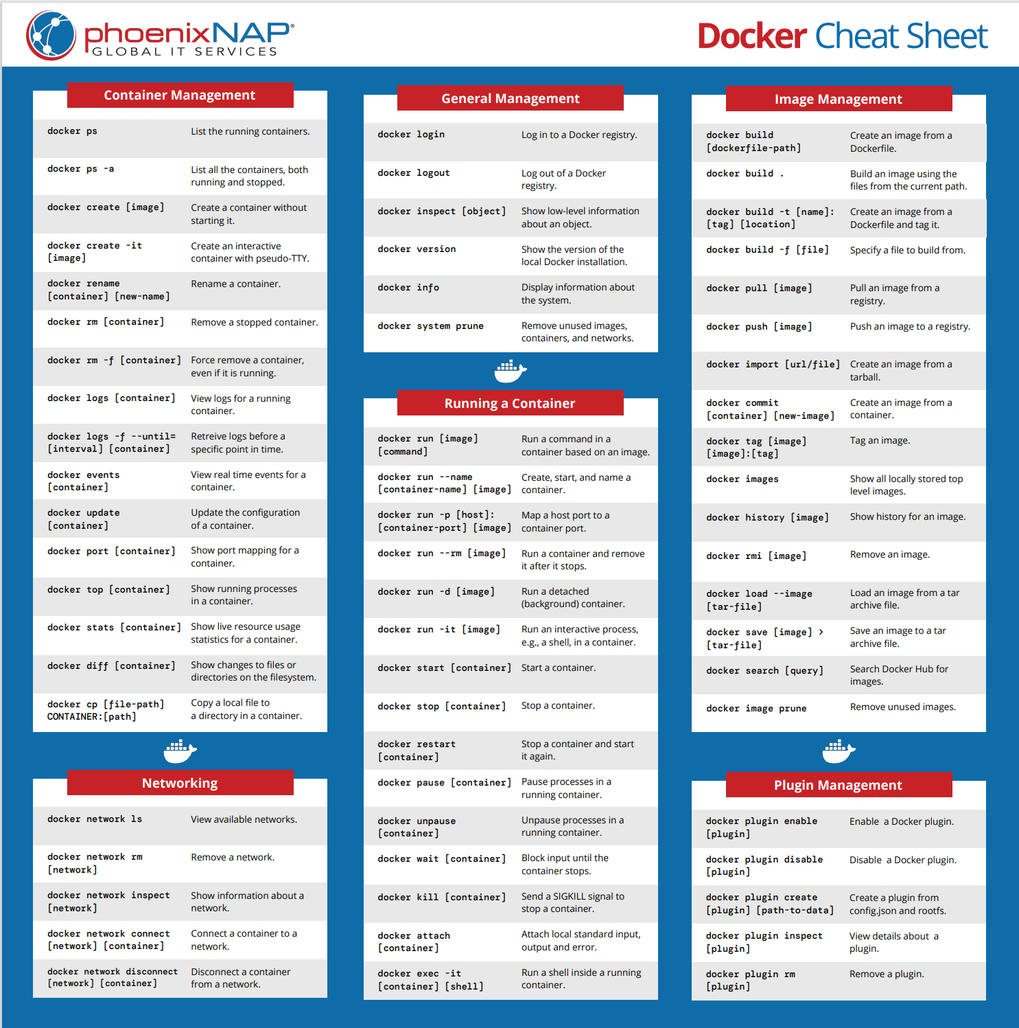
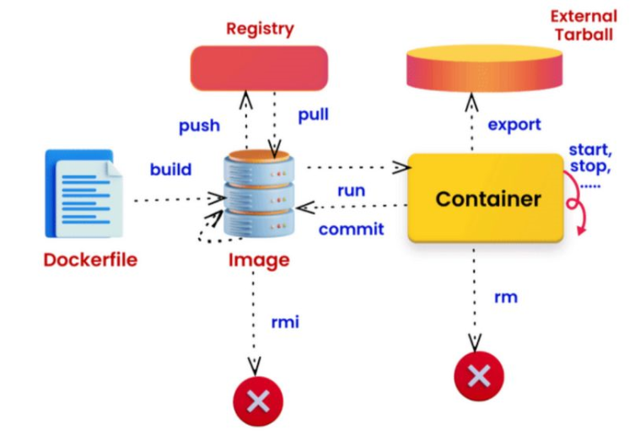
DOCKER Command
Refer more in Docker run reference | Docker Docs
Or use command docker --help

Slide 17
Renesas.com

