Slide 1

ELC Module
  FSP
09-Feb-2023
Vo minh du
EMBEDDED SOFTWARE ENGINEER,
SS1_FSP
Renesas Electronics Corporation

Slide 2
Agenda
Overview Page 03
Feature Page 08
Operation Page 14
Function Documentation Page 17
Configuration Page 24
Interface Page 28
Usage Notes Page 32

Slide 3
Overview

Slide 4
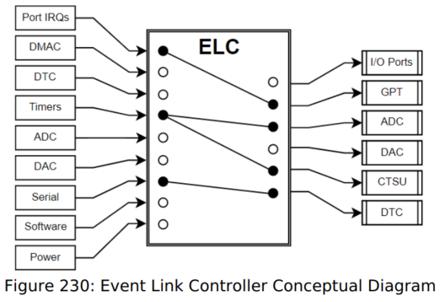
Overview
The event link controller (ELC) uses the event requests generated by various peripheral modules as source signals to connect (link) them to different modules, allowing direct cooperation between the modules without central processing unit (CPU) intervention.

Slide 5
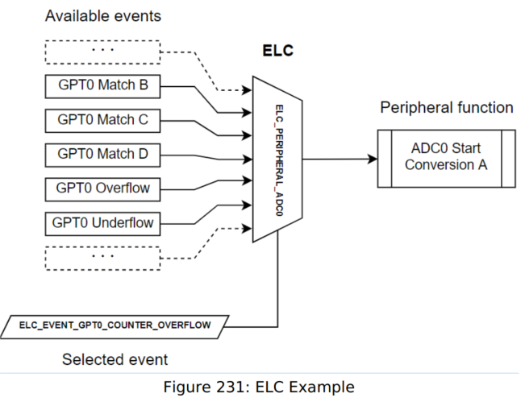
Overview
In essence, the ELC is an array of multiplexers to route a wide variety of interrupt signals to a subset of peripheral functions. Events are linked by setting the multiplexer for the desired function to the desired signal (through R_ELC_LinkSet).

Slide 6
Overview
ELC Specification
Item | Description
Event link function | 92+2(closed for customer) types of event signals can be directly connected to modules. The ELC generates the ELC event signal, and events that activate the DTC
Module-stop function | Module-stop state can be set
TrustZone filter | Security attribution can be set for each registers

Slide 7
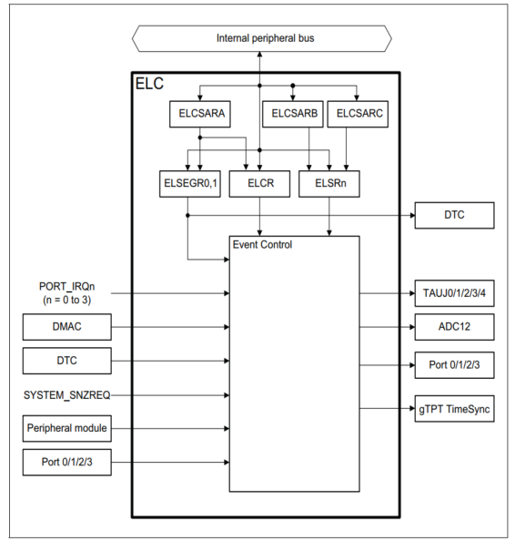
Overview
ELC Block diagram

Slide 8
feature

Slide 9
Features
The ELC HAL module can perform the following functions:
Initialize the ELC to a pre-defined set of links
Create an event link between two blocks
Break an event link between two blocks
Generate one of two software events that interrupt the CPU
Globally enable or disable event links

Slide 10
Features
A variety of functions can be activated via events, including:
General-purpose timer (GPT) control
ADC and DAC conversion start
Synchronized I/O port output (ports 1-4 only)
Capacitive touch unit (CTSU) measurement activation

Slide 11
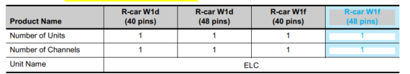
features number of units and channels

Slide 12

features clock supply

Slide 13
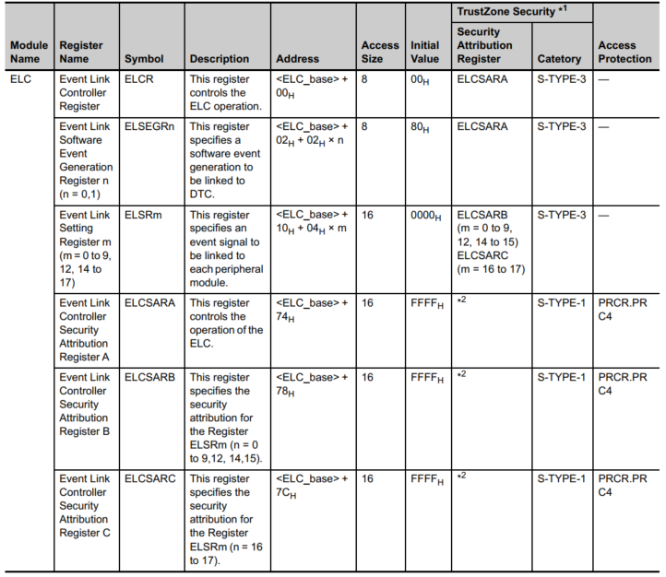
List of registers
  Note *2: Only secure access can write to this register. Both secure access and Non-secure read access are allowed but Non-secure write access is not allowed and TrustZone access error is not generated.

Slide 14
operation

Slide 15
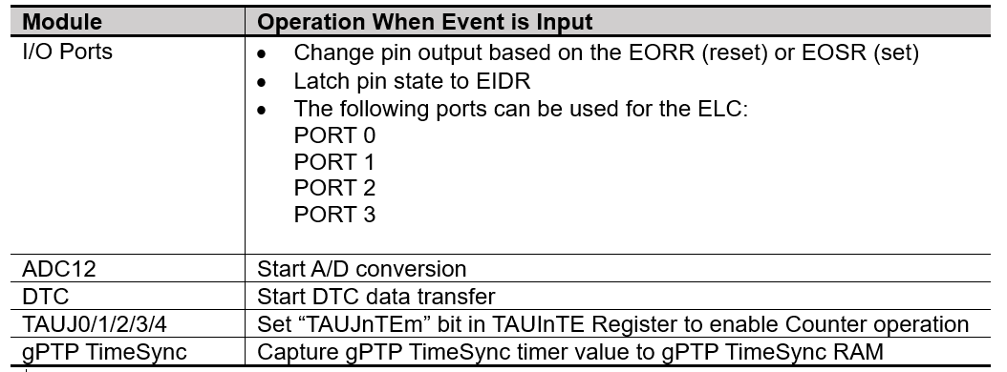
Operation relation between interrupt handling and event link
Event number for an event link is the same as that for the associated interrupt source
LINKING EVENTS
When an event occurs and that event is already set as a trigger in the Event Link Setting Register (ELSRn), the associated module is activated. The operation of the module must be set up in advance.

Slide 16
Operation
Example of procedure of linking events
To link event:
Set the operation of the module for which an event is to be linked
Set the appropriate ELSRn.ELS[8:0] bits for to be linked.
Set the ELCR.ELCON bit to 1 to enable linkage of all events
Configure the module from which an event is output and activate the module. The link between the two modules is now active.
To stop event linkage of module individually, set 0 to the ELSRn.ELS[8:0] bits associated with the modules. To stop linkage of all the events, set the ELCR.ELCON bit to 0.
If event link output from the RTC is to be used, set the ELC after the RTC settings, for example, for initialization and time setting. Unintended events may be generated if RTC settings are made after the
ELC settings.
If event link output from the PVD is to be used, set the ELC after setting the LVD (low voltage directive). To disable the PVD, do so after setting 0x00 to the associated ELSRn register.

Slide 17
function documentation

Slide 18
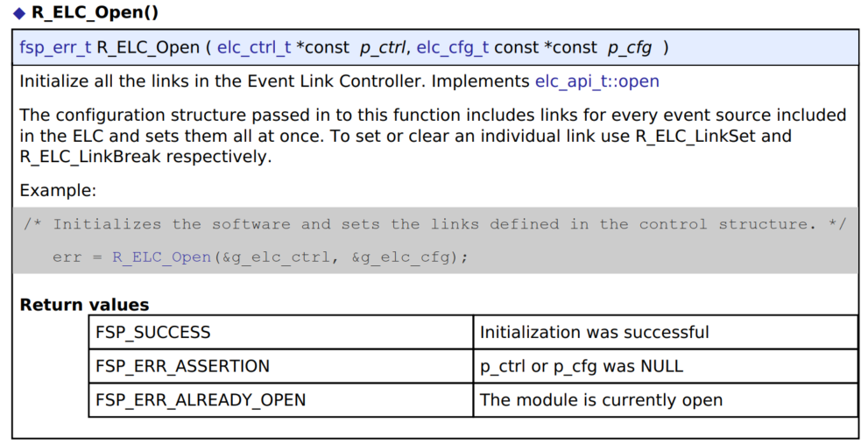
Function documentation

Slide 19
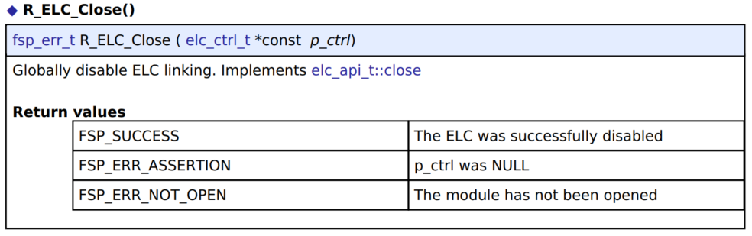
Function documentation

Slide 20
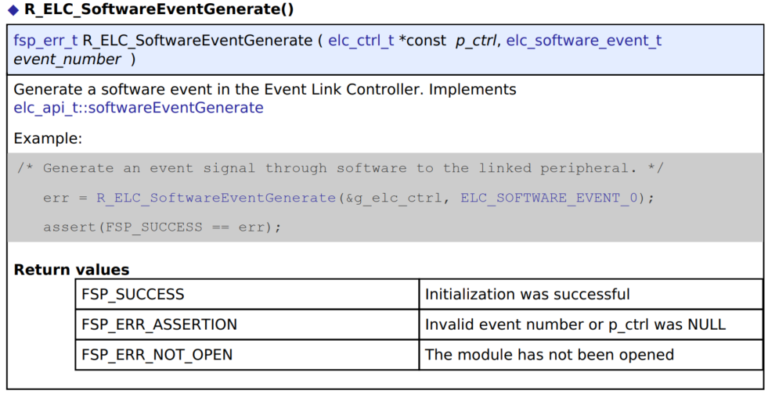
Function documentation

Slide 21
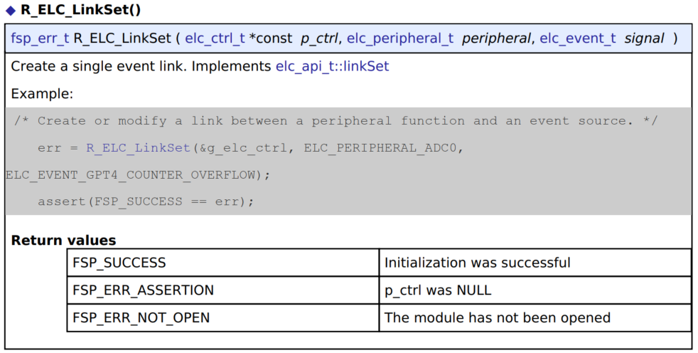
Function documentation

Slide 22
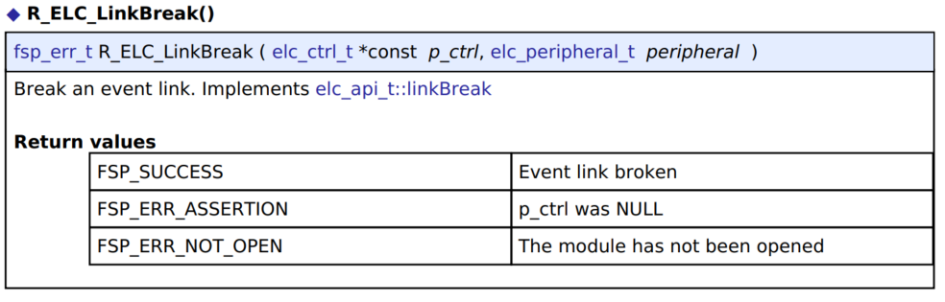
Function documentation

Slide 23
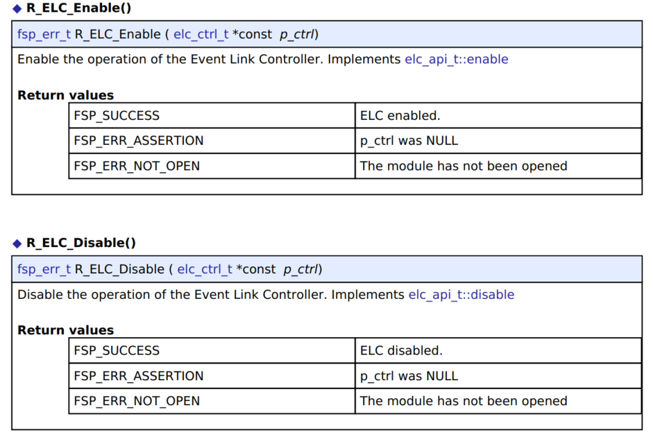
Function documentation

Slide 24
configuration

Slide 25
Configuration
  Notes:
    Event links will be automatically generated based on the selections made in module properties. To view the
    currently linked events check the Event Links tab in the RA Configuration editor.
    Calling R_ELC_Open followed by R_ELC_Enable will automatically link all events shown in the Event Links tab.
    To manually link an event to a peripheral at runtime perform the following steps:
    Configure the operation of the destination peripheral (including any configuration necessary to receive events)
    Use R_ELC_LinkSet to set the desired event link to the peripheral
    Use R_ELC_Enable to enable transmission of event signals
    Configure the signaling module to output the desired event (typically an interrupt)

Slide 26
Configuration
  To disable the event, either use R_ELC_LinkBreak to clear the link for a specific event or R_ELC_Disable to globally disable event linking.
  Note:
    The ELC module needs no pin, clocking or interrupt configuration; it is merely a mechanism to connect signals
    between peripherals. However, when linking I/O Ports via the ELC the relevant I/O pins need to be configured as
    inputs or outputs.

Slide 27
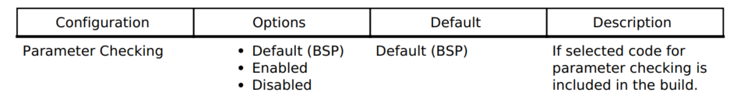
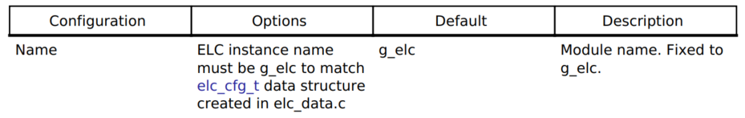
configuration build time configuration for r_elc
The following build time configurations are defined in fsp_cfg/r_elc_cfg.h:
Configurations for System > Event Link Controller (r_elc)
This module can be added to the Stacks tab via New Stack > System > Event Link Controller (r_elc).
Non-secure callable guard functions can be generated for this module by right clicking the module in the RA Configuration tool and checking the "Non-secure Callable" box.

Slide 28
interface

Slide 29

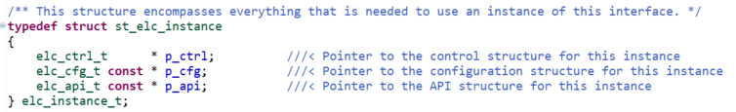
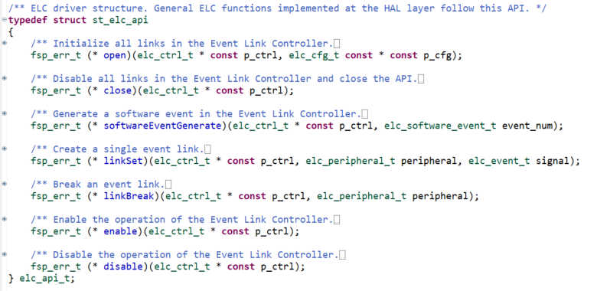
Interface data structure

Slide 30
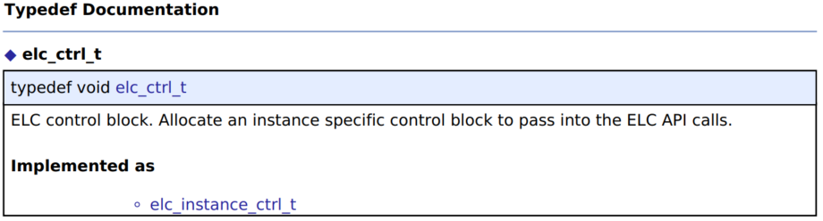
interface

Slide 31
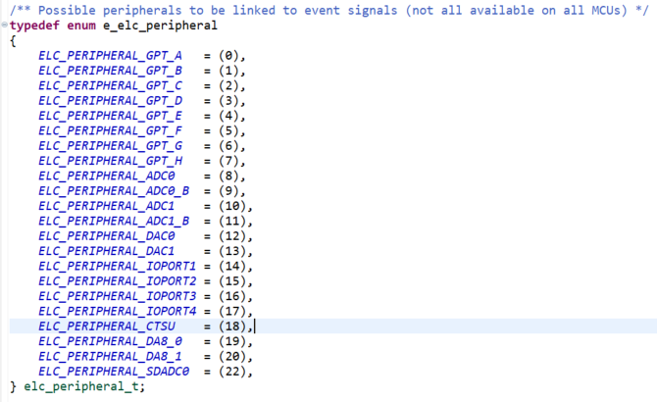
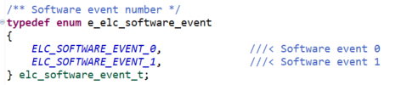
interface
Enumeration Type Documentation

Slide 32
Usage notes

Slide 33
Usage notes
  Linking DMAC/DTC Transfer End Signals as Events
    When linking the DMAC/DTC transfer end signals as events, do not set the same peripheral module as the DMAC/DTC transfer destination and event link destination. If set, the peripheral module might be started before DMAC/DTC transfer to the peripheral module is complete
  Setting Clock
    To link events, you must enable the ELC and the related modules. The modules cannot operate if the
    related modules are in the module-stop state or in low power mode in which the module is stopped
    (Software Standby mode or Deep Stop mode) .
  Module-Stop Function Settings
    The Module Stop Control Register C (MSTPCRC) can enable or disable ELC operation. The ELC is
    initially stopped after reset. Releasing the module-stop state enables access to the registers. The
    ELCON bit must be set to 0 before disabling ELC operation using the Module Stop Control Register.

Slide 34
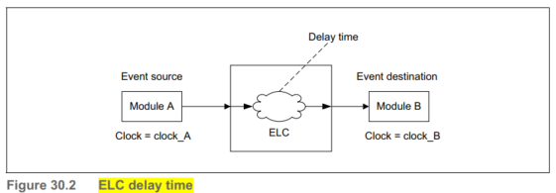
Usage notes elc delay time
Clock domain | Clock frequency | ELC delay time
clock_A = clock_B | clock_A = clock_B | 0 cycle
clock_A ≠ clock_B | clock_A = clock_B | 1 cycle to 2 cycle
 | clock_A > clock_B | 1 cycle to 2 cycle of clock_B
 | clock_A < clock_B | 1 cycle to 2 cycle of clock_A

