Slide 1

RA FSP
Unity test
Date: Mar 07, 2023
Department: FSP1
Renesas Electronics Corporation

Slide 2
Agenda
ThrowTheSwitch Page 03
Prepare environment Page 09
Setup project on e2 studio Page 10

Slide 3
Unity test ThrowTheSwitch
Throw the switch is a testing framework for embedded software develop which is written in C
Main page can be found at: http://www.throwtheswitch.org/

Slide 4
Unity test ThrowTheSwitch
Unity by ThrowTheSwitch is a superb unit testing framework for C.
Function | Argument | Definition
UnityMain(int argc, char* argv[], void (*runAllTests)()) | argc: | Number of options to be looped in argv[]
 | argv[] | -v: Verbose output: show all tests executed even if they pass
 |  | -s: Silent mode: minimal output showing only test failures
 |  | -g NAME: Only run tests in groups that contain the string NAME
 |  | -n NAME: Only run tests whose name contains the string NAME
 |  | -r NUMBER: Repeatedly run all tests NUMBER times
 |  | -h, --help: Display this help message
 | runAllTests | Function pointer to a function which executes all test cases
void main()
{
UnityMain(0, 0, RunAllTests);
while(1)
{
/* Infinite loop. */
}
}

Slide 5
Unity test ThrowTheSwitch
int UnityMain(int argc, char* argv[], void (*runAllTests)())
{
int result = UnityGetCommandLineOptions(argc, argv);
unsigned int r;
if (result != 0)
return result;
for (r = 0; r < UnityFixture.RepeatCount; r++)
{
announceTestRun(r);
UnityBegin();
runAllTests();
UNITY_OUTPUT_CHAR('\n’);
UnityEnd();
}
return UnityFailureCount();
}
Function to invoke all test cases

Slide 6
Unity test ThrowTheSwitch
TEST(R_SCI_Open_Test, TG001_001)
{
sci_err_t error = SCI_SUCCESS;
uint8_t chan;
sci_mode_t mode;
sci_cfg_t* p_cfg = &g_config;
void (*p_callback)(void *p_args);
sci_hdl_t *p_hdl = &g_sci_handle;
chan = 100;
p_callback = test_sci_callback;
error = R_SCI_Open(chan, mode, p_cfg, p_callback, p_hdl);
TEST_ASSERT_EQUAL(SCI_MODE_OFF, g_sci_handle->mode);
TEST_ASSERT_EQUAL(SCI_ERR_BAD_CHAN, error);
}
Test inputs
Expected outputs
Unity assertion

Slide 7
Unity test ThrowTheSwitch
Unity assertion reference:
Unity/UnityAssertionsReference.md at master · ThrowTheSwitch/Unity (github.com)
Basic assertion | Definition
TEST_ASSERT_TRUE(condition) | Evaluates whatever code is in condition and fails if it evaluates to false
TEST_ASSERT_FALSE(condition) | Evaluates whatever code is in condition and fails if it evaluates to true
TEST_ASSERT(condition) | Another way of calling TEST_ASSERT_TRUE
TEST_ASSERT_UNLESS(condition) | Another way of calling TEST_ASSERT_FALSE
TEST_FAIL() TEST_FAIL_MESSAGE(message) | This test is automatically marked as a failure. The message is output stating why.
TEST_ASSERT_EQUAL_INT(expected, actual) | Compare two integers for equality and display errors as signed integers.

Slide 8
Unity test ThrowTheSwitch
Unity assertion reference:
Unity/UnityAssertionsReference.md at master · ThrowTheSwitch/Unity (github.com)
Basic assertion | Definition
TEST_ASSERT_TRUE(condition) | Evaluates whatever code is in condition and fails if it evaluates to false
TEST_ASSERT_FALSE(condition) | Evaluates whatever code is in condition and fails if it evaluates to true
TEST_ASSERT(condition) | Another way of calling TEST_ASSERT_TRUE
TEST_ASSERT_UNLESS(condition) | Another way of calling TEST_ASSERT_FALSE
TEST_FAIL() TEST_FAIL_MESSAGE(message) | This test is automatically marked as a failure. The message is output stating why.
TEST_ASSERT_EQUAL_INT(expected, actual) | Compare two integers for equality and display errors as signed integers.

Slide 9
Unity Test Prepare environment
Please install below packages:
pip install scons
pip install pyyaml
pip install chardet
pip install prettytable
Install Clang-tidy
Install LLVM-xxx-win64.exe(latst version) from https://github.com/llvm/llvm-project/releases/download/llvmorg-15.0.7/LLVM-15.0.7-win64.exe
After installing, add the folder path that clang-tidy.exe exist to environment variable on PC.

Slide 10
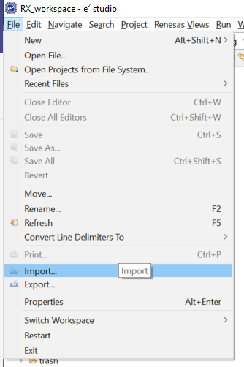
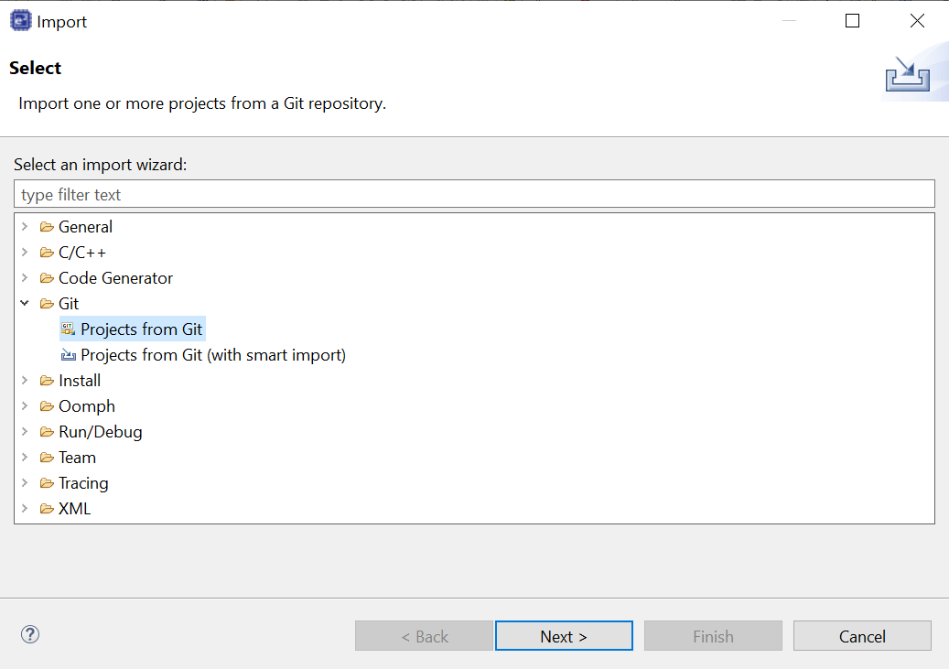
Unity Test Set up project on e2 Studio
Step 1: Import fsp gitlab
1
2

Slide 11
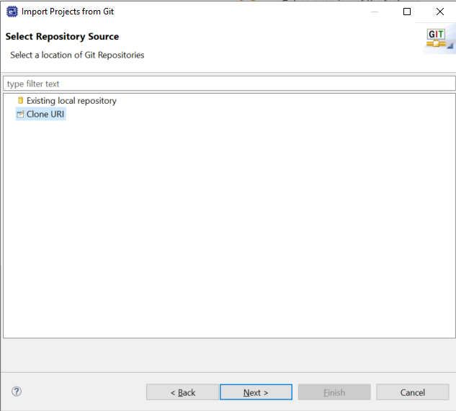
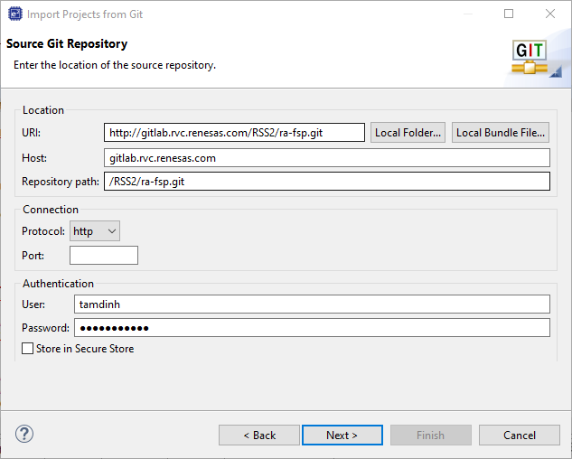
Unity Test Set up project on e2 Studio
3
4

Slide 12
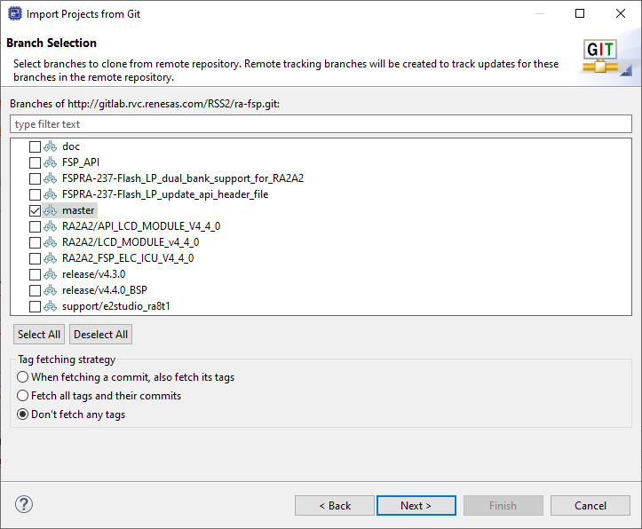
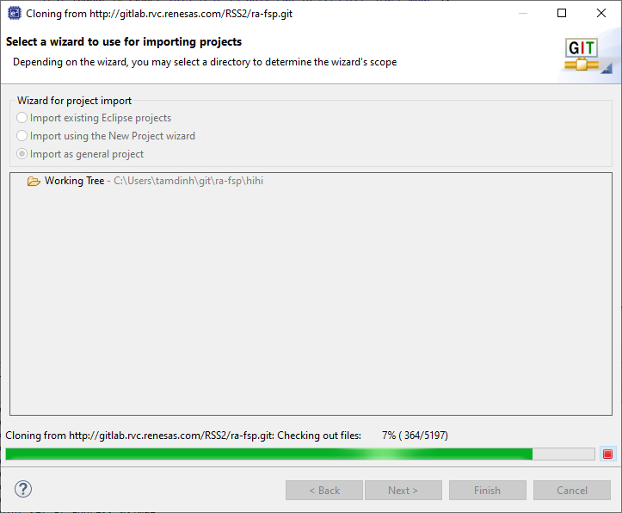
Unity Test Set up project on e2 Studio
5
6

Slide 13
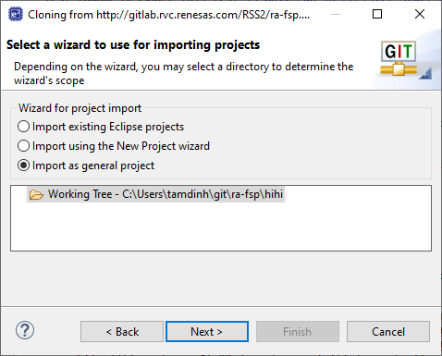
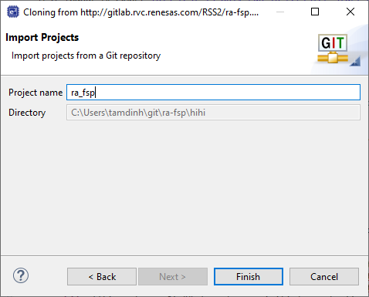
Unity Test Set up project on e2 Studio
7
8

Slide 14
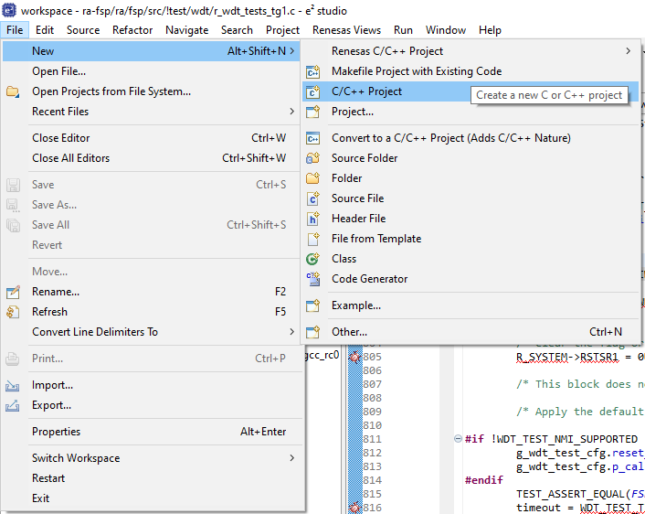
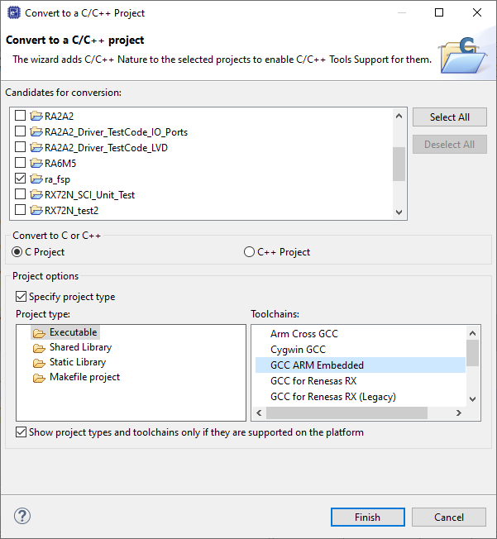
Unity Test Set up project on e2 Studio
Step 2: Convert to C/C++ project
1
2

Slide 15
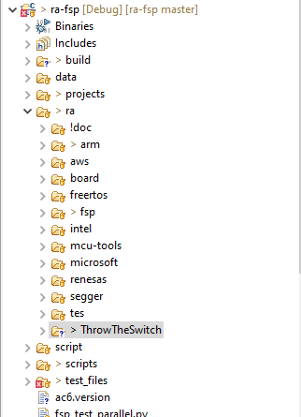
Unity Test Set up project on e2 Studio
Step 3: Update submodule
Open command prompt
Change current directory to ra-fsp that is top folder of the repository.
Run the below git command
a. git submodule update --init --recursive .\ra\arm\CMSIS_5\
b. git submodule update --init --recursive .\ra\ThrowTheSwitch\

Slide 16
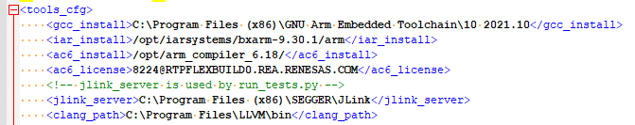
Unity Test Set up project on e2 Studio
Step 4: Set compiler
Open the below file with text format
ra-fsp\test_files\shared\tools_cfg_ref.xml
Change the <gcc_install> tag to GCC installation folder on local PC.
Change the <clang_path> tag to LLVM installation folder on local PC.

Slide 17
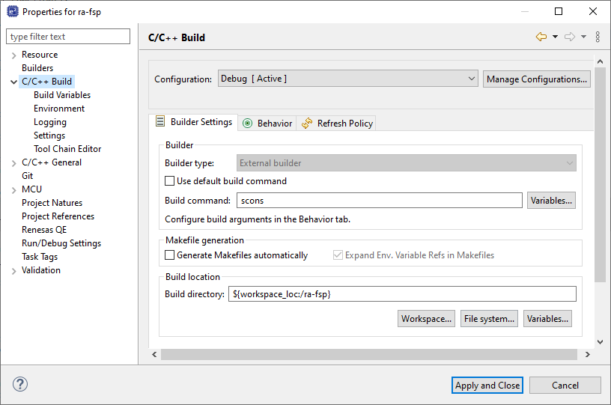
Unity Test Set up project on e2 Studio
Step 5: Change e2 studio setting
1

Slide 18
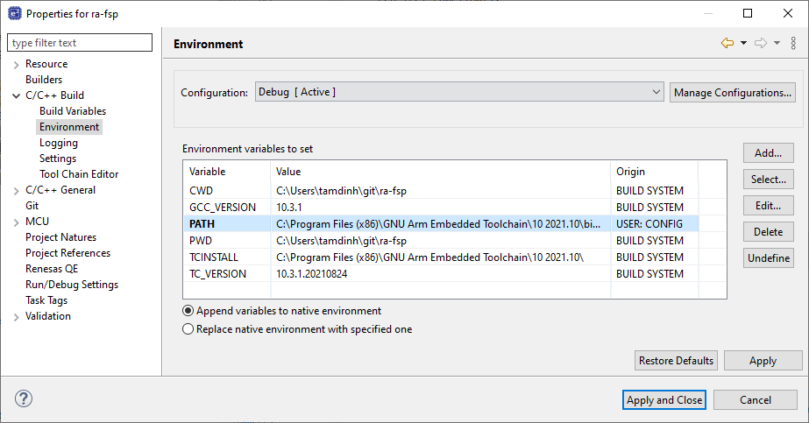
Unity Test Set up project on e2 Studio
Step 5: Change e2 studio setting
Confirm again PATH environment
2
Please check if paths of scons.exe and clang-tidy are added already.
At my PC, they are located at
C:\Users\tamdinh\AppData\Roaming\Python\Python39\Scripts;C:\Program Files\LLVM\bin

Slide 19
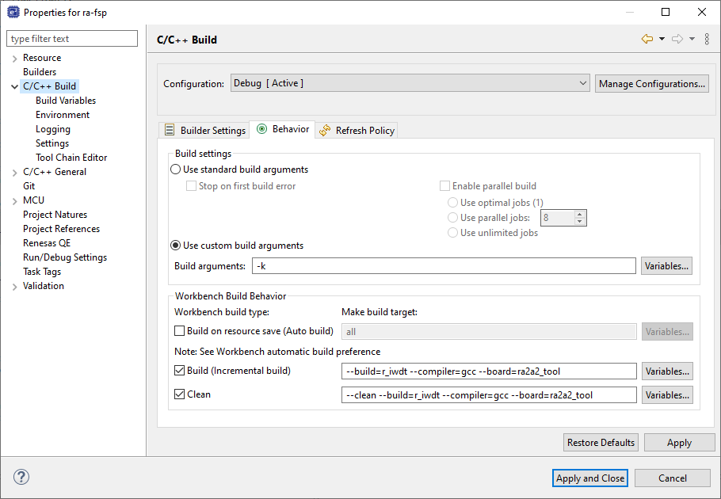
Unity Test Set up project on e2 Studio
Step 5: Change e2 studio setting
3
Please add
"--static_analyze=exoprt"
if you want to check static analysis.

Slide 20
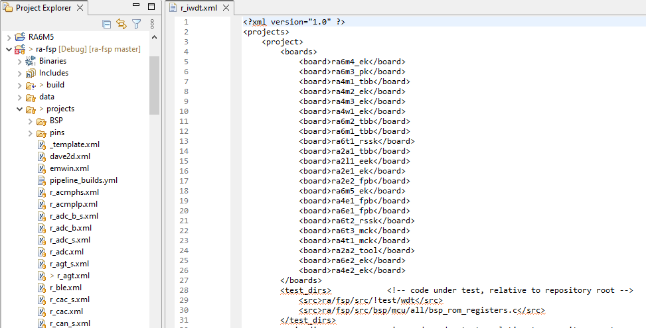
Unity Test Set up project on e2 Studio
Step 6: Add board information to target module
Please add board name to taget module xml file
Board name is same with Step 5.

Slide 21
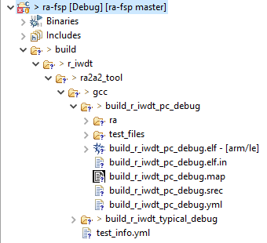
Unity Test Set up project on e2 Studio
Step 7: Build project
If build is successful, output is created into following folder
ra-fsp\build\<Module Name >\<Board Name>\gcc\<build option of test program>\

Slide 22
Unity Test Set up project on e2 Studio
Step 8: Run project
Download binary file that is created into
ra-fsp\build\<Module Name >\<Board Name>\gcc\build_<Module Name>_pc_debug\build_<ModuleName>_pc_debug.elf\

Slide 23
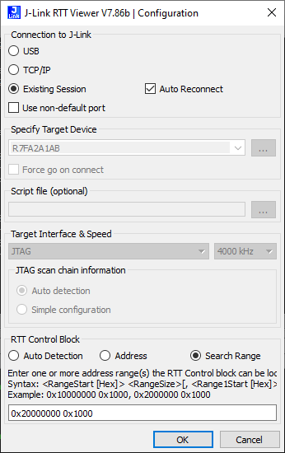
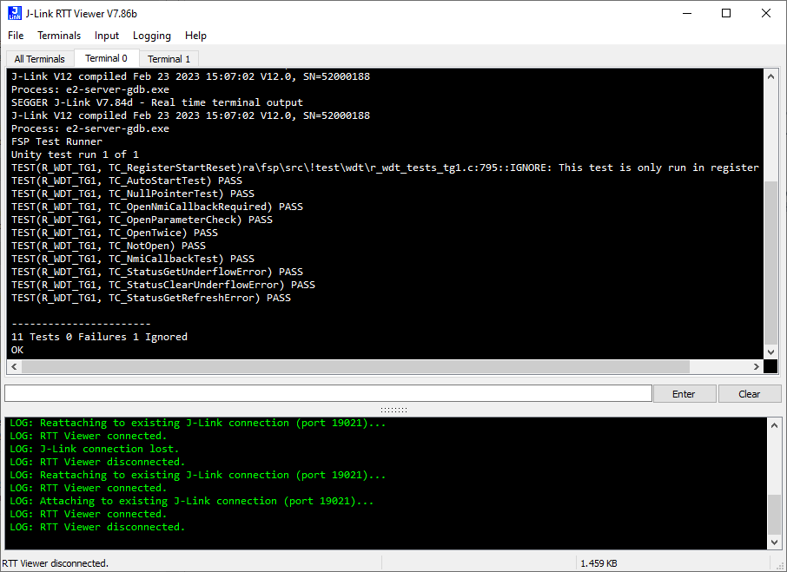
Unity Test Set up project on e2 Studio
In RA FSP, J-Link RTT Viewer is used to display test result

Slide 24
Revision history
Version | Date | Change history | Author
0.01 | 06/02/2023 | Initial version | TamDinh
0.02 | 06/03/2023 | Update steps for local Unity test | TamDinh

Slide 25
Renesas.com

Slide 26
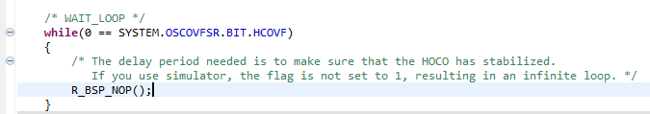
Coverage view
Coverage measurement is supported by e2studio
IECube emulator (RL78)
E20 emulator (some RX devices with external trace feature. E.g. RX64M, RX71M, etc.)
Simulator (RX, RL78)
Issue: Simulator cannot simulate exact behavior of HW register => cannot execute automatically

