Slide 1
FreeRTOS-Inves
Date: Jul.2023
Name: Huynh Thai
Renesas Electronics Corporation

Slide 2
Overview

Slide 3
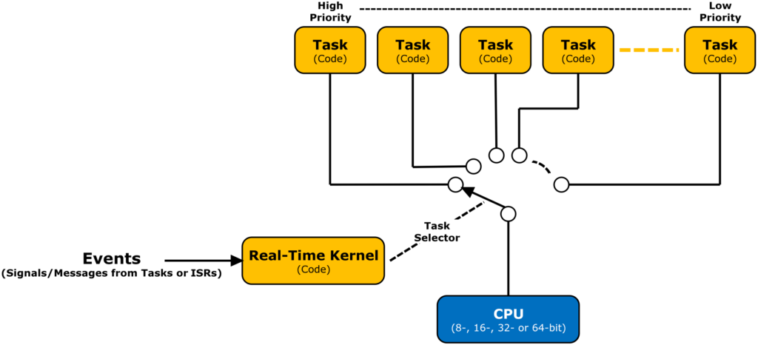
RTOS

Slide 4
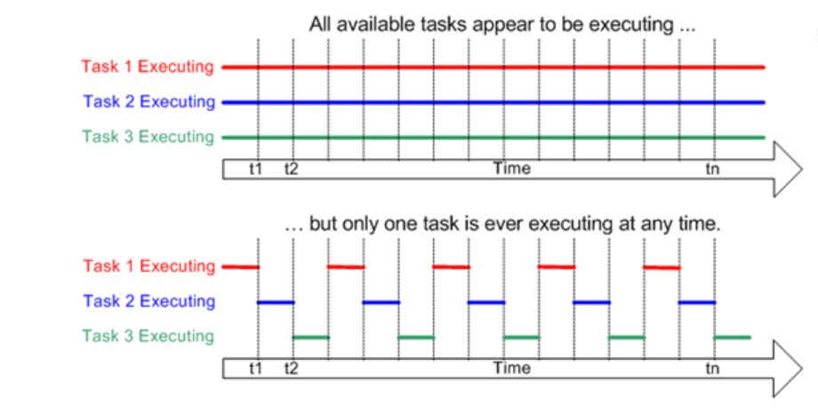
RTOS

Slide 5
FREERTOS

Slide 6
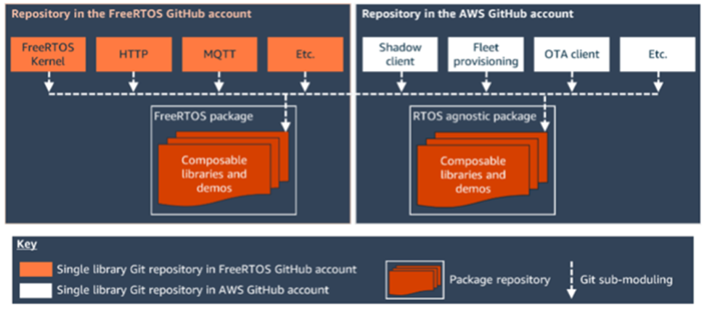
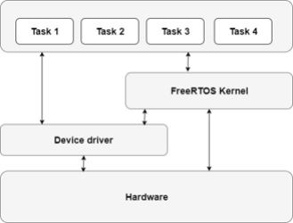
FreeRTOS Architecture
FreeRTOS is a real-time kernel (or real-time scheduler) can be built to meet their real-time requirements. The kernel decides which task should be executing by examining the priority assigned to each by the application designer.

Slide 7
FreeRTOS features
Preemptive Multitasking
Task Management
Synchronization and Communication
Interrupt Handling
Timers
Memory Management
Tick Management
Portable and Scalable
Configurability
Robustness and Reliability

Slide 8
FreeRTOS
Memory management
Tasks management
Safer Interrupt
Queues management
Resource management
Example FreeRTOS

Slide 9
Memory Management

Slide 10
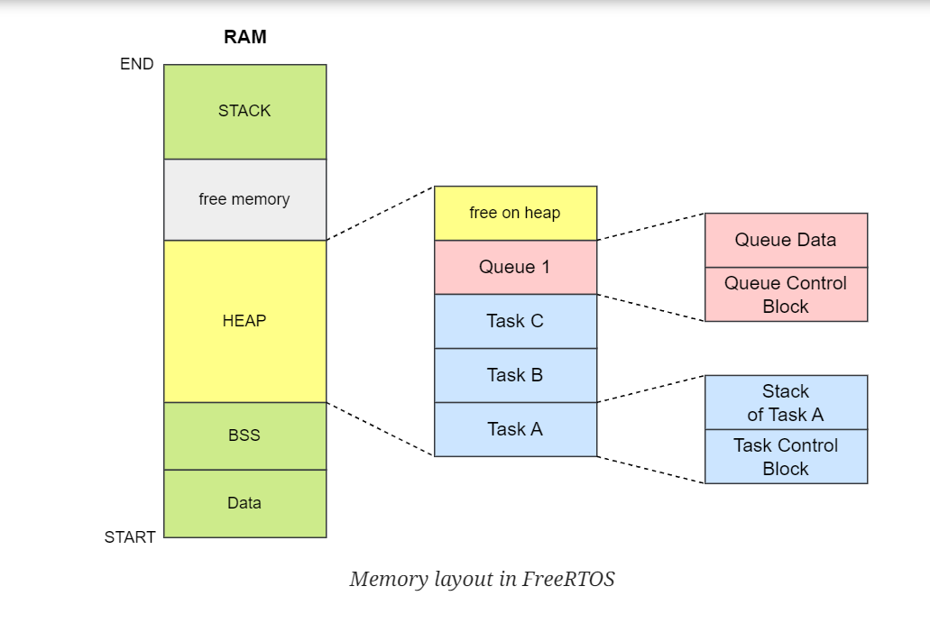
Memory Management
The RTOS kernel needs RAM each time a task, queue, or other RTOS object is created. The RAM can be allocated:
Statically at compile time.
Dynamically from the RTOS heap by the RTOS API object creation functions.

Slide 11
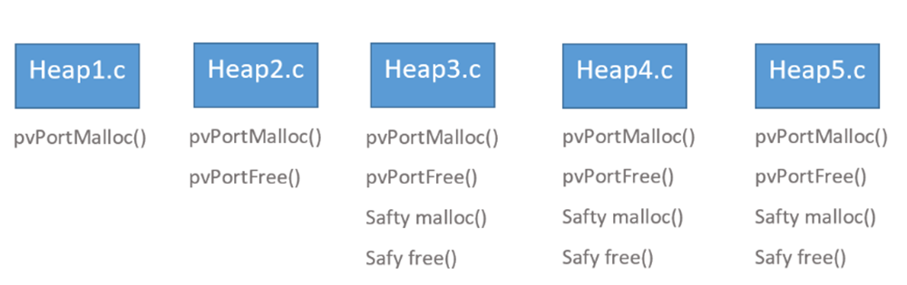
heap memory management
heap_1
— the very simplest, does not permit memory to be freed.
heap_2
— permits memory to be freed, but does not coalescence adjacent free blocks.
heap_3
— simply wraps the standard malloc() and free() for thread safety.
heap_4
— coalescence adjacent free blocks to avoid fragmentation. Includes absolute address placement option.
heap_5
— as per heap_4, with the ability to span the heap across multiple non-adjacent memory areas

Slide 12
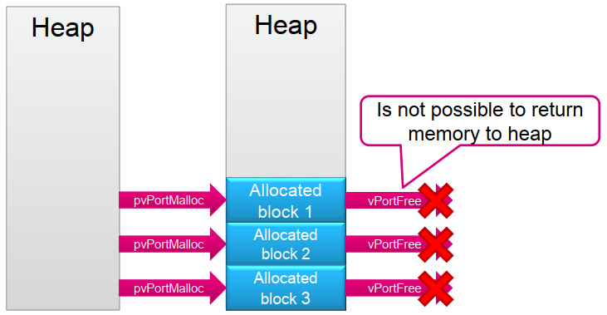
Heap_1
.
This implementation uses first-fit algorithm to allocate memory.
It is the simplest allocation method (deterministic), but does not allow freeing of allocated memory.

Slide 13
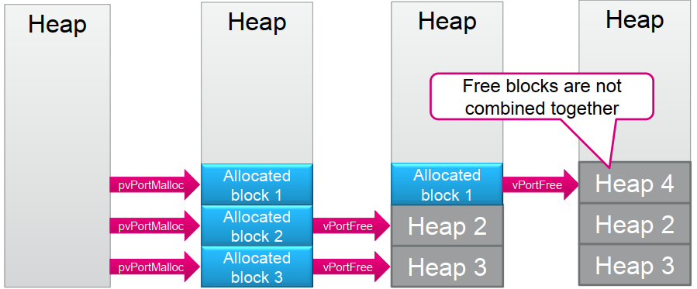
Heap_2
.
This method implements the best fit algorithm for allocation.
It allows memory free() operation but doesn’t combine adjacent free blocks.
This method has risk of fragmentation.

Slide 14
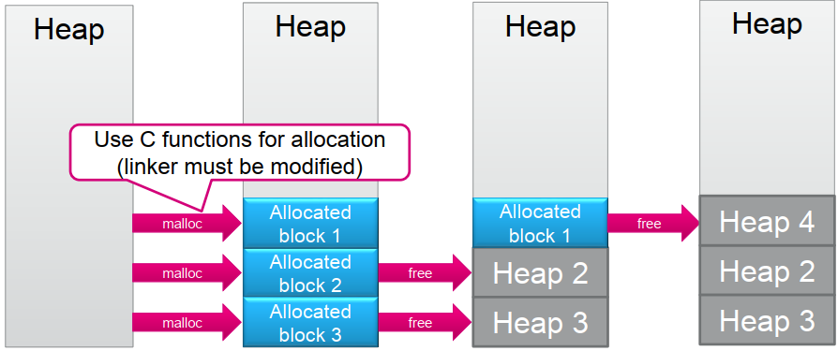
Heap_3
This method implements simple wrapper for standard C library malloc() and free(); wrapper makes these functions thread safe, but makes code increase and not deterministic
It uses linker heap region.
The configTOTAL_HEAP_SIZE setting has no effect when this model is used
.

Slide 15
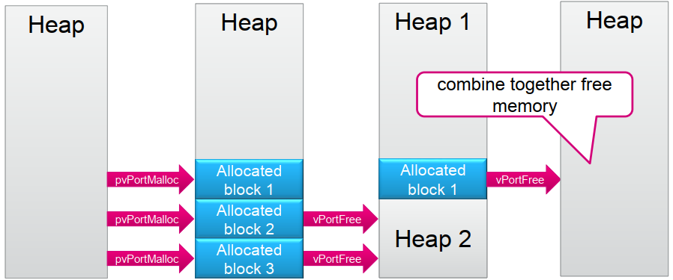
Heap_4
.
This method uses first fit algorithm to allocate memory. It is able to combine adjacent free memory blocks into a single block.
The heap is organized as a linked list: for better efficiency when dynamically allocating/Freeing memory. As a consequence when allocating N bytes in the heap memory using pvPortMalloc() API it consumes:
To manually set the memory array address:

Slide 16
Heap_5
The Fit algorithm in this method is able to combine adjacent free memory blocks into a single block using the same algorithms as in , but supporting different memory regions (i.e. SRAM1, SRAM2) being not in linear memory spaceheap_4
It is the only memory allocation scheme that must be explicitly initialized before any OS object can be created (before first call of ).pvPortMalloc()
Application specifies start address and size of each separate memory area.
Lower address appears in the array first
To initialize this scheme, function should be called.vPortDefineHeapRegions()
.

Slide 17
Task Management

Slide 18
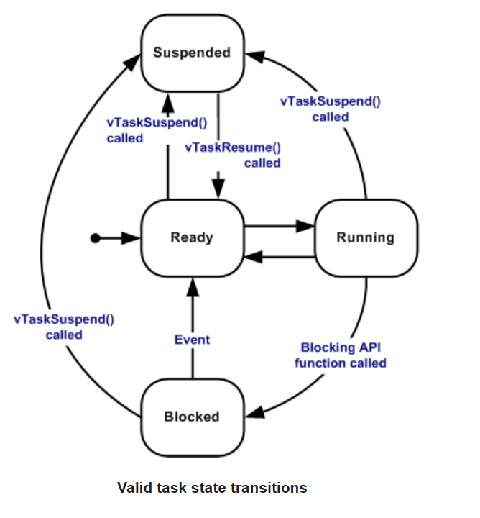
Task States
There are 4 states for a task:
Running: The task is being executed
Suspend: The task has been suspended (deactivated) by the application
Blocked: The task is blocked and waiting for the synchronization event
Ready: Ready to execute, but a task with higher priority is running

Slide 19
Task Priority
Each task is assigned a priority from 0 to ( configMAX_PRIORITIES - 1 ), where configMAX_PRIORITIES is defined within FreeRTOSConfig.h.
Lower Task Priority Value means lower Task Priority Level
The uxPriority parameter of the xTaskCreate() API function assigns an initial priority to the task being created.

Slide 20
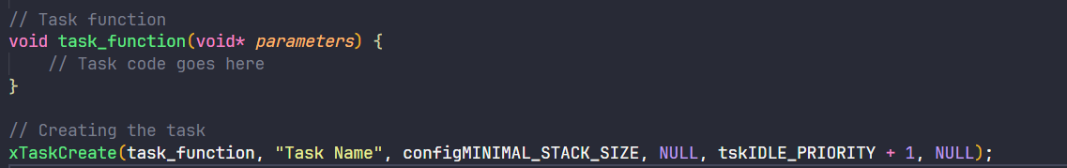
Implementing a task
Define the Task Function:
Start by defining the code that will be executed by the task in a function.
Create the Task:
- Use the xTaskCreate() API to create the task.
Provide the task function, a unique name for the task, the stack size, priority, and optional parameters.
Here's an example of creating a task:

Slide 21
Implementing a task
Start the Scheduler:
Before the tasks can run, you need to start the FreeRTOS scheduler.
Call the vTaskStartScheduler() function to start the scheduler.
Task Execution:
Once the scheduler starts, the tasks will be executed based on their priorities.
The task function you defined will run in a loop until it is either deleted or suspended.
Within the task function, you can write the code specific to the task's functionality.
Use appropriate FreeRTOS APIs for synchronization, inter-task communication, and other required functionalities.
Task Deletion (Optional):
If a task needs to be deleted during runtime, call the vTaskDelete() API from within the task function or another task.
Deleting a task will remove it from the scheduler and release its allocated resources.
Task Cleanup:
After starting the scheduler, it typically does not return.
However, if the scheduler does return (which indicates an error condition), you can perform any necessary cleanup before exiting the application.

Slide 22
Safer Interrupt

Slide 23
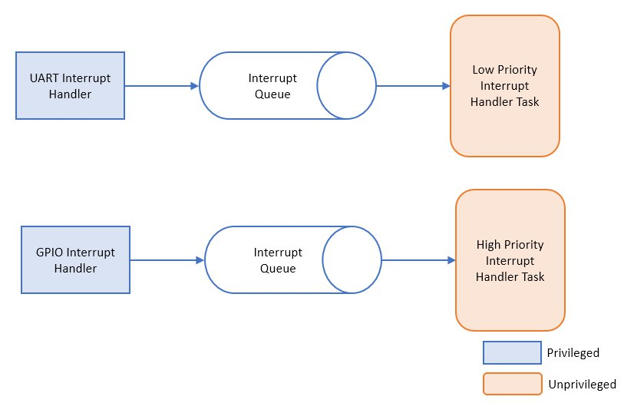
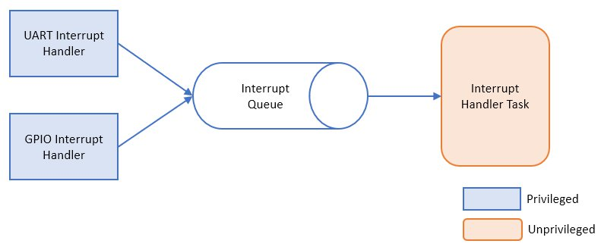
Standard ISR Processing
When an interrupt-safe API function is called from an ISR, FreeRTOS ensures that the context switching is performed correctly.
If the interrupted task has a higher priority than the currently running task, a context switch may occur, allowing the higher-priority task to execute after the ISR.

Slide 24
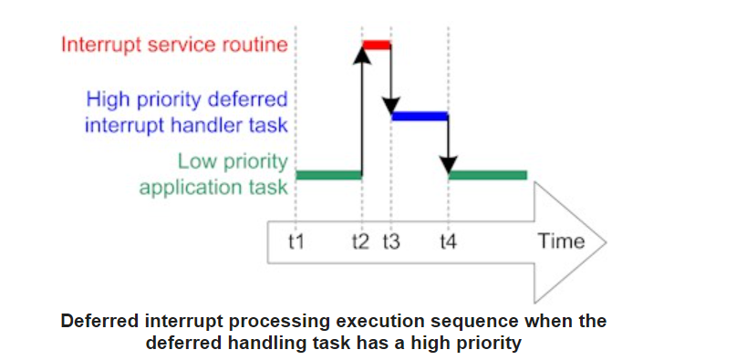
Deferred Interrupt Processing
At time t2: A low priority task is pre-empted by an interrupt.
At time t3: The ISR returns directly to a task that was unblocked from within the ISR. The majority of interrupt processing is performed within the unblocked task.
At time t4: The task that was unblocked by the ISR returns to the Blocked state to wait for the next interrupt, allowing the lower priority application task to continue its execution.

Slide 25
Renesas.com

