Slide 1

Self-investigate freertos
Date:
Soc software
Renesas Electronics Corporation

Slide 2
Agenda
Theme 1 Page 00
Theme 2 Page 00
Theme 3 Page 00
Theme 4 Page 00
Theme 5 Page 00

Slide 3
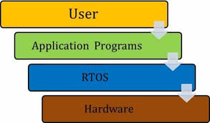
overview basic definition
What is FreeRTOS ?
Free is just a name of the distribution of RTOS, such as “ubuntu” in Linux.
RTOS (Real-Time operating system): is the OS was developed for application which require event to be responded/processed in a short time (ex: when using brake, brake must respond almost immediately)
Type of kenel: Microkernel

Slide 4
overview basic definition
Why we need FreeRTOS ?
As mentioned in previous slide, target of using FreeRTOS is for environments where a large number affect to our system and system need to be respond in a short time
Why RTOS is faster in responding than GPOS (General Purpose Operating System: Linux, Unix, Window,..) ?
RTOS has task priority process, in the opposite GPOS does not ( interrupt can not be count as task priority process since expect interrupt others task of GPOS is same priority )
Task of RTOS was predicted and proceeded in specify time that leaded to RTOS has very small latency. In case of GPOS, the more task coming (each task have different execution time) the more latency is (some task can be executed in short time but have to wait longer-time task which come before done to be executed)
Reduces the interdependencies between the modules by abstracting timing dependencies and task-based design ( it mean there is no dependence of timing between modules)

Slide 5
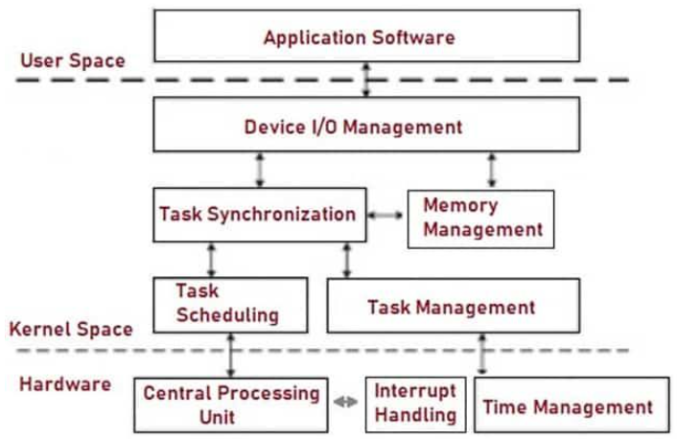
overview basic definition
There are 6 types of common services provided:
+ Task Management
+ Task Scheduling
+ Task Synchronization
+ Memory Management
+ Time Management
+ Interrupt Handling
+ Device I/O Management
Source: https://electricalfundablog.com/rtos-real-time-operating-system/

Slide 6
task task and co-routine
Task:
Corresponding which we expect to be proceeded when an event occur
Each task execute on his own context, there is no dependency on other tasks
Only ONE task can be executed at any point in time
Each task will have their own stack, when task be swapped by scheduler, current executing task will be store into his stack. Therefore, when we re-call the task, we can continue from where we stopped
Note:
- There are 2 types of task:
+ Periodic task ( such as sensor be checked periodically )
+ Event task ( task which corresponding for special event )
+ Idle task ( task with lowest priority and always have in every FreeRTOS system, responsible for freeing memory which allocated )
Source: https://www.freertos.org/taskandcr.html

Slide 7
task task and co-routine
Co-routine:
Co-routine has same concept with “Task” but there are some difference which make them distinguish with each other
+ Stack usage: All the co-routines within an application share a single stack
+ Scheduling and priorities: Co-routines use prioritised cooperative scheduling with respect to other co-routines, but can be included in an application that uses preemptive tasks
+ Macro implementation: The co-routine implementation is provided through a set of macros.
+ Restrictions on use: The reduction in RAM usage
Source: https://www.freertos.org/taskandcr.html

Slide 8
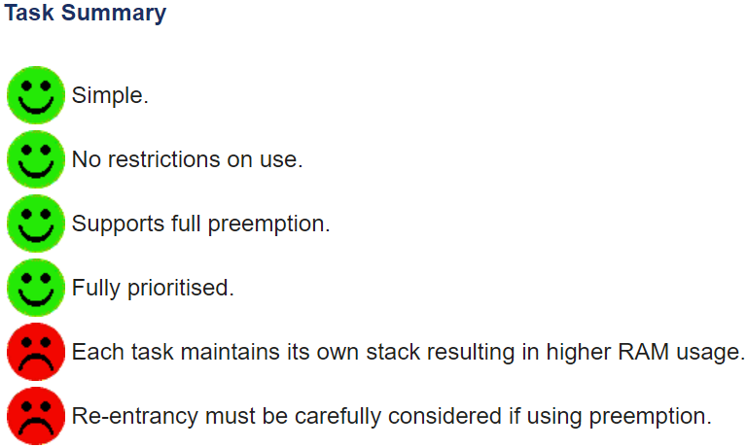
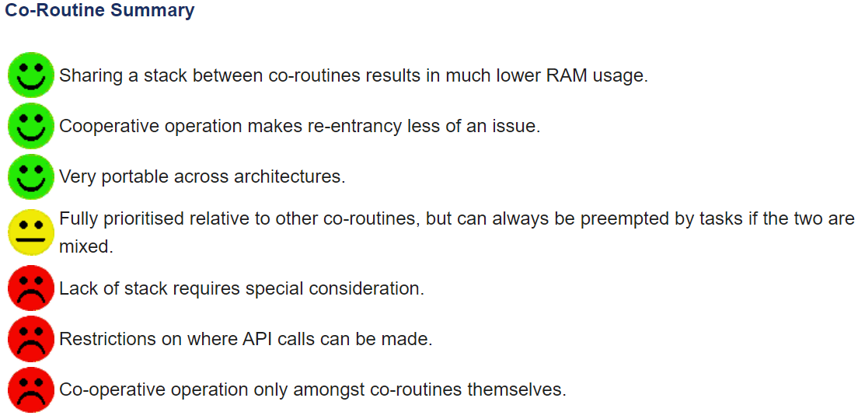
task task and co-routine
Note: Co-routines were implemented for use on very small devices and seem rarely used nowadays
Source: https://www.freertos.org/taskandcr.html

Slide 9
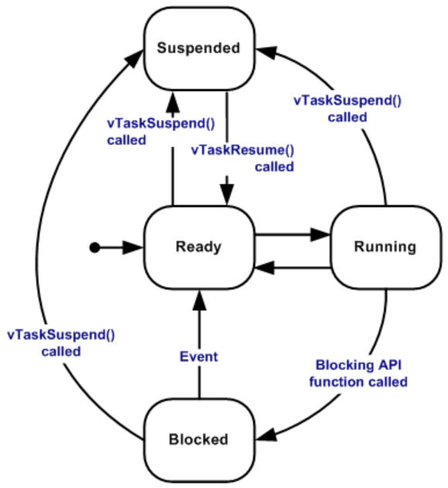
task state of task
Running: task which being executed, numbers of task can be executed depend on the numbers of core, each core can only execute 1 task at moment
Ready: task which have not is state of “Blocked” of “Suspended”
Blocked: task which waiting for external event or amount of time. Itself also have “timeout” when time out expired, task will be unblocked
Suspended: another version of “Blocked” but do not have “timeout”. Can only enter or exit via vTaskSuspend() and xTaskResume() API calls

Slide 10
task Tasks management
Via task priority, scheduler will schedule the task to execute basing on priority of task, task has same priority they will be swapped to utilize the time consume.
There is no automatic management of priorities which mean a task always keeps the same priority unless the programmer change it explicitly.
Priority of task can be set when create the task. Range of priority is from “0” to “configMAX_PRIORITIES-1” (which was defined in FreeRTOSConfig.h)
The maximum priority level by default is 32. In case, you want to define higher value “configUSE_PORT_OPTIMISED_TASK_SELECTION” should be change to 0 (which was defined in FreeRTOSConfig.h)
Note: For RAM usage efficiency, priority level should be kept to the minimum value actually necessary

Slide 11
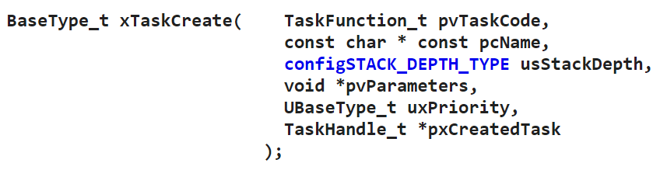
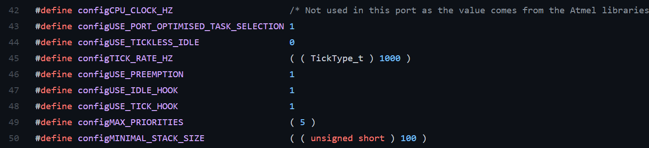
task Tasks management
Define priority level here !
Change value of this definition to 0 if your “Priority level” bigger than 32
Change 5 to which value you want for highest priority level

Slide 12
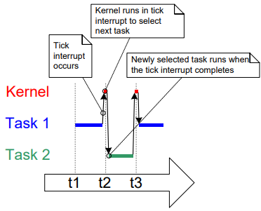
task Tasks scheduling – tick interrupt
Tick interrupt is used for controlling the time spend for each task.
When executing, tasks which have the same priority and must be the highest among runnable tasks will be executed alternatively by the trigger of positive or negative edge of controlling clock
Tick interrupt only be applied when “time-slicing” was enabled
To setting the time between tick interrupt we can modify the value of “configTICK_RATE_HZ” in “FreeRTOSConfig.h”

Slide 13
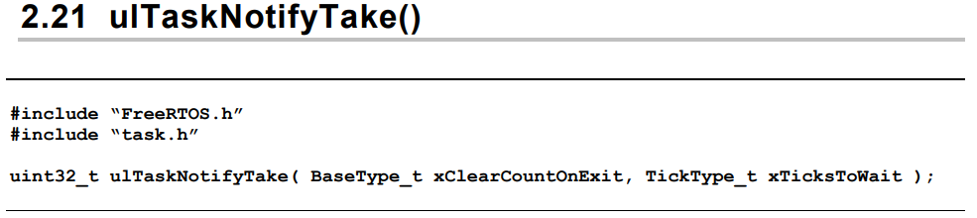
task Tasks scheduling – time measurement
Time which used for FreeRTOS will be used in tick count instead. If you want task do something in defined time, time must be converted to tick count
Number of ticks need to be provided

Slide 14
task Tasks scheduling – time measurement
Note: It is not recommended to specify times in ticks directly within the application, but instead to use the pdMS_TO_TICKS() macro to specify times in milliseconds, and in so doing, ensuring times specified within the application do not change if the tick frequency is changed.
Ex: pdMS_TO_TICKS( 200 )
In above example, “200 ms” will be converted automatically into tick following the defined system frequency (configTICK_RATE_HZ)
In case use tick directly, when “configTICK_RATE_HZ” be changed the value of tick may not indicate the value we expected (200 ms) anymore

Slide 15
task Tasks scheduling – types
There are 3 types of task scheduling:
+ Prioritized Pre-emptive Scheduling with Time Slicing (easy to implement)
+ Prioritized Pre-emptive Scheduling without Time Slicing (need experience to implement)
+ Co-operative Scheduling

Slide 16
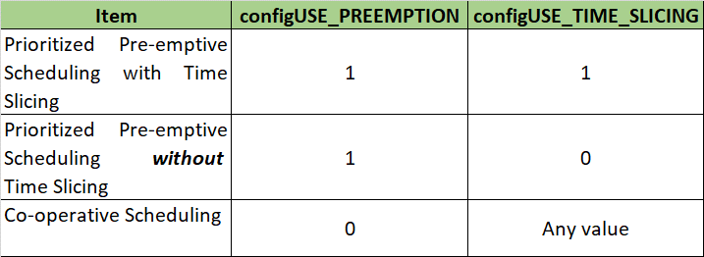
task Tasks scheduling – types
There are 2 macro value defined for using to choose the scheduling algorithms:
configUSE_PREEMPTION : when value = 0 no matter what priority is, task switching only occur when task enter state “Running” (only when taskYIELD() is called), “Blocked”, “Suspended”.
configUSE_TIME_SLICING: when value = 0 the scheduler will not switch between equal priority tasks on each tick interrupt.

Slide 17
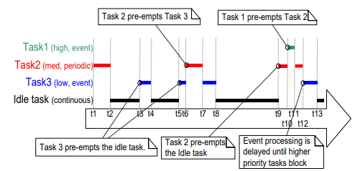
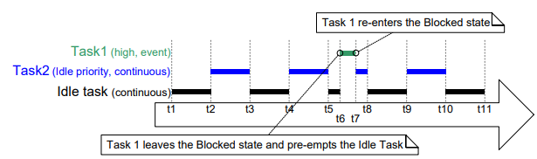
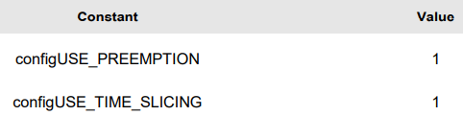
task Tasks scheduling – Prioritized Pre-emptive Scheduling with Time Slicing
Task 2 and Idle task share same priority level, task 1 has highest priority
Tasks have different priority level
- Higher priority task will be executed immediately as soon as he occur, lower task will enter “Blocked” state.
- Same priority task will be executed alternatively

Slide 18
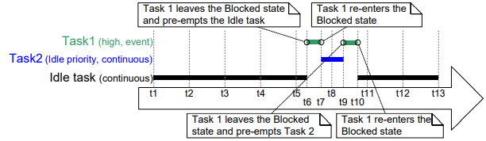
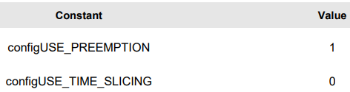
task Tasks scheduling – Prioritized Pre-emptive Scheduling without Time Slicing
- The task in the Running state enters the Blocked or Suspended state.
- A higher priority task enters the Ready state.
- The result of not using “time – slicing” is the amount of time distributed between same priority task is not equal (Task 2 and Idle task)

Slide 19
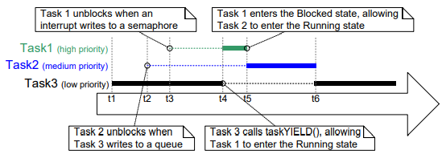
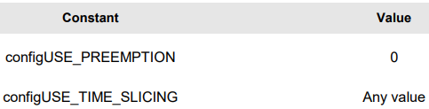
task Tasks scheduling – Co-operative Scheduling
- Context switch only occur when the Running state task enters the Blocked state, or the Running state task explicitly yields (manually requests a re-schedule) by calling taskYIELD().

Slide 20
task Tasks scheduling – Scheduler comparison
Easy pie for everyone but the cost is “time-slicing” sometimes make the scheduler overhead !
Prioritized Pre-emptive Scheduling with Time Slicing
Can reduce scheduler overhead since not using “time-slicing” but need experience to implement !
Prioritized Pre-emptive Scheduling without Time Slicing
Co-operative Scheduling
Avoid problem caused by simultaneous access and as nature the cost is system will less responsive !
Can avoid “starving process” of lower priority task

Slide 21
interrupt Task vs interrupt
Task
A task is a software feature that is unrelated to the hardware
The priority of a task is assigned in software
Interrupt
An interrupt service routine is a hardware feature
The priority of interrupt is decided by hardware desgin
Tasks will only run when there are no ISRs running !
The lowest priority interrupt will interrupt the highest priority task, and there is no way for a task to pre-empt an ISR !

Slide 22
interrupt using freertos api from isr
Some FreeRTOS API function will have separate version, one use for calling from task, other is use for calling from IRSs.
Why do we need separate the API for tasks and ISRs ?
-> In some case, task which was called inside ISR was requested to change state into “Blocked”. Since task not been called from a task, there will be no task that can replace that “Blocked” task
Note: FreeRTOs API which able to be called inside ISR MUST have “FromISR” in their name.

Slide 23

interrupt using freertos api from isr
Interrupt safe API functions have a pointer parameter called pxHigherPriorityTaskWoken. If a context switch should be performed, then the interrupt safe API function will set *pxHigherPriorityTaskWoken to pdTRUE.

Slide 24
interrupt Deferred Interrupt Processing
What is “Deferred Interrupt Processing” ?
-> “Deferred Interrupt Processing” is a type of ISR processing, necessity action to responding interrupt will be handled by task which was “Unblocked” right after interrupt exit
Standard ISR Processing
Record reason interrupt -> Cleaning interrupt -> Process the action within ISR -> Exit ISR
Deferred Interrupt Processing
Record reason interrupt -> Cleaning interrupt -> Exit ISR -> Return task which should be returned in ISR for processing

Slide 25
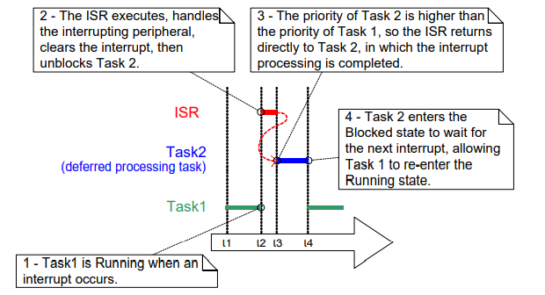
interrupt Deferred Interrupt Processing
Why we need to use “Deferred Interrupt Processing” ?
-> Reduce time ISR held the system, while ISR holding there is no task can be processed
-> In some FreeRTOS architecture, it might be not possible to accept any new interrupts
-> Some interrupt need long time to process, incase there is a lower priority interrupt and he also important to human safety was raised, system cannot graduate to process him in time

Slide 26
task communication types of communication
There are 7 types of task communication:
+ RTOS Task Notifications ( for communication )
+ Stream and Message Buffers ( for communication )
+ Queues ( for communication )
+ Binary Semaphores ( for synchronization )
+ Counting Semaphores ( for synchronization )
+ Mutexes ( for synchronization )
+ Recursive Mutexes ( for synchronization )

Slide 27
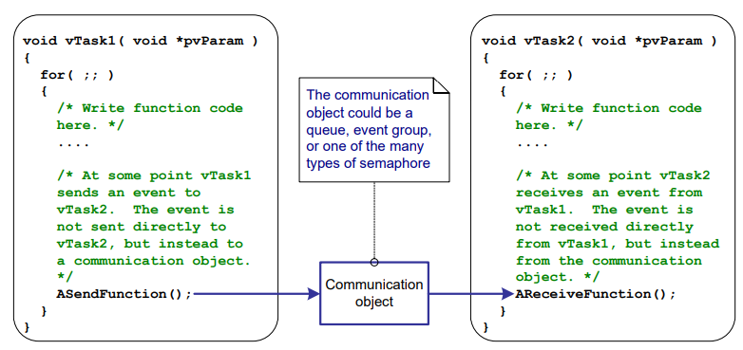
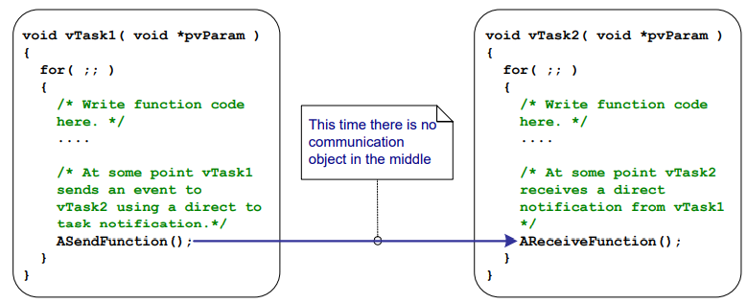
task communication types of communication - Task Notifications
Other communication methods
Task notifications
When using “Task notification”, there is no need to “Communication object”
Allow task to interact with other tasks and synchronize with ISRs
Task/Interrupt can use task notification to send event directly to receiving task

Slide 28
task communication types of communication - Task Notifications
Notification state:
+ Pending: when task receiving a notification
+ Not-Pending: when task read a modification
Notification value: an unsigned integer value to be send between tasks
Advantage:
+ Significantly faster than queue, semaphore or event group
+ Use less RAM
Limitation:
+ Cannot be used to send an event or data to ISR ( from ISR to task is no problem )
+ Task notification can be processed only by task which received them
+ Notification value can have only 1 value at a time
+ Can not send notification to multi-task
+ Cannot waiting in the blocked state for a send to complete

Slide 29
task communication types of communication – Stream buffer
Stream buffers allow a stream of bytes to be passed from an interrupt service routine to a task, or from one task to another task.
A byte stream can be of arbitrary length and data will be sent byte-by-byte
Such as “Task notification”, “Stream buffer” is use for single communication ( 1 sender – 1 receiver )
The difference when comparing with “Task notification” is the “Stream buffer”, as his name, we can send unlimited stream of byte whereas “Task notification” can only send 32-bit “notification value”
-> In short, we can say that “Task notification” is only send status while “Stream buffer” is used for sending data
-> Incase there are multi-task write to “Stream buffer”, protection mechanism such as “mutex” should be used to ensure the “1-1” communication characteristic
-> “Task notification” is needed to use “Stream buffer” since the usage of “Stream buffer” is for transit data

Slide 30
task communication types of communication – message buffer
“Message buffer” is built on top of “Stream buffer” which mean, they will share some characteristic such as:
+ “1-1” communication relation ( 1 sender – 1 receiver )
+ Use to transit data from interrupt to task or task to task ( task to interrupt is not available )
Main difference is “Message buffer” will read out whole buffer data instead of “byte-by-byte” such as “Steam buffer”
-> Buffer size will be limited

Slide 31
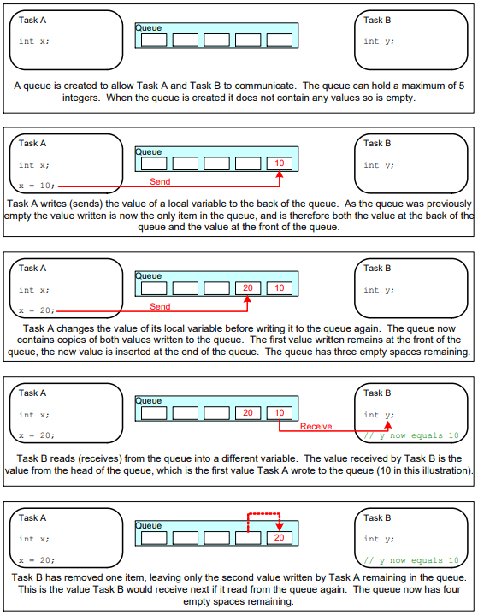
task communication types of communication – queue
Queue is can easily understand as an array/linked list with defined “length” and follow FIFO (First-In-First-Out).
But it is possible to write to the front of a queue, and to overwrite data that is already at the front of a queue
There is two type of implementation:
+ Queue by copy ( the data sent to the queue is copied byte for byte into the queue )
+ Queue by reference ( the queue only holds pointers to the data sent to the queue, not the data itself )
Queue can have multi writers and multi readers

Slide 32
task communication types of communication – queue
Blocking when Queue read:
- When a task required to read data from queue, task state will be changed into “Blocked” in amount of time which called “Block time”.
- State of task will change into “Ready” when other task/interrupt write data into queue of “Block time” expired
- When there are multi-reader, only 1 task can be unblocked in the time data available
- If tasks have same priority, the longest waiting time task will be unblocked

Slide 33
task communication types of communication – queue
Blocking when Queue write:
- Such as reading, there is also “Block time” waiting for available space on queue ( incase queue already be full)
- Max “Block time” should be the time that task should be held in “Block state”
- When there are multi-writer, only 1 task can be unblocked for writing data at the time space is available on queue
Blocking when Multiple Queues:
- Queues can be grouped into sets
- A task can be changed into “Blocked” state to wait any of the queue in the set available

Slide 34
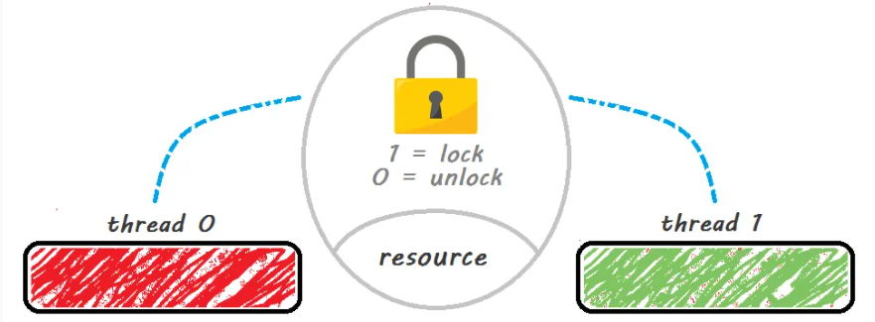
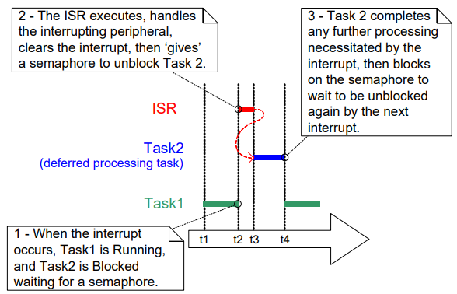
task communication synchronization – binary semaphores
Semaphores can easy understanding is a key, if you have “key” you can execute your context. If not, there is nothing happen.
Semaphores can be use for synchronize task/interrupt
At any time, there can be multi semaphores within a program but only 1 semaphore has status of “unlock”

Slide 35
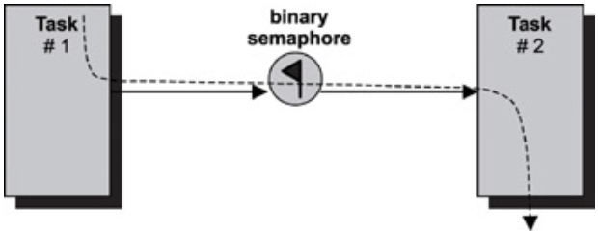
task communication types of communication – binary semaphores
Since Task 1 give semaphores, Task 2 will execute from defined context
Semaphores change from “1” to “0” to give token to Task 2
Task-to-task synchronization using binary semaphores

Slide 36
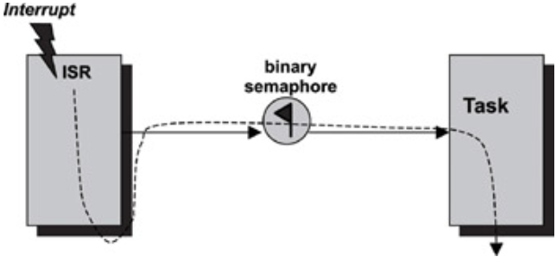
task communication types of communication – binary semaphores
Since Interrupt give semaphores, Task 2 will execute from defined context
Semaphores change from “1” to “0” to give token to Task
Interrupt-to-task synchronization using binary semaphores

Slide 37
task communication types of communication – Counting Semaphores
Counting semaphores is semaphores which will be created when the semaphores count value is 0
There are 2 uses of this kind of semaphores:
+ Event counting ( if event repeat numbers of time, semaphores will be triggered )
+ Resource management ( Every time available resources were used, decrease count, in case resources were released, increasing count )

Slide 38
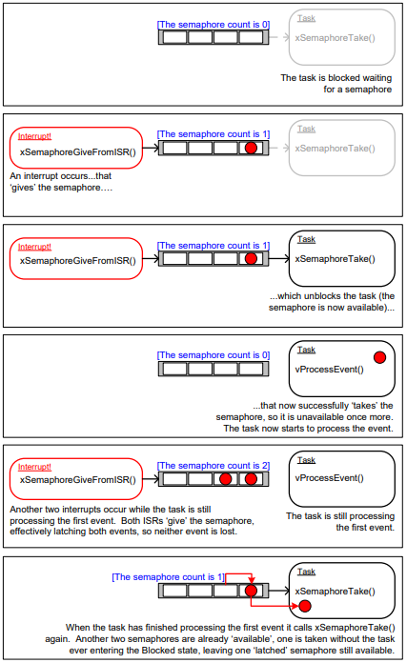
task communication types of communication – Counting Semaphores
Incase task still processing the first event, there are new interrupts, the semaphores of interrupts will be stored and wait for task finish the processing
When task finish event 1, next event will be sent (Semaphores of event 2), numbers of waiting Semaphores will decrease for 1
It is necessary to check whether there is available “space” for new event and handle for scenario there is no “space” left
Source: http://www.embeddedlinux.org.cn/rtconforembsys/5107final/LiB0095.html

Slide 39
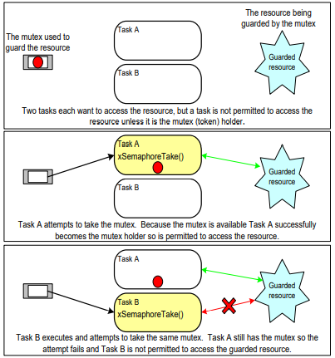
task communication types of communication – mutex – Basic definition
Mutex is a locking mechanism used to synchronize access to “shared resource”
Mutex can only be released by thread which created that mutex. Task who need use the mutex must wait for mutex-holding-task release the mutex
-> In some scenario when a mutex was created and inside the execution, some how he calls to lock himself once again that will lead to “dead lock” which mean our application will wait forever
At any point of time, only one task can acquire the mutex
To enable “Mutex” configUSE_MUTEXES must be set to 1 in FreeRTOSConfig.h
Note: “dead lock” can be avoided by using a recursive mutex which allow to “lock” mutex more than once by the same task

Slide 40
task communication types of communication – mutex – Priority inversion
Due to the characteristic “ownership” ( mutex only be released by his own task ). In some case, “priority inversion” will occur.
“priority inversion” occur when higher priority task have to wait lower priority task to release his “Mutex”

Slide 41
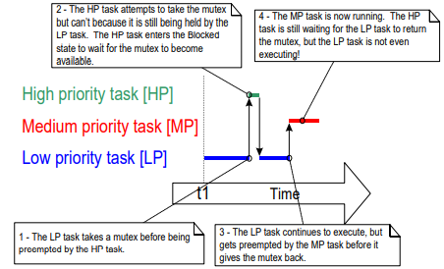
task communication types of communication – mutex – Priority inversion
HP cannot gain the execution -> Priority inversion
LP and HP use same resources and use mutex to control the access.
LP execute before HP and take “mutex”. When HP preempted, since LP still hold “mutex”, HP will change to “Blocked” to wait LP finish and release “mutex”
When LP has just finished execution in “critical section” and preparing to release “mutex”. Suddenly, MP preempted LP, since MP not share resource with LP -> no need to wait “mutex” -> MP execute
-> HP still has not been executed !

Slide 42
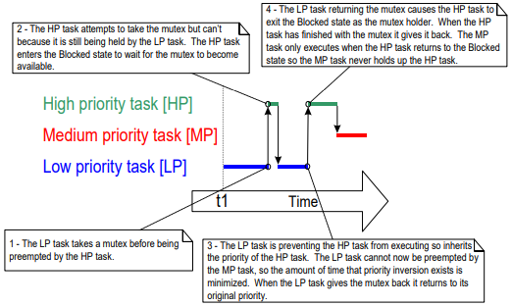
task communication types of communication – mutex – Priority inheritance
To fix issue “Priority inversion”, we can use “Priority inheritance”
“Priority inheritance” is change priority of LP task (which holding “mutex”) temporary to priority of HP task
-> MP unable to preempt LP before LP finished execution and release “mutex”
-> Priority inheritance will complicate system timing analysis, and it is not good practice to rely on it for correct system operation

Slide 43
task communication types of communication – mutex – comparison
The difference between MUTEX and SEMAPHORES are:
+ “Mutex” is a lock mechanism while “Semaphores” is a signaling mechanism
+ “Mutex” can be released only by his owner while “Semaphores” will change to “unlock” when the condition meet
+ “Mutex” has “Priority inheritance” while “Semaphores” does not

Slide 44
task communication types of communication – event group
Event group is such as an array help to store event flag of tasks into an array and by this way we can block/unblock many tasks together
This characteristic made “Event group” standout comparing to “Binary semaphores” which only can block/unblock only 1 task per execution
Numbers of bit can be increase up to 8-bit or 24 bit with following setting:
+ configUSE_16_BIT_TICKS = 1 -> each event group will have 8 event flag
+ configUSE_16_BIT_TICKS = 0 -> each event group will have 24 event flag
Event groups are useful for synchronizing multiple tasks, broadcasting events to more than one task.

Slide 45
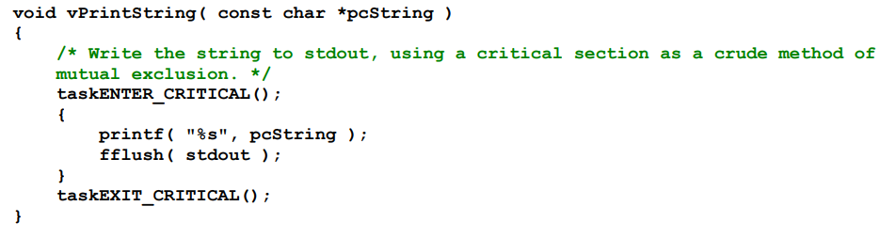
Resources management basic definition
Why we need resources management ?
-> To ensure a task can have there need resources when implement and that resources can not be access by other tasks
What is “Critical Section” ?
-> A section of code which request resources to process, resources will be locked and cannot be reach even the high priority task request ( refer to “Priority inversion”)

Slide 46
Resources management basic definition
There are 2 methods to management the resources:
+ Using “Mutex” ( refer to here )
+ Using “Gatekeeper Tasks”

Slide 47
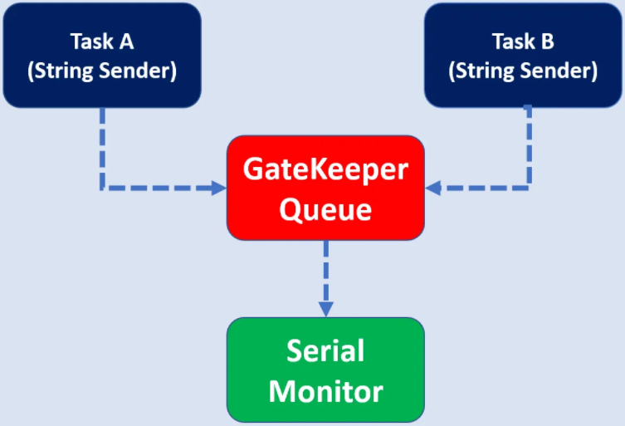
Resources management gatekeeper tasks
Gatekeeper work as a queue, data will be processed serialize in queue
At any point of time only 1 task can access gatekeepers
Most of his time will reserved in “Blocked state” and wait for message to arrive on the queue
Since “Gatekeeper” is the only can access directly to “Resources”, even if interrupt occur, she can not preempt the “Resources”. Therefor, we can avoid “dead lock” and “priority inversion”

Slide 48
Resources management gatekeeper tasks
Why we need “Mutex” while “Gatekeeper task” seem like can avoid issue occur on “Mutex” ?
-> On one hand, “Gatekeeper task” can avoid “dead lock” and “priority inversion” but on the other hand the cost is the “respond ability” of our system
-> “Gatekeeper task” more suitable for task which not require high responding rate since work in “Gatekeeper task” will be processed in sequence, and he does not care who you are, just get in the line and wait for your turn.
-> Opposite with above, “Mutex” may has troublesome issue but he more suitable for task which require high responding rate.
Ex: Task A is using “resources” in “critical section” with “mutex” and there is a signal from sensor raise for human safety, interrupt can immediately preempt the task A without caring about “mutex”. I case “gatekeeper” we can not do that
Note: Incase “Interrupt” preempt task A which holding mutex, ISR must not call for “mutex” for the resources sharing with task A. If we do so, “dead lock” will occur.

Slide 49
Software timer management basic definition
Software timers are used to schedule the execution of a function at a set time in the future, or periodically with a fixed frequency.
The function executed by the software timer is called the software timer’s callback function.
For the efficiency, software timers do not use any processing time unless a software timer callback function is actually executing
There are 2 types of “Software timer”:
+ One-shot timers
+ Auto-reload timers
Note: To use “Software timer” below step should be performed
+ Build the FreeRTOS source file FreeRTOS/Source/timers.c as part of your project
+ Set configUSE_TIMERS to 1 in FreeRTOSConfig.h

Slide 50
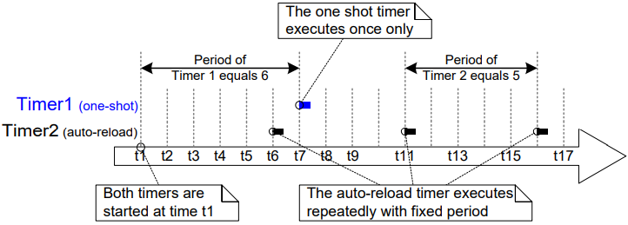
Software timer management types of timer
As their name, “one-shot” will execute its callback function once only. A one-shot timer can be restarted manually, but will not restart itself
Auto-loader will re-start itself each time it expires, resulting in periodic execution of its callback function.

Slide 51
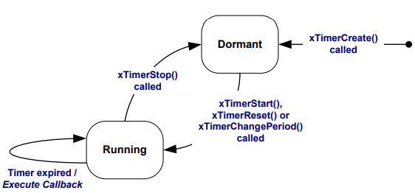
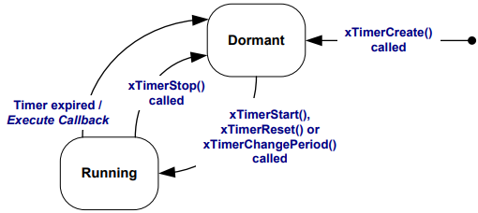
Software timer management state of timer
Dormant: Can be knew as a “ready” state software timer exists and can be referenced by its handle, but is not running, so its callback functions will not execute.
There are 2 state of timer:
+ Dormant
+ Running
Running: Call back function will be executed after time equal to period of timer has elapsed since the “Software timer” entered “Running” state.
Auto-reload software timer states and transitions
One-shot software timer states and transitions

Slide 52
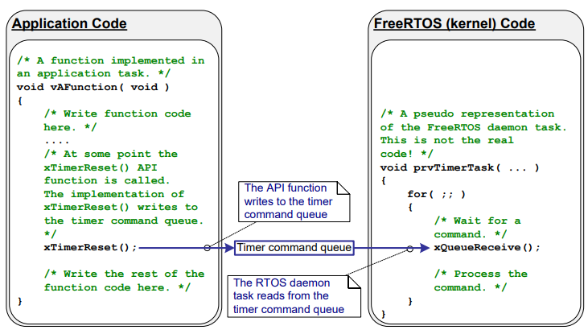
Software timer management daemon task
Daemon task is task which used to manage the work of the “Software timer” at Kenel space
He was created automatically when the scheduler is started.
Software timer API functions send commands from the calling task to the daemon task on a queue called the ‘timer command queue’.

Slide 53
memory management types of memory
There are two types of memory:
+ Stack ( also know as static allocation )
+ Heap ( also know as dynamic allocation )
Both of above memory was allocated in RAM but since the characteristic of “stack” is de-allocate automatically when kernel object was deleted mean while the “heap” need to be de-allocated manually and we can de-allocate whenever we want, we can say that “heap” is more RAM saving ( if we can de-allocate unnecessary variable for gaining space for the new ones )
But when using “heap” programmer must “free” memory if there is no further use of variable. If we forgot to “free” the allocated, there will be “memory leak”
One more problem when using heap, different with “stack” strictly follow FILO rule, “heap” does not. Heap can store/retrieve wherever we want that lead to memory fragment

Slide 54
memory management HOW to allocate and some utility
In FreeRTOS, instead of calling “malloc()” to allocate memory, “pvPortMalloc()” is used instead and the same with “free()”, “vPortFree()” will be used instead
There are some utility API provided to improve the using of “heap”:
+ xPortGetFreeHeapSize() -> Check the free memory at the time function is called
+ xPortGetMinimumEverFreeHeapSize() -> Check how close the heap is full when using by application

Slide 55
Renesas.com

