Slide 1

General PWM Timer (Gpt) module
Ra fsp investigate report
Feb 17, 2023
The Nguyen
Software development department,
Ra fsp group
Renesas Electronics Corporation

Slide 2
Agenda
OVERVIEW Page 03
OPERATION Page 06
ELC & INTERRUPT SOURCE Page 21
CONFIGURATION Page 24
DATA STUCTURE/ENUM Page 29
API/FUNCTIONS Page 33
EXAMPLES Page 51
REFERENCE Page 53

Slide 3
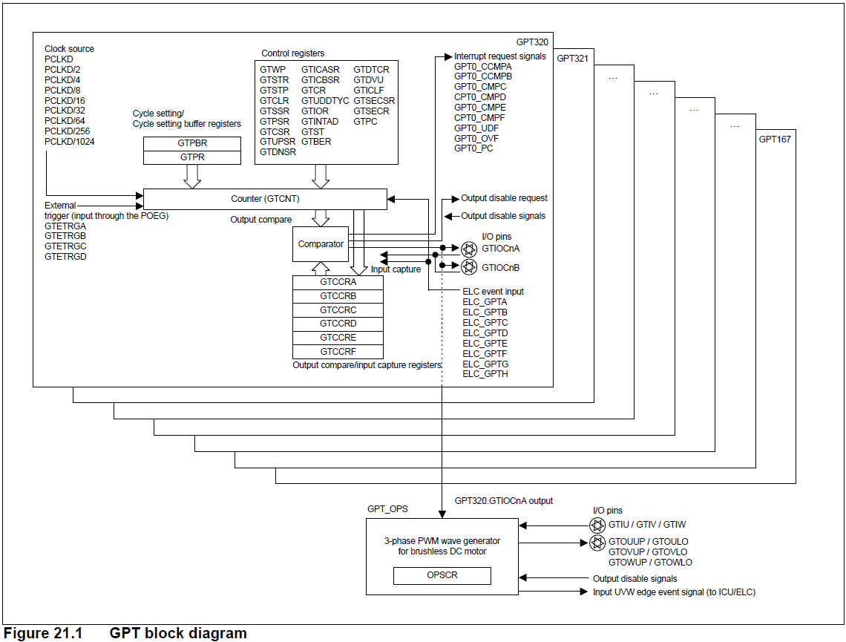
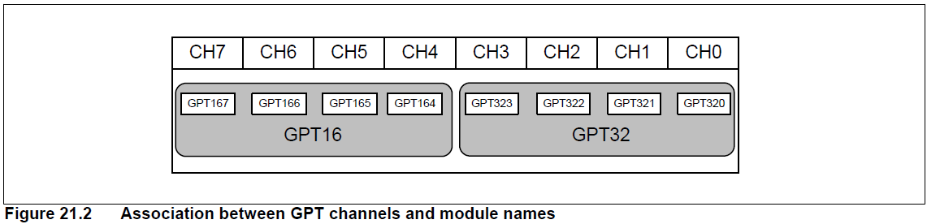
overview what is “gpt”?
The General PWM Timer (GPT) is a 32-bit timer with GPT32 × 4 channels and a 16-bit timer with GPT16 × 4 channels.
PWM waveforms can be generated by controlling the up-counter, down-counter, or the up- and down-counter. In addition, PWM waveforms can be generated for controlling brushless DC motors. The GPT can also be used as a general-purpose timer.

Slide 4
overview features
Refer to: RA Flexible Software Package Documentation: Timer, General PWM (r_gpt) (renesas.github.io):
Overview → Features

Slide 5
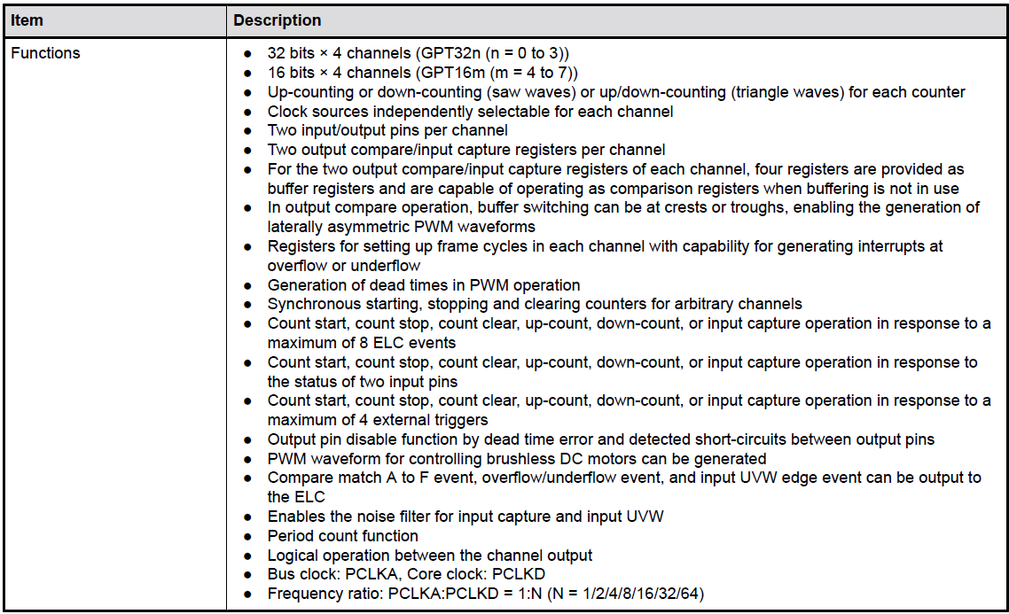
overview specifications
Refer to: EK-RA4M3 v1 User's Manual (renesas.com):
21. General PWM Timer (GPT) → Table 21.1 GPT specifications

Slide 6
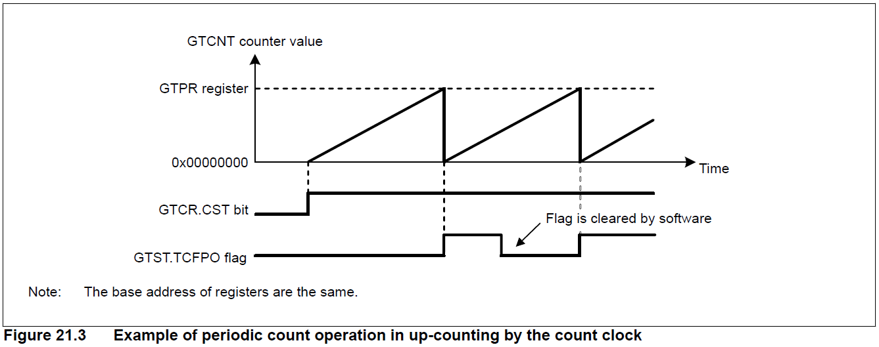
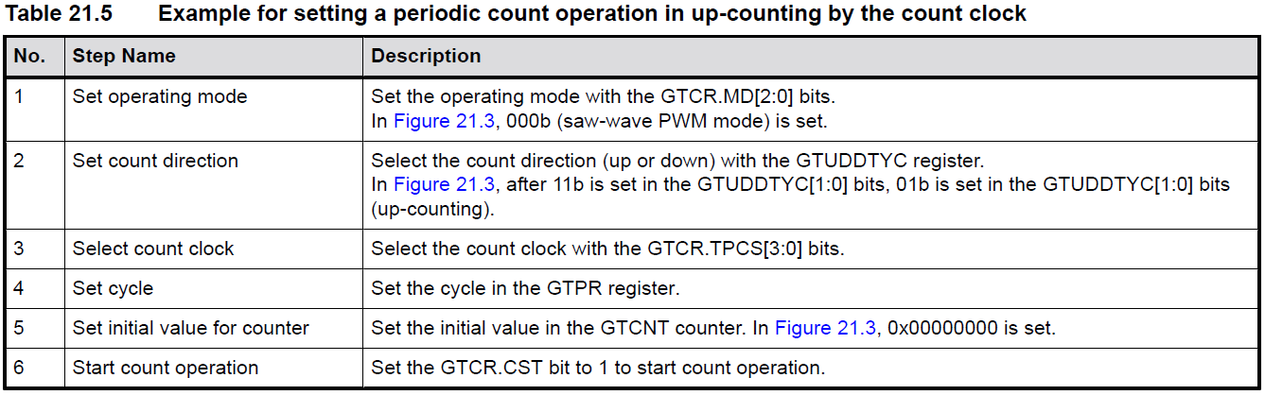
Basic operation Periodic count operation in up-counting
Periodic count operation in up-counting by count clock is showed as Figure 21.3:
The GTCNT counter in each channel starts up-counting when the associated GTCR.CST bit is set to 1 with GTUPSR and GTDNSR registers set to 0x00000000.
When the GTCNT value changes from the GTPR value to 0 (overflow), the GTST.TCFPO flag is set to 1, and the overflow interrupt (GPTn_OVF) is also generated.
After GTCNT overflows, up-counting resumes from 0x00000000.
An example for setting periodic count operation in up-counting by the count clock is showed as Table 21.5:

Slide 7
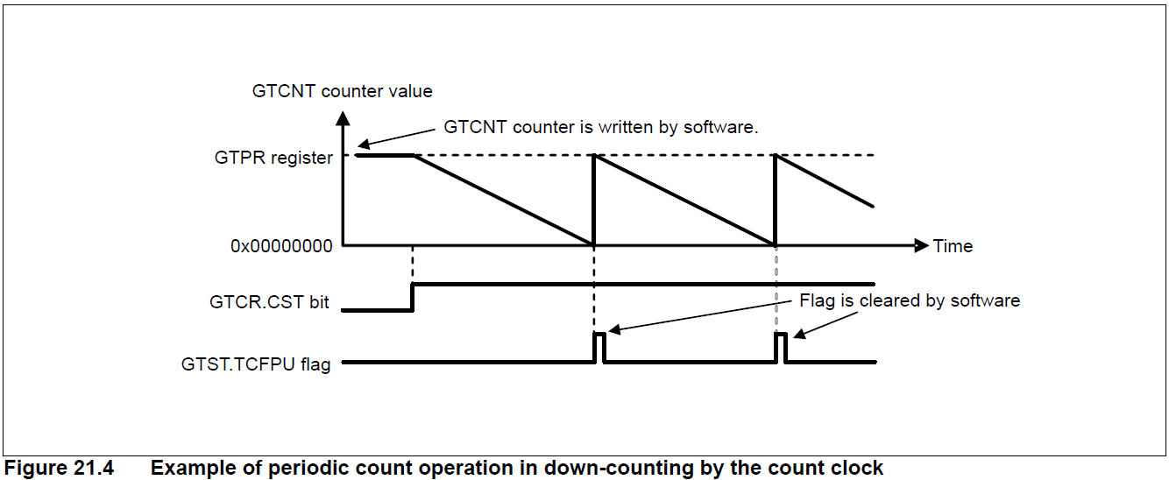
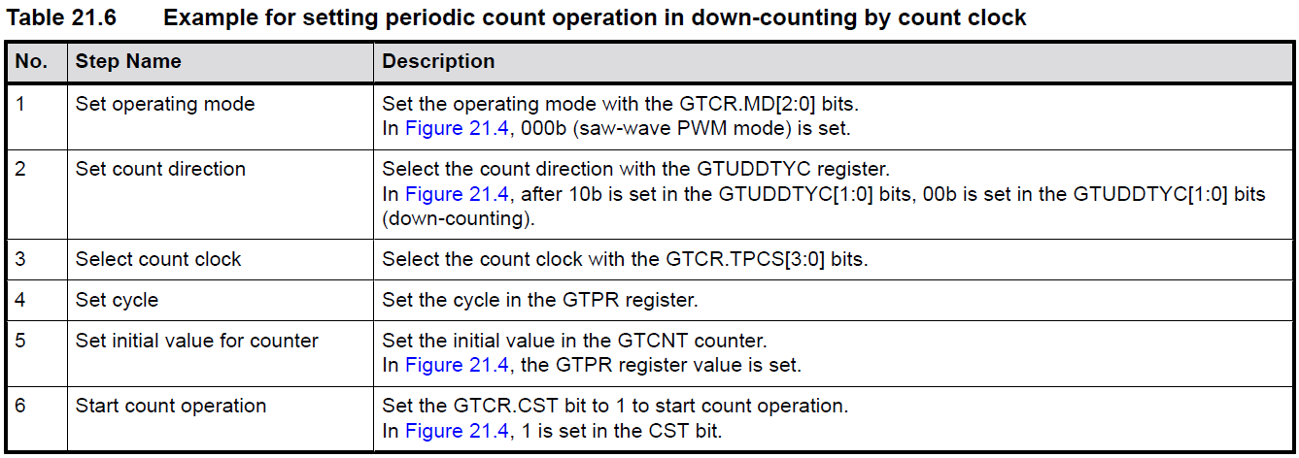
Basic operation Periodic count operation in down-counting
Periodic count operation in down-counting by count clock is showed as Figure 21.4:
The GTCNT counter in each channel can perform down-counting by setting GTUDDTYC.UD with GTUPSR and GTDNSR registers set to 0x00000000.
When GTCNT changes from 0 to the GTPR value (underflow), GTST.TCFPU is set to 1, and the underflow interrupt (GPTn_UDF) is also generated.
After the GTCNT counter underflows, down-counting resumes from the GTPR value.
An example for setting periodic count operation in down-counting by the count clock is showed as Table 21.6:

Slide 8
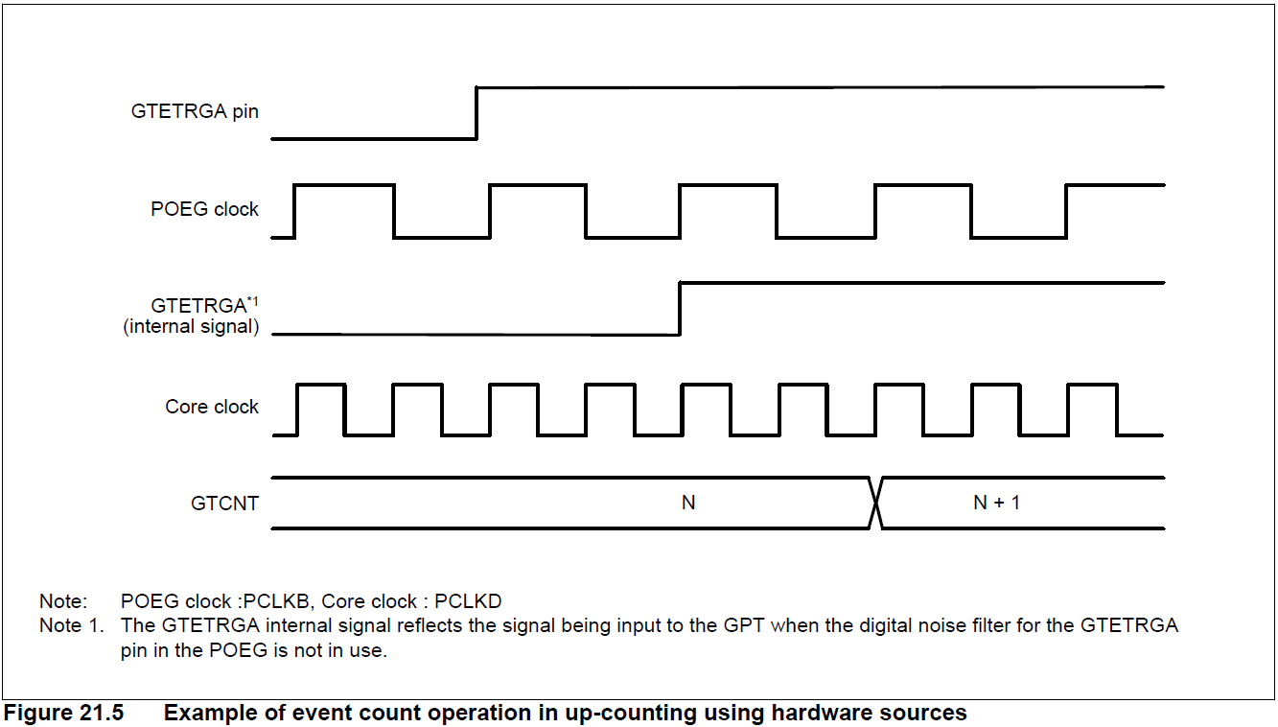
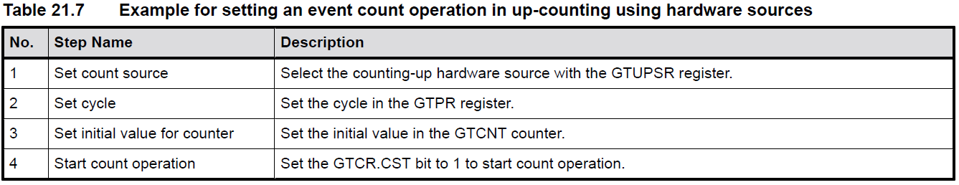
Basic operation Event count operation in up-counting using hardware sources
The GTCNT counter in each channel can perform up-counting using hardware sources as set in GTUPSR as Figure 21.5:
GTETRGA pin state change from 0 to 1 → GTETRGA connects to GPT through the POEG module.
After 1 POEG clock delay, GTETRGA internal signal change state according GTETRGA pin.
After 1 POEG clock delay, GTCNT register value increase by 1.
An example for setting event count operation in up-counting by a hardware source is showed as Table 21.7:

Slide 9
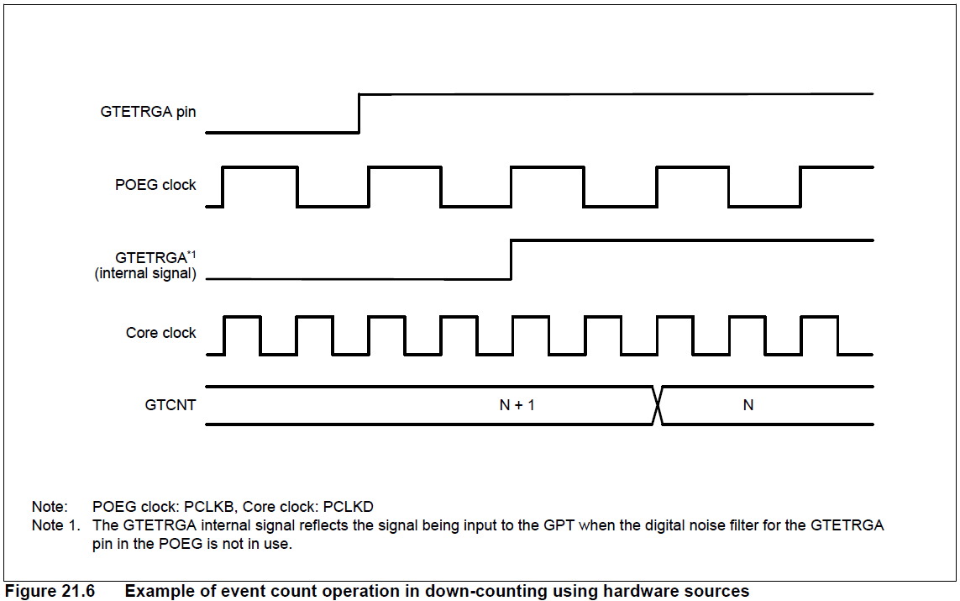
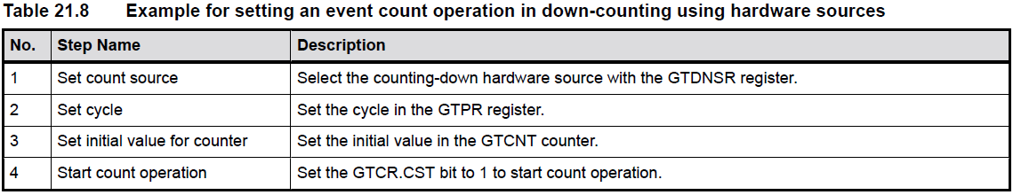
Basic operation Event count operation in down-counting using hardware sources
The GTCNT counter in each channel can perform down-counting using hardware sources as set in GTUPSR as Figure 21.5:
GTETRGA pin state change from 0 to 1 → GTETRGA connects to GPT through the POEG module.
After 1 POEG clock delay, GTETRGA internal signal change state according GTETRGA pin.
After 1 POEG clock delay, GTCNT register value decrease by 1.
An example for setting event count operation in up-counting by a hardware source is showed as Table 21.7:

Slide 10
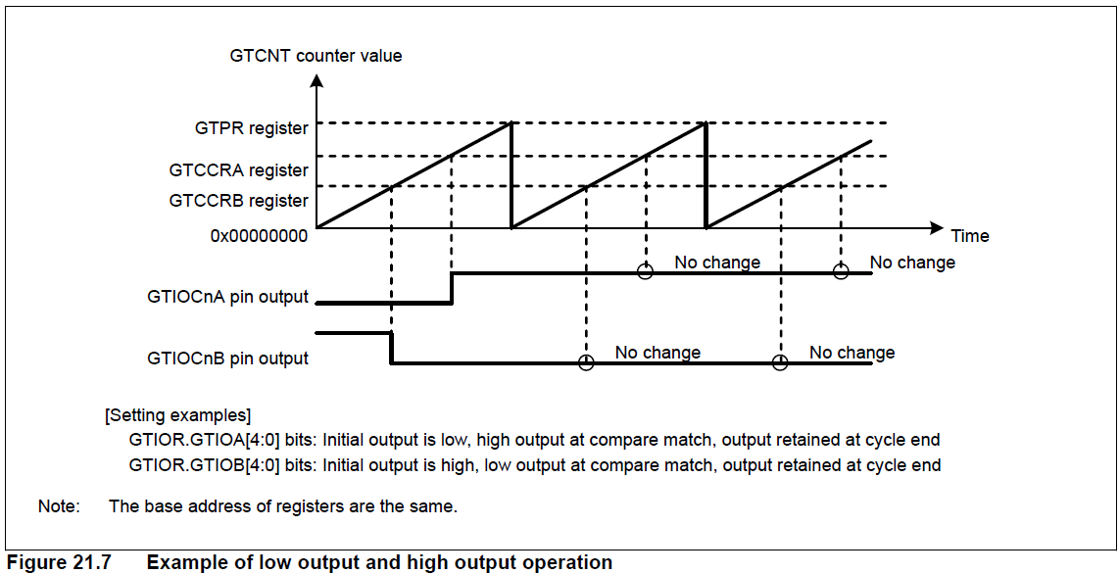
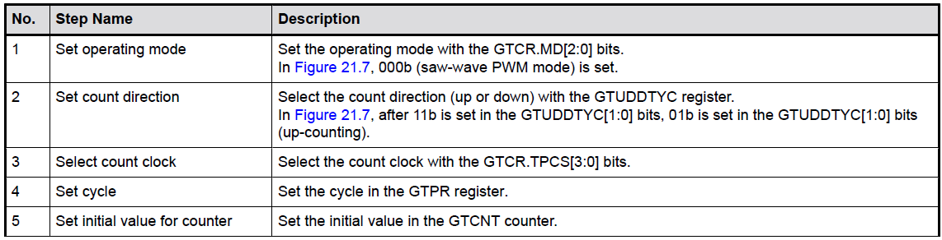
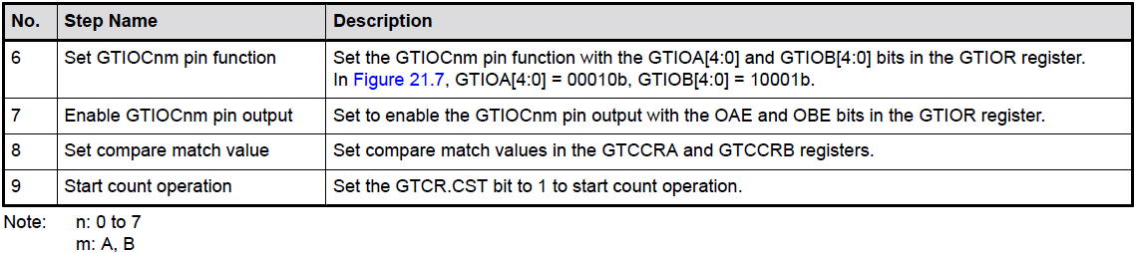
Basic operation Waveform output by compare match: Low output and high output
Compare match means that the GTCNT counter value matches the value of GTCCRA or GTCCRB. At the same time, the GPT can output low, high from the associated GTIOCnA or GTIOCnB output pin (n = 0 to 7). In addition, the GTIOCnA or GTIOCnB pin output can be low, high, or toggled at the cycle end which is determined by GTPR.
An example of perform Waveform output by compare match with high output of GTIOCnA and low output of GTIOCnB is showed as Figure 21.7.
An example for setting Waveform output by compare match: Low output and high output is showed as Table 21.9:

Slide 11
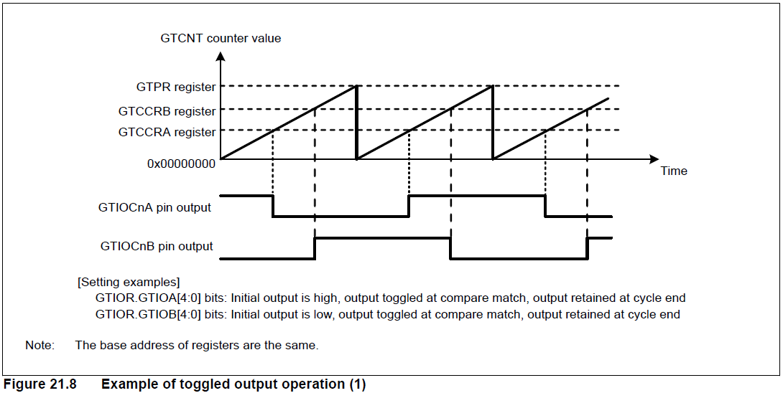
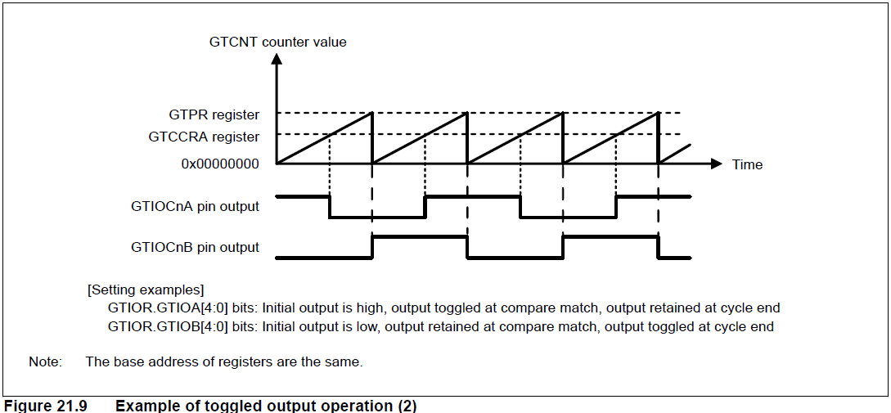
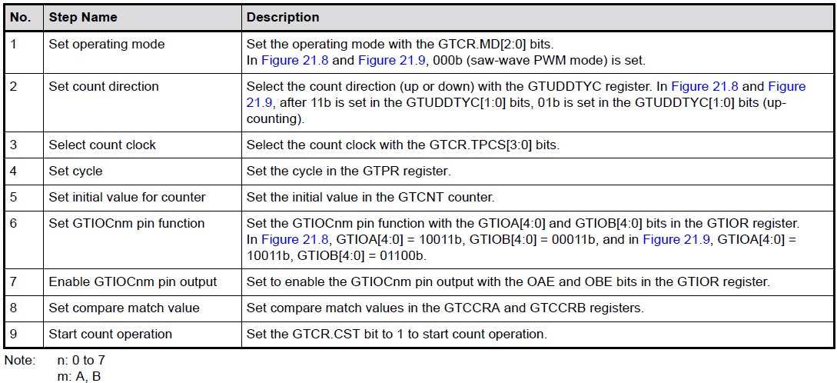
Basic operation Waveform output by compare match: Toggled output
Figure 21.8 and Figure 21.9 show examples of toggled output operation by compare matches of GTCCRA and GTCCRB.
Figure 21.8, GTIOCnA pin output by a GTCCRA compare match and GTIOCnB pin output by a GTCCRB compare match are toggled.
Figure 21.9, GTCCRA compare match toggles the GTIOCnA pin output level and a cycle end toggles the GTIOCnB pin output level.
An example for setting Waveform output by compare match: Toggled output is showed as Table 21.10:

Slide 12
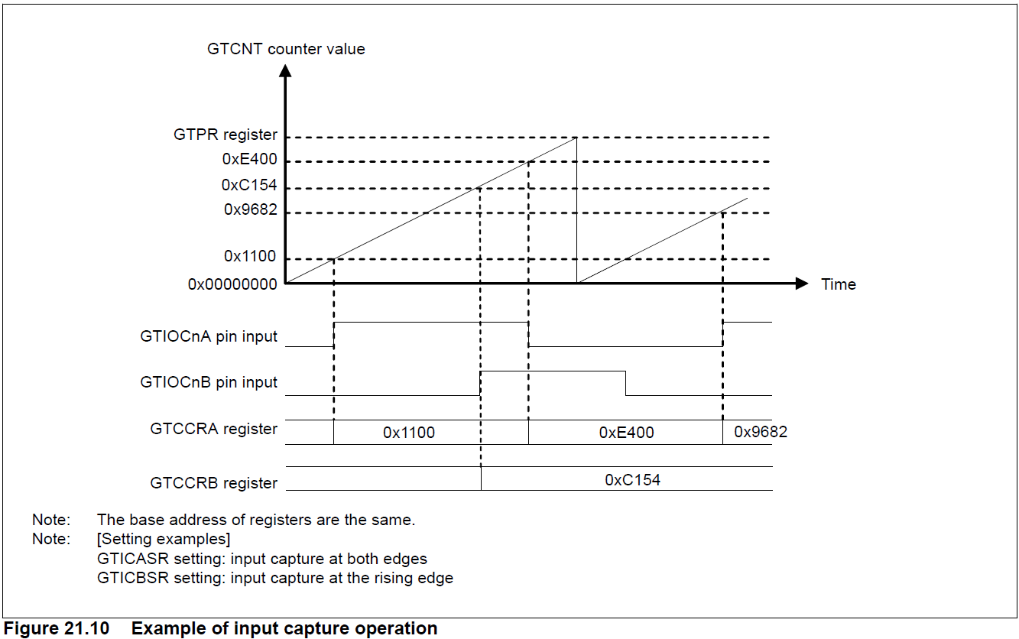
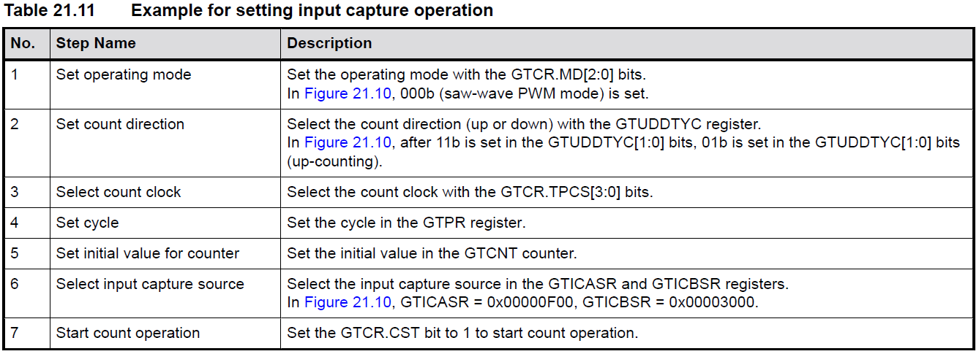
Basic operation Input Capture Function
The GTCNT counter value can be transferred to either GTCCRA or GTCCRB on detection of the hardware source that is set in GTICASR and GTICBSR.
Figure 21.10 shows an example of the input capture function.
In this example, the GTCNT counter performs up-counting by the count clock, and settings are made so that an input capture is performed to GTCCRA at both edges of the GTIOCnA input pin and to GTCCRB on the rising edge of the GTIOCnB input pin.
Table 21.11 show the example for setting an input capture operation with count operation by the count clock.

Slide 13
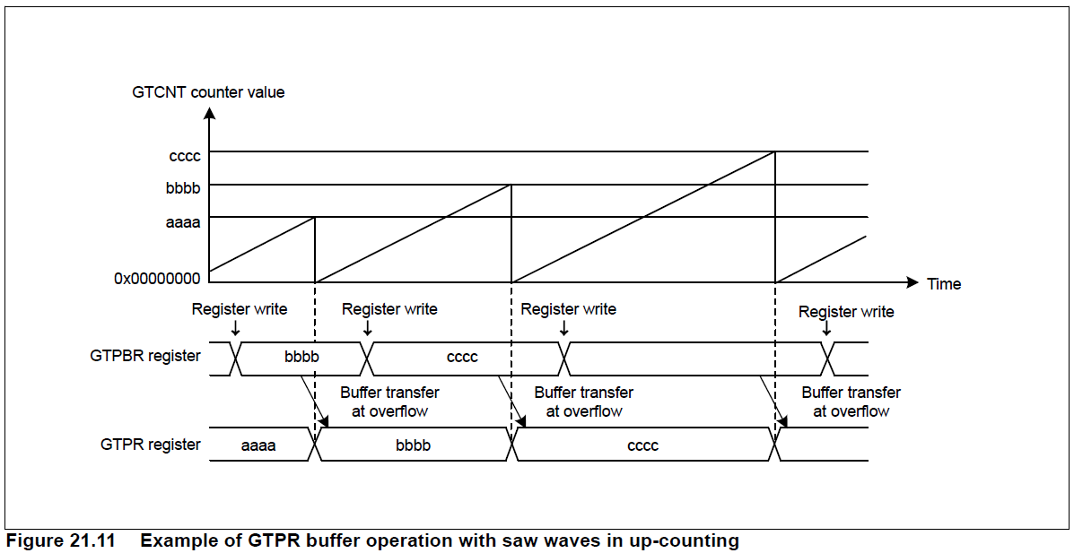
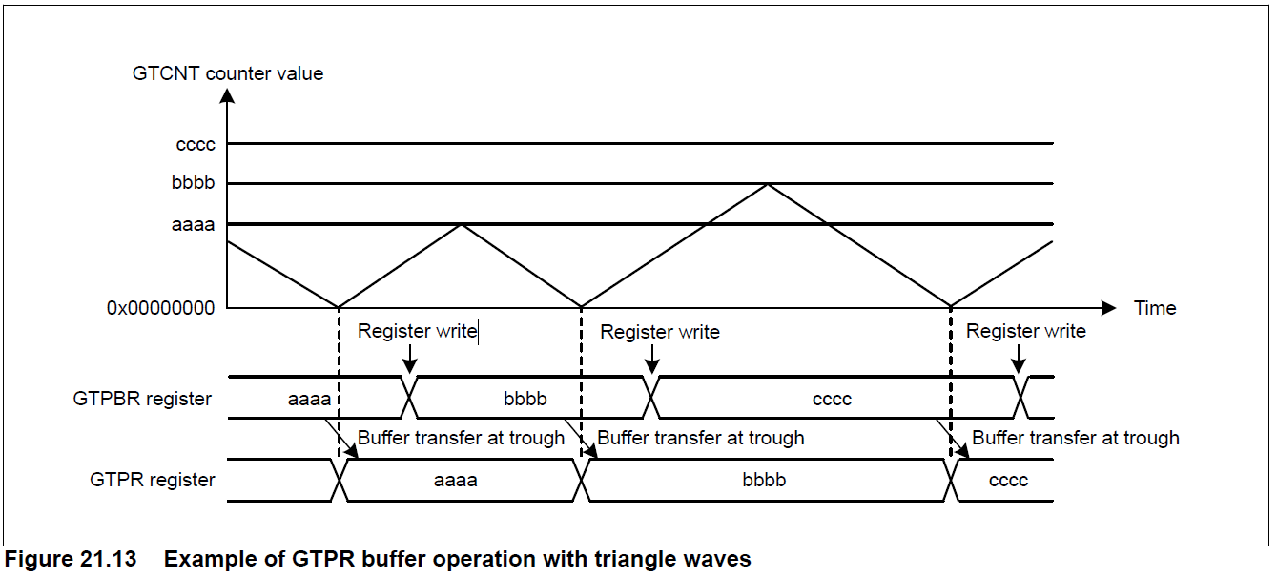
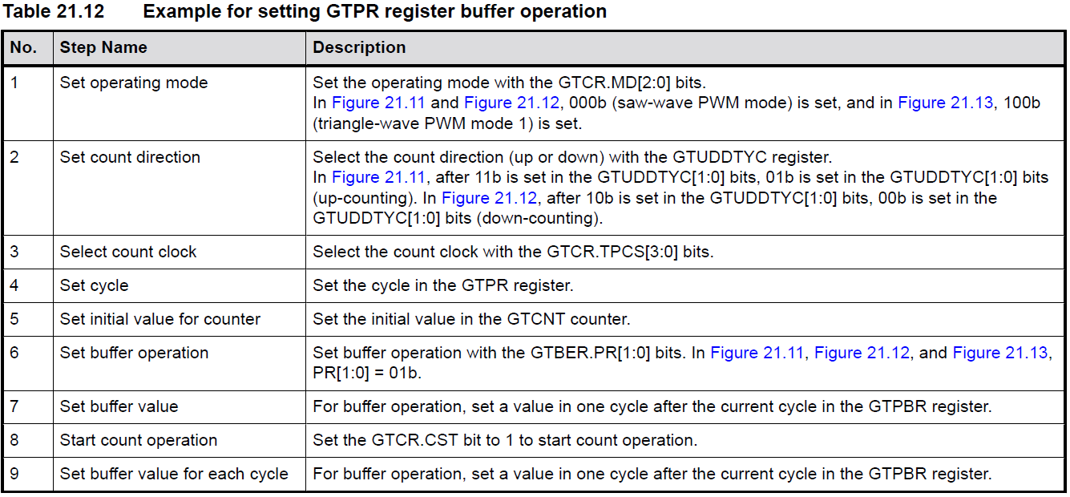
Buffer operation GTPR Register Buffer Operation
The following buffer operations can be set with GTBER:
GTPR and GTPBR
GTCCRA, GTCCRC, and GTCCRD
GTCCRB, GTCCRE, and GTCCRF
Figure 21.11 and 21.13 show operation when GTPBR is set to be buffer of GTPR register.
Setting for GTPR buffer operation can follow with Table 21.12:

Slide 14
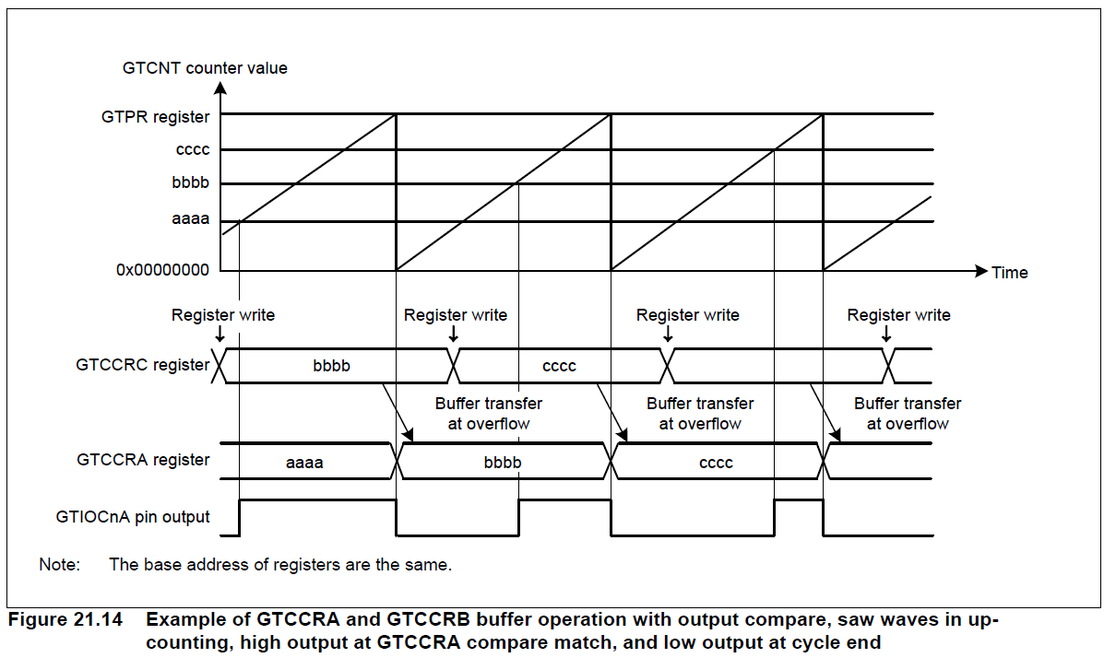
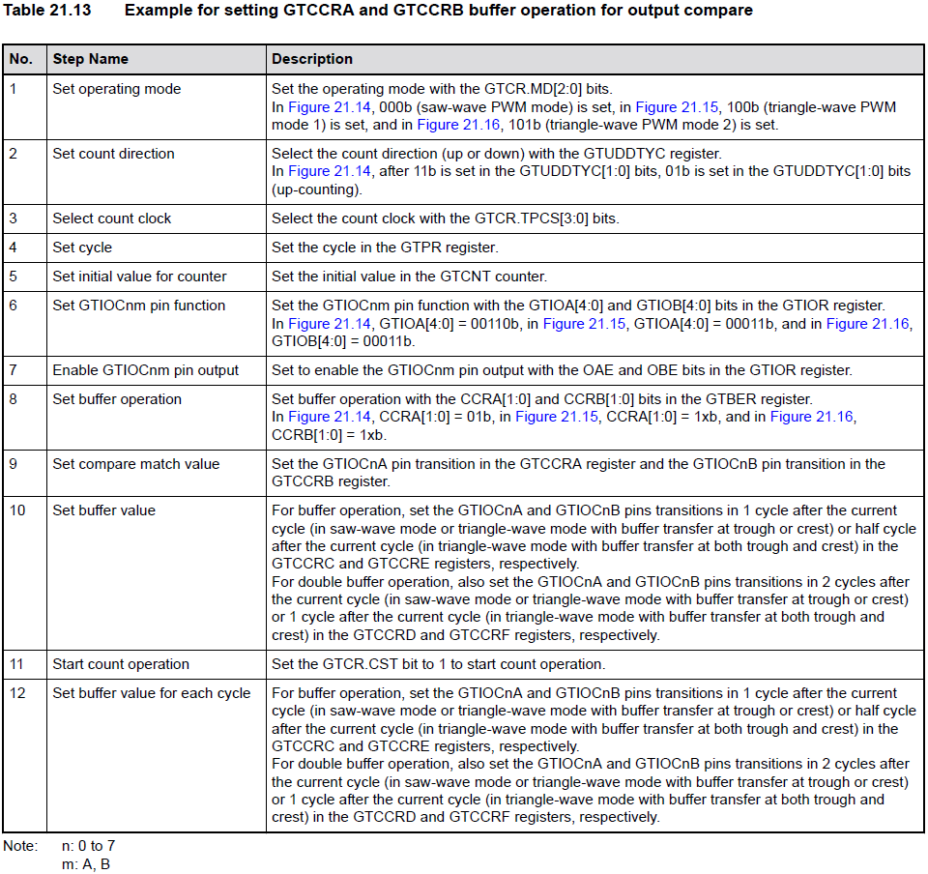
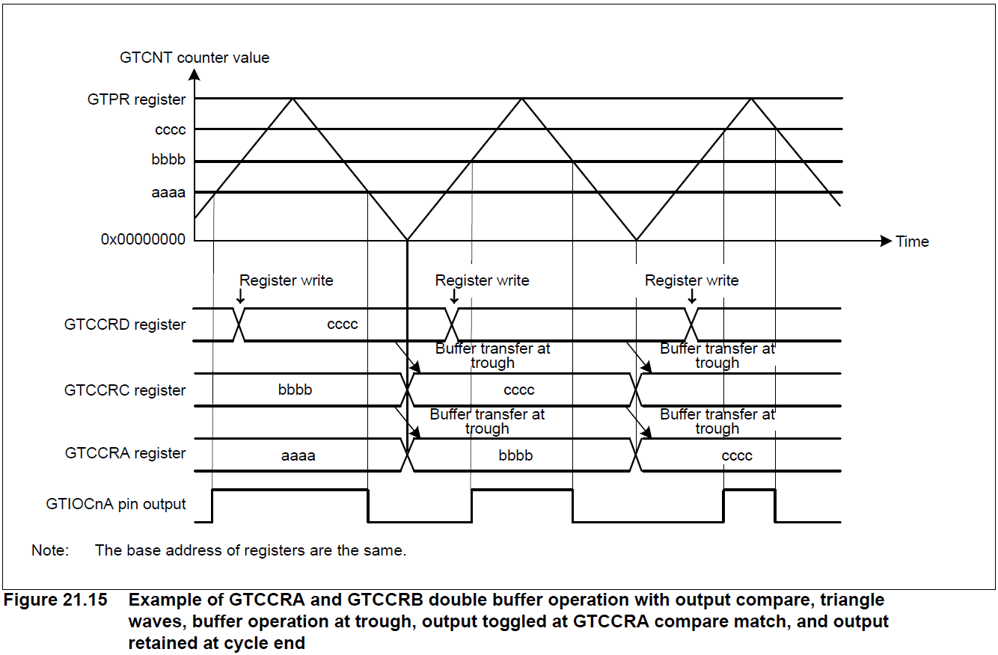
Buffer operation Buffer Operation for GTCCRA & GTCCRB Registers
GTCCRC can function as the GTCCRA buffer register and GTCCRD can function as the GTCCRC buffer register (double-buffer register for GTCCRA). Similarly, GTCCRE can function as the GTCCRB buffer register and GTCCRF can function as the GTCCRE buffer register (double-buffer register for GTCCRB).

Slide 15
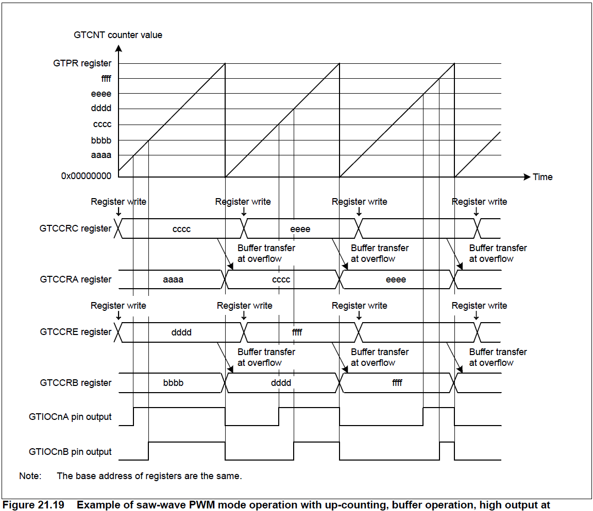
PWM Output Operating Mode Saw-Wave PWM Mode
In saw-wave PWM mode, GTCNT performs saw-wave (half-wave) operation by setting the cycle in GTPR and a PWM waveform is output to the GTIOCnA or GTIOCnB pin (n = 0 to 7) when a GTCCRA or GTCCRB compare match occurs. The pin output value can be selected from low output, high output, or toggle output separately for a compare match and for the cycle end according to the GTIOR setting.
No. | Step Name | Description
1 | Set operating mode | Set the operating mode with the GTCR.MD[2:0] bits. In Figure 21.19, 000b (saw-wave PWM mode) is set.
2 | Set count direction | Select the count direction (up or down) with the GTUDDTYC register. In Figure 21.19, after 11b is set in the GTUDDTYC[1:0] bits, 01b is set in the GTUDDTYC[1:0] bits (up-counting).
3 | Select count clock | Select the count clock with the GTCR.TPCS[3:0] bits.
4 | Set cycle | Set the cycle in the GTPR register.
5 | Set initial value for counter | Set the initial value in the GTCNT counter.
6 | Set GTIOCnm pin function | Set the GTIOCnm pin function with the GTIOA[4:0] and GTIOB[4:0] bits in the GTIOR register. In Figure 21.19, GTIOA[4:0] = 00110b and GTIOB[4:0] = 00110b.
7 | Enable GTIOCnm pin output | Set to enable the GTIOCnm pin output with the OAE and OBE bits in the GTIOR register.
8 | Set buffer operation | Set buffer operation with the CCRA[1:0] and CCRB[1:0] bits in the GTBER register. In Figure 21.19, CCRA[1:0] = 01b and CCRB[1:0] = 01b.
9 | Set compare match value | Set the GTIOCnA pin transition in the GTCCRA register and the GTIOCnB pin transition in the GTCCRB register.
No. | Step Name | Description
10 | Set buffer value | For buffer operation, set the GTIOCnA and GTIOCnB pins transitions in 1 cycle after the current cycle in the GTCCRC and GTCCRE registers, respectively. For double buffer operation, also set the GTIOCnA and GTIOCnB pins transitions in 2 cycles after the current cycle in the GTCCRD and GTCCRF registers, respectively.
11 | Start count operation | Set the GTCR.CST bit to 1 to start count operation.
12 | Set buffer value for each cycle | For buffer operation, set the GTIOCnA and GTIOCnB pins transitions in 1 cycle after the current cycle in the GTCCRC and GTCCRE registers, respectively. For double buffer operation, also set the GTIOCnA and GTIOCnB pins transitions in 2 cycles after the current cycle in the GTCCRD and GTCCRF registers, respectively.

Slide 16
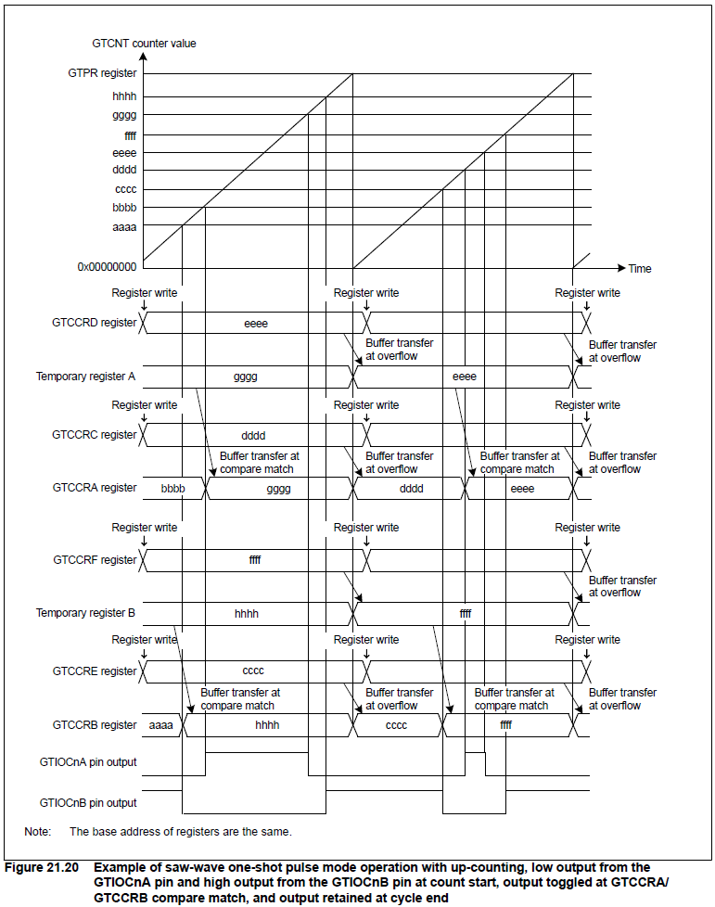
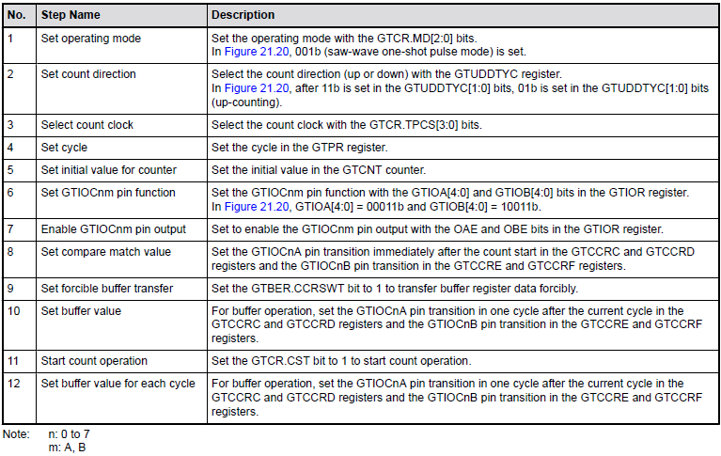
PWM Output Operating Mode Saw-Wave One-Shot Pulse Mode
The one-shot pulse mode is an asymmetric PWM mode that provides more control over the rising and falling edges of the output. The user provides a period and initial output level and controls the signal by specifying compare match values for the leading and trailing edges each period.

Slide 17
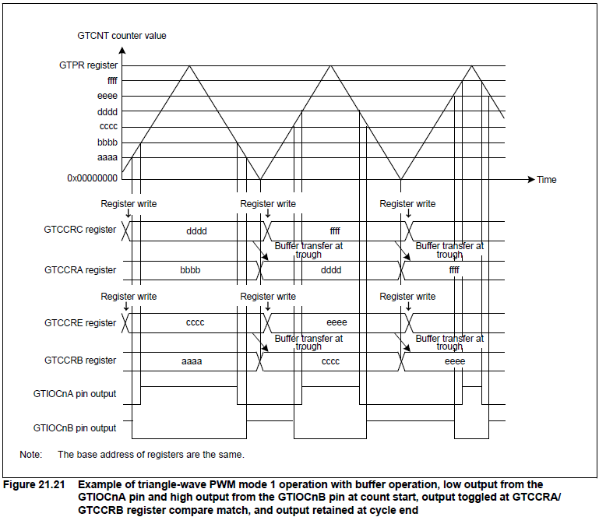
PWM Output Operating Mode Triangle-Wave PWM Mode 1 (32-Bit Transfer at Trough
The GTCNT counter performs triangle-wave (full-wave) operation, and a PWM waveform is output to the GTIOCnA or GTIOCnB pin (n = 0 to 7) when a GTCCRA or GTCCRB compare match occurs. Buffer transfer is performed at the trough. The pin output value can be selected from low output, high output, or toggled output separately for a compare match and for the cycle end according to the GTIOR setting.
No. | Step Name | Description
1 | Set operating mode | Set the operating mode with the GTCR.MD[2:0] bits. In Figure 21.21, 100b (triangle-wave PWM mode 1) is set.
2 | Select count clock | Select the count clock with the GTCR.TPCS[3:0] bits.
3 | Set cycle | Set the cycle in the GTPR register.
4 | Set initial value for counter | Set the initial value in the GTCNT counter.
5 | Set GTIOCnm pin function | Set the GTIOCnm pin function with the GTIOA[4:0] and GTIOB[4:0] bits in the GTIOR register. In Figure 21.21, GTIOA[4:0] = 00011b and GTIOB[4:0] = 10011b.
6 | Enable GTIOCnm pin output | Set to enable the GTIOCnm pin output with the OAE and OBE bits in the GTIOR register.
7 | Set buffer operation | Set buffer operation with the CCRA[1:0] and CCRB[1:0] bits in the GTBER register. In Figure 21.21, CCRA[1:0] = 01b and CCRB[1:0] = 01b.
8 | Set compare match value | Set the GTIOCnA and GTIOCnB pins transitions in the GTCCRA and GTCCRB registers, respectively.
9 | Set buffer value | For buffer operation, set the GTIOCnA and GTIOCnB pins transitions in 1 cycle after the current cycle in the GTCCRC and GTCCRE registers, respectively. For double buffer operation, also set the GTIOCnA and GTIOCnB pins transitions in 2 cycles after the current cycle in the GTCCRD and GTCCRF registers, respectively.
No. | Step Name | Description
10 | Start count operation | Set the GTCR.CST bit to 1 to start count operation.
11 | Set buffer value for each cycle | For buffer operation, set the GTIOCnA and GTIOCnB pins transitions in 1 cycle after the current cycle in the GTCCRC and GTCCRE registers, respectively. For double buffer operation, also set the GTIOCnA and GTIOCnB pins transitions in 2 cycles after the current cycle in the GTCCRD and GTCCRF registers, respectively.

Slide 18
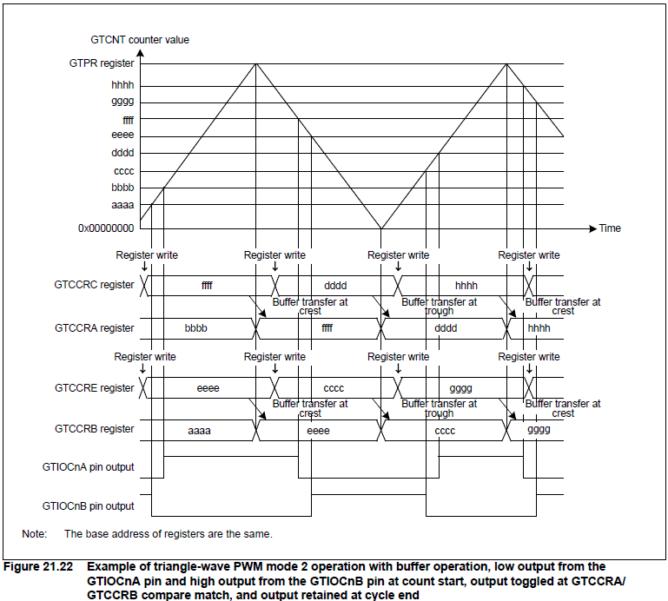
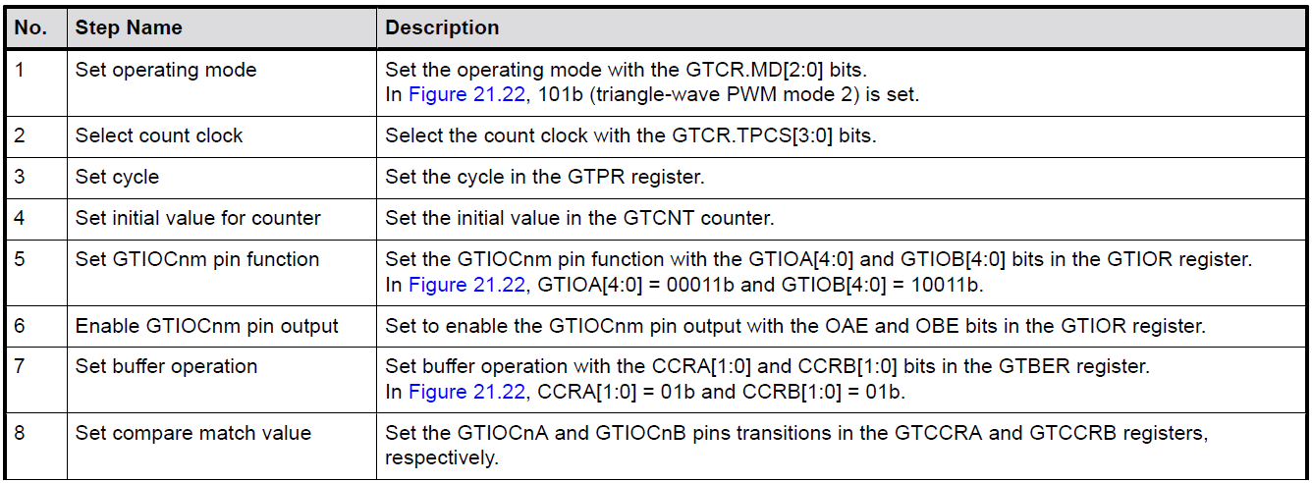
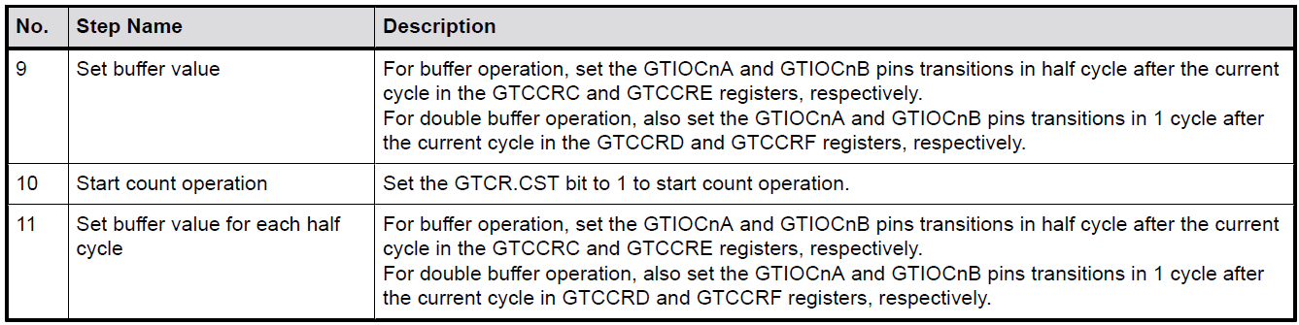
PWM Output Operating Mode Triangle-Wave PWM Mode 2 (32-Bit Transfer at Crest and Trough)
The GTCNT counter performs triangle-wave (full-wave) operation, and a PWM waveform is output to the GTIOCnA or GTIOCnB pin (n = 0 to 7) when a GTCCRA or GTCCRB compare match occurs. The buffer transfer is performed at both crests and troughs. The pin output value can be selected from low output, high output, or toggle output separately for a compare match and for the cycle end according to the GTIOR setting.

Slide 19
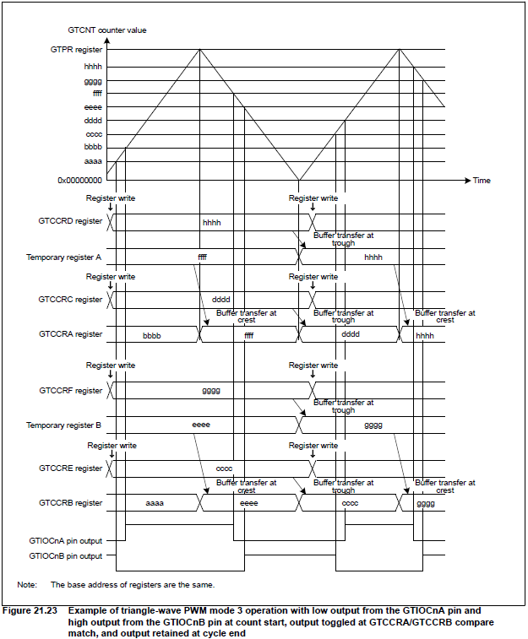
PWM Output Operating Mode Triangle-Wave PWM Mode 3 (64-Bit Transfer at Trough)
The GTCNT counter performs triangle-wave (full-wave) operation and a PWM waveform is output to the GTIOCnA or GTIOCnB pin (n = 0 to 7) at a compare match of GTCCRA or GTCCRB with buffer operation fixed
No. | Step Name | Description
1 | Set operating mode | Set the operating mode with the GTCR.MD[2:0] bits. In Figure 21.23, 110b (triangle-wave PWM mode 3) is set.
2 | Select count clock | Select the count clock with the GTCR.TPCS[3:0] bits.
3 | Set cycle | Set the cycle in the GTPR register.
4 | Set initial value for counter | Set the initial value in the GTCNT counter.
5 | Set GTIOCnm pin function | Set the GTIOCnm pin function with the GTIOA[4:0] and GTIOB[4:0] bits in the GTIOR register. In Figure 21.23, GTIOA[4:0] = 00011b and GTIOB[4:0] = 10011b.
6 | Enable GTIOCnm pin output | Set to enable the GTIOCnm pin output with the OAE and OBE bits in the GTIOR register.
7 | Set compare match value | Set the GTIOCnA pin transition immediately after the count start in the GTCCRC and GTCCRD registers and the GTIOCnB pin transition in the GTCCRE and GTCCRF registers.
8 | Set forcible buffer transfer | Set the GTBER.CCRSWT bit to 1 to transfer buffer register data forcibly.
9 | Set buffer value | Set the GTIOCnA pin transition in 1 cycle after the current cycle in the GTCCRC and GTCCRD registers and the GTIOCnB pin transition in the GTCCRE and GTCCRF registers.
10 | Start count operation | Set the GTCR.CST bit to 1 to start count operation.
11 | Set buffer value for each cycle | Set the GTIOCnA pin transition in 1 cycle after the current cycle in the GTCCRC and GTCCRD registers and the GTIOCnB pin transition in the GTCCRE and GTCCRF registers.

Slide 20
Other operation
Other function operations can be referred to RA4M3 Group User's Manual: Hardware (renesas.com):
21.3.4 Automatic Dead Time Setting Function (use for 3 phases PWM output – 3 phase motor control)
21.3.5 Count Direction Changing Function
21.3.6 Function of Output Duty 0% and 100%
21.3.7 Hardware Count Start/Count Stop and Clear Operation
21.3.8 Synchronized Operation (multi-channel timer signal synchronization)
21.3.10 Period Count Function
21.3.11 Phase Counting Function (detect phase difference between 2 external signals)
21.3.12 Output Phase Switching (GPT_OPS) (use for DC brushless motor control)
21.3.13 Inter Channel Logical Operation Function

Slide 21
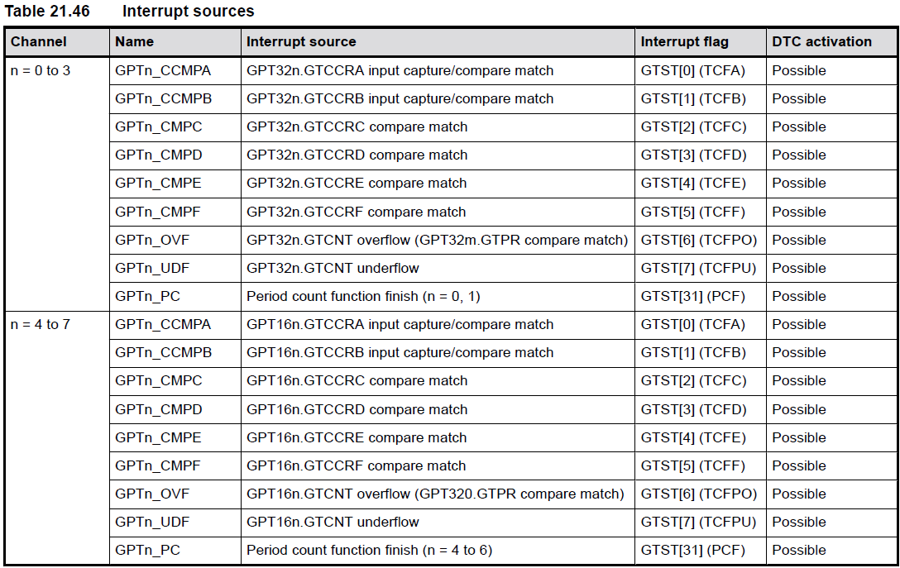
Interrupt sources
The GPT provides the following interrupt sources:
GTCCR input capture/compare match.
GTCNT counter overflow (GTPR compare match)/underflow.
Period count function finish.

Slide 22
Operations Linked by ELC Event Signal Output to ELC
The GPT has the following ELC event signals:
Generation of compare match and input capture A interrupt (GPTn_CCMPA)
Generation of compare match and input capture B interrupt (GPTn_CCMPB)
Generation of compare match C interrupt (GPTn_CMPC)
Generation of compare match D interrupt (GPTn_CMPD)
Generation of compare match E interrupt (GPTn_CMPE)
Generation of compare match F interrupt (GPTn_CMPF)
Generation of overflow interrupt (GPTn_OVF)
Generation of underflow interrupt (GPTn_UDF)
Finish of period count function (GPTm_PC)

Slide 23
Operations Linked by ELC Event Signal Inputs from ELC
The GPT can perform the following operations in response to a maximum of 8 events from the ELC:
Start counting, stop counting, clear counting
Up-counting, down-counting
Input capture.
See section 18, Event Link Controller (ELC) (RA4M3 Group User's Manual: Hardware (renesas.com)) for the connection between the ELC and the event signal input.

Slide 24
Configuration
Configuration
Build Time Configurations
Parameter Checking:
- Default (BSP)
- Enabled
- Disabled
Pin Output Support:
- Disabled
- Enabled
- Enabled with Extra Features
Write Protect Enable:
- Enabled
- Disabled
Clock Source:
- MCU Specific Options
Configurations for Timers > Timer, General PWM (r_gpt)
Refer to RA Flexible Software Package Documentation: Timer, General PWM (r_gpt) (renesas.github.io):
Timer, General PWM (r_gpt) → Configuration → Configurations for Timers > Timer, General PWM (r_gpt)
Clock Configuration
Pin Configuration
- GTETRGA, GTETRGB, GTETRGC, GTETRGD, GTIOCA and GTIOCB pins can used as count sources.
- GTIOCA and GTIOCB pins can used as output pins for periodic or PWM signals.
- GTIOCA and GTIOCB can used as input pins to measure input signals.
The GPT clock is based on the PCLKD frequency (config by Clocks tab of the RA Configuration editor or by using the CGC Interface at run-time)

Slide 25
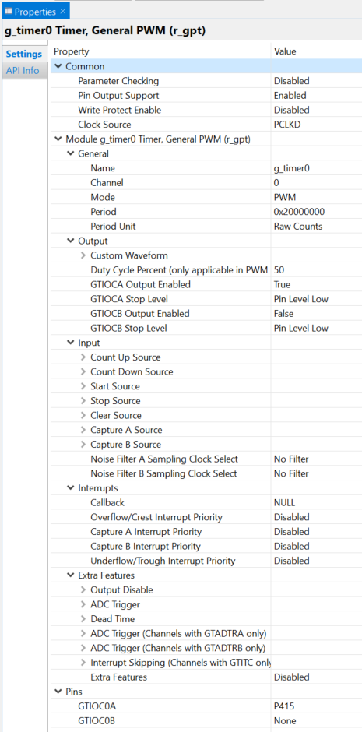
Configuration E2 studio module configuration
Some configuration need to consider:
Pin output support and pin (if use PWM mode)
Clock source (default is PCLKD, clock config by clock tabs)
Operation mode
Period and period unit
Input source (if use hardware source through POEG module)

Slide 26
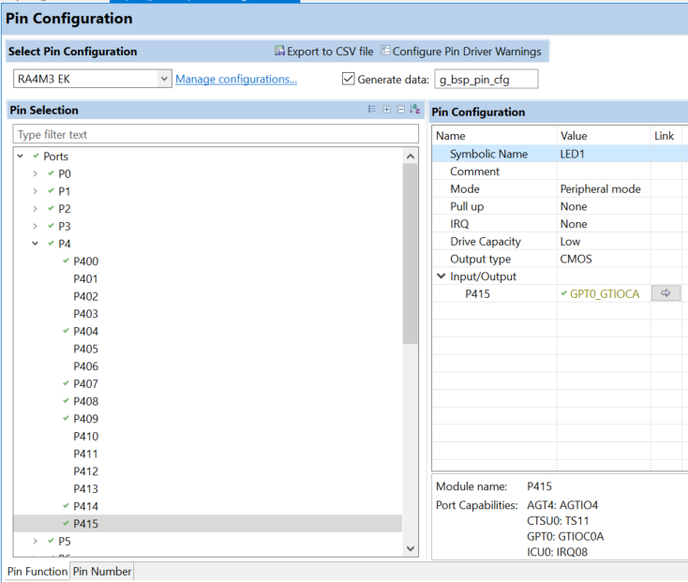
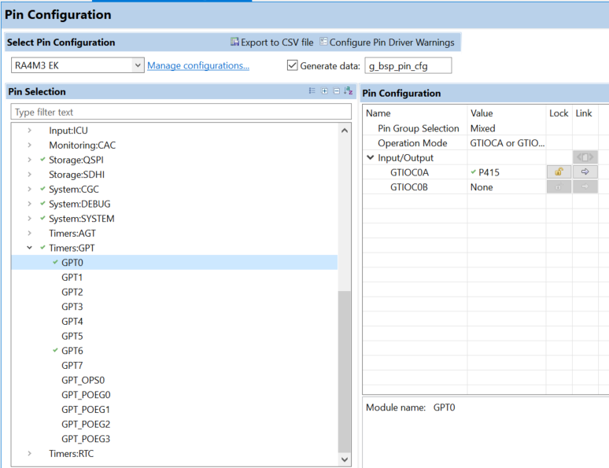
Configuration E2 studio pin configuration
GPT pin configuration:
Operation mode (GIOCA, GTIOCB or both)
Input/output
PORT pin configuration:
Mode (change to Peripheral mode)

Slide 27
Usage notes Maximum Period
When the selected period unit is "Raw counts", the maximum period setting is 0x40000000000 on a 32-bit timer or 0x4000000 on a 16-bit timer. This will configure the timer with the maximum period and a count clock divisor of 1024.
Note:
16-bit channels inherently have a reduced maximum period compared to 32-bit channels. When setting period values of hundreds of milliseconds or more on 16-bit channels be sure to check the generated output to confirm the actual configured value as it will clip much earlier than 32-bit channels. In general, it is recommended to use a lower-power timer like AGT or RTC if long hardware delays are required.

Slide 28
Usage notes Updating Period and Duty Cycle
The period and duty cycle are updated after the next counter overflow after calling R_GPT_PeriodSet() or R_GPT_DutyCycleSet(). To force them to update before the next counter overflow, call R_GPT_Reset() while the counter is running.
Note:
When manually changing the timer period counts the maximum value for a 32-bit GPT is 0x100000000. This number overflows the 32-bit value for timer_cfg_t::period_counts. To configure the timer for the maximum period, set timer_cfg_t::period_counts to 0.

Slide 29
Fsp interface Data Structure
struct gpt_output_pin_t
Configurations for output pins.
struct gpt_gtior_setting_t
Custom GTIOR settings used for configuring GTIOCxA and GTIOCxB pins.
struct gpt_instance_ctrl_t
Channel control block. DO NOT INITIALIZE. Initialization occurs when timer_api_t::open is called.
struct gpt_extended_pwm_cfg_t
GPT extension for advanced PWM features
struct gpt_extended_cfg_t
GPT extension configures the output pins for GPT

Slide 30
Fsp interface Enumerations
enum gpt_io_pin_t
Input/Output pins, used to select which duty cycle to update in R_GPT_DutyCycleSet().
enum gpt_buffer_force_push
Forced buffer push operation used in One-Shot Pulse mode with R_GPT_DutyCycleSet().
enum gpt_pin_level_t
Level of GPT pin
enum gpt_source_t
Sources can be used to start the timer, stop the timer, count up, or count down. These enumerations represent a bitmask. Multiple sources can be ORed together.
enum gpt_capture_filter_t
Input capture signal noise filter (debounce) setting. Only available for input signals GTIOCxA and GTIOCxB. The noise filter samples the external signal at intervals of the PCLK divided by one of the values. When 3 consecutive samples are at the same level (high or low), then that level is passed on as the observed state of the signal. See "Noise Filter Function" in the hardware manual, GPT section.

Slide 31
Fsp interface Enumerations
enum gpt_adc_trigger_t
Trigger options to start A/D conversion.
enum gpt_poeg_link_t
POEG channel to link to this channel.
enum gpt_output_disable_t
Select trigger to send output disable request to POEG.
enum gpt_gtioc_disable_t
Disable level options for GTIOC pins.
enum gpt_adc_compare_match_t
Trigger options to start A/D conversion.
enum gpt_interrupt_skip_source_t
Interrupt skipping modes

Slide 32
Fsp interface Enumerations
enum gpt_interrupt_skip_count_t
Number of interrupts to skip between events
enum gpt_interrupt_skip_adc_t
ADC events to skip during interrupt skipping
enum gpt_pwm_output_delay_setting_t
Delay setting for the PWM Delay Generation Circuit (PDG).
enum gpt_pwm_output_delay_edge_t
Select which PWM Output Delay setting to apply.

Slide 33
Fsp interface timer api
open
fsp_err_t(* timer_api_t::open) (timer_ctrl_t *const p_ctrl, timer_cfg_t const *const p_cfg)
Initial configuration. Implemented as R_GPT_Open() R_AGT_Open() Parameters [in] p_ctrl Pointer to control block. Must be declared by user. Elements set here. [in] p_cfg Pointer to configuration structure. All elements of this structure must be set by user.

Slide 34
Fsp interface timer api
start
fsp_err_t(* timer_api_t::start) (timer_ctrl_t *const p_ctrl)
Start the counter. Implemented as R_GPT_Start() R_AGT_Start() Parameters [in] p_ctrl Control block set in timer_api_t::open call for this timer.

Slide 35
Fsp interface timer api
stop
fsp_err_t(* timer_api_t::stop) (timer_ctrl_t *const p_ctrl)
Stop the counter. Implemented as R_GPT_Stop() R_AGT_Stop() Parameters [in] p_ctrl Control block set in timer_api_t::open call for this timer.

Slide 36
Fsp interface timer api
reset
fsp_err_t(* timer_api_t::reset) (timer_ctrl_t *const p_ctrl)
Reset the counter to the initial value. Implemented as R_GPT_Reset() R_AGT_Reset() Parameters [in] p_ctrl Control block set in timer_api_t::open call for this timer.

Slide 37
Fsp interface timer api
enable
fsp_err_t(* timer_api_t::enable) (timer_ctrl_t *const p_ctrl)
Enables input capture. Implemented as R_GPT_Enable() R_AGT_Enable() Parameters [in] p_ctrl Control block set in timer_api_t::open call for this timer.

Slide 38
Fsp interface timer api
disable
fsp_err_t(* timer_api_t::disable) (timer_ctrl_t *const p_ctrl)
Disables input capture. Implemented as R_GPT_Disable() R_AGT_Disable() Parameters [in] p_ctrl Control block set in timer_api_t::open call for this timer.

Slide 39
Fsp interface timer api
periodSet
fsp_err_t(* timer_api_t::periodSet) (timer_ctrl_t *const p_ctrl, uint32_t const period)
Set the time until the timer expires. See implementation for details of period update timing. Implemented as R_GPT_PeriodSet() R_AGT_PeriodSet() Note: Timer expiration may or may not generate a CPU interrupt based on how the timer is configured in timer_api_t::open. Parameters [in] p_ctrl Control block set in timer_api_t::open call for this timer.

Slide 40
Fsp interface timer api
dutyCycleSet
fsp_err_t(* timer_api_t::dutyCycleSet) (timer_ctrl_t *const p_ctrl, uint32_t const duty_cycle_counts, uint32_t const pin)
Sets the number of counts for the pin level to be high. If the timer is counting, the updated duty cycle is reflected after the next timer expiration. Implemented as R_GPT_DutyCycleSet() R_AGT_DutyCycleSet() Parameters [in] p_ctrl Control block set in timer_api_t::open call for this timer. [in] duty_cycle_counts Time until duty cycle should expire. [in] pin Which output pin to update. See implementation for details.

Slide 41
Fsp interface timer api
infoGet
fsp_err_t(* timer_api_t::infoGet) (timer_ctrl_t *const p_ctrl, timer_info_t *const p_info)
Stores timer information in p_info. Implemented as R_GPT_InfoGet() R_AGT_InfoGet() Parameters [in] p_ctrl Control block set in timer_api_t::open call for this timer. [out] p_info Collection of information for this timer.

Slide 42
Fsp interface timer api
statusGet
fsp_err_t(* timer_api_t::statusGet) (timer_ctrl_t *const p_ctrl, timer_status_t *const p_status)
Get the current counter value and timer state and store it in p_status. Implemented as R_GPT_StatusGet() R_AGT_StatusGet() Parameters [in] p_ctrl Control block set in timer_api_t::open call for this timer. [out] p_status Current status of this timer.

Slide 43
Fsp interface timer api
callbackSet
fsp_err_t(* timer_api_t::callbackSet) (timer_ctrl_t *const p_api_ctrl, void(*p_callback)(timer_callback_args_t *), void const *const p_context, timer_callback_args_t *const p_callback_memory)
Specify callback function and optional context pointer and working memory pointer. Implemented as R_GPT_CallbackSet() R_AGT_CallbackSet() Parameters [in] p_ctrl Control block set in timer_api_t::open call for this timer. [in] p_callback Callback function to register [in] p_context Pointer to send to callback function [in] p_working_memory Pointer to volatile memory where callback structure can be allocated. Callback arguments allocated here are only valid during the callback.

Slide 44
Fsp interface timer api
close
fsp_err_t(* timer_api_t::close) (timer_ctrl_t *const p_ctrl)
Allows driver to be reconfigured and may reduce power consumption. Implemented as R_GPT_Close() R_AGT_Close() Parameters [in] p_ctrl Control block set in timer_api_t::open call for this timer.

Slide 45
Fsp interface Gpt only - functions
R_GPT_CounterSet()
fsp_err_t R_GPT_CounterSet (timer_ctrl_t *const p_ctrl, uint32_t counter)
Set counter value. Note Do not call this API while the counter is counting. The counter value can only be updated while the counter is stopped. Return values
FSP_SUCCESS FSP_ERR_ASSERTION FSP_ERR_NOT_OPEN FSP_ERR_IN_USE | Counter value updated. p_ctrl or p_status was NULL. The instance is not opened. The timer is running. Stop the timer before calling this function.

Slide 46
Fsp interface Gpt only - functions
R_GPT_OutputEnable()
fsp_err_t R_GPT_OutputEnable (timer_ctrl_t *const p_ctrl, gpt_io_pin_t pin)
Enable output for GTIOCA and/or GTIOCB. Return values
FSP_SUCCESS FSP_ERR_ASSERTION FSP_ERR_NOT_OPEN | Output is enabled. p_ctrl or p_status was NULL. The instance is not opened.

Slide 47
Fsp interface Gpt only - functions
R_GPT_OutputDisable()
fsp_err_t R_GPT_OutputDisable (timer_ctrl_t *const p_ctrl, gpt_io_pin_t pin)
Disable output for GTIOCA and/or GTIOCB. Return values
FSP_SUCCESS FSP_ERR_ASSERTION FSP_ERR_NOT_OPEN | Output is disabled. p_ctrl or p_status was NULL. The instance is not opened.

Slide 48
Fsp interface Gpt only - functions
R_GPT_AdcTriggerSet()
fsp_err_t R_GPT_AdcTriggerSet (timer_ctrl_t *const p_ctrl, gpt_adc_compare_match_t which_compare_match, uint32_t compare_match_value)
Set A/D converter start request compare match value. Return values
FSP_SUCCESS FSP_ERR_ASSERTION FSP_ERR_NOT_OPEN | Counter value updated. p_ctrl or p_status was NULL. The instance is not opened.

Slide 49
Fsp interface Gpt only - functions
R_GPT_PwmOutputDelaySet()
fsp_err_t R_GPT_PwmOutputDelaySet (timer_ctrl_t *const p_ctrl, gpt_pwm_output_delay_edge_t edge, gpt_pwm_output_delay_setting_t delay_setting, uint32_t const pin)
Set the Output Delay setting for the PWM output pin. Return values
FSP_SUCCESS FSP_ERR_ASSERTION FSP_ERR_NOT_OPEN FSP_ERR_INVALID_CHANNEL FSP_ERR_NOT_INITIALIZED FSP_ERR_INVALID_STATE FSP_ERR_UNSUPPORTED | The output delay was set. An input parameter was invalid. The instance is not opened. The channel does not support this feature. The PWM Output Delay Circuit has not been initialized. The PWM Output Delay setting cannot be updated in the current state. This feature is not supported on this MCU.

Slide 50
Fsp interface Gpt only - functions
R_GPT_PwmOutputDelayInitialize ()
fsp_err_t R_GPT_PwmOutputDelayInitialize ()
Initialize the PWM Delay Generation Circuit (PDG). This function must be called before calling R_GPT_PwmOutputDelaySet. Return values
FSP_SUCCESS FSP_ERR_INVALID_STATE FSP_ERR_UNSUPPORTED | Initialization sequence completed successfully. The source clock frequnecy is out of the required range for the PDG. This feature is not supported.

Slide 51
Examples
Refer to RA Flexible Software Package Documentation: Timer, General PWM (r_gpt) (renesas.github.io) (Module → Timer → Timer, General PWM (r_gpt)):
GPT Basic Example
GPT Callback Example
GPT Free Running Counter Example
GPT Input Capture Example
GPT Period Update Example
GPT Duty Cycle Update Example
GPT A/D Converter Start Request Example
GPT One-Shot Pulse Mode Example

Slide 52
Examples project
PWM demo project (using FSP API): S:\20_user\thenguyen\GPT_PWM_demo_with_API.zip
GPT module initialization and configuration
Runtime config (duty cycle update and period update)
PWM demo project (config by register write): S:\20_user\phucche\FSP\00_Investigation\RA4M3_PWM_GTIOCnA

Slide 53
REFERENCE
RA Flexible Software Package Documentation: Introduction (renesas.github.io)
RA4M3 Group Datasheet (renesas.com)
RA4M3 Group User's Manual: Hardware (renesas.com)

Slide 54
Renesas.com

