Slide 1

Inter-integrated circuit – IIC
Self-Investigate
Date Feb.14
Name Huynh Thai
Engineer, RA FSP ,
Fsp 1
Renesas Electronics Corporation

Slide 2
Agenda
Overview Page 03
Master, Slave Transmit Operation Page 05
API Page 08
I2C configuration Page 10

Slide 3
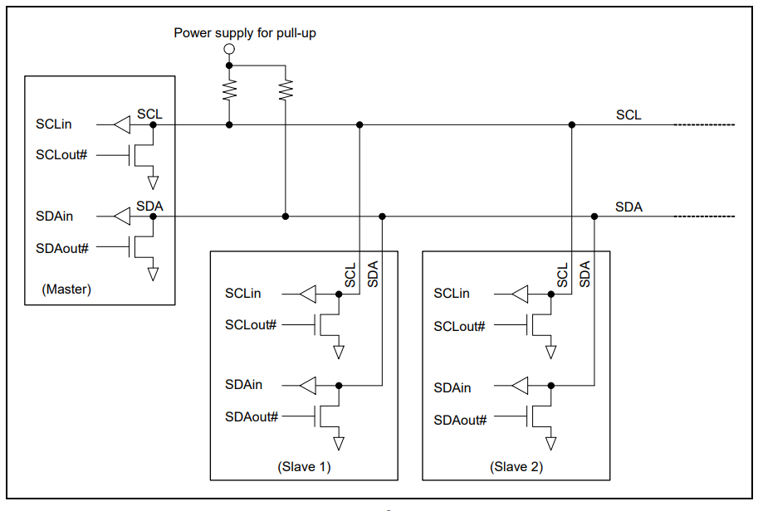
Overview
Inter-Integrated Circuit is a two-wire data transfer bus.
SDA (Serial Data) – The line for the master and slave to send and receive data.
SCL (Serial Clock) – The line that carries the clock signal.
I2C is a serial communication protocol, so data is transmitted bit by bit along a single line (SDA line).
Only supported for IIC0. IIC1 and IIC2 are not supported.

Slide 4
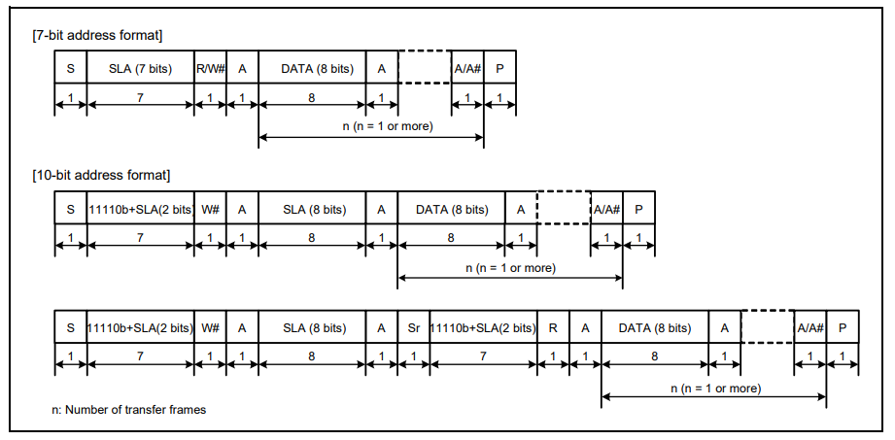
Overview I2U bus format

Slide 5
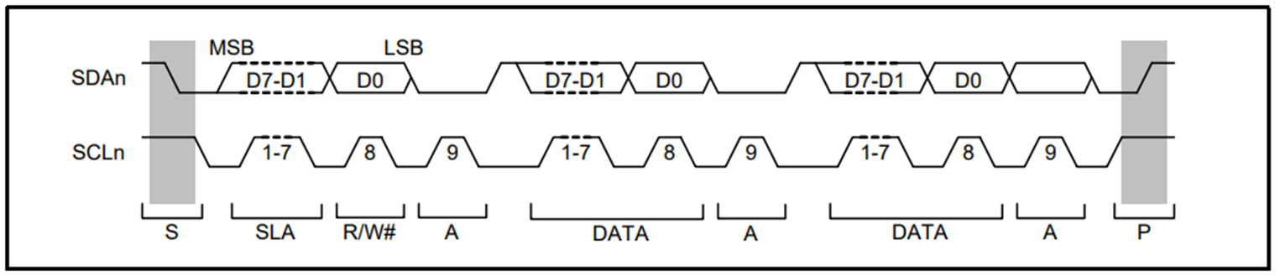
Operation
I2C bus timing when SLA is 7 bits
SLA: Indicates a slave address, by which the master device selects a slave device
R/W#: Indicates the direction of data transfer
A: Acknowledge. The receiving device drives the SDAn line low
A#: Not Acknowledge. The receive device drives the SDAn line high.
Sr: Restart condition. The master device drives the SDAn line low from the high level after the setup time has elapsed with the SCLn line high.
DATA: Transmitted or received data.

Slide 6
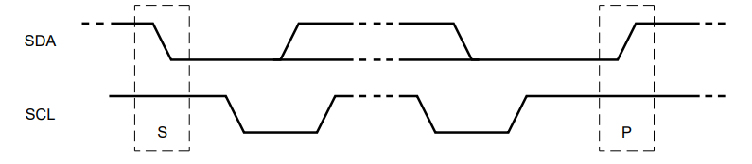
Operation START and STOP condition
A HIGH to LOW transition on the SDA line, while SCL is HIGH, defines a START condition.
A LOW to HIGH transition on the SDA line, while SCL is HIGH, defines a STOP condition

Slide 7
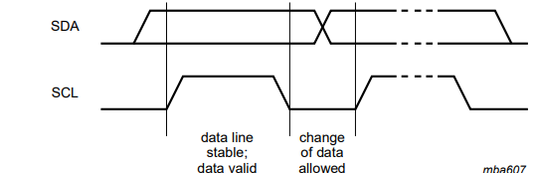
Operation data validity
The data on the SDA line must be stable during the HIGH period of the clock.
The HIGH or LOW state of the data line can only change when the clock signal on the SCL line is LOW
One clock pulse is generated for each data bit transferred.

Slide 8
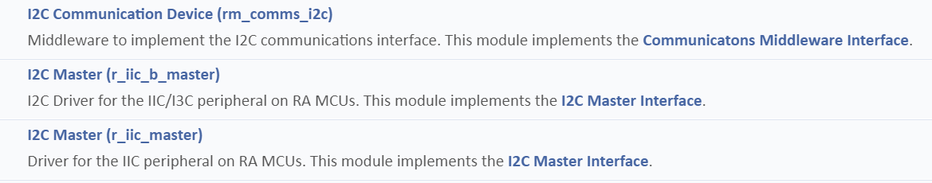

API

Slide 9
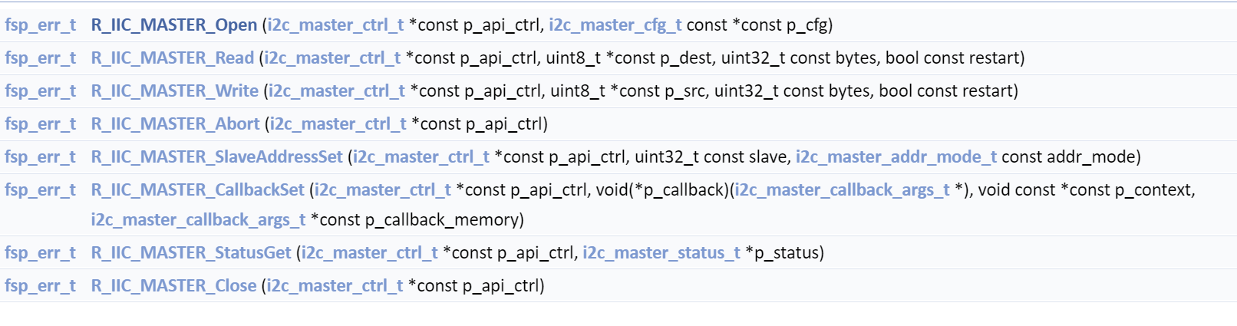
API I2C Communication Device (rm_comms_i2c)
RM_COMMS_I2C_Open(): Opens and configures the Communications Middle module
RM_COMMS_I2C_Close(): Disables specified Communications Middle module
RM_COMMS_I2C_Read(): Performs a read to the I2C device
RM_COMMS_I2C_Write(): Performs a write from the I2C device
RM_COMMS_I2C_WriteRead(): Performs a write to, then a read from the I2C device

Slide 10
API I2c Master (R_IIC_MASTER)
R_IIC_MASTER_Open(): Open the instance and initialize the hardware
R_IIC_MASTER_Read(): Performs a read operation on an I2C device.
R_IIC_MASTER_Write(): Performs a write to the I2C device
R_IIC_MASTER_Abort(): Safely aborts any in-progress transfer and forces the IIC peripheral into ready state.
R_IIC_MASTER_SlaveAddressSet(): Sets address and addressing mode of the slave device
R_IIC_MASTER_CallbackSet(): Updates the user callback and has option of providing memory for callback structure.
R_IIC_MASTER_StatusGet(): Provides driver status.
R_IIC_MASTER_Close(): Closes the I2C device. May power down IIC peripheral

Slide 11
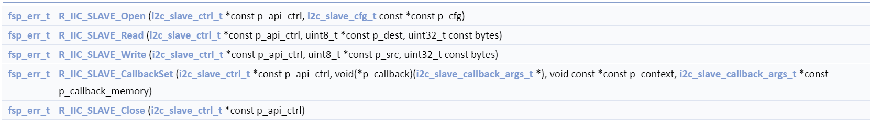
API I2c SLAVE (R_IIC_SLave)
R_IIC_SLAVE_Open Open the instance and initialize the hardware
R_IIC_SLAVE_Read Performs a read operation on an I2C device.
R_IIC_SLAVE_Write : Performs a write to the I2C device
R_IIC_SLAVE_CallbackSet Updates the user callback and has option of providing memory for callback structure.
R_IIC_SLAVE_Close Closes the I2C device. May power down IIC peripheral

Slide 12
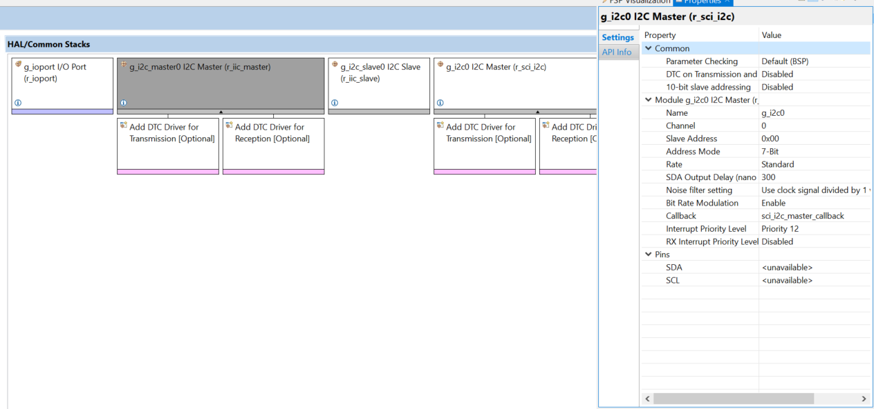
I2C CONFIGUration

Slide 13
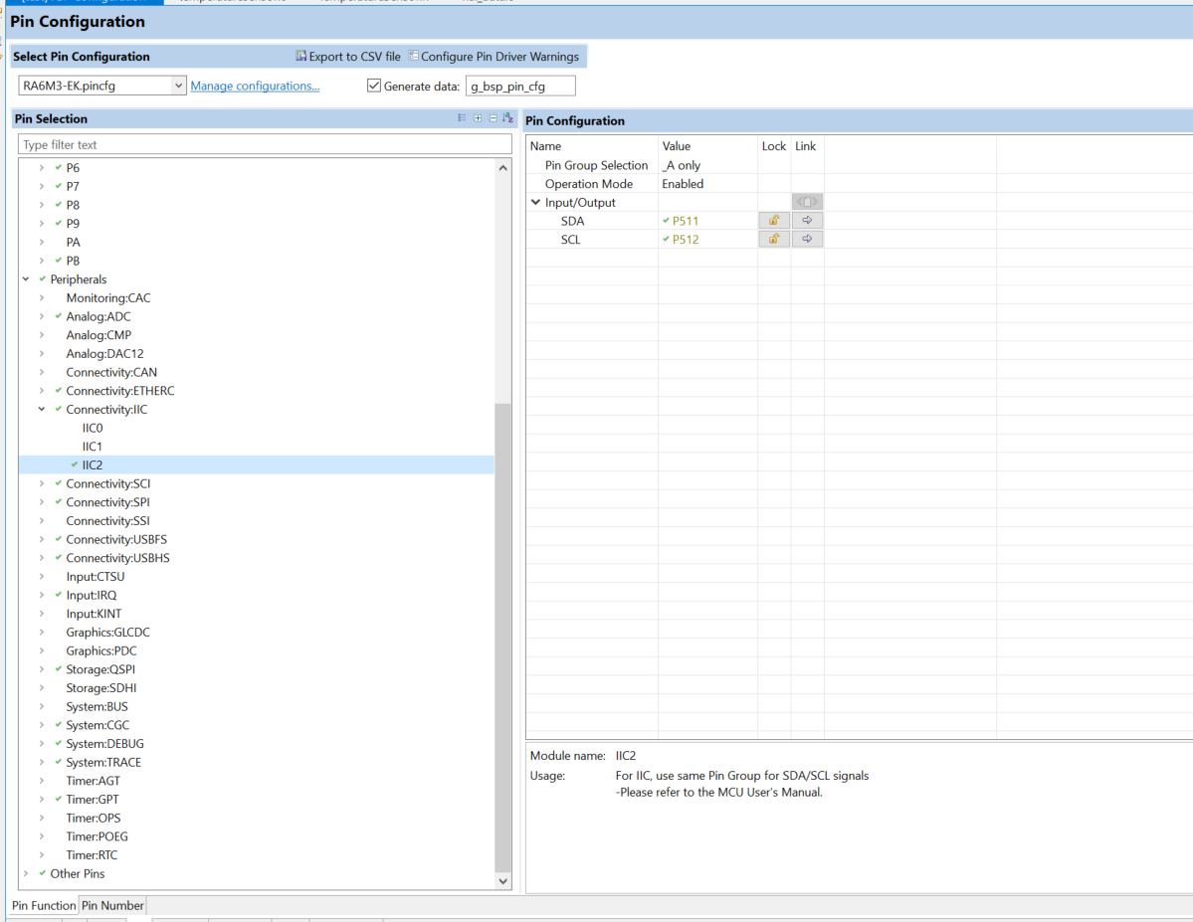
PIN CONFIGUration

Slide 14
Renesas.com

