Slide 1

Interrupt controller unit (ICU)
Self - investigation
Date:
Name: Phuc Che
engineer, RA fsp1,
fsp1
Renesas Electronics Corporation

Slide 2
Agenda
Overview Page 03
ICU operation Page 06
FSP of ICU Page 11
Appendix Page 17

Slide 3
overview what is ICU ?
ICU is the short term of Interrupt Controller Unit
As his name, he has responsibility of management the event signal which are linked to Nested Vector Interrupt Controller (NVIC), the DMA Controller (DMAC)and the Data Transfer Controller (DTC)
Moreover, he also controls the non-maskable interrupts

Slide 4
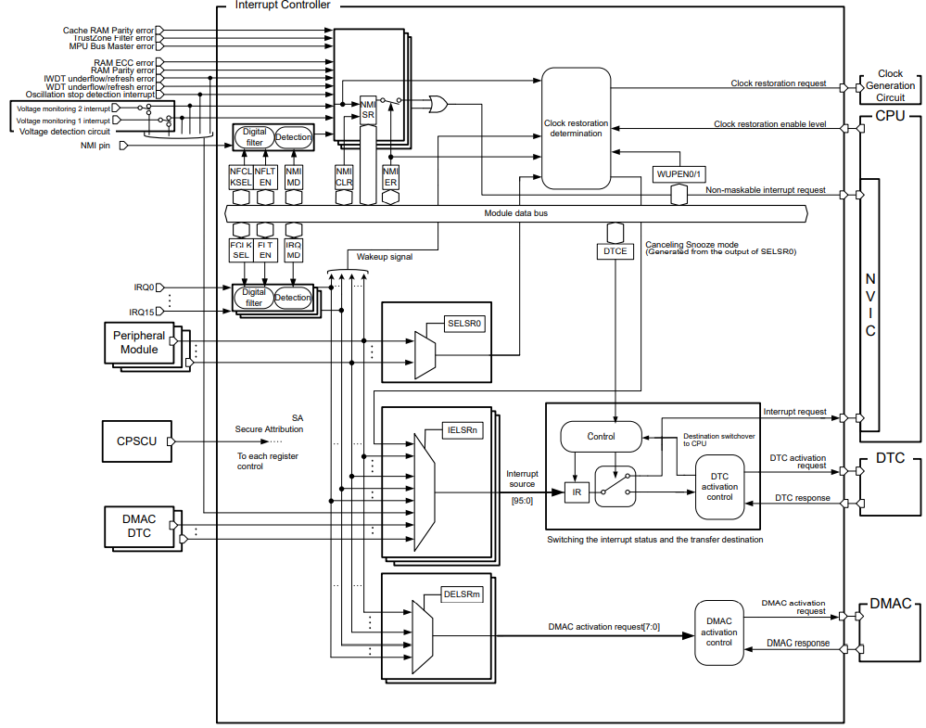
overview what is ICU ?
ICU perform below operation:
+ Detecting interrupts
+ Enabling and disabling interrupts
+ Selecting interrupt request destinations such as CPU interrupt, DTC activation, or DMAC activation
Note: This diagram took from HWUM of RA4M3

Slide 5
overview what is ICU ?
There are 2 types of interrupt which handled by ICU:
+ Maskable interrupt
+ Non-maskable interrupt
Able to be disabled or ignored by MCU
Unable to be disabled or ignored by MCU
Typically, the Maskable is interrupt which come from the external interrupt, peripheral, DMAC, DTC, …
The Non-Maskable is interrupt which will handle for HW error, high priority jobs …
Note: There may be some others type of interrupt depend on the classification

Slide 6
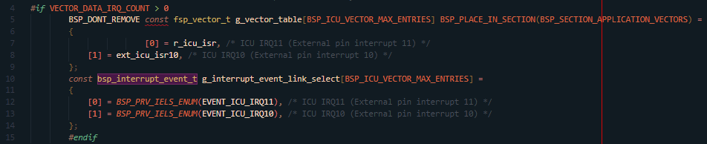
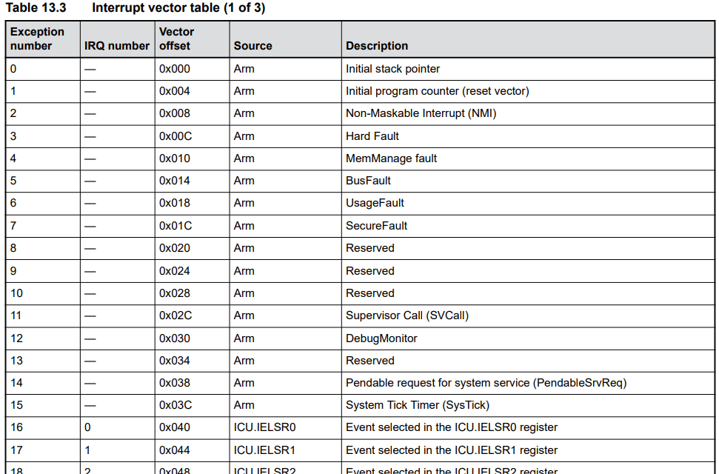

ICU operation how he works – interrupt Vector table
What is “Vector table” ?
An example about vector table which generated by e2studio
25 is the order of IRQ in the vector table
Address of IRQ25 is 0x000000A4
In the memory of ARM, there is an area of memory which will be reserved for storing the address of interrupt/exception routine
In short, the Vector table is the table of memory, at each address, the address of ISR/exception which handle for the interrupt will be stored.
The start address of Vector table is 0x00000000
Note: Above table took from RA4M3HWUM

Slide 7
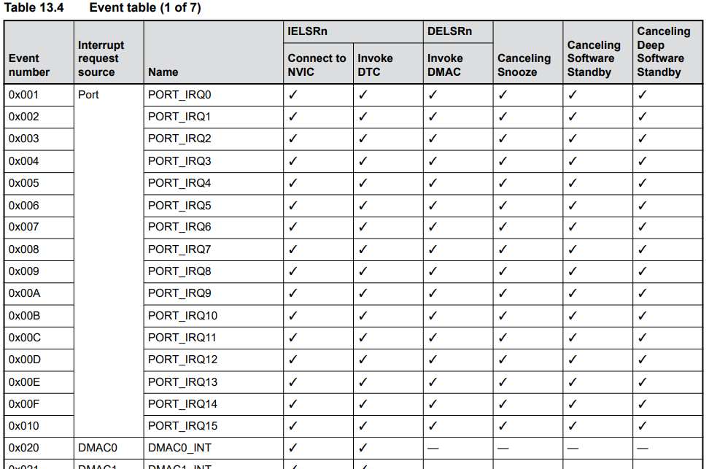
ICU operation how he works – eVent table
What is “Event table” ?
The “Event table” used to indicate the event number, interrupt name, connectivity of all interrupts supported by RA chip.
Note: Above table took from RA4M3HWUM

Slide 8
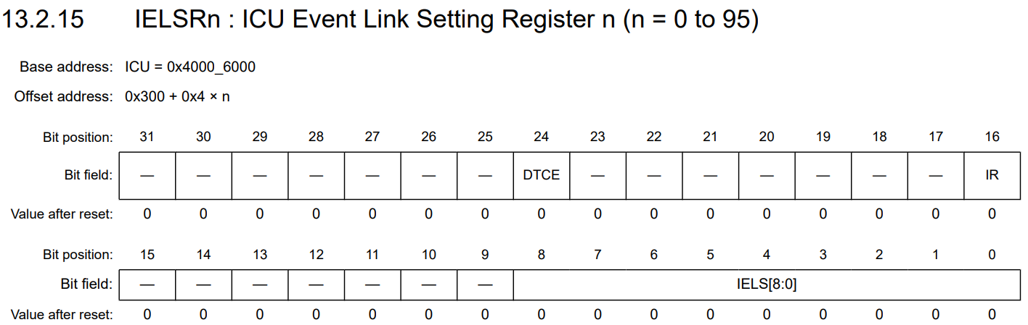
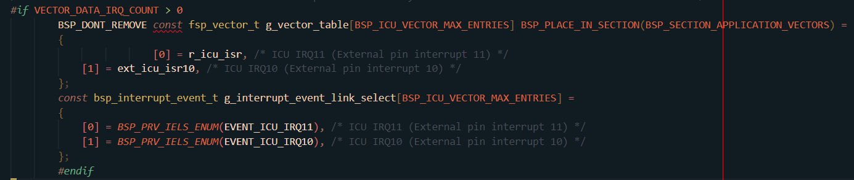
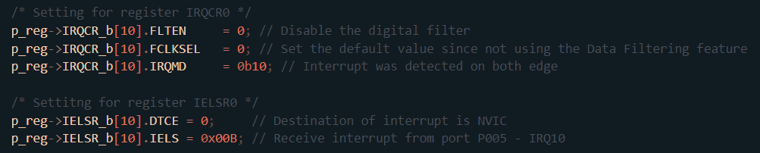
ICU operation how he works – why vector table/event table matter ?
The “n” based on the order of IRQ in the vector table
For the vector table, the address of ISR will be assigned to special area of MCU memory.
When IRQ occur, signal will be identified from which module, after that he will be sent to NVIC, NVIC will call the ISR function by access the address assigned to interrupt vector table.
The event number of IRQ being configured
Example configuration for IRQ10
Event number is needed to setup the register for telling the MCU where the interrupt event come from.

Slide 9
ICU operation how he works – interrupt source
Non-maskable interrupts signal source
When an event occur in the execution of MCU, signal will be sent to ICU
ICU will classify the signal depend on his event number and send to specific HW
External interrupts signal
Interrupts signal of peripheral
Signal from DMAC/DTC

Slide 10
ICU operation how he works – interrupt source
External interrupts, peripheral interrupts, non-maskable interrupt will be sent to NVIC for CPU executing their ISR
Signal of DTC will trigger the IRQ to DTC module
Signal of DMA will trigger the IRQ of DMAC module

Slide 11
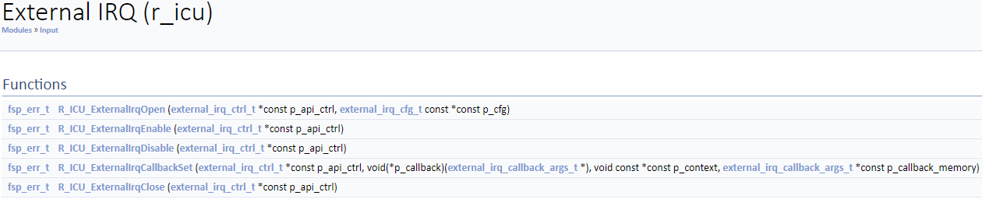
FSP OF ICU API
R_ICU_ExternalIrqOpen(): Configure an IRQ input pin for use with the external interrupt interface
R_ICU_ExternalIrqEnable(): Enable external interrupt for specified channel at NVIC
R_ICU_ExternalIrqDisable(): Disable external interrupt for specified channel at NVIC
R_ICU_ExternalIrqCallbackSet(): Updates the user callback and has option of providing memory for callback structure
R_ICU_ExternalIrqClose(): Close the external interrupt channel

Slide 12
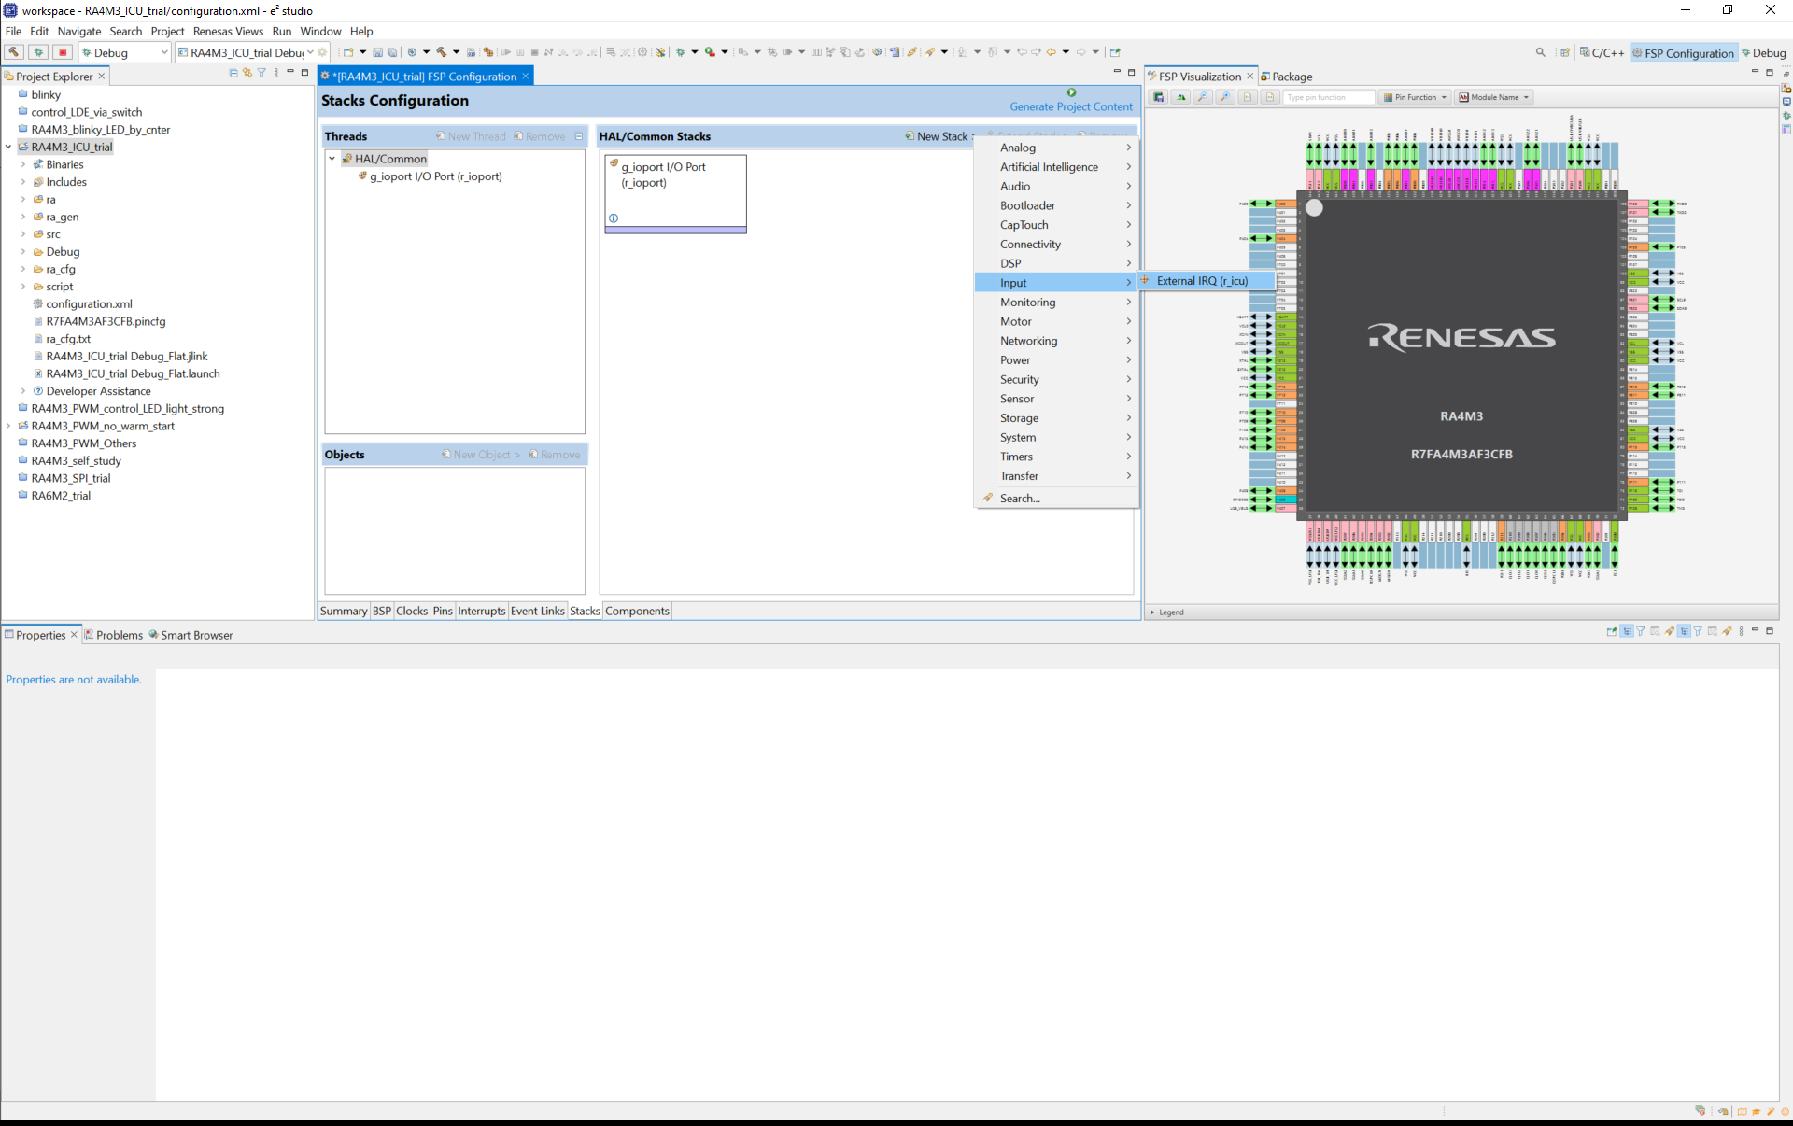
FSP OF ICU config with e2studio

Slide 13
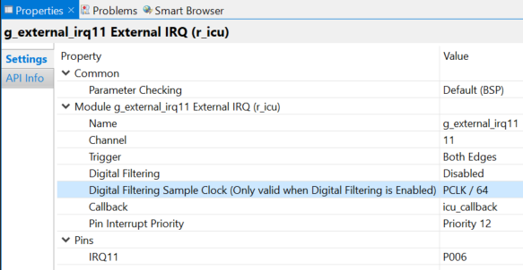
FSP OF ICU config with e2studio
Interrupt channel which being configuring
The trigger edge of interrupt
Note: the interrupt signal is active low
Digital Filtering will remove signal which has width less than 3 sampling cycles
Only valid when Digital Filtering was enabled
User callback function for interrupt
Priority of the interrupt
Selected interrupt channel and his corresponding pin port
Note: This configuration is used for external interrupt operation only

Slide 14
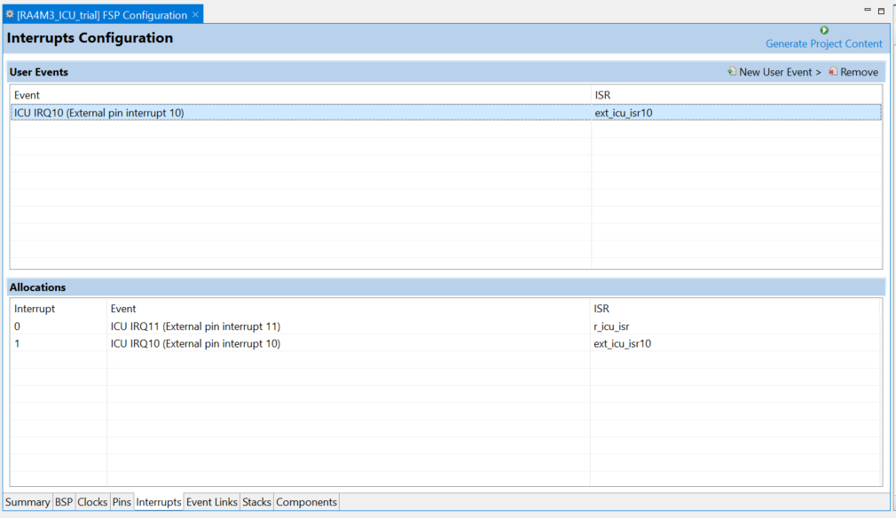
FSP OF ICU config with e2studio
User can add the ISR as their desire
When added ICU stack, r_icu_isr() will be generated by default and user cannot change it
Callback function will be invoked by r_icu_isr()
Note: This configuration is used for external interrupt operation only

Slide 15
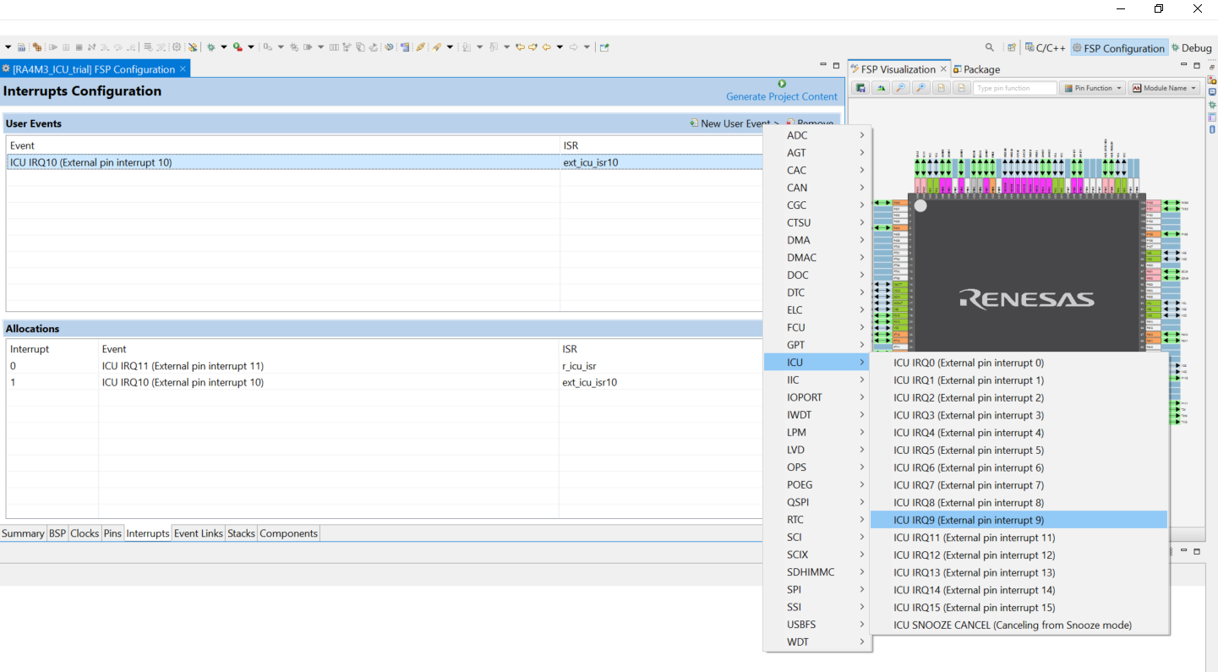
FSP OF ICU config with e2studio
How to add user’s interrupt event
Note: This configuration is used for external interrupt operation only

Slide 16
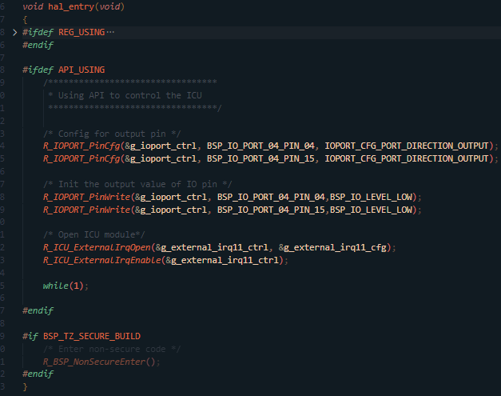
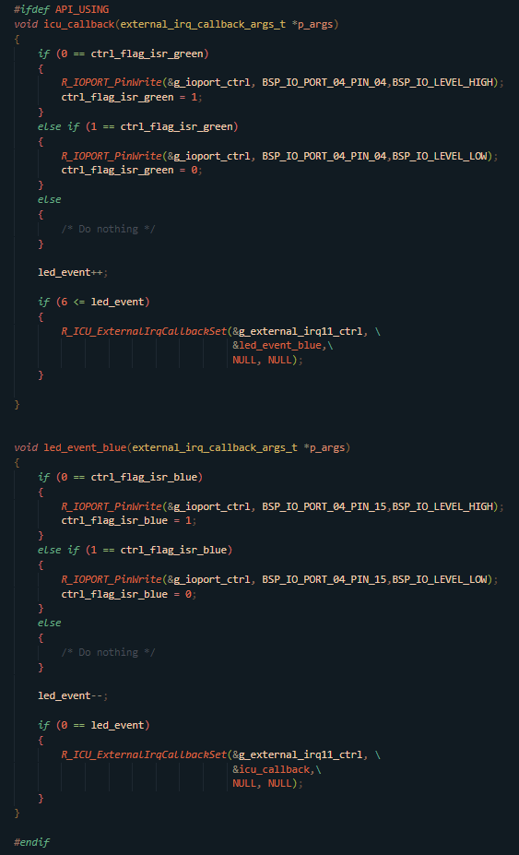
FSP OF ICU example – USING API
The example will control green LED and blue LED via switch S2 on EK-RA4M3.
Each time pressing the SW, LED will be turned on and off when release, and after 3 times the color will change
hal_entry() when using ICU via API
Note 1: Example was stored at S:\20_user\phucche\FSP\00_Investigation\RA4M3_ICU_trial
Note 2: Board used for the example is EK-RA4M3
Callback function for ISR

Slide 17
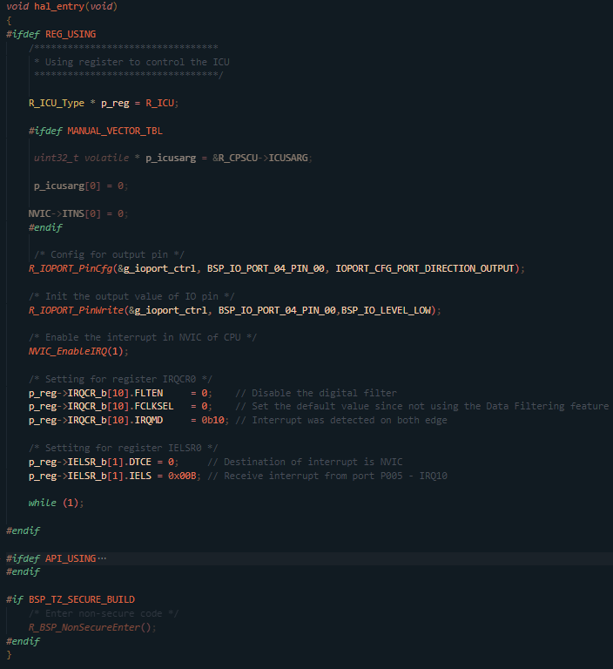
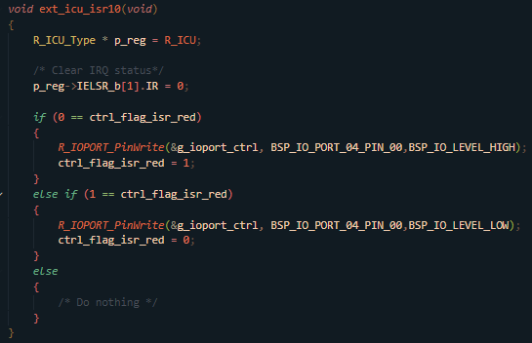
FSP OF ICU example – USING REGISTER
The example will control red LED via SW S1.
When pressing, LED will be turned on and turned off when release
ISR to control the LED
Note 1: Example was stored at S:\20_user\phucche\FSP\00_Investigation\RA4M3_ICU_trial
Note 2: Board used for the example is EK-RA4M3
hal_entry() when using ICU via API

Slide 18

Q&A

Slide 19
appendix reference material
Interrupt classification: https://www.geeksforgeeks.org/interrupts-8085-microprocessor/
Vector table: https://microcontrollerslab.com/what-is-interrupt-vector-table/
NVIC: The Definitive Guide to ARM Cortex -M0 and Cortex-M0+ Processors.pdf

Slide 20
appendix abbreviation
NVIC: Nest Vector Interrupt Controller
DMA: Direct Memory Access
DMAC: Direct Memory Access Controller
ISR: Interrupt service routine
IRQ: Interrupt request
CPSCU: CPU System Security Control Unit

Slide 21
Renesas.com

