Slide 1

CAN with Flexible Data-rate (CANFD) MODULE
RA FSP KNOWLEDGE SHARING REPORT
NOV 14, 2023
THINH NGUYEN
SOFTWARE DEVELOPMENT Department
RA FSP GROUP
Renesas Electronics Corporation

Slide 2
Agenda
Introduction Page 03
Frame Type Page 11
Comparing CAN vs CAN FD Page 21
Acceptance Filtering Function Page 25
Mode Operation Page 29
Register Summary Page 34
Hardware Requirement Page 38
Module Configuration Page 40
API for CAN FD module Page 45
Demonstrate Operation Page 49

Slide 3

Can with flexible data – rate (can fd)
introduction

Slide 4
Introduction what is can fd?
CAN FD (Controller Area Network with Flexible Data-rate).
Advantages of CAN FD:
- Increased data length: CAN FD support up to 64 bytes per data frame, while classical CAN support 8 bytes per data frame.
- Increased transfer speed: CAN FD support dual bitrate, the nominal bitrate is limited to 1Mbit/s, while data bitrate is possible to achieve up to 5 Mbit/s (can be achieved in actual application 8 Mbit/s, but there is no standard). The data bitrate depends on the network topology or transceiver.
- Better reliability: CAN FD improved Cyclic Redundancy Check (CRC) and a protected fill bit counter.
- More efficient and faster communication between multiple ECUs.

Slide 5
Introduction CAN-FD module specifications
Data Link Layer:
Frame: Standard frame, Extended frame, Data frame, Remote frame, etc.
CAN Arbitration: If a bus conflict occurs, the highest priority frame (lower message ID) will be granted media access.
Error handling and limitations.
Physical Layer:
Different synchronous communication methods using clock signal (I2C, SPI), CAN is not synchronized with clock signal.
It is an asynchronous communication that only has CAN High (CANH) and CAN Low (CANL).
There are two main form of physical layer: closed loop bus network and open loop bus network.

Slide 6
Introduction Physical layer
Closed loop bus network:
The ISO11898 standard CAN bus configuration scheme is used for high speed and short distance.
The maximum bus length of 40 meters.
The communication speed is 125kbps → 1Mbps.
Each end of bus requires a resistor 120Ω.
CANH
120Ω
120Ω
CANL
CAN bus transceiver
CAN bus transceiver
CAN bus transceiver
Microcontroller
Microcontroller
Microcontroller
CAN Controller
CAN Controller
CAN Controller
CAN Node 1
CAN Node 2
CAN Node N

Slide 7
Introduction Physical layer
Open loop bus network:
The ISO11519-2 standard CAN bus configuration scheme is used for low speed and long distance.
The maximum bus length of 1 kilometers.
The communication speed is 10kbps → 125kbps.
Each of bus requires a resistor 2.2kΩ.
2.2kΩ
CANH
2.2kΩ
CANL
CAN bus transceiver
CAN bus transceiver
CAN bus transceiver
Microcontroller
Microcontroller
Microcontroller
CAN Controller
CAN Controller
CAN Controller
CAN Node 1
CAN Node 2
CAN Node N

Slide 8
Introduction CAN-FD module specifications
Table 1. Types of frame in CAN and CAN_FD
In addition, data frame and remote frame have two formats:
- Standard frame.
- Extended frame.
Where the standard format is 11 bits identifier (ID), and the extended format is 29 bits ID.
Type of Frame | Usage
Data frame | Used for send unit to transfer data to the receiving unit.
Remote Control Frame (only CAN) | For the receiving unit to have the same ID. The sending unit requests the data frame.
Error Frame | Frame used to notify other units of an error when an error is detected.
Overload Frame | Frame used to notify the receiving unit that it is not ready to receive it.
Frame Interval | Frame used to separate data frames and remote control frames from previous frames.

Slide 9
Introduction Data frame
 | CAN FD Message
 |  | Arbitration field |  |  |  |  |  | Control field |  |  |  |  |  |  |  | Data field |  |  |  |  | CRC field
 | SOF | ID extension |  |  |  |  | SRR | IDE | FDF | BRS | ESI | DLC |  |  |  | Byte 0 | Byte 1 | … | Byte n-1 | Byte n | Stuff Count |  |  |  | CRC sequence |  |  |  |  | CRC Delimiter | ACK Slot
 |  | Bit 10 | Bit 9 | … | Bit 1 | Bit 0 |  |  |  |  |  | Bit 3 | Bit 2 | Bit 1 | Bit 0 |  |  |  |  |  | Bit 2 | Bit 1 | Bit 0 | Parity | Bit 16 | Bit 15 | … | Bit 1 | Bit 0
Standard frame
 | Arbitration field |  |  |  |  |  |  |  |  |  |  |  |  | Control field |  |  |  |  |  |  |  | Data field |  |  |  |  | CRC field
SOF | Base ID |  |  |  |  | SRR | IDE | ID extension |  |  |  |  | RRS | FDF | res | BRS | ESI | DLC |  |  |  | Byte 0 | Byte 1 | … | Byte n-1 | Byte n | Stuff Count |  |  |  | CRC sequence |  |  |  |  | CRC Delimiter | ACK Slot
 | Bit 28 | Bit 27 | … | Bit 19 | Bit 18 |  |  | Bit 17 | Bit 16 | … | Bit 1 | Bit 0 |  |  |  |  |  | Bit 3 | Bit 2 | Bit 1 | Bit 0 |  |  |  |  |  | Bit 2 | Bit 1 | Bit 0 | Parity | Bit 16 | Bit 15 | … | Bit 1 | Bit 0
Extended frame
CAN FD | Bosch semiconductors for Automotive (bosch-semiconductors.com)

Slide 10
Introduction frame speed
Same speed (up to 1Mb/s)
CAN
 | SOF | 11-bit ID | RTR | IDE | r0 | DLC | 1 – 8 bytes data | 15-bit CRC | DEL | ACK
Standard frame
CAN FD
 | SOF | 11-bit ID | SRR | IDE | FDF | BRS | ESI | DLC | 1 – 64 bytes data | 17 or 21-bit CRC | DEL | ACK
Nominal speed (up to 1Mb/s)
Data speed (up to 8Mb/s)
Nominal speed (up to 1Mb/s)
Same speed
CAN
 | SOF | 11 high order bit ID | SRR | IDE | 18 low order bit ID | RTR | r0 | r1 | DLC | 1 – 8 bytes data | 15-bit CRC | DEL | ACK
Extended frame
CAN FD
 | SOF | 11 high order bit ID | SRR | IDE | 18 low order bit ID | RRS | FDF | res | BRS | ESI | DLC | 1 – 64 bytes data | 17 or 21-bit CRC | DEL | ACK
Nominal speed
Data speed
Nominal speed

Slide 11
Can with flexible data – rate (can fd)
Frame type

Slide 12
Frame type data frame
 | Arbitration field |  |  |  |  |  |  |  |  |  |  |  |  | Control field |  |  |  |  |  |  |  | Data field |  |  |  |  | CRC field
SOF | Base ID |  |  |  |  | SRR | IDE | ID extension |  |  |  |  | RRS | FDF | res | BRS | ESI | DLC |  |  |  | Byte 0 | Byte 1 | … | Byte n-1 | Byte n | Stuff Count |  |  |  | CRC sequence |  |  |  |  | CRC Delimiter | ACK Slot
 | Bit 28 | Bit 27 | … | Bit 19 | Bit 18 |  |  | Bit 17 | Bit 16 | … | Bit 1 | Bit 0 |  |  |  |  |  | Bit 3 | Bit 2 | Bit 1 | Bit 0 |  |  |  |  |  | Bit 2 | Bit 1 | Bit 0 | Parity | Bit 16 | Bit 15 | … | Bit 1 | Bit 0
Start of Frame
Remote Request Substitution
(always RRS = 0, receiver accept RRS = 1 without error)
Next slide
CAN FD uses either a 17-bit CRC for data fields up to and including 16 bytes, or a 21-bit CRC for data fields 20 bytes and over.
Substitute Remote Request (always sent recessive SRR = 1, receiver will accept SRR = 0 without triggering a form error)
FD Format indicator FDF = 0 is CAN, FDF = 1 is CAN FD
Error State Indicator ESI = 0 is normal, ESI = 1 is error
Identifier Extension
(IDE = 1 to use Extended frame (29 bits ID) IDE = 0 to use Standard frame (11 bits ID))
At least one receiver has confirmed reception of the frame. It only takes one node to drive the bus dominant, ACK bit tells the transmitting node as it finished transmitting a frame.
Reserved bit in FD Frames for future use
Bit Rate Switch
(BRS = 1 to switch up to faster rate)
CAN FD | Bosch semiconductors for Automotive (bosch-semiconductors.com)

Slide 13
Frame type data length code
Table 2. Coding of the numbers of data bytes and CRC bits for DLC values
DLC Indicator | DLC (binary) | Classical CAN (bytes) | CAN FD (bytes) | Classical CAN CRC | CAN FD CRC
0 | 0000 | 0 | 0 | 15 | 17
1 | 0001 | 1 | 1 | 15 | 17
2 | 0010 | 2 | 2 | 15 | 17
3 | 0011 | 3 | 3 | 15 | 17
4 | 0100 | 4 | 4 | 15 | 17
5 | 0101 | 5 | 5 | 15 | 17
6 | 0110 | 6 | 6 | 15 | 17
7 | 0111 | 7 | 7 | 15 | 17
8 | 1000 | 8 | 8 | 15 | 17
9 | 1001 | 8 | 12 | 15 | 17
10 | 1010 | 8 | 16 | 15 | 17
11 | 1011 | 8 | 20 | 15 | 21
12 | 1100 | 8 | 24 | 15 | 21
13 | 1101 | 8 | 32 | 15 | 21
14 | 1110 | 8 | 48 | 15 | 21
15 | 1111 | 8 | 64 | 15 | 21
In both classical CAN and CAN FD there are four control bits, called Data Length Code (DLC), that indicate the size of the data payload. The first eight bytes of data are mapped one-to-one to the DLC value, so the DLC directly indicates the number of data bytes in the data phase if there are zero to eight bytes of data.

Slide 14
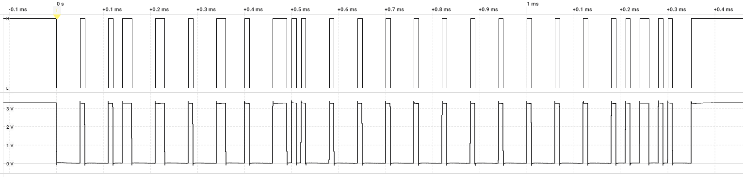
Frame type bit stuffing: dynamic stuff bit
Digital TX
Analog TX
0 0000 1 00000 1 00 11 00000 11 00000 1 00000 11 0 000 1 000 00 111 0 10 1 00000 1 000 00 1 00000 1 00000 1 00000 1 00000 1 00000 1 00000 1 00000 1 00000 1 00000 1 00 1 00 11 00 1 0 1 000 0
SOF
11 high order bit
18 low order bit
Byte 1
Byte 2
Byte 3 - 8
CRC
SRR
RTR
IDE
r0
Insertion of a bit of opposite polarity after five consecutive bit of same polarity.
r1
4-bit DLC
0
0
0
0
0
0
0
1
1
0
0
0
0
0
1
1
…
1,0: normal bit
1,0: stuffed bit
Stuffed bit
Stuffed bit
Same bit
Same bit
0
0
0
0
0
1
0
0
1
1
0
0
0
0
0
1
1
1
…

Slide 15
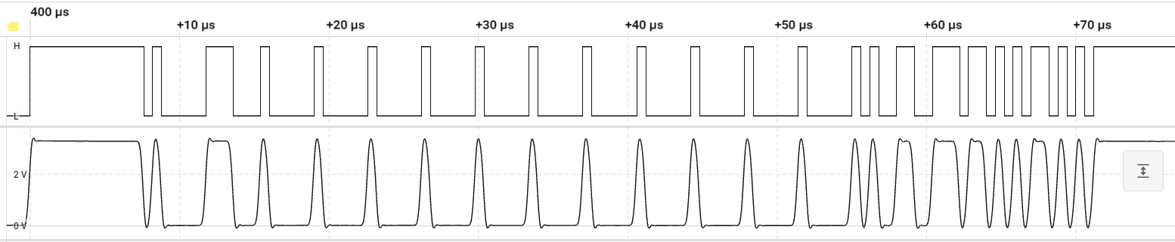
Frame type bit stuffing: fixed stuff bit
Table 3. Coding of the stuff bit count
Digital TX
Stuff bit count modulo 8 | Bits added to CAN FD frame
 | Gray-code value | Parity bit | Fixed stuff bit
0 | 000 | 0 | 1
1 | 001 | 1 | 0
2 | 010 | 0 | 1
3 | 011 | 1 | 0
4 | 100 | 0 | 1
5 | 101 | 1 | 0
6 | 110 | 0 | 1
7 | 111 | 1 | 0
Analog TX
1 0100 1100 111011 01010 110 10 10 1111
3-bit Stuff count
Fixed stuff bit
1-bit Parity bit
The stuff bits are inserted at fixed positions, once at the start of the CRC field and then after each fourth bit of the field. The value of such a fixed stuff bit is the inverse value of the preceding bit.
Ex: 17 dynamic stuff bits → Stuff count = 17%8 = 1

Slide 16
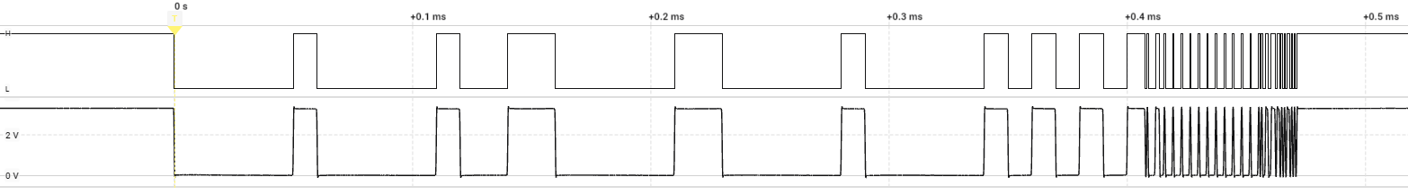
Frame type transmission of can fd frame
Nominal rate
Data rate
Digital TX
Analog TX
0 0 0 0 0 1 0 0 0 0 0 1 0 0 1 1 0 0 0 0 0 1 1 0 0 0 0 0 1 0 0 0 0 0 1 0 1 0 1 0 1
SOF
11 high order bit
18 low order bit
RRS
BRS
SRR
FDF
res
IDE
res
BRS
1,0: normal bit
1,0: dynamic stuff bit
1,0: fixed stuff bit
0 1 000 00111 0001 000 … 1 00000 1 0100 1100 111011 01010 110 10 10 1 1 1 1
ESI
Byte 1
Byte 2 – 8
4-bit Stuff count and 17-bit CRC
4-bit DLC

Slide 17
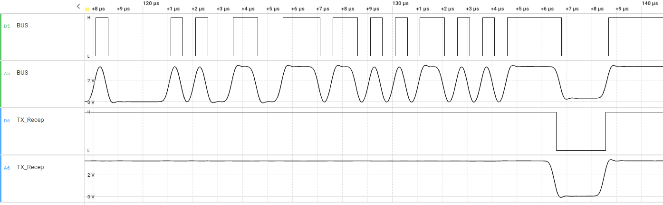
Frame type cyclic redundancy check and acknowledgement
1 00000 1 0 1 0 0 1 1 0 0 1 1 1 0 1 1 0 1 0 1 0 1 1 0 1 0 1 0 1 1 1 1 0
res
BRS
1 00000 1 0 1 0 0 1 1 0 0 1 1 1 0 1 1 0 1 0 1 0 1 1 0 1 0 1 0 1 1 1 1 0
1,0: normal bit
1,0: dynamic stuff bit
1,0: fixed stuff bit
3-bit Stuff count
1-bit Parity bit
17-bit CRC
2-bit Delimiter CRC
ACK bit
CRC delimiter transmitted as 1-bit, however receiver can accept up to 2-bit times (due to phase shift).

Slide 18
Frame type error frame description
A frame used to detect and notify errors when receiving and sending messages. The error frame consists of Error flags and Error delimiter.
Error flags: Error flags include Active error flag and Passive error flag.
Active error flag: The error flag output when the unit in active error state detects an error (6 dominant bit).
Passive error flag: The error flag output when the unit in passive error state detects an error (6 dominant bit).
Error delimiter: The error delimiter is given by 8 recessive bit composition of bits.
 | Error Frame
CAN FD Message | Superposition of Error Flags |  | Error Delimiter
CAN FD Message | Active Error Flag | Passive Error Flag | Error Delimiter
 | 6 bits | 0-6 bits | 8 bits

Slide 19
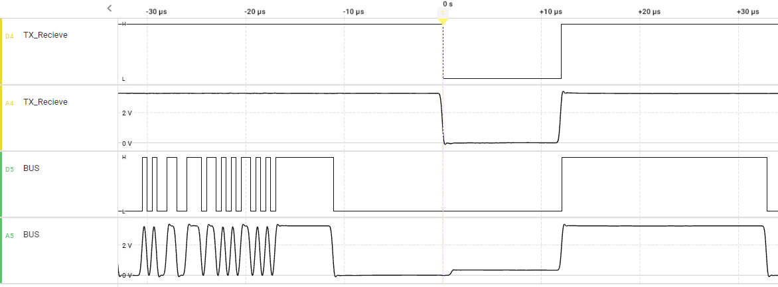
Frame type realistic error frame
6-bit Active Error Flag
6-bit Passive Error Flag
Error Delimiter

Slide 20
Frame type overload frame description
The overload frame is a frame used by the receiving unit to notify that it has not completed its reception preparation. The overload frame consists of an overload flag and an overload delimiter.
Overload flag: 6 dominant bit of the bit, the overload flag has the same structure as the active error flag.
Overload delimiter: 8 recessive bit.
The composition of the overload delimiter is the same as that of the error delimiter.
 | Overload Frame
CAN FD Message | Superposition of Overload Flags |  | Overload Delimiter
CAN FD Message | Overload Flag |  | Error Delimiter
 | 6 bits |  | 8 bits

Slide 21
Can with flexible data – rate (can fd)
Comparing can vs can fd

Slide 22
Comparing can vs can fd efficiency
Table 4. Compare CAN vs CAN FD
Frame Type | Data Length | Arbitration Rate | Data Rate | Frame Duration
CAN | 8 Bytes | 1 Mbit/s | - | 111 us
CAN FD | 8 Bytes | 1 Mbit/s | 4 Mbit/s | 50.75 us
CAN FD | 8 Bytes | 1 Mbit/s | 8 Mbit/s | 39.875 us
CAN FD | 64 Bytes | 1 Mbit/s | 4 Mbit/s | 163.75 us
CAN FD | 64 Bytes | 1 Mbit/s | 8 Mbit/s | 96.375 us
[Tariq Javaid, Universitatea Politehnica Timișoara, 2023]

Slide 23
Comparing can vs can fd summary
Table 5. Compare CAN vs CAN FD
Feature | Classical CAN | CAN FD
Maximum bitrate in arbitration field | 1Mb/s | 1Mb/s
Maximum bitrate in data field | 1Mb/s | 8Mb/s depend on length of wire, controller and transceiver
Maximum payload size | 8 Bytes | 64 bytes
Error detection method | Bit monitoring CRC (15 bits) Stuff bits Frame check Acknowledgment | Bit monitoring CRC (17 or 21 bits) Stuff bits (Fixed and dynamic) Stuff count Frame check Acknowledgment
Support remote frame | Yes | No

Slide 24
combining can vs can fd can FD
Classical CAN
Classical CAN
If all nodes are CAN FD capable:
Classical CAN frame and CAN FD frame can be mixed.
If some nodes are not CAN FD capable:
- Communicate only with Classical CAN frame.
- Switch off the not – capable nodes.
CAN FD
CAN FD
CAN FD
CAN FD
Classical CAN
CAN FD
Classical CAN
CAN FD
Classical CAN frame
: Classical CAN frame
: CAN FD frame

Slide 25
Can with flexible data – rate (can fd)
Acceptance Filtering Function

Slide 26
Acceptance Filtering Function acceptance filtering list (afl)
The IDs messages that pass the filter are obtained by applying the mask to the identifier.
0x3B9
0
1
1
1
0
1
1
1
0
0
1
ID of the received message
XOR
0x7F8
1
1
1
1
1
1
1
1
0
0
0
AFL entry ID (user config)
0x441
1
0
0
0
1
0
0
0
0
0
1
NAND
0x3BE
0
1
1
1
0
1
1
1
1
1
0
AFL entry mask (user config)
0x7FF
1
x
1
x
1
x
1
x
1
x
1
x
1
x
1
x
1
x
1
x
1
=
1
Acceptance determination

Slide 27
Acceptance Filtering Function easier understand rule
0
: do not care
1
: compared bit
-
: ignore compared bit
Ex 1: 0x3FF
1
1
1
1
1
1
1
1
1
1
1
Mask ID
1
1
1
1
1
1
1
1
1
1
1
Reception ID
Only receive CAN_FD frames with ID of 0x3FF.
0x3FF
1
1
1
1
1
1
1
1
1
1
1
Filter ID
Ex 2: 0x3FE
1
1
1
1
1
1
1
1
1
1
0
Mask ID
1
1
1
1
1
1
1
1
1
1
x
Reception ID
Receive CAN_FD frames with ID of 0x3FE or 0x3FF because bit 0 of filter ID is disable by mask.
0x3FF
1
1
1
1
1
1
1
1
1
1
x
Filter ID

Slide 28
Acceptance Filtering Function example
Ex 3: Explain in Example Project. Receive CAN_FD frames with ID from 0x1000 to 0x1FFF because from bit 0 to bit 11 of filter ID are disable by mask.
28
…
13
12
11
10
9
8
7
6
5
4
3
2
1
0
0x1FFFF000
1
…
1
1
0
0
0
0
0
0
0
0
0
0
0
0
Mask ID
0x00001000
0
…
0
1
0
0
0
0
0
0
0
0
0
0
0
0
Filter ID
Do not care
0
…
0
0
0
0
0
0
0
0
0
0
0
0
0
0
Wrong ID
0x1000 → 0x1FFF
0
…
0
1
0
1
0
0
0
0
0
0
0
0
0
1
Correct ID
0
…
1
0
1
0
0
0
0
0
0
0
0
0
1
0
Wrong ID
0
…
1
1
0
0
1
0
0
0
1
0
0
0
1
1
Wrong ID

Slide 29
Can with flexible data – rate (can fd)
Modes of operation

Slide 30
Modes of operation overview
The modes of the CANFD module can be classified into 2 groups:
Global modes: are applicable for the complete CANFD module and therefore are called Global modes. The global modes of the CANFD module are:
Global Sleep
Global Reset
Global Halt
Global Operation.
Channel modes: Each CAN channel can be in one of the following four channel modes:
Reset
Halt
Operation
Sleep.
Operation
Sleep
Reset
CPU Reset or CFDGRSTC.SRST
Halt
[Figure 32.2 Transition between CANFD common modes, p1455]
[RA6M5 Group User’s Manual: Hardware, p1454-1470]

Slide 31
Modes of operation global modes
Global Sleep Mode: After the release of a hardware reset or after setting and clearing a CFDGRSTC.SRST bit, the CANFD module automatically enters Global Sleep mode. Sleep mode is used for power saving purpose.
Global Reset Mode: In Global Reset mode, all CANFD module functions are suspended, and all status and flag registers are initialized.
Global Halt Mode: In Global Halt mode, all communications are suspended and CANFD logic does not cause any change to the Status and Flag registers (only when a channel is in the bus-off that its REC and TEC values are cleared). Additionally, the test mode configuration and control registers are not initialized in this mode.
Global Operation Mode: The CANFD module enters this mode when the Global Mode Configuration bits are set to Global Operation mode. The CANFD channels can only be set to Channel Operation mode and start CAN communication when CANFD is in Global Operation mode.
[RA6M5 Group User’s Manual: Hardware, p1454-1470]

Slide 32
Modes of operation channel modes
CAN Channel Sleep Mode: Similar Global Sleep Mode but for each channel.
CAN Channel Reset Mode: Similar Global Reset Mode but for each channel.
CAN Channel Halt Mode: Similar Halt Mode but for each channel.
CAN Channel Operation Mode: Within the CAN Channel Operation mode, the channel may be in four different sub-modes, depending on which type of communication functions are performed:
Channel idle: The CAN channel is neither receiving nor transmitting
Channel receives: The channel is receiving a CAN message sent by another CAN node
Channel transmits: The channel is transmitting a CAN message. Note: The channel may receive its own message simultaneously when Self-test mode is enabled.
Channel is in bus-off state: The CAN channel is cut-off from CAN bus communication.
CAN Channel Bus-Off State: The CAN channel bus-off state is entered according to the fault confinement rules of the CAN specification.
[RA6M5 Group User’s Manual: Hardware, p1454-1470]

Slide 33
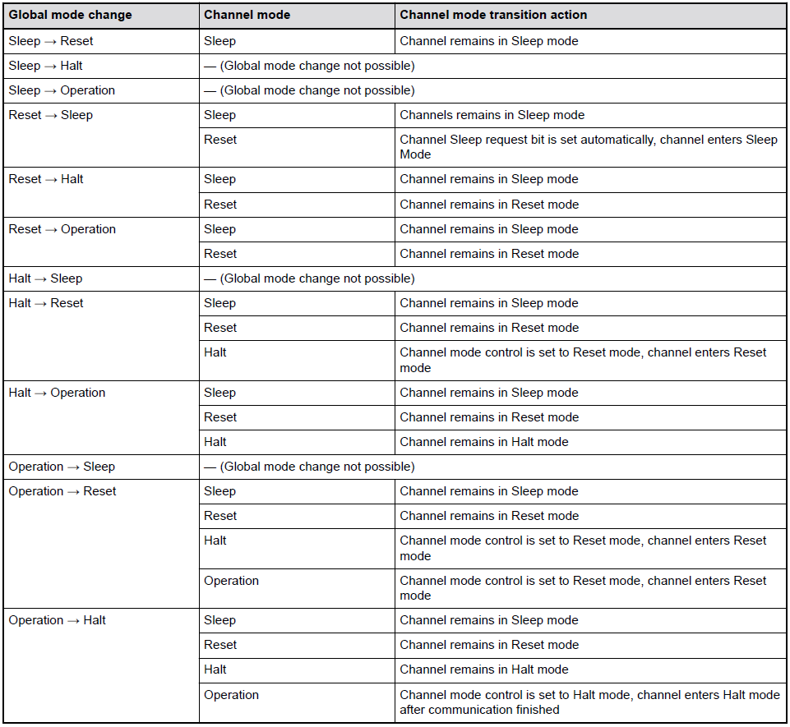
Modes of operation global mode and channel mode transition interactions
Table 6. Interaction between Global and Channel mode transition
The interaction between Global mode setting and Channel mode setting is as follows:
Changing the Channel Mode Control bit CFDCnCTR.CHMDC in the Channel Control Registers does not affect the Global Mode Control bit CFDGCTR.GMDC.
Changing the Global Mode Control bit CFDGCTR.GMDC affects the channel mode control as described in next Table 6.
[RA6M5 Group User’s Manual: Hardware, p1454-1470]

Slide 34
Can with flexible data – rate (can fd)
Register SUMMARY

Slide 35
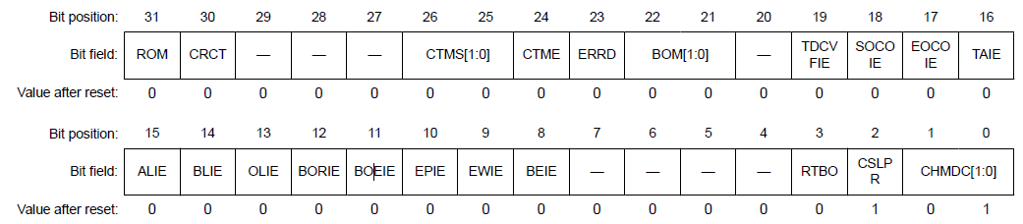
Register SUMMARY CHANNEL N CONTROL REGISTERS
Base address: CANFD = 0x400B_0000
Offset address: 0x0004 + 0x10 × n
Channel Test Mode Select R/W
0 0: Basic test mode
0 1: Listen-only mode
1 0: Self-test mode 0 (External loopback mode)
1 1: Self-test mode 1 (Internal loopback mode)
Channel Bus-Off Mode R/W
0 0: Normal mode (comply with ISO 11898-1)
0 1: Entry to Halt mode automatically at bus-off start
1 0: Entry to Halt mode automatically at bus-off end
1 1: Entry to Halt mode (during bus-off recovery period) by software
Channel Test Mode Enable
Channel Mode Control R/W
0 0: Channel operation mode request
0 1: Channel reset request
1 0: Channel halt request
1 1: Keep current value
[RA6M5 Group User’s Manual: Hardware, p1333-1338]

Slide 36
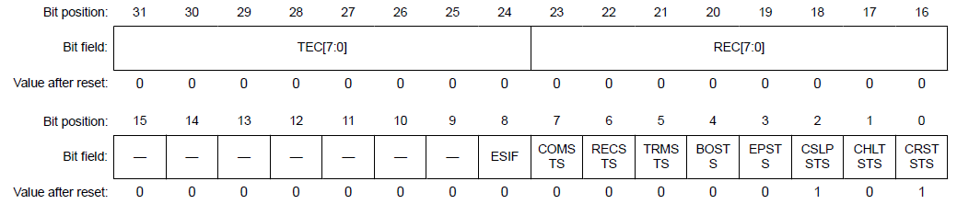
Register SUMMARY CHANNEL N STATUS REGISTERS
Base address: CANFD = 0x400B_0000
Offset address: 0x0008 + 0x10 × n
Transmission Error Count
These bits increment or decrement the counter value according to error status of the CAN channel during transmission.
Reception Error Count
These bits increment or decrement the counter value according to error status of the CAN channel during reception.
Error State Indication Flag
Channel Error Passive Status
Channel Communication Status
[RA6M5 Group User’s Manual: Hardware, p1338-1340]

Slide 37
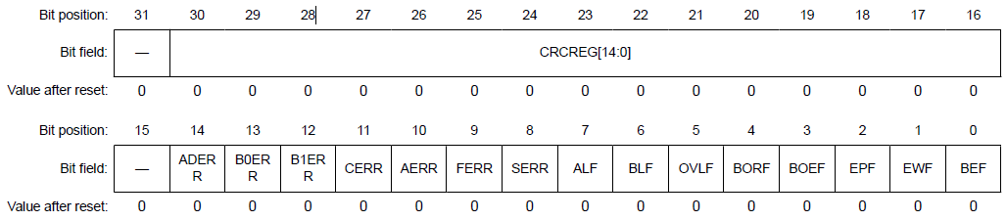
Register SUMMARY CHANNEL N ERROR FLAG REGISTERS
Base address: CANFD = 0x400B_0000
Offset address: 0x000C + 0x10 × n
CRC Register value
Acknowledge Delimiter Error
Overload Flag
Bus Error Flag
CRC Error
Arbitration Lost Flag
Error Passive Flag
[RA6M5 Group User’s Manual: Hardware, p1338-1340]

Slide 38
Can with flexible data – rate (can fd)
Hardware requirement

Slide 39
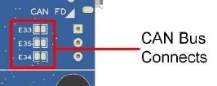
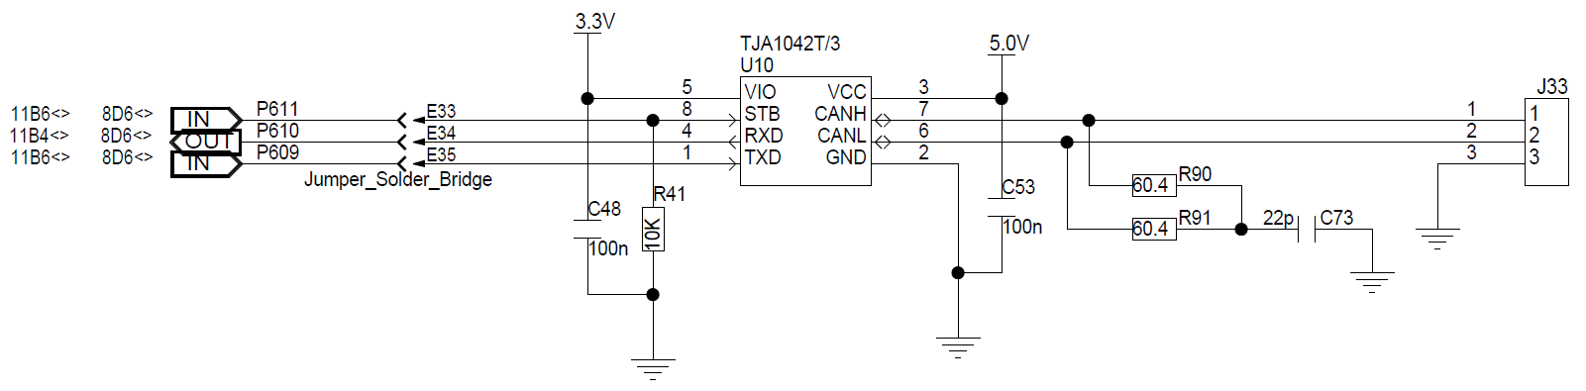
Hardware requirement can fd on ek-ra6m5 board
Short E33, E34 & E35 to use onboard CAN Transceivers.
J33 is Channel 1 of CAN-FD with P609 (CTX1) and P610 (RTX1).
CANH
CANL
GND

Slide 40
Can with flexible data – rate (can fd)
module configuration

Slide 41
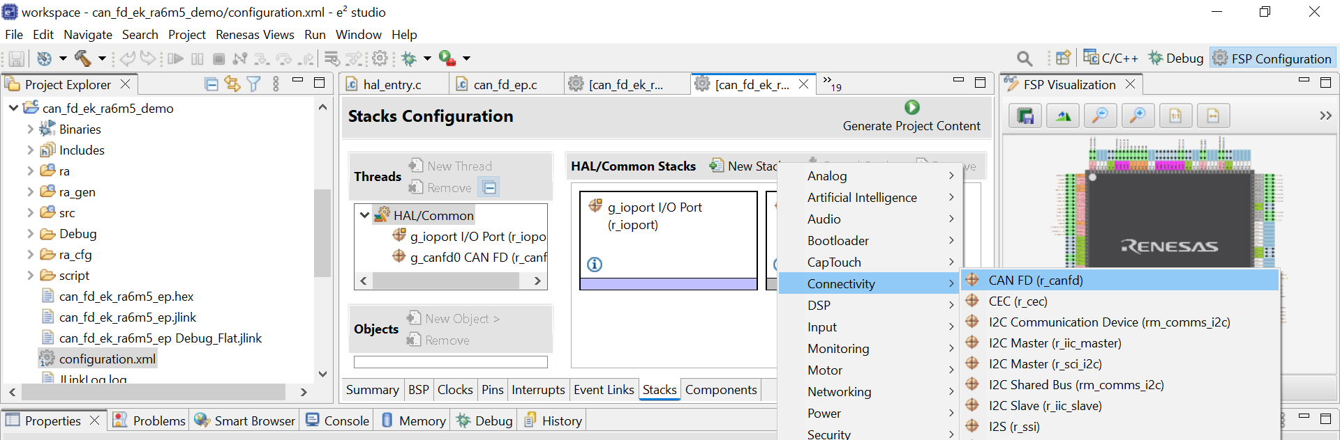
module configuration add new module can fd
Step 1: Stack Configurate. On project tree select:
Configuration.xml → tab Stacks → New Stack → Connectivity → CAN_FD (r_canfd)
3
4
5
1
2

Slide 42
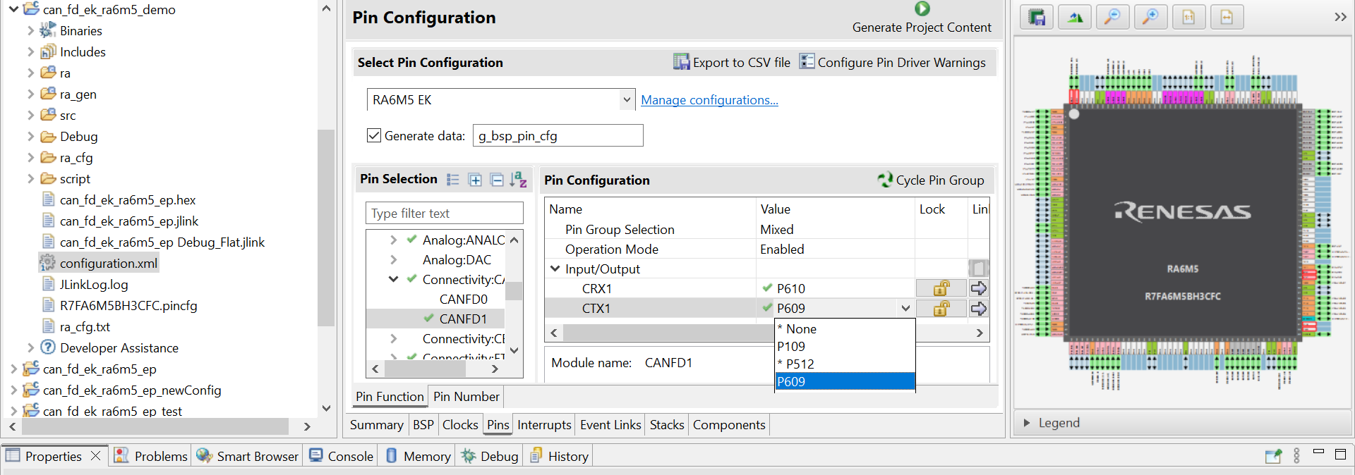
module configuration pin configuration
Step 2: Configurate pins. On configuration.xml file do:
Select Pins tab → Select channel in Connectivity: CANFD→ Enable channel → Select pins for CRXn and CTXn
3
2
4
1

Slide 43
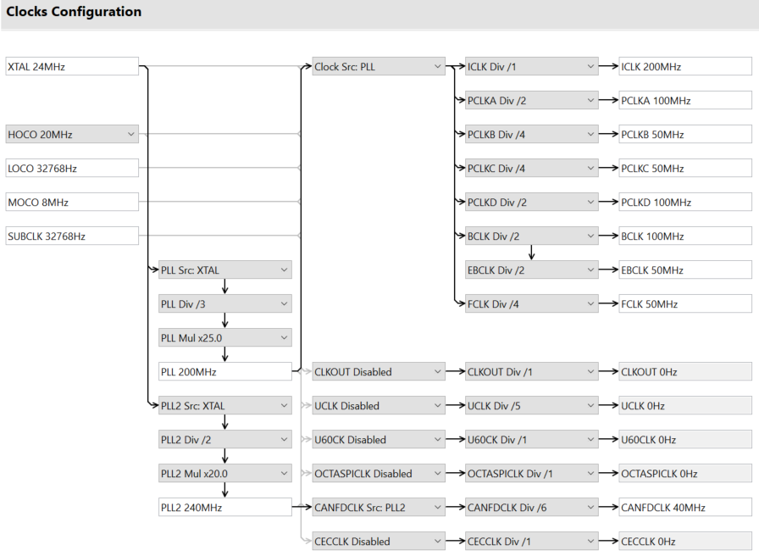

module configuration Set clock for ra6m5
Step 3: Configuration.xml → Select Clock tab → PLL2 Src is XTAL→ PLL2 Div/2→ PLL2 Mul x20.0 for PLL2 equal 240 MHz → Up to 40 MHz and division ratio: 1/2/4/6/8.
Either the CAN channel system clock (clean clock) or the external oscillator clock can be selected globally for all CAN
channels as CAN communication clock.

Slide 44
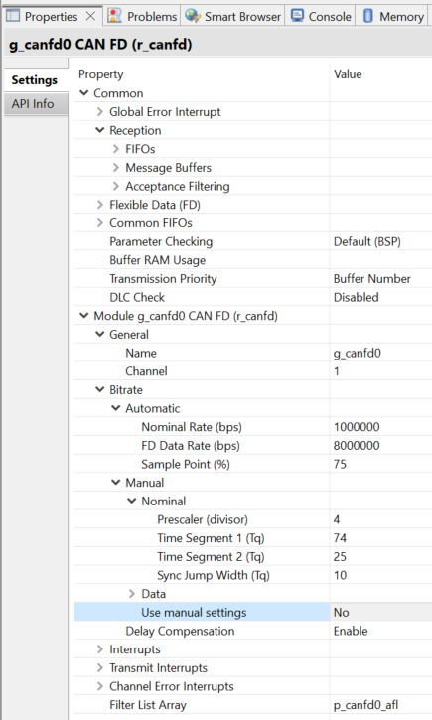
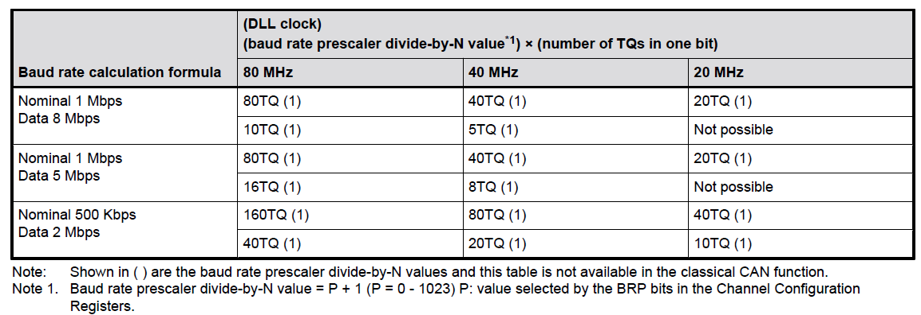
module configuration bitrate
Step 4: Configurate properties of CAN FD module.
Select Stacks tab → Select CAN FD Block→ Select Properties tab→ Check correct channel, correct bitrate in Automatic field if turn off Manual, otherwise need to calculate the required bit rate and its timing parameters based on the module input clock.
Table 7. Baud rate calculation example for nominal and data bit rate CAN communication configurations

Slide 45
Can with flexible data – rate (can fd)
api for can fd module

Slide 46
api for can fd module Acceptance filter list (afl)
Each Acceptance Filter List (AFL) entries shall use AFL structure is determined in this code.
Parameter can be specified:
- CAN FD filter ID.
- ID mode is either Standard or Extended ID.
- CAN FD mask ID.
- Mask ID mode.
- Minimum DLC value to accept (valid when DLC Check is enabled).
- RX Message Buffer to receive messages accepted by this rule.
const canfd_afl_entry_t p_canfd0_afl[CANFD_CFG_AFL_CH0_RULE_NUM] =
{
{ /* Accept all messages with Extended ID 0x1000-0x1FFF */
.id =
{
.id = CANFD_FILTER_ID,
.frame_type = CAN_FRAME_TYPE_DATA,
.id_mode = CAN_ID_MODE_EXTENDED
},
.mask =
{
.mask_id = MASK_ID,
.mask_frame_type = ZERO,
.mask_id_mode = MASK_ID_MODE
},
.destination =
{
.minimum_dlc = (canfd_minimum_dlc_t)ZERO,
.rx_buffer = CANFD_RX_MB_0,
.fifo_select_flags = CANFD_RX_FIFO_0,
}
},
};

Slide 47
api for can fd module using api
Table 8. R_CANFD API function
Function | Usage | Example
R_CANFD_Open() | Open and configure the CAN FD channel for operation. | err =R_CANFD_Open (&g_canfd0_ctrl, &g_canfd0_cfg);
R_CANFD_Close() | Close the CANFD channel.
R_CANFD_Write() | Write data to the CANFD channel. | err = R_CANFD_Write(&g_canfd0_ctrl, CANFD_TX_MB_0, &g_can_tx_frame); assert(FSP_SUCCESS == err);
R_CANFD_Read() | Read data from a CANFD Message Buffer or FIFO. | err = R_CANFD_Read(&g_canfd0_ctrl, ZERO, &g_canfd_rx_frame);
R_CANFD_ModeTransition() | Switch to a different channel, global or test mode. | err = R_CANFD_ModeTransition(&g_canfd0_ctrl, CAN_OPERATION_MODE_NORMAL, CAN_TEST_MODE_LOOPBACK_EXTERNAL); assert(FSP_SUCCESS == err);
R_CANFD_InfoGet() | Get CANFD state and status information for the channel. | err = R_CANFD_InfoGet(&g_canfd0_ctrl, &can_rx_info);
Link for more documentation:
RA Flexible Software Package Documentation: CAN FD (r_canfd) (renesas.github.io)

Slide 48
api for can fd module can transmit frame
In order to write data over Classical CAN frame or CAN FD frame, shall configurate frame parameter as below.
/* Update transmit classical CAN frame parameters */
g_canfd_tx_frame.id = 0x1002;
g_canfd_tx_frame.id_mode = CAN_ID_MODE_EXTENDED;
g_canfd_tx_frame.type = CAN_FRAME_TYPE_DATA;
g_canfd_tx_frame.data_length_code = CAN_CLASSIC_FRAME_DATA_BYTES;
g_canfd_tx_frame.options = ZERO;
Write Classical CAN frame
/* Update transmit CAN FD frame with Bit Rate Switch parameters */
g_canfd_tx_frame.id = 0x1001;
g_canfd_tx_frame.id_mode = CAN_ID_MODE_EXTENDED;
g_canfd_tx_frame.type = CAN_FRAME_TYPE_DATA;
g_canfd_tx_frame.data_length_code = CAN_CLASSIC_FRAME_DATA_BYTES;
g_canfd_tx_frame.options = CANFD_FRAME_OPTION_FD | CANFD_FRAME_OPTION_BRS;
Write CAN FD frame with Bit Rate Switch
/* Update transmit CAN FD frame without Bit Rate Switch parameters */
g_canfd_tx_frame.id = 0x1001;
g_canfd_tx_frame.id_mode = CAN_ID_MODE_EXTENDED;
g_canfd_tx_frame.type = CAN_FRAME_TYPE_DATA;
g_canfd_tx_frame.data_length_code = CAN_CLASSIC_FRAME_DATA_BYTES;
g_canfd_tx_frame.options = CANFD_FRAME_OPTION_FD;
Write CAN FD frame without Bit Rate Switch

Slide 49
Can with flexible data – rate (can fd)
Demonstrate operation

Slide 50
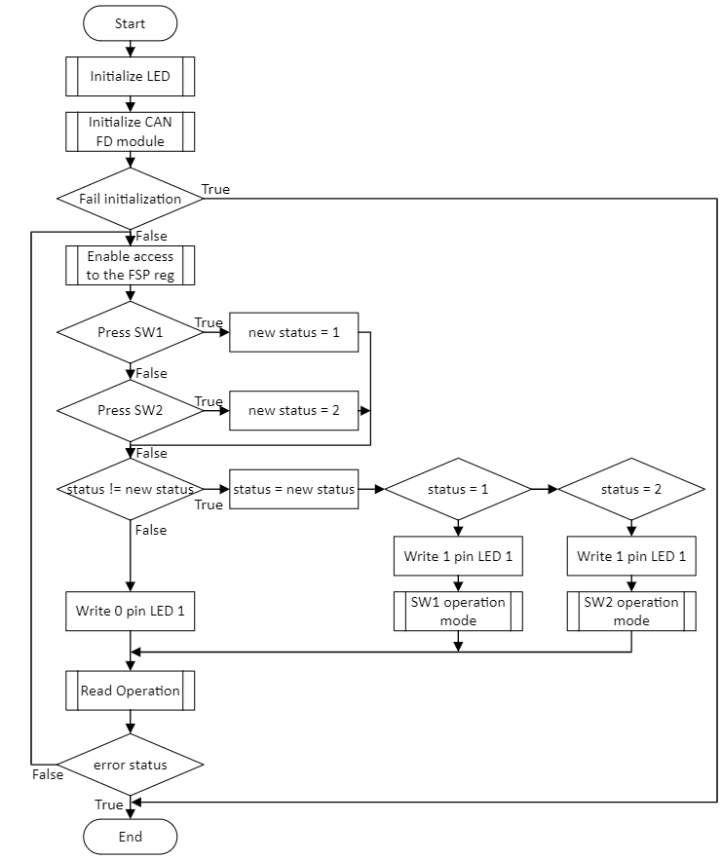
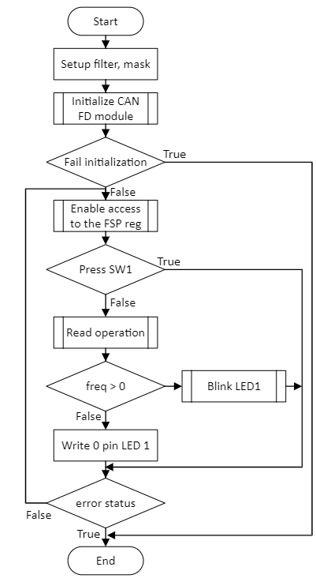
Demonstrate operation introduction
Read Operation
Transmission Process in RA6M5:
SW1: send ID 0x1001 data “5” over CAN FD Frame with BRS.
SW2: send ID 0x1002 data “1” with Classical CAN frame.
Transmission Process in RA4M3:
SW1: send ID 0x1004 data “3”.
SW2: send ID 0x1004 data “8”.
Reception Process:
Blink LED with received frequency.
Files · can_fd_ek_ra6m5_new_ep · RSS2 / ra-fsp · GitLab (renesas.com)
Files · can_fd_ek_ra4m3_new_ep · RSS2 / ra-fsp · GitLab (renesas.com)

Slide 51
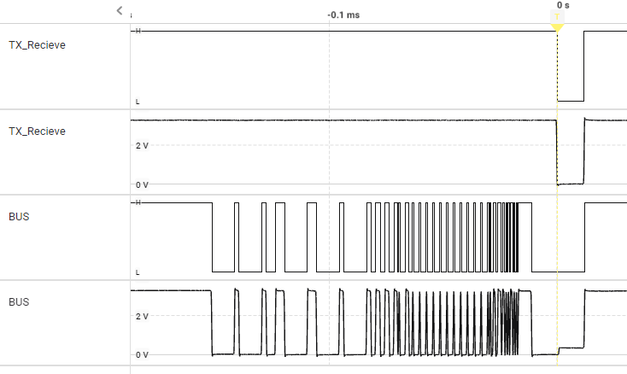
Demonstrate operation compatible between can and can fd
Press SW1
RA6M5
RA6M5
RA6M5
: CAN FD capable
LED Blink with 5 Hz
RA6M5
RA6M5
RA4M3
: only CAN 2.0
Press SW2
LED Blink with 1 Hz
Press SW1 or SW2
RA4M3
RA6M5
: Classical CAN frame
LED Blink with 3 Hz or 8 Hz
: CAN FD frame
Press SW2
RA6M5
RA4M3
LED Blink with 1 Hz
What happen when have one node which is CAN FD not-capable node and writing CAN FD frame to BUS?
CAN FD frame
Error frame
RA6M5
RA6M5
RA4M3

Slide 52
Renesas.com

