Slide 1

CONTROLLER AREA NETWORK (CAN) MODULE
RA FSP KNOWLEDGE SHARING REPORT
nov 14, 2023
Quan tran
SOFTWARE DEVELOPMENT Department
RA FSP GROUP
Renesas Electronics Corporation

Slide 2
Agenda
OVERVIEW Page 03
BASIC OPERATION Page 12
CAN IN FSP Page 32
Example project Page 41
REFERENCE Page 50

Slide 3

Overview

Slide 4
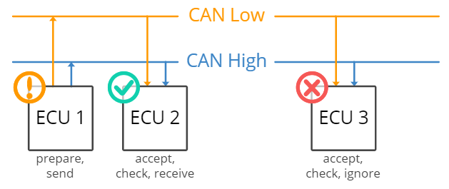
OVERVIEW CAN BUS SYSTEM
CAN Bus uses 2 wires to transmit data.

Slide 5
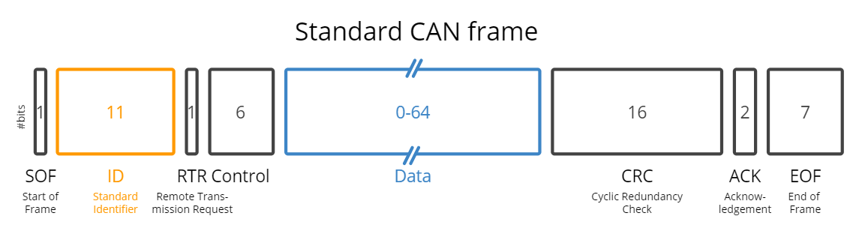
OVERVIEW ConCept
Communication over the CAN bus is done via CAN frames.
SOF: The Start of Frame is a 'dominant 0' to tell the other nodes that a CAN node intends to talk
ID: The ID is the frame identifier - lower values have higher priority
RTR: The Remote Transmission Request indicates whether a node sends data or requests dedicated data from another node
Control: The Control contains the Identifier Extension Bit (IDE) which is a 'dominant 0' for 11-bit. It also contains the 4 bits Data Length Code (DLC) that specifies the length of the data bytes to be transmitted (0 to 8 bytes)
Data: The Data contains the data bytes aka payload, which includes CAN signals that can be extracted and decoded for information
CRC: The Cyclic Redundancy Check is used to ensure data integrity
ACK: The ACK slot indicates if the node has acknowledged and received the data correctly
EOF: The EOF marks the end of the CAN frame

Slide 6
OVERVIEW can’s frame type
CAN allows for 04 different message types:
Data Frame: The frame carries data from the data transmitter to the data receivers. This frame has an area to carry bytes of data.
Remote Frame: The framework is transmitted from any one node to request data from another node. When that node receives the request, it will retransmit the data whose ID matches the sent ID.
Error Frame: The frame is transmitted from any node when that node detects an error from the bus.
Overflow Frame: When a node receives too much data and does not process it in time, it sends this framework so that other nodes do not transmit more data to it.

Slide 7
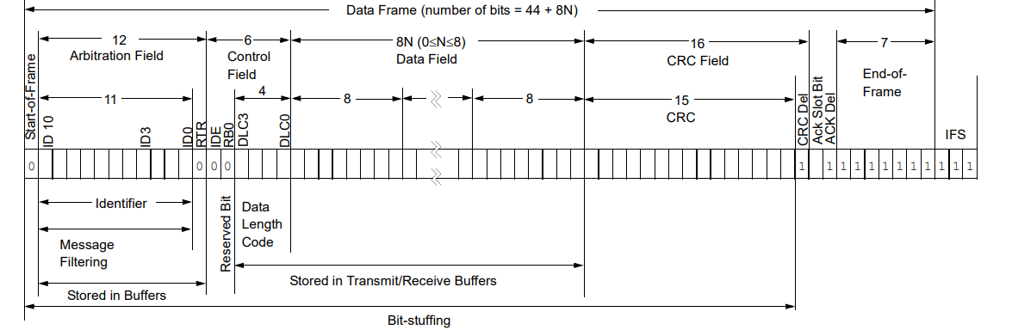
OVERVIEW STANDARD DATA FRAME (CAN2.0A)

Slide 8
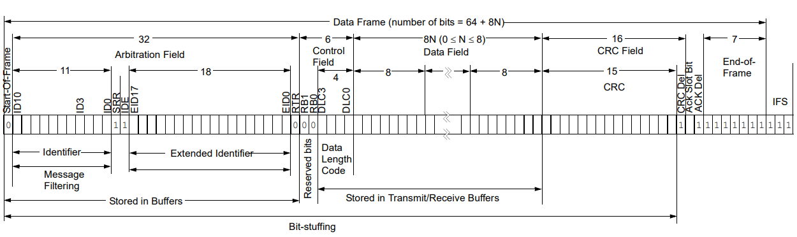
OVERVIEW EXTENDED DATA FRAME (CAN2.0B)

Slide 9
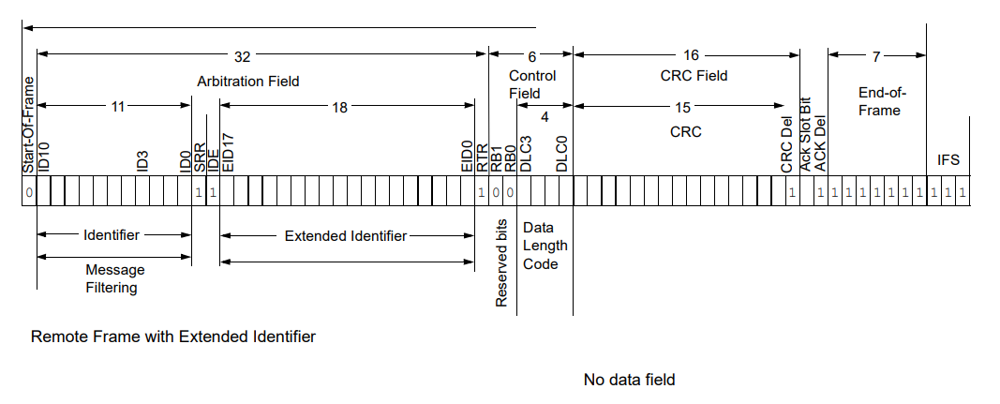
OVERVIEW REMOTE FRAME

Slide 10
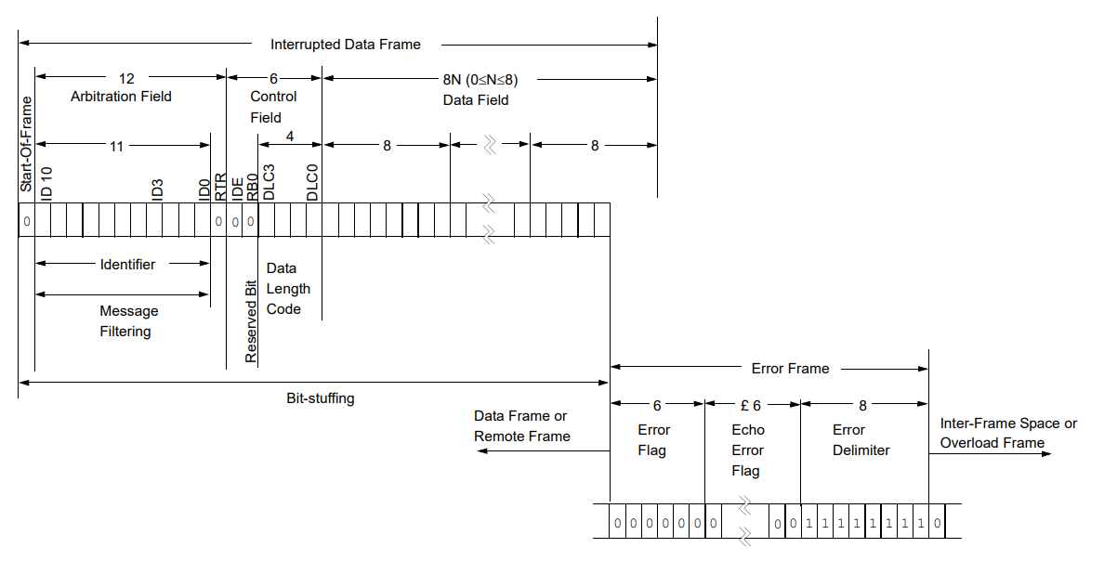
OVERVIEW ERROR FRAME

Slide 11
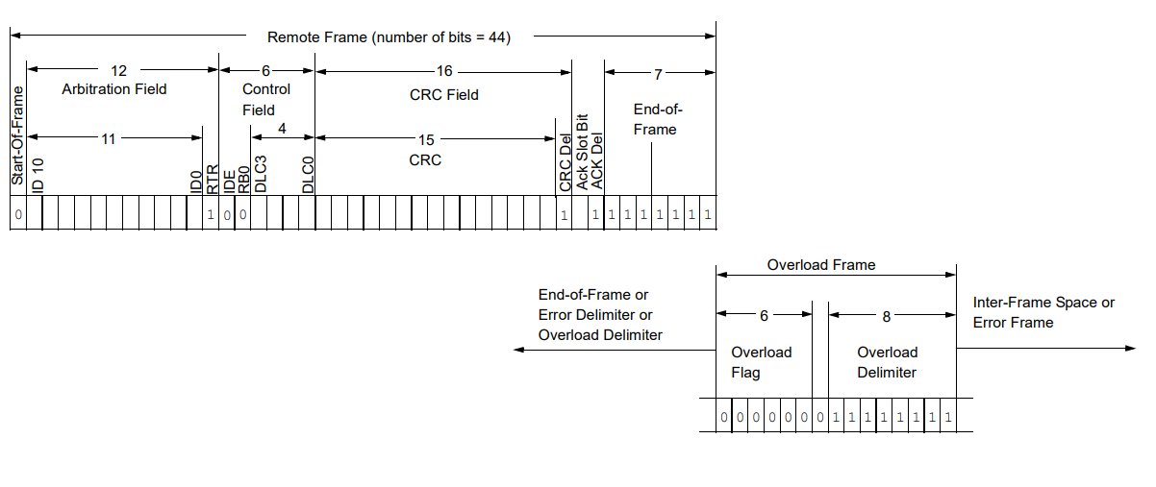
OVERVIEW OVERLOAD FRAME

Slide 12
BASIC OPERATION

Slide 13
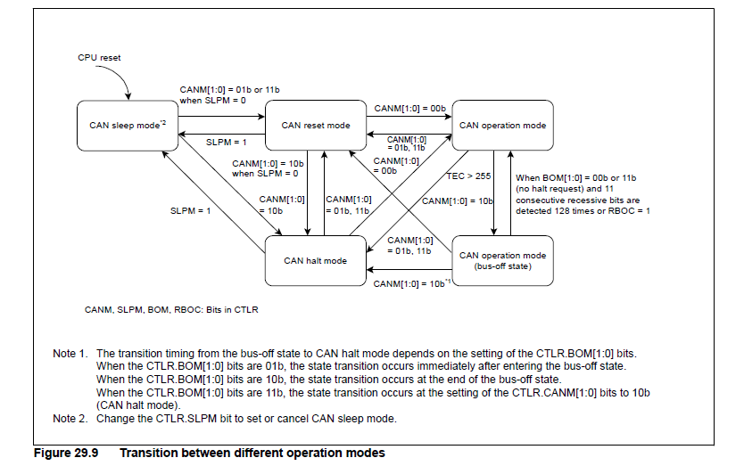
BASIC OPERATION CAN’S Operation mode
The CAN module operation includes the following modes:
CAN sleep mode
CAN reset mode
CAN halt mode
CAN operation mode
Notes:
The CAN module requires an additional external CAN transceiver.

Slide 14
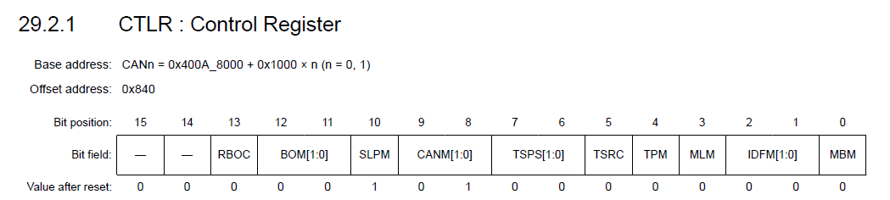
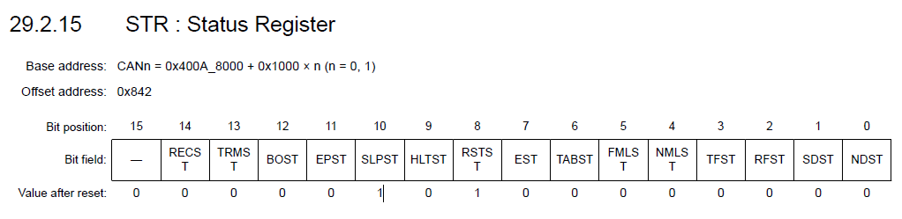


BASIC OPERATION CAN sleep mode
CAN sleep mode reduces power consumption by stopping the clock supply to the CAN module. After a reset from an MCU
pin or a software reset, the CAN module starts from CAN sleep mode.
When the SLPM bit in CTLR is set to 1, the CAN module enters CAN sleep mode, and the SLPST bit in STR is set to 1.
When the SLPM bit is set to 0, the CAN module is released from CAN sleep mode. When the CAN module exits CAN
sleep mode, the other registers remain unchanged.
Notes:
The CAN module requires an additional external CAN transceiver.

Slide 15

BASIC OPERATION CAN HALT MODE AND CAN RESET MODE
CAN reset mode is provided for CAN communication configuration. When the CTLR.CANM[1:0] bits are set to 01b or
11b, the CAN module enters CAN reset mode.
CAN halt mode is used for mailbox configuration and test mode setting.
When the CTLR.CANM[1:0] bits are set to 10b, CAN halt mode is selected, and the STR.HLTST bit is set to 1. Do not
change the CTLR.CANM[1:0] bits until the HLTST bit is 1.
Notes:
The CAN module requires an additional external CAN transceiver.

Slide 16
BASIC OPERATION CAN HALT MODE AND CAN RESET MODE
The following registers are initialized to their reset values after entering CAN reset mode, and their initial values are saved during CAN reset mode:
Register | Base address | Offset address | Number of bit | Description | Refer
MCTL_TX[j] | 0x400A_8000 | 0x820 | 8 | MCTL_TX[j] sets mailbox j to transmit mode or receive mode. In transmit mode, MCTL_TX[j] also controls and indicates the transmission status | 29.2.9 MCTL_TX[j] : Message Control Register for Transmit (RA4M3 Group User's Manual: Hardware (renesas.com))
MCTL_RX[j] | 0x400A_8000 | 0x820 | 8 | MCTL_RX[j] sets mailbox j to transmit or receive mode. In receive mode, MCTL_RX[j] also controls and indicates the reception status. | 29.2.10 MCTL_RX[j] : Message Control Register for Receive (RA4M3 Group User's Manual: Hardware (renesas.com))
STR (except for the SLPST and TFST bits) | 0x400A_8000 | 0x842 | 16 | The STR register show the status of other register | 29.2.15 STR: Status Register (RA4M3 Group User's Manual: Hardware (renesas.com))
EIFR | 0x400A_8000 | 0x84D | 8 | If an event associated with an EIFR flag occurs, the associated bit in EIFR is set to 1, regardless of the setting of EIER. | 29.2.21 EIFR : Error Interrupt Factor Judge Register (RA4M3 Group User's Manual: Hardware (renesas.com))
RECR | 0x400A_8000 | 0x84E | 8 | RECR indicates the value of the receive error counter. See the CAN specification (ISO11898-1) for information on the increment and decrement conditions of the receive error counter. | 29.2.22 RECR : Receive Error Count Register (RA4M3 Group User's Manual: Hardware (renesas.com))
TECR | 0x400A_8000 | 0x84F | 8 | TECR indicates the value of the transmit error counter. See the CAN specification (ISO11898-1) for information on the increment and decrement conditions of the transmit error counter. | 29.2.22 TECR : Transmit Error Count Register (RA4M3 Group User's Manual: Hardware (renesas.com))
TSR | 0x400A_8000 | 0x854 | 16 | The TSR register returns the current value of the 16-bit free-running time stamp counter | 29.2.25 TSR : Time Stamp Register (RA4M3 Group User's Manual: Hardware (renesas.com))
Notes:
The CAN module requires an additional external CAN transceiver.

Slide 17
BASIC OPERATION CAN HALT MODE AND CAN RESET MODE
The following registers are initialized to their reset values after entering CAN reset mode, and their initial values are saved during CAN reset mode:
Register | Base address | Offset address | Number of bit | Description | Refer
MSSR | 0x400A_8000 | 0x852 | 8 | MSSR is to search result mailbox number status | 29.2.17 MSSR : Mailbox Search Status Register (RA4M3 Group User's Manual: Hardware (renesas.com))
MSMR | 0x400A_8000 | 0x853 | 8 | The MSMR register select the search mode for the mailbox search function. | 29.2.16 MSMR : Mailbox Search Mode Register (RA4M3 Group User's Manual: Hardware (renesas.com))
RFCR | 0x400A_8000 | 0x848 | 8 | The RFCR register enable/disable the FIFO reception mailbox, read the status of unread mailboxes and FIFO flags. | 29.2.11 RFCR : Receive FIFO Control Register (RA4M3 Group User's Manual: Hardware (renesas.com))
TFCR | 0x400A_8000 | 0x84A | 8 | The TFCR register enable/disable the FIFO transmit mailbox, read the status of full/empty mailboxes and FIFO sent messages | 29.2.13 TFCR : Transmit FIFO Control Register (RA4M3 Group User's Manual: Hardware (renesas.com))
TCR | 0x400A_8000 | 0x858 | 8 | TCR controls the CAN test mode. | 29.2.26 TCR : Test Control Register (RA4M3 Group User's Manual: Hardware (renesas.com))
ECSR | 0x400A_8000 | 0x850 | 8 | ECSR indicates whether an error occurs on the CAN bus. See the CAN specification (ISO11898-1) for the conditions when each error occurs. | 29.2.24 ECSR : Error Code Store Register (RA4M3 Group User's Manual: Hardware (renesas.com))
Notes:
The CAN module requires an additional external CAN transceiver.

Slide 18
BASIC OPERATION CAN HALT MODE AND CAN RESET MODE
The following registers retain their previous values even after entering CAN reset mode:
Register | Base address | Offset address | Number of bit | Description | Refer
CTRL | 0x400A_8000 | 0x840 | 16 | Control register | 29.2.1 CTLR : Control Register (RA4M3 Group User's Manual: Hardware (renesas.com))
STR (only the SLPST and TFST bits) | 0x400A_8000 | 0x853 | 16 | The STR register show the status of other register | 29.2.15 STR : Status Register (RA4M3 Group User's Manual: Hardware (renesas.com))
MIER | 0x400A_8000 | 0x42C | 32 | MIER can enable interrupts for each mailbox independently. This register is available in normal mailbox mode. Do not access this register in FIFO mailbox mode. | 29.2.7 MIER : Mailbox Interrupt Enable Register (RA4M3 Group User's Manual: Hardware (renesas.com))
MIER_FIFO | 0x400A_8000 | 0x42C | 32 | MIER_FIFO can independently enable interrupts for each mailbox and FIFO. This register is available in FIFO mailbox mode. Do not access it in normal mailbox mode. | 29.2.8 MIER_FIFO : Mailbox Interrupt Enable Register for FIFO Mailbox Mode (RA4M3 Group User's Manual: Hardware (renesas.com))
EIER | 0x400A_8000 | 0x84C | 8 | The EIER register enables or disables each error interrupt source independently in EIFR. Write to EIER in CAN reset mode.. | 29.2.20 EIER : Error Interrupt Enable Register (RA4M3 Group User's Manual: Hardware (renesas.com))
BCR | 0x400A_8000 | 0x844 | 32 | For details about setting the bit timing, see section 29.4. Data Transfer Rate Configuration. Set BCR before entering CAN halt or CAN operation mode from CAN reset mode. | 29.2.2 BCR : Bit Configuration Register (RA4M3 Group User's Manual: Hardware (renesas.com))
Notes:
The CAN module requires an additional external CAN transceiver.

Slide 19
BASIC OPERATION CAN HALT MODE AND CAN RESET MODE
The following registers retain their previous values even after entering CAN reset mode:
Register | Base address | Offset address | Number of bit | Description | Refer
CSSR | 0x400A_8000 | 0x851 | 8 | Control register | 29.2.18 CSSR : Channel Search Support Register (RA4M3 Group User's Manual: Hardware (renesas.com))
ECSR (only the EDPM bit) | 0x400A_8000 | 0x850 | 8 | ECSR indicates whether an error occurs on the CAN bus. See the CAN specification (ISO11898-1) for the conditions when each error occurs. | 29.2.24 ECSR : Error Code Store Register (RA4M3 Group User's Manual: Hardware (renesas.com))
MBj_ID | 0x400A_8000 | 0x200 + 0x10 × j | 32 | MBj_ID register contain information of the frame’s ID and the RTR bit with IDE bit | 29.2.6.1 MBj_ID : Mailbox ID Register j (j = 0 to 31) (RA4M3 Group User's Manual: Hardware (renesas.com))
MBj_DL | 0x400A_8000 | 0x204 + 0x10 × j | 16 | MBj_DL register contain information of the frame’s DLC | 29.2.6.2 MBj_DL : Mailbox Data Length Register j (j = 0 to 31) (RA4M3 Group User's Manual: Hardware (renesas.com))
MBj_Dm | 0x400A_8000 | (0x206 + m) + 0x10 × j | 8 | MBj_Dm register contain information of the frame’s data field | 29.2.6.3 MBj_Dm : Mailbox Data Register j (j = 0 to 31, m = 0 to 7) (RA4M3 Group User's Manual: Hardware (renesas.com))
MBj_TS | 0x400A_8000 | 0x20E + 0x10 × j | 16 | The MBj_TS store the counter value of the time stamp when received messages are stored in the mailbox. | 29.2.6.4 MBj_TS : Mailbox Time Stamp Register j (j = 0 to 31) (RA4M3 Group User's Manual: Hardware (renesas.com))
Notes:
The CAN module requires an additional external CAN transceiver.

Slide 20
BASIC OPERATION CAN HALT MODE AND CAN RESET MODE
The following registers retain their previous values even after entering CAN reset mode:
Register | Base address | Offset address | Number of bit | Description | Refer
MKR[k] | 0x400A_8000 | 0x400 + 0x04 × k | 32 | Enabling to compare with EID or SID | 29.2.3 MKR[k] : Mask Register k (k = 0 to 7) (RA4M3 Group User's Manual: Hardware (renesas.com))
FIDCR0 and FIDCR1 | 0x400A_8000 | 0x420 + 0x04 × k | 32 | FIDCR0 and FIDCR1 are enabled when the MBM bit in CTLR is set to 1 (FIFO mailbox mode). In this mode, the EID[17:0], SID[10:0], RTR, and IDE bits in mailboxes 28 to 31 are disabled. For information on using FIDCR0 and FIDCR1, see section 29.6. Acceptance Filtering and Masking Functions. | 29.2.4 FIDCRk : FIFO Received ID Compare Register k (k = 0, 1) (RA4M3 Group User's Manual: Hardware (renesas.com))
MKILVR | 0x400A_8000 | 0x200 + 0x10 × j | 32 | When a mask invalid bit is set to 1, a message is received by the associated mailbox only if the receive message ID matches the mailbox ID exactly. | 29.2.5 MKIVLR : Mask Invalid Register (RA4M3 Group User's Manual: Hardware (renesas.com))
AFSR | 0x400A_8000 | 0x204 + 0x10 × j | 16 | In the data table, all standard IDs that are created are set as valid or invalid in bit units. When AFSR is written with data in 16-bit units a decoded row (byte offset) position and column (bit) position for data table search can be read. The ASU can be used for standard (11-bit) IDs only. | 29.2.19 AFSR : Acceptance Filter Support Register (RA4M3 Group User's Manual: Hardware (renesas.com))
RFPCR | 0x400A_8000 | (0x206 + m) + 0x10 × j | 8 | When the receive FIFO is not empty, write 0xFF to RFPCR through software to increment the CPU pointer to the next mailbox location. | 29.2.12 RFPCR : Receive FIFO Pointer Control Register (RA4M3 Group User's Manual: Hardware (renesas.com))
TFPCR | 0x400A_8000 | 0x20E + 0x10 × j | 16 | When the transmit FIFO is not full, write 0xFF to TFPCR through software to increment the CPU pointer for the transmit FIFO to the next mailbox location. | 29.2.14 TFPCR : Transmit FIFO Pointer Control Register (RA4M3 Group User's Manual: Hardware (renesas.com))
Notes:
The CAN module requires an additional external CAN transceiver.

Slide 21
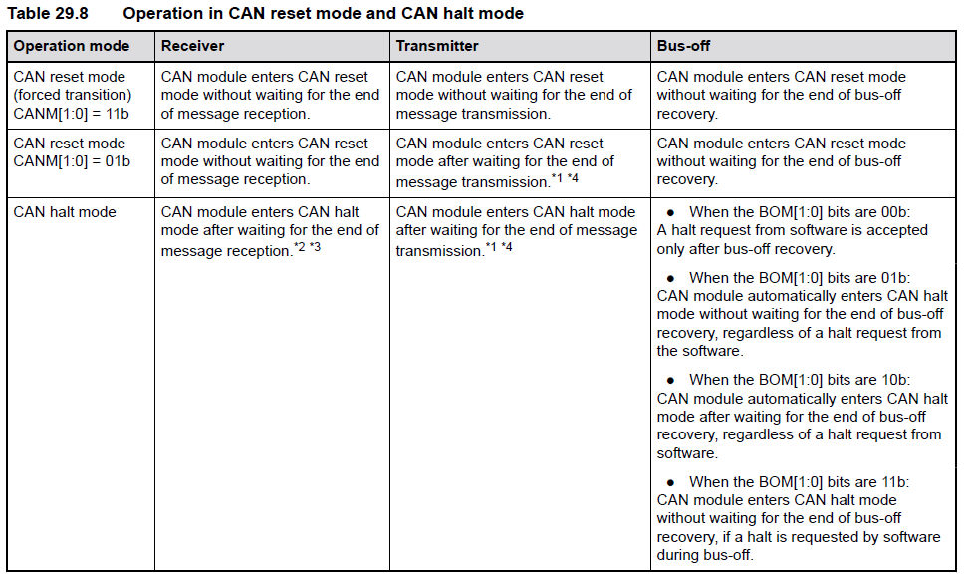
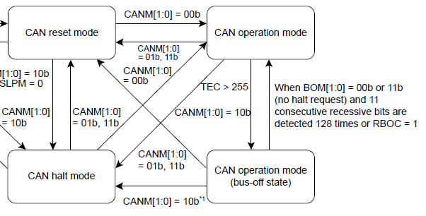

BASIC OPERATION CAN HALT MODE AND CAN RESET MODE
Notes:
The CAN module requires an additional external CAN transceiver.

Slide 22
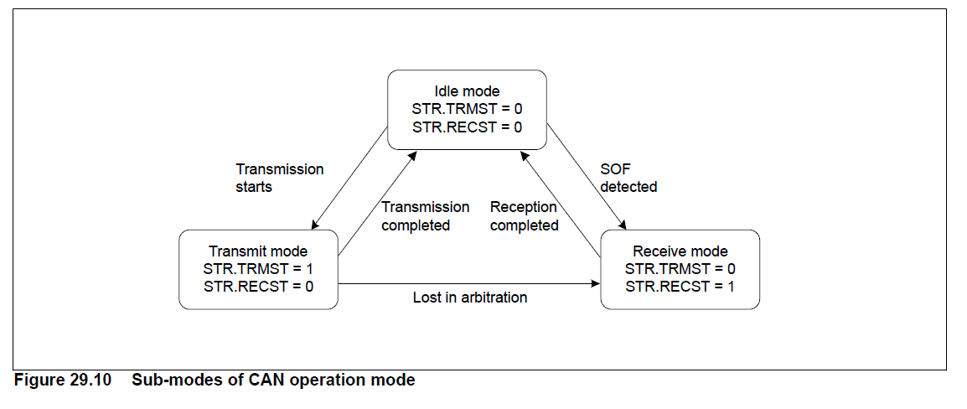
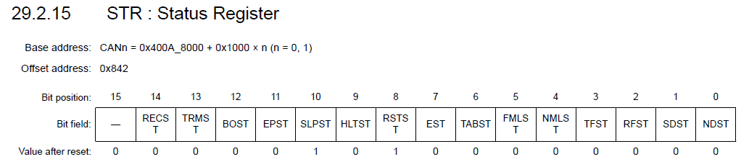

BASIC OPERATION CAN Operation mode
During CAN operation mode, the CAN module might be in one of the following three sub-modes, depending on the status of the CAN bus:
Idle mode: No transmission or reception occurs.
Receive mode: A CAN message sent by another node is being received.
Transmit mode: A CAN message is being transmitted. The CAN module receives a message transmitted by the local node simultaneously when self-test mode 0 (TSTM[1:0] bits in TCR = 10b) or self-test mode 1 (TSTM[1:0] bits = 11b) is selected.
Notes:
The CAN module requires an additional external CAN transceiver.

Slide 23
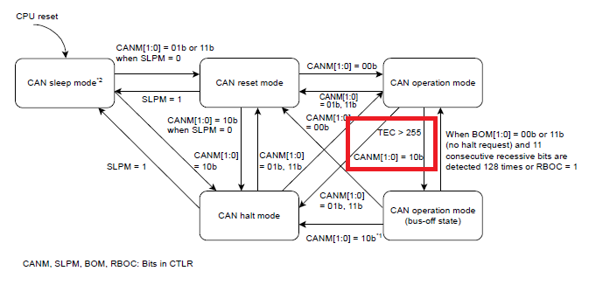
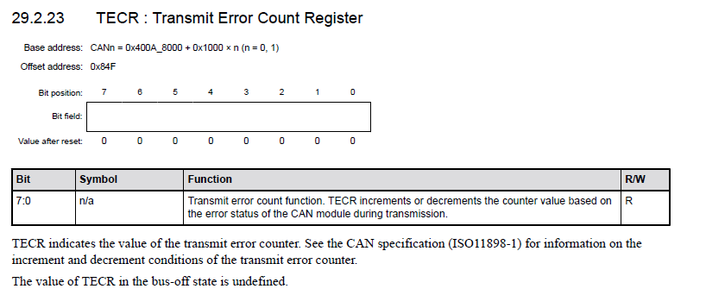
BASIC OPERATION CAN Operation mode (BUS OFF STATE)
The CAN module enter the bus-off state based on the incrementing or decrementing rules for the transmit and error counters defined in the CAN specifications.
Notes:
The CAN module requires an additional external CAN transceiver.

Slide 24
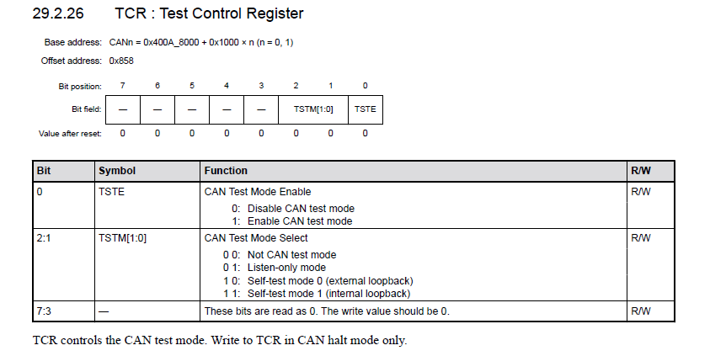
BASIC OPERATION CAN TEST MODE
Notes:
The CAN module requires an additional external CAN transceiver.

Slide 25
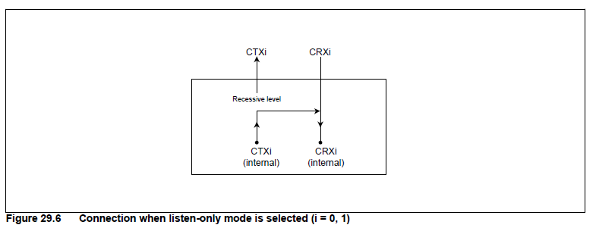
BASIC OPERATION CAN TEST MODE
1. Listen-only mode
The CAN specification (ISO11898-1) recommends an optional bus monitoring mode. In listen-only mode, valid data frames
and valid remote frames can be received. However, only recessive bits can be sent on the CAN bus. The ACK bit, overload
flag, and active error flag cannot be sent.
Notes:
The CAN module requires an additional external CAN transceiver.

Slide 26
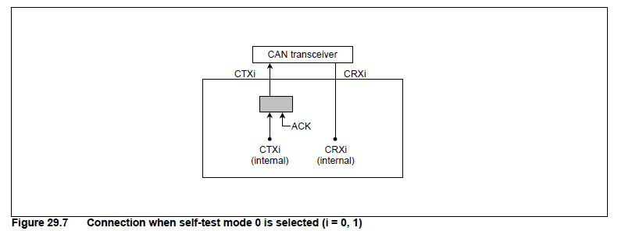
BASIC OPERATION CAN TEST MODE
2. Self-test mode 0 (external loopback)
Self-test mode 0 is provided for CAN transceiver tests. In this mode, the protocol module treats its own transmitted messages as those received by the CAN transceiver and stores them into the receive mailbox. To be independent from external stimulation, the protocol module generates the ACK bit. Connect the CTXi and CRXi pins to the transceiver.
Notes:
The CAN module requires an additional external CAN transceiver.

Slide 27
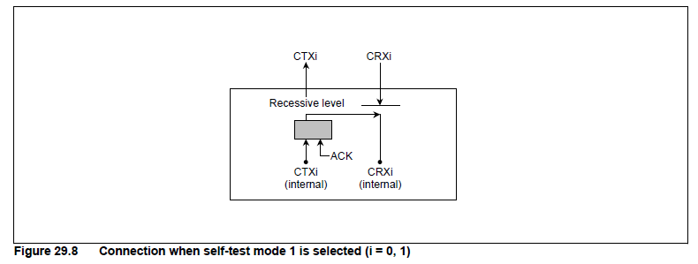
BASIC OPERATION CAN TEST MODE
3. Self-test mode 1 (internal loopback)
Self-test mode 1 is provided for self-test functions. In this mode, the protocol controller treats its transmitted messages as received messages and stores them into the receive mailbox. To be independent from external stimulation, the protocol
controller generates the ACK bit.
In self-test mode 1, the protocol controller performs an internal feedback from the internal CTXi pin to the internal CRXi
pin. The input value of the external CRXi pin is ignored. The external CTXi pin outputs only recessive bits. The CTXi and
CRXi pins are not required to be connected to the CAN bus or any external device.
Notes:
The CAN module requires an additional external CAN transceiver.

Slide 28
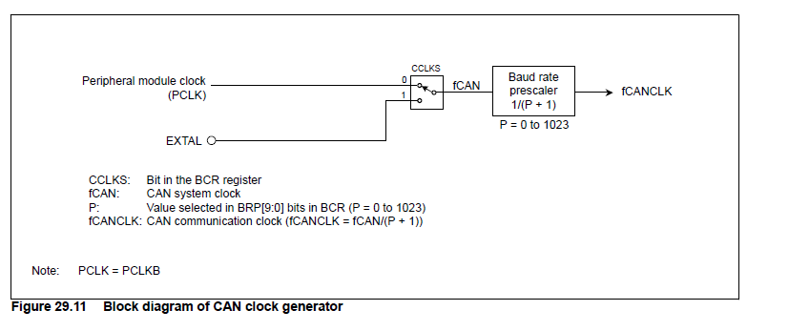
BASIC OPERATION Configure data transfer rate
Notes:
The CAN module requires an additional external CAN transceiver.

Slide 29

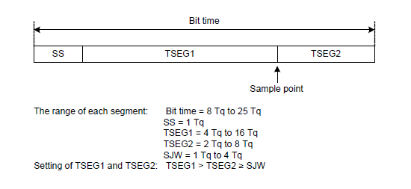
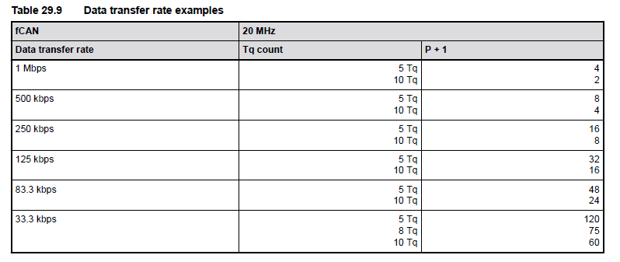
BASIC OPERATION Configure data transfer rate
Calculate bitrate to config using this formula:
Notes:
The CAN module requires an additional external CAN transceiver.

Slide 30
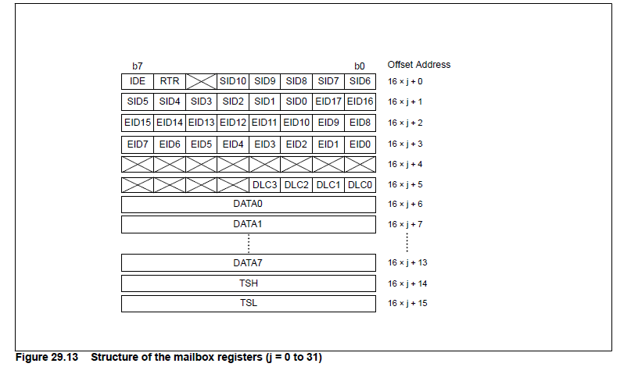
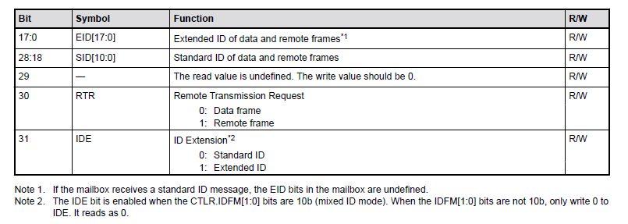
BASIC OPERATION mailbox and mask register structure
Notes:
The CAN module requires an additional external CAN transceiver.

Slide 31
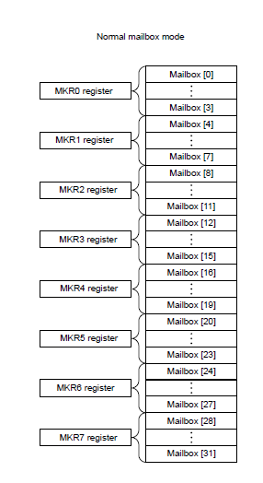
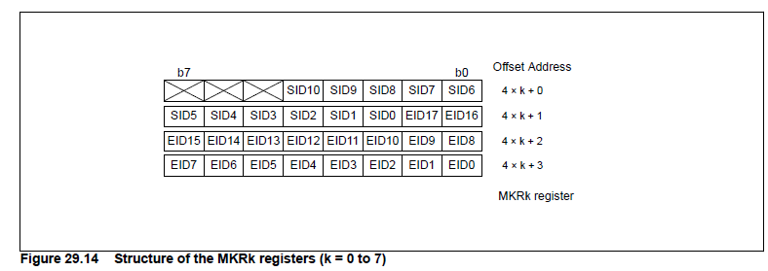
BASIC OPERATION mailbox and mask register structure
Notes:
The CAN module requires an additional external CAN transceiver.

Slide 32
CAN IN FSP

Slide 33
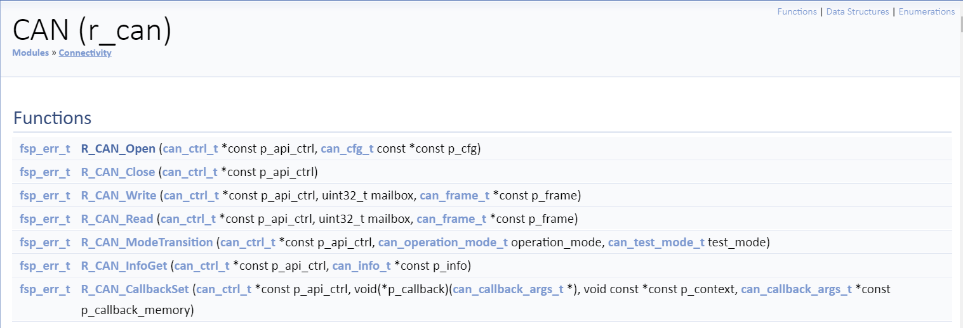
CAN in FSP CAN API

Slide 34
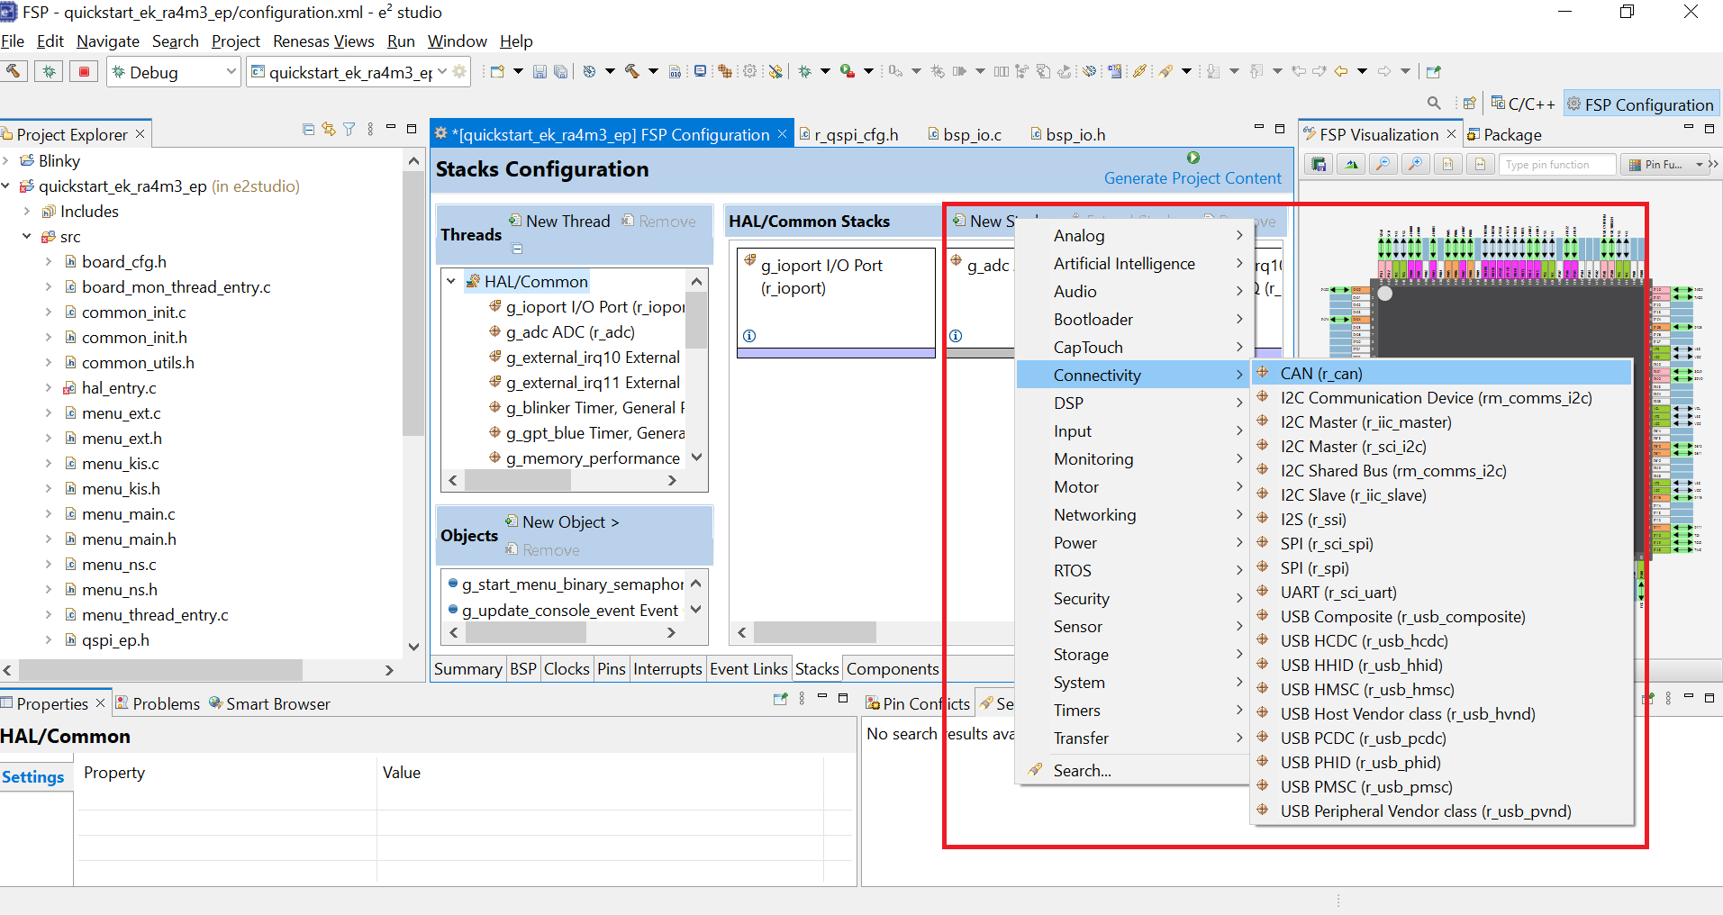
CAN in FSP CAN on e2studio
Notes:
The CAN module requires an additional external CAN transceiver.

Slide 35
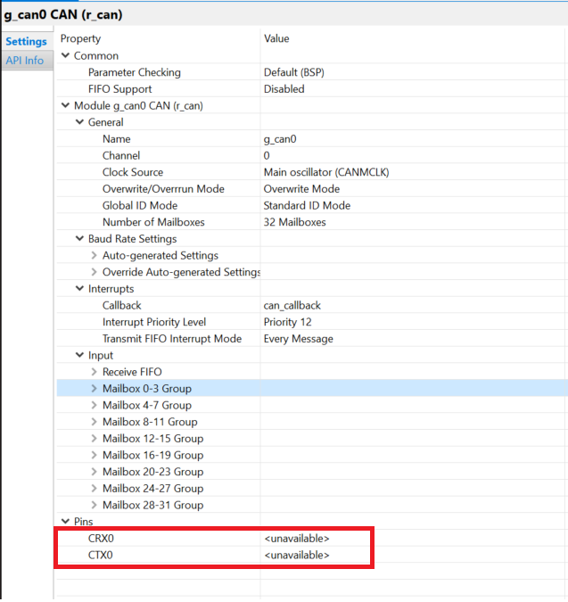
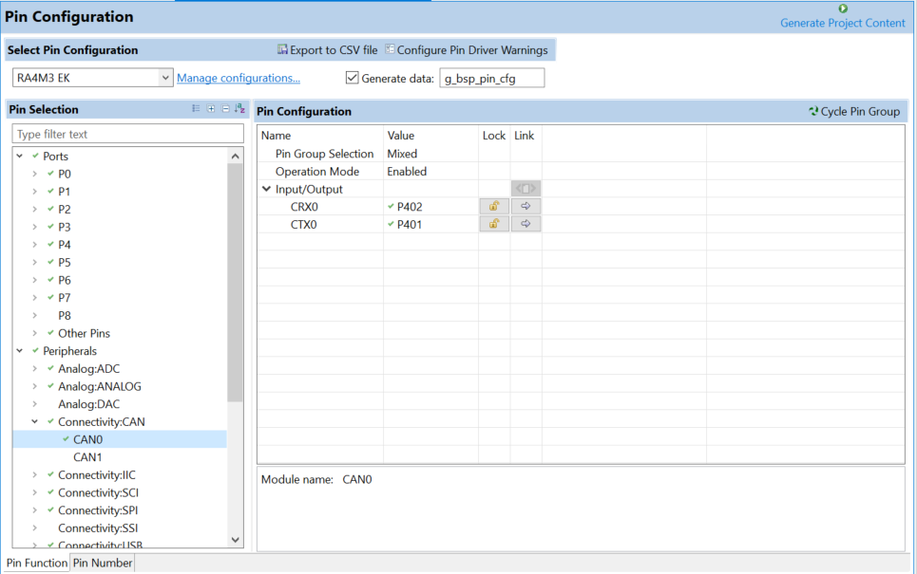
CAN in FSP CAN on e2studio
Notes:
The CAN module requires an additional external CAN transceiver.

Slide 36
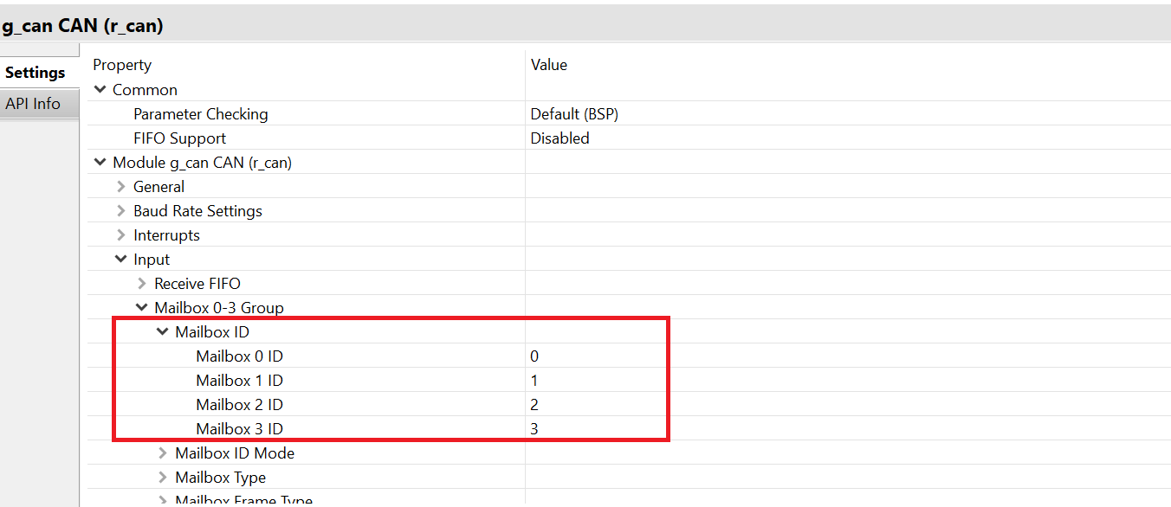
CAN in FSP CAN on e2studio
Notes:
The CAN module requires an additional external CAN transceiver.

Slide 37
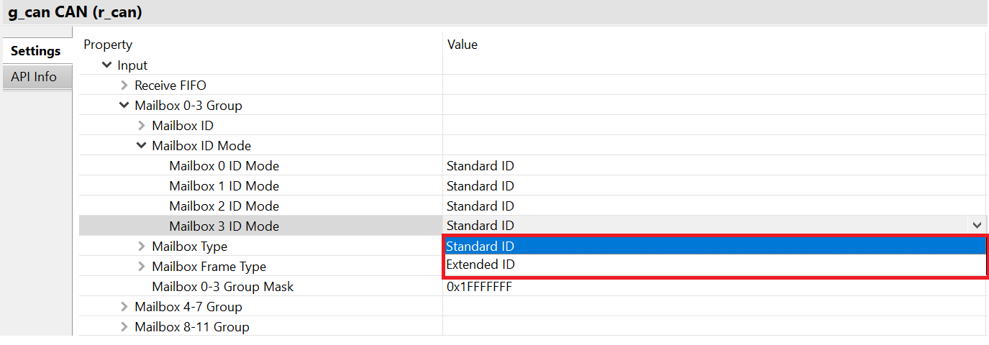
CAN in FSP CAN on e2studio
Notes:
The CAN module requires an additional external CAN transceiver.

Slide 38
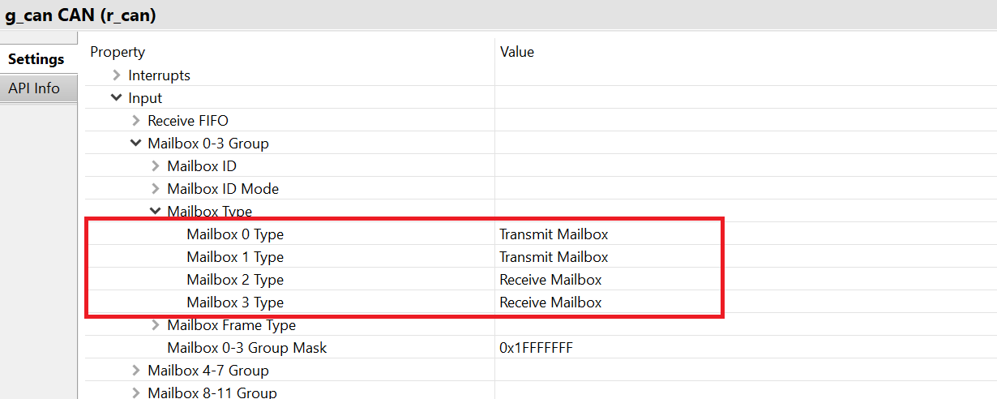
CAN in FSP CAN on e2studio
Notes:
The CAN module requires an additional external CAN transceiver.

Slide 39
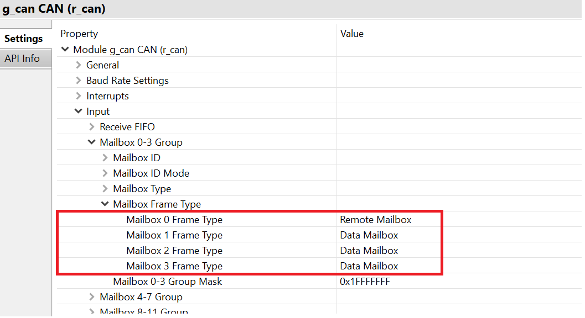
CAN in FSP CAN on e2studio
Notes:
The CAN module requires an additional external CAN transceiver.

Slide 40
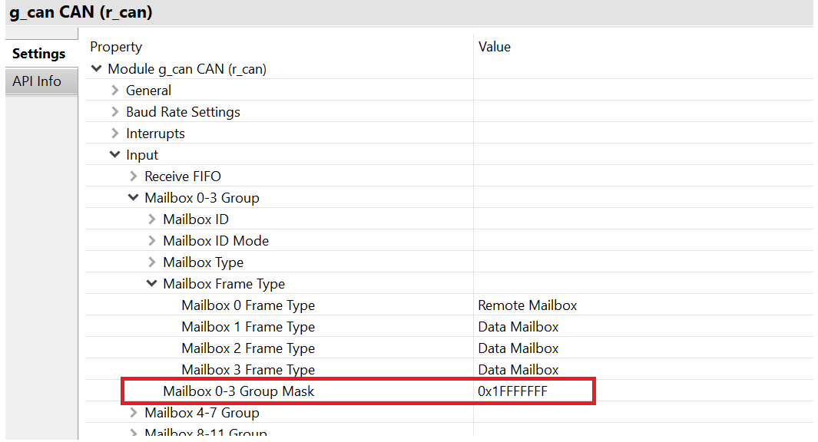
CAN in FSP CAN on e2studio
Notes:
The CAN module requires an additional external CAN transceiver.

Slide 41
Example project

Slide 42
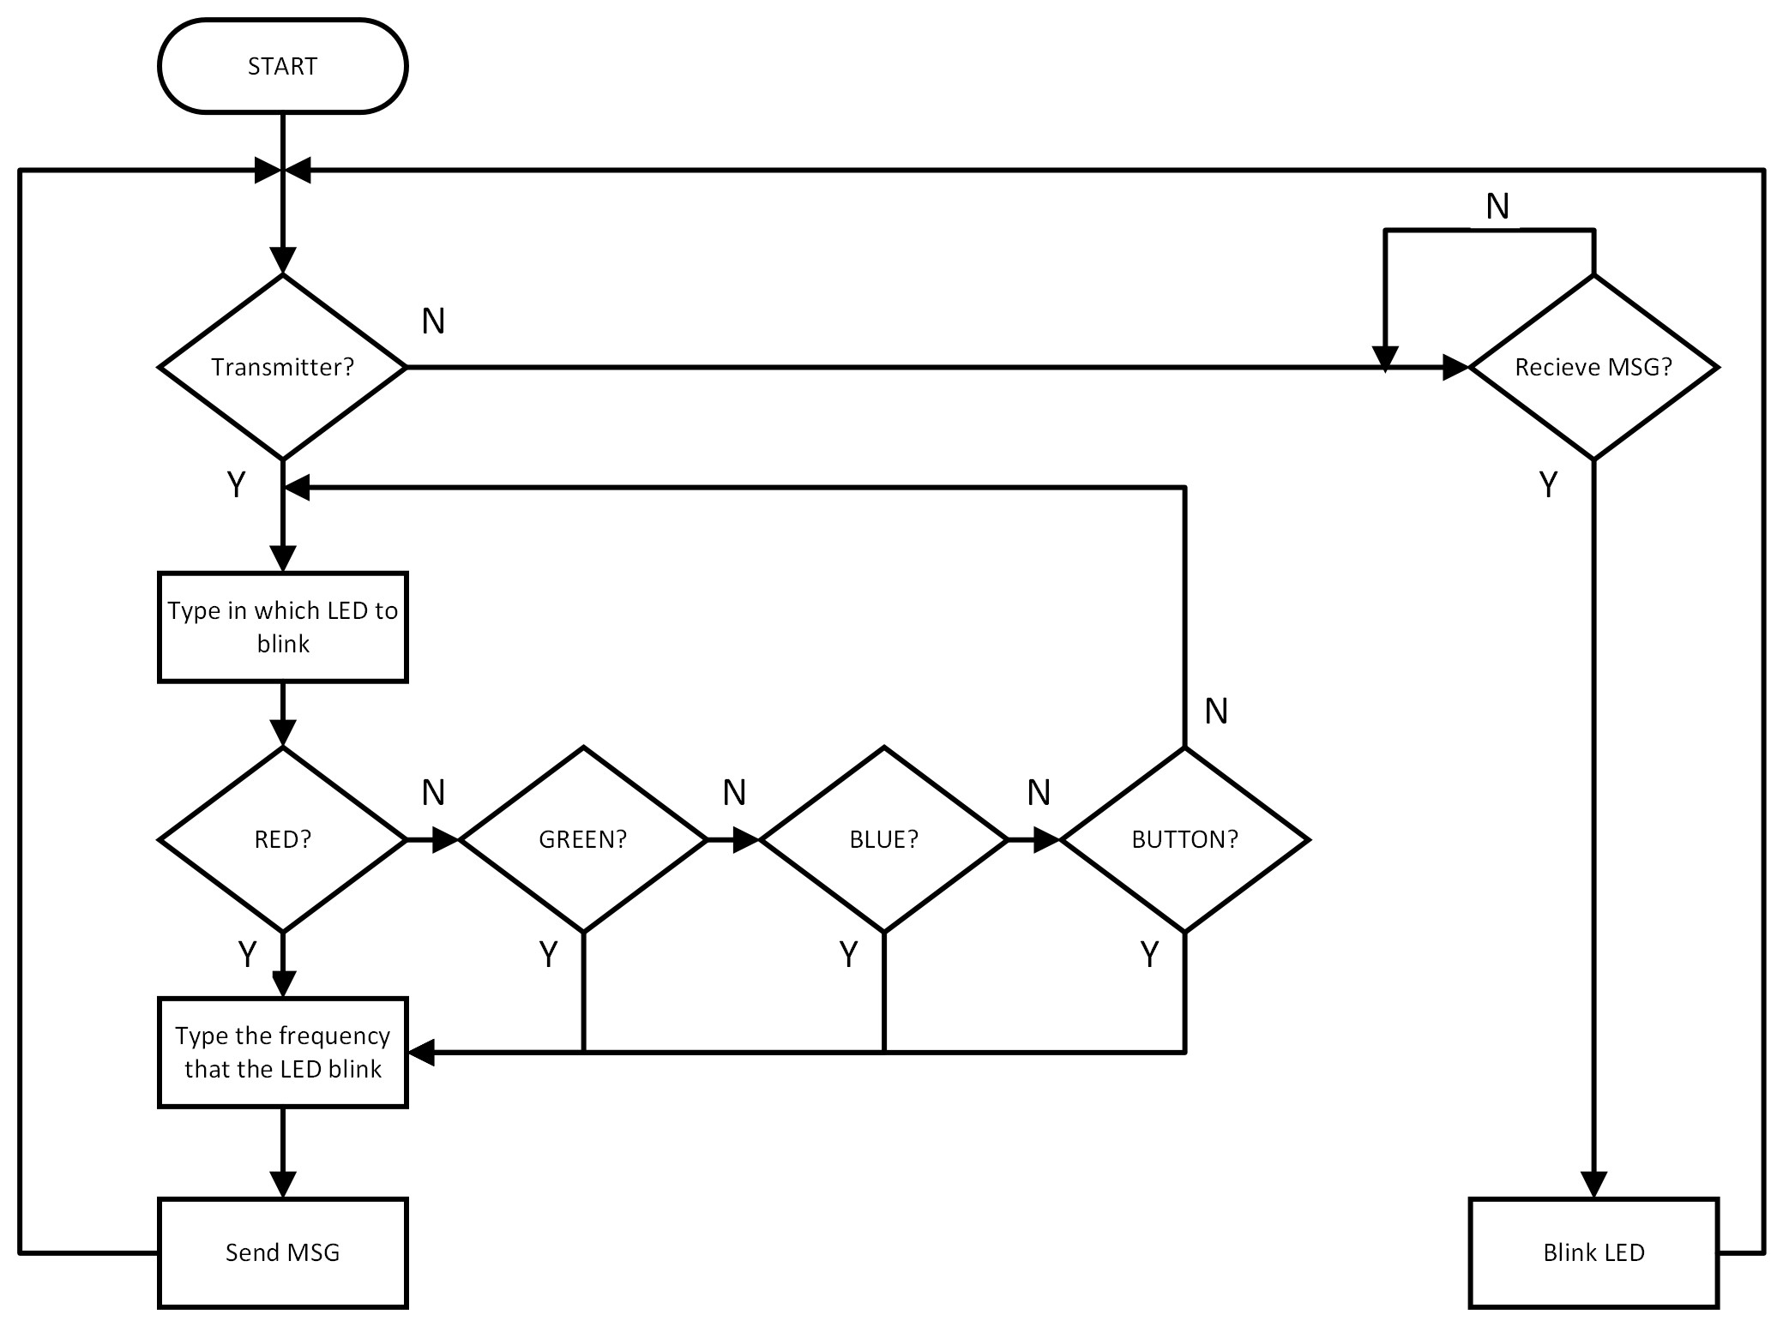
Example project Flow chart
Notes:
The CAN module requires an additional external CAN transceiver.

Slide 43
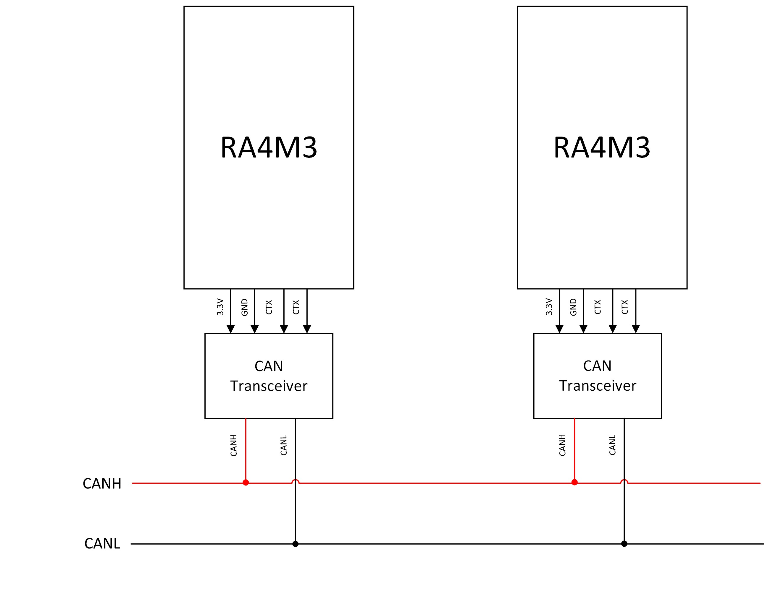
Example project HARDWARE CONFIGURATION
Notes:
The CAN module requires an additional external CAN transceiver.

Slide 44
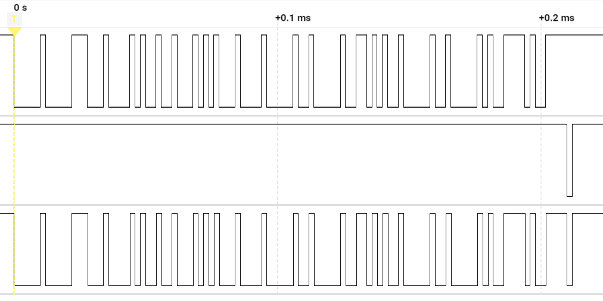
Example project real-time data
CAN_TX
CAN_RX
CAN_BUS
Data transmitted and received successfully
Notes:
The CAN module requires an additional external CAN transceiver.

Slide 45
Example project real-time data
CAN_BUS
Bit stuffing: In the CAN bus protocol, bit stuffing occurs after five consecutive bits of the same value. If these bits are all 1s or 0s, an additional bit of the opposite value is inserted into the data stream. This additional bit, known as the 'stuff bit,' is inserted regardless of the data's content.
ARBITRATION FIELD
SOF (1 bit) : 0
SID (11 bits): 0x003
Notes:
The CAN module requires an additional external CAN transceiver.

Slide 46
Example project real-time data
CAN_BUS
CONTROL FIELD
RTR (1 bit) : 0 r0 (1 bit) : 0
IDE (1 bit) : 0 DLC (4 bits) : 0
Notes:
The CAN module requires an additional external CAN transceiver.

Slide 47
Example project real-time data
CAN_BUS
DATA FIELD
Data sent: “RED 5 ”
Data[0...7] = {0x52, 0x45, 0x44, 0x20, 0x20, 0x35, 0x20, 0x20}
Notes:
The CAN module requires an additional external CAN transceiver.

Slide 48
Example project real-time data
CAN_BUS
CRC FIELD
CRC (15 bits)
Notes:
The CAN module requires an additional external CAN transceiver.

Slide 49
Example project real-time data
CAN_BUS
ACK FIELD
ACK slot (1 bit)
Notes:
The CAN module requires an additional external CAN transceiver.

Slide 50
reference

Slide 51
REFERENCE
RA Flexible Software Package Documentation: CAN (r_can) (renesas.github.io)
RA4M3 Group Datasheet (renesas.com)
RA4M3 Group User's Manual: Hardware (renesas.com)

Slide 52
Renesas.com

