Slide 1

CONTROLLER AREA NETWORK FLEXIBLE DATA (CAN-FD) MODULE
RA FSP KNOWLEDGE SHARING REPORT
FEB 15, 2023
NAM NGUYEN
SOFTWARE DEVELOPMENT Department
RA FSP GROUP
Renesas Electronics Corporation

Slide 2
Agenda
OVERVIEW Page 03
CAN/CAN-FD in FSP Page 07

Slide 3
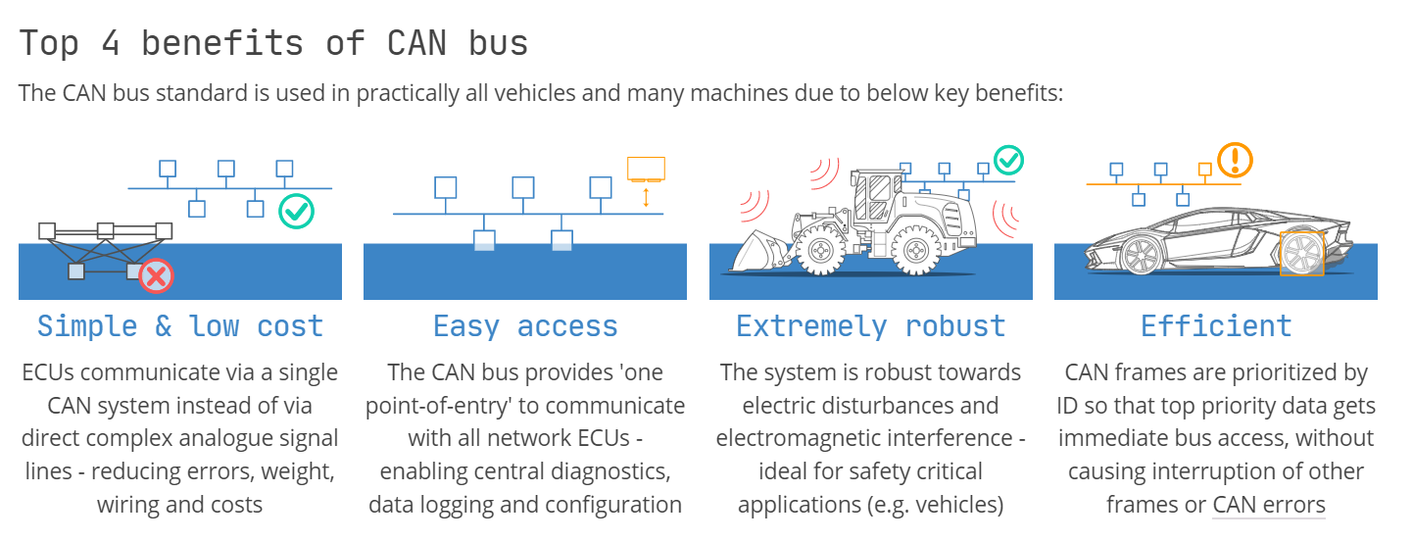
OVERVIEW WHAT CAN, CAN-FD ARE AND THEIR BENEFITS
The Controller Area Network (CAN) is a serial communication bus designed for robust and flexible performance in harsh environments, and particularly for industrial and automotive applications. CAN-FD is stand for CAN with Flexible Data-rate.
Notes:
The first cars using CAN FD will appear in 2019/2020 and CAN FD will replace step-by-step Classical CAN

Slide 4
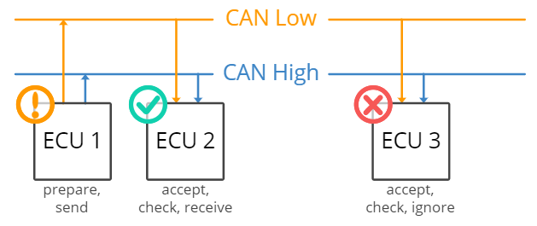
OVERVIEW CAN BUS SYSTEM
CAN Bus uses 2 wires to transmit data.

Slide 5
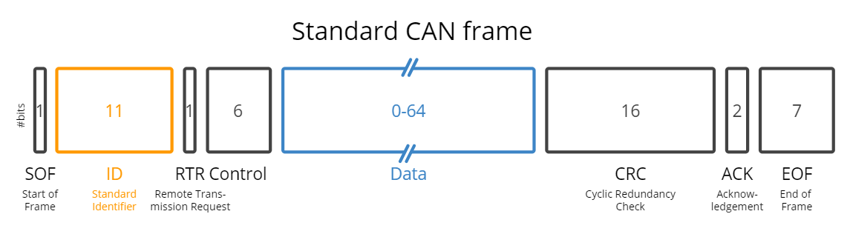
OVERVIEW ConCept
Communication over the CAN bus is done via CAN frames.
SOF: The Start of Frame is a 'dominant 0' to tell the other nodes that a CAN node intends to talk
ID: The ID is the frame identifier - lower values have higher priority
RTR: The Remote Transmission Request indicates whether a node sends data or requests dedicated data from another node
Control: The Control contains the Identifier Extension Bit (IDE) which is a 'dominant 0' for 11-bit. It also contains the 4 bit Data Length Code (DLC) that specifies the length of the data bytes to be transmitted (0 to 8 bytes)
Data: The Data contains the data bytes aka payload, which includes CAN signals that can be extracted and decoded for information
CRC: The Cyclic Redundancy Check is used to ensure data integrity
ACK: The ACK slot indicates if the node has acknowledged and received the data correctly
EOF: The EOF marks the end of the CAN frame

Slide 6
OVERVIEW ConCept
CAN allows for 04 different message types:
Data Frame: The frame carries data from the data transmitter to the data receivers. This frame has an area to carry bytes of data.
Remote Frame: The framework is transmitted from any one node to request data from another node. When that node receives the request, it will retransmit the data whose ID matches the sent ID.
Error Frame: The frame is transmitted from any node when that node detects an error from the bus.
Overflow Frame: When a node receives too much data and does not process it in time, it sends this framework so that other nodes do not transmit more data to it.

Slide 7
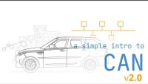
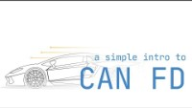
OVERVIEW More details
CAN Bus Explained
CAN FD Explained

Slide 8
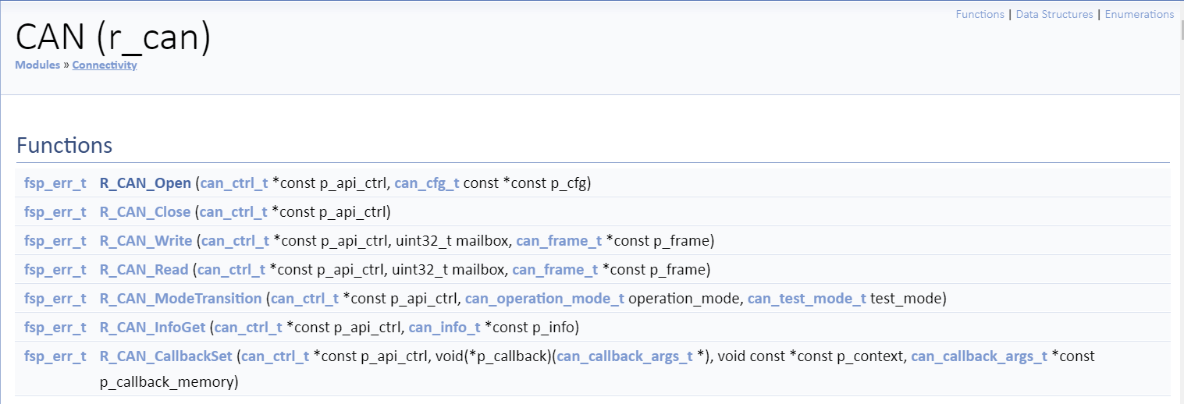
CAN/CAN-FD in FSP CAN API

Slide 9
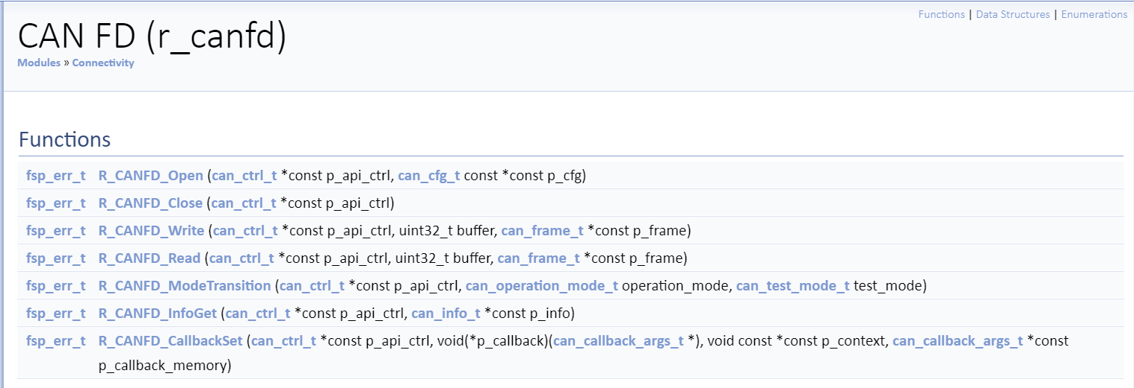
CAN/CAN-FD in FSP CAN-FD API

Slide 10
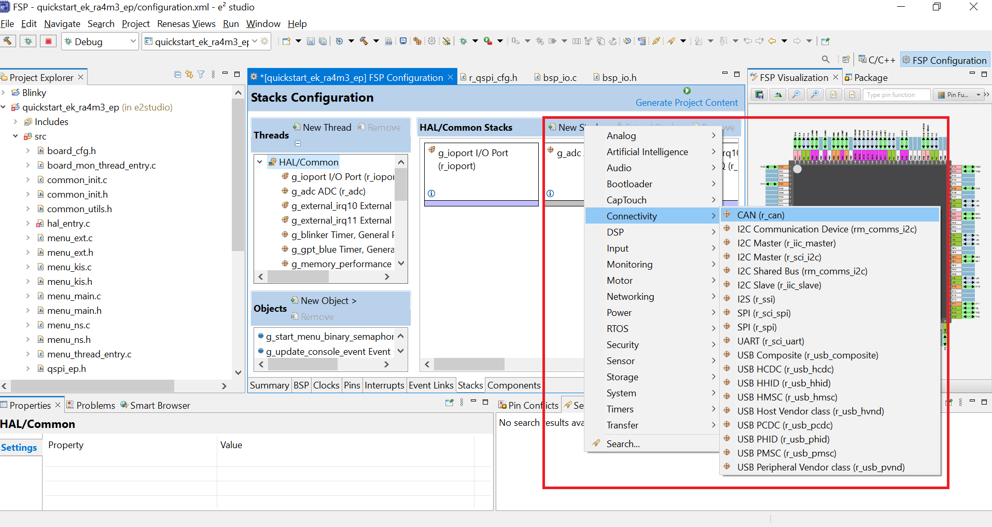
CAN/CAN-FD in FSP CAN on e2studio
Notes:
The CAN module requires an additional external CAN transceiver.

Slide 11
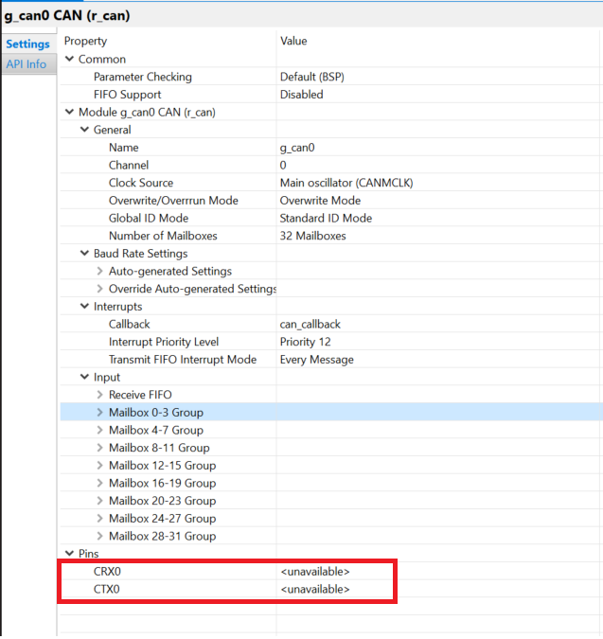
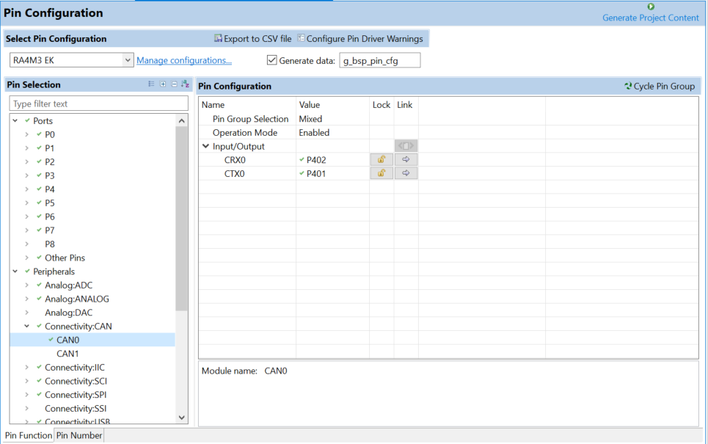
CAN/CAN-FD in FSP CAN on e2studio
Notes:
The CAN module requires an additional external CAN transceiver.

Slide 12
Renesas.com

