Slide 1

Gitlab ci/cd
Ra fsp investigation report
Feb 16, 2023
Hang Nguyen
Software development department
Ra fsp group
Renesas Electronics Corporation

Slide 2
Agenda
Overview Page 03
.gitlab-ci.yml Page 06
Gitlab CI/CD for FSP Page 11

Slide 3
overview what is gitlab ci/cd?
GitLab CI/CD is a tool for software development using the continuous methodologies:
Continuous Integration (CI)
Continuous Delivery (CD)
Continuous Deployment (CD)
Use GitLab CI/CD to catch bugs and errors early in the development cycle. Ensure that all the code deployed to production complies with the code standards you established for your app.
GitLab CI/CD can automatically build, test, deploy, and monitor your applications by using Auto DevOps

Slide 4
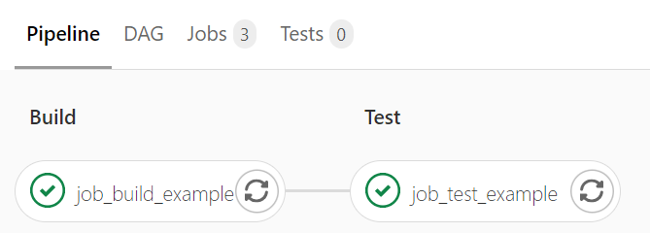
overview pipeline (1/2)
Pipelines are the top-level component of continuous integration, delivery, and deployment
Pipelines comprise:
Jobs, which define what to do
Stages, which define when to run the jobs

Slide 5
overview pipeline (2/2)
To execute a pipeline manually:
On the top bar, select Main menu > Projects and find your project.
On the left sidebar, select CI/CD > Pipelines.
Select Run pipeline.
In the Run for branch name or tag field, select the branch or tag to run the pipeline for.
Enter any CI/CD variables required for the pipeline to run. You can set specific variables to have their values prefilled in the form.
Select Run pipeline.

Slide 6
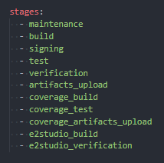
.gitlab-ci.yml configuration
To use GitLab CI/CD, you need:
Application code hosted in a Git repository.
A file called .gitlab-ci.yml in the root of your repository, which contains the CI/CD configuration.
In the .gitlab-ci.yml file, you can define:
The scripts you want to run.
Other configuration files and templates you want to include.
Dependencies and caches.
The commands you want to run in sequence and those you want to run in parallel.
The location to deploy your application to.
Whether you want to run the scripts automatically or trigger any of them manually.

Slide 7
.gitlab-ci.yml global keyword
Keyword | Description
default | Custom default values for job keywords.
include | Import configuration from other YAML files.
stages | The names and order of the pipeline stages.
variables | Define CI/CD variables for all job in the pipeline.
workflow | Control what types of pipeline run.

Slide 8
.gitlab-ci.yml job keyword (1/3)
Keyword | Description
after_script | Override a set of commands that are executed after job.
allow_failure | Allow job to fail. A failed job does not cause the pipeline to fail.
artifacts | List of files and directories to attach to a job on success.
before_script | Override a set of commands that are executed before job.
cache | List of files that should be cached between subsequent runs.
coverage | Code coverage settings for a given job.
dast_configuration | Use configuration from DAST profiles on a job level.
dependencies | Restrict which artifacts are passed to a specific job by providing a list of jobs to fetch artifacts from.
environment | Name of an environment to which the job deploys.
except | Control when jobs are not created.

Slide 9
.gitlab-ci.yml job keyword (2/3)
Keyword | Description
extends | Configuration entries that this job inherits from.
image | Use Docker images.
inherit | Select which global defaults all jobs inherit.
interruptible | Defines if a job can be canceled when made redundant by a newer run.
needs | Execute jobs earlier than the stage ordering.
only | Control when jobs are created.
pages | Upload the result of a job to use with GitLab Pages.
parallel | How many instances of a job should be run in parallel.
release | Instructs the runner to generate a release object.
resource_group | Limit job concurrency.
retry | When and how many times a job can be auto-retried in case of a failure.

Slide 10
.gitlab-ci.yml job keyword (3/3)
Keyword | Description
rules | List of conditions to evaluate and determine selected attributes of a job, and whether or not it’s created.
script | Shell script that is executed by a runner.
secrets | The CI/CD secrets the job needs.
services | Use Docker services images.
stage | Defines a job stage.
tags | List of tags that are used to select a runner.
timeout | Define a custom job-level timeout that takes precedence over the project-wide setting.
trigger | Defines a downstream pipeline trigger.
variables | Define job variables on a job level.
when | When to run job.

Slide 11
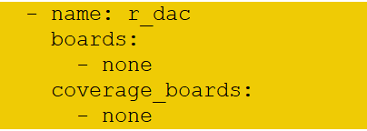
Gitlab ci/cd for fsP
Step 1: Add module to project/rx/pipeline_builds.yml include 3 information: name, boards and coverage_boards
the name of the module to build
a list of boards you want to run for normal unit tests
a list of boards you want to run for coverage tests

Slide 12
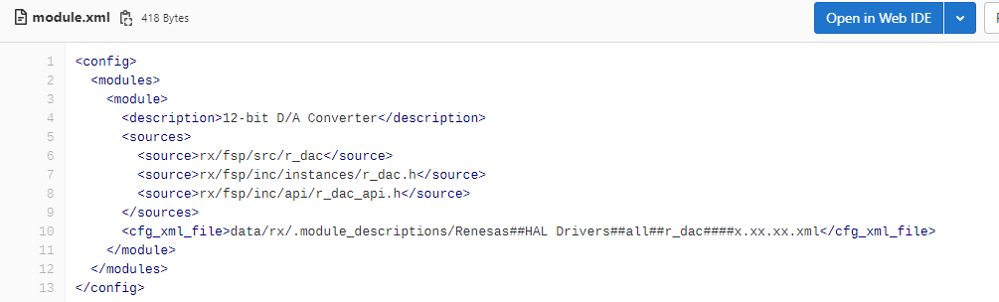
Gitlab ci/cd for fsP
Step 2: Copy driver of module DAC of RA => modify base on other modules
Step 3: Modify rx\fsp\src\r_dac\!dsn\module.xml

Slide 13
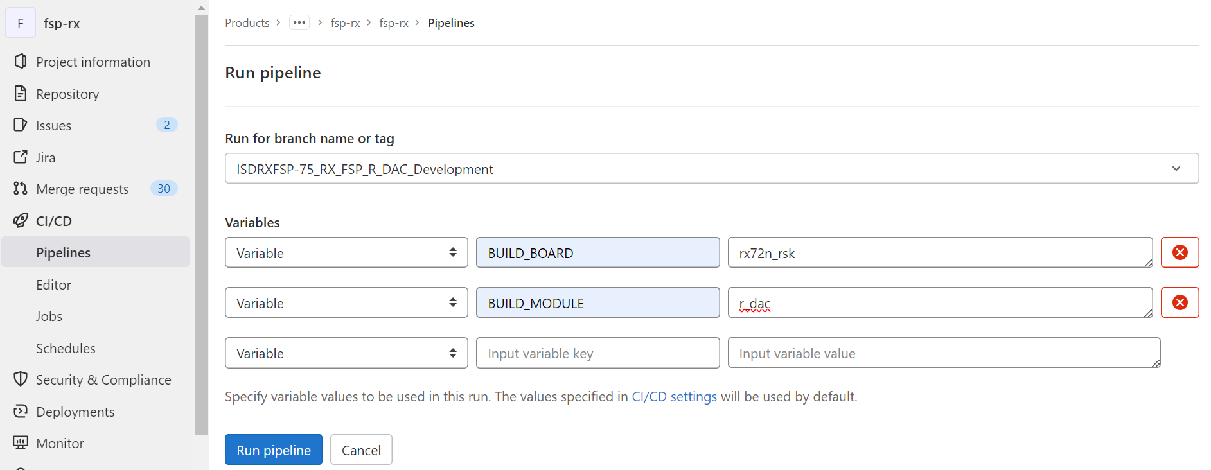
Gitlab ci/cd for fsP
Select branch
If you want to run single board
-> Select board to run pipeline
Select module

Slide 14
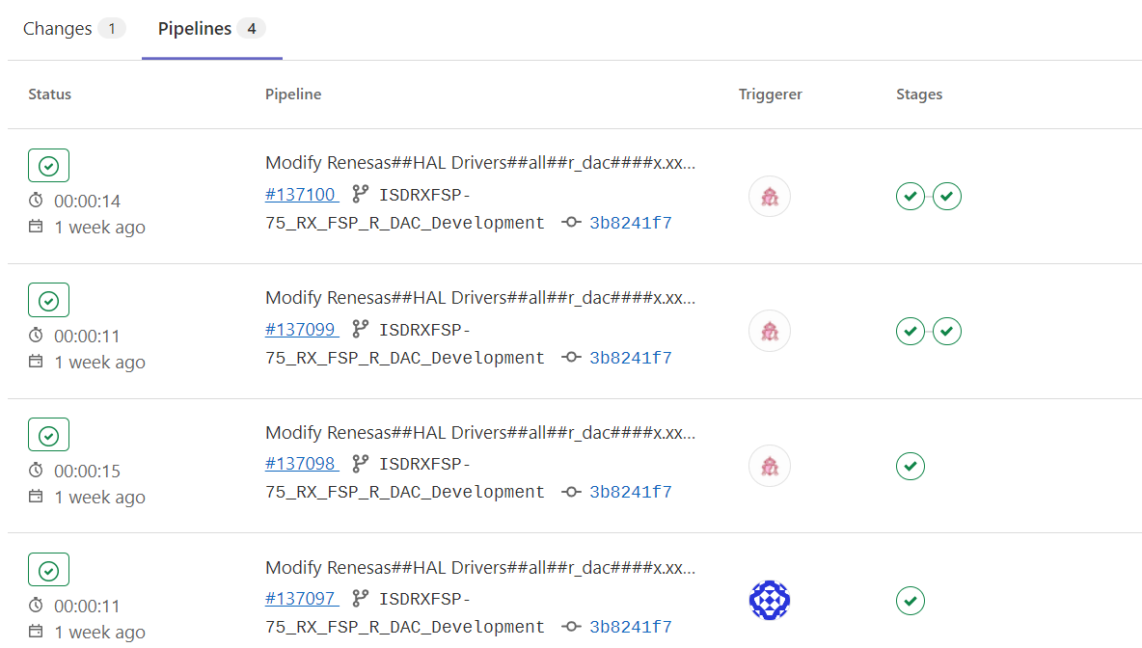
Gitlab ci/cd for fsP
(4)
(3)
(2)
(1)

Slide 15
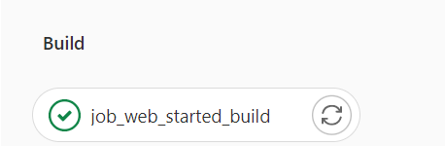
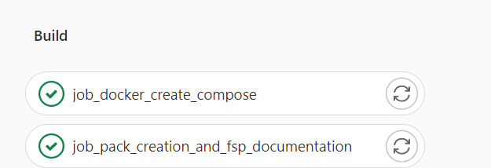
Gitlab ci/cd for fsP
(1)
(2)

Slide 16
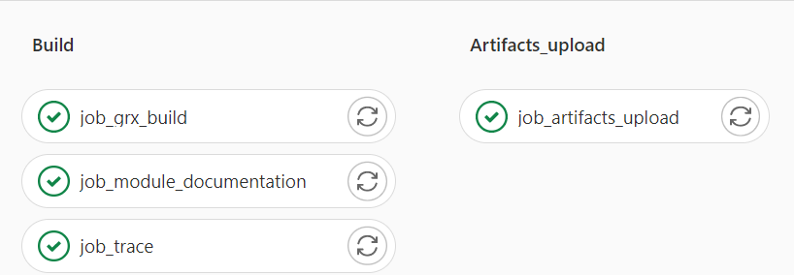
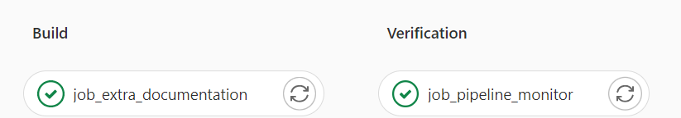
Gitlab ci/cd for fsP
(3)
(4)

Slide 17
Renesas.com

