Slide 1

moduLE
port
Feb. 14
Bao Nguyen
RA FSP, SWDD,
Renesas Electronics Corporation

Slide 2
Agenda
IO Port Page 03
POEG Page 27
Appendix Page 42

Slide 3

i/o port

Slide 4
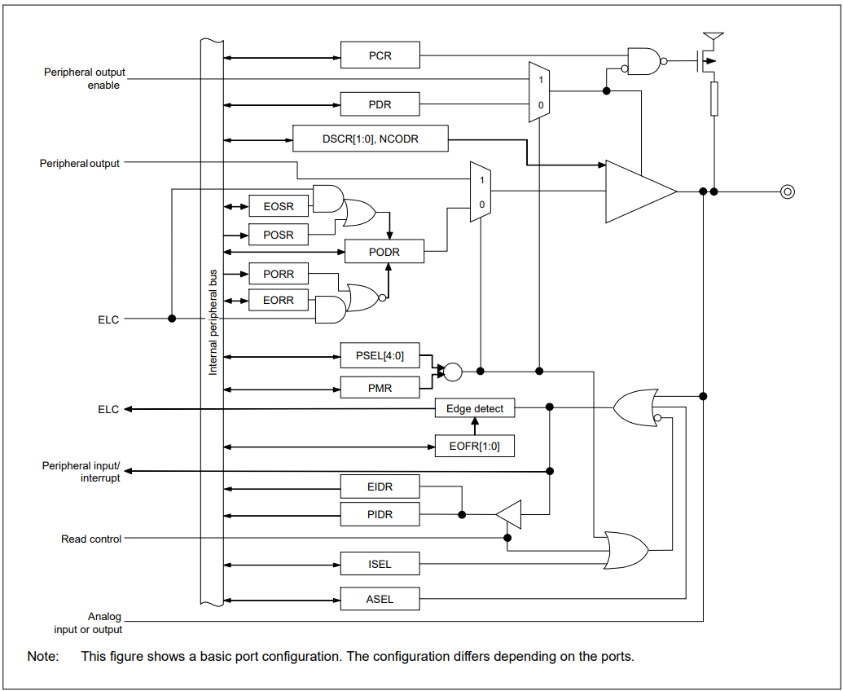
I/o PORT overview
The I/O port pins operate as general I/O port pins, I/O pins for peripheral modules, interrupt input pins, analog I/O, port group function for the ELC

Slide 5
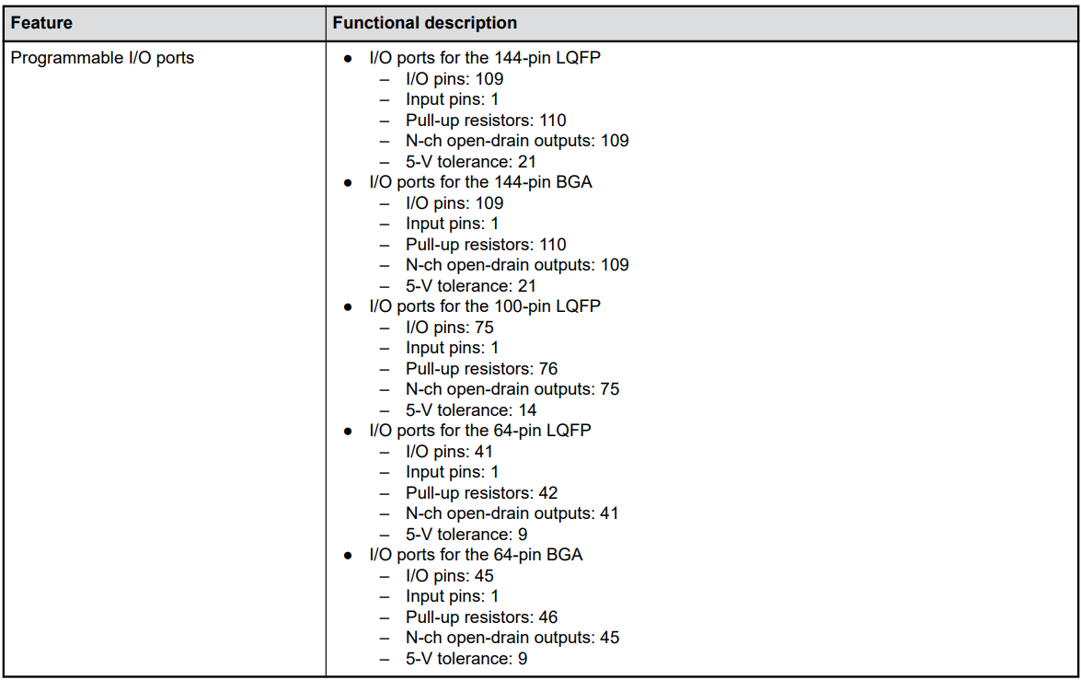
I/o PORT overview
General I/O ports are organized as 16 bits per port and can be accessed by port with the Port Control Registers (PCNTRn, where n = 1 to 4), or by individual pins with the Port mn Pin Function Select register.
RA4M3 144 pins:
Pmn I/O General-purpose input/output pins (m: port number, n: pin number)
Include 9 ports 109 pins
P200 Input General-purpose input pin

Slide 6
IO PORT feature
The IOPORT HAL module can configure the following pin settings:
Pin direction
Default output state
Pull-up
NMOS/PMOS
Drive strength
Event edge trigger (falling, rising or both)
Whether the pin is to be used as an IRQ pin
Whether the pin is to be used as an analog pin
Peripheral connection
Config by Port Control Registers (PCNTRn, where n = 1 to 4)
The module also provides the following functionality:
Read/write GPIO pins/ports
Sets event output data
Reads event input data

Slide 7
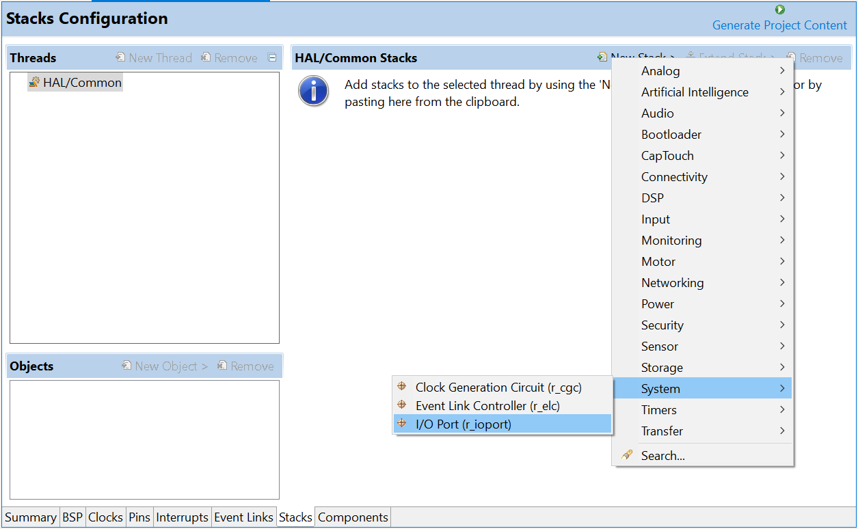
IO PORT configuration
Add stack I/O Port to the project. Normally, I/O port is added automatically.

Slide 8
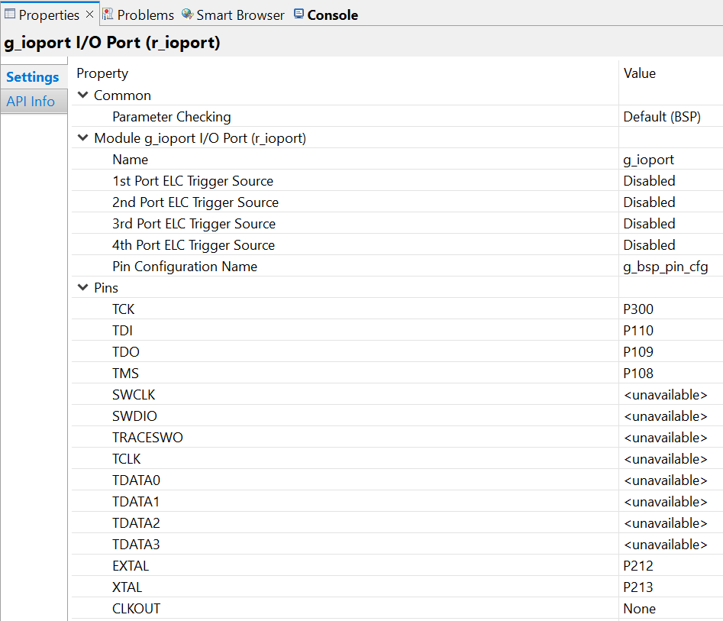
IO PORT configuration
Enable/Disable Parameter checking
Event port
Debug and Clock pin

Slide 9
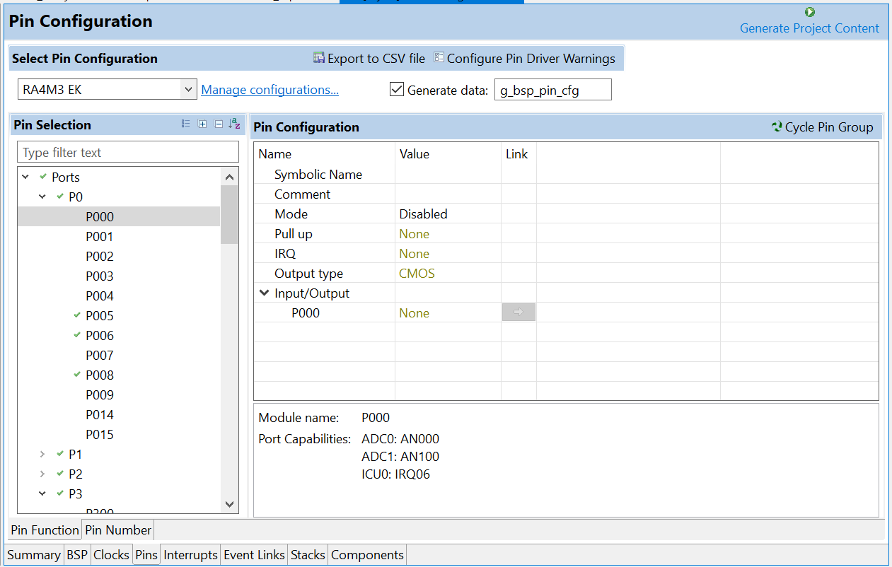
IO PORT peripherals connection
PORT Capabilities of this pin

Slide 10
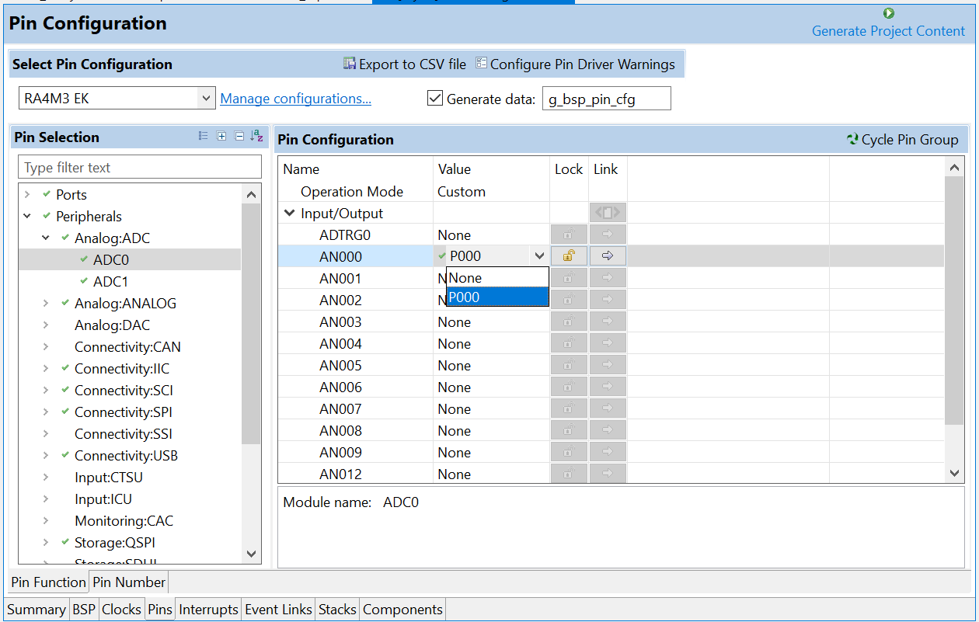
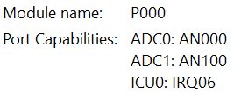
IO PORT peripherals connection
Config Peripherals connect to Port
Pin available with peripherals corresponding to HWM and some channels can be assigned to the same port.
Ex:

Slide 11
IO PORT configuration
Clock Configuration
The I/O PORT HAL module does not require a specific clock configuration.
Pin Configuration
The IOPORT module is used for configuring pins.
Port Group Function for ELC
Depending on pin configuration, the IOPORT module can perform automatic reads and writes on 4 ports (RA2 series support 2 ports only) on receipt of an ELC event.
When an event is received by a port, the state of the input pins on the port is saved in a hardware register. Simultaneously, the state of output pins on the port is set or cleared based on settings configured by the user. The functions R_IOPORT_PinEventInputRead and R_IOPORT_PortEventInputRead allow reading the last event input state of a pin or port, and event-triggered pin output can be configured through R_IOPORT_PinEventOutputWrite and R_IOPORT_PortEventOutputWrite.
In addition, each pin on these ports can be configured to trigger an ELC event on rising, falling or both edges. This event can be used to activate other modules when the pin changes state.

Slide 12
IO PORT interface
Data Structures
struct | ioport_pin_cfg_t
struct | ioport_cfg_t
struct | ioport_api_t
struct | ioport_instance_t
Enumerations
enum | ioport_peripheral_t
enum | ioport_cfg_options_t
enum | ioport_pwpr_t
Typedefs
typedef uint16_t | ioport_size_t IO port size on this device. More...
typedef void | ioport_ctrl_t

Slide 13
IO PORT function
fsp_err_t R_IOPORT_Open | ( | ioport_ctrl_t *const | p_ctrl,
 |  | const ioport_cfg_t * | p_cfg
 | )
Initializes internal driver data, then calls pin configuration function to configure pins.
Return values | FSP_SUCCESS, FSP_ERR_ASSERTION, FSP_ERR_ALREADY_OPEN

Slide 14
IO PORT function
fsp_err_t R_IOPORT_Close | ( | ioport_ctrl_t *const | p_ctrl )
Resets IOPORT registers. Implements ioport_api_t::close
Return values | FSP_SUCCESS, FSP_ERR_ASSERTION, FSP_ERR_NOT_OPEN

Slide 15
IO PORT function
fsp_err_t R_IOPORT_PinsCfg | ( | ioport_ctrl_t *const | p_ctrl,
 |  | const ioport_cfg_t * | p_cfg
 | )
Configures the functions of multiple pins by loading configuration data into pin PFS registers. Implements ioport_api_t::pinsCfg.
Return values | FSP_SUCCESS, FSP_ERR_NOT_OPEN, FSP_ERR_ASSERTION

Slide 16
IO PORT function
fsp_err_t R_IOPORT_PinCfg | ( | ioport_ctrl_t *const | p_ctrl,
 |  | bsp_io_port_pin_t | pin,
 |  | uint32_t | cfg
 | )
Configures the settings of a pin. Implements ioport_api_t::pinCfg.
Return values | FSP_SUCCESS, FSP_ERR_NOT_OPEN, FSP_ERR_ASSERTION

Slide 17
IO PORT function
fsp_err_t R_IOPORT_PinRead | ( | ioport_ctrl_t *const | p_ctrl,
 |  | bsp_io_port_pin_t | pin,
 |  | bsp_io_level_t * | p_pin_value
 | )
Reads the level on a pin. Implements ioport_api_t::pinRead.
Return values | FSP_SUCCESS, FSP_ERR_NOT_OPEN, FSP_ERR_ASSERTION

Slide 18
IO PORT function
fsp_err_t R_IOPORT_PortRead | ( | ioport_ctrl_t *const | p_ctrl,
 |  | bsp_io_port_t | port,
 |  | ioport_size_t * | p_port_value
 | )
Reads the value on an IO port. Implements ioport_api_t::portRead. The specified port will be read, and the levels for all the pins will be returned. Each bit in the returned value corresponds to a pin on the port. For example, bit 7 corresponds to pin 7, bit 6 to pin 6, and so on.
Return values | FSP_SUCCESS, FSP_ERR_ASSERTION, FSP_ERR_NOT_OPEN

Slide 19
IO PORT function
fsp_err_t R_IOPORT_PortWrite | ( | ioport_ctrl_t *const | p_ctrl,
 |  | bsp_io_port_t | port,
 |  | ioport_size_t | value,
 |  | ioport_size_t | mask
 | )
Writes to multiple pins on a port. Implements ioport_api_t::portWrite. The input value will be written to the specified port. Each bit in the value parameter corresponds to a bit on the port. For example, bit 7 corresponds to pin 7, bit 6 to pin 6, and so on. Each bit in the mask parameter corresponds to a pin on the port.
Return values | FSP_SUCCESS, FSP_ERR_ASSERTION, FSP_ERR_ALREADY_OPEN

Slide 20
IO PORT function
fsp_err_t R_IOPORT_PinWrite | ( | ioport_ctrl_t *const | p_ctrl,
 |  | bsp_io_port_pin_t | pin,
 |  | bsp_io_level_t | level
 | )
Sets a pin's output either high or low. Implements ioport_api_t::pinWrite.
Return values | FSP_SUCCESS, FSP_ERR_INVALID_ARGUMENT, FSP_ERR_NOT_OPEN, FSP_ERR_ASSERTION

Slide 21
IO PORT function
fsp_err_t R_IOPORT_PortDirectionSet | ( | ioport_ctrl_t *const | p_ctrl,
 |  | bsp_io_port_t | port,
 |  | ioport_size_t | direction_values,
 |  | ioport_size_t | mask
 | )
Sets the direction of individual pins on a port. Implements ioport_api_t::portDirectionSet(). Multiple pins on a port can be set to inputs or outputs at once. Each bit in the mask parameter corresponds to a pin on the port. For example, bit 7 corresponds to pin 7, bit 6 to pin 6, and so on. If a bit is set to 1 then the corresponding pin will be changed to an input or an output as specified by the direction values. If a mask bit is set to 0 then the direction of the pin will not be changed.
Return values | FSP_SUCCESS, FSP_ERR_INVALID_ARGUMENT, FSP_ERR_NOT_OPEN, FSP_ERR_ASSERTION

Slide 22
IO PORT function
fsp_err_t R_IOPORT_PortEventInputRead | ( | ioport_ctrl_t *const | p_ctrl,
 |  | bsp_io_port_t | port,
 |  | ioport_size_t * | p_event_data
 | )
Reads the value of the event input data. Implements ioport_api_t::portEventInputRead(). The event input data for the port will be read. Each bit in the returned value corresponds to a pin on the port. For example, bit 7 corresponds to pin 7, bit 6 to pin 6, and so on. The port event data is captured in response to a trigger from the ELC. This function enables this data to be read. Using the event system allows the captured data to be stored when it occurs and then read back at a later time.
Return values | FSP_SUCCESS, FSP_ERR_INVALID_ARGUMENT, FSP_ERR_ASSERTION, FSP_ERR_NOT_OPEN

Slide 23
IO PORT function
fsp_err_t R_IOPORT_PinEventInputRead | ( | ioport_ctrl_t *const | p_ctrl,
 |  | bsp_io_port_pin_t | pin,
 |  | bsp_io_level_t * | p_pin_event
 | )
Reads the value of the event input data of a specific pin. Implements ioport_api_t::pinEventInputRead. The pin event data is captured in response to a trigger from the ELC. This function enables this data to be read. Using the event system allows the captured data to be stored when it occurs and then read back at a later time.
Return values | FSP_SUCCESS, FSP_ERR_ASSERTION, FSP_ERR_NOT_OPEN, FSP_ERR_INVALID_ARGUMENT

Slide 24
IO PORT function
fsp_err_t R_IOPORT_PortEventOutputWrite | ( | ioport_ctrl_t *const | p_ctrl,
 |  | bsp_io_port_t | port,
 |  | ioport_size_t | event_data,
 |  | ioport_size_t | mask_value
 | )
This function writes the set and reset event output data for a port. Implements ioport_api_t::portEventOutputWrite. Using the event system enables a port state to be stored by this function in advance of being output on the port. The output to the port will occur when the ELC event occurs. The input value will be written to the specified port when an ELC event configured for that port occurs. Each bit in the value parameter corresponds to a bit on the port. For example, bit 7 corresponds to pin 7, bit 6 to pin 6, and so on. Each bit in the mask parameter corresponds to a pin on the port.
Return values | FSP_SUCCESS, FSP_ERR_INVALID_ARGUMENT, FSP_ERR_NOT_OPEN, FSP_ERR_ASSERTION

Slide 25
IO PORT function
fsp_err_t R_IOPORT_PinEventOutputWrite | ( | ioport_ctrl_t *const | p_ctrl,
 |  | bsp_io_port_pin_t | pin,
 |  | bsp_io_level_t | pin_value
 | )
This function writes the event output data value to a pin. Implements ioport_api_t::pinEventOutputWrite. Using the event system enables a pin state to be stored by this function in advance of being output on the pin. The output to the pin will occur when the ELC event occurs.
Return values | FSP_SUCCESS, FSP_ERR_INVALID_ARGUMENT, FSP_ERR_NOT_OPEN, FSP_ERR_ASSERTION

Slide 26
IO PORT EXAMPLE BLYNKY
void blinky_example()
{
fsp_err_t err;
/* Initialize the IOPORT module and configure the pins */
err = R_IOPORT_Open (&g_ioport_ctrl, &g_bsp_pin_cfg);
/* Handle any errors. This function should be defined by the user. */
assert(FSP_SUCCESS == err);
/* Configure Pin as output
* Call the R_IOPORT_PinCfg if the configuration was not part of initial configurations made in open */
err = R_IOPORT_PinCfg (&g_ioport_ctrl, BSP_IO_PORT_06_PIN_00, IOPORT_CFG_PORT_DIRECTION_OUTPUT);
assert(FSP_SUCCESS == err);
bsp_io_level_t level = BSP_IO_LEVEL_LOW;
while (1)
{
/* Determine the next state of the LEDs */
if (BSP_IO_LEVEL_LOW == level)
{
level = BSP_IO_LEVEL_HIGH;
}
else
{
level = BSP_IO_LEVEL_LOW;
}
/* Update LED on RA6M3-PK */
err = R_IOPORT_PinWrite (&g_ioport_ctrl, BSP_IO_PORT_06_PIN_00, level);
assert(FSP_SUCCESS == err);
/* Delay */
R_BSP_SoftwareDelay (100, BSP_DELAY_UNITS_MILLISECONDS); // NOLINT
}
}

Slide 27
poeg

Slide 28
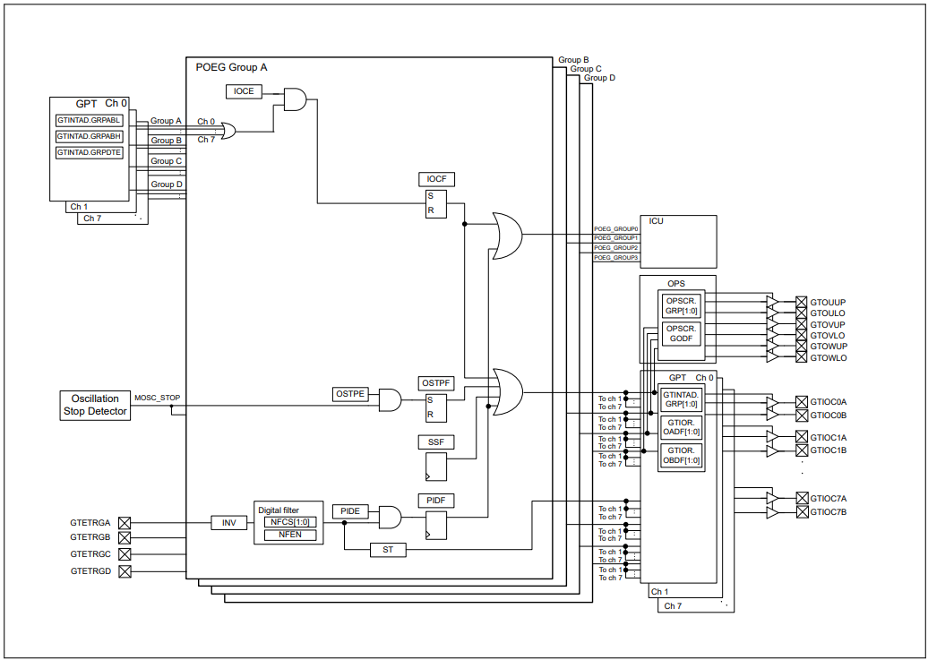
POEG Overview
The Port Output Enable (POEG) function can place the General PWM Timer (GPT) output pins in the output disable state in
one of the following ways:
● Input level detection of the
GTETRGn (n = A to D) pins
● Output-disable request from the GPT
● Oscillation stop detection of the clock generation circuit
● Register settings

Slide 29
POEG feature
The POEG module has the following features:
Supports disabling GPT output pins based on GTETRG input pin level.
Supports disabling GPT output pins based on comparator crossing events (configurable in the Comparator, High-Speed (r_acmphs) driver).
Supports disabling GPT output pins when GTIOC pins are the same level (configurable in the Timer, General PWM (r_gpt) driver).
Supports disabling GPT output pins when main oscillator stop is detected.
Supports disabling GPT output pins by software API.
Supports notifying the application when GPT output pins are disabled by POEG.
Supports resetting POEG status.

Slide 30
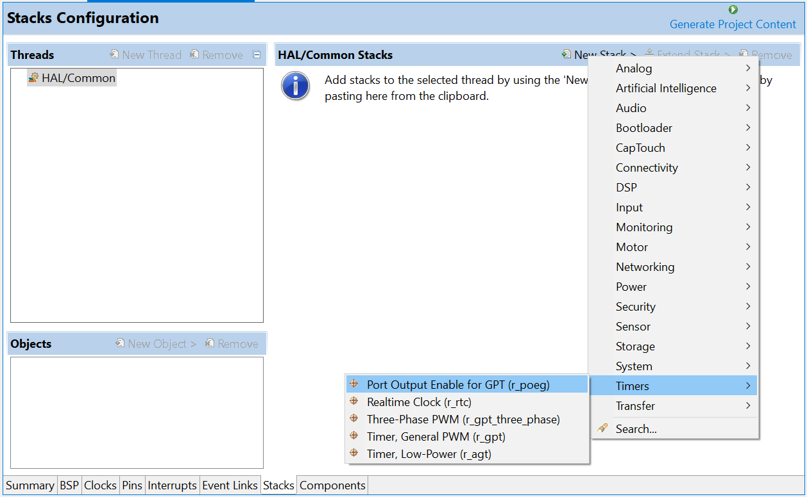
POEG configuration
Add POEG in Stack configuration of FSP Configuration

Slide 31
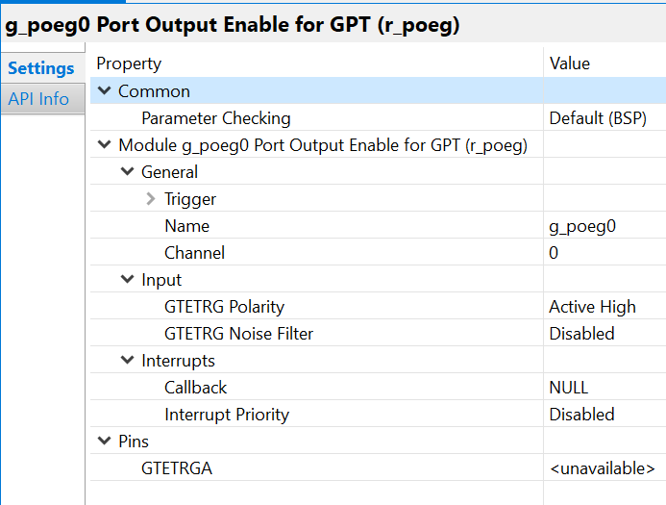
POEG configuration
Enable/Disable Parameter checking
HW Channel must be a valid POEG channel
Only applicable if GTETRG pin is selected under Trigger.
User call back function, it will be called be called from (ISR) when GPT output pins are disabled by POEG.
Select the POEG interrupt priority.

Slide 32
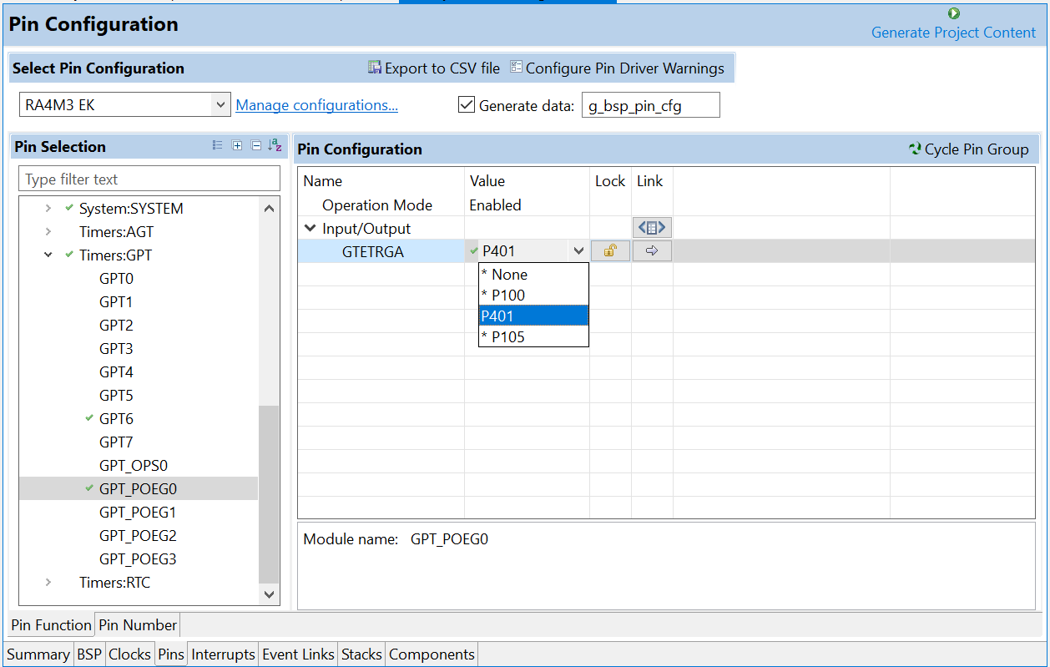
POEG configuration
POEG can use GTETRGA, GTETRGB, GTETRGC, or GTETRGD as an input signal to disable GPT output pins. GTETRGA must be used with POEG channel 0, GTETRGB must be used with POEG channel 1, etc

Slide 33
POEG Configuration
Clock Configuration
The POEG clock is based on the PCLKB frequency.
Limitations
The POEG trigger source can only be set once per channel. Modifying the POEG trigger source after it is set is not allowed by the hardware.
The POEG cannot be disabled using POEG API. The interrupt is disabled in R_POEG_Close(), but the POEG will still disable the GPT output pins if a trigger is detected even if the module is closed.

Slide 34
poeg interface
Data Structures
struct | poeg_status_t
struct | poeg_callback_args_t
struct | poeg_cfg_t
struct | poeg_api_t
struct | poeg_instance_t
Enumerations
enum | poeg_state_t
enum | poeg_trigger_t
enum | poeg_gtetrg_polarity_t
enum | poeg_gtetrg_noise_filter_t
Typedefs
typedef void | poeg_ctrl_t

Slide 35
poeg function
fsp_err_t R_POEG_Open | ( | poeg_ctrl_t *const | p_ctrl,
 |  | poeg_cfg_t const *const | p_cfg
 | )
Initializes the POEG module and applies configurations. Implements poeg_api_t::open.
Return values | FSP_SUCCESS, FSP_ERR_ASSERTION, FSP_ERR_ALREADY_OPEN, FSP_ERR_IRQ_BSP_DISABLED, FSP_ERR_IP_CHANNEL_NOT_PRESENT

Slide 36
poeg function
fsp_err_t R_POEG_OutputDisable | ( | poeg_ctrl_t *const | p_ctrl )
Disables GPT output pins. Implements poeg_api_t::outputDisable.
Return values | FSP_SUCCESS, FSP_ERR_ASSERTION, FSP_ERR_NOT_OPEN

Slide 37
poeg function
fsp_err_t R_POEG_StatusGet | ( | poeg_ctrl_t *const | p_ctrl,
 |  | poeg_status_t *const | p_status
 | )
Get current POEG status and store it in provided pointer p_status. Implements poeg_api_t::statusGet.
Return values | FSP_SUCCESS, FSP_ERR_ASSERTION, FSP_ERR_NOT_OPEN

Slide 38
poeg function
fsp_err_t R_POEG_Reset | ( | poeg_ctrl_t *const | p_ctrl )
Resets status flags. Implements poeg_api_t::reset.
Return values | FSP_SUCCESS, FSP_ERR_ASSERTION, FSP_ERR_NOT_OPEN

Slide 39
poeg function
fsp_err_t R_POEG_CallbackSet | ( | poeg_ctrl_t *const | p_ctrl,
 |  | void(*)(poeg_callback_args_t *) | p_callback,
 |  | void const *const | p_context,
 |  | poeg_callback_args_t *const | p_callback_memory
 | )
Updates the user callback with the option to provide memory for the callback argument structure. Implements poeg_api_t::callbackSet.
Return values | FSP_SUCCESS, FSP_ERR_ASSERTION, FSP_ERR_NOT_OPEN, FSP_ERR_NO_CALLBACK_MEMORY

Slide 40
poeg function
fsp_err_t R_POEG_Close | ( | poeg_ctrl_t *const | p_ctrl )
Disables POEG interrupt. Implements poeg_api_t::close.
Return values | FSP_SUCCESS, FSP_ERR_ASSERTION, FSP_ERR_NOT_OPEN

Slide 41
POEG EXAMPLE CALL BACK
/* Example callback called when POEG disables GPT output pins. */
void poeg_callback(poeg_callback_args_t *p_args)
{
FSP_PARAMETER_NOT_USED (p_args);
/* (Optional) Determine the cause of the POEG event. */
poeg_status_t status;
(void) R_POEG_StatusGet (&g_poeg0_ctrl, &status);
/* Correct the cause of the POEG event before resetting POEG. */
/* Reset the POEG before exiting the callback. */
(void) R_POEG_Reset (&g_poeg0_ctrl);
/* Wait for the status to clear after reset before exiting the callback to ensure the interrupt does not fire
* again. */
do
{
(void) R_POEG_StatusGet (&g_poeg0_ctrl, &status);
}
while (POEG_STATE_NO_DISABLE_REQUEST != status.state);
/* Alternatively, if the POEG cannot be reset, disable the POEG interrupt to prevent it from firing continuously.
* Update the 0 in the macro below to match the POEG channel number. */
NVIC_DisableIRQ (VECTOR_NUMBER_POEG0_EVENT);
}

Slide 42
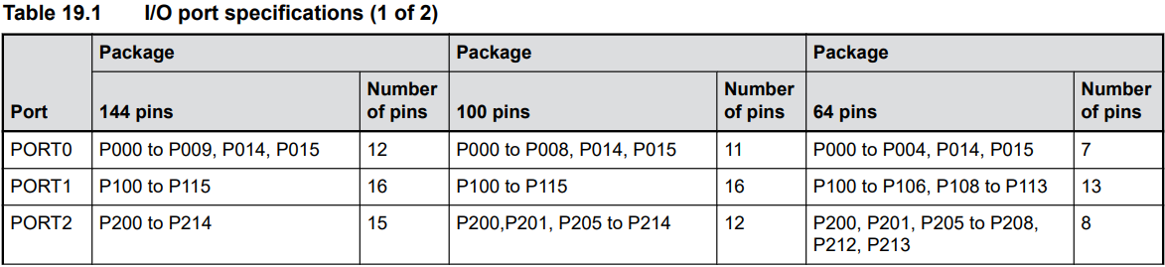
APENDIX

Slide 43
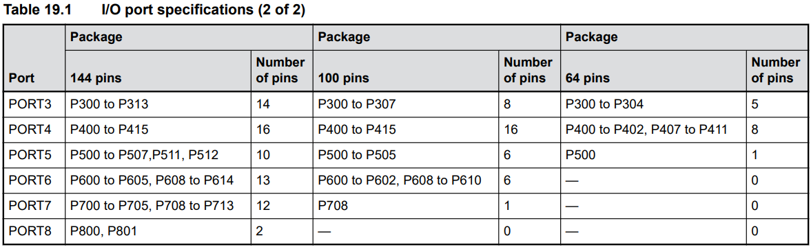
APENDIX

Slide 44
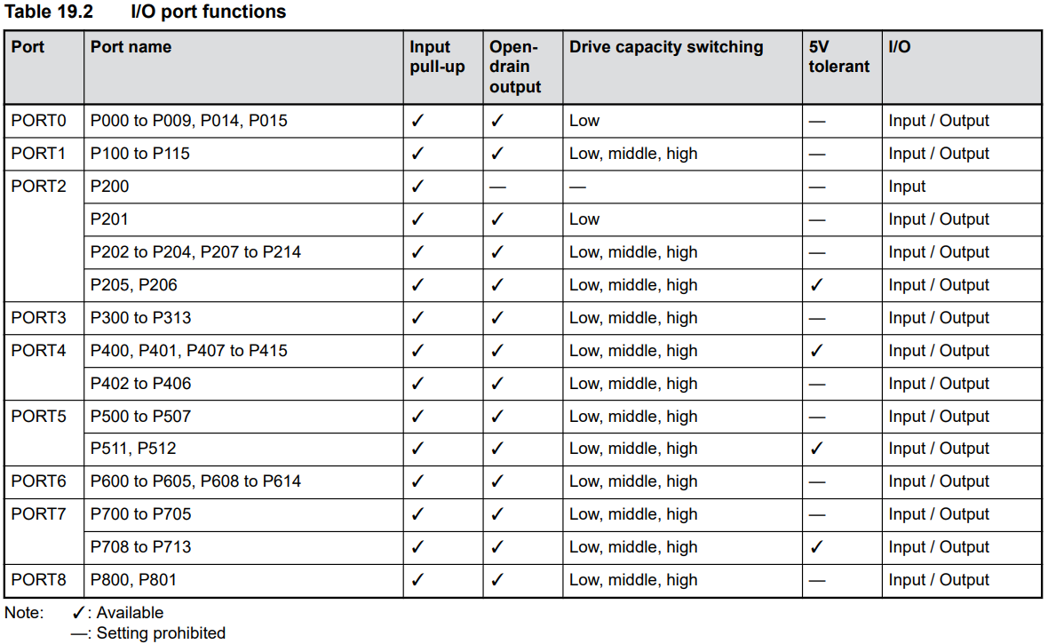
APENDIX

Slide 45
Renesas.com

