Slide 1
How to remote debug
Bao nguyen
RA FSP
Renesas Electronics Corporation

Slide 2
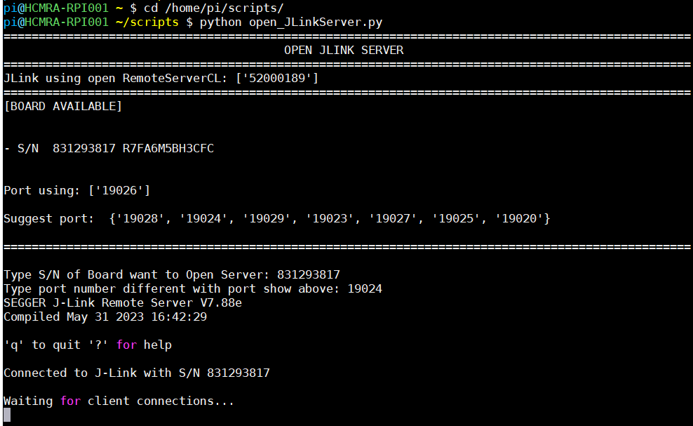
OPEN JLINK SERVER on RPI
Each Board should not open to listen in multi server. Script will prevent it.
Connect Board to RPI
SSH and Run Script to open file.
$ cd /home/pi/scripts/
$ python open_JLinkServer.py
Select Board want to open server by S/N and suggest Port
show on console

Slide 3
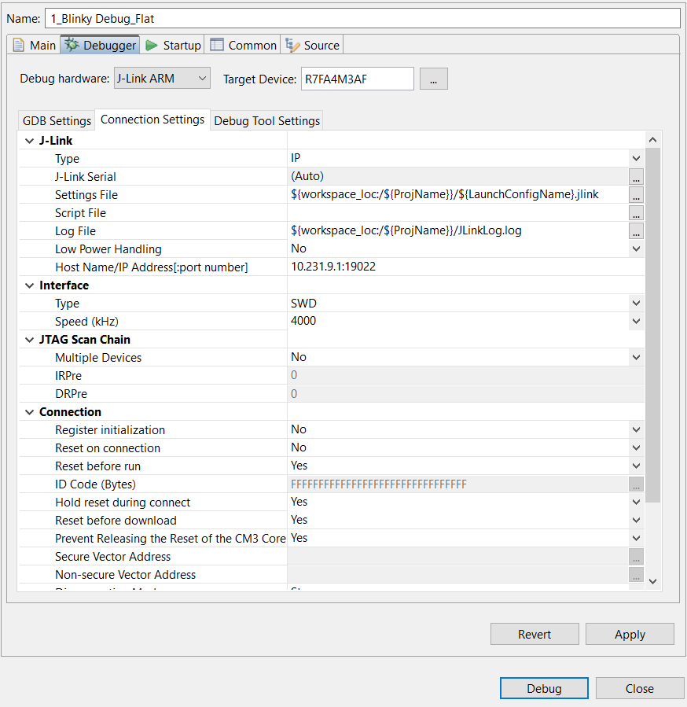
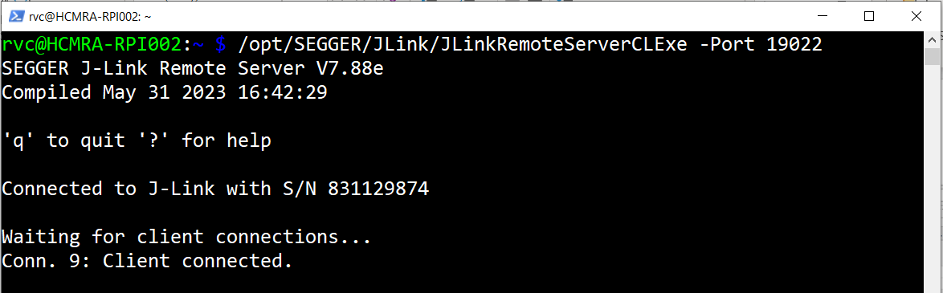
Debug configuration
Open and Build project on e2 Studio
Select Debug As -> Debug Configurations
Debugger -> Connection Settings
Select JLink Type: IP
Type IP and port of JLink server: IP:port
Ex: 10.231.9.1:19022
Select Debug and debug as normal
1
2
3
Connect success to JLink server

Slide 4
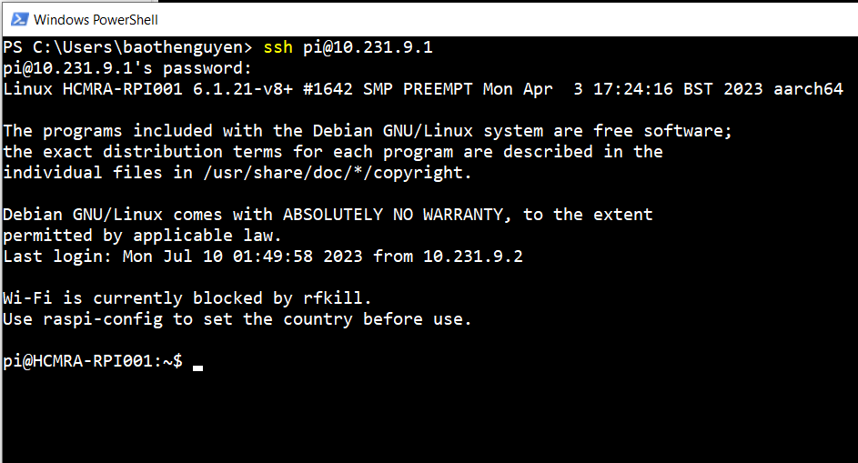
RPI available:
RPI001: 10.231.9.1
RPI002: 10.231.9.2
Ssh user: pi
Password: renesas

Slide 5
Renesas.com

Slide 6
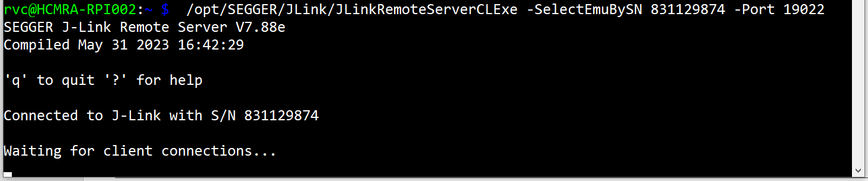
OPEN JLINK SERVER without script
Each Board should not open duplicate in multi server.
Connect Board to (laptop/LabPC)
Open PS/CMD on laptop or SSH to LabPC
Use JLinkRemoteServerCLExe to open JLink server:
Add –SelectEmuBySN to use S/N of board to open specific server.
Ex on RPI:
$ /opt/SEGGER/JLink/JLinkRemoteServerCLExe -SelectEmuBySN 831129874 -Port <19022>
Can select port, but not at all port can use. Suggest:(19020,19022, 19023, 19024, 19025, 19026)

