Slide 1

RX repos’s CiCD investigation
Renesas Electronics corporation
Feb, 2023
Notes:
Today I am going to present the latest updates from FSP, what is going on at the RA SW side!!

Slide 2
agenda
How to run a pipeline
RX repos‘ s CI/CD work flow - job_web_started_build
Artifact purposes
Summary – Note
Notes:
In this session, I will go through the overview of recent FSP releases, new features released in FSP, features that are in development and planned features and finally the FSP roadmap.

Slide 3
How to run a pipeline
Go to CI/CD,
then click “Run pipeline”
Select your branch from the drop down
Click "Run Pipeline" to start the pipeline
(1)
(1) your branch is configured in pipeline_builds.yml
(2) your branch is not configured in pipeline_builds.yml
- BUILD_MODULE
- BUILD_BOARD
- BUILD_COVERAGE_OFF
- BUILD_COVERAGE_ONLY
- BUILD_STAGE_ONLY
- BUILD_PACK_ONLY
- BUILD_NIGHTLY
- BUILD_XML_TESTS_ONLY
- BUILD_TEST_XML_DEFAULT_PROJECTS
- BUILD_XML_FRAMEWORK_TESTS
Configure variables then click "Run Pipeline" to start the pipeline
(2)
Notes:
In this session, I will go through the overview of recent FSP releases, new features released in FSP, features that are in development and planned features and finally the FSP roadmap.

Slide 4
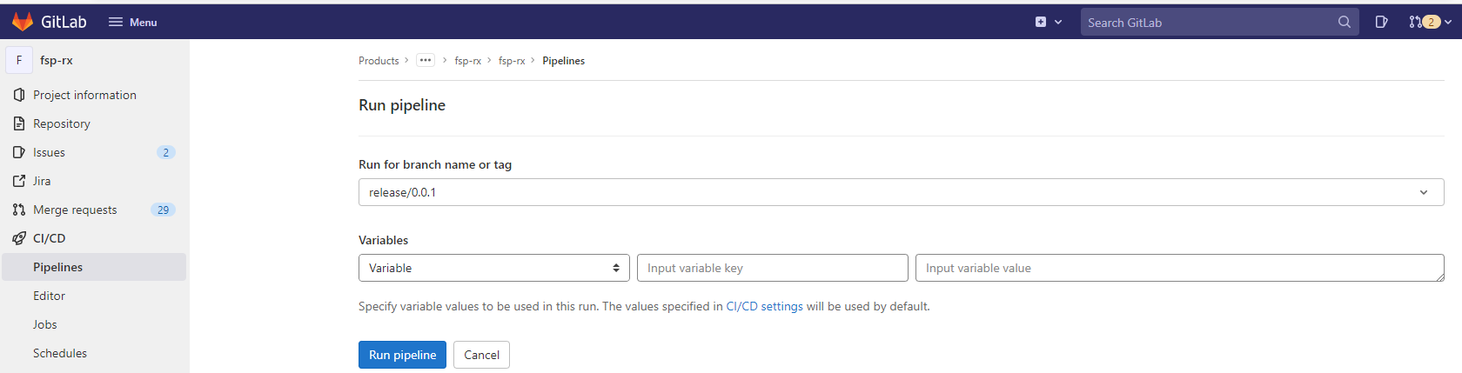
How to run a pipeline
Go to CI/CD,
then click “Run pipeline”
Select your branch from the drop down
Click "Run Pipeline" to start the pipeline
(1)
(1) your branch is configured in pipeline_builds.yml
(2) your branch is not configured in pipeline_builds.yml
- BUILD_MODULE
- BUILD_BOARD
- BUILD_COVERAGE_OFF
- BUILD_COVERAGE_ONLY
- BUILD_STAGE_ONLY
- BUILD_PACK_ONLY
- BUILD_NIGHTLY
- BUILD_XML_TESTS_ONLY
- BUILD_TEST_XML_DEFAULT_PROJECTS
- BUILD_XML_FRAMEWORK_TESTS
Configure variables then click "Run Pipeline" to start the pipeline
(2)
Notes:
In this session, I will go through the overview of recent FSP releases, new features released in FSP, features that are in development and planned features and finally the FSP roadmap.

Slide 5
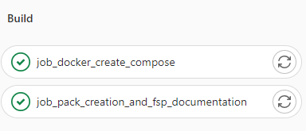
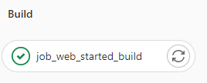
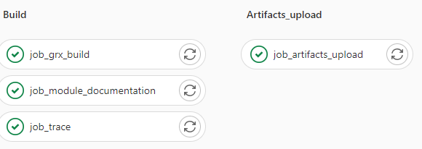
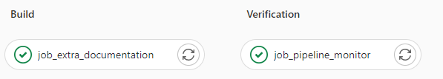
job_web_started_build
Starting pack creation
Starting pack Pipeline
Notes:
In this session, I will go through the overview of recent FSP releases, new features released in FSP, features that are in development and planned features and finally the FSP roadmap.

Slide 6
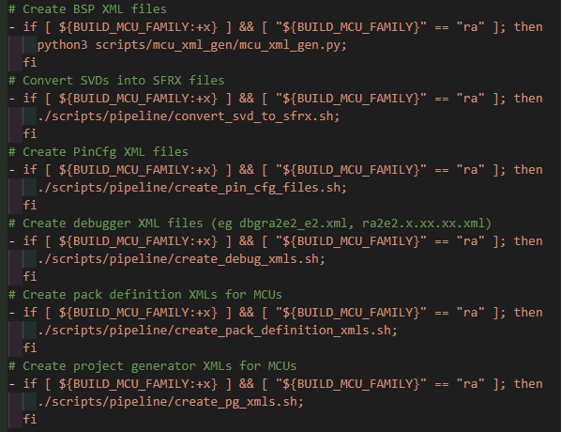
job_web_started_build
job_docker_create_compose
job_pack_creation_and_fsp_documentation
Create artifact docker-compose.yml
1. Build any dependent module libs
2. Create related XML files
3. Pack creation
(such as fsp_documentation_v0.0.2-rc.0+20230208.5226b602.zip)
Notes:
In this session, I will go through the overview of recent FSP releases, new features released in FSP, features that are in development and planned features and finally the FSP roadmap.

Slide 7
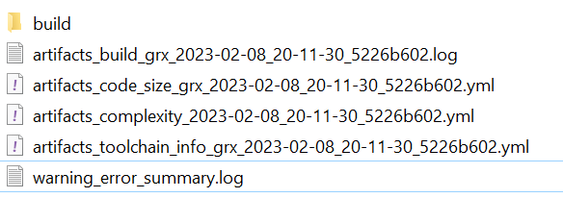
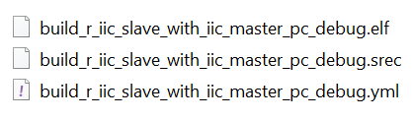
job_web_started_build
Build
Artifacts_upload
job_grx_build
job_module_documentation
job_trace
job_artifacts_upload
Build job with $BUILD_COMPILER_GRX == "1“
- Check target boards, MUC family
* create YML artifact file
* create *.Complexity file
* Parse code size for each module
* Parse complexity files and create YML artifact file
* created objdump files
scripts\sdlc_document_creator.py:
Update the doxyfile for the module
Create UM FSP documents based on *.md file
Verify there are no gaps in the trace matrix
scripts/trace_check.py:
Create artifacts_trace_*.yml
Artifact list: ${BUILD_MODULE}/requirements,
${BUILD_MODULE}/tests,
${BUILD_MODULE}/trace_summary
print environment variables
Combine all artifact files
See artifacts here (website):: http://global-infra-jp-main.dgn.renesas.com:8081/artifactory/webapp/#/artifacts/browse/tree/Properties/rx-driver-package/fsp_rx/manual
Notes:
In this session, I will go through the overview of recent FSP releases, new features released in FSP, features that are in development and planned features and finally the FSP roadmap.

Slide 8
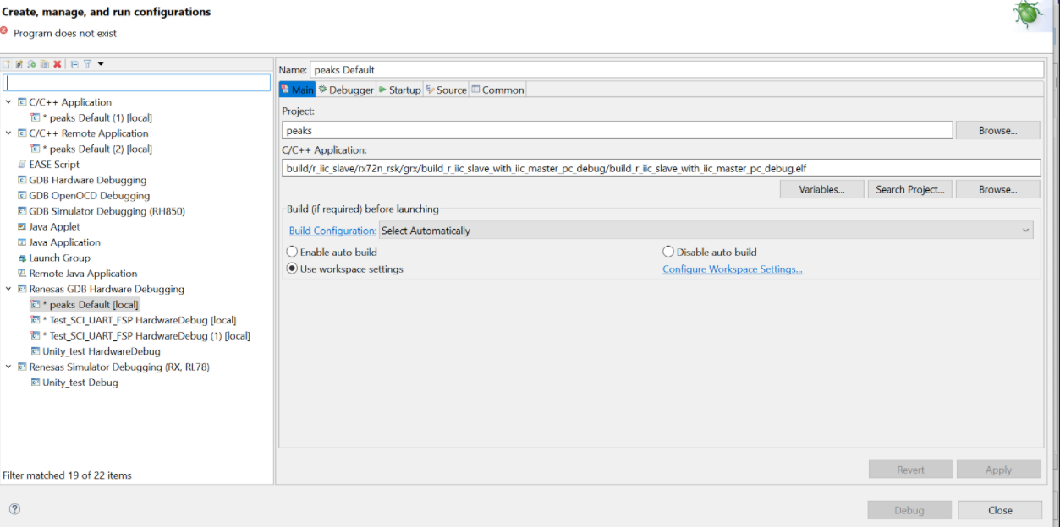
job_web_started_build
Build
Artifacts_upload
job_grx_build
job_module_documentation
job_trace
job_artifacts_upload
Build job with $BUILD_COMPILER_GRX == "1“
- Check target boards, MUC family
* create YML artifact file
* create *.Complexity file
* Parse code size for each module
* Parse complexity files and create YML artifact file
* created objdump files
scripts\sdlc_document_creator.py:
Update the doxyfile for the module
Create UM FSP documents based on *.md file
Verify there are no gaps in the trace matrix
scripts/trace_check.py:
Create artifacts_trace_*.yml
Artifact list: ${BUILD_MODULE}/requirements,
${BUILD_MODULE}/tests,
${BUILD_MODULE}/trace_summary
print environment variables
Combine all artifact files
See artifacts here (website):: http://global-infra-jp-main.dgn.renesas.com:8081/artifactory/webapp/#/artifacts/browse/tree/Properties/rx-driver-package/fsp_rx/manual
Notes:
In this session, I will go through the overview of recent FSP releases, new features released in FSP, features that are in development and planned features and finally the FSP roadmap.

Slide 9
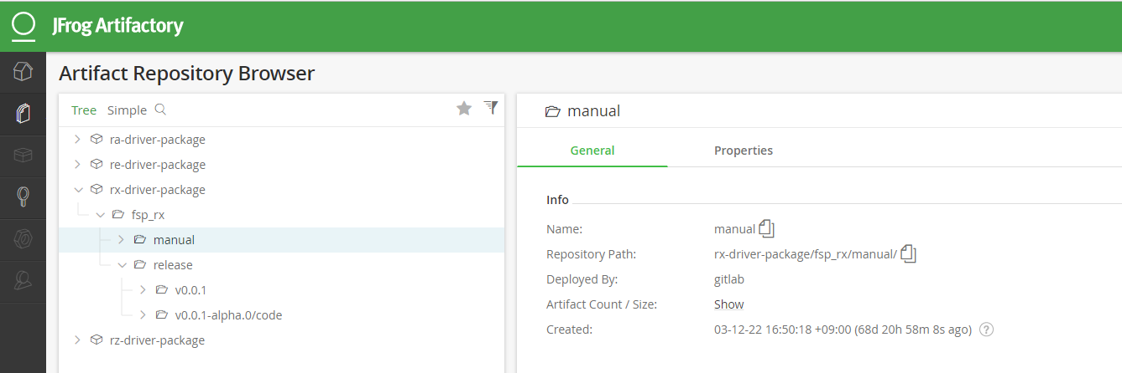
job_web_started_build
Artifact website:
Notes:
In this session, I will go through the overview of recent FSP releases, new features released in FSP, features that are in development and planned features and finally the FSP roadmap.

Slide 10
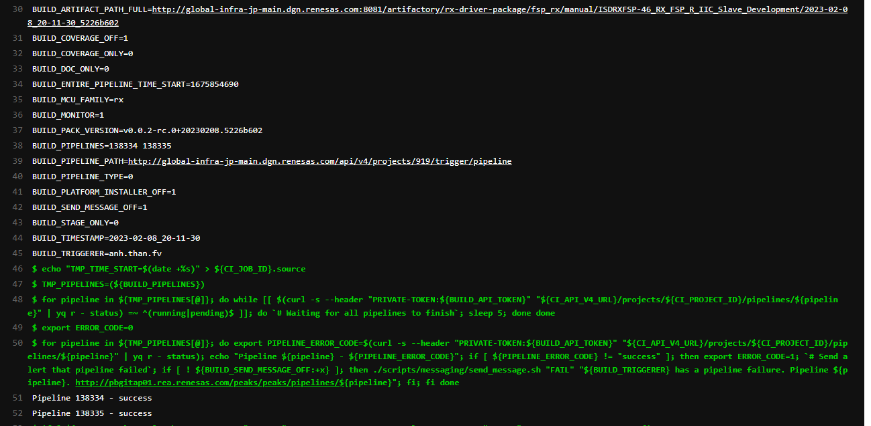
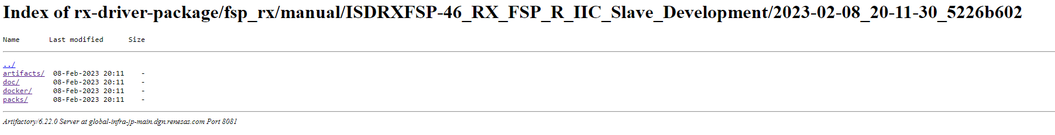
job_web_started_build
job_extra_documentation
job_pipeline_monitor
- Generate doxyfile based off template
- Generate HTML
- Zip up generated documentation
Upload document to artifact repo
Push full artifact on repos
(Ex: Index of rx-driver-package/fsp_rx/manual/ISDRXFSP-46_RX_FSP_R_IIC_Slave_Development/2023-02-08_20-11-30_5226b602 (renesas.com))
This job will monitor pipelines when multiple pipelines are triggered through 'job_web_started_build’
- Waiting for all pipelines to finish
Notes:
In this session, I will go through the overview of recent FSP releases, new features released in FSP, features that are in development and planned features and finally the FSP roadmap.

Slide 11
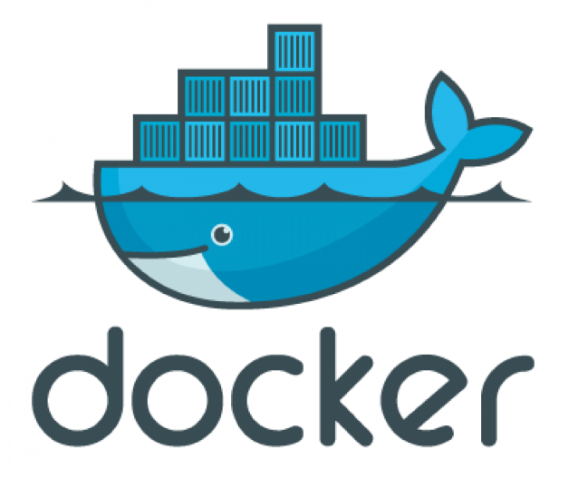
Artifact pUrposes
- artifacts/${BUILD_MODULE}_artifacts_combined_${BUILD_ARTIFACT_ID}.yml (created from 2st pipeline):
+ This artifact create by “job_trace”.
+ Purpose: using for traceability from requirements, coding to testing
doc/fsp_documentation_v*.zip: This is RX Flexible Software Package Documentation (website) (created from 1st pipeline)
docker/docker-compose.yml: record environment (such as ENV_FSP_PACKS_URL) and ports setting in case using “docker”. (created from 1st pipeline)
Packs/RX_FSP_Packs_*.zip: include *.pack files, use to install to e2 studio. (created from 1st pipeline)

Slide 12
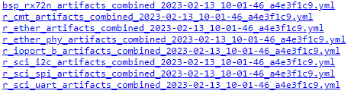
Summary - Note
SUMMARY: RX’s CI/CD purpose
Create artifacts: + YML files
+ fsp_user_manual (web)
+ docker_compose YML
+ packs
NOTE:
- Configuration for runner in config.toml files are located on REL’s lab PC, we must invest these configurations later.

Slide 13
Renesas.com
Notes:
Thank you everyone for your great support. FSP is growing to the next level with lot of new features and new device supports. Also expanding beyond RA to other Renesas MCU and MPU families.. So thank you very much for your contributions!

