Slide 1

Crypto api
Self investigate
FEB. 24
Bao Nguyen
Ra fsp, swdd,
Renesas Electronics Corporation

Slide 2
Agenda
Security of RA FSP Page 02
Secure Cryptographic Engine Page 04

Slide 3
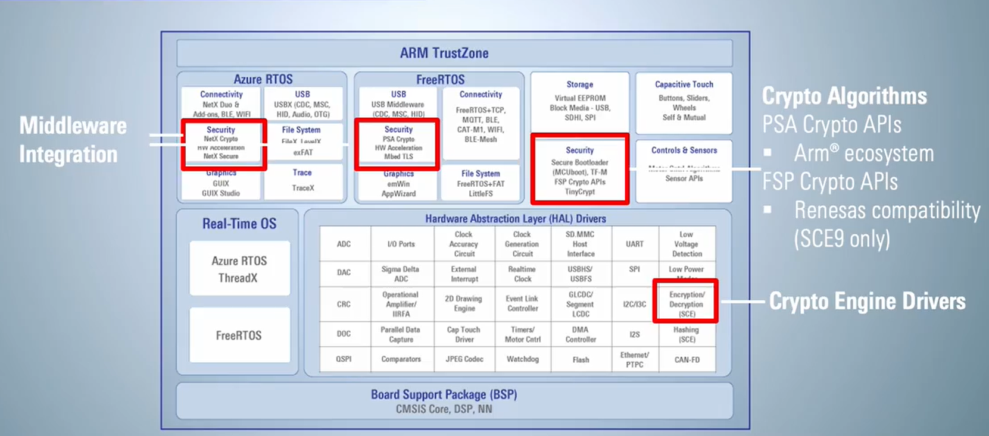
Security of RA FSP
Figure: Security of RA FSP
RA Family Integrated Crypto Engines | Renesas Electronics Corporation

Slide 4
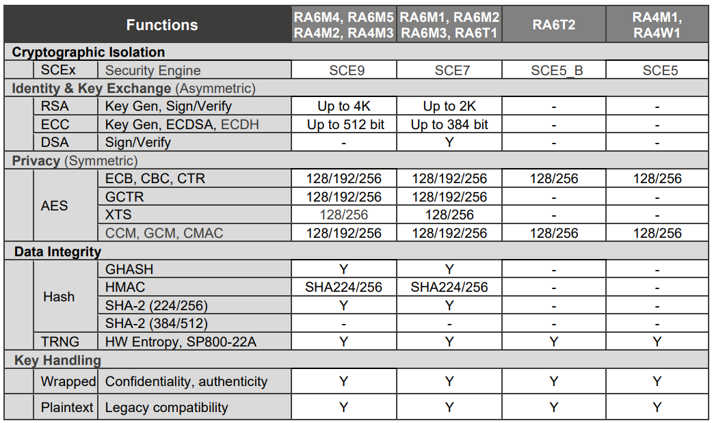
Secure Cryptographic Engine (SCE)
Table: SCE Cryptographic Capabilities
Notes:
Encryto engine: AES, AES-GCM(is realized by combining AES-GCTR and GHASH), Key management (only valid within the SCE9)
Random number generation: True Random Number Generate
Signature generation and verification: RSA, DSA, ECC
Message digest computation: HASH
HWUK:

Slide 5
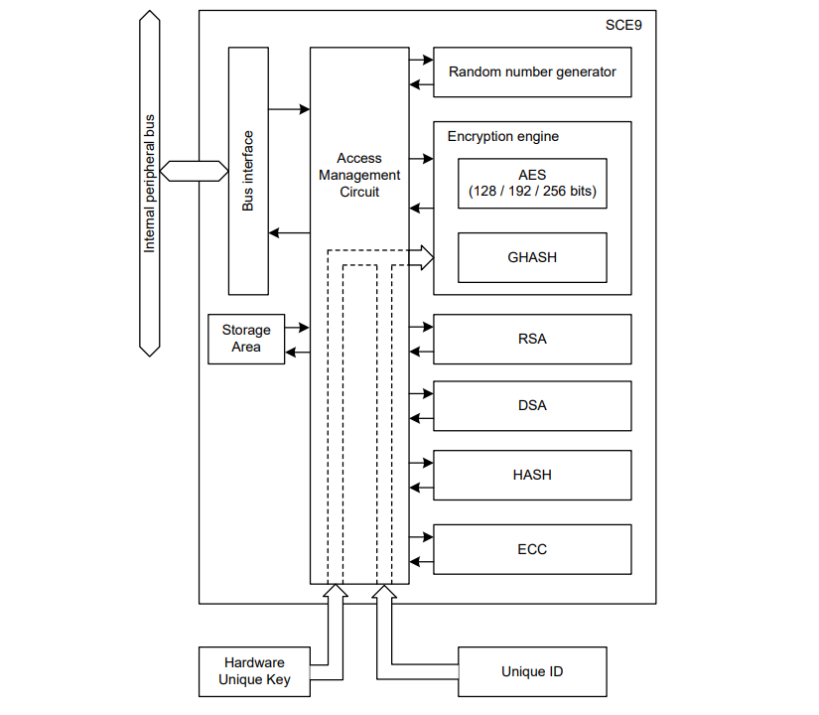
Secure Cryptographic Engine (SCE9)
SCE9 Secure Cryptographic Engine (SCE9) consists of the access management circuit, hardware accelerators for symmetric and asymmetric cryptographic algorithms, as well as various hashes and message authentication codes. It also contains a True Random Number Generator (TRNG), providing an entropy source for the cryptographic operations.
Key information required for encryption and decryption is stored only in the SCE9 and all accesses from the outside can be blocked, SCE9 enables building a more robust security system. Only access control circuit, random number generation circuit, and unique ID are supported, other is not guaranteed.
Figure: SCE Block diagram
Notes:
Encryto engine: AES, AES-GCM(is realized by combining AES-GCTR and GHASH), Key management (only valid within the SCE9)
Random number generation: True Random Number Generate
Signature generation and verification: RSA, DSA, ECC
Message digest computation: HASH
HWUK:

Slide 6
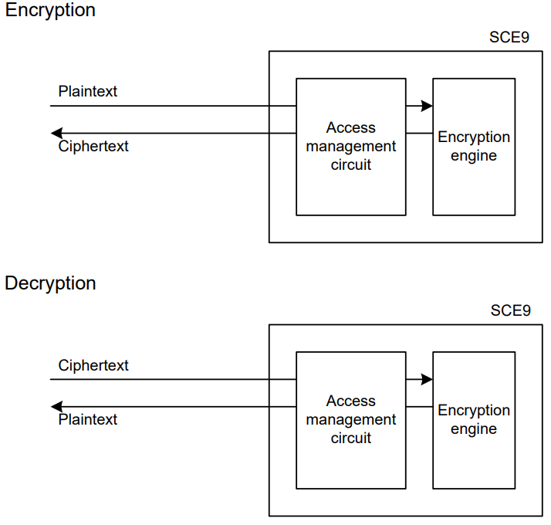
The encryption/decryption process
Encryption Engine uses the key generation information and converts the plaintext data to ciphertext or ciphertext data to plaintext through the hardware.
Figure: Conceptual diagram of the encryption engine

Slide 7
Feature of SCE
Cryptography in Encryption Engine:
Symmetric Encryption: AES
Asymmetric Encryption: RSA, DSA, ECC
Hashes: HASH, GHASH
Message Authentication Code
Key Support
TRNG
TLS
Encryption Engine
Symmetric Encryption
Asymmetric Encryption
Hashes
Figure: Encryption Engine
Notes:
Message Authentication Code
HMAC-SHA256bit
AES-CMAC 128/256bit
Key Support
AES 128/256bit
AES Key Wrap/Key Unwrap 128/256bit
RSA 1024/2048bit
RSA 3072/4096bit (public key only)
ECC secp192r1/secp224r1/secp256r1/secp384r1
HMAC-SHA256bit
TRNG
TLS
SSL / TLS support function (TLS1.2 compliant)

Slide 8
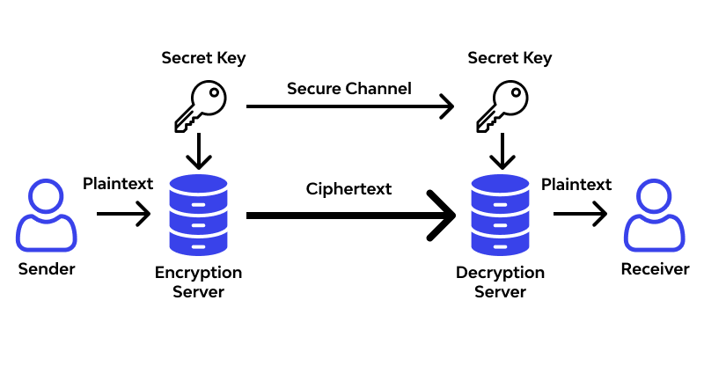
Feature of SCE ASE
Figure: Symmetric Encryption/Decryption

Slide 9
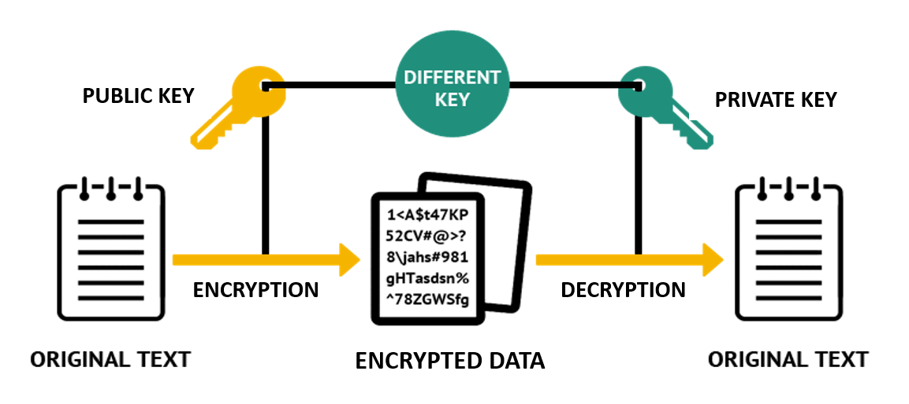
Feature of SCE rsa/ecc
Figure: Asymmetric Encryption/Decryption

Slide 10
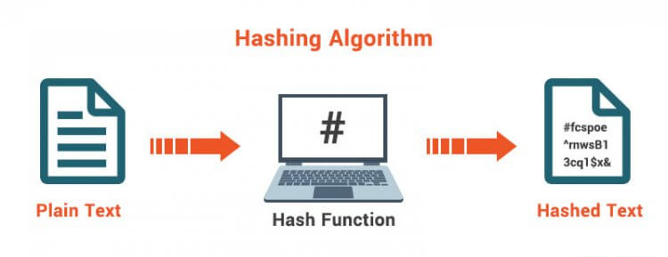
Feature of SCE hash
Figure: Hash Functions

Slide 11
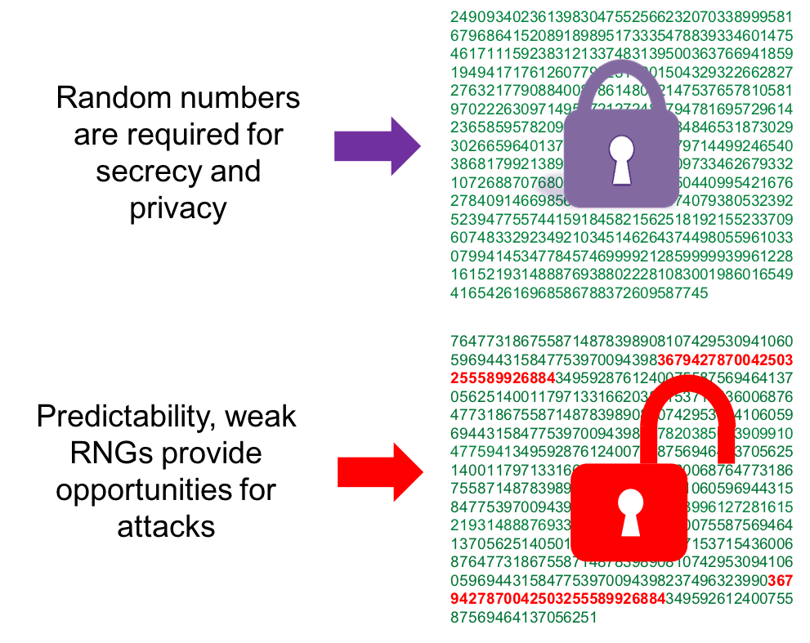
Feature of SCE TRNG
Figure: TRNG
Notes:
True Random Number Generator (TRNG), providing an entropy source for the cryptographic operations

Slide 12
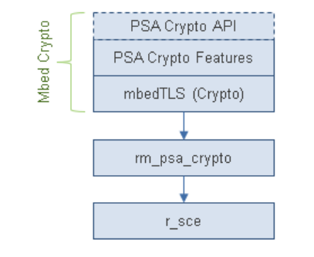
MODULEs SEcURITY
Azure RTOS NetX Crypto HW Acceleration (rm_netx_secure_crypto): Hardware acceleration for the Netx Crypto implementation of the Microsoft Azure RTOS NetX Crypto API.
Mbed Crypto HW Acceleration (rm_psa_crypto): Hardware acceleration for the mbedCrypto implementation of the ARM PSA Crypto API.
TinyCrypt TRNG (rm_tinycrypt_port): AES128 Hardware acceleration for TinyCrypt on the RA2 family.
SCE Protected Mode: Driver for the Secure Crypto Engine (SCE9) on RA MCUs.
Secure Crypto Engine (r_sce_protected_cavp): Driver for the CAVP Certified Secure Crypto Engine (SCE) on RA MCUs.
Secure Key Injection (r_sce_key_injection): Driver for the Secure Key Injection on RA MCUs.
Figure: Crypto Stack
Notes:
r_sce access hw SCE9
For most application
use the middleware Platform Security Architecture (PSA) Crypto layer to
interface with the SCE9
However
some SCE9 functionality does not map to PSA Crypto APIs; therefore,
r_sce key injection related APIs must be used directly.

Slide 13
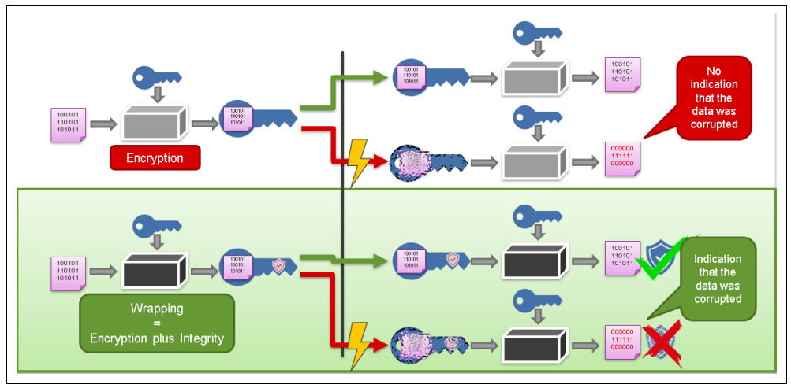
SCE mode
Secure Crypto Engine 9 (SCE9) on Renesas RA Family MCUs can operate in two different modes, called Compatibility Mode and Protected Mode. In Compatibility Mode, SCE9 can inject secure keys as well as plaintext keys. In Protected Mode, SCE9 can inject only secure keys.
Plaintext keys: key to encrypt a plaintext to cyphertext. If the recipient unknowingly receives corrupted information, the decryption algorithm will generate garbage data, with no indication that the original data has been corrupted.
Secure keys: accomplished by storing application keys in wrapped format, encrypted and tagged with a Message Authentication Code to the encrypted output for integrity checking.
Figure: Key Wrapping versus Key Encryption
Notes:
When data is encrypted and sent to another recipient, if that recipient has the same key, they can decrypt the data. This results in a confidential exchange of information. However, what if there was a problem with the transmission of the encrypted data? If the recipient unknowingly receives corrupted information, the decryption algorithm will generate garbage data, with no indication that the original data has been corrupted. Wrapping solves this problem by appending a Message Authentication Code to the encrypted output for integrity checking.

Slide 14
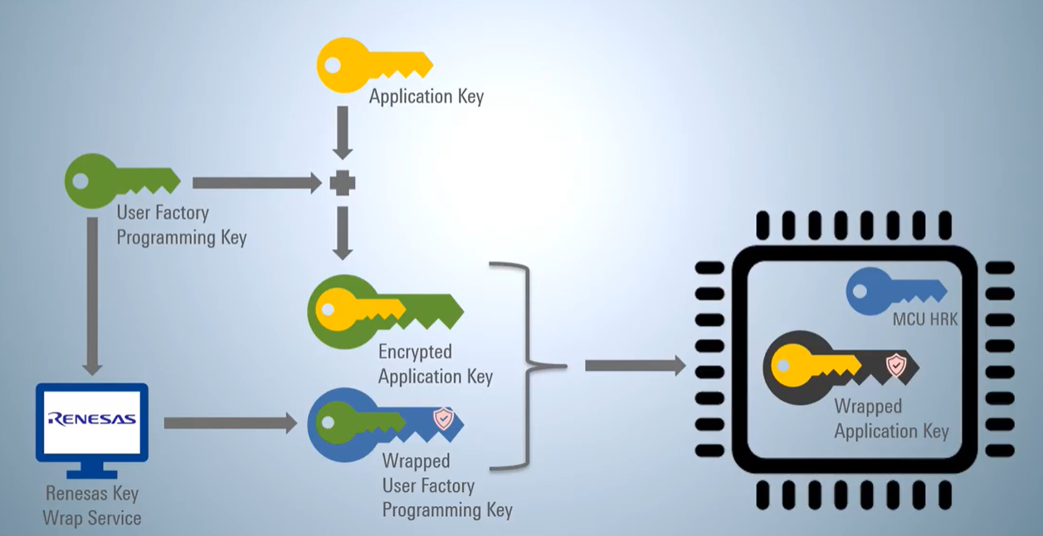
Steps for Secure Key(SECUREd MODE)
Figure: Steps for Secure Key
RA Family Secure Key Installation | Renesas
Detail Example Project for RA6M4 (SCE9 Protected Mode) in R11AN0496

Slide 15
Tools Used in the Secure Key(SECUREd MODE)
1. Gpg4win establish a PGP encrypted communication channel between user and the Renesas Key Wrap server.
2. Security Key Management Tool: Generate key, Wrap key
3. Renesas Flash Programmer: Install this key to MCU.
4. E2 studio use as software project development environment.

Slide 16
Example and reference
Example:
\ra-fsp\ra\fsp\src\r_sce_protected\!example\r_sce_protected_example.c
RA Flexible Software Package Documentation: SCE Protected Mode (renesas.github.io)
Reference:
RA4M3 HWM
RA Flexible Software Package Documentation: Security (renesas.github.io)
Renesas RA Family Device Lifecycle Management Key Installation
RA and FSP Curriculum: I-009 Introduction to Security for RA and FSP (FSP 4.0.0) | Renesas Customer Hub
RA Family Integrated Crypto Engines | Renesas Electronics Corporation

Slide 17
Renesas.com

