Slide 1

TRUSTZONE for
AARCH64
Date: May.23
Name: Huynh Thai
Engineer, RA FSP ,
Fsp 1
Renesas Electronics Corporation

Slide 2
Agenda
What is TrustZone ? Page 03
TrustZone In The Processor Page 08
System Architecture Page 13
Use Case Page 20

Slide 3
What is TrustZone ?

Slide 4
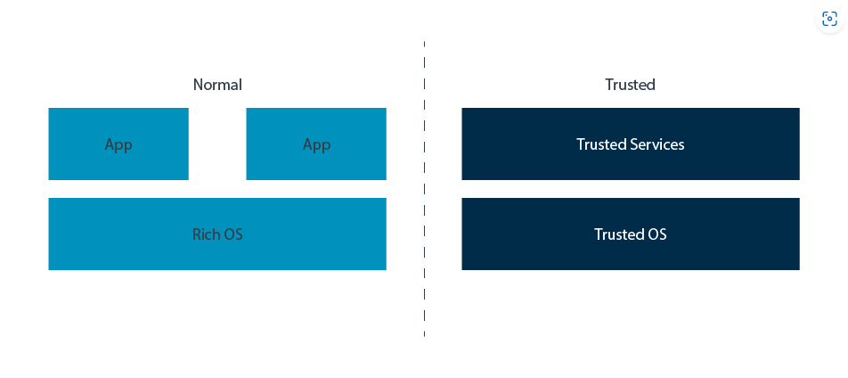
What is trustzone ?
TrustZone is the name of the Security architecture in the Arm A-profile architecture
TrustZone provides two execution environments with system-wide hardware enforced isolation between them, as shown in this diagram

Slide 5
What is trustzone ?
The Normal world or Rich Execution Environment (REE) runs a rich software stack. This software stack typically includes a large application set, a complex operating system like Linux, and possibly a hypervisor. Such software stacks are large and complex. While efforts can be made to secure them, the size of the attack surface means that they are more vulnerable to attack.
The Trusted world runs a smaller and simpler software stack, which is referred to as a Trusted Execution Environment (TEE). Typically, a TEE includes several Trusted services that are hosted by a lightweight kernel. The Trusted services provide functionality like key management. This software stack has a considerably smaller attack surface, which helps reduce vulnerability to attack.
TrustZone is supported on both processor and memory

Slide 6
Trustzone in the processor

Slide 7
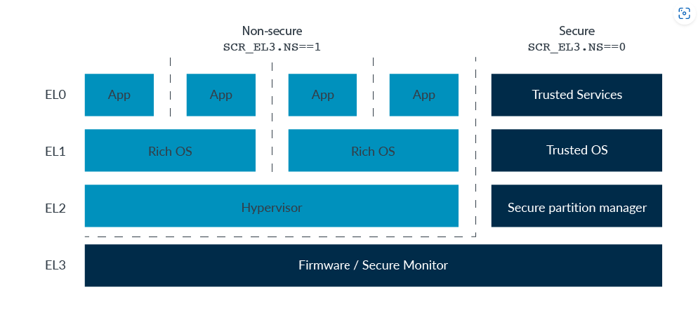
Exception Level
Exception Level (EL):
EL0 = User, EL1 = Supervisor (OS), EL2 = Hypervisor, EL3 = Monitor
At EL0, EL1, and EL2 the processor can be in either Secure state or Non-secure state, which is controlled by the SCR_EL3.NS bit. EL3 is always in Secure state, regardless of the value of the SCR_EL3.NS bit
It mean that on User, OS, Hypervisor on REE can be S or NS, TEE and firmware always at S

Slide 8
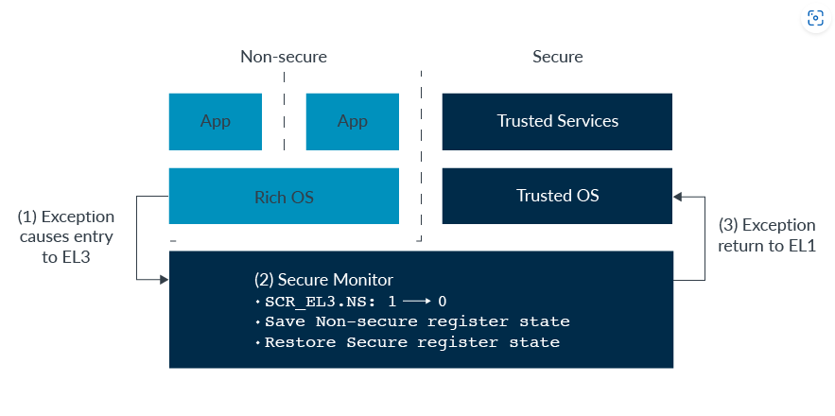
Switching between Security states
Entering a higher Exception level requires an exception. Typically, this exception would be an FIQ or an SMC (Secure Monitor Call) exception.
FIQ: In ARM FIQ mean Fast Interrupt, the priority of FIQ is higher than normal interrupt (IRQ), FIQ handler code typically cannot be written in C - it needs to be written directly in assembly language.
EL3 is entered at the appropriate exception vector. Software that is running in EL3 toggles the SCR_EL3.NS bit.
There is only one copy of the vector registers (NS), the general-purpose registers (NS), and most System registers (S). When moving between Security states it is the responsibility of software, not hardware, to save and restore register state. By convention, the piece of software that does this is called the Secure Monitor.

Slide 9
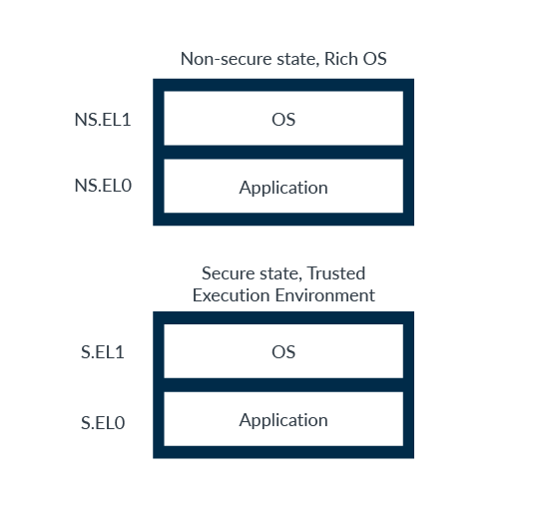
Virtual/Physical address space
When writing addresses, it is convention to use prefixes to identify which translation regime is being referred to:
NS.EL1:0x8000 - Virtual address 0x8000 in the Non-secure EL0/1 translation regime
S.EL1:0x8000 - Virtual address 0x8000 in the Secure EL0/1 translation regime
It is important to note that S.EL1:0x8000 and NS.EL1:0x8000 are two different and independent virtual addresses. The processor does not use a NS.EL1 translation while in Secure state, or a S.EL1 translation while in Non-secure state.
While in Non-secure state, virtual addresses always translate to Non-secure physical addresses. This means that software in Non-secure state can only see Non-secure resources, but it can never see Secure resources.
While in Secure state, software can access both the Secure and Non-secure physical address spaces.

Slide 10
Cache
When software issues a cache invalidate operation (TLBI instruction) at EL1 or EL2, the software targets the current Security state. Therefore, TLBI ALLE1 from Secure state invalidates all cached entries for the S.EL0/1 translation regime.
EL3 is a special case. As covered earlier in Security states, when in EL0/1/2 the SCR_EL3.NS bit controls which Security state the processor is in. However, EL3 is always in Secure state, regardless of the SCR_EL3.NS bit. When in EL3, SCR_EL3.NS lets software control which Security state TLBIs operate on.
For example, executing TBLI ALLE1 at EL3 with:
SCR_EL3.NS==0: Affects Secure EL0/1 translation regime
SCR_EL3.NS==1: Affects Non-secure EL0/1 translation regime

Slide 11
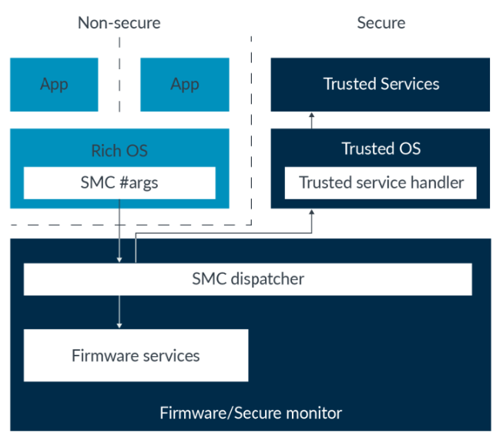
Secure Monitor Call (SMC)
SMC are normally used to request services, either from firmware resident in EL3 or from a service that is hosted by the Trusted Execution Environment. The SMC is initially taken to EL3, where an SMC dispatcher determines which entity the call will be handled by. The SMC instruction is not available at EL0 in either Security state.

Slide 12
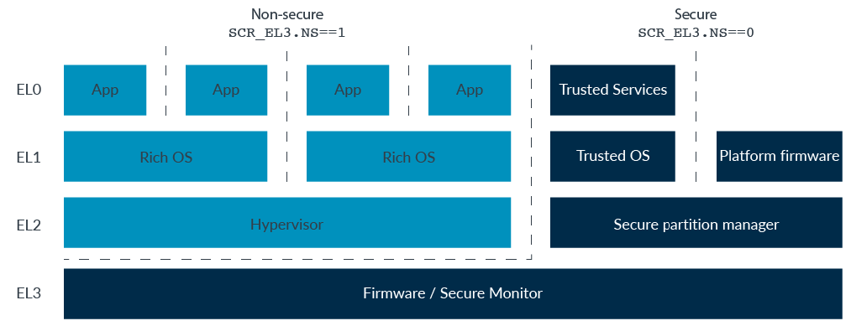
Secure virtualization
Rather than a full hypervisor, S.EL2 typically hosts a Secure Partition Manager (SPM). An SPM allows the creation of the isolated partitions, which are unable to see the resources of other partitions. A system could have multiple partitions containing Trusted kernels and their Trusted services.
A partition can also be created to house platform firmware, removing the need to have that code that is run at EL3.
When S.EL2 is supported, it can be enabled or disabled. Whether S.EL2 is enabled is controlled by the SCR_EL3.EEL2 bit:
0: S.EL2 disabled, behavior is as on a processor not supporting S.EL2
1: S.EL2 enabled

Slide 13
System architecture

Slide 14
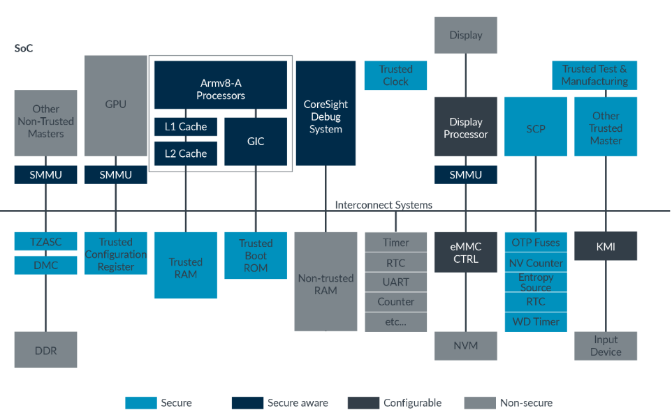
System architecture
TrustZone-enabled system:

Slide 15
Enforcing isolation
The requester signals the security of its access, and the memory system decides whether to allow the access
Secure::
Only Secure accesses are passed to device. Interconnect generates a fault for all Non-secure accesses, without the access being presented to the device.
Non-secure:
Only Non-secure accesses are passed to device. Interconnect generates a fault for all Secure accesses, without the access being presented to the device.
Boot time configurable:
At boot time, system initialization software can program the device as Secure or Non-secure. The default is Secure.
TrustZone aware:
The interconnect allows all accesses through. The connected device must implement isolation.

Slide 16
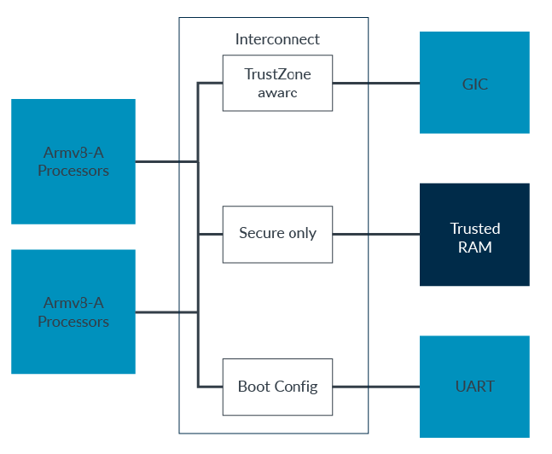
Enforcing isolation
Implement Isolation:

Slide 17
Interrupts
The processor has two interrupt exceptions, IRQ and FIQ. When an interrupt becomes pending, the Generic Interrupt Controller (GIC) uses different interrupt signals depending on the group of the interrupt and the current Security state of the processor:
Group 0 interrupt:
Always signaled as FIQ exception
Secure Group 1:
Processor currently in Secure state – IRQ exception
Processor currently in Non-secure state – FIQ exception
Non-secure Group 1:
Processor currently in Secure state – FIQ exception
Processor currently in Non-secure state – IRQ exception
Remember that Group 0 interrupts are typically used for the EL3 firmware. This means that:
IRQ means a Group 1 interrupt for the current Security state.
FIQ means that we need to enter EL3, either to switch Security state or to have the firmware handle the interrupt.

Slide 18
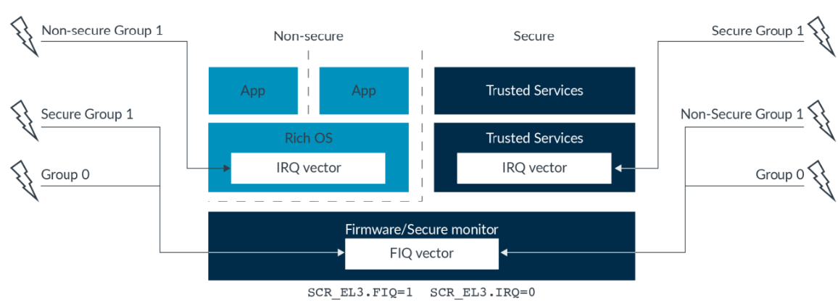
Interrupts
Interrupt groups

Slide 19
Other devices
One-time programmable memory (OTP) or fuses
These are memories that cannot be changed once they are written. Unlike a boot ROM which contains the same image on each chip
One of the things that is stored in OTP is a device unique private key. When each chip is manufactured, a randomly generated unique key is written to the OTP. This device unique private key is used to tie data to the chip.
The advantage of a device unique private key is that it prevents class attacks. If each chip had the same key, if one device is compromised then all similar devices would also be vulnerable.
OTP is also often used to store hashes of OEM public keys. OTP is relatively expensive compared to other memories. For public keys, only storing the hash and not storing the full key saves cost.
Trusted RAM and Trusted ROM
These are on-chip Secure access only memories.
The Trusted ROM is where the first boot code is fetched from. Being on-chip means that an attacker cannot replace it. Being a ROM means that an attacked cannot reprogram it. This means that we have a known, trusted, starting point of execution, and will be discussed in the Software architecture section of this guide.
The Trusted RAM is typically an SRAM of a couple of hundred kilobytes. This is the working memory of the software that is running in Secure state. Again, being on-chip makes it difficult for an attacker to gain access to its content.

Slide 20
Use case

Slide 21
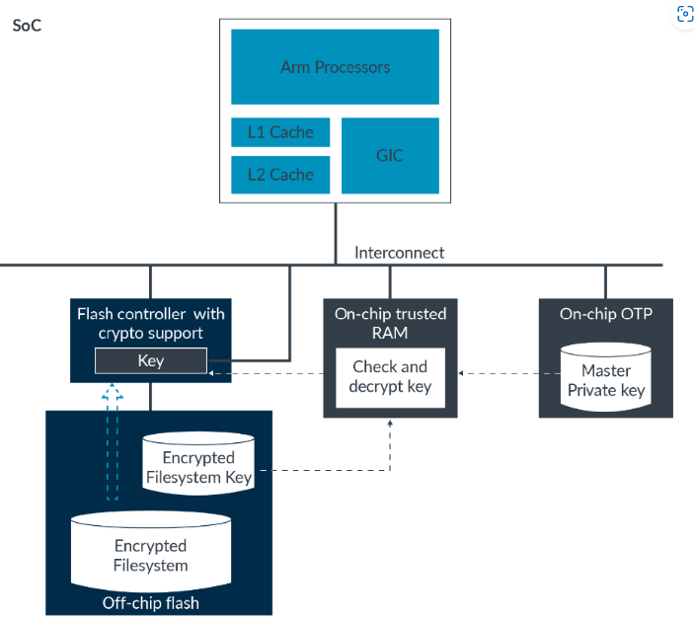
Use case
Mobile devices like smartphones contain a lot of personal data. Users care about the confidentiality of that data if the device is lost or stolen. This is why most recent devices support file system encryption. TrustZone can be used part of the solution for protecting this data.
Data stored in the external flash is encrypted. On boot, the device authenticates the user and then provisions the key to decrypt the filesystem. Decryption might be handled by an accelerator or might be integrated into the flash controller.
The key for the file system also needs to have its confidentiality protected. If they key is compromised, an attacker could decrypt the filesystem.

Slide 22
Renesas.com

