Slide 1

UART
Ra fsp investigation
Feb 17, 2023
Canh phan
Software development department
Ra fsp group
Renesas Electronics Corporation

Slide 2
Agenda
What is UART?
UART on FSP
Reference

Slide 3
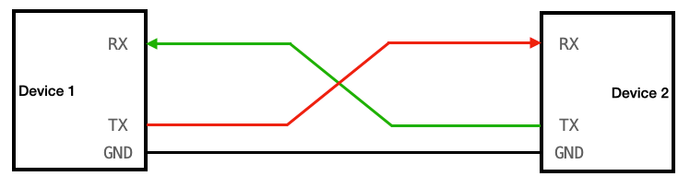
What is UART?
Universal Asynchronous Receiver/Transmitter, usually call UART, is a serial, asynchronous, full-duplex communication protocol that is widely used in the embedded field.
As a kind of asynchronous serial communication protocol, UART works by transmitting each binary bit of the transmitted data bit by bit.

Slide 4
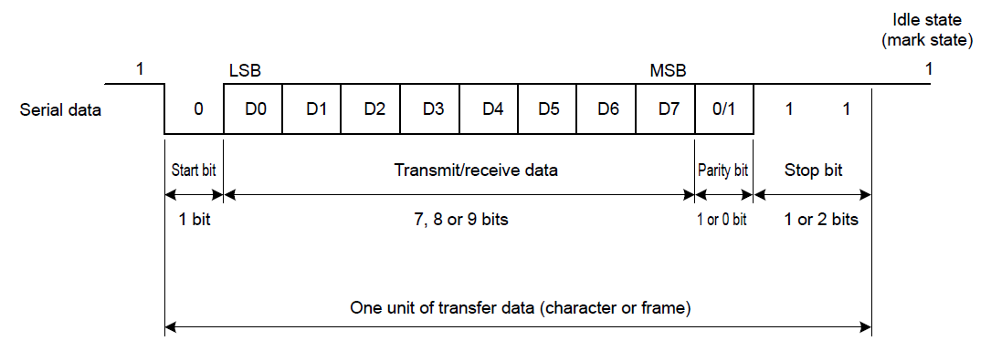
What is UART?
Data framing
A UART frame consists of 5 elements:
Idle state (high level)
Start bit (low level)
Data bits
Parity bit (high or low level)
Stop bit (high level)

Slide 5
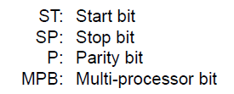
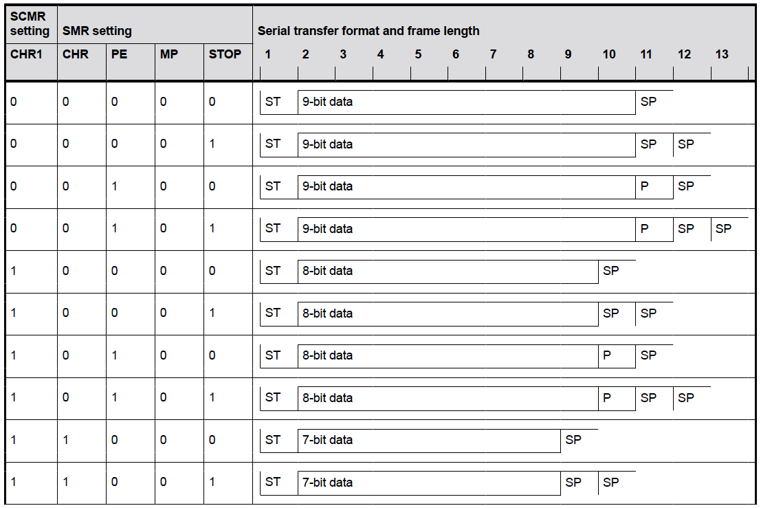
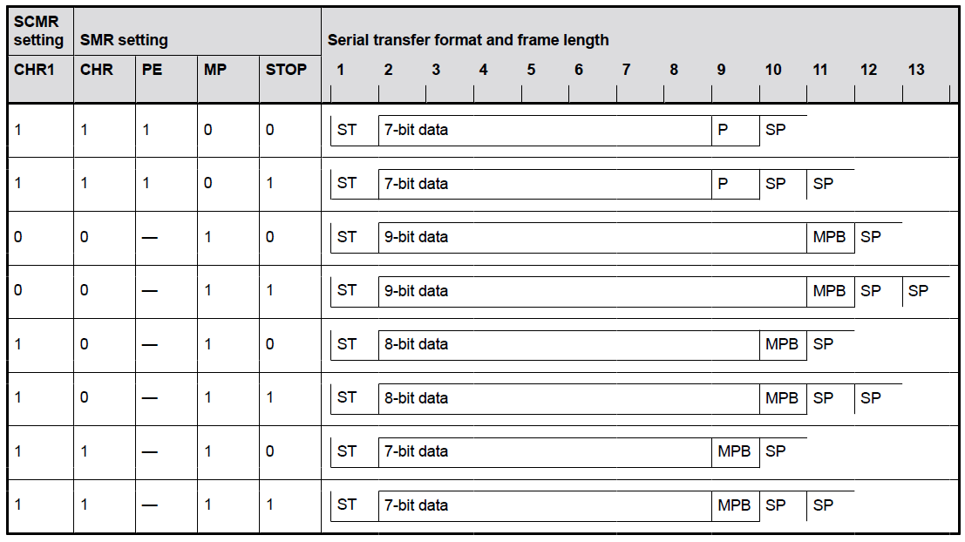
What is UART?
Any of 18 transfer formats can be selected with the SMR and SCMR settings.
RA4M3 Group User’s Manual Hardware

Slide 6
What is UART?
Baud rate:
The Baud rate is the number of signal changes that occur in one second, and it directly influences how quickly a device can transmit data.
In the serial port context, "9600 baud" means that the serial port is capable of transferring a maximum of 9600 bits per second.
Since there is no clock signal in asynchronous communication, the two communication devices need to agree on a baud rate. Common ones are 4800, 9600, 115200, etc.

Slide 7
What is UART?
Error states
Parity error: A parity error occurs when the parity of the number of one-bits disagrees with that specified by the parity bit.
Overrun error: An overrun error occurs when the receiver cannot process the character that just came in before the next one arrives.
Framing error: A UART will detect a framing error when it does not see a "stop" bit at the expected "stop" bit time.
RA4M3 Group User’s Manual Hardware

Slide 8
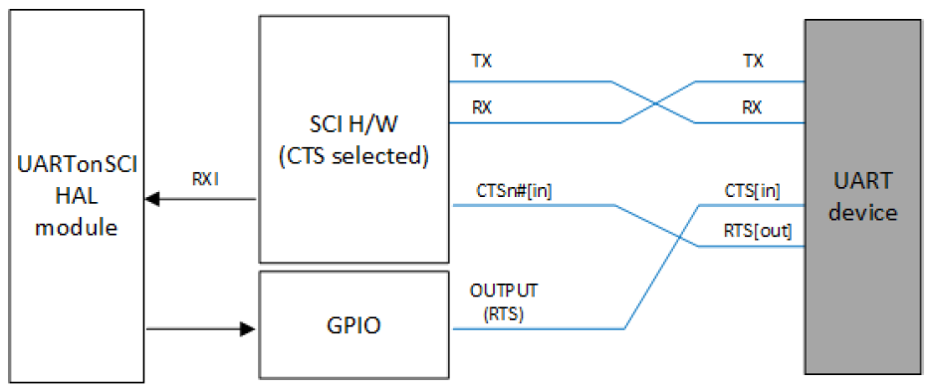
What is UART?
CTS/RTS Hardware Flow Control
UART HAL module guide

Slide 9
UART on FSP
Function | Description
fsp_err_t R_SCI_UART_Open ( uart_ctrl_t *const p_api_ctrl, uart_cfg_t const *const p_cfg ) | Configures the UART driver based on the input configurations. If reception is enabled at compile time, reception is enabled at the end of this function.
fsp_err_t R_SCI_UART_Close ( uart_ctrl_t *const p_api_ctrl) | Aborts any in progress transfers. Disables interrupts, receiver, and transmitter. Closes lower level transfer drivers if used. Removes power.
fsp_err_t R_SCI_UART_Read ( uart_ctrl_t *const p_api_ctrl, uint8_t *const p_dest, uint32_t const bytes ) | Receives user specified number of bytes into destination buffer pointer.
fsp_err_t R_SCI_UART_Write ( uart_ctrl_t *const p_api_ctrl, uint8_t const *const p_src, uint32_t const bytes ) | Transmits user specified number of bytes from the source buffer pointer.
fsp_err_t R_SCI_UART_CallbackSet ( uart_ctrl_t *const p_api_ctrl, void(*)(uart_callback_args_t *) p_callback, void const *const p_context, uart_callback_args_t *const p_callback_memory ) | Updates the user callback and has option of providing memory for callback structure.
fsp_err_t R_SCI_UART_BaudSet ( uart_ctrl_t *const p_api_ctrl, void const *const p_baud_setting ) | Updates the baud rate using the clock selected in Open. p_baud_setting is a pointer to a baud_setting_t structure.
fsp_err_t R_SCI_UART_InfoGet ( uart_ctrl_t *const p_api_ctrl, uart_info_t *const p_info ) | Provides the driver information, including the maximum number of bytes that can be received or transmitted at a time.
fsp_err_t R_SCI_UART_Abort ( uart_ctrl_t *const p_api_ctrl, uart_dir_t communication_to_abort ) | Provides API to abort ongoing transfer. Transmission is aborted after the current character is transmitted. Reception is still enabled after abort(). Any characters received after abort() and before the transfer is reset in the next call to read(), will arrive via the callback function with event UART_EVENT_RX_CHAR.
fsp_err_t R_SCI_UART_ReadStop ( uart_ctrl_t *const p_api_ctrl, uint32_t * remaining_bytes ) | Provides API to abort ongoing read. Reception is still enabled after abort(). Any characters received after abort() and before the transfer is reset in the next call to read(), will arrive via the callback function with event UART_EVENT_RX_CHAR.
fsp_err_t R_SCI_UART_BaudCalculate ( uint32_t baudrate, bool bitrate_modulation, uint32_t baud_rate_error_x_1000, baud_setting_t *const p_baud_setting ) | Calculates baud rate register settings. Evaluates and determines the best possible settings set to the baud rate related registers.

Slide 10
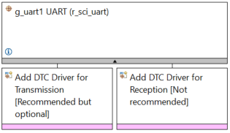
UART on FSP
UART HAL Module on r_sci_uart
UART HAL Module Stack
UART HAL Module Lower Level Modules
the Transfer Driver on r_dtc Event SCI0 TXI
the Transfer Driver on r_dtc Event SCI0 RXI

Slide 11
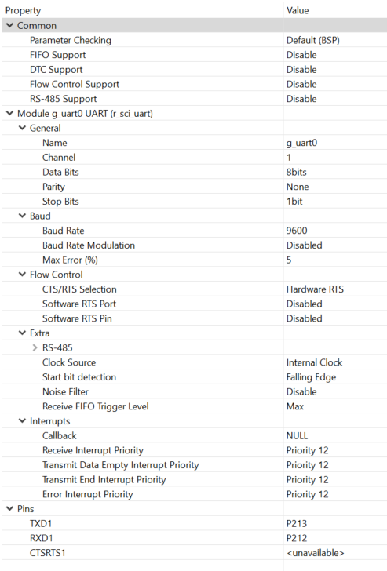
UART on FSP
selected code for parameter checking
Enable/disable FIFO Support, DTC Support, Flow Control Support, RS-485 Support
Configuring the UART HAL Module
Module name
Select the SCI channel
Select the number of bits per word
Select the parity mode
Select the number of stop bits
Enter the desired baud rate
Enable/disable Baud rate modulation
Maximum percent error
Configure for flow control
RS-485 configuration
Selection of the clock source
Start bit detected as falling edge or low level
Enable/disable the digital noise filter
Set to One/Max for Receive FIFO Trigger Level
A user callback function can be provided
Select the interrupt priority
Display the configured pins

Slide 12
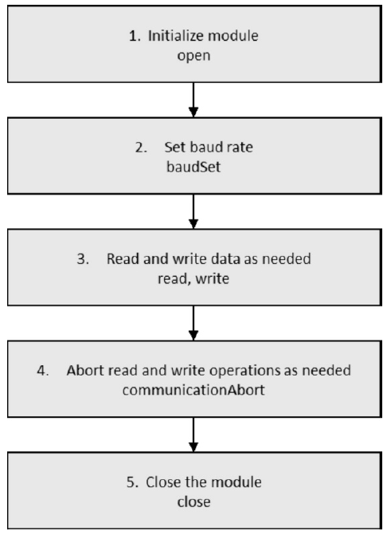
UART on FSP
Flow Diagram of a Typical UART HAL Module Application

Slide 13
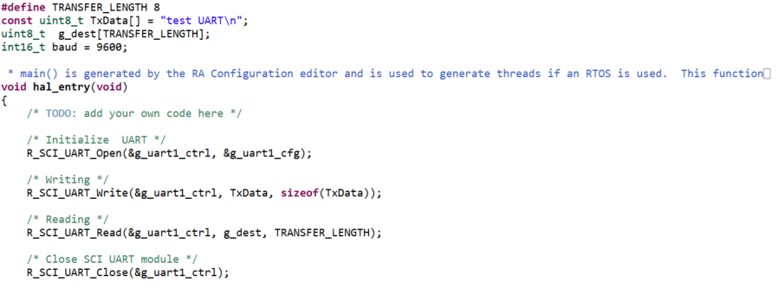
UART on FSP
UART Example

Slide 14
reference
RA Flexible Software Package Documentation https://renesas.github.io/fsp/
UART HAL module guide https://www.renesas.com/us/en/document/apn/uart-hal-module-guide
RA4M3 Group User’s Manual Hardware https://www.renesas.com/us/en/document/man/ra4m3-group-users-manual-hardware?r=1400806
https://www.seeedstudio.com/blog/2022/09/08/uart-communication-protocol-and-how-it-works/

Slide 15
Renesas.com

