Slide 1

USB 2.0
SW investigation
Renesas Electronics corporation
OCT, 2023

Slide 2
agenda
I. Common
II. Device - USB PPRN EP with FreeRTOS
III. Host - USB PPRN EP with FreeRTOS
IV. Run a PPRN Test case sample

Slide 3
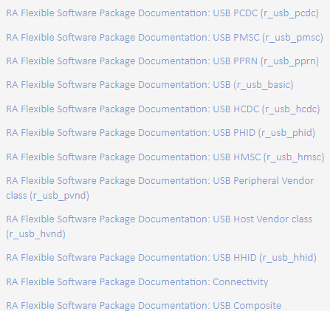
I. Common
USB (r_usb_basic) for the common API (r_usb_basic) to be called from the application.
These module provide USB Peripheral/Host Specific Class Driver:
PCDC: USB Peripheral Communications Device Class Driver
HCDC: USB Host Communications Device Class Driver
PMSC: USB Peripheral Mass Storage Class Driver
HMSC: USB Host Mass Storage Class Driver
PHID: USB Peripheral Human Interface Device Class Driver
HHID: USB Host Human Interface Device Class Driver
PVND: USB Peripheral Vendor Class Driver
HVND: USB Host Vendor Class Driver
PPRN: USB Peripheral Printer Device Class Driver

Slide 4
I. Common r_usb_basic
The USB module has the following key features: (RA Flexible Software Package Documentation: USB (r_usb_basic) (renesas.github.io))
USB Host mode
Enumerates Low/Full/High-speed devices (see note below)
Automatic transfer error determination and retry
USB Peripheral mode
Supports USB1.1/2.0/3.0 hosts
Automatic processing of device connect/disconnect, suspend/resume, and USB bus reset
Up to 10 pipes
Control transfers supported on pipe 0
Data transfer on pipes 1 to 9 (Bulk or Interrupt)
Functions with or without an RTOS

Slide 5
Ii. USB pprn ep with FreeRTOS
Device
Host
JlinkRTT Viewer
RA MCU
USB PPRN Driver
will configure the board as printer device
USB status output
Communicate on COM port and Writing data

Slide 6
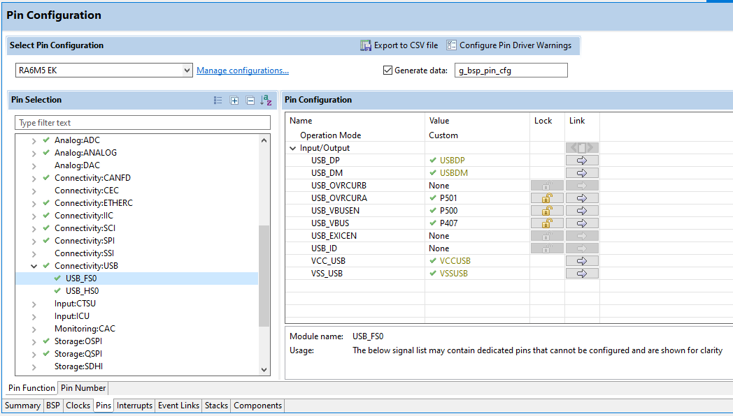
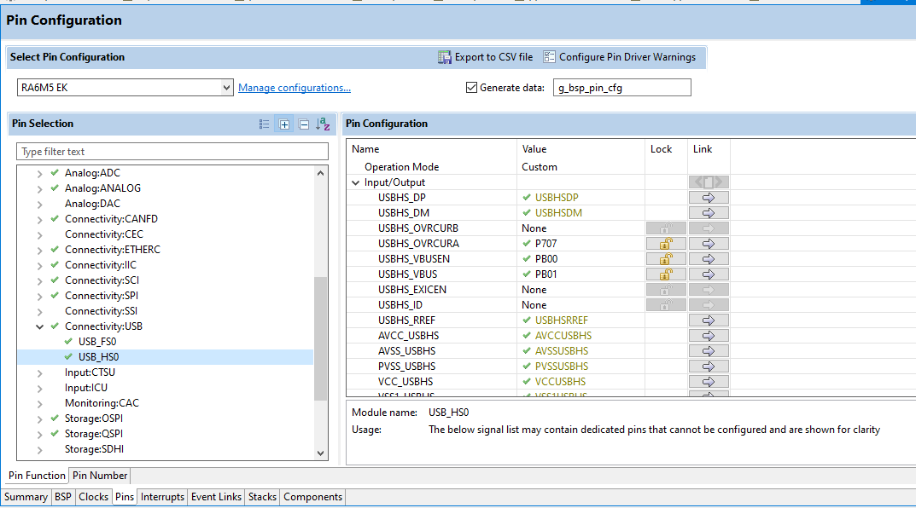
Ii. Device - USB pprn ep with FreeRTOS 2.1 step to create EP
Step 1: Create new project
Step 2: Pin configuration
Tip: Pin configuration can be reused from similar project (then upgrade FSP version and modify stack/code).

Slide 7
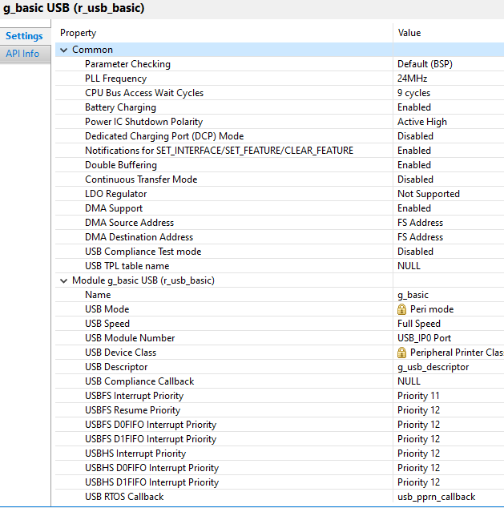
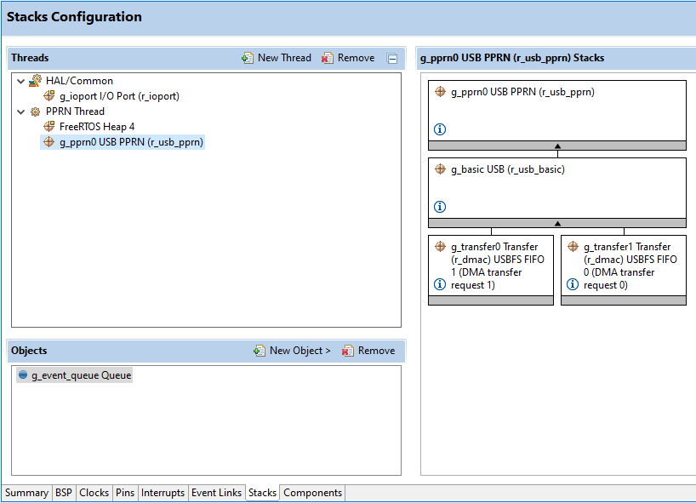
Ii. Device - USB pprn ep with FreeRTOS 2.1 step to create USB EP
Step 3: Add new USB stack and queue object
1
2
3
Important properties

Slide 8
Ii. Device - USB pprn ep with FreeRTOS 2.1 step to create EP
Step 4: Code generation
Step 5: Add user code
Below contents must be implement:
5.1 Descriptors/Descriptor file
5.2 USB PPRN thread

Slide 9
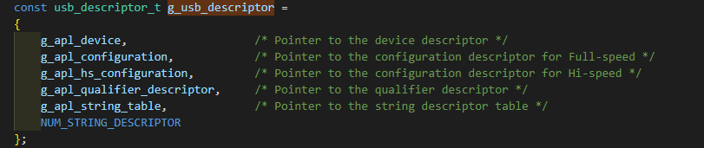
Ii. Device - USB pprn ep with FreeRTOS 2.2 Descriptor
USB devices report their attributes using descriptors. A descriptor is a data structure with a defined format.
Information in descriptor file: (Ex: usb_composite_ek_ra4m2_ep\e2studio\src\r_usb_pcdc_pmsc_descriptor.c)
USB descriptor struct:

Slide 10
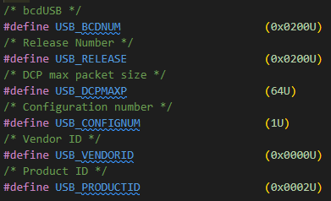
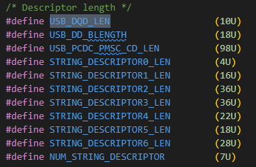
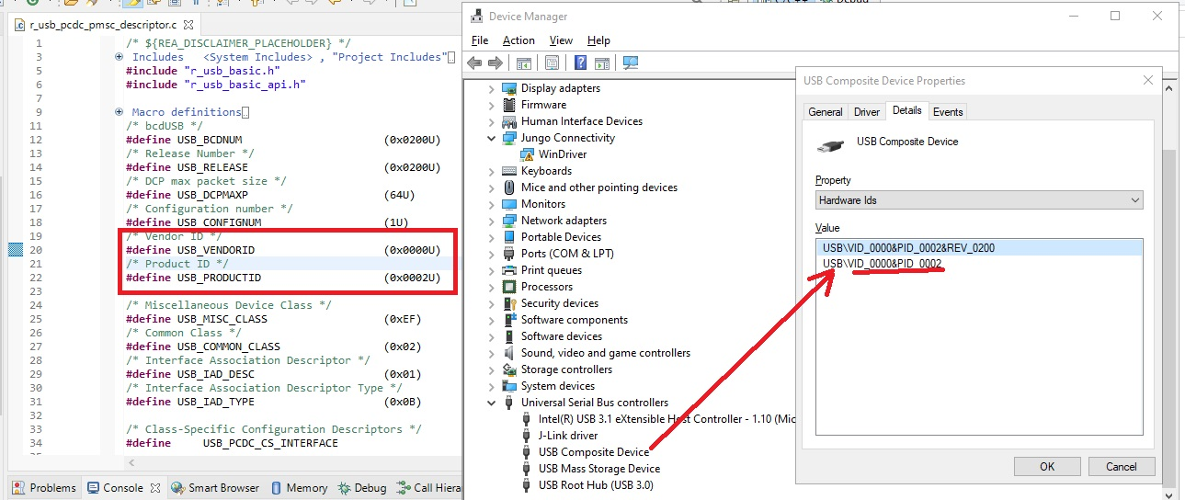
Ii. Device - USB pprn ep with FreeRTOS 2.2 Descriptor
USB devices report their attributes using descriptors. A descriptor is a data structure with a defined format.
Information in descriptor file: (Ex: usb_composite_ek_ra4m2_ep\e2studio\src\r_usb_pcdc_pmsc_descriptor.c)
Common information:
Device common informations
Standard Device Descriptor
Device Qualifier Descriptor
Configuration Or Other_Speed_Configuration Descriptor
Interface Descriptor
Endpoint Descriptor 0
String Descriptor

Slide 11
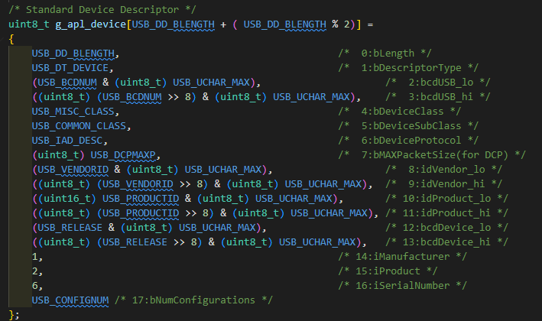
Ii. Device - USB pprn ep with FreeRTOS 2.2 Descriptor
USB devices report their attributes using descriptors. A descriptor is a data structure with a defined format.
Information in descriptor file: (Ex: usb_composite_ek_ra4m2_ep\e2studio\src\r_usb_pcdc_pmsc_descriptor.c)
Common information:
Device common informations
Standard Device Descriptor
Device Qualifier Descriptor
Configuration Or Other_Speed_Configuration Descriptor
Interface Descriptor
Endpoint Descriptor 0
String Descriptor

Slide 12
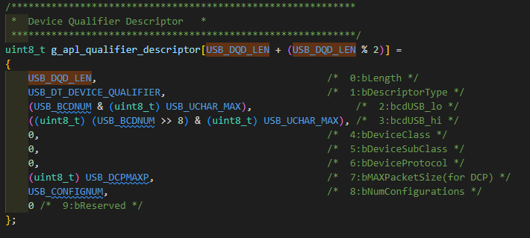
Ii. Device - USB pprn ep with FreeRTOS 2.2 Descriptor
USB devices report their attributes using descriptors. A descriptor is a data structure with a defined format.
Information in descriptor file: (Ex: usb_composite_ek_ra4m2_ep\e2studio\src\r_usb_pcdc_pmsc_descriptor.c)
Common information:
Device common informations
Standard Device Descriptor
Device Qualifier Descriptor
Configuration Or Other_Speed_Configuration Descriptor
Interface Descriptor
Endpoint Descriptor 0
String Descriptor

Slide 13
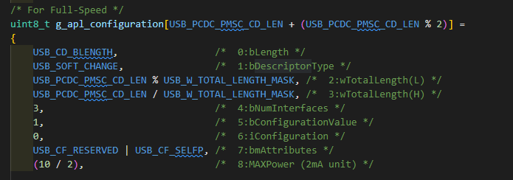
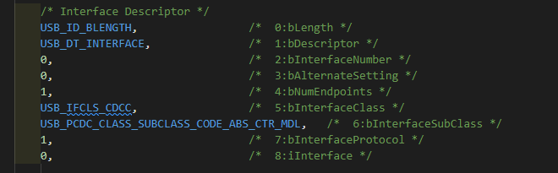
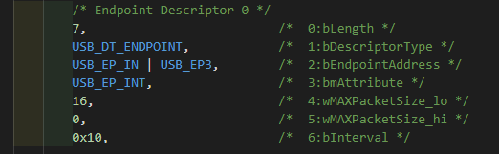
Ii. Device - USB pprn ep with FreeRTOS 2.2 Descriptor
USB devices report their attributes using descriptors. A descriptor is a data structure with a defined format.
Information in descriptor file: (Ex: usb_composite_ek_ra4m2_ep\e2studio\src\r_usb_pcdc_pmsc_descriptor.c)
Common information:
Device common informations
Standard Device Descriptor
Device Qualifier Descriptor
Configuration Or Other_Speed_Configuration Descriptor
Interface Descriptor
Endpoint Descriptor 0
String Descriptor

Slide 14
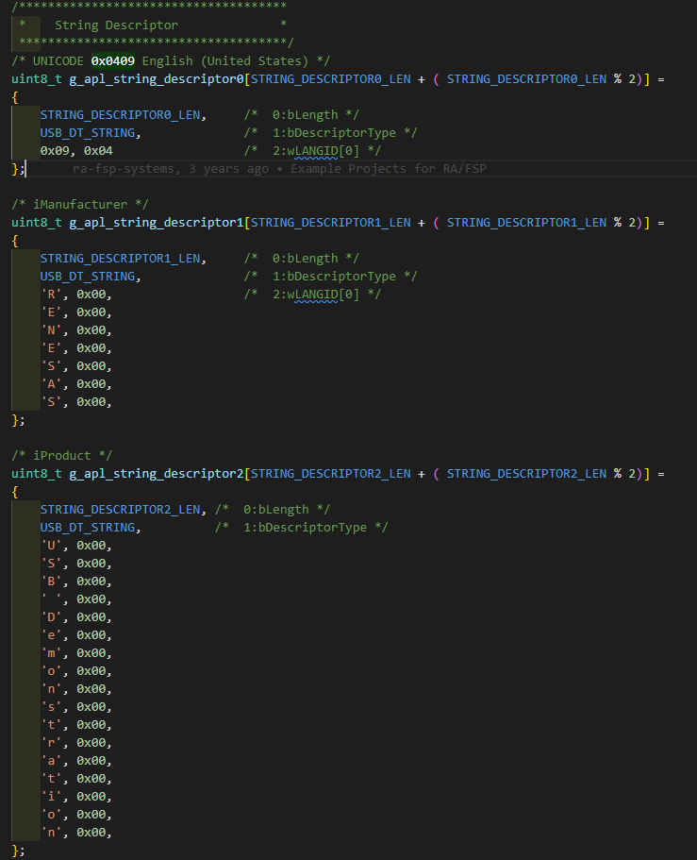
Ii. Device - USB pprn ep with FreeRTOS 2.2 Descriptor
USB devices report their attributes using descriptors. A descriptor is a data structure with a defined format.
Information in descriptor file: (Ex: usb_composite_ek_ra4m2_ep\e2studio\src\r_usb_pcdc_pmsc_descriptor.c)
Common information:
Device common informations
Standard Device Descriptor
Device Qualifier Descriptor
Configuration Or Other_Speed_Configuration Descriptor
Interface Descriptor
Endpoint Descriptor 0
String Descriptor

Slide 15
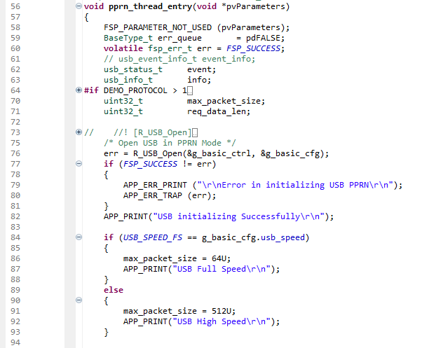
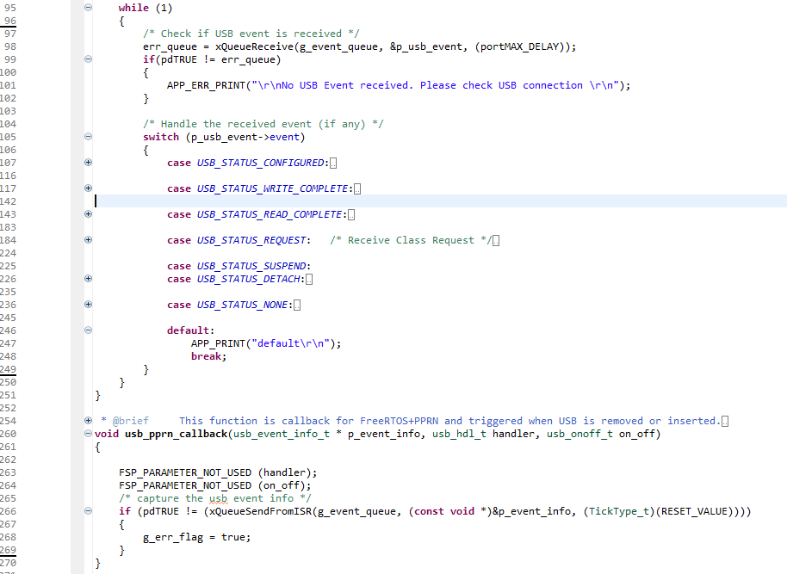
Ii. Device - USB pprn ep with FreeRTOS 2.2 USB PPRN THread
Purpose: Handling USB event/handling connectivity
Check if USB event is received, handle the received event

Slide 16
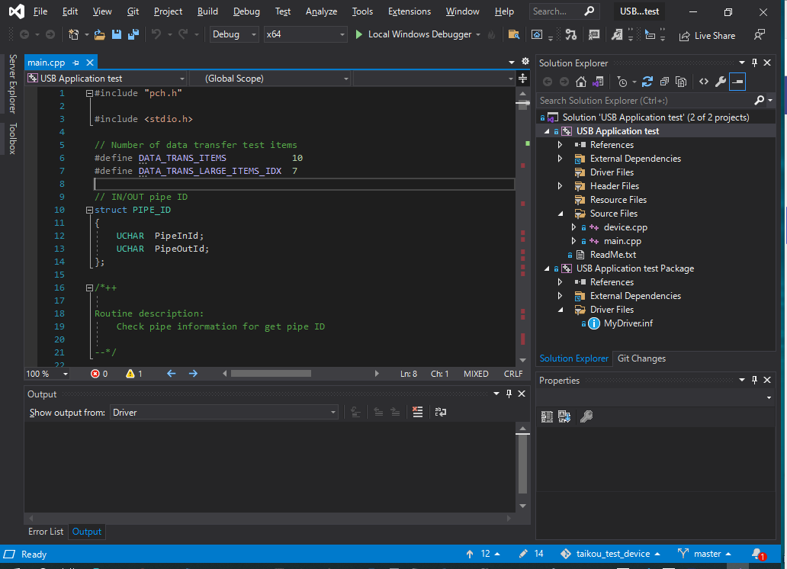
IiI. HOST - USB pprn ep with FreeRTOS 3.1 USB Driver (inf file)
Detail guideline and source for USB driver + application: 1.input/Printer_APP.zip · doc · RSS2 / ra-fsp · GitLab (renesas.com)
USB application
USB driver

Slide 17
IiI. HOST - USB pprn ep with FreeRTOS 3.1 USB Driver (inf file)
Detail guideline and source for USB driver + application: 1.input/Printer_APP.zip · doc · RSS2 / ra-fsp · GitLab (renesas.com)
USB application
USB driver

Slide 18
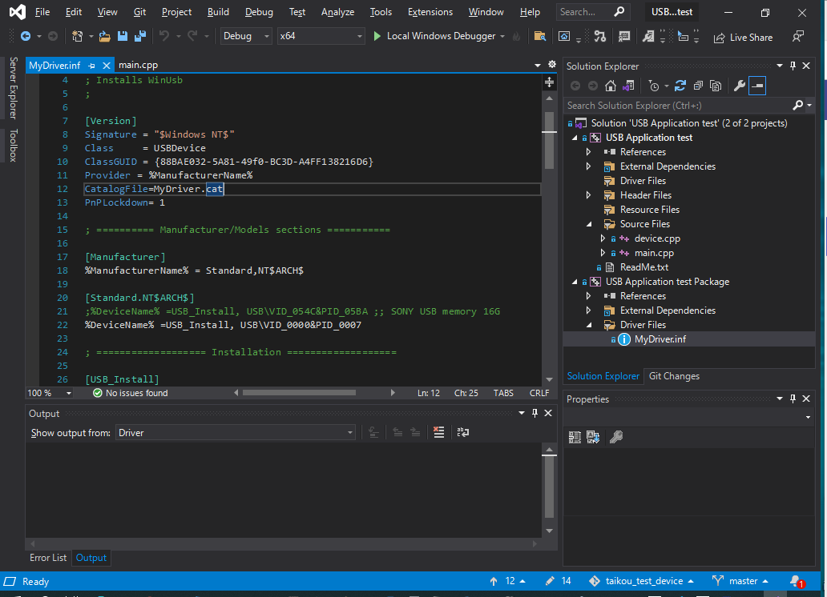
IiI. HOST - USB pprn ep with FreeRTOS 3.1 USB Driver (inf file)
Step 1: Build INF file
Building the [USB Application test Package] project in the solution will generate .inf and .cat files in the following locations:
USB Application test\x64\Debug\USB Application test Package
You can change the driver settings by editing the [MyDriver.inf] file in the [USB Application test Package] project
Set the vendor ID and product ID according to the device used for the test.
* At the time of provision, the vendor ID (0x0000) and product ID (0x0007) that match the Printer device are already set
So, no changes are required here unless you change them on the device side.

Slide 19
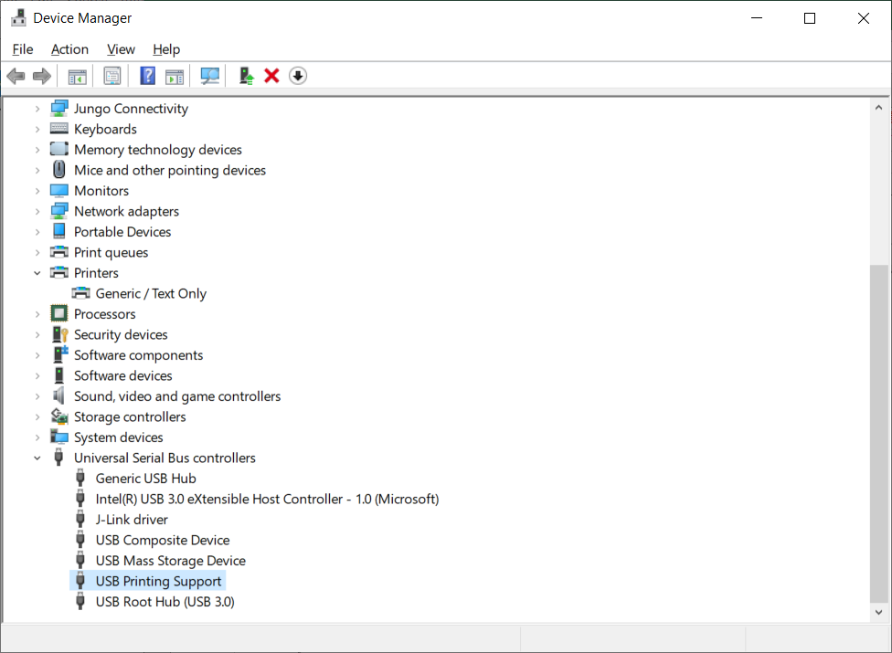
IiI. HOST - USB pprn ep with FreeRTOS 3.1 USB Driver (inf file)
Step 2: Install the driver
To install the driver, the host PC must be boot in test mode. (Detail in [USB DEVICE Printer] USB host (windows) application usage .xlsx)
Please also refer above guideline to for step to install driver
- When a USB device (printer) is connected, the device manager will be as follows.

Slide 20
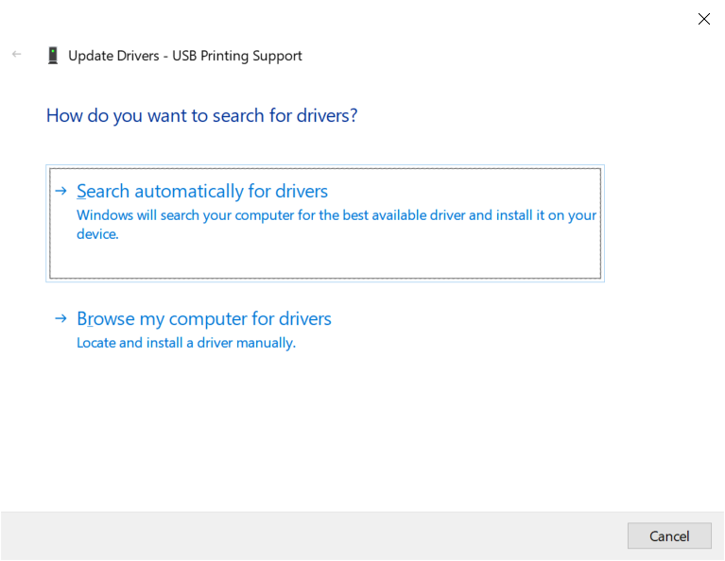
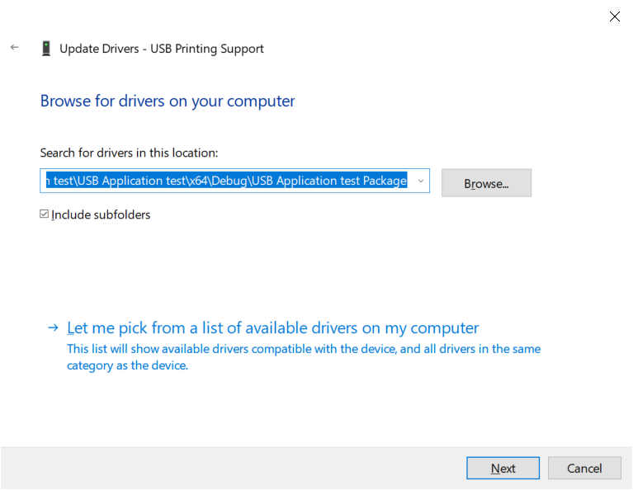
IiI. HOST - USB pprn ep with FreeRTOS 3.1 USB Driver (inf file)
Step 2: Install the driver
Right-click on [USB Printing Support] and select [Update driver]
Click below

Slide 21
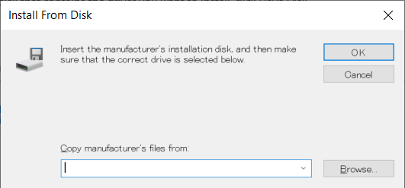
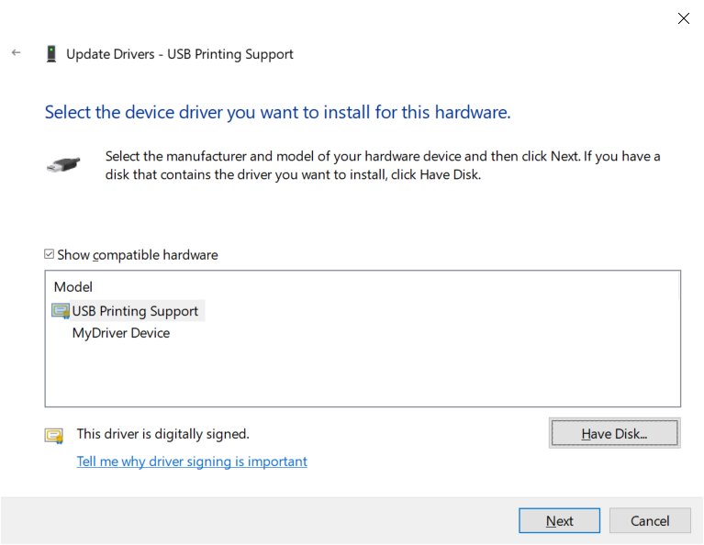
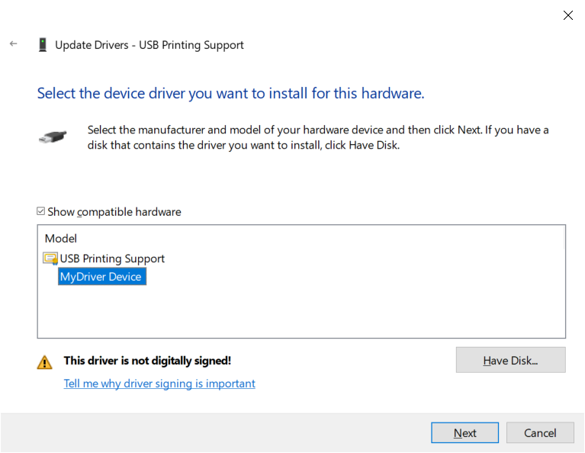
IiI. HOST - USB pprn ep with FreeRTOS 3.1 USB Driver (inf file)
Step 2: Install the driver
Select [MyDriver Device] and click [Next].
If a dialog such as "Unable to verify the publisher of the driver software" appears, click "Install".

Slide 22
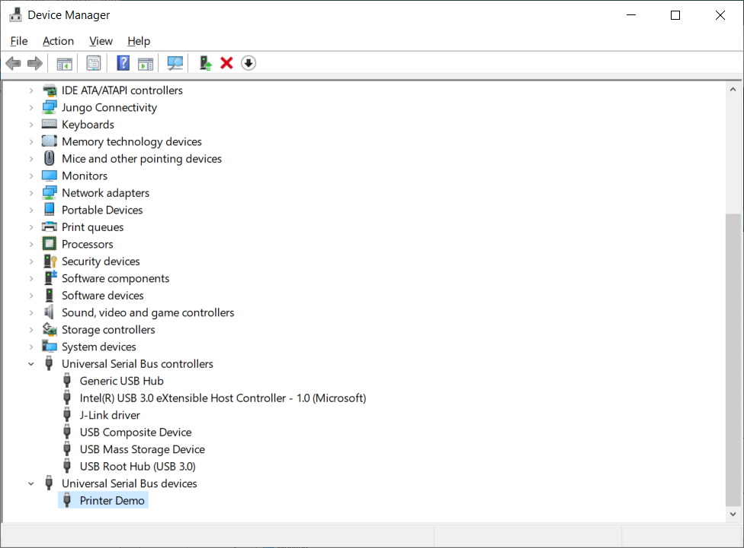
IiI. HOST - USB pprn ep with FreeRTOS 3.1 USB Driver (inf file)
Step 2: Install the driver
The following is displayed in Device Manager.

Slide 23
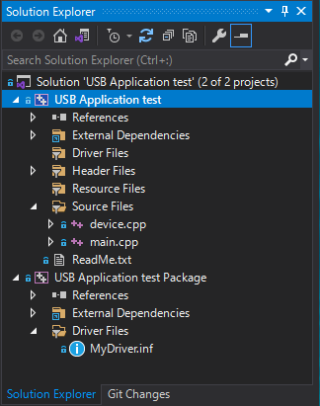
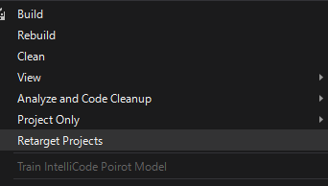
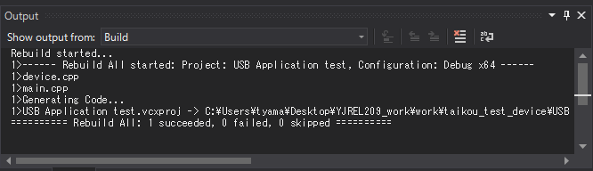
IiI. HOST - USB pprn ep with FreeRTOS 3.2 USB host application
Build USB host application
Run USB host application

Slide 24


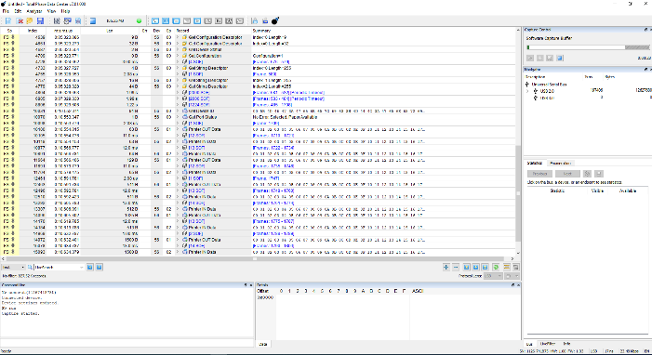

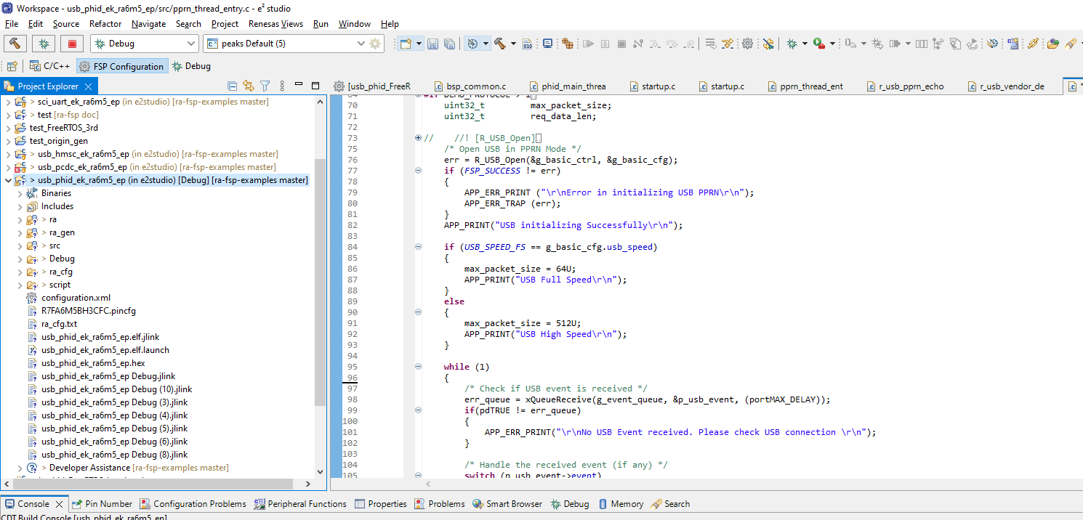
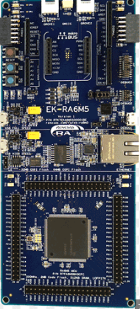
IV. Sample run a USB PPRN test case
This chapter give a break view to understand how to setup and run USB PPRN manual test (test case No. 3-1-7)
Detail test specification: 2.output/SWFLEX-5652/FreeRTOS_PPRN_testspec_EN.docx · doc · RSS2 / ra-fsp · GitLab (renesas.com)
Data Center software
Connectivity:
Host application
e2 / laptop

Slide 25
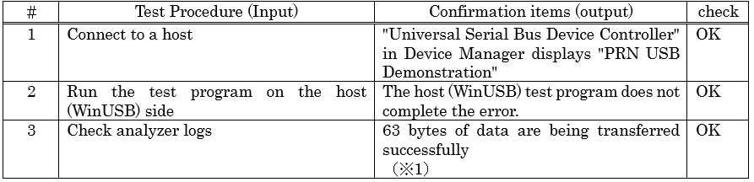
IV. Sample run a USB PPRN test case
Test case No. 3-1-7:
Test procedure:
Step 1: Connect as previous page
Step 2: Run Data Center on Analyze PC (Run capture)
Step 3: Run device’s project e2
Step 4: Run the test program on the host
Step 5: Stop capture and export data

Slide 26
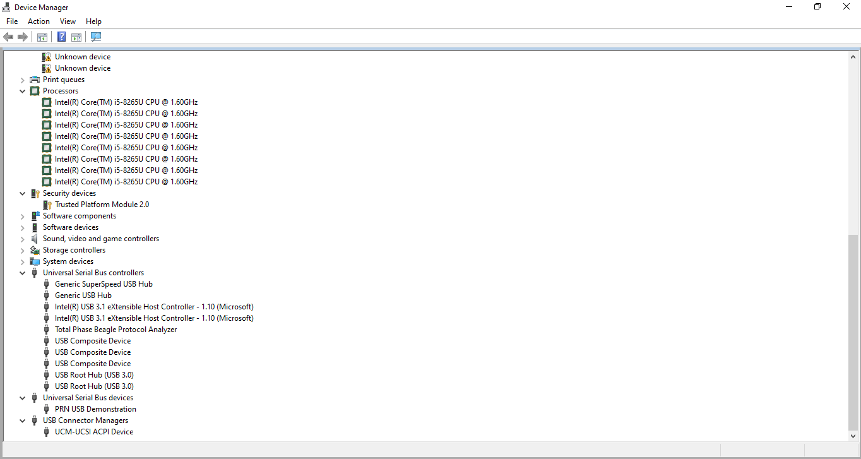
V. USB PPRN Automation Test Feasibility
C
A
Run both e2, VS, Data Center on a Host PC only
Sample basical flow of AutoIT:
Step 1: Start Data Center/Run capture
Step 2: Start device on e2
Step 3: Run Host USB app
Step 4: Stop capture
Step 5: Export file (how to name it?)
B
D
E
G
Enable/Disable relay
Naming exported file
F
Run script check log

Slide 27
Renesas.com
Notes:
Thank you everyone for your great support. FSP is growing to the next level with lot of new features and new device supports. Also expanding beyond RA to other Renesas MCU and MPU families.. So thank you very much for your contributions!

