Slide 1

UNIveral serial bus investigation
Renesas Electronics corporation
sep, 2023

Slide 2
agenda
I. USB Device Framework
II. USB Host: Hardware and Software
III. Hub Specification

Slide 3
I. USB Device framwork
A USB device may be divided into three layers:
The top layer
Is the functionality provided by the serial bus device, for instance, a mouse or ISDN interface.
The middle layer
handles routing data between the bus interface and various endpoints on the device.
The bottom layer
is a bus interface that transmits and receives packets
Notes:
USB device chia thành 3 layer:
Top layer: là lớp function hỗ trợ các serial bus device, như chuột, ISDN interface (Integrated Services Digital Network)
Middle layer : Lớp giữa xử lý dữ liệu định tuyến giữa bus interface và endpoint.
Bottom layer: Lớp dưới cùng là bus interface truyền và nhận các gói tin

Slide 4
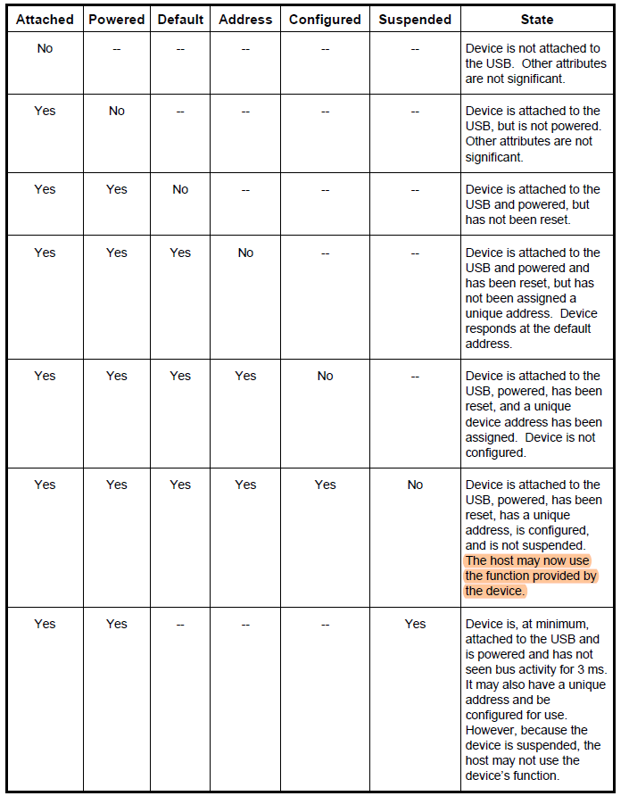
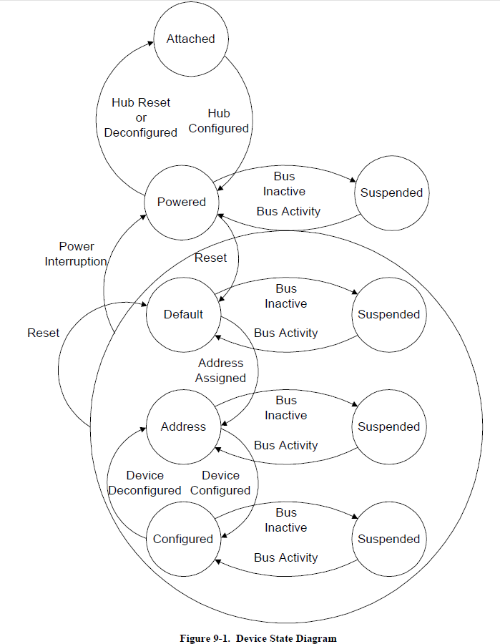
I. USB Device framework 1.1 USB Device states
Attached
Powered
Default
Address
Configured
Suspended
Visible Device States
Notes:
Slice này giới thiệu các state từ khi cắm USB device
device USB có một số trạng thái có thể xảy ra. Các trạng thái này hiển thị với USB và host.

Slide 5
I. USB Device framework 1.1 USB Device states
Attached
Powered
Default
Address
Configured
Suspended
Visible Device States
reset
Operate at correct speed
Notes:
1: No Attached: device chưa cắm vào USB port
2: Attached + not powered
3: Attached + powered + No default: device được attached và cấp nguồn nhưng chưa reset
4: Attached + powered + have been reset + No address: chưa duoc câp điạ chỉ
5: Attached + powered + have been reset + addressed + No configure: chua configuration
6: Attached + powered + have been reset + addressed + configured + No suspend: ko suspended
7: Attached + powered + have been reset + addressed + configured + suspended: suspend khi không thấy activity trong 3ms, host ko thể dùng device’s fuction

Slide 6
I. USB Device framework 1.1 USB Device states
Attached
Powered
Default
Address
Configured
Suspended
### NOTE ###
Powered:
USB devices may obtain power from an external source and/or from the USB through the hub to which they are attached.
Externally powered USB devices are termed self-powered. Although self-powered devices may already be powered before they are attached to the USB, they are not considered to be in the Powered state until they are attached to the USB and VBUS is applied to the device.
If a configuration supports only one power mode and the power source of the device changes, the device will lose its current configuration and address and return to the Powered state.
A hub port must be powered in order to detect port status changes, including attach and detach. Bus powered hubs do not provide any downstream power until they are configured, at which point they will provide power as allowed by their configuration and power source.
Default:
After the device has been powered, it must not respond to any bus transactions until it has received a reset from the bus. After receiving a reset, the device is then addressable at the default address.
When the reset process is complete, the USB device is operating at the correct speed:
The speed selection for low- and full-speed is determined by the device termination resistors.
A device that is capable of high-speed operation determines whether it will operate at high-speed as a part of the reset process
Address:
Each USB device is assigned a unique address by the host after attachment or after reset.
Configured:
Before a USB device’s function may be used, the device must be configured. From the device’s perspective, configuration involves correctly processing a SetConfiguration() request with a non-zero configuration value.
Suspended:
In order to conserve power, USB devices automatically enter the Suspended state when the device has observed no bus traffic for a specified period. When suspended, the USB device maintains any internal status, including its address and configuration.
A USB device exits suspend mode when there is bus activity
Notes:
Một số note cho các state:
POWER:
Các USB device có thể lấy nguồn từ nguồn bên ngoài và/hoặc từ USB thông qua hub mà chúng được gắn vào.
Các USB device được cấp nguồn bên ngoài được gọi là tự cấp nguồn. Mặc dù các device tự cấp nguồn có thể đã được cấp nguồn trước khi được gắn vào nhưng chúng không được coi là ở trạng thái Powered state cho đến khi chúng được gắn vào USB và VBUS được dùng.
Nếu một device hỗ trợ một chết độ câp nguồn mà bị thay đổi thì device sẽ mất configure hiện tại/ địa chỉ và trở về trạng thái Powered state
Hub port luôn được cấp điện để detect port status change khi có device cắm vào. Nhưng ko cấp điện cho tầng dưới nó cho tới khi được configure.
DEFAULT:
Sau khi device được cấp nguồn, nó ko phản hồi được bất kỳ bus transaction nào cho tới khi nhận được reset từ bus. Sau khi được reset thì nó sẽ được set giá trị address default.
Sau khi reset: USB device sẽ hoat động đúng với speed:
Với low- and full-speed device, được xác định bằng device termination resistors
Với high-speed device, device được xác định là có phải high-speed hay ko trong quá trình reset
ADDRESS:
mỗi USB device được cấp 1 địa chỉ độc nhất bởi host sau khi reset
Configured:
trước khi USB device function dùng được, thì device phải được configure. Configure bằng API SetConfiguration
SUSPENDED:
Để tiết kiệm năng lượng, device USB sẽ tự động chuyển sang trạng thái Suspended khi device nhận thấy không có bus traffic nào trong một khoảng thời gian nhất định. Khi suspended, device USB sẽ duy trì mọi trạng thái bên trong, bao gồm địa chỉ và cấu hình của nó.
device USB thoát khỏi chế độ tạm dừng khi có hoạt động bus

Slide 7
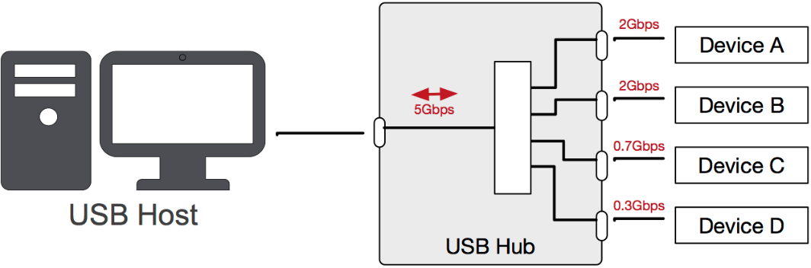
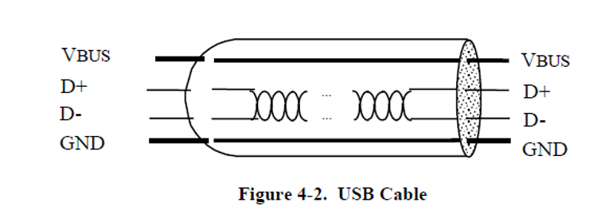
I. USB Device framework 1.1 USB Device states
Bus Enumeration: :
When a USB device is attached to a powered port, the following actions are taken:
1. The hub to which the USB device is now attached informs the host of the event via a reply on its status change pipe (the USB device is in the Powered state and the port to which it is attached is disabled)
2. The host determines the exact nature of the change by querying the hub.
3. The host knows the port to which the new device has been attached, the host then waits for at least 100 ms to allow completion of an insertion process and for power at the device to become stable. The host then issues a port enable and reset command to that port
4. The hub performs the required reset processing for that port. When the reset signal is released, the port has been enabled.
5. Default state: its Default Control Pipe is still accessible via the default address. The host reads the device descriptor to determine what actual maximum data payload size this USB device’s default pipe can use.
6. The host assigns a unique address to the USB device, moving the device to the Address state.
7. The host reads the configuration information from the device by reading each configuration
8. Based on the configuration information and how the USB device will be used, the host assigns a configuration value to the device. The USB device may now draw the amount of VBUS power described in its descriptor for the selected configuration. From the device’s point of view, it is now ready for use.
When the USB device is removed, the hub again sends a notification to the host. Detaching a device
disables the port to which it had been attached
Notes:
Khi một USB device được gắn vào hoặc tháo ra khỏi,host sẽ sử dụng một quy trình được gọi là bus Enumeration để xác định và quản lý các thay đổi về trạng thái device.
Khi device USB được gắn vào cổng được cấp nguồn, các hành động sau sẽ được thực hiện:
Hub sẽ thông báo cho host biết thay đổi thông qua status change pipe. Lúc này port ở Power state và port vẫn đang disable
Host xác định thay đổi trên hub
Host biết port mà device được căm. Host đợi ít nhất 100ms cho power được ổn định. Host enable port rồi reset port
Hub thực hiện quá trình reset port. Khi tín hiệu reset được giải phóng, cổng đã được enable
Trạng thái mặc định: Default Control Pipe có thể truy cập được thông qua địa chỉ mặc định. Host đọc device descriptor để xác định maximum data payload mà default pipe của device USB này có thể sử dụng.
Host cấp cho device địa chị độc nhất, device ở state address
Host đọc thông tin configuration info
Dựa trên configuration infor, Host sẽ assign configuration value cho device. VBUS power được ấp nguồn, Device sẵn sàng hoạt động.
Khi USB device bị tháo ra, hub lại gửi thông báo đến host. Việc tháo device sẽ vô hiệu hóa cổng mà device đã được gắn vào

Slide 8
I. USB Device framework 1.2 Generic USB Device operations
Dynamic Attachment and Removal
Address Assignment
Configuration
Data Transfer
Power Management
Request Processing
Request Error
Notes:
USB device hỗ trợ một số operation common như list này

Slide 9
I. USB Device framework 1.2 Generic USB Device operations
Dynamic Attachment and Removal
Address Assignment
Configuration
Data Transfer
Power Management
Request Processing
Request Error
Dynamic Attachment and Removal:
USB devices may be attached and removed at any time. The hub that provides the attachment point or port is responsible for reporting any change in the state of the port.
The host enables the hub port where the device is attached upon detection of an attachment, which also has the effect of resetting the device. A reset USB device has the following characteristics:
Responds to the default USB address
Is not configured
Is not initially suspended
When a device is removed from a hub port, the hub disables the port where the device was attached and notifies the host of the removal.
Notes:
USB device có thể được cắm rút bất cứ khi nào.
Hub cung cấp các port chịu trạch nhiệm report thay đổi state.
Host enable hub port nới device được cắm vào, việc enable này sẽ reset device. 1 Device sau khi reset sẽ có những tính chất sau:
- USB address mặc định.
- Không được config
Ko ở suspend state
Khi device được rút ra khỏi port, hub disable port đó, và thông báo cho host biết

Slide 10
I. USB Device framework 1.2 Generic USB Device operations
Dynamic Attachment and Removal
Address Assignment
Configuration
Data Transfer
Power Management
Request Processing
Request Error
Address Assignment:
When a USB device is attached, the host is responsible for assigning a unique address to the device. This is done after the device has been reset by the host, and the hub port where the device is attached has been enabled.
Notes:
Khi USB được cắm, host đặt cho device 1 địa chỉ độc nhất. Sau khi device được reset bởi host và hub port enable

Slide 11
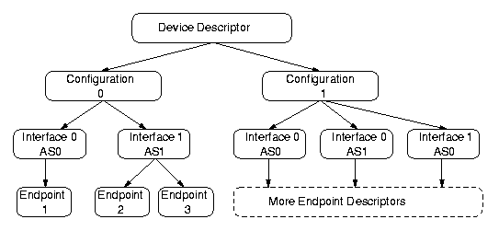
I. USB Device framework 1.2 Generic USB Device operations
Dynamic Attachment and Removal
Address Assignment
Configuration
Data Transfer
Power Management
Request Processing
Request Error
Configuration:
A USB device must be configured before its function(s) may be used. The host is responsible for configuring a USB device. The host typically requests configuration information from the USB device to determine the device’s capabilities.
Within a single configuration, a device may support multiple interfaces. An interface is a related set of endpoints that present a single feature or function of the device to the host.
Configuration can be changed: an interface within a configuration may have alternate settings that redefine the number or characteristics of the associated endpoints. If this is the case, the device must support the GetInterface() request to report the current alternate setting for the specified interface and SetInterface() request to select the alternate setting for the specified interface.
In support of adaptive device drivers that are capable of managing a related group of USB devices, the device and interface descriptors contain Class, SubClass, and Protocol fields. These fields are used to identify the function(s) provided by a USB device and the protocols used to communicate with the function(s) on the device. A class code is assigned to a group of related devices that has been characterized as a part of a USB Class Specification. A class of devices may be further subdivided into subclasses, and, within a class or subclass, a protocol code may define how the Host Software communicates with the device.
Notes:
USB device phải được configure trước khi function sử dụng được. Host chịu trách nhiệm config.
Host request configure infor từ USB device để biết được khả năng của device
1 configure có thể support nhiều interface. 1 interface là 1 nhóm các endpoint có liên quan của 1 feature/function mà device support.
Để hỗ trợ khả năng quản lý nhiều USB devices, thì device và interface describtor chứa 3 field: Class, SubClass, Protocol.

Slide 12
I. USB Device framework 1.2 Generic USB Device operations
Dynamic Attachment and Removal
Address Assignment
Configuration
Data Transfer
Power Management
Request Processing
Request Error
Data Transfer:
Data may be transferred between a USB device endpoint and the host in one of four ways:
Control Transfers
Isochronous Transfers
Interrupt Transfers
Bulk Transfers

Slide 13
I. USB Device framework 1.2 Generic USB Device operations
Dynamic Attachment and Removal
Address Assignment
Configuration
Data Transfer
Power Management
Request Processing
Request Error
Power Management:
Power Budgeting:
USB bus power is a limited resource. If the power requirements of a particular configuration exceed the power available to the device, Host Software shall not select that configuration.
USB devices shall limit the power they consume from VBUS to one unit load or less until configured.
Depending on the power capabilities of the port to which the device is attached, a USB device may be able to draw up to five unit loads from VBUS after configuration.
Remote Wakeup:
Remote wakeup allows a suspended USB device to signal a host that may also be suspended.
A USB device reports its ability to support remote wakeup in a configuration descriptor. If a device supports remote wakeup, it must also allow the capability to be enabled and disabled using the standard USB requests.
Remote wakeup is accomplished using electrical signaling.
Notes:
Có 2 vấn đề liên quan đến power management:
1. Power budgeting
USB bus power là có giới hạn.
Trong quá trình device enumeration, host sẽ đánh giá power require của device. Nếu power requirement của device quá khả năng cảu device thì Host software sẽ ko chộn configuration đó.
Các device USB sẽ giới hạn nguồn điện mà chúng tiêu thụ từ VBUS ở một đơn vị tải hoặc ít hơn cho đến khi được định cấu hình. Sau khi được configure thì có thể lên đến 5 đơn vị tải,
2. Remote wakeup
Remote wakeup cho phép device USB đang ở suspended state gửi tín hiệu đến host (cũng có thể đang ở suspended state).
USB device có support remote wakeup hay ko thể hiện trong configuration descriptor
Remote wakeup được thực hiện bằng tín hiệu điện

Slide 14
I. USB Device framework 1.2 Generic USB Device operations
Request Processing
Request Processing Timing
USB sets an upper limit of 5 seconds as the upper limit for any command to be processed.
This upper limit will improve user experience -> implementations should strive to complete requests in times that are as short as possible.
Reset/Resume Recovery Time
After a port is reset or resumed, the USB System Software is expected to provide a “recovery” interval of 10 ms before the device attached to the port is expected to respond to data transfers. The device may ignore any data transfers during the recovery interval.
After the end of the recovery interval (measured from the end of the reset or the end of the EOP at the end of the resume signaling), the device must accept data transfers at any time
Set Address Processing
After the reset/resume recovery interval, if a device receives a SetAddress() request, the device must be able to complete processing of the request and be able to successfully complete the Status stage of the request within 50 ms.
After successful completion of the Status stage, the device is allowed a SetAddress() recovery interval of 2 ms. At the end of this interval, the device must be able to accept Setup packets addressed to the new address.
Standard Device Requests
Class-specific Requests
Speed Dependent Descriptors
For standard device requests that require no Data stage, a device must be able to complete the request and be able to successfully complete the Status stage of the request within 50 ms of receipt of the request. This limitation applies to requests to the device, interface, or endpoint
Unless specifically exempted in the class document, all class-specific requests must meet the timing limitations for standard device requests. If a class document provides an exemption, the exemption may only be specified on a request-by-request basis.
A class document may require that a device respond more quickly than is specified in this section. Faster response may be required for standard and class-specific requests.
A device capable of operation at high-speed can operate in either full- or high-speed
Two descriptors allow a high-speed capable device to report configuration information about the other operating speed. The two descriptors are: the (other_speed) device_qualifier descriptor and the other_speed_configuration descriptor. These two descriptors are retrieved by the host by using the GetDescriptor request with the corresponding descriptor type values.
Request Processing:
With the exception of SetAddress() requests (see Section 9.4.6), a device may begin processing of a request as soon as the device returns the ACK following the Setup
Notes:
Quy trình của các loại request
Request processing timing:
giới hạn là 5s cho tất cả các request command. Giới hạn này nhắm cải thiện trải nghiệm của người dùng, mọi request nên được xong trong thời gian ngắn nhất có thể
2. Reset/resume recovery time
USB software expect cần 10ms sau khi device reset/ resume, để có thể phản hồi data transfer. Trong 10ms này device ignore data transfer.
3. Set Address Processing
Sau reset/resume recovery time thì device nhận SetAddress() request, device complete trong 50ms..
Sau thời gian này thì device có thể nhận package với địa chỉ mới
4. Standard Device Requests
Device phải completed được request và completed status stage trong vòng 50ms. Limitation này áp dụng cho tất cả request của device, interface endpoint
5. Class-specific Requests
class-specific requests phải đáp ứng standard device request,
Device respond có thể được set nhanh hơn với class document.
6. Speed Dependent Descriptors
High speed device có thể hoạt động ở full – high speed
Có 2 descriptor liên quan:
the (other_speed) device_qualifier descriptor
the other_speed_configuration descriptor
host dùng GetDescriptor với descriptor type value tương ứng để truy xuất.

Slide 15
I. USB Device framework 1.2 Generic USB Device operations
Dynamic Attachment and Removal
Address Assignment
Configuration
Data Transfer
Power Management
Request Processing
Request Error
Request Error:
When a request is received by a device that is not defined for the device, is inappropriate for the current setting of the device, or has values that are not compatible with the request, then a Request Error exists
The device deals with the Request Error by returning a STALL PID in response to the next Data stage transaction or in the Status stage of the message
Notes:
Khi request bởi 1 device ko define, ko phù hợp với configure của device, hoặc giá trị ko tương thích với request -> Request error exist
Request error đưuọc return trong next data stage transaction hoặc Status stage của message.

Slide 16
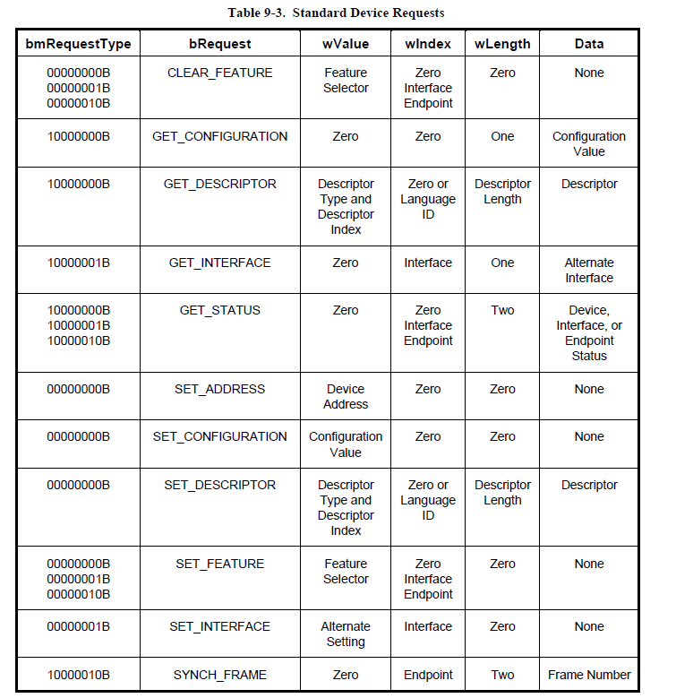
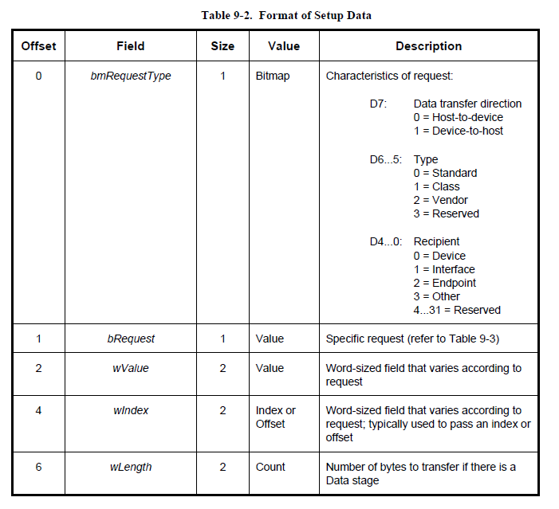
I. USB Device framework 1.3 USB device request
The state of the Direction bit is ignored if the wLength field is zero, signifying there is no Data stage.
The request and the request’s parameters are sent to the device in the Setup packet.
The host is responsible for establishing the values passed in the fields listed in Table 9-2. Every Setup packet has eight bytes.
It is used to pass a parameter to the device, specific to the request.
This field specifies the length of the data transferred during the second phase of the control transfer
Notes:
USB device phản hồi request của Host bằng Default Control Pipe
Host gửi request tới USB device bằng Control transfer
Request and request parameter gửi tới device trong Setup Packet (8 bytes)

Slide 17
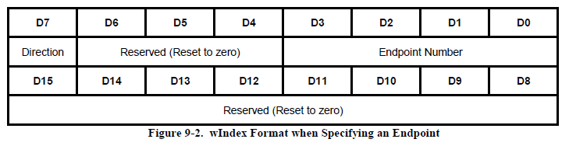
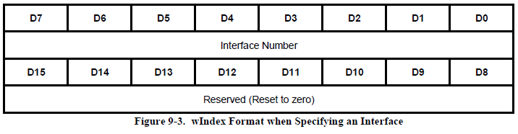
I. USB Device framework 1.3 USB device request
The request and the request’s parameters are sent to the device in the Setup packet.
The host is responsible for establishing the values passed in the fields listed in Table 9-2. Every Setup packet has eight bytes.
The wIndex field is often used in requests to specify an endpoint or an interface

Slide 18
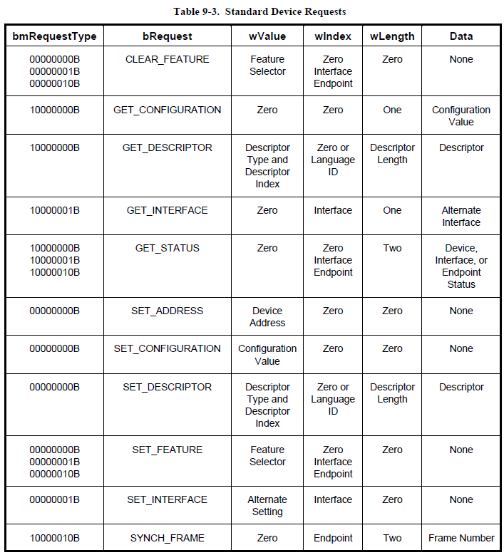
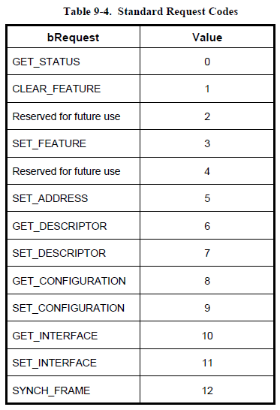
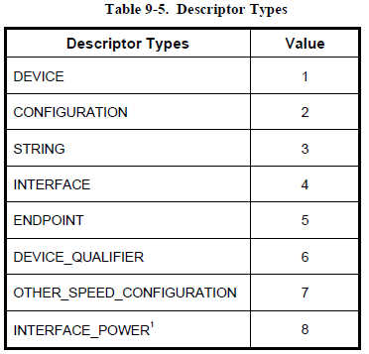
I. USB Device framework 1.4 Standard device requests
Notes:
Này là list request type, request code, và descriptor type để set giá trị cho setup packet

Slide 19
I. USB Device framework 1.4 Standard device requests
Clear Feature:
This request is used to clear or disable a specific feature.
Get Configuration
This request returns the current device configuration value.
If the returned value is zero, the device is not configured.
Get Descriptor
This request returns the specified descriptor if the descriptor exists.
Get Interface
This request returns the selected alternate setting for the specified interface.
Get Status
This request returns status for the specified recipient.
Set Address
This request sets the device address for all future device accesses.
Set Configuration
This request sets the device configuration.
Set Descriptor
This request is optional and may be used to update existing descriptors or new descriptors may be added.
Set Feature
This request is used to set or enable a specific feature.
Set Interface
This request allows the host to select an alternate setting for the specified interface.
Synch Frame
- This request is used to set and then report an endpoint’s synchronization frame.
Notes:
Một số common device request.
Get Interface
Trả về giá trị setting đang được dùng tạm thời của 1 interface cụ thể
Set Interface
Cho phép host set 1 setting tạm thời cho 1 interface cụ thể

Slide 20
I. USB Device framework 1.5 Descriptors
USB devices report their attributes using descriptors.
A descriptor is a data structure with a defined format.
Using descriptors allows concise storage of the attributes of individual configurations because each configuration may reuse descriptors or portions of descriptors from other configurations that have the same characteristics. descriptors contain references to string descriptors that provide displayable information describing a descriptor in human-readable form.
Related API: GetDescriptor: get the configuration information
Notes:
USB device report thuộc tính bằng descriptor
Descriptor là một cấu trúc dữ liệu được define format.
Sử dụng descriptor có thể lưu trữ ngắn ngón các thuộc tính của các cấu hình riêng lẻ, bởi vì các configuration có thể reuse descriptor hoặc 1 phần descriptor

Slide 21
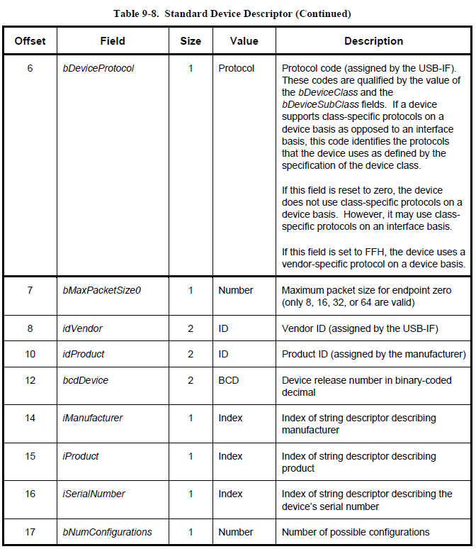
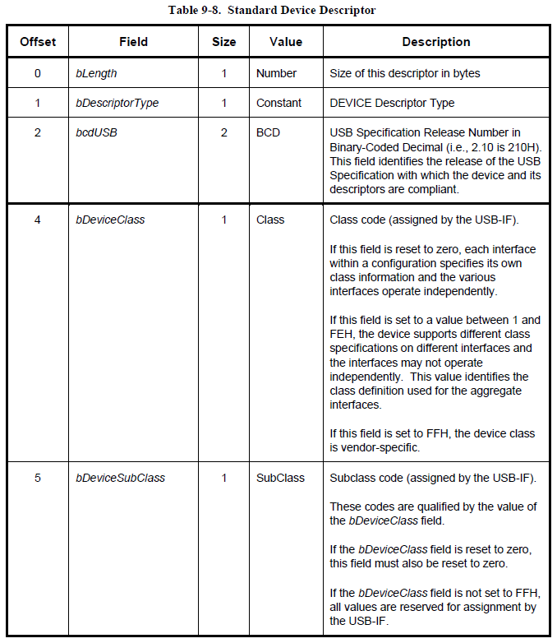
I. USB Device framework 1.6 Standard usb descriptor defination
1.6.1 Device descriptor
A device descriptor describes general information about a USB device. It includes information that applies globally to the device and all of the device’s configurations.
A USB device has only one device descriptor.
Notes:
Device descriptor mô tả thông tin chung về USB device. Nó bao gồm thông tin áp dụng chung cho device và tất cả cấu hình của device.
Một USB device chỉ có một device descriptor..

Slide 22
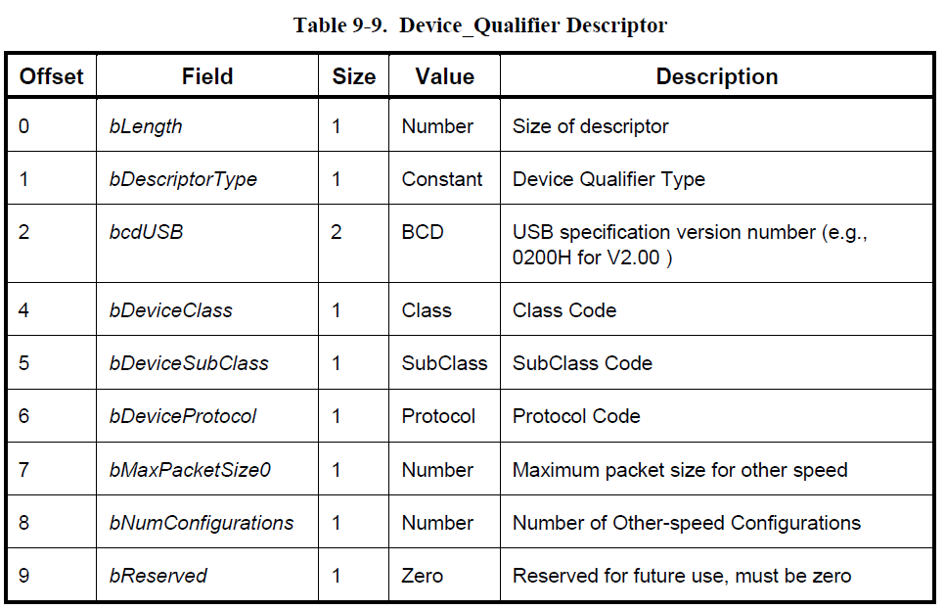
I. USB Device framework 1.6 Standard usb descriptor defination
1.6.2 Device_qualifier descriptor
The device_qualifier descriptor describes information about a high-speed capable device that would change if the device were operating at the other speed.
The vendor, product, device, manufacturer, product, and serial number fields of the standard device descriptor are not included in this descriptor since that information is constant for a device for all supported speeds.
The host accesses this descriptor using the GetDescriptor() request.
If a full-speed only device (with a device descriptor version number equal to 0200H) receives a GetDescriptor() request for a device_qualifier, it must respond with a request error. The host must not make a request for an other_speed_configuration descriptor unless it first successfully retrieves the device_qualifier descriptor.
Notes:
Device_qualifier descriptor mô tả thông tin của device có support high-speed, khi device hoạt động ở speed khác.
Những thông tin khác của device ko chứa trong descriptor này.
Host access descriptor này bằng GetDescriptor API
Nếu device full-speed only call GetDescriptor() cho device_qualifier descriptor, return request error
=> Host ko cần GetDescriptor() cho other_speed_configuration descriptor

Slide 23
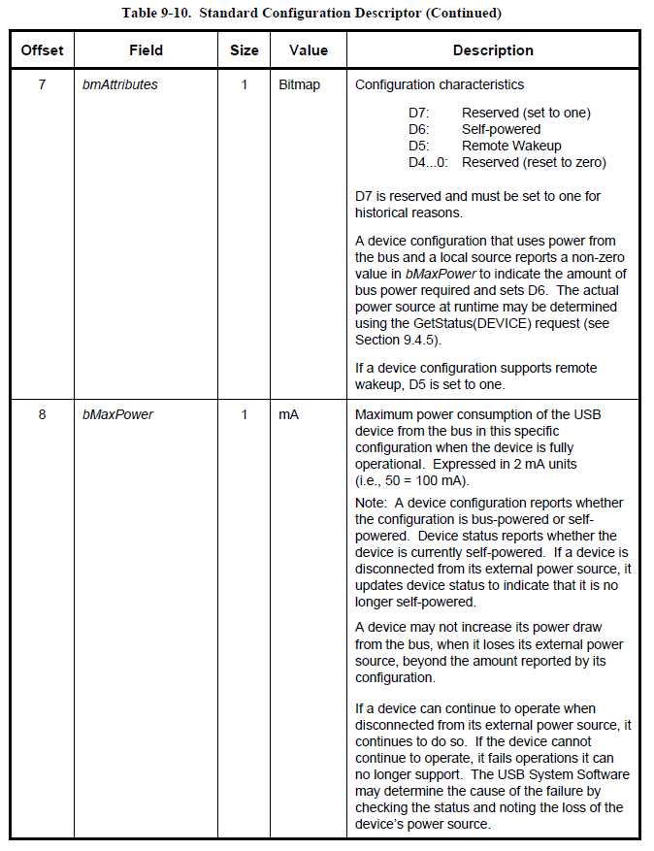
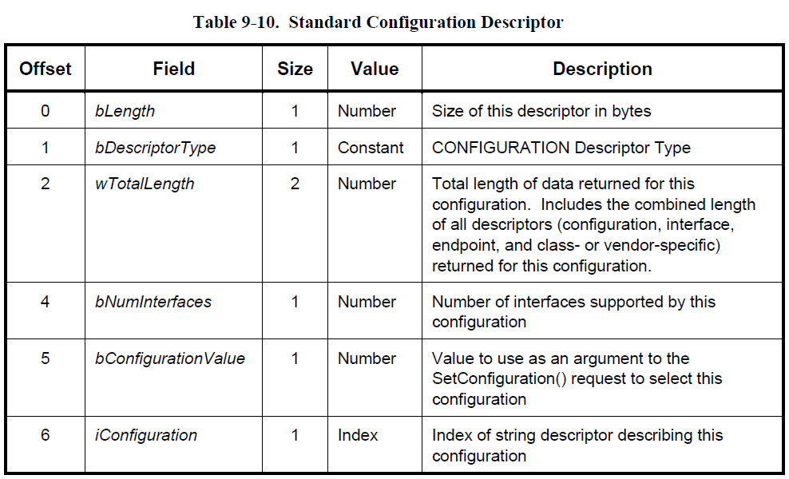
I. USB Device framework 1.6 Standard usb descriptor defination
1.6.3 Configuration descriptor
The configuration descriptor describes information about a specific device configuration.
The descriptor contains a bConfigurationValue field with a value that, when used as a parameter to the SetConfiguration() request, causes the device to assume the described configuration.
The descriptor describes the number of interfaces provided by the configuration. Each interface may operate independently.
When the host requests the configuration descriptor, all related interface and endpoint descriptors are returned
Notes:
Configuration descriptor mô tả thông tin configure của device
Descriptor có field bConfigurationValue được hiểu như là 1 parameter của SetConfiguration function
Thể hiện đượch số lượng interface của configuration

Slide 24
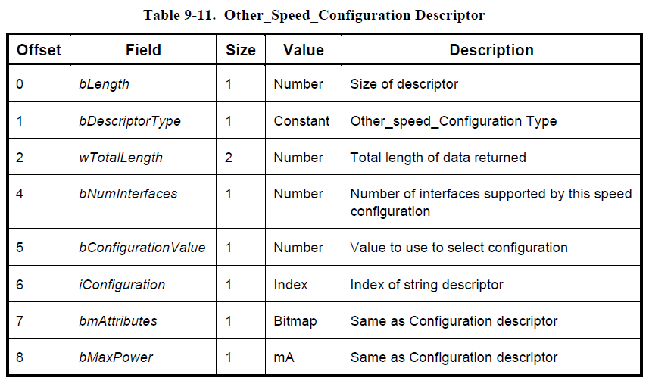
I. USB Device framework 1.6 Standard usb descriptor defination
1.6.4 Other_Speed_Configuration descriptor
Describes a configuration of a highspeed capable device if it were operating at its other possible speed.
The host accesses this descriptor using the GetDescriptor() request. The descriptor type in the GetDescriptor() request is set to other_speed_configuration
Notes:
Descriptor này mô ta configure của 1 device có khả năng hoạt đông high-speed, khi nó đang hoạt động ở một tốc độ khác

Slide 25
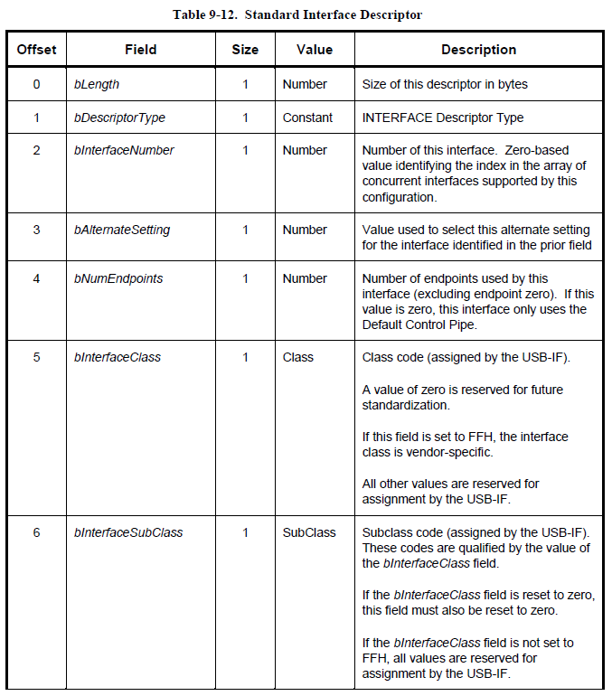
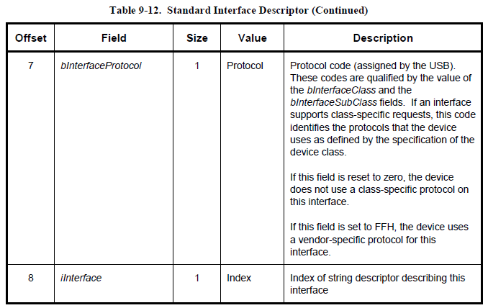
I. USB Device framework 1.6 Standard usb descriptor defination
1.6.5 Interface descriptor
The interface descriptor describes a specific interface within a configuration.
A configuration provides one or more interfaces, each with zero or more endpoint descriptors describing a unique set of endpoints within the configuration.
When a configuration supports more than one interface, the endpoint descriptors for a particular interface follow the interface descriptor in the data returned by the GetConfiguration() request.
An interface descriptor is always returned as part of a configuration descriptor. Interface descriptors cannot be directly accessed with a GetDescriptor() or SetDescriptor() request.
The SetInterface() request is used to select an alternate setting or to return to the default setting. The GetInterface() request returns the selected alternate setting.
Notes:
Interface descriptor mô tả 1 interface cụ thể cuả 1 configuration. Configuration có thể có 1 hoặc nhiều interface
Khi 1 configuration support nhiều interface, thì endpoint descriptor sẽ theo interface descriptor
Interface descriptor là 1 phần của configuration descriptor. Ko thể access trực tiếp bằng GetDescriptor() or SetDescriptor() . Mà dùng SetInterface()

Slide 26
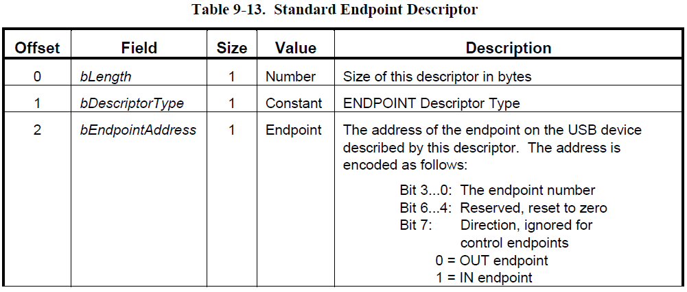
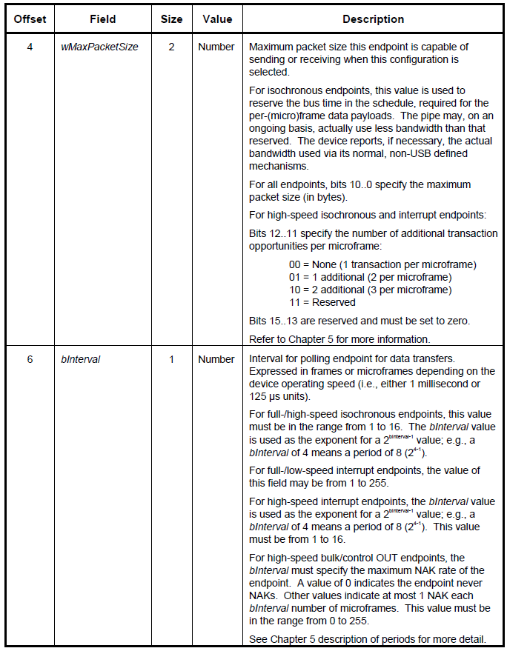
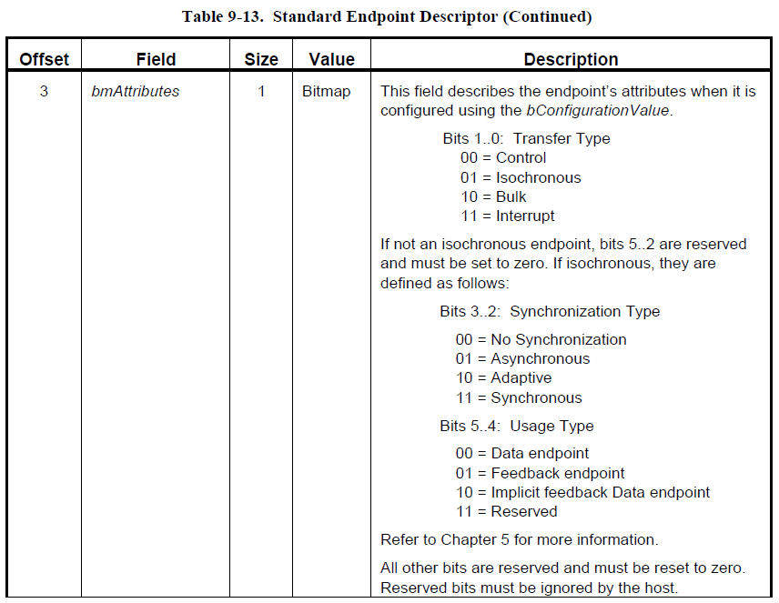
I. USB Device framework 1.6 Standard usb descriptor defination
1.6.6 Endpoint descriptor
Each endpoint used for an interface has its own descriptor.
This descriptor contains the information required by the host to determine the bandwidth requirements of each endpoint.
An endpoint descriptor cannot be directly accessed with a GetDescriptor() or SetDescriptor() request.
Notes:
Mỗi endpoint có 1 descriptor riêng, chứa thông tin bandwidth
Endpoint descriptor ko thể access trực tiếp bằng GetDescriptor() or SetDescriptor()

Slide 27
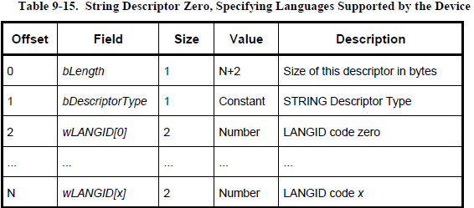
I. USB Device framework 1.6 Standard usb descriptor defination
1.6.7 String descriptor
String descriptors are optional. if a device does not support string descriptors, all references to string descriptors within device, configuration, and interface descriptors must be reset to zero.
Notes:
Bộ mô tả chuỗi là tùy chọn.
nếu một thiết bị không hỗ trợ string descriptor, thì tất cả các tham chiếu đến string descriptor trong device descriptor, cấu hình và giao diện phải được đặt lại về 0.

Slide 28
I. USB Device framework 1.7 device class definations
All devices must support the requests and descriptor definitions described in this chapter. Most devices provide additional requests and, possibly, descriptors for device-specific extensions
In order to define a class of devices, the following information must be provided to completely define the appearance and behavior of the device class.
1. Descriptors:
- If the class requires any specific definition of the standard descriptors, the class definition must include those requirements as part of the class definition. In addition, if the class defines a standard extended set of descriptors, they must also be fully defined in the class definition. Any extended descriptor definitions must follow the approach used for standard descriptors; for example, all descriptors must begin with a length field.
2. Interfaces and endpoint usage:
- When a class of devices is standardized, the interfaces used by the devices, including how endpoints are used, must be included in the device class definition. Devices may further extend a class definition with proprietary features as long as they meet the base definition of the class.
3. Requests
- All of the requests specific to the class must be defined.
Notes:
Tất cả USB device phải support request và descriptor được nói ở phần trên.
Nhưng hầu hết device sẽ support them additional request và descriptor để extension của những device cụ thể khác.
Để define 1 class của device thì những cung cấp những infor sau:
Descriptors
Interfaces and endpoint usage:
Requests

Slide 29
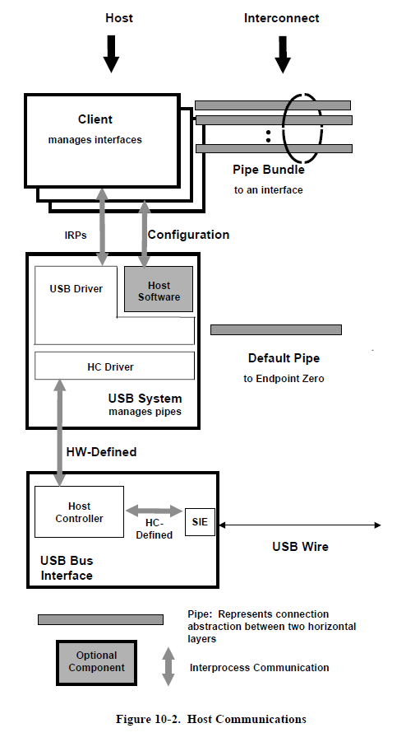
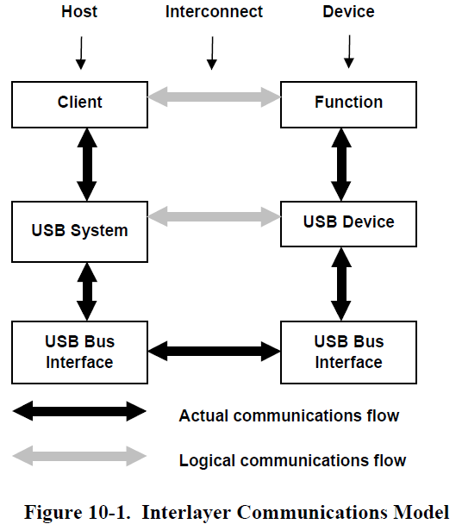
II. USB Host: hardware and software 2.1 overview of the usb host
The USB interconnect supports data traffic between a host and a USB device.
This chapter describes the host interfaces necessary to facilitate USB communication between a software client, resident on the host, and a function implemented on a device.
Notes:
USB interconnect hỗ trợ truyền data giữa host và USB device.
Chương này mô tả host interface cần thiết để USB giao tiếp giữa software client và function được implement trên device

Slide 30
II. USB Host: hardware and software 2.1 overview of the usb host
There is only one host for each USB. The major layers of a host consist of the following:
USB bus interface: handles interactions for the electrical and protocol layers
USB System: uses the Host Controller to manage data transfers between the host and USB devices.
Client
The USB System has three basic components:
Host Controller Driver: exists to more easily map the various Host Controller implementations into the USB System, such that a client can interact with its device without knowing to which Host Controller the device is connected.
USB Driver: provides the basic host interface (USBDI) for clients to USB devices. The interface between the HCD and the USBD is known as the Host Controller Driver Interface (HCDI). This interface is never available directly to clients and thus is not defined by the USB Specification.
Host Software
The USBD provides data transfer mechanisms in the form of I/O Request Packets (IRPs), which consist of a request to transport data across a specific pipe.
Overall, the host layers provide the following capabilities:
Detecting the attachment and removal of USB devices
Managing USB standard control flow between the host and USB devices
Managing data flow between the host and USB devices
Collecting status and activity statistics
Controlling the electrical interface between the Host Controller and USB devices, including the provision of a limited amount of power
Notes:
Mỗi USB system có 1 host. Host có 2 layer chính:
USB bus interface: xử lý thao tác liên quan tới điện và phương thức
USB system: dùng HC quản lý data transfer giữa host và USB device
Client
USB system có 3 component cơ bản:
HC driver: map HCD với USB system, client có thể thao tác với device mà ko cần hiểu HC nào đang connect
USB driver: cung cấp USBDI: interface giữa HCD và USBD, interface này ko bao giờ được cấp cho user, ko define trong spec này
Host SW
USBD hỗ trợ truyền data thông qua I?O request packet thông qua 1 pipe cụ thể.
các lớp host cung cấp các khả năng sau:
Phát hiện việc gắn và tháo device USB
Quản lý USB control flow giữa host và USB device
Quản data flow giữa host và USB device
Thu thập số liệu thống kê về trạng thái và hoạt động
Kiểm soát electrical interface giữa host và USB device

Slide 31
II. USB Host: hardware and software 2.1 overview of the usb host
Control Mechanisms:
Control information may be passed between the host and a USB device using in-band or out-of-band signaling
In-band signaling mixes control information with data in a pipe outside the awareness of the host.
Out-of-band signaling places control information in a separate pipe.
Data Flow:
The Host Controller is responsible for transferring streams of data between the host and USB devices.
These data transfers are treated as a continuous stream of bytes. The USB supports four basic types of data transfers:
- Control transfers
- Isochronous transfers
- Interrupt transfers
- Bulk transfers
Each device presents one or more interfaces that a client may use to communicate with the device. Each interface is composed of zero or more pipes that individually transfer data between the client and a particular endpoint on the device.
A pipe has several characteristics based on the delivery requirements of the data to be transferred.
Examples of these characteristics include the following:
- The rate at which data needs to be transferred
- Whether data is provided at a steady rate or sporadically
- How long data may be delayed before delivery
- Whether the loss of data being transferred is catastrophic
Notes:
Cơ chế điều khiển:
Thông tin điều khiển có thể được truyền giữa máy chủ và thiết bị USB bằng in-band or out-of-band signaling
in-band signaling kết control information với dât trong pipe nằm ngoài nhận thức của máy chủ.
out-band signaling đặt control information trong một pipe riêng biệt.
Data Flow:
HC chịu trách nhiệm truyền data giữa Host và USB device.
Một pipe có một số đặc điểm dựa trên yêu cầu của data được truyền
Ví dụ về những đặc điểm này bao gồm:
Tốc độ truyền dữ liệu
Dữ liệu được cung cấp với tốc độ ổn định hay ko
Data được delay bao lâu
Lost data

Slide 32
II. USB Host: hardware and software 2.2 HOSt controller requirements
State Handling
As a component of the host, the Host Controller reports and manages its states.
Serializer/Deserializer
For data transmitted from the host, the Host Controller converts protocol and data information from its native format to a bit stream transmitted on the USB. For data being received into the host, the reverse operation is performed.
(micro)frame Generation
The Host Controller produces SOF tokens at a period of 1 ms when operating with full-speed devices, and at a period of 125 μs when operating with high-speed devices
Data Processing
Protocol Engine
Transmission Error Handling
Remote Wakeup
The Host Controller processes requests for data transmission to and from the host.
The Host Controller supports the protocol specified by the USB.
All Host Controllers exhibit the same behavior when detecting and reacting to the defined error categories
All Host Controllers must have the ability to place the bus into the Suspended state and to respond to bus wakeup events.
Root hub
The root hub provides standard hub function to link the Host Controller to one or more USB ports.
Host System Interface
Provides a high-speed data path between the Host Controller and host system
HC be capable of detecting the following transmission error; Timeout conditions, Data errors, Protocol errors
Notes:
Tròng hầu hết trường hợp thì HC thưc nhiện các nhiệm vụ cơ bản giống nhau đối với USB device
HC nhận request từ cả host và USB device. Sau đây miêu tả ngắn gọn chức năng HC cung cấp:
State handling: report quà quản lý port state tới Host
Serializer/Deserializer:
Với data từ host, HC sẽ conver data infor từ format của các packet thành chuỗi bit để tranfer tới USB device.
Với data truyền tới host thì ngược lại
(micro)frame Generation:
Tạo start of frame token lúc 1ms với full-speed device
Tạo SOF token tại 125 ú với high-speed device
Data processing: HC xử lý request data transmission từ và tới host
Protocol Engine
Nó chèn thông tin giao thức thích hợp cho việc truyền đi. Nó cũng loại bỏ thông tin giao thức đến một cách thích hợp.
Transmission Error Handling: HC sẽ có behavior giống nhau khi detect và phản hồi 1 error đã defined
HC phải có khả năng bắt những lỗi sau:
Timeout conditions after a host-transmitted token or packet
Data errors resulting in missing or invalid transmissions
Protocol errors (An invalid handshake PID, A false EOP A bit stuffing error)
Remote Wakeup: HC phải có khả ăng đặt bus cào suspend state và phản hồi wakeup event,
Root hub: cung cấp standard hub function để link HC tới nhiều USB port. Rõ hơn ở chapter sau
Host System Interface: cung cấp đường truyền high-speed giữa HC và host system

Slide 33
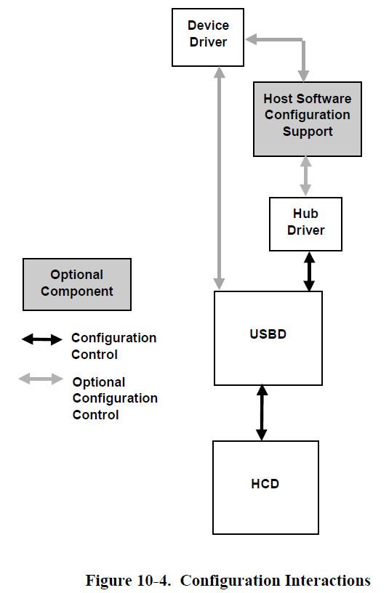
II. USB Host: hardware and software 2.3 Overview of Software Mechanisms
The HCD and the USBD present software interfaces based on different levels of abstraction.
The division of duties between the USBD and the HCD is not defined.
the USB System provides buffer management capabilities and allows the synchronization of the data transmittal to the needs of the client and the function.
Device Configuration: (Figure 10-4)
- Different operating system environments perform device configuration using different software components and different sequences of events.
- The USB System assumes a specialized client of the USBD, called a hub driver, that acts as a clearinghouse for the addition and removal of devices from a particular hub.
Workflow:
- 1: When a device is attached, the hub driver receives a notification from the hub detecting the change. The hub driver, using the information provided by the hub, requests a device identifier from the USBD. The USBD in turn sets up the default pipe for that device and returns a device identifier to the hub drive -- 2: The device is now ready to be configured for use. For each device, there are three configurations that must be complete before that device is ready for use:
Device Configuration: This includes setting up all of the device’s USB parameters and allocating all USB host resources that are visible to the device.
USB Configuration: In order to actually create a USBD pipe ready for use by a client, additional USB information, not visible to the device, must be specified by the client. This information, known as the Policy for the pipe, describes how the client will use the pipe. This includes such items as the maximum amount of data the client will transfer with one IRP, the maximum service interval the client will use, the client’s notification identification, and so on.
Function Configuration:Once configuration types 1 and 2 have been accomplished, the pipe is completely ready for use from the USB’s point of view. However, additional vendor- or class-specific setup may be required before the client can actually use the pipe. This configuration is a private matter between the device and the client and is not standardized by the USBD -
Notes:
Tổng quan co chế software
HCD và USBD giao tiếp trên nhiều level abstraction. Việc chia nhiệm vụ của HCD và USBD ko được define.
USB System cung cấp khả năng quản lý buffer và cho phép đông bộ việc truyền dữ liệu theo client và function
Device configuration:
Với OS khác nhau thì device config khác component và khác chuỗi event.
USB system goi 1 client cụ thể của USBD là hub driver, làm nhiệm vụ thêm bớt device cho hub
Workflow:
Khi device được cắm vào, hub driver sẽ nhận được thông báo từ the hub.
Hub driver dùng infor cấp bởi hub, sẽ request a device identifier from USBD.
USBD lần lượt thiết lập đường ống mặc định cho device đó và trả về mã nhận dạng device cho ổ đĩa trung tâm
2. Bây giờ thì device đã sẵn sàng để configure, với mỗi device thì có 3 cái cần config:
- Device configure: setting USB device parameter – allocate USB host resource
- USB config: add USB information (the Policy for the pipe, describes how the client will use the pipe: như là tối đa data khi transfer với 1 IRP, …) cần thiết để tạo USBD pipe
- Function configure: có thể cần then infor như additional vendor- or class-specifictrước khi client sùng pipe. Configure này là private giữa device va client, ko có trong standard

Slide 34
II. USB Host: hardware and software 2.3 Overview of Software Mechanisms
Resource management:
One of the endpoint requirements, which must be supported in order to create a pipe for an endpoint, is the bandwidth necessary for that endpoint’s transfers. There are two stages to check for available bandwidth. First the maximum execution time for a transaction is calculated. Then the (micro)frame schedule is consulted to determine if the indicated transaction will fit.
The calculation of the maximum transaction execution time requires that the following information be provided:
Number of data bytes (wMaxPacketSize) to be transmitted.
Transfer type.
Depth in the topology (If less precision is allowed, the maximum topology depth may be assumed)
Data Transfers:
- The basis for all client-function communication is the interface: a bundle of related pipes associated with a particular USB device.
Exactly one client on the host manages a given interface. The client initializes each pipe of an interface by setting the Policy for that pipe. his includes the maximum amount of data to be transmitted per IRP and the maximum service interval for the pipe
When a client wishes to transfer data, it will send an IRP to the USBD. Depending on the direction of data transfer, a full or empty data buffer will be provided. When the request is complete (successfully or due to an error condition), the IRP and its status is returned to the client.
Notes:
Resource management:
Xác định bandwidth là một trong những yêu cầu của endpoint transfer. Có 2 stage để check:
Tính maximum execute time của transaction. Sau đó microframe schedule được dùng để xem transaction có phù hợp ko.
Để tính transaction execute time time thì cần những thông tin sau
số data byte cần truyền
Tranfer type
Depth in topology
Data transfer:
Co sở cho mọi giao tiếp giữa client và function là interface: một chuỗi pipe liên quan với 1 USB device cụ thể
Chính xác một khách hàng trên host quản lý một giao diện nhất định. Máy khách khởi tạo từng ống của giao diện bằng cách đặt Chính sách cho ống đó. his includes the maximum amount of data to be transmitted per IRP and the maximum service interval for the pipe

Slide 35
II. USB Host: hardware and software 2.4 Host Controller Driver
The Host Controller Driver (HCD) is an abstraction of Host Controller hardware and the Host Controller’s view of data transmission over the USB. The HCDI meets the following requirements:
- Provides an abstraction of the Host Controller hardware.
- Provides an abstraction for data transfers by the Host Controller across the USB interconnect.
- Provides an abstraction for the allocation (and de-allocation) of Host Controller resources to support guaranteed service to USB devices.
Presents the root hub and its behavior according to the hub class definition.
The HCD provides a software interface (HCDI) that implements the required abstractions. The function of the HCD is to provide an abstraction, which hides the details of the Host Controller hardware.
Below the Host Controller hardware is the physical USB and all the attached USB devices.
The HCD is the lowest tier in the USB software stack. The HCD has only one client: the Universal Serial Bus Driver (USBD). The USBD maps requests from many clients to the appropriate HCD. A given HCD
may manage many Host Controllers.
The HCDI is not directly accessible from a client. Therefore, the specific interface requirements for the HCDI are not discussed here.
Notes:
HCD là một bản tóm tắt của phần cứng HC và truyền dữ liệu qua USB của HC. HDDI đáp ứng các yêu cầu sau:
• Cung cấp một bản tóm tắt về phần cứng HC hardware.
• Cung cấp việc truyền dữ liệu bằng HC qua USB interconnect.
• Cung cấp phân bổ (và hủy phân bổ) resource HC để hỗ trợ dịch vụ được đảm bảo cho USB device
• Trình bày Root hub và hành vi của nó theo định nghĩa lớp hub.
HCD cung cấp HCDI. ẩn đi các chi tiết về phần cứng HC.
Bên dưới phần cứng Host Controller là USB vật lý và tất cả các device USB kèm theo.
HCD là cấp thấp nhất của USB SW.
HCD chỉ có một client: USBD
USBD thể hiện các yêu cầu từ nhiều client tới HCD thích hợp.
Một HCD nhất định có thể quản lý nhiều HC. Client không thể truy cập trực tiếp HCDI. Do đó, các yêu cầu giao diện cụ thể cho HDDI không được thảo luận ở đây.

Slide 36
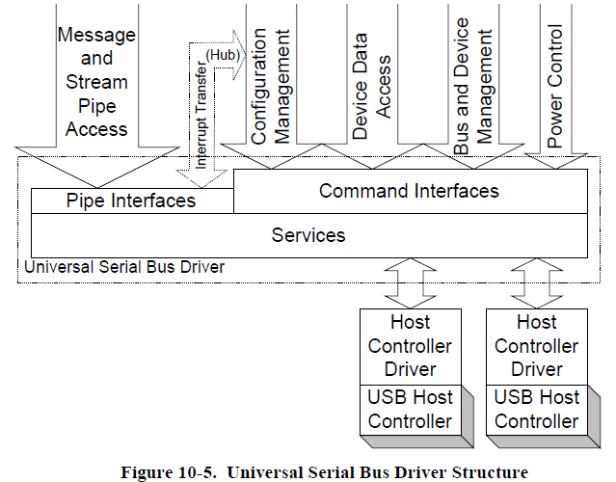
II. USB Host: hardware and software 2.5 Universal Serial Bus Driver
The USBD provides a collection of mechanisms that operating system components, typically device drivers, use to access USB devices. The only access to a USB device is that provided by the USBD. The USBD implementations are operating system-specific.
A single instance of the USBD directs accesses to one or more HCDs that in turn connect to one or more Host Controllers. If allowed, how USBD instancing is managed is dependent upon the operating system environment.
However, from the client’s point of view, the USBD with which the client communicates manages all of the attached USB devices.
Overview:
The USBD presents two groups of software mechanisms to clients: command mechanisms and pipe mechanisms.
Command mechanisms allow clients to configure and control USBD operation as well as to configure and generically control a USB device. command mechanisms provide all access to the device’s default pipe.
Pipe mechanisms allow a USBD client to manage device specific data and control transfers. Pipe mechanisms do not allow a client to directly address the device’s default pipe.
Notes:
USBD trình bày hai nhóm cơ chế SW tới client:
cơ chế lệnh và cơ chế đường ống.
Command mechanisms cho phép client định cấu hình và kiểm soát hoạt động của USBD cũng như định cấu hình và điều khiển chung một thiết bị USB. cơ chế lệnh cung cấp tất cả quyền truy cập vào đường ống mặc định của thiết bị.
Pipe mechanisms cho phép máy khách USBD quản lý dữ liệu cụ thể của thiết bị và kiểm soát việc truyền dữ liệu. Cơ chế đường ống không cho phép khách hàng trực tiếp xử lý đường ống mặc định của thiết bị.

Slide 37
II. USB Host: hardware and software 2.5 Universal Serial Bus Driver
USBD Initialization
Specific USBD initialization is operating system-dependent. When a particular USB managed by USBD is initialized, the management information for that USB is also created. Part of this management information is the default address device and its default pipe used to communicate to a newly reset device.
When a device is attached to a USB, it responds to a special address known as the default address (refer to Chapter 9) until its unique address is assigned by the bus enumerator. In order for the USB System to interact with the new device, the default device address and the device’s default pipe must be available to the hub driver when a device is attached. During device initialization, the default address is changed to a unique address.
USBD Pipe Usage
Pipes are the method by which a device endpoint is associated with a Host Software entity.
Although the basic concept of a pipe is the same no matter who the owner, some distinction of capabilities provided to the USBD client occurs between two groups of pipes:
- Default pipes, which are owned and managed by the USBD
- All other pipes, which are owned and managed by clients of the USBD
Default pipes are never directly accessed by clients, although they are often used to fulfill some part of client requests relayed via command mechanisms.
Notes:
Khởi tạo USBD
Việc khởi tạo USBD cụ thể phụ thuộc vào hệ điều hành.
Khi một USB cụ thể được quản lý bởi USBD được khởi tạo, thông tin quản lý cho USB đó cũng được tạo.
Một phần thông tin quản lý này là địa chỉ mặc định của device và default control pipe của nó
Khi một device được gắn vào USB, nó sẽ phản hồi một địa chỉ đặc biệt được gọi là mặc định (tham khảo Chương 9) cho đến khi địa chỉ duy nhất của nó được gán bởi bộ liệt kê bus.
Để Hệ thống USB tương tác với device mới, địa chỉ device mặc định và đường ống mặc định của device phải có sẵn cho trình điều khiển trung tâm khi gắn device.
Sử dụng ống USBD Ống là phương thức mà điểm cuối của device được liên kết với thực thể Phần mềm host. Các ống được sở hữu bởi chính xác một thực thể như vậy trên host. Mặc dù khái niệm cơ bản về đường ống là giống nhau bất kể chủ sở hữu là ai, nhưng một số khác biệt về khả năng được cung cấp cho máy khách USBD xảy ra giữa hai nhóm đường ống: • Các đường dẫn mặc định do USBD sở hữu và quản lý • Tất cả các đường ống khác do khách hàng của USBD sở hữu và quản lý Các đường dẫn mặc định không bao giờ được khách hàng truy cập trực tiếp, mặc dù chúng thường được sử dụng để thực hiện một số phần yêu cầu của khách hàng được chuyển tiếp thông qua các cơ chế lệnh.

Slide 38
III. Hub Specification 3.1 Overview
This chapter describes the architectural requirements for the USB hub.
The chapter also describes the hub’s operation for error recovery, reset, and suspend/resume. The second half of the chapter defines hub request behavior and hub descriptors.
Hubs provide the electrical interface between USB devices and the host.
Listed below are the major aspects of USB functionality that hubs must support:
Connectivity behavior
Power management
Device connect/disconnect detection
Bus fault detection and recovery
High-, full-, and low-speed device support
Notes:
Chương này miêu tả architect requirement của USB hub. Nó gồm 3 sub-block.
Chapter này miêu tả operation của hub khi reset/suspend/resume. 1 nữa define hub request và hub descriptor
Hub cung cấp electrical interface giữa USB device và host.
List function mà Hub phải support: …
Hub Repeater: chịu trách nhiệm thiết lập và phân tách kết nối, hỗ trợ xử lý ngoại lệ
Hub controller: cung cấp cơ chế giao tiếp từ host tới hub
The Transaction Translator: phản hồi các giao dịch phân chia tốc độ cao và chuyển chúng thành các giao dịch tốc độ đầy đủ/thấp với các device tốc độ đầy đủ/thấp được gắn trên các cổng hướng về phía hạ lưu.

Slide 39
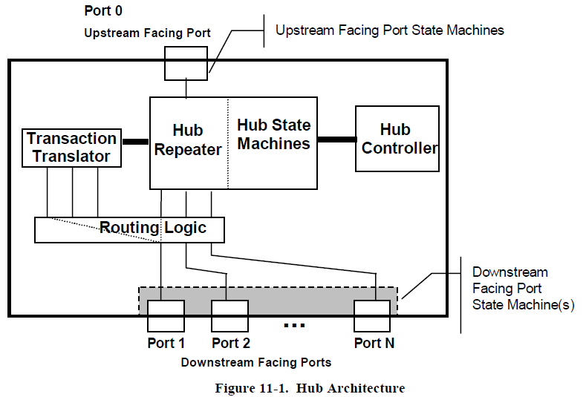
III. Hub Specification 3.1 Overview
A hub consists of three components:
The Hub Repeater: is responsible for connectivity setup and tear-down, supports exception handling
The Hub Controller: provides the mechanism for host-to-hub communication
The Transaction Translator: responds to high-speed split transactions and translates them to full-/low-speed transactions with full-/low-speed devices attached on downstream facing ports.
Notes:
Hub Repeater: chịu trách nhiệm thiết lập và phân tách kết nối, hỗ trợ xử lý ngoại lệ
Hub controller: cung cấp cơ chế giao tiếp từ host tới hub
The Transaction Translator: phản hồi các giao dịch phân chia tốc độ cao và chuyển chúng thành các giao dịch tốc độ đầy đủ/thấp với các device tốc độ đầy đủ/thấp được gắn trên các cổng hướng về phía hạ lưu.

Slide 40
III. Hub Specification 3.1 Overview
Hub Frame/Microframe Timer : Each hub has a (micro)frame timer whose timing is derived from the hub’s local clock and is synchronized to the host (micro)frame period by the host-generated Start-of-(micro)frame (SOF)
High-speed Microframe Timer Range: The range for a microframe timer must be from 59904 to 60096 high-speed bits.
Full-speed Frame Timer Range: The range of the frame timer must be from 11958 to 12042 full-speed bits.
Frame/Microframe Timer Synchronization:
A hub’s (micro)frame timer is clocked by the hub’s clock source
After a reset or resume, the hub’s (micro)frame timer is not synchronized. Whenever the hub receives two consecutive SOF packets, its (micro)frame timer must be synchronized.
Please refer USB 2.0 spec for below advanced part:
Microframe Jitter Related to Frame Jitter
EOF1 and EOF2 Timing Points
…
Notes:
Mỗi hub có 1 frame timer cấp clock bởi hub’s local clock. Được đồng bộ với host frame bở SOF packet
Timmer range của high-speed và full speed.
Timmer sync:
hub’s frame timer được cấp clock bởi hub clock src
Sau khi reset hoặc resume, the hub frame timer ko được đông bộ, được đông bộ khi nhận được 2 SÒ packet liên tiếp

Slide 41
III. Hub Specification 3.2 Descriptors
Hub descriptors are derived from the general USB device framework. Hub descriptors define a hub device and the ports on that hub. The host accesses hub descriptors through the hub’s default pipe.
The USB specification (refer to Chapter 9) defines the following descriptors:
Device
Configuration
Interface
Endpoint
String (optional)
The hub class defines additional descriptors (refer to Section 11.23.2). In addition, vendor-specific descriptors are allowed in the USB device framework. Hubs support standard USB device commands as defined in Chapter 9.
Notes:
A USB device has several possible states. Some of these states are visible to the USB and the host, while
others are internal to the USB device.

Slide 42
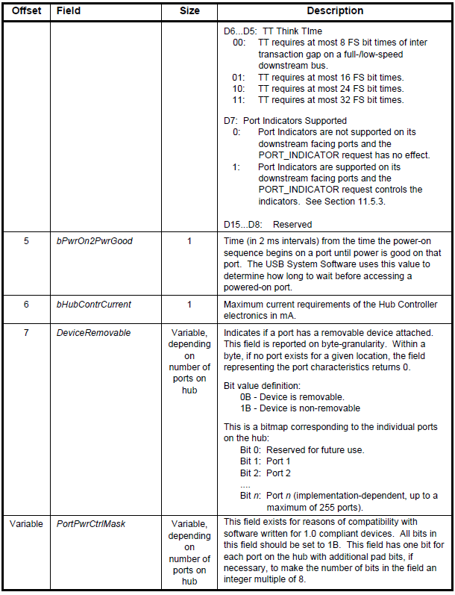
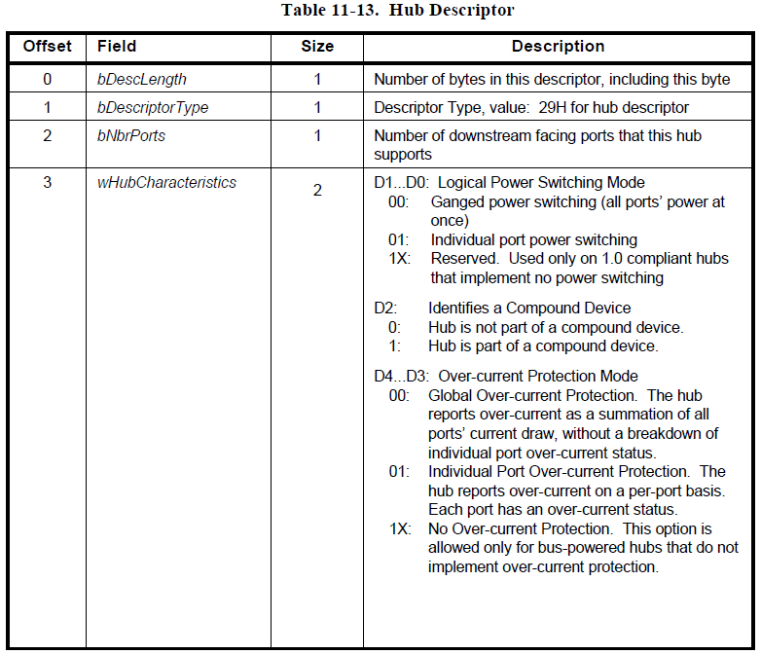
III. Hub Specification 3.2 Descriptors
Class-specific Descriptors: Hub Descriptor

Slide 43
III. Hub Specification 3.3 Requests
Standard Requests:
Hubs have tighter constraints on request processing timing than specified in Section 9.2.6 for standard devices because they are crucial to the "time to availability" of all devices attached to USB. The worst case request timing requirements are listed below (apply to both Standard and Hub Class requests):
Completion time for requests with no data stage: 50 ms
Completion times for standard requests with data stage(s):
Time from setup packet to first data stage: 50 ms
Time between each subsequent data stage: 50 ms
Time between last data stage and status stage: 50 ms
As hubs play such a crucial role in bus enumeration, it is recommended that hubs average response times be
less than 5 ms for all requests.

Slide 44
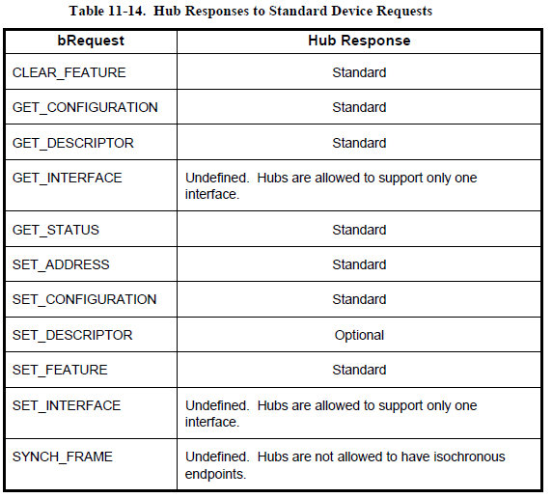
III. Hub Specification 3.3 Requests
Standard Requests:
Hubs have tighter constraints on request processing timing than specified in Section 9.2.6 for standard devices because they are crucial to the "time to availability" of all devices attached to USB. The worst case request timing requirements are listed below (apply to both Standard and Hub Class requests):
Completion time for requests with no data stage: 50 ms
Completion times for standard requests with data stage(s):
Time from setup packet to first data stage: 50 ms
Time between each subsequent data stage: 50 ms
Time between last data stage and status stage: 50 ms
As hubs play such a crucial role in bus enumeration, it is recommended that hubs average response times be
less than 5 ms for all requests.

Slide 45
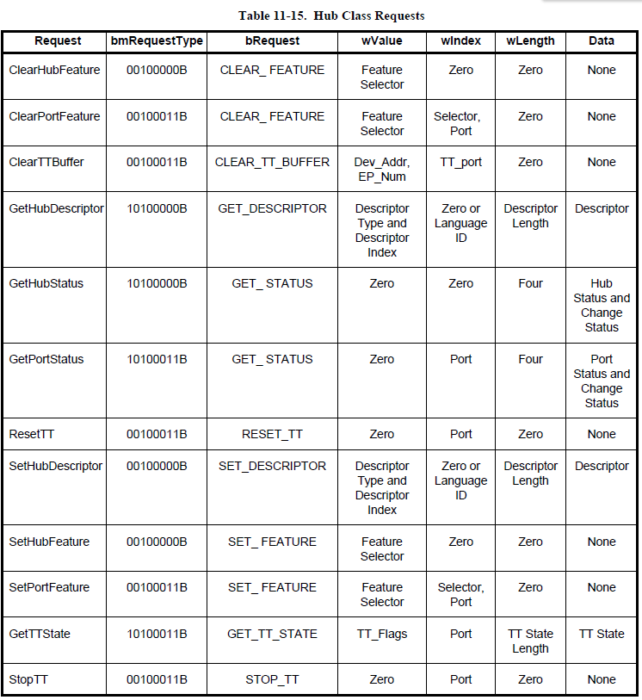
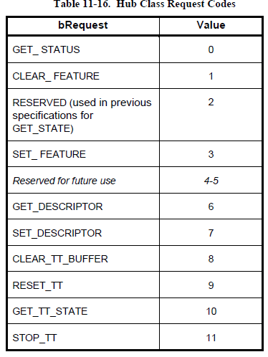
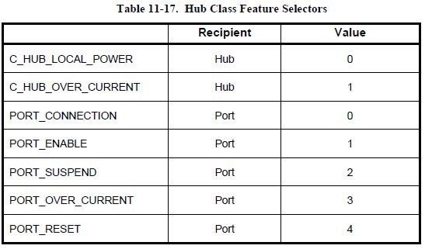
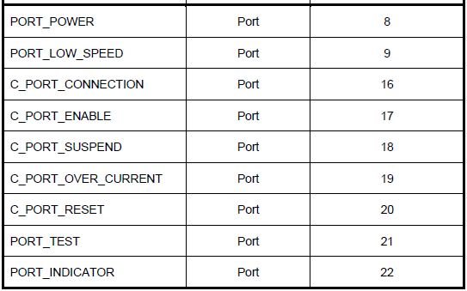
III. Hub Specification 3.3 Requests
Class-specific Requests:

Slide 46
Renesas.com
Notes:
Thank you everyone for your great support. FSP is growing to the next level with lot of new features and new device supports. Also expanding beyond RA to other Renesas MCU and MPU families.. So thank you very much for your contributions!

