Slide 1

Watchdog timer (R_WDT)
nov 2023
minh nguyen
Ra fsp group
Renesas Electronics Corporation

Slide 2
Agenda
Overview. Page 03.
Operation. Page 09.
WDT in FSP. Page 26.
How to create an EP. Page 36.
Reference Page 50.

Slide 3
Watchdog timer (r_wdt)
overview

Slide 4
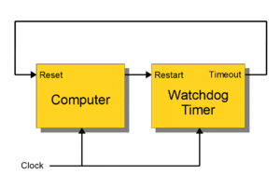
Overview What is watchdog timer ?
The watchdog timer (WDT) is a 14-bit down counter that monitors MCU programs to see if they are out of control or stopped operating. It acts as a “watchdog” watching over MCU operation.
It can be used to reset the system when the counter underflows because its value cannot be refreshed due to the system being out of control.
In addition, a non-maskable interrupt can be generated by an underflow. The refresh-permitted period can be set to refresh the counter and used as the condition to detect when the system runs out of control.

Slide 5
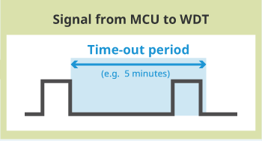
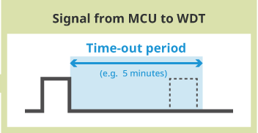
overview basic operation
Time-out mode:
In this mode, the WDT determines the MCU is malfunctioning and outputs a reset signal If it does not receive a signal from the MCU within the set interval
The Time-out mode is a major WDT monitoring mode or method, but it sometimes fails to detect MCU faults.
In Time-out mode, the WDT will not detect an MCU fault if the MCU inputs multiple signals (= double pulse) in the set period.
MCU sends signal to refresh the WDT.
MCU won’t send signal to refresh the WDT due to some errors and the wdt will reset the MCU.

Slide 6
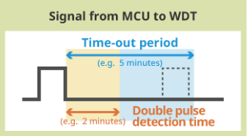
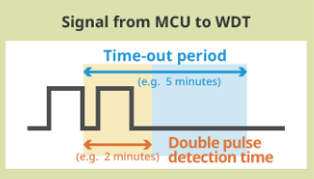
overview basic operation
WDT won’t receive a refresh signal within the set time-out period → Reset MCU
Window mode:
The window mode enables more accurate detection of faults than the Time-out mode.
In window mode, the watchdog timer determines that the MCU is malfunctioning and outputs a reset signal If it does not receive a signal or multiple signal from the MCU within the set interval.
A window mode watchdog timer may be more suitable for applications such as automotive devices that require greater safety.
WDT receives multiple signals in a set double pulse period → Reset MCU

Slide 7
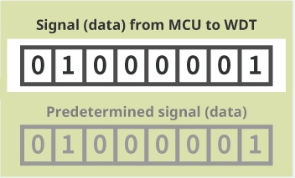
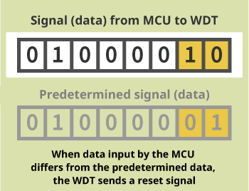
overview basic operation
Q&A mode:
Enable mor accurate fault detection than 2 modes above.
In Q&A mode, the MCU sends predetermined data to the WDT. The WDT determines whether or not the MCU is operating normally depending on whether or not the signal sent by the MCU matches predetermined data.
Devices that require a high degree of safety may require a Q&A WDT.
MCU inputs data differs from the predetermined data.
→ Reset MCU.

Slide 8
Overview What applications require WDT ?
The WDT is required or not depends on the “level of safety demanded by or deemed necessary for a specific application.”
Automotive devices are devices where MCU failures or malfunction could lead to life-threatening accidents. In water heaters and kitchen stoves, MCU failure or malfunction poses a fire risk.
In system that impact human life or in applications where malfunction of electronic control can cause serious accidents, WDT is required to ensure sufficient redundancy.

Slide 9
Watchdog timer (r_wdt)
operation

Slide 10
operation key features of watchdog timer
Clock division ratio: Divide by 4, 64, 128, 512, 2048 or 8192.
Counter operation: Counting down using a 14-bit down-counter.
Condition for starting the counter:
Auto-start mode: Counting automatically starts after reset or after and underflow or refresh error occurs.
Register start mode: Counting is started by refresh operation (writing to the WDTRR register).
Conditions for stopping the counter:
Reset (the down-counter and other registers return to their initial values).
A counter underflows or a refresh error is generated.
Window function: Window start and end positions can be specified(refresh-permitted and refresh- prohibited periods).

Slide 11
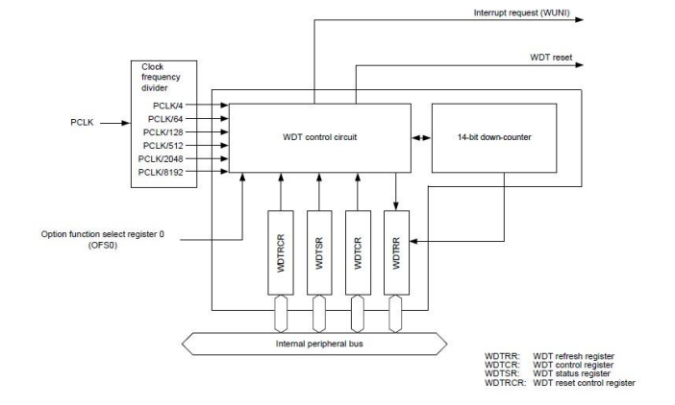
operation Block diagram

Slide 12
operation list of registers
Register | Base Address | Offset Address
WDTRR: WDT Refresh Register | WDT = 0x4008_3400 | 0x00
WDTCR: WDT Control Register | WDT = 0x4008_3400 | 0x02
WDTSR: WDT Status Register | WDT = 0x4008_3400 | 0x04
WDTRCR: WDT Reset Control Register | WDT = 0x4008_3400 | 0x06
WDTCSTPR: WDT Count Stop Control Register | WDT = 0x4008_3400 | 0x08

Slide 13
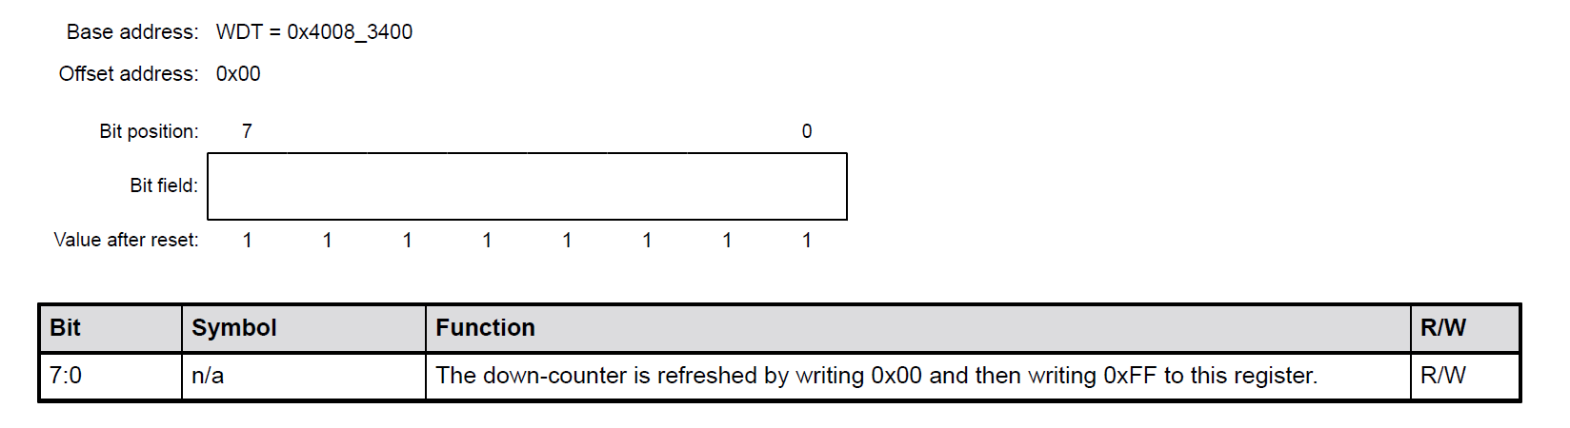
operation WDTRR: WDT refresh register

Slide 14
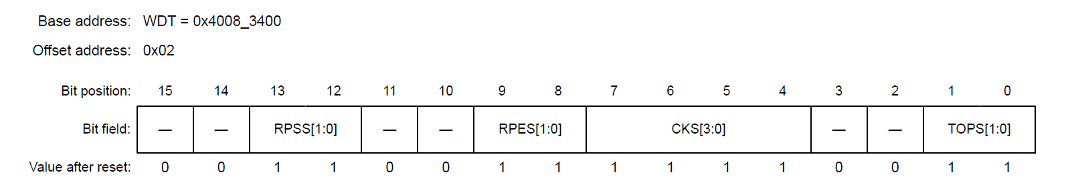
operation WDTcr: WDT control register
Bit | Symbol | Function | R/W
1:0 | TOPS[1:0] | Timeout Period Select | R/W
3:2 | - | These bits are read as 0. The write value should be 0. | R/W
7:4 | CKS[3:0] | Clock Division Ratio Select | R/W
9:8 | RPES[1:0] | Window End Position Select | R/W
11:10 | - | These bits are read as 0. The write value should be 0. | R/W
13:12 | RPSS[1:0] | Window Start Position Select | R/W
15:14 | - | These bits are read as 0. The write value should be 0. | R/W

Slide 15
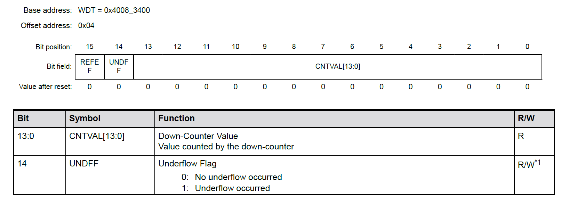
operation WDTSr: WDT status register

Slide 16
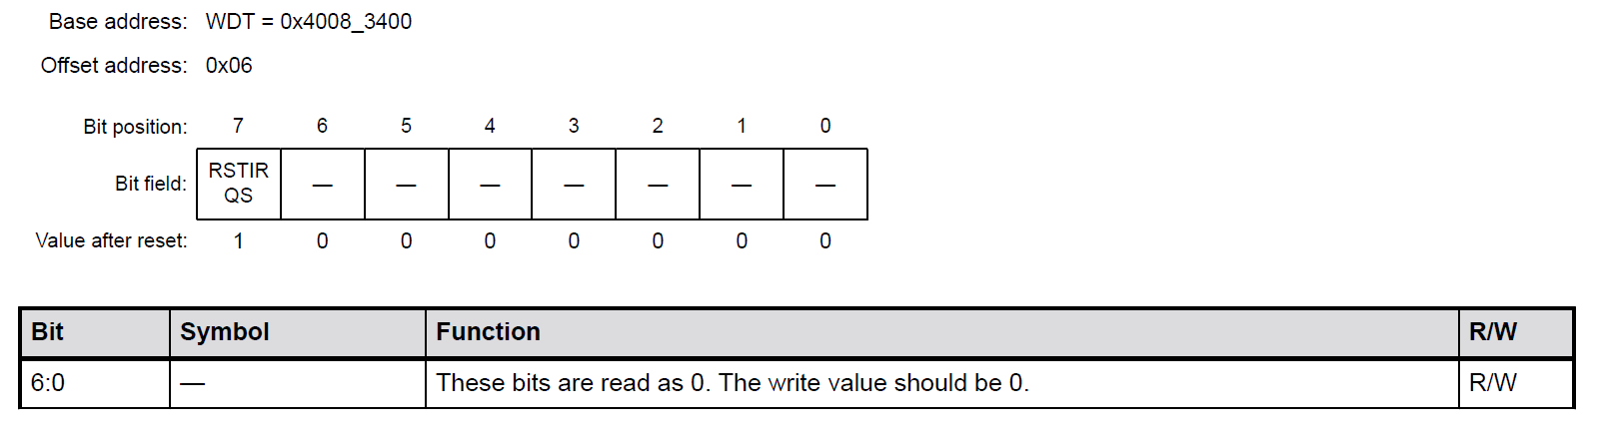
operation WDTrcr: WDT reset control register

Slide 17
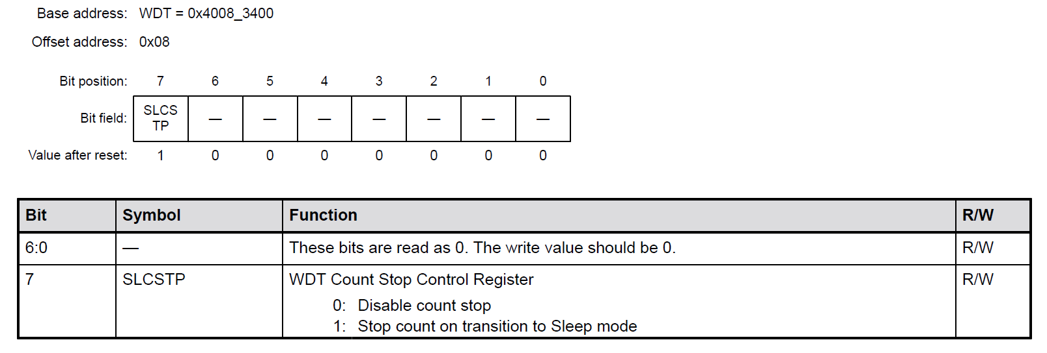
operation WDTCstpr: WDT control stop register

Slide 18
operation count operation in each start mode
The WDT has two start modes:
Auto start mode, in which counting automatically starts after a release from the reset state.
Register start mode, in which counting starts with a refresh by writing to the register.
Select auto start mode or register start mode by setting the WDT Start Mode Select bit (OFS0.WDTSTRT) in the OFS0 register.
When the auto start mode (OFS0.WDTSTRT=1) is selected, the settings in the WDT Control Register (WDTCR), WDT Reset Control Register (WDTRCR), and WDT Count Stop Control Register (WDTCSTPR) are disabled while the settings in the OFS0 register are enabled.
When the register start mode (OFS0.WDTSTRT=0) is selected, the setting for the OFS0 register is disabled while the settings for the WDT Control Register (WDTCR), WDT Reset Control Register (WDTRCR), and WDT Count Stop Control Register (WDTCSTPR) are enabled.

Slide 19
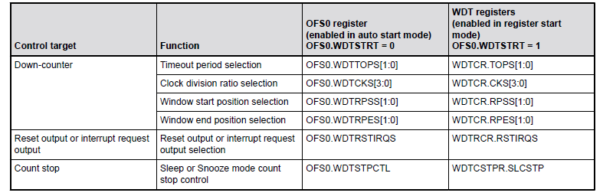
operation count operation in each start mode
Association between Option Function Select Register 0 (OFS0) and WDT Registers

Slide 20
operation register start mode
Enable: WDTCR, WDTRCR, WDTCSTPR
After the reset state is released, set the following to Sleep mode in the WDTCSTPR register:
Clock division ratio.
Window start and end positions
Time out period in the WDTCR.
Reset output or interrupt request output in the WDTRCR.
Counter stop control during transitions to Sleep mode in the WDTCSTPR.
Shows an example:
Register start mode (OFS0.WDTSTRT = 1)
Reset output is enabled (WDTRCR.RSTIRQS = 1)
The window start position is 75% (WDTCR.RPSS[1:0] = 10b)
The window end position is 25% (WDTCR.RPES[1:0] = 10b)

Slide 21
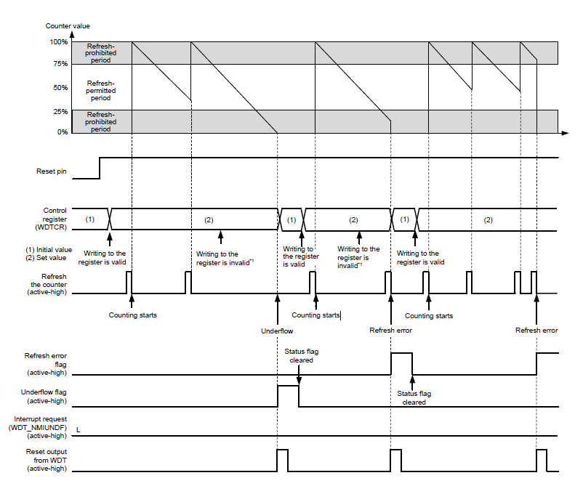
operation register start mode

Slide 22
operation auto start mode
Disable: WDTCR, WDTRCR, WDTCSTPR
Within the reset state, the setting values for the following in the Option Function Select Register 0 (OFS0) are set in the
WDT registers:Clock division ratio.
Clock division ratio
Window start and end positions
Timeout period
Reset output or interrupt request
Counter stop control during transition to Sleep mode
Shows an example:
Auto start mode (OFS0.WDTSTRT = 0)
Non-maskable interrupt request output is enabled (OFS0.WDTRSTIRQS = 0)
The window start position is 75% (OFS0.WDTRPSS[1:0] = 10b)
The window end position is 25% (OFS0.WDTRPES[1:0] = 10b)

Slide 23
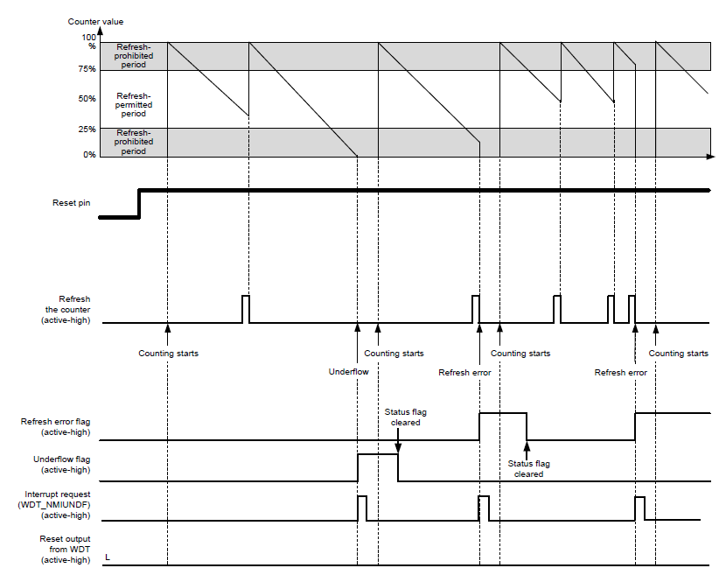
operation auto start mode

Slide 24
operation refresh operation
The down-counter is refreshed and starts counting operation on a write of the values 0x00 and 0xFF to the WDT Refresh Register (WDTRR).
If a value other than 0xFF is written after 0x00, the down-counter is not refreshed. If an invalid value is written, correct refreshing resumes on a write of 0x00 and 0xFF to the WDTRR register.
[Example write sequences that are valid for refreshing the counter]
● 0x00 → 0xFF
● 0x00 ((n–1)th time) → 0x00 (nth time) → 0xFF
● 0x00 → access to another register or read from WDTRR → 0xFF
[Example write sequences that are invalid for refreshing the counter]
● 0x23 (a value other than 0x00) → 0xFF
● 0x00 → 0x54 (a value other than 0xFF)
● 0x00 → 0xAA (0x00 and a value other than 0xFF) → 0xFF

Slide 25
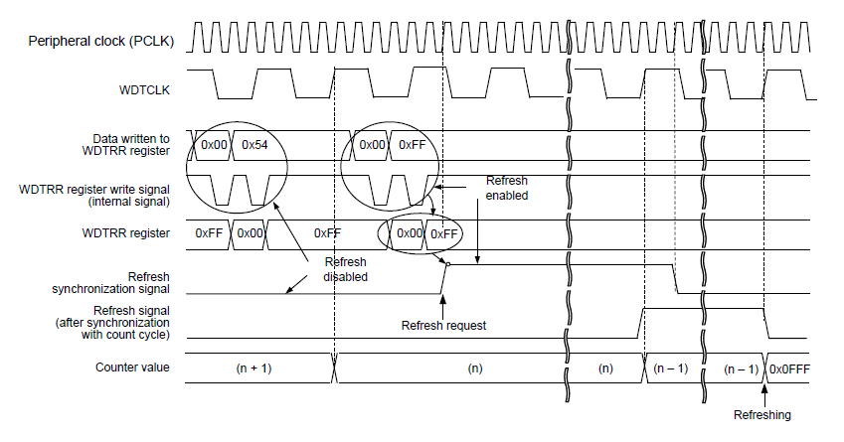
operation refresh operation

Slide 26
Watchdog timer (r_wdt)
Wdt in fsp

Slide 27
WDT in fsp BUILDTIME CONFIGURATIONS FOR R_WDT
The following build time configurations are defined in fsp_cfg/r_wdt_cfg.h:
Configuration | Options | Default | Description
Parameter Checking | Default (BSP) Enabled Disabled | Default (BSP) | If selected code for parameter checking is included in the build
Register Start NMI Support | Enable Disabled | Disabled | If enabled, code for NMI support in register start mode is included in the build

Slide 28
Wdt in fsp configurations for monitoring > watchdog (r_wdt)
WDT module can be added too the Stacks tab via New Stack > Monitoring > Watchdog (r_wdt). Non- secure callable guard functions can be generated for this module by right clicking the module in the RA Configuration tool and checking the “Non-secure Callable” box.
Configuration | Options | Default | Description
Name | Name must be a valid C symbol | g_wdt0 | Module name.
Time out | 1,024 Cycles 4,096 Cycles 8,192 Cycles 16,384 Cycles | 16,384 Cycles | Select the watchdog timeout in cycles.
Clock Division Ratio | PCLK/4 PCLK/64 PCLK/128 PCLK/512 PCLK/2048 PCLK/8192 | PCLK/8192 | Select thw watchdog clock divisor.
Window Start Position | 100 (Window Position Not Specified) 75 50 25 | 100%(Window Position Not Specified) | Select the allowed watchdog refresh start point in %.

Slide 29
Wdt in fsp BUILDTIME CONFIGURATIONS FOR R_WDT
Configuration | Options | Default | Description
Window End Position | 0 (Window Position Not Specified) 25 50 75 | 0% (Window Position Not Specified) | Select the allowed watchdog refresh start point in %
Reset Control | Reset Output NMI Generated | Reset Output | Select what happens when the watchdog timer expires.
Stop Control | WDT Count Enabled in Low Power Mode WDT Count Disabled in Low Power Mode | WDT Count Disabled in Low Power Mode | Select the watchdog state in low power mode.
NMI Callback | Name must be a valid C symbol. | NULL | A user callback function must be provided if the WDT is configuared to generate an NMI when the timer underflows or a refresh error occurs. If this callback function is provided, it will be called from the NMI handler each time the watchdog triggers.

Slide 30
Wdt in fsp other configurations
Clock Configuration:
The WDT Clock is based on the PCLKB frequency. You can set the PCLKB frequency using the Clocks tab of the RA Configuration editor or by using the CGC Interface at run-time. The maximum timeout period with PCLKB running at 60MHz is approximately 2.2 seconds.
Pin Configuration:
This module does not use I/O pins.

Slide 31
Wdt in fsp Period calculation
The WDT operates from PCLKB. With a PCLKB of 60MHz, the maximum time from the last refresh to device reset or NMI generation will be just over 2.2 seconds as detailed below.
PLCKB = 60MHz
Clock Division Ratio = PCLKB/8192
WDT Clock Frequency = 60 MHz/8192 = 7.324 kHz
Cycle time = 1/7.324 kHz = 136.53 us.
Timeout = 136.53 us x 16384 cycles = 2.23 seconds
Note: The smaller PLCKB, the longer Timeout.

Slide 32
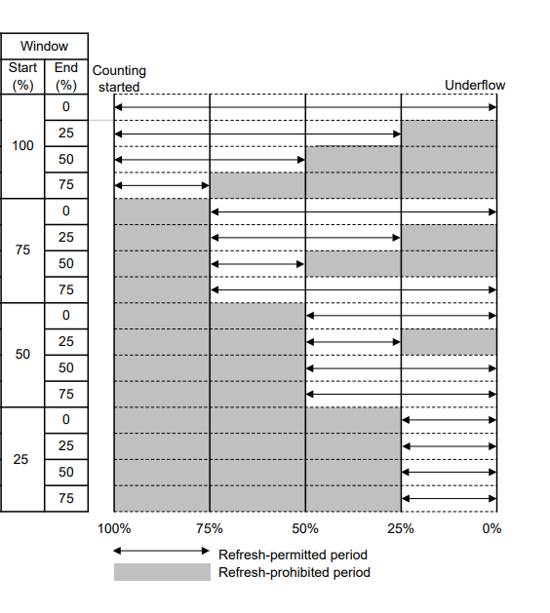
Wdt in fsp window mode configuration

Slide 33
Wdt in fsp Limitations
Developers should be aware of the following limitations when using WDT:
When using a J-Link debugger the WDT counter does not count therefore will not reset the device or generate an NMI. To enable the WDT to count and generate a reset or NMI while debugging, add this line code tin the application:
/* (Optional) Enable the WDT to count and generate NMI or reset when the
* debugger is connected. */
R_DEBUG->DBGSTOPCR_b.DBGSTOP_WDT = 0;
If the WDT is configured to stop the counter in low power mode, then your application must restart the WDT by calling R_WDT_Refresh() after the MCU wakes from low power mode.
Note: The smaller PLCKB, the longer Timeout.

Slide 34
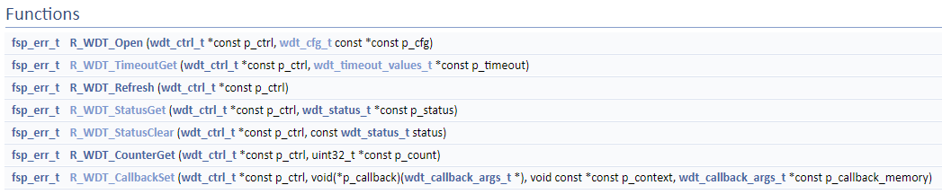
Wdt in fsp Functions

Slide 35
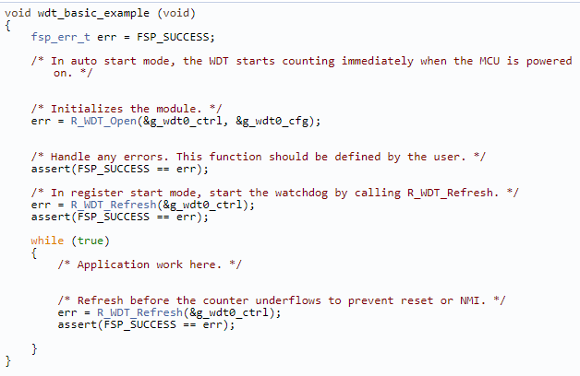
Wdt in fsp Examples
WDT Basic Example:
This is a basic example of minimal use of the WDT in an application.

Slide 36
Watchdog timer (r_wdt)
How to create an ep

Slide 37
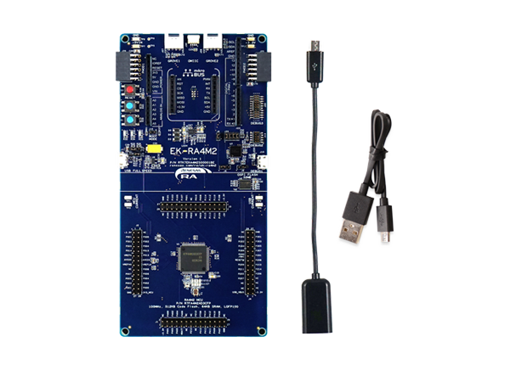
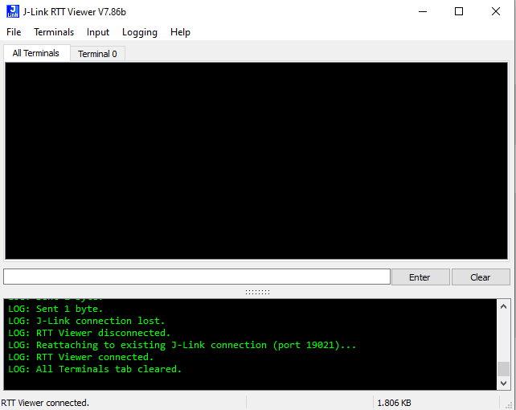

How to create an ep prepare enviroment
E2 studio for code building and debugging.
An RA Board and USB-A to Micro USB cable.
J-Link viewer to view log

Slide 38
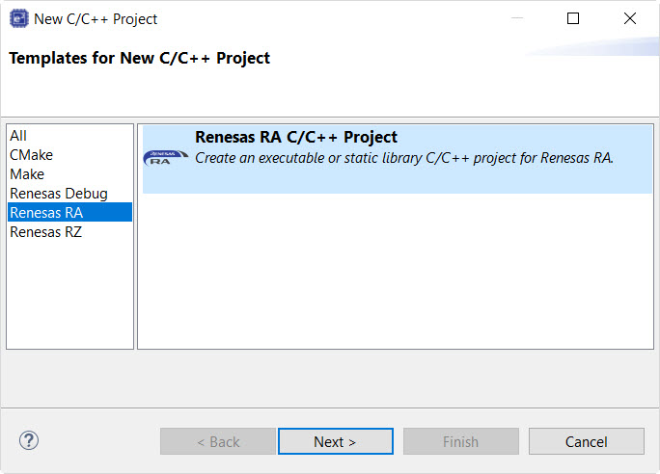
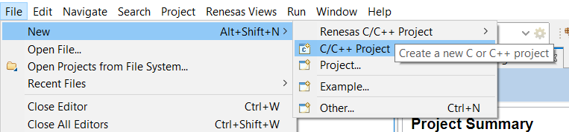
How to create an ep Create an ep

Slide 39
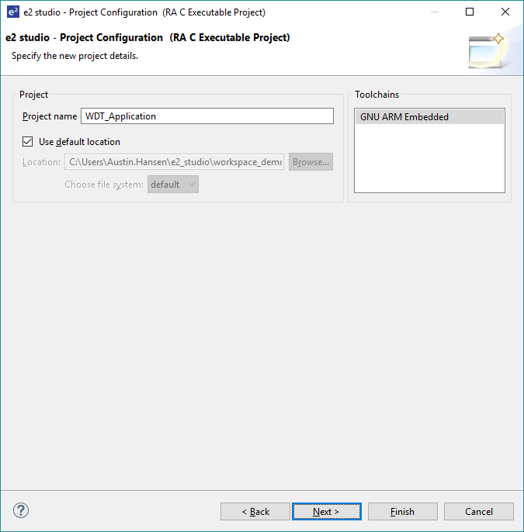
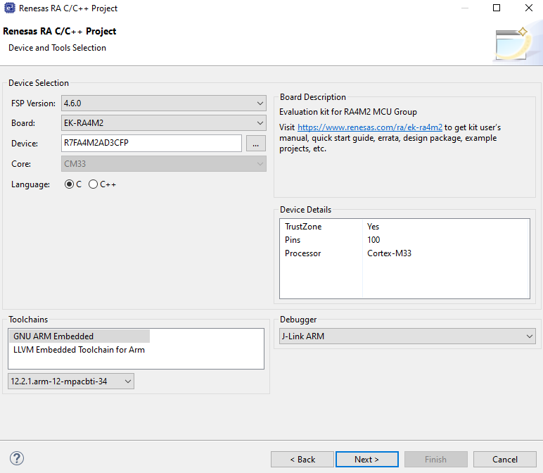
How to create an ep Create an ep
Select the correct model for your RA Board

Slide 40
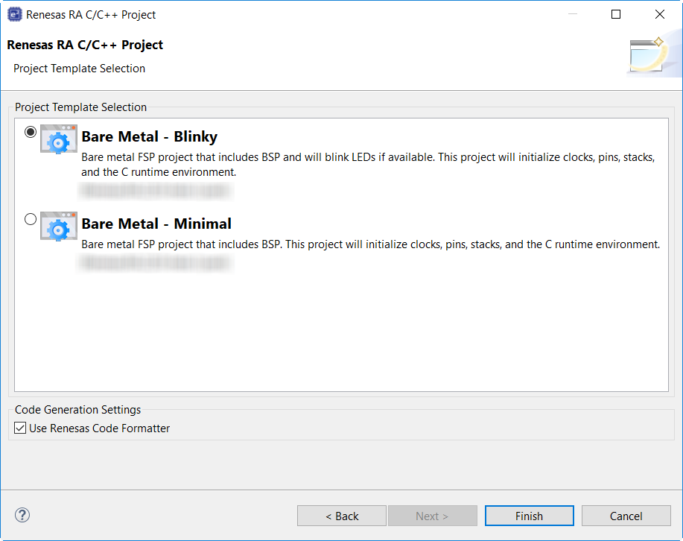
How to create an ep Create an ep

Slide 41
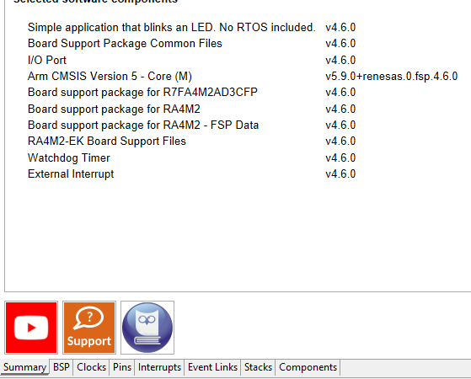
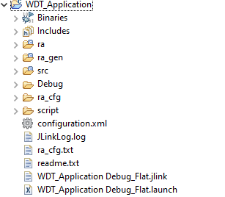

How to create an ep WDT module configuration

Slide 42
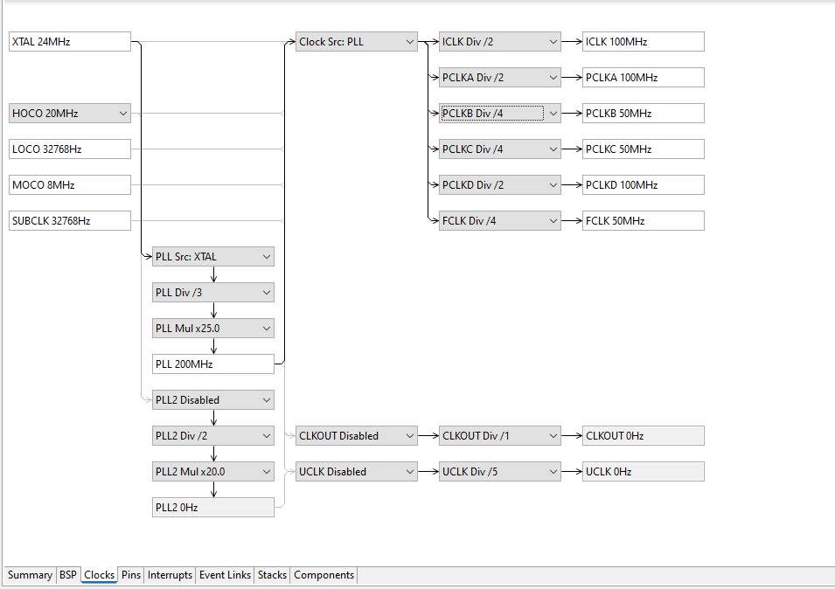

How to create an ep WDT module configuration
The PCLKB clock use for calculate the WDT timeout. The default of EK-4M2 is 50 MHz = 2.68s
Lower the value PCLKB clock can extend duration of WDT

Slide 43
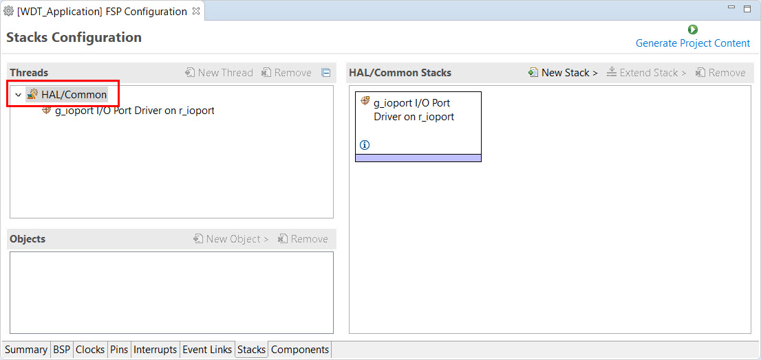
How to create an ep WDT module configuration

Slide 44
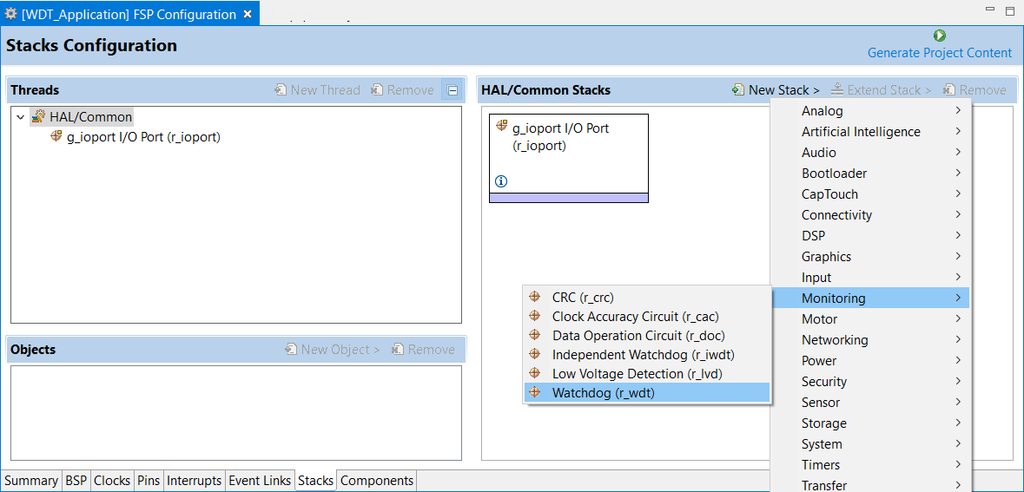
How to create an ep WDT module configuration

Slide 45
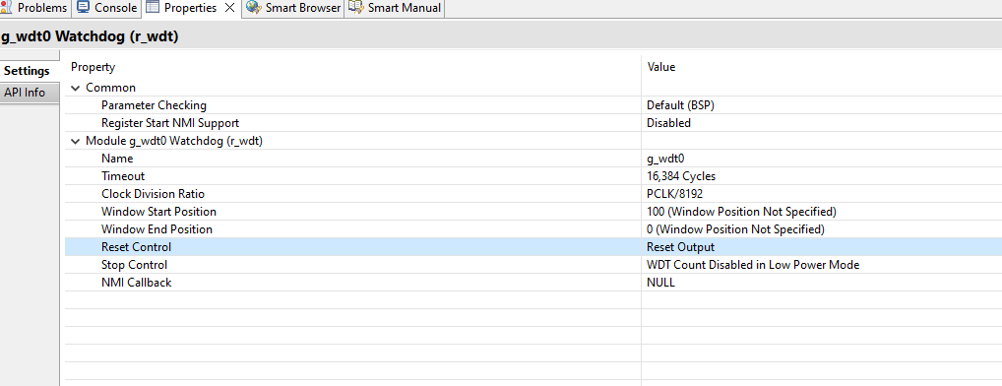
Watchdog timer Configuration WDT module configuration

Slide 46
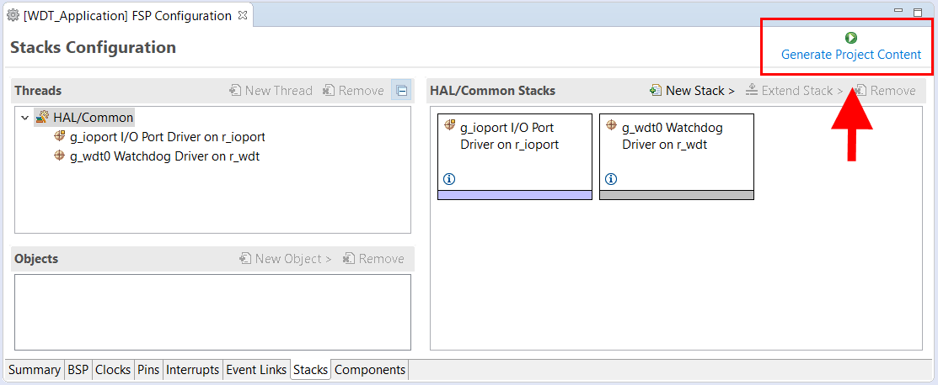
How to create an ep WDT module configuration
Clicking the Generate Project Content button performs the following tasks.
r_wdt folder and WDT driver content created at: ra/fps/src
r_wdt_api.h created in: ra/fsp/inc/api
r_wdt.h created in: ra/fsp/inc/instances
Note: Copy SEGGER Library and common_utils.h to <Project>/src to interact with JLink

Slide 47
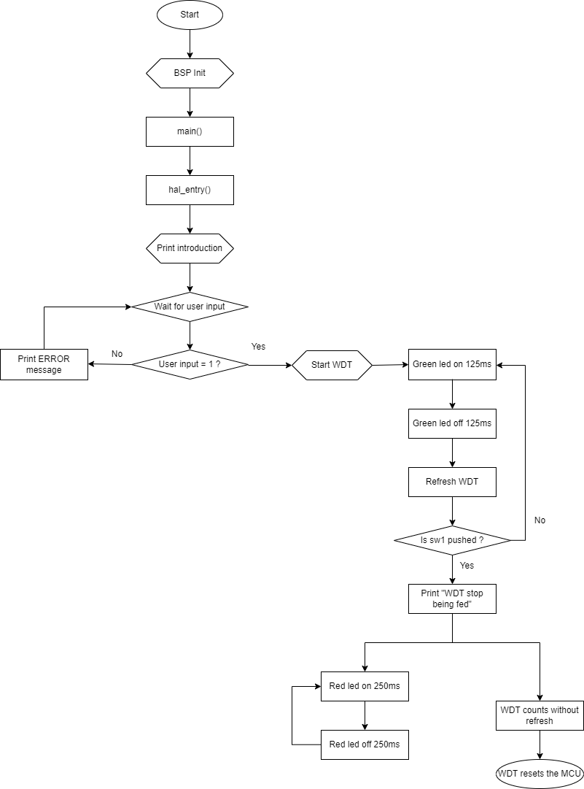
How to create an ep Flow chart

Slide 48
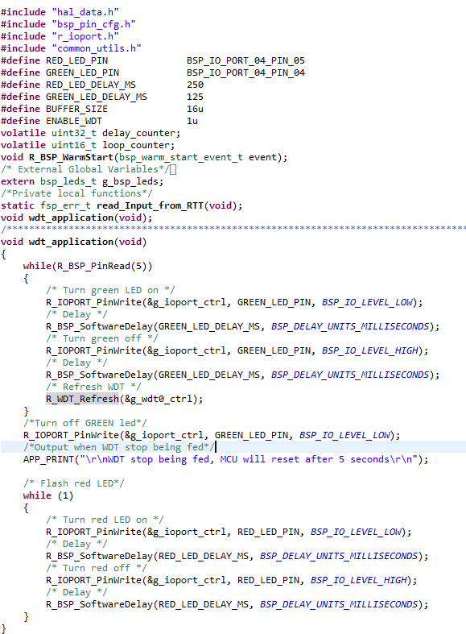
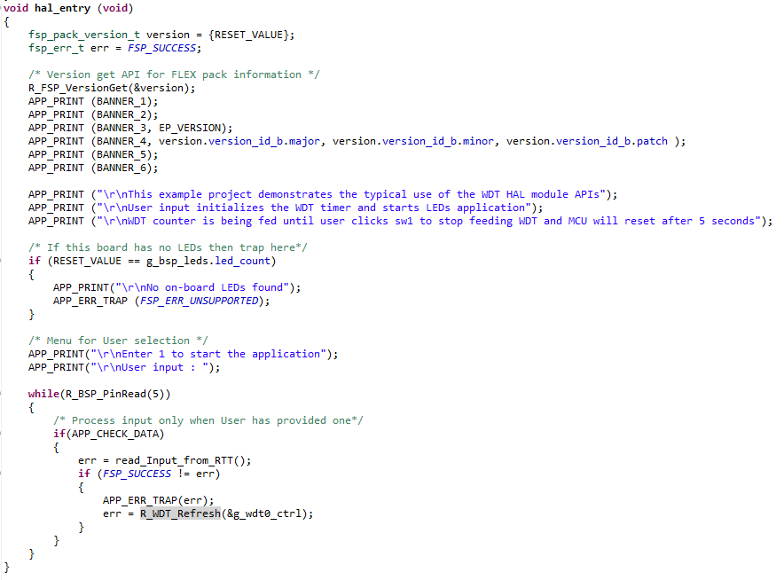
How to create an ep code

Slide 49
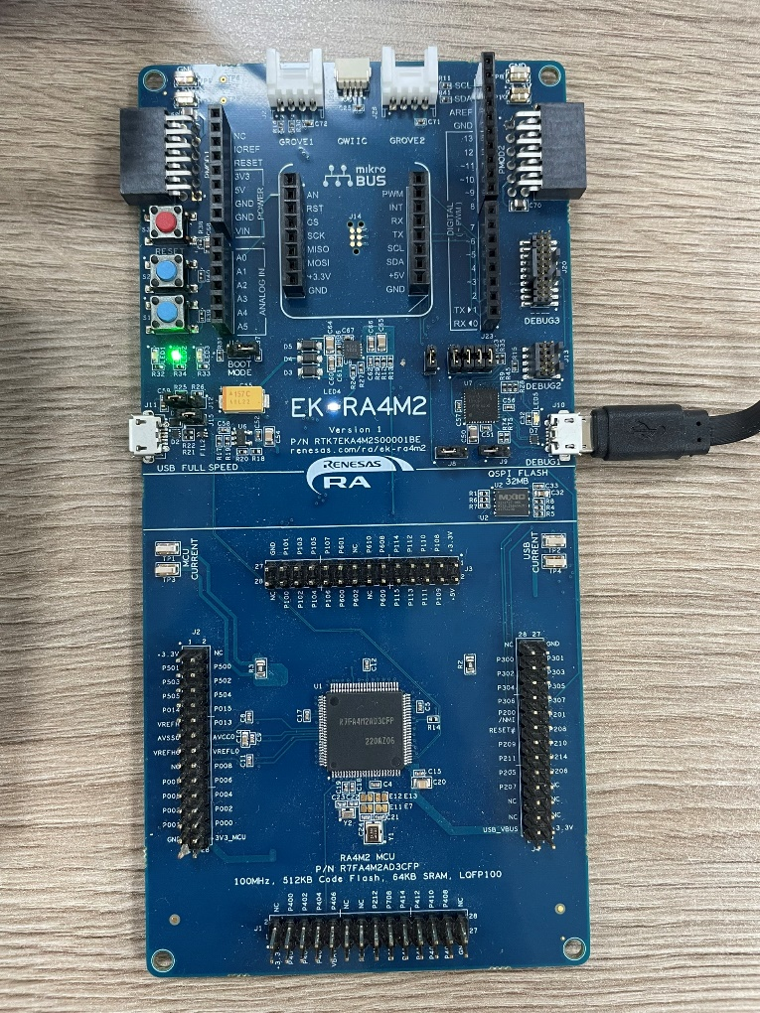
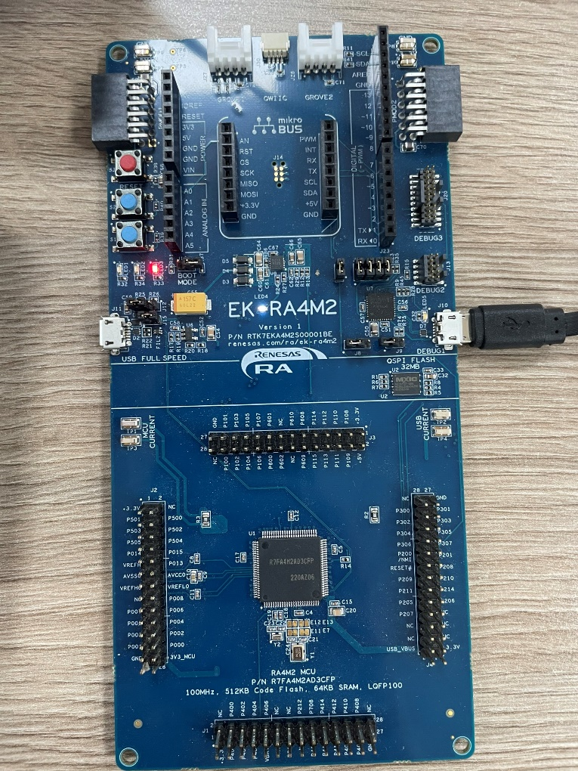
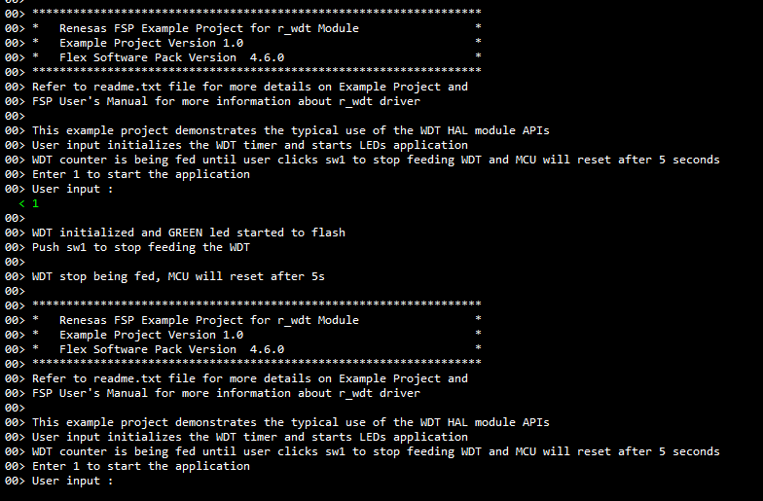
How to create an ep run an ep
System log shows on J-Link
GREEN led flashes after the user input
RED led flashes before the MCU resetting

Slide 50
Watchdog timer (r_wdt)
reference

Slide 51
Reference
RA Flexible Software Package Documentation – r_wdt.
What is a watchdog timer (WDT)?
Renesas EK-4M2 User Manual.
Renesas EK-4M2 User Manual - Hardware.

Slide 52
Renesas.com

