Slide 1

Specify option on ra2a2
Date
Name
Position, Department,
Unit
Renesas Electronics Corporation

Slide 2
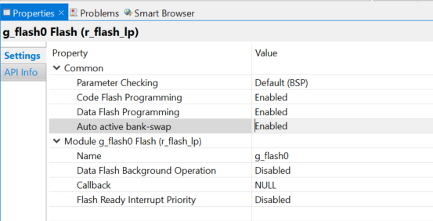
modify method step 1
Step 1: Add your desire option to <config></config> field in file Renesas##HAL Drivers##all##<your_module>####x.xx.xx.xml

Slide 3
modify method step 2
Step 2: Add constrain field to <module></module> in file Renesas##HAL Drivers##all##<your_module>####x.xx.xx.xml
Meaning: “Bank swap was not supported by this MCU” will be displayed when user not use RA2A2 MCU and the auto active swapped bank is switched to enable

Slide 4
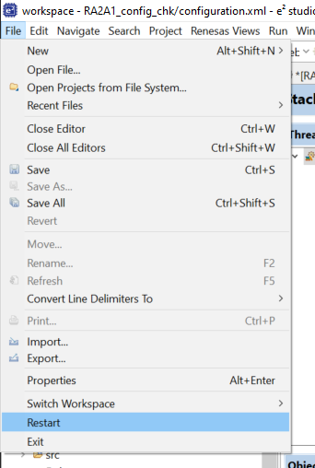
how to check updated MDF
Step 1: Copy your updated MDF file to
C:\Users\<your_user>\.eclipse\com.renesas.platform_1435879475\internal\projectgen\ra\modules
Ex: C:\Users\phucche\.eclipse\com.renesas.platform_1435879475\internal\projectgen\ra\modules
Step 2: Rename updated file to the name you want to replace
Step 3: Restart the e2studio

Slide 5
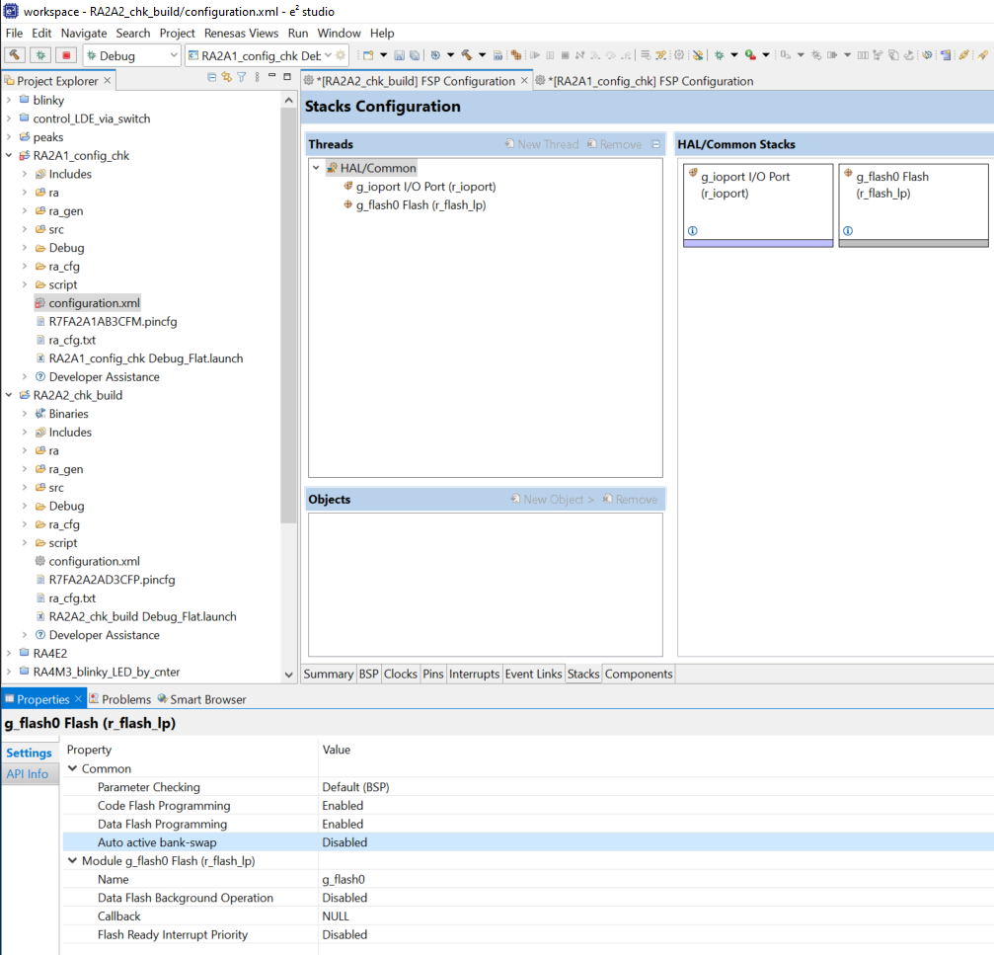
example ra2a2 – disable auto active swapped bank

Slide 6
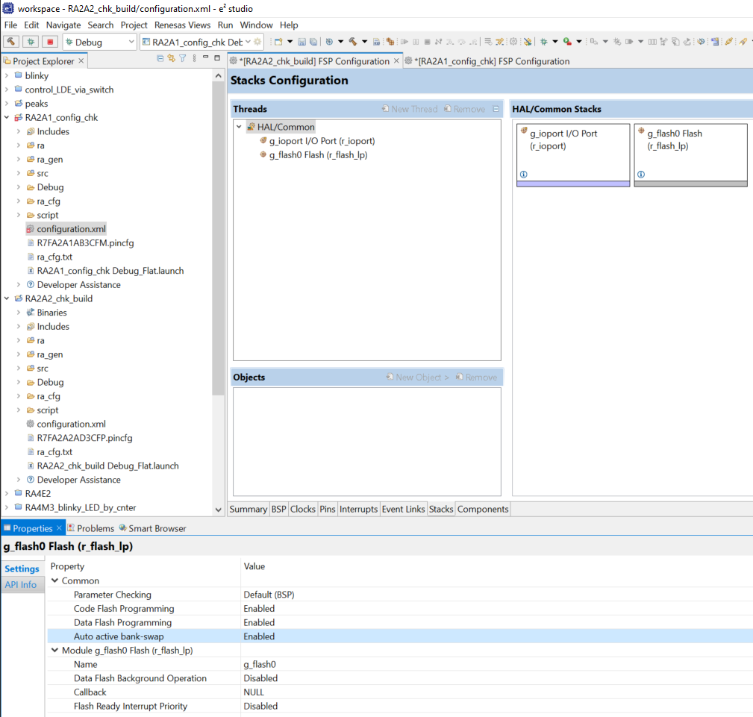
example ra2a2 – enable auto active swapped bank

Slide 7
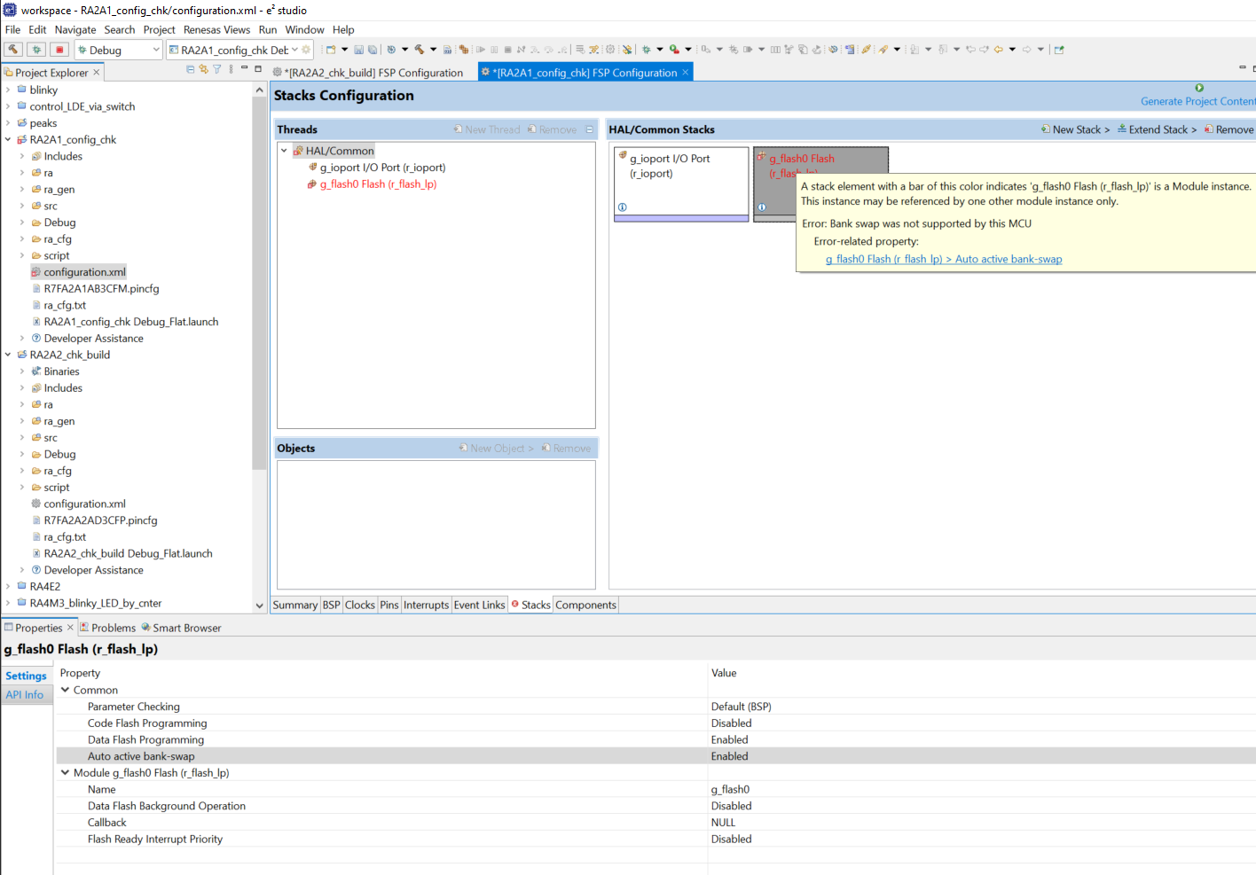
example ra2a1 – enable auto active swapped bank

Slide 8
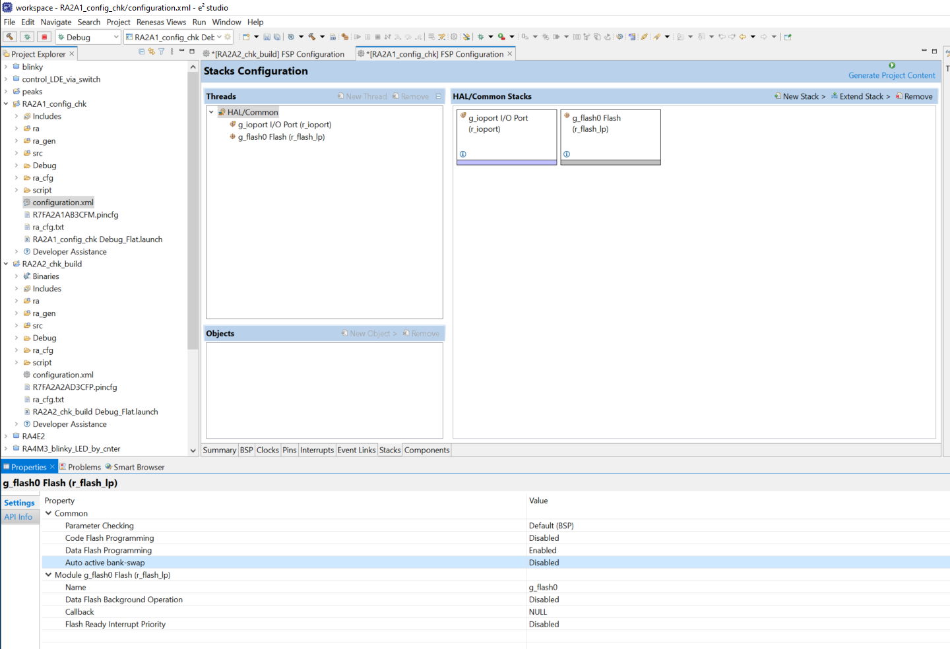
example ra2a2 – disable auto active swapped bank

Slide 9
Renesas.com

