Slide 1

Zephyr os
Self-investigation report
Sep 2023
The nguyen
engineer, swd department,
Ra fsp group
Renesas Electronics Corporation

Slide 2
Agenda
Overview Page 00
Zephyr SDK Page 00
Hardware support Page 00
Zephyr kernel Page 00
Device driver model Page 00

Slide 3
Zephyr os
overview

Slide 4
Zephyr os introduction
Developer: Linux Foundation and Wind River Systems
OS family: Real-time operating systems (RTOS)
Official website: www.zephyrproject.org
Repository: github.com/zephyrproject-rtos/zephyr
Features:
A small kernel.
A flexible configuration and build system for compile-time definition of required resources and modules.
A set of protocol stacks (IPv4 and IPv6, Constrained Application Protocol (CoAP), LwM2M, MQTT, 802.15.4, Thread, Bluetooth Low Energy, CAN).
A virtual file system interface with several flash file systems for non-volatile storage (FatFs, LittleFS, NVS).
Management and device firmware update mechanisms.

Slide 5
Zephyr os supported device
The Zephyr kernel supports multiple architectures, including:
ARCv2 (EM and HS) and ARCv3 (HS6X)
ARMv6-M, ARMv7-M, and ARMv8-M (Cortex-M)
ARMv7-A and ARMv8-A (Cortex-A, 32- and 64-bit)
ARMv7-R, ARMv8-R (Cortex-R, 32- and 64-bit)
Intel x86 (32- and 64-bit)
MIPS (MIPS32 Release 1 specification)
NIOS II Gen 2
RISC-V (32- and 64-bit)
SPARC V8
Tensilica Xtensa

Slide 6
Zephyr os comparing with freertos
 | Zephyr | FreeRTOS
Vendor | Linux Foundation | Amazon AWS
Developmental ecosystem | Open-source contribution | Open-source contribution
Characteristic | Larger in terms of energy usage and computing power than FreeRTOS | Small in terms of energy usage and computing power
Feature | Intends to provide all components needed to embedded or microcontroller-based applications: Kernel, BSP and HAL driver A set of protocol stacks A virtual file system interface Management and device firmware update ,… | Almost bare metal with limit feature Kernel AWS stack
Usages | Application with high require security and reliability with high computing power Application with complex multitasking | Applications on devices have resources constraints Application with simple multitasking

Slide 7
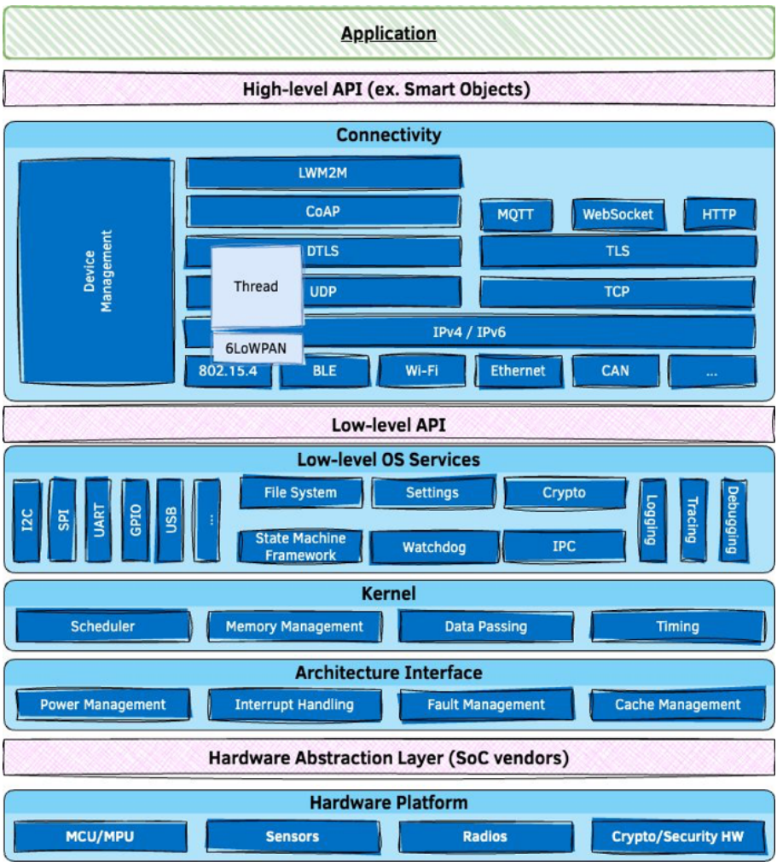
Zephyr os architecture
Zephyr providing developer these interface to develop their apps:
High-level API
Low-level API
HAL driver layer (hardware-vendor specific)

Slide 8
Zephyr developing
Investigate Zephyr repository and zephyr sdk

Slide 9
Zephyr developing get zephyr sdk and zephyr source code
Zephyr SDK now be available on Linux, Windows and macOS, but most stable on Linux.
To get Zephyr source code and Zephyr SDK , these steps in this guide should be done:
Getting Started Guide — Zephyr Project Documentation
Zephyr GitHub repository:
github.com/zephyrproject-rtos/zephyr

Slide 10
Zephyr developing zephyr modules
Zephyr modules mean the source code of several externally maintained projects, these modules must be integrated with the Zephyr build system
Zephyr depends on several categories of modules, including but not limited to:
Debugger integration
Silicon vendor Hardware Abstraction Layers
Cryptography libraries
File Systems
Inter-Process Communication (IPC) libraries

Slide 11
Zephyr developing build system
CMake is used to build Zephyr application together with the Zephyr kernel.
The Zephyr build process can be divided into two main phases:
Configuration phase (driven by CMake)
Build phase (driven by Make or Ninja).

Slide 12
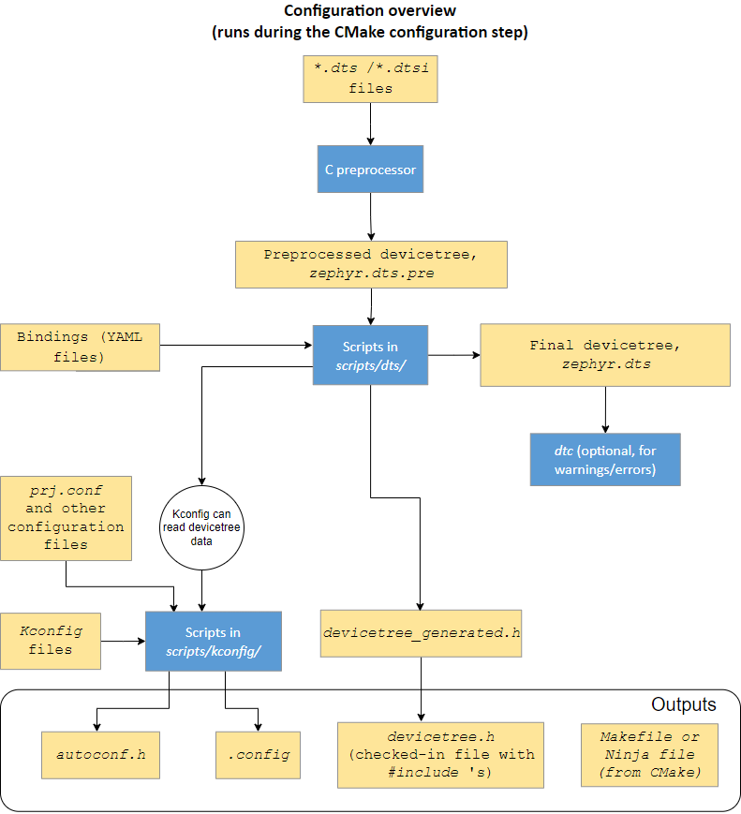
Zephyr developing build system
Input for configuration phase:
Devicetree: a hierarchical data structure primarily used to describe hardware:
To describe hardware to the Device Driver Model
To provide that hardware’s initial configuration
Kconfig: define available configuration options for the target architecture, SoC, board, and application, as well as dependencies between options
Notes:
More details at: https://docs.zephyrproject.org/latest/build/cmake/index.html#configuration-phase

Slide 13
Zephyr developing build system
Devicetree file: Syntax and structure
Nodes: Like any tree data structure, a devicetree has a hierarchy of nodes. The above tree has three nodes:
A root node: /
A node named a-node, which is a child of the root node
A node named a-sub-node, which is a child of a-node
Properties: Devicetree nodes can also have properties. Properties are name/value pairs:
Property values can be any sequence of bytes.
In some cases, the values are an array of what are called cells (A cell is just a 32-bit unsigned integer)
/dts-v1/ ;
/ {
soc {
i2c-bus-controller {
i2c-peripheral-1 {
};
i2c-peripheral-2 {
};
i2c-peripheral-3 {
};
};
};
};
An example DTS file
Notes:
More details at: https://docs.zephyrproject.org/latest/build/cmake/index.html#configuration-phase

Slide 14
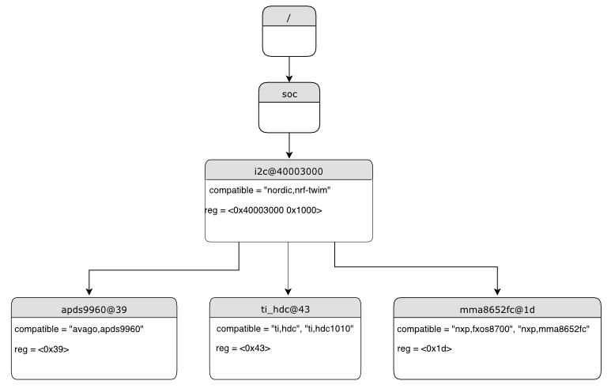
Zephyr developing build system
Devicetrees reflect hardware:
In practice, devicetree nodes usually correspond to some hardware, and the node hierarchy reflects the hardware’s physical layout.
/dts-v1/ ;
/ {
soc {
i2c@40003000 {
compatible = "nordic,nrf-twim";
reg = <0x40003000 0x1000>;
apds9960@39 {
compatible = "avago,apds9960";
reg = <0x39>;
};
ti_hdc@43 {
compatible = "ti,hdc", "ti,hdc1010";
reg = <0x43>;
};
mma8652fc@1d {
compatible = "nxp,fxos8700", "nxp,mma8652fc";
reg = <0x1d>;
};
};
};
};
Notes:
More details at: https://docs.zephyrproject.org/latest/build/cmake/index.html#configuration-phase

Slide 15
Zephyr developing build system
/dts-v1/ ;
/ {
aliases {
sensor-controller = &i2c1;
};
soc {
i2c1: i2c@40002000 {
compatible = "vnd,soc-i2c";
label = "I2C_1";
reg = <0x40002000 0x1000>;
status = "okay";
clock-frequency = < 100000 >;
};
};
};
Devicetree access from C/C++:
Node identifiers: Can be get by these C macros that refers to the node:
Use DT_PATH(): ex DT_PATH(soc, i2c_40002000)
Use DT_NODELABEL(): ex DT_NODELABEL(i2c1)
Use DT_ALIAS(): ex DT_ALIAS(sensor_controller)
Use DT_INST(): ex DT_INST(x, vnd_soc_i2c)
Use DT_CHOSEN(): to get a node identifier for /chosen node properties.
Use DT_PARENT() and DT_CHILD(): to get a node identifier for a parent or child node, starting from a node identifier you already have.
Notes:
More details at: https://docs.zephyrproject.org/latest/build/cmake/index.html#configuration-phase

Slide 16
Zephyr developing build system
Devicetree access from C/C++:
Property access: Simple properties access
Checking properties and values: DT_NODE_HAS_PROP() can be used to check if a node has a property. For the example devicetree:
Use DT_PROP(node_id, property) to read basic integer, boolean, string, numeric array, and string array properties:
/dts-v1/ ;
/ {
aliases {
sensor-controller = &i2c1;
};
soc {
i2c1: i2c@40002000 {
compatible = "vnd,soc-i2c";
label = "I2C_1";
reg = <0x40002000 0x1000>;
status = "okay";
clock-frequency = < 100000 >;
};
};
};
DT_NODE_HAS_PROP(DT_NODELABEL(i2c1), clock_frequency) /* expands to 1 */
DT_NODE_HAS_PROP(DT_NODELABEL(i2c1), not_a_property) /* expands to 0 */
DT_PROP(DT_PATH(soc, i2c_40002000), clock_frequency) /* This is 100000, */
DT_PROP(DT_NODELABEL(i2c1), clock_frequency) /* and so is this, */
DT_PROP(DT_ALIAS(sensor_controller), clock_frequency) /* and this. */
Notes:
More details at: https://docs.zephyrproject.org/latest/build/cmake/index.html#configuration-phase

Slide 17
Zephyr developing build system
Devicetree access from C/C++:
Property access: reg properties access
DT_NUM_REGS(node_id) gives the total number of register blocks in the node’s reg property.
For the node only has one register block:
DT_REG_ADDR(node_id): the given node’s register block address
DT_REG_SIZE(node_id): its size
For the node has multiple register blocks:
DT_REG_ADDR_BY_IDX(node_id, idx): address of register block at index idx
DT_REG_SIZE_BY_IDX(node_id, idx): size of block at index idx
/dts-v1/ ;
/ {
aliases {
sensor-controller = &i2c1;
};
soc {
i2c1: i2c@40002000 {
compatible = "vnd,soc-i2c";
label = "I2C_1";
reg = <0x40002000 0x1000>;
status = "okay";
clock-frequency = < 100000 >;
};
};
};
Notes:
More details at: https://docs.zephyrproject.org/latest/build/cmake/index.html#configuration-phase

Slide 18
Zephyr developing build system
Devicetree access from C/C++:
Property access: interrupts properties access
Given a node identifier node_id, DT_NUM_IRQS(node_id) is the total number of interrupt specifiers in the node’s interrupts property.
To get a value within an interrupt specifier at an index, DT_IRQ_BY_IDX(node_id, idx, val) can be used
my-serial: serial@abcd1234 {
interrupts = < 33 0 >, < 34 1 >;
};
#define SERIAL DT_NODELABEL(my_serial)
Example usage Value
------------- -----
DT_IRQ_BY_IDX(SERIAL, 0, irq) 33
DT_IRQ_BY_IDX(SERIAL, 0, priority) 0
DT_IRQ_BY_IDX(SERIAL, 1, irq, 34
DT_IRQ_BY_IDX(SERIAL, 1, priority) 1
Notes:
More details at: https://docs.zephyrproject.org/latest/build/cmake/index.html#configuration-phase

Slide 19
Zephyr developing build system
# CONFIG_INPUT is not set
# CONFIG_WIFI is not set
# CONFIG_LV_COLOR_16_SWAP is not set
CONFIG_LV_DPI_DEF=130
# CONFIG_MODEM is not set
CONFIG_UART_INTERRUPT_DRIVEN=y
# CONFIG_SPI is not set
CONFIG_BOARD="rpi_pico"
CONFIG_RP2_FLASH_W25Q080=y
CONFIG_NUM_IRQS=26
…
Configurations system: use Kconfig to build-time configure for Zephyr kernel and subsystems. To use interactive configuration interface:
To run the terminal-based menuconfig interface:
To run the graphical guiconfig, use either of these commands:
$ west build -t menuconfig
$ ninja menuconfig
Example of .config outputs file
$ west build -t guiconfig
$ ninja guiconfig
Notes:
More details at: https://docs.zephyrproject.org/latest/build/cmake/index.html#configuration-phase

Slide 20
Zephyr developing build system
Comparing devicetree vs Kconfig
Devicetree versus Kconfig: ref Devicetree versus Kconfig — Zephyr Project Documentation
For example, consider a device with a 2.4GHz, multi-protocol radio supporting both the Bluetooth Low Energy and 802.15.4 wireless technologies:
 | Devicetree | Kconfig
Motivation | To describe hardware | To configure software support
Usage | Boot-time configuration | Build-time configuration
Describe the presence of the radio hardware
TX power in dBm be specified using devicetree.
Kconfig
Determine which software features should be built for the radio:
BLE or 802.15.4 protocol stack.
Boot-time configuration
devicetree
What driver or drivers it’s compatible with
Notes:
More details at: https://docs.zephyrproject.org/latest/build/cmake/index.html#configuration-phase

Slide 21
ZEPHYR DEVELOPING BUILD SYSTEM
Build phase have 5 steps:
Pre-build
Intermediate binaries
Intermediate binaries post-processing
Post processing
Final binary
Occurs before any source files are compiled, because during this phase header files used by the source files are generated.
Source files are collected from various subsystems and compiled into archives.
The binary from the previous stage is incomplete, with empty and/or placeholder sections that must be filled in by, essentially, reflection → to produce the missing pieces needed for the final binary.
The link from the previous stage is repeated, this time with the missing pieces populated.
Finally, if necessary, the completed kernel is converted from ELF to the format expected by the loader and/or flash tool required by the target.
Notes:
More details at: https://docs.zephyrproject.org/latest/build/cmake/index.html#build-phase

Slide 22
Hardware support
HARDWARE SUPPORT for Arm Cortex-M

Slide 23
Hardware support arm cortex-m Key supported features
The table below summarizes the status of key OS features in the different Arm Cortex-M implementation variants.
 |  | Processor families
 |  | Arm v7-M | Arm v8-M
 |  | M4 | M23 | M33
Programmable fault IRQ priorities |  | Y | N | Y
Single-thread kernel support |  | Y | Y | Y
Thread local storage support |  | Y | Y | Y
Interrupt handling | Regular interrupts | Y | Y | Y
 | Dynamic interrupts | Y | Y | Y
 | Direct interrupts | Y | Y | Y
 | Zero Latency interrupts | Y | Y | Y
Notes:
Ref: https://docs.zephyrproject.org/latest/hardware/arch/arm_cortex_m.html#key-supported-features

Slide 24
Hardware support arm cortex-m Key supported features
The table below summarizes the status of key OS features in the different Arm Cortex-M implementation variants.
 |  | Processor families
 |  | Arm v7-M | Arm v8-M
 |  | M4 | M23 | M33
CPU idling |  | Y | Y | Y
Native system timer (SysTick) |  | Y | Y | Y
Memory protection | User mode | Y | Y | Y
 | HW stack protection (MPU) | Y | Y | Y
 | HW-assisted stack limit checking | N | Y | Y
HW-assisted null-pointer dereference detection |  | Y | Y | Y
HW-assisted atomic operations |  | Y | N | Y
Support for non-cacheable regions |  | Y | N | Y
Notes:
Ref: https://docs.zephyrproject.org/latest/hardware/arch/arm_cortex_m.html#key-supported-features

Slide 25
Hardware support arm cortex-m Key supported features
The table below summarizes the status of key OS features in the different Arm Cortex-M implementation variants.
 |  | Processor families
 |  | Arm v7-M | Arm v8-M
 |  | M4 | M23 | M33
Execute SRAM functions |  | Y | Y | N
Floating Point Services |  | Y | Y | N
DSP ISA |  | Y | Y | N
Trusted-Execution | Native TrustZone-M support | N | N | Y
 | TF-M integration | N | N | N
Code relocation |  | Y | Y | Y
SW-based vector table relaying |  | Y | Y | Y
HW-assisted timing functions |  | Y | Y | N
Notes:
Ref: https://docs.zephyrproject.org/latest/hardware/arch/arm_cortex_m.html#key-supported-features

Slide 26
Hardware support OS features
Threads:
Thread stack alignment:
See detail at 7.1. Architecture-related Guides (Threads - Thread stack alignment)
Config by these macros:
CONFIG_STACK_ALIGN_DOUBLE_WORD: enforces a double word thread stack alignment (default by Cortex-M).
CONFIG_MPU_STACK_GUARD: enable HW-assisted stack overflow detection.
CONFIG_ARM_MPU_REGION_MIN_ALIGN_AND_SIZE: thread stacks need to be aligned with a larger value than double word, need to define if CONFIG_MPU_STACK_GUARD is 1.
CONFIG_USERSPACE: specific on Arm v6-M and Arm v7-M, support stacks in applications that need to support user mode to be align with a value equal to their size.
CONFIG_MPU_REQUIRES_POWER_OF_TWO_ALIGNMENT: enforced in Arm v6-M and Arm v7-M builds with user mode support.
Notes:
Ref: https://docs.zephyrproject.org/latest/hardware/arch/arm_cortex_m.html#thread-stack-alignment

Slide 27
Hardware support OS features
Threads:
Stack pointers:
These are 2 type of stack pointer:
Process Stack Pointer (PSP): while executing in thread mode the processor
Main Stack Pointer (MSP): while executing in handler mode, that is, while servicing exceptions and HW interrupts.
In Arm Cortex-M builds a single interrupt stack memory is shared among exceptions and interrupts.
The size of the interrupt stack needs to be selected taking into consideration nested interrupts, each pushing an additional stack frame.
Developers can modify the interrupt stack size using CONFIG_ISR_STACK_SIZE.
Notes:
Ref: https://docs.zephyrproject.org/latest/hardware/arch/arm_cortex_m.html#stack-pointers

Slide 28
Hardware support OS features
Thread context switching:
PendSV exception is used in order to trigger a context switch to a different thread, configured with the lowest possible interrupt priority level
Typically a thread context-switch will perform the following operations:
When switching-out the current thread, the processor stores:
The callee-saved registers (R4 - R11) in the thread’s container for callee-saved registers, which is located in kernel memory.
The thread’s current operation mode
The floating point callee-saved registers (S16 - S31) in the thread’s container for FP calleesaved registers, if the current thread has an active FP context
The PSP of the current thread which points to the beginning of the current thread’s exception stack frame. The latter contains the caller-saved context and the return address of the switched-out thread.
Notes:
Ref: https://docs.zephyrproject.org/latest/hardware/arch/arm_cortex_m.html#thread-context-switching

Slide 29
Hardware support OS features
Thread context switching:
Typically a thread context-switch will perform the following operations:
When switching-in a new thread the processor
Restores the new thread’s callee-saved registers from the thread’s container for callee-saved registers
Restores the new thread’s operation mode
Restores the FP callee-saved registers if the switched-in thread had an active FP context before being switched-out
Re-programs the dynamic MPU regions to allow a user thread access its stack and application memories, and/or programs a stack-overflow MPU guard at the bottom of the thread’s privileged stack
Restores the PSP for the incoming thread and re-programs the stack pointer limit register (if applicable, see CONFIG_BUILTIN_STACK_GUARD)
Optionally does a stack limit checking for the switched-in thread, if sentinel-based stack limit checking is enabled (see CONFIG_STACK_SENTINEL).
Notes:
Ref: https://docs.zephyrproject.org/latest/hardware/arch/arm_cortex_m.html#thread-context-switching

Slide 30
Kernel
Investigate about kernel services

Slide 31
Kernel kernel Services
Scheduling, Interrupts, and Synchronization:
Threads: a thread has the following key properties:
A stack area: a region of memory used for the thread’s stack.
A thread control block: for private kernel bookkeeping of the thread’s metadata.
An entry point function: which is invoked when the thread is started.
A scheduling priority: which instructs the kernel’s scheduler how to allocate CPU time to the thread.
A set of thread options: which allow the thread to receive special treatment by the kernel under specific circumstances
A start delay: which specifies how long the kernel should wait before starting the thread.
An execution mode: which can either be supervisor (allow access to privileged CPU instructions, the entire memory address space, and peripherals) or user mode.

Slide 32
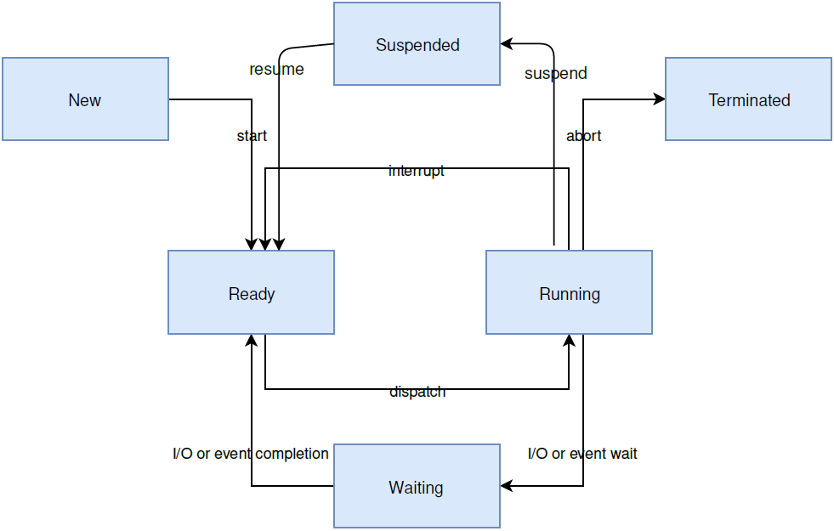
Kernel Kernel Services
A thread can be prevented from executing for an indefinite period of time (suspended).
k_thread_suspend() can be used to suspend any thread.
A suspended thread cannot be scheduled until another thread calls k_thread_resume() to remove the suspension.
Once a thread is started it typically executes forever. However, a thread may synchronously end its execution by returning from its entry point function (termination).
A thread that terminates is responsible for releasing any shared resources it may own (such as mutexes and dynamically allocated memory) prior to returning, since the kernel does not reclaim them automatically.
Thread lifecycle:
A thread must be created before it can be used.
The kernel initializes the thread control block as well as one end of the stack portion.
A thread may asynchronously end its execution by aborting.
A thread may be abort if the thread triggers a fatal error condition, such as dereferencing a null pointer or by a k_thread_abort() call.
Ready: A thread that has no factors that prevent its execution and is eligible to be selected as the current thread.
Running: The thread is currently executed.
Waiting: The thread is waiting for a kernel object to complete an operation, or an event occurs.

Slide 33
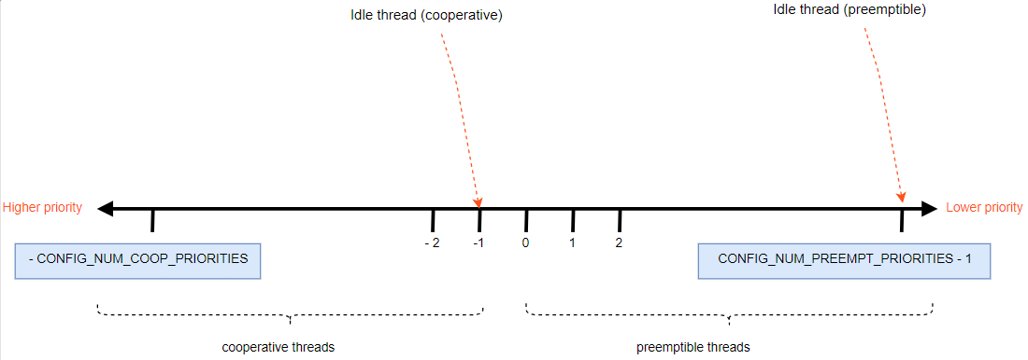
Kernel Kernel Services
Thread Priorities: an integer value can be either negative or non-negative. Numerically lower priorities takes precedence over numerically higher values.
A cooperative thread (negative priority value): once it becomes the current thread, a cooperative thread remains the current thread until it performs an action that makes it unready.
A preemptible thread (non-negative priority value): once it becomes the current thread, a preemptible thread may be supplanted at any time if a cooperative thread, or a preemptible thread of higher or equal priority, becomes ready.

Slide 34
Kernel Kernel Services
Thread meta-IRQ Priorities: When enabled (see CONFIG_NUM_METAIRQ_PRIORITIES), there is a special subclass of cooperative priorities at the highest (numerically lowest) end of the priority space: meta-IRQ threads.
These are scheduled according to their normal priority, but also have the special ability to preempt all other threads (and other meta-IRQ threads) at lower priorities.
Meta-IRQ threads are still threads, however, and can still be interrupted by any hardware interrupt.
Meta-IRQ threads are true threads and run on their own stack (which must be allocated normally), not the per-CPU interrupt stack.
The OS won’t schedule other thread until the current thread deliberately blocks.
Notes:
Ref: https://docs.zephyrproject.org/latest/kernel/services/threads/index.html#meta-irq-priorities

Slide 35
Kernel Kernel Services
Thread Options: The kernel supports a small set of thread options that allow a thread to receive special treatment under specific circumstances. A thread can have an option value of zero or multiple options:
K_ESSENTIAL: this instructs the kernel to treat the termination or aborting of the thread as a fatal system error.
K_SSE_REGS: this x86-specific option indicate that the thread uses the CPU’s SSE registers.
K_FP_REGS: this option indicate that the thread uses the CPU’s floating point registers.
K_USER: if CONFIG_USERSPACE is enabled, this thread will be created in user mode and will have reduced privileges.
K_INHERIT_PERMS: if CONFIG_USERSPACE is enabled, this thread will inherit all kernel object permissions that the parent thread had, except the parent thread object.

Slide 36
Kernel Kernel Services
int call_tracking_routine(void)
{
uint32_t call_count;
if (k_is_in_isr()) {
/* ignore any call made by an ISR */
} else {
call_count = (uint32_t)k_thread_custom_data_get();
call_count++;
k_thread_custom_data_set((void *)call_count);
}
/* do rest of routine's processing */
...
}
Thread Custom Data: Every thread has a 32-bit custom data area, accessible only by the thread itself, and may be used by the application for any purpose it chooses.
The k_thread_custom_data_set() and k_thread_custom_data_get() functions are used to write and read a thread’s custom data, respectively.
A thread can only access its own custom data, and not that of another thread.
Examples code uses the custom data feature

Slide 37
Kernel kernel Services
Scheduling, Interrupts, and Synchronization:
Scheduling: There are various points in time when the scheduler is given an opportunity to change the identity of the current thread (reschedule points). Some potential reschedule points are:
Transition of a thread from running state to a suspended or waiting state, for example by k_sem_take() or k_sleep().
Transition of a thread to the ready state, for example by k_sem_give() or k_thread_start().
Return to thread context after processing an interrupt.
When a running thread invokes k_yield().

Slide 38
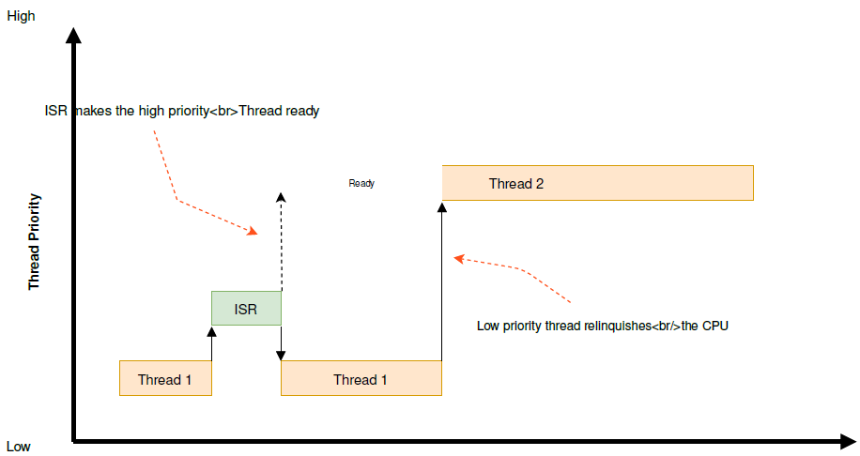
Kernel kernel Services
Scheduling, Interrupts, and Synchronization:
Cooperative Time Slicing:
Once a cooperative thread becomes the current thread, it remains the current thread until it performs an action that makes it unready.
A cooperative thread can voluntarily relinquish the CPU from time to time to permit other threads to execute. A thread can relinquish the CPU in two ways:
Calling k_yield() puts the thread at the back of the scheduler’s prioritized list of ready threads, and then invokes the scheduler.
Calling k_sleep() makes the thread unready for a specified time period. Ready threads of all priorities are then allowed to execute.

Slide 39
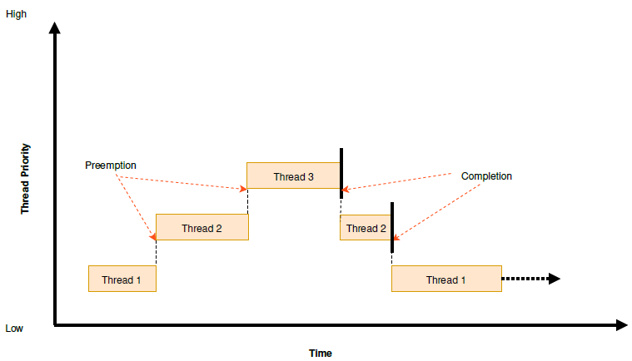
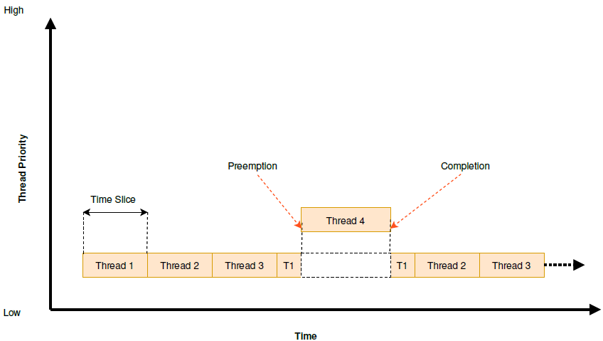
Kernel kernel Services
Scheduling, Interrupts, and Synchronization:
Preemptive Time Slicing:
Once a preemptive thread becomes the current thread, it remains the current thread until a higher priority thread becomes ready, or until the thread performs an action that makes it unready.
At the end of every time slice, the scheduler checks to see if the current thread is preemptible and, if so, implicitly invokes k_yield() on behalf of the thread. This gives other ready threads of the same priority the opportunity to execute before the current thread is scheduled again.
Threads with a priority higher than specified limit are exempt from preemptive time slicing, and are never preempted by a thread of equal priority.

Slide 40
Kernel kernel Services
Scheduling, Interrupts, and Synchronization:
Synchronize features:
Polling API: https://docs.zephyrproject.org/latest/kernel/services/polling.html
Semaphores: https://docs.zephyrproject.org/latest/kernel/services/synchronization/semaphores.html
Mutexes: https://docs.zephyrproject.org/latest/kernel/services/synchronization/mutexes.html
Condition Variables: https://docs.zephyrproject.org/latest/kernel/services/synchronization/condvar.html
Events: https://docs.zephyrproject.org/latest/kernel/services/synchronization/events.html

Slide 41
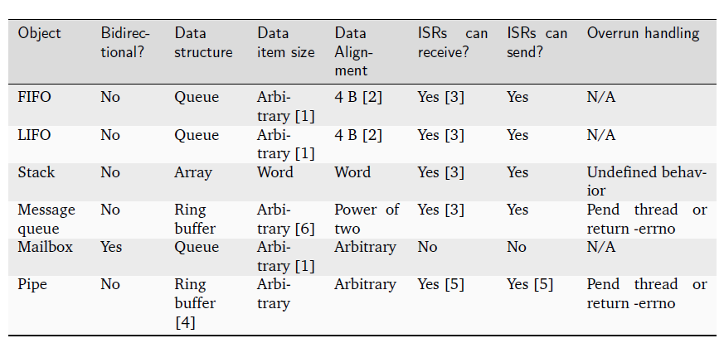
Kernel kernel Services
Supported data parsing:

Slide 42
Device driver model
driver interface / implementation and module instance

Slide 43
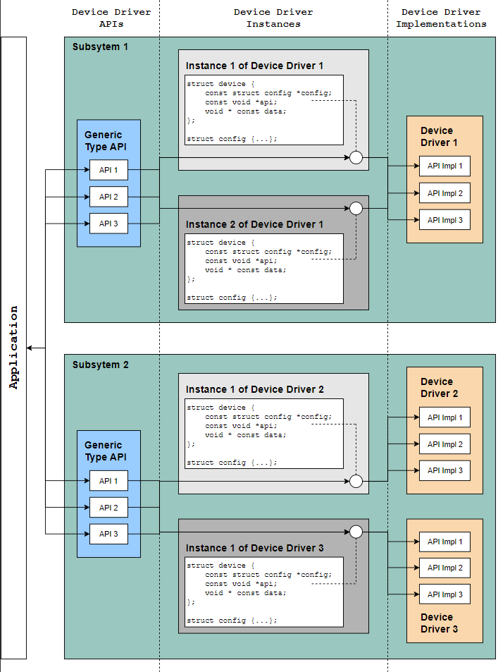
Kernel device driver model
The Zephyr kernel supports a variety of device drivers. Whether a driver is available depends on the board and the driver.
The Zephyr device model provides a consistent device model for configuring the drivers that are part of a system. The device model is responsible for initializing all the drivers configured into the system.
Each type of driver (e.g. UART, SPI, I2C) is supported by a generic type API.
In this model the driver fills in the pointer to the structure containing the function pointers to its API functions during driver initialization. These structures are placed into the RAM section in initialization level order.

Slide 44
Kernel device driver model
Driver data structure:
The device initialization macros populate some data structures at build time which are split into read-only and runtime-mutable parts. At a high level we have:
struct device {
const char *name;
const void *config;
const void *api;
void * const data;
};
Driver Data Structures

Slide 45
Kernel device driver model
typedef int (*subsystem_do_this_t)(const struct device *dev, int foo, int bar);
typedef void (*subsystem_do_that_t)(const struct device *dev, void *baz);
struct subsystem_api {
subsystem_do_this_t do_this;
subsystem_do_that_t do_that;
};
static inline int subsystem_do_this(const struct device *dev, int foo, int bar)
{
struct subsystem_api *api = (struct subsystem_api *)dev->api;
return api->do_this(dev, foo, bar);
}
static inline void subsystem_do_that(const struct device *dev, void *baz)
{
struct subsystem_api *api = (struct subsystem_api *)dev->api;
api->do_that(dev, baz);
}
Subsystems and API Structures:
Most drivers will be implementing a device-independent subsystem API. Applications can simply program to that generic API, and application code is not specific to any particular driver implementation.
A subsystem API definition

Slide 46
Kernel device driver model
Subsystems and API Structures:
A driver implementing a particular subsystem will define the real implementation of these APIs, and populate an instance of subsystem_api structure:
static int my_driver_do_this(const struct device *dev, int foo, int bar)
{
...
}
static void my_driver_do_that(const struct device *dev, void *baz)
{
...
}
static struct subsystem_api my_driver_api_funcs = {
.do_this = my_driver_do_this,
.do_that = my_driver_do_that
};
An instance of API structure

Slide 47
Renesas.com

