Slide 1
Karnel Travels
Semester: III
Class: T1.2208.M2
Group: 02
Mr. Le Thanh Nhan

Slide 2
Introduction
Name Roll No.
1. Hứa Trường An Student1414334
2. Lê Bá Thành Student1409136
3. Nguyễn Trung Quân Student1414325

Slide 3
Content
Introduction
Actual requirements
Requirements of the project
Deployment diagram
Test result
Conclusion and development
Task list

Slide 4
Introduction - Actual requirements
The URL should be http://www.Karneltravelguide.com
User:
Can register as a member and manage personal account.
Can view and book a tour, hotels, restaurants, and resorts.
Can view their old tour, hotels, restaurant, and resorts.
Can view the list of tour, hotels, restaurant, and resort which they can book.
Can leave comment on the hotels, restaurants, and resorts that they booked.
Administrator:
Can add / edit / delete tours, hotels, restaurants, and resorts.
Can view customer’s information or deactivate an account.
Can view all orders and approve booking.
Can view report feedback.

Slide 5
Requirements of the project
1. The URL should be http://www.Karneltravelguide.com
2. The website should contain a menu through which the different topics can be fetched out with an ease.
3. The menu should contain the following:
Home Page
About Us
Search page
Information Page
Tourist Spots available with in the country.
Travel Information
Hotel Information
Restaurant Information.
Resorts Information
Notes:
Non-functional (how the system works)
Functional (what the system should do)

Slide 6
Requirements of the project
4. The About Us Page should include the details about the company, also it should include the details about the facilities that it will provide like transportation, packages, transportation and accommodation facility to tourist locations, etc.
5. The Search page should implement the search for the various tourist spots like beaches, monuments, etc. and also it should include the search for the Hotels, Restaurants and resorts based on the location, price, quality, quantity and availability. Also on this page there should be a link for the advanced search page.
6. The information page should contain 5 links as mentioned above and it should display the information about the new hotels restaurants and the resorts information also if there is any package or discounts that the company is providing can also be displayed.
Notes:
Non-functional (how the system works)
Functional (what the system should do)

Slide 7
Requirements of the project
7. Tourist spots should include the various tourist locations available with in the country.
8. Travel information should include the various transportation facilities available with in the country.
9. Similarly the various hotels, restaurants and resorts that are available with in the country should be displayed for the Hotels, Restaurants, and resorts information.
10. The contact us Page is the page where the customer can contact the company for placing an order and this page should also include the feedback, which will collect the feedback from the various users of the website.
Notes:
Non-functional (how the system works)
Functional (what the system should do)

Slide 8
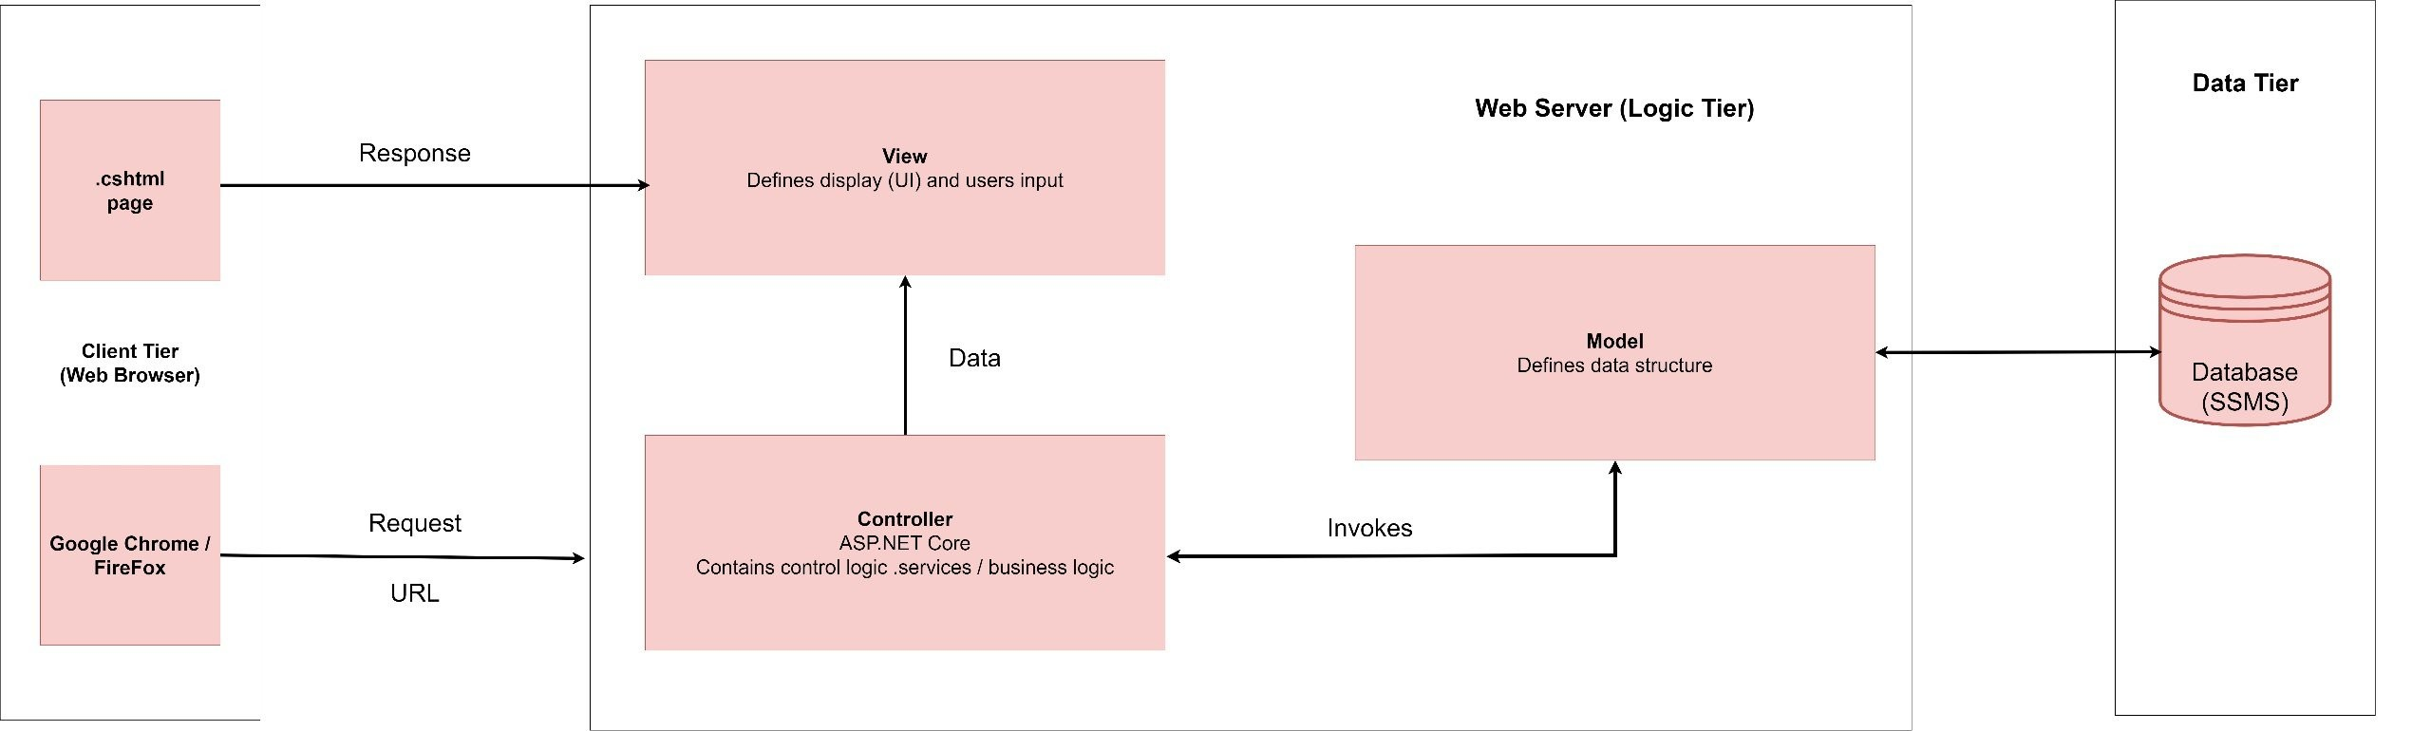
Introduction - Deployment diagram

Slide 9
Test Result [1-n]
Option | Validated
URL Testing: http://www.Karneltravelguide.com | YES
Menu Testing: Home Page, About Us, Search Page, Information, Account Page | YES
About Us Page + Management Testing | YES
Search Page and Advanced Search Testing | YES
Hotels, Restaurants, and Resorts Information + Management Testing | YES
Tourist Spots + Management Testing | YES
Travel Information + Management Testing | YES
Contact Us Page Testing | YES
Account page + Management testing | YES

Slide 10
Test Result [2-n]
Option | Validated
Do all numeric variables have a default value of zero? | YES
Does the administrator have all the rights to create and delete the records? | YES
Are all the records properly fed into the appropriate database? | YES
Have all the modules been properly integrated and are completely functional? | YES
Have all the Design and Coding Standards been followed and implemented? | YES
Is the GUI design consistent all over? | YES
Is the navigation sequence correct through all the forms/ screens in the application? | YES
Is exception handling mechanism implemented in all the screens? | YES
Are all the program codes working? | YES

Slide 11
Conclusion
Sr.No. | Particulars | Yes | No | NA | Comments
1. | Are all users able to search for a particular record? | Yes
2. | Are all old records properly saved and retrieved when required? | Yes
3. | Have all modules been properly integrated and are completely functional? | Yes
4. | Are GUI contents devoid of spelling mistakes? | Yes
5. | Is the application user-friendly? | Yes
6. | Is the project published properly into a setup file? | Yes

Slide 12
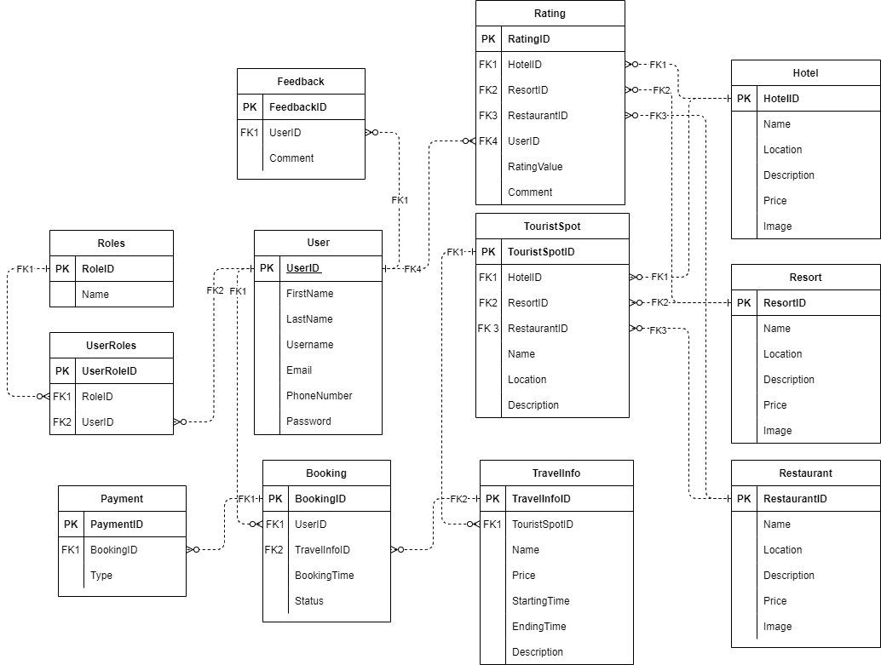
Development

Slide 13
Task List
No | Member | Task |  | Table Name | Activity Plan | Date of Preparation of Activity Plan
 |  |  |  |  | Planed Start Date | Actual Start Date | Actual Days | Status
1 | Hứa Trường An | Admin | Feedback Management Dashboard Restaurant Management | Feedback Restaurant |  |  |  | OK
2 |  |  |  |  |  |  |  | OK
3 |  |  |  |  |  |  |  | OK
4 |  | User | Introduction + Home |  |  |  |  | OK
5 |  |  | Contact Us + Restaurant Info |  |  |  |  | OK
1 | Lê Bá Thành | Admin | Hotel Management Resort Management Tour Management Travel Management | Hotel Resort Tourist TravelInfo |  |  |  | OK
2 |  |  |  |  |  |  |  | OK
3 |  |  |  |  |  |  |  | OK
4 |  |  |  |  |  |  |  | OK
5 |  | User | Travel Service: Hotel, Resort, Tour |  |  |  |  | OK
6 |  |  | Advanced Search |  |  |  |  | OK
1 | Nguyễn Trung Quân | Admin | Booking Management Customer Management | User UserRoles Payment Booking Rating Comment |  |  |  | OK
2 |  |  |  |  |  |  |  | OK
3 |  | User | Account + Login/Logout |  |  |  |  | OK
4 |  |  | Comment + Rating |  |  |  |  | OK
5 |  |  | Booking + Payment |  |  |  |  | OK

Slide 14

Thank You

