Slide 1
Brain Tumor MRI Classification and Localization
University of Information Technology (UIT) – VNU HCMC
AI – CS106
Quan Hoang Ngoc - 22521178
Cam-Giang Tran-Thi - 22520361
Professor: PhD. Hoang Luong Ngoc
6/2024

Slide 2
01
Introduction
02
Problem Statement
Methodology and Breakout
03
Table of
Contents
Multi Study Cases
04
Result Experiment
05
Conclusion
06
07
Discussion

Slide 3
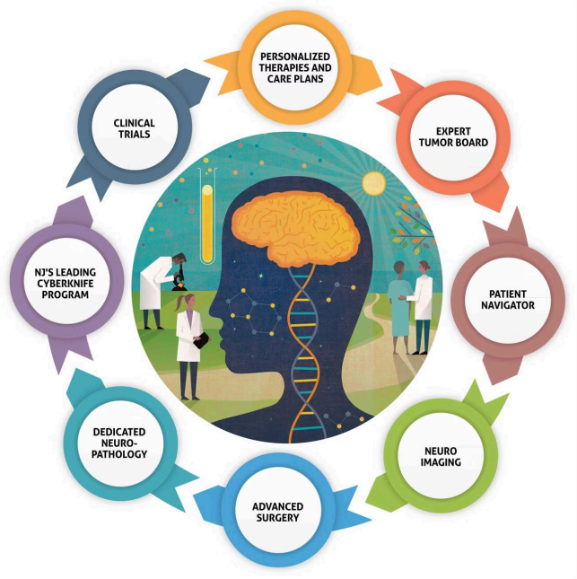
Table of Contents

Slide 4
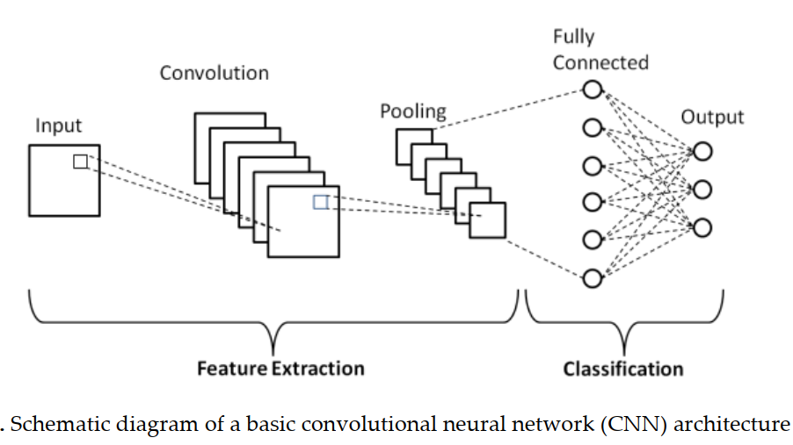

Introduction
Why it matters?
Brain tumor classification and localization: is a crucial task in medical imaging for accurate diagnosis and treatment planning.
CNNs model are very robust to address with large amounts of training data.
But, more and more scarcity of medical data. How to deal these challenges?

Slide 5
Problem
Input:
Output:
Inference: a brain MRI image, which be a 2D slice.
Training: a shortage dataset consists of labeled images with the corresponding annotation for each image.
The output of the model is a predicted label (yes or no tumor).
Besides, we also provide the predicted location of the tumor center, as an evidence for the model's decision.
Constraint: this is a few short learning problem.
Notes:
, which can be probability scores indicating the likelihood of belonging to a specific tumor class.

Slide 6
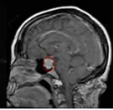
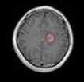
Problem
Inference illustration
Yes
Yes
No

Slide 7
Contribution
The aim of research project
The aim of this research project is to develop methods can accurately classify and provide evidence of the center of the tumor that dealing good with scarcity of data.
Besides, we also perform a comprehensive comparison of various strategies and evaluate their effectiveness on shortage data benchmarks. Then, we try to explain those results.
Finally, we find out some novel insights and directions in Reinforcement Learning.

Slide 8
Methodology
History of project
In all this project,
We have come up with and applied a variety of strategies and techniques, including Machine Learning, Computer Vision, Reinforcement Learning, and combine them.
However, within the limitation of time, we can only focus on breakthrough solutions and present the highlights of the project.

Slide 9

The breakthrough
Reinforcement Learning
Hypothesis: It is our conviction that Reinforcement Learning (RL) will exhibit similarities to human learning by leveraging a minimal amount of information to generalize across differences. Through a process of insight search, exploration and exploitation of the training dataset, RL can efficiently navigate limited data spaces.

Slide 10
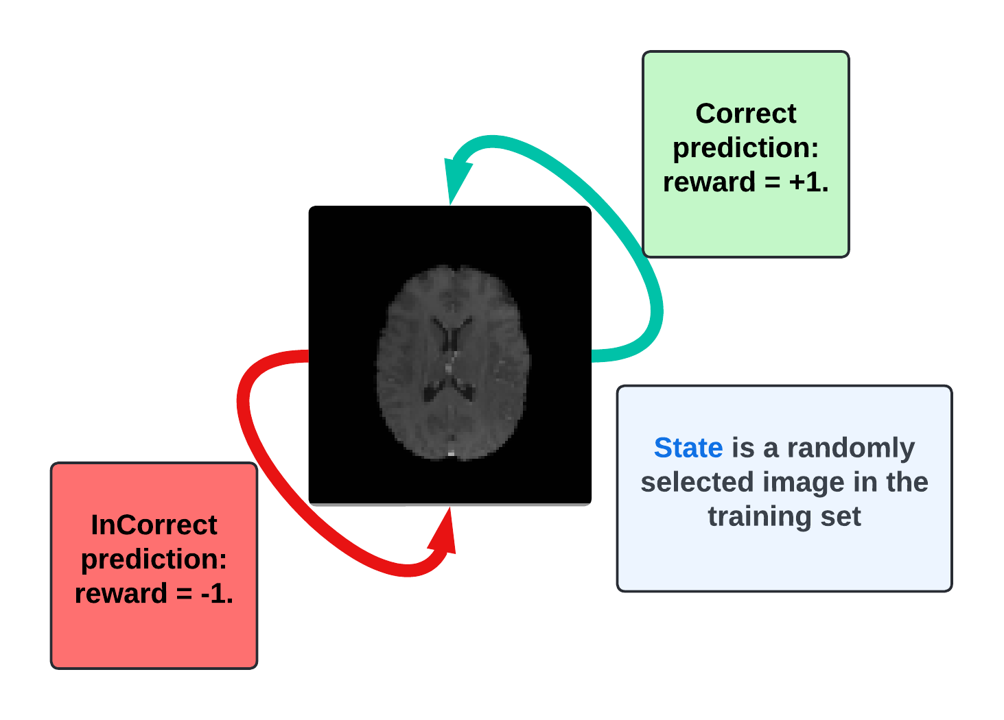
Classification
How to define a MDP
Action: An agent's action is a label prediction for the image which is a state of the environment, where 0 corresponds to no, and 1 corresponds to yes.

Slide 11
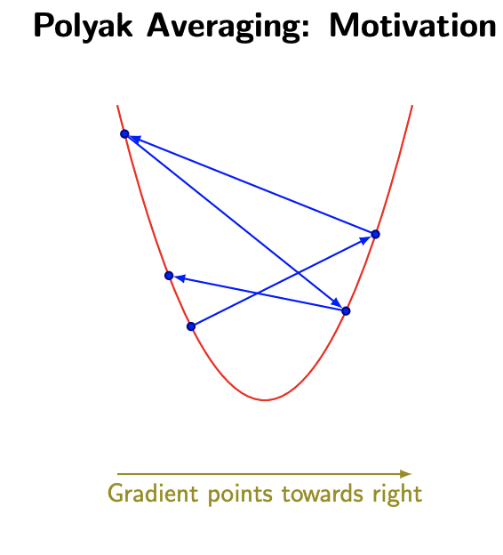
Classification
The algorithm: Momentum DQN
Polyak Averaging (Exponential Moving Average): is a technique used to optimize parameters in certain mathematical algorithms. The idea is to take the average of recent parameter values and set the final parameter to that average. The purpose is to help algorithms converge to a better final solution.

Slide 12

Classification
The algorithm: off-policy greedy strategy
Epsilon = 1.0 -> 0.01, epsilon decay = 0.995

Slide 13




Classification
The algorithm: Q computation
Q definition
Target computation:
Prediction computation:

Slide 14
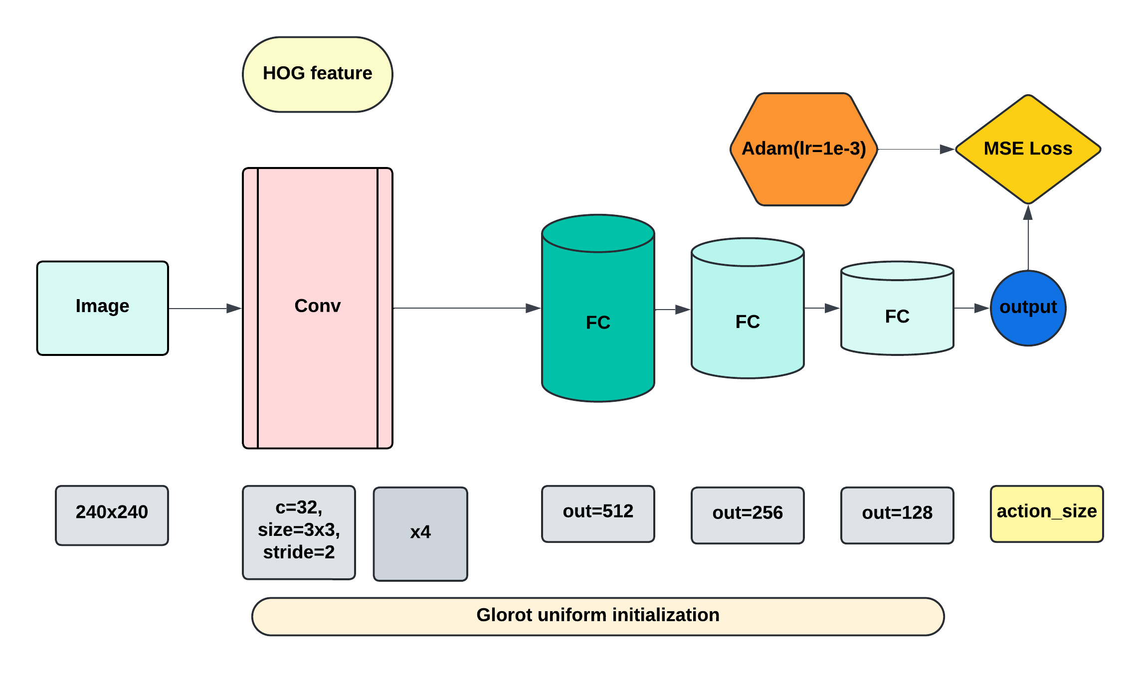
Classification
Deep Q Network Architecture

Slide 15
Classification
Network Update
After each K steps both local and target network will be updated. The local network will be learned from experiences and the target network parameters will be updated with polyak averaging.
p_target = tau * p_local + (1-tau) * p_target

Slide 16
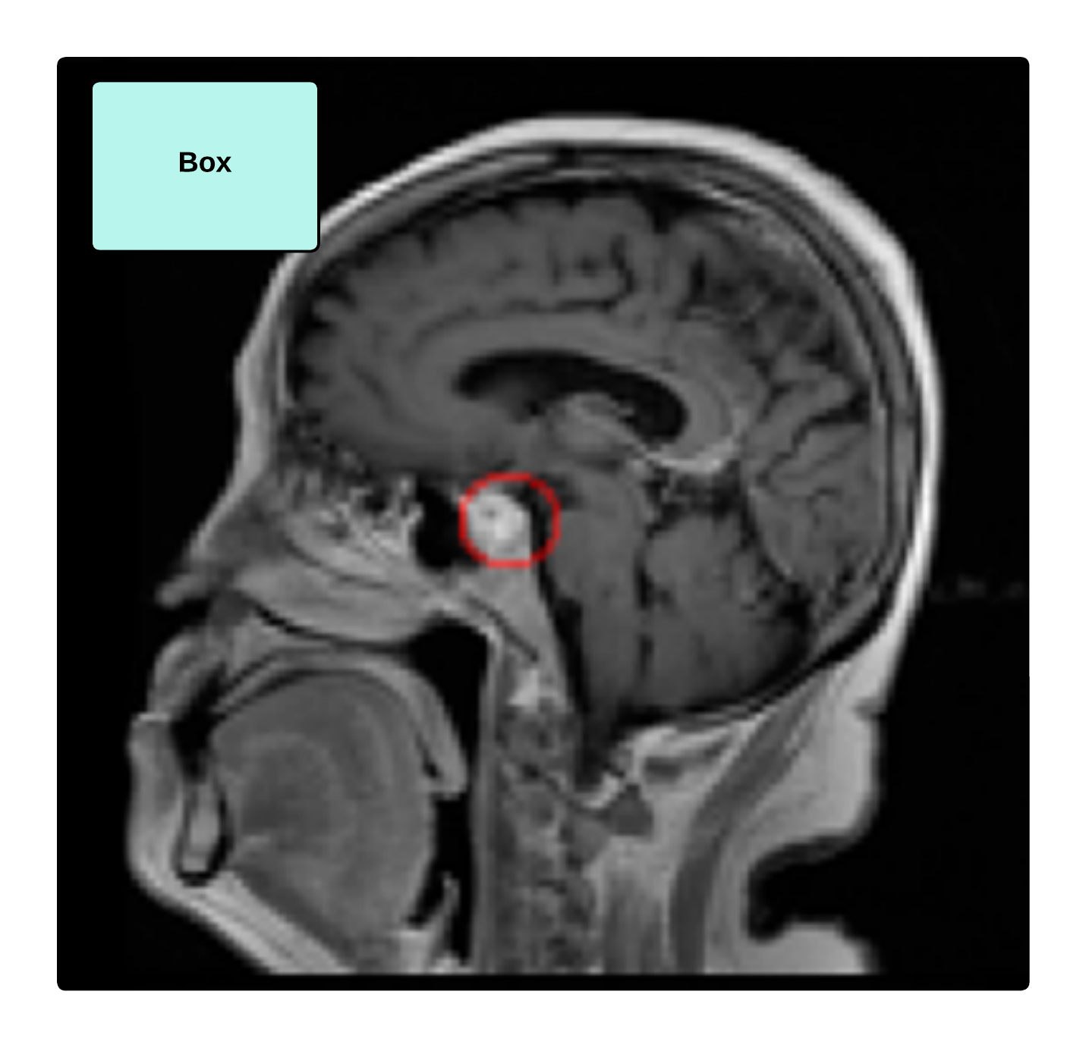
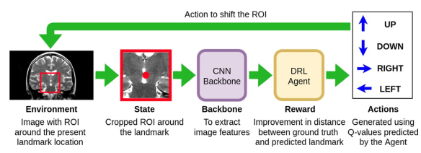
Localization
Traditional Approach

Slide 17
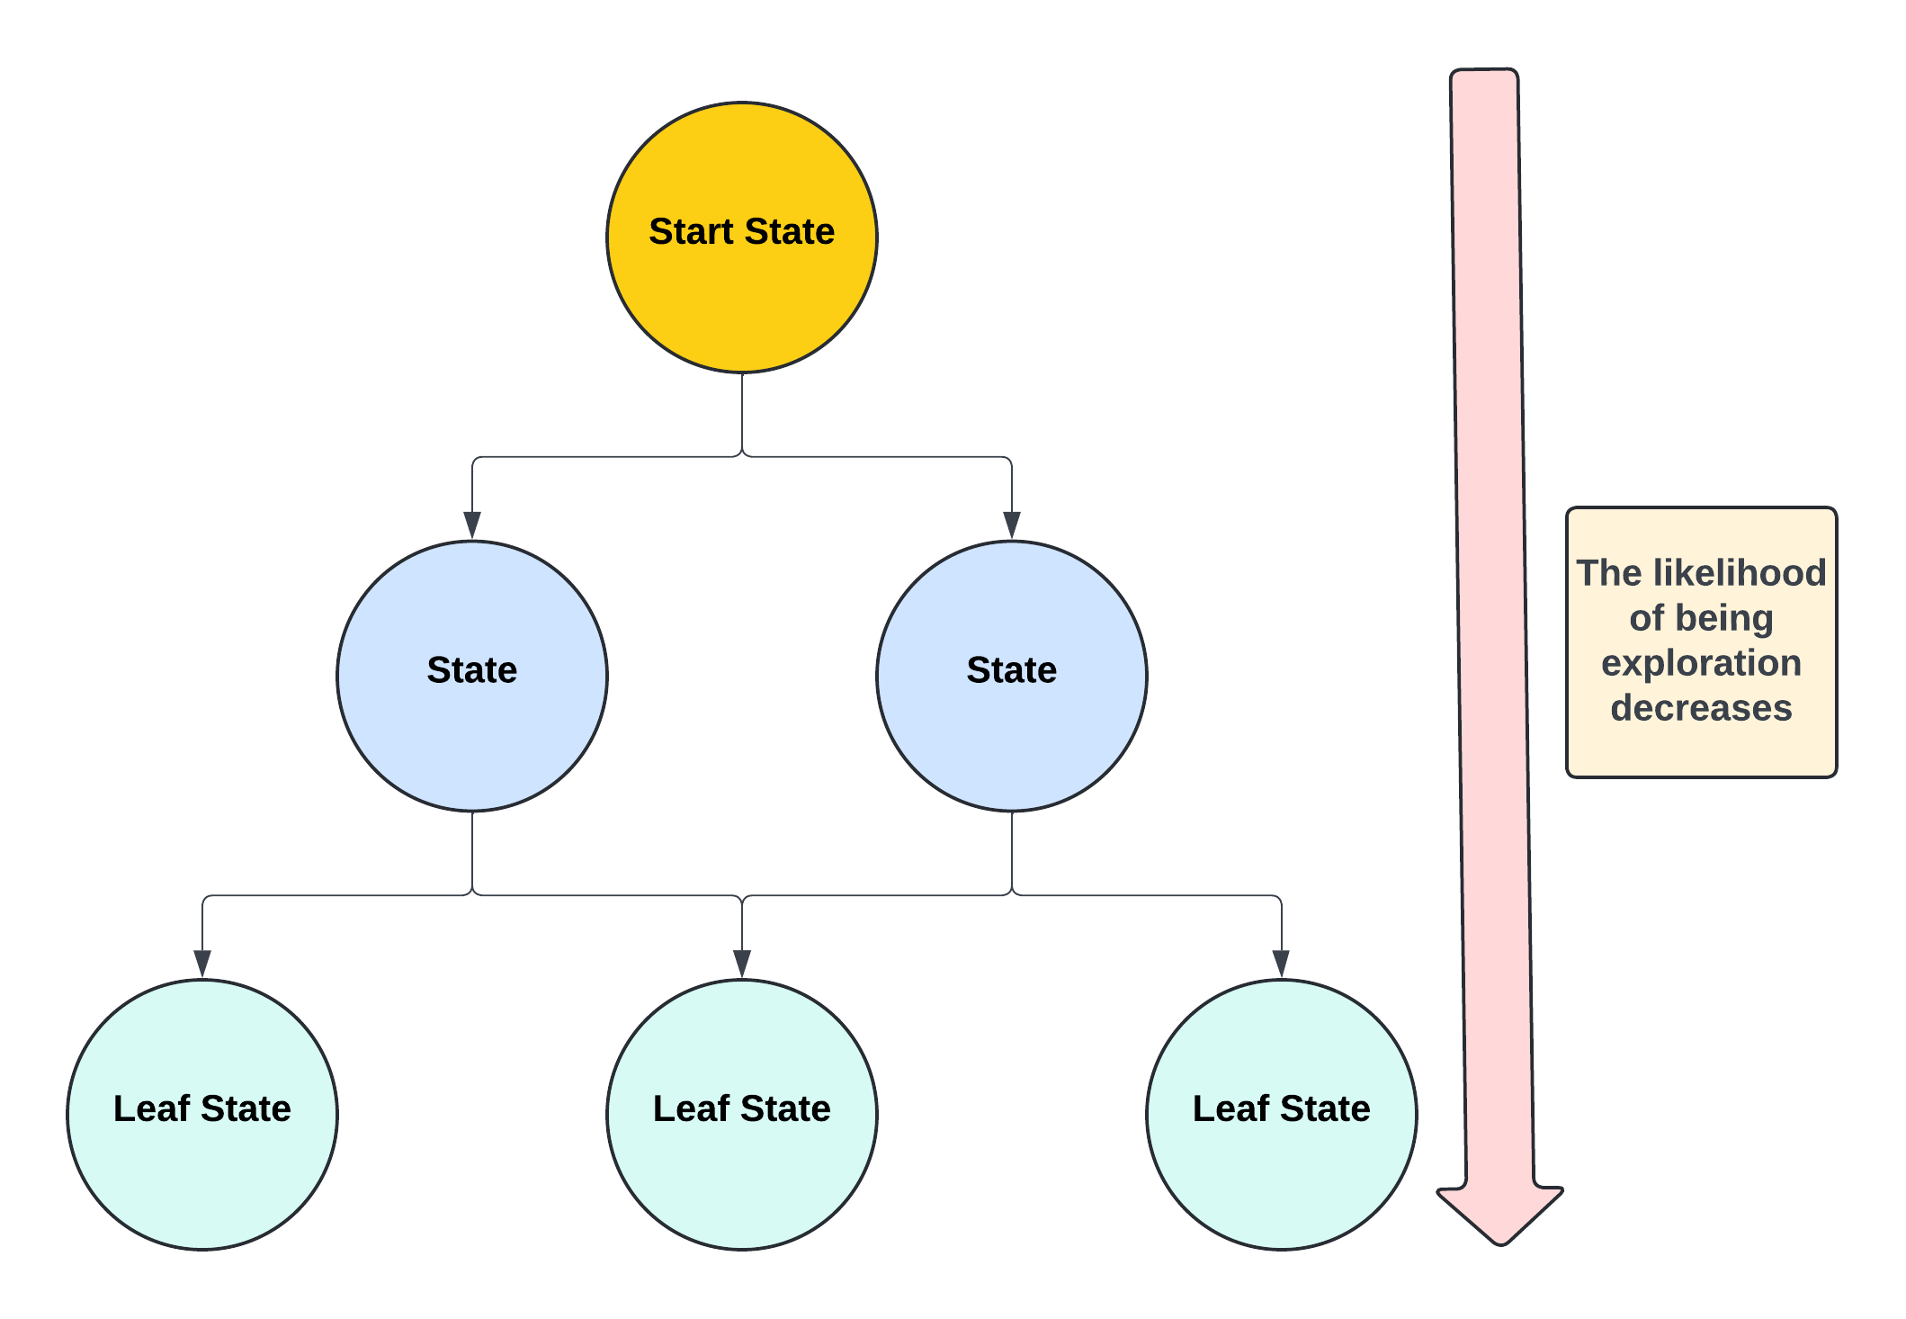
Localization
Traditional Limitation: DAG Environment

Slide 18
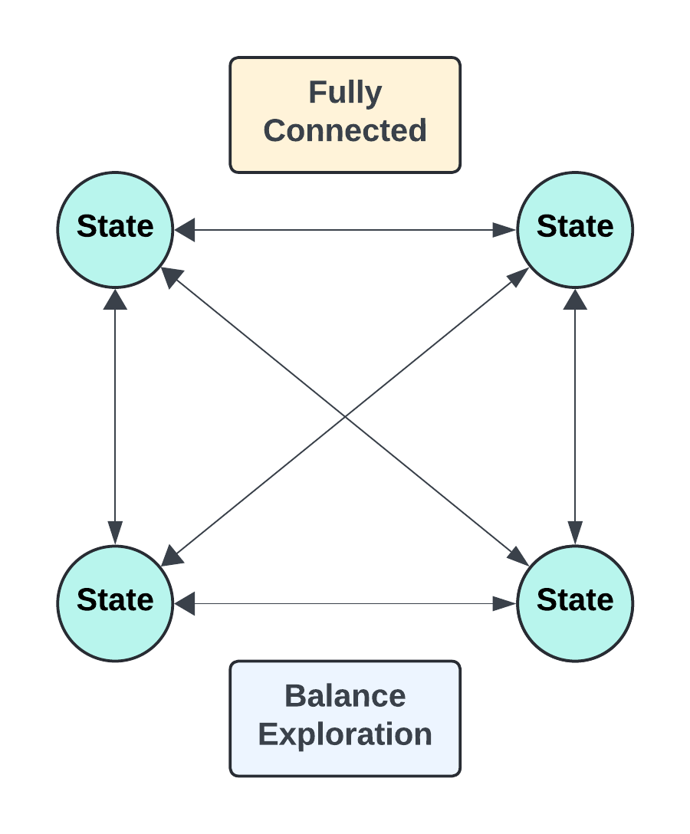
Localization
Finding: Complete Graph

Slide 19
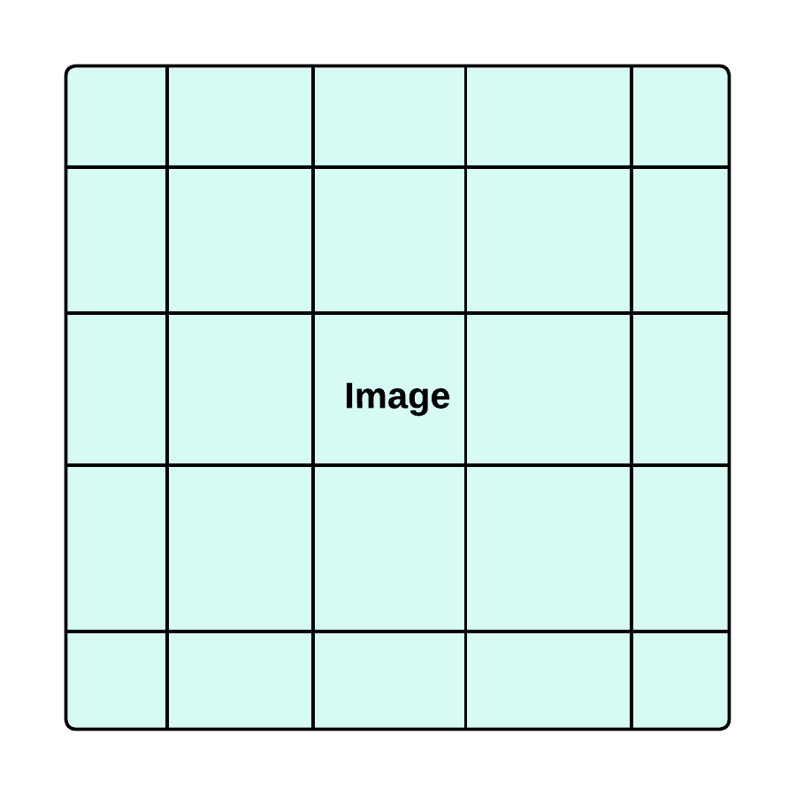

Localization
Finding: The breakthrough
Idea: Predicting the location of the tumor center instead of moving the bounding box to the tumor
Infinite action space: each action = a pixel of image (state)
From Localization to Regression
State

Slide 20
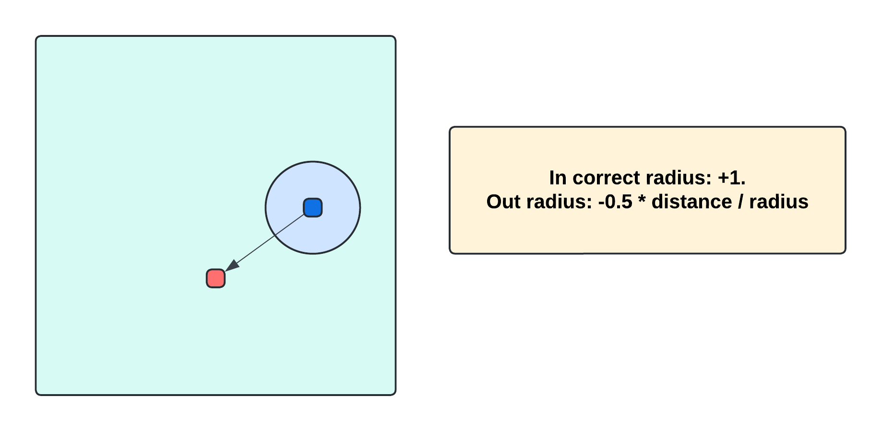
Localization
Finding: Reward Computation

Slide 21
Comprehensive Experiment
Multi case: classification

Slide 22
Comprehensive Experiment
Multi case:
localization

Slide 23
Comprehensive Experiment
Multi baseline
Machine Learning: SVC, KNN
Deep Learning: VGG16
Reinforcement Learning: Deep Q Network and Momentum DQN

Slide 24
Result Experiment (1)
Comprehensive results using HOG vs LSIB vs Segmentation
 | KNN-10 | KNN-5 | KNN-2 | KNN-1 | SVM-ln | SVM-rbf | RF
mCV acc | 0.8783 | 0.8977 | 0.9060 | 0.9161 | 0.8213 | 0.8934 | 0.8507
mCV acc | 0.8633 | 0.8934 | 0.9340 | 0.9401 | 0.9084 | 0.9119 | 0.8598
mCV acc | 0.8403 | 0.8725 | 0.8965 | 0.9326 | 0.8920 | 0.9035 | 0.8181
acc | 0.8367 | 0.8748 | 0.9549 | 0.9602 | 0.8535 | 0.9008 | 0.8848
acc | 0.8291 | 0.8810 | 0.9603 | 0.9733 | 0.9252 | 0.9039 | 0.8940
acc | 0.8032 | 0.8604 | 0.9207 | 0.9756 | 0.9237 | 0.9092 | 0.8703
F1-score | 0.8192 | 0.8654 | 0.9528 | 0.9586 | 0.8445 | 0.8932 | 0.8749
F1-score | 0.8103 | 0.8700 | 0.9580 | 0.9715 | 0.9193 | 0.8975 | 0.8852
F1-score | 0.7820 | 0.8484 | 0.9122 | 0.9735 | 0.9181 | 0.9033 | 0.8599
HOG first LSIB second
Seg third

Slide 25
Result Experiment (1)
HOG
LSIB
Seg

Slide 26
Result Experiment (1)
HOG
Seg
LSIB

Slide 27
Result Experiment (1)
HOG
Seg
LSIB

Slide 28
Result Experiment (1)
HOG first LSIB second
Seg third

Slide 29
Result Experiment (1)
LSIB
Seg
HOG

Slide 30
Result Experiment (1)
LSIB
Seg
HOG

Slide 31
Result Experiment (1)
LSIB
Seg
HOG

Slide 32
Result Experiment (2)
Comparison results using LSIB vs. Segmentation
 | Top 3 | Unique Top 3 | The best
mCV acc | 0.9287 | 0.9039 | 0.9401
acc | 0.9529 | 0.9308 | 0.9733
F1-score | 0.9496 | 0.9253 | 0.9715
mCV acc | 0.9109 | 0.8847 | 0.9326
Acc | 0.9400 | 0.9232 | 0.9756
F1-score | 0.9346 | 0.9168 | 0.9735
LSIB
Seg

Slide 33
Result Experiment (3)
Comparison results with Related work
Method | Dataset | CV accuracy | Accuracy | F1-score
Enh + HOG (the best) | BRMRI 2022 | 0.916161 | 0.9602 | 0.9586
Enh + Statistics (the best) | BRMRI 2022 | 0.9401 | 0.9733 | 0.9715
Segmentation (the best) | BRMRI 2022 | 0.9326 | 0.9756 | 0.9735
Enh + CNN - 2023 paper | BRMRI 2022 | None | 0.9784 | 0.9790
I&C + RCNN - 2022 paper | SARTAJ | None | 0.9517 | 0.9363 (89.28-98.42)
Xception FineTuning | BRMRI 2022 | 0.9739 | 0.9764 | 0.9750

Slide 34
Research Finding
We found the effectiveness of capture local edge information, shape of tumor and also texture, spatial relationship (location), different intensity distribution of tumor region for Brain Tumor MRI classification using feature extraction such as HOG, LSIB.
Besides, combining them can be an better way for the accurate identification and classification of complex tumors.
Conclusion
Segmentation based classification could be a novel way that help isolate the tumor regions and focus on them instead of entire brain.
The experiment result shows potential of model resonation by an ML segmentation method.
Amid the explosion of DL and CNN, our research shows that understanding and creatively combining traditional ML methods still shows effectiveness and has essential application values.
Notes:
However, spatial relationship, different intensity distribution features seem to be more essential.

Slide 35
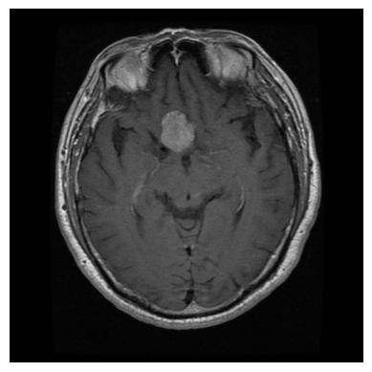
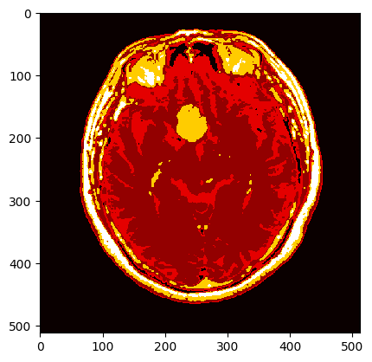
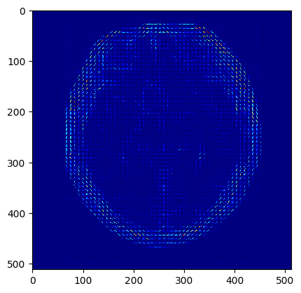
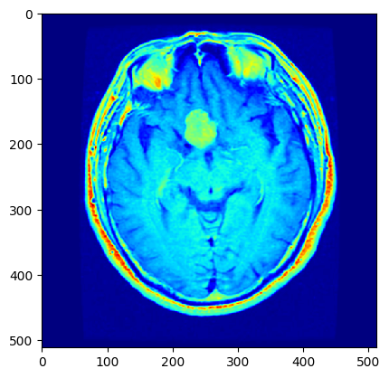
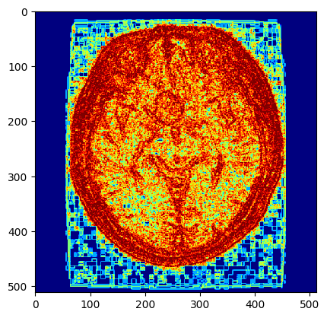

Visualization
pituitary/Tr-pi_0621.jpg

Slide 36
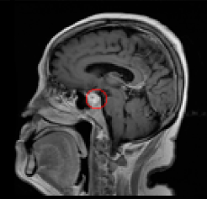
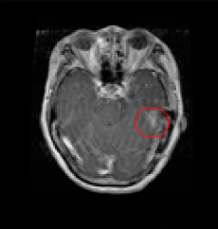
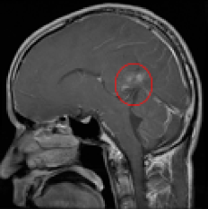
Limitation Finding
Pituitary
Glioma
Glioma
Predicted Label
Notes:
Very small, unclear shape, may be very similar to surrounding healthy brain tissue

Slide 37
Recommendation
New Insight Finding
How to self-attention with multi input image?
Multi – tone augmentation?

Slide 38
Thank you
THANKS

Slide 39
Classification
The algorithm: Momentum DQN
Double DQN: was first proposed by Google Deep Mind in an article titled Deep Reinforcement Learning with Double Q-learning. It is a technique used in Deep Q-Networks (DQNs) to address the issue of overestimation bias.
Reduces overestimation bias, leading to more accurate learning.
Improve the stability and performance of DQN, especially with small datasets.

Slide 40
References
Doctor:
Hoang Ngoc Huynh
Quang Tri General Hospital
Phone: 091 5711133
Mertrics:
On evaluation metrics for medical applications of artificial intelligence | Scientific Reports (nature.com) - 2022 - 163 citations
Applied Sciences | Free Full-Text | Classification of Brain Tumors from MRI Images Using a Convolutional Neural Network (mdpi.com) - 2020 - 302 citations
TOWARDS A GUIDELINE FOR EVALUATION METRICS IN MEDICAL IMAGE SEGMENTATION - 2022 - 96 citations
Dataset:
Brain Tumor MRI Dataset (kaggle.com) - 2022

Slide 41
References
Method:
Applied Sciences | Free Full-Text | Classification of Brain Tumors from MRI Images Using a Convolutional Neural Network (mdpi.com) - 2020 - 302 citations – Figshare
Brain tumor MRI images identification and classification based on the recurrent convolutional neural network - ScienceDirect - 2022 - 62 citations – Sartaj
BRAIN TUMOR MRI IMAGE CLASSIFICATION WITH FEATURE SELECTION AND EXTRACTION USING LINEAR DISCRIMINANT ANALYSIS - 2012 - 79 citations
Brain tumor detection and classification using machine learning: a comprehensive survey | Complex & Intelligent Systems (springer.com) - 2021 - 118 citations
Brain tumor classification for MR images using transfer learning and fine-tuning – ScienceDirect - 2019 - 491 citations - lock [not free] – Figshare
Medical images classification using deep learning: a survey | Multimedia Tools and Applications(springer.com) - 2023 - 1 cite - lock [not free]
Brain MRI Detection | Segmentation | ResUNet (kaggle.com) - ResUnet
Brain Tumor Classification from MRI Using Image Enhancement and Convolutional Neural Network Techniques - PMC (nih.gov) - 2023 - Same Dataset

Slide 42
Thank you
N-THANKS

