Slide 1
Backpropagation in CNNs

Slide 2

Chain rule

Slide 3

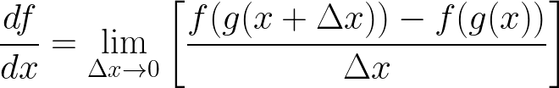



1. Chain Rule
Notes:
\frac{df}{dx} = \underset{\Delta x\rightarrow 0 }{\lim} \left [ \frac{f(g(x+\Delta x))-f(g(x))}{\Delta x} \right ]
=\underset{\Delta x\rightarrow 0 }{\lim} \left [ \frac{f(g(x+\Delta x))-f(g(x))}{\Delta x} \cdot \frac{g(x+ \Delta x) - g(x))}{g(x+ \Delta x) - g(x))} \right ]
=\underset{\Delta x\rightarrow 0 }{\lim} \left [ \frac{f(g(x+\Delta x))-f(g(x))}{g(x+ \Delta x) - g(x))}\right ] \cdot g'(x)
=\underset{\Delta x\rightarrow 0 }{\lim} \left [ \frac{f(g(x+\Delta x))-f(g(x))}{g(x+ \Delta x) - g(x))} \cdot \frac{g(x+ \Delta x) - g(x))}{\Delta x} \right ]
=\underset{\Delta x\rightarrow 0 }{\lim} \left [ \frac{f(g(x+\Delta x))-f(g(x))}{g(x+ \Delta x) - g(x))}\right ] \cdot \underset{\Delta x\rightarrow 0 }{\lim} \left [ \frac{g(x+ \Delta x) - g(x))}{\Delta x} \right ]

Slide 4
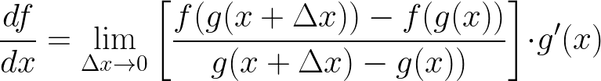


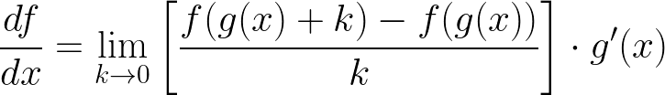

1. Chain Rule
Let
Notes:
\frac{df}{dx} = \underset{\Delta x\rightarrow 0 }{\lim} \left [ \frac{f(g(x+\Delta x))-f(g(x))}{g(x+ \Delta x) - g(x))}\right ] \cdot g'(x)
\frac{df}{dx} = \underset{k \rightarrow 0 }{\lim} \left [ \frac{f(g(x) + k)-f(g(x))}{k}\right ] \cdot g'(x)

Slide 5

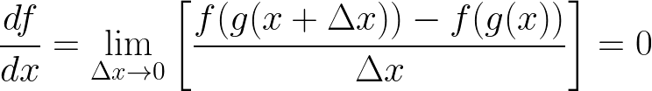


1. Chain Rule

Slide 6
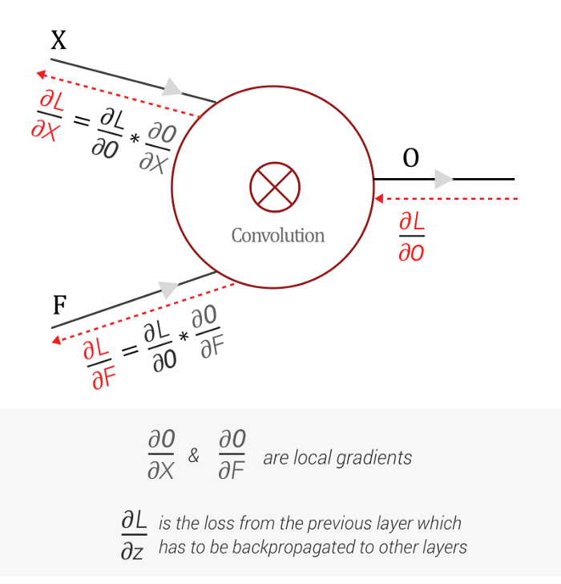
2. Convolution backpropagation
Notes:
How does Backpropagation work in a CNN? | Medium
Backpropagation In Convolutional Neural Networks | DeepGrid (jefkine.com)

Slide 7
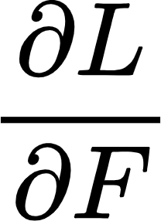
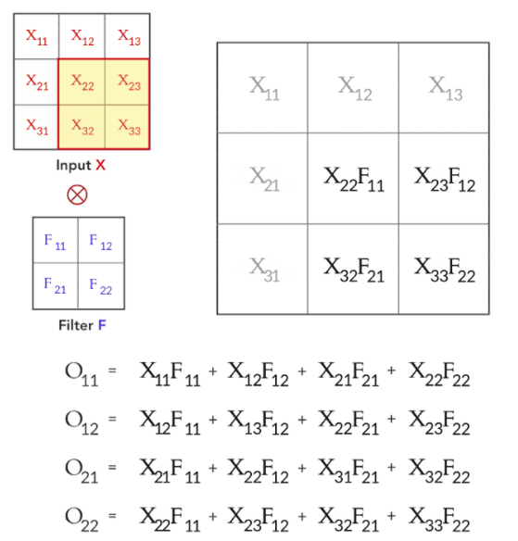
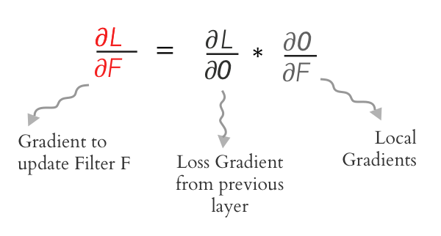
2. Convolution backpropagation - Find

Slide 8
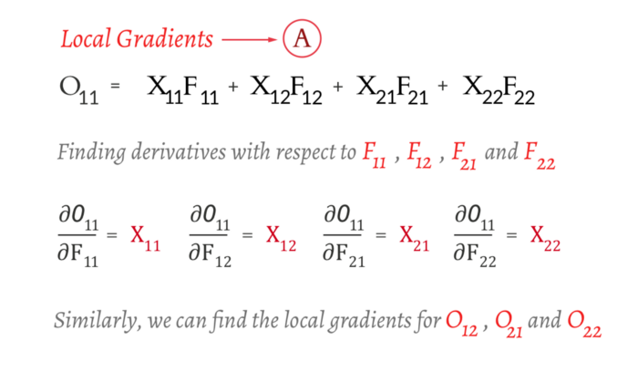
2. Convolution backpropagation - Find

Slide 9
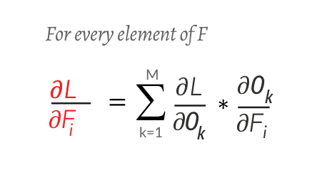
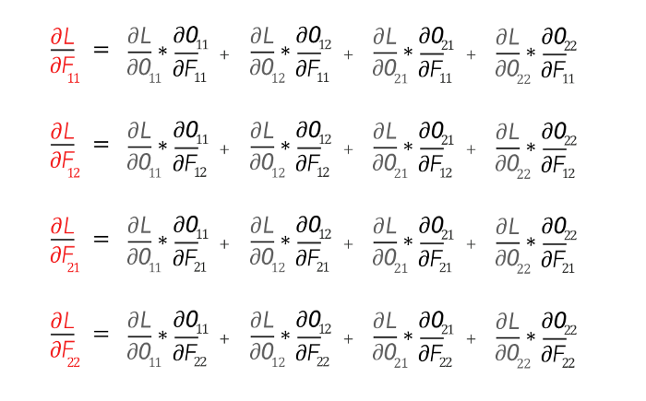
2. Convolution backpropagation - Find

Slide 10
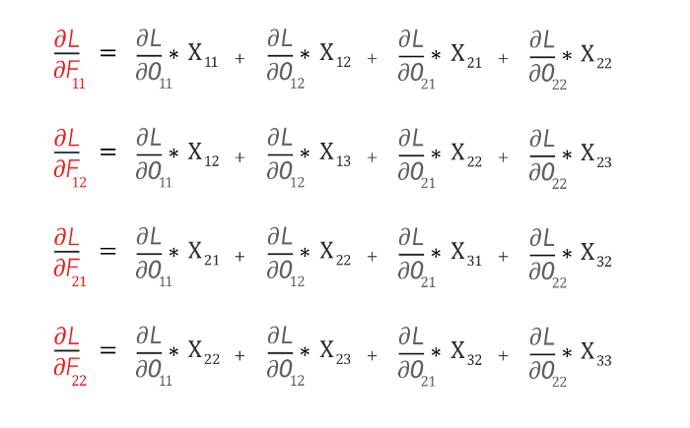
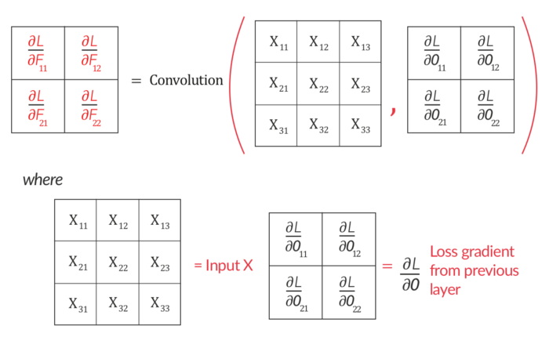
2. Convolution backpropagation - Find

Slide 11
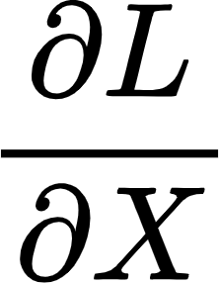
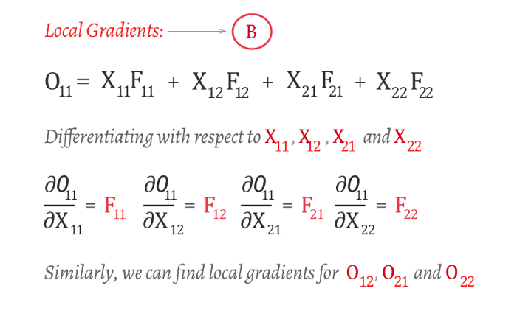
2. Convolution backpropagation - Find

Slide 12
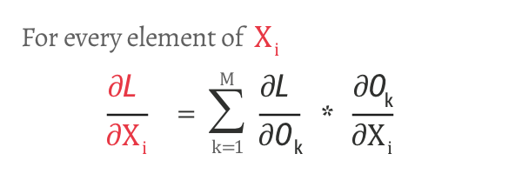

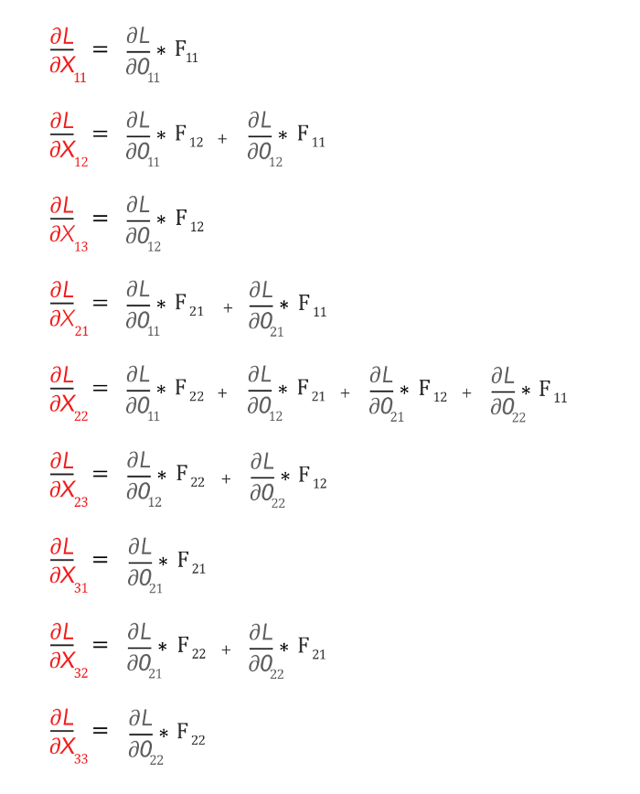
2. Convolution backpropagation - Find

Slide 13
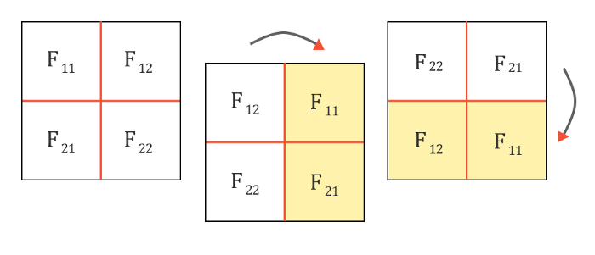
2. Convolution backpropagation - Find

Slide 14
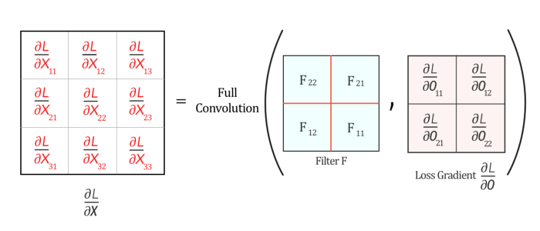
2. Convolution backpropagation - Find

Slide 15
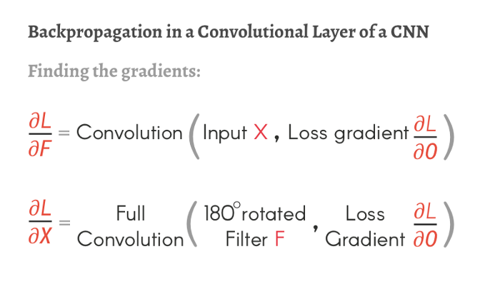
2. Convolution backpropagation - Summary

Slide 16
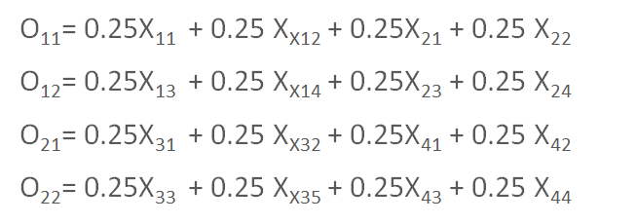
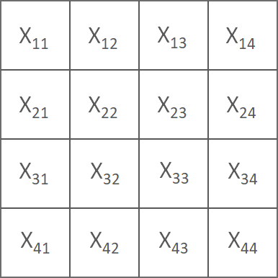
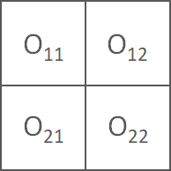
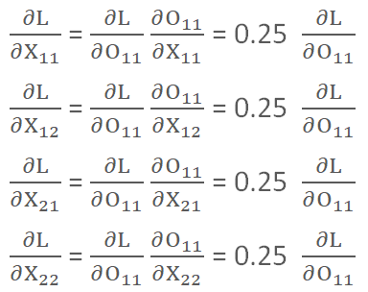


2. Pooling backpropagation - Average pooling
Average pooling
Notes:
Only Numpy: Understanding Back Propagation for Max Pooling Layer in Multi Layer CNN with Example and Interactive Code. (With and Without Activation Layer) | by Jae Duk Seo | The Bioinformatics Press | Medium

Slide 17
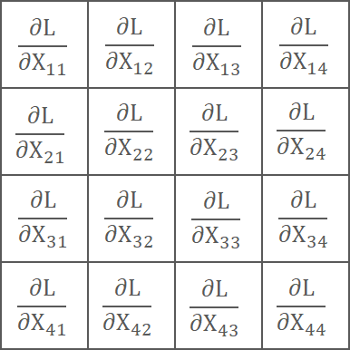
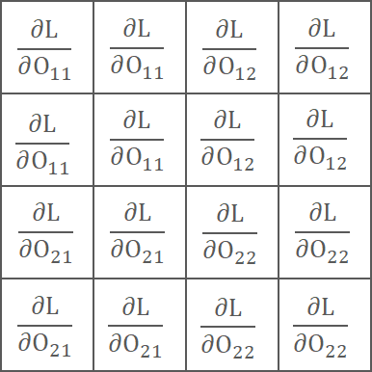



2. Pooling backpropagation - Average pooling
=
*

Slide 18
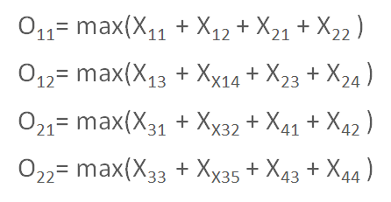
2. Pooling backpropagation - Max pooling
Max pooling

Slide 19
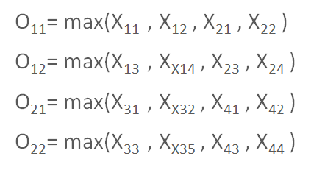
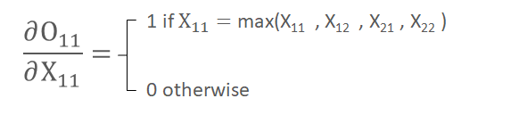
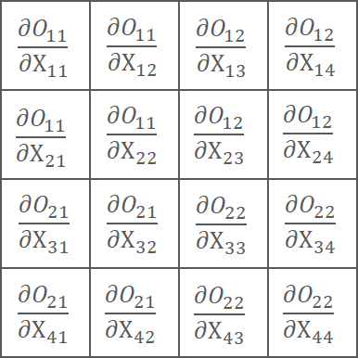
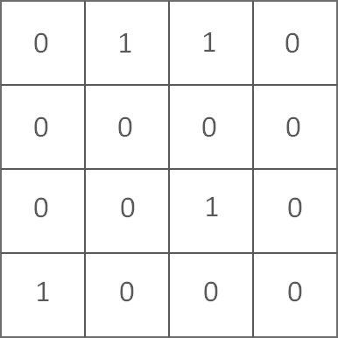
2. Pooling backpropagation - Max pooling
=

Slide 20
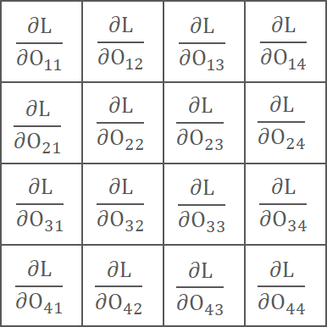

2. Pooling backpropagation - Max pooling
=
*

