Slide 1
A Data-Based Perspective on Transfer Learning
MIT
Conference on Computer Vision and Pattern Recognition (CVPR), 2023, pp. 3613-3622
Top Paper
Discover how transfer learning can boost your model's performance by leveraging knowledge from pre-trained datasets.

Slide 2

Table of Contents

Slide 3
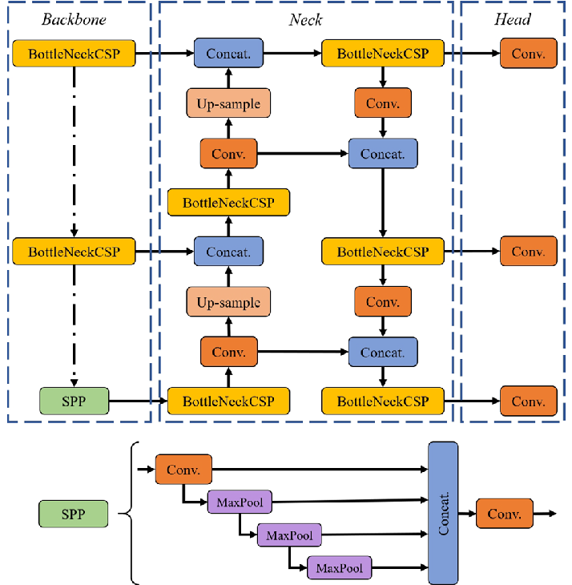
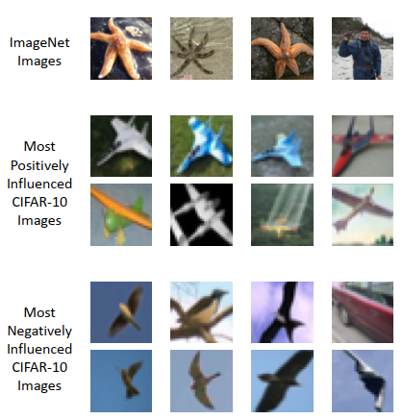
Introduction
Why it matters?
Transfer learning: enables us to adapt a model trained on a source dataset to perform better on a downstream target task. Despite its successes, however, it is still not clear what the drivers of performance gains brought by transfer learning actually are?
Model Improve Based: Various robust backbone models have been developed: ResNet, Unet, Yolo, etc.
Data Improve Based: Increases the generality of the trained dataset (source dataset or target task dataset).

Slide 4
How to improve dataset?
Target task dataset:
Source Dataset:
Data Augmentation: but, it can cause unnecessary bias because these dataset is often very small.
Increasing the size of the source dataset is often a good way, but it is challenging in practice because of data collection problems.
Notes:
, which can be probability scores indicating the likelihood of belonging to a specific tumor class.

Slide 5
The aim of research project?
Novel Approach: Why don’t remove some subsets to improve the source dataset instead of increasing the size?
Question: How can we pinpoint the exact impact of the source dataset in transfer learning?

Slide 6
Proposal – Contribution
Data-Based Framework
In particular, our framework allows
us to study how the quality of the transfer learning model’s predictions changes when subsets of the source dataset are removed?
A robust framework for measuring and analyzing the impact of the source dataset’s composition on transfer learning performance
Automatically find subsets of the source dataset that - positively or negatively -impact downstream behavior

Slide 7
Proposal Features
Features of framework
Pinpoint what parts of the source dataset are most utilized by the downstream task.
Automatically extract “granular subpopulations” in the target dataset through projection of the fine grained labels of the source dataset.
Remove detrimental data from the source dataset to improve transfer learning performance.

Slide 8
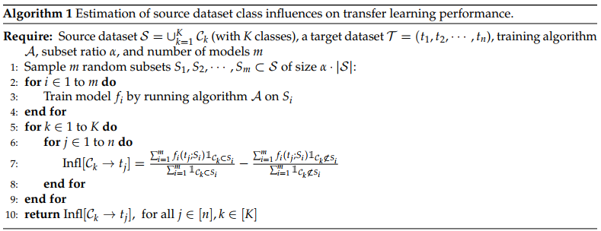
Proposal Pipeline

Slide 9
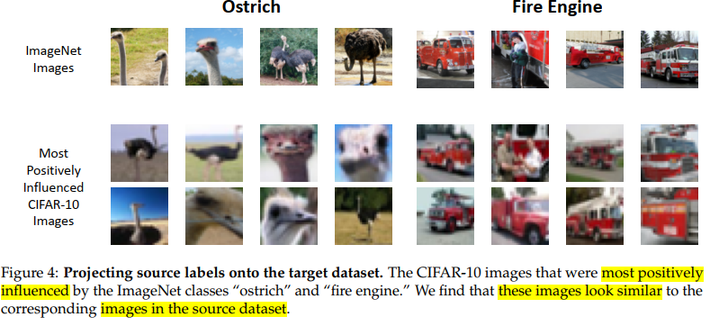
Application
Capability 1: Extracting target subpopulations by projecting source class labels
Enables the identification of “granular subpopulations” in the target dataset by projecting fine-grained labels from the source dataset.

Slide 10
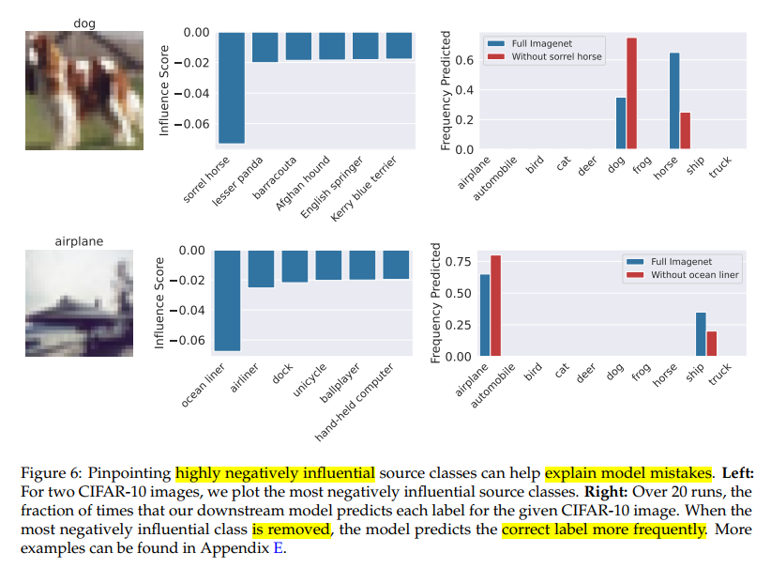
Application
Capability 2: Debugging the failures of a transferred model
Reasoning about the mistakes of the transferred model caused by specific classes in the source dataset. By identifying classes that negatively influence model predictions, the framework aids in debugging model failures and improving prediction accuracy.

Slide 11
Application
Capability 3: Detecting data leakage and misleading source example
Key capabilities of the framework is pinpointing transfer learning brittleness. By detecting pathologies such as data leakage and misleading examples in the source dataset, the framework helps in addressing issues that can hinder transfer learning performance.
Automatic analysis of how subsets of the source dataset impact downstream behavior. This capability provides insights into which subsets positively contribute to transfer learning performance and which ones have a negative impact.
→ Comprehensive set of capabilities for measuring, analyzing, and optimizing the impact of the source dataset's composition on transfer learning performance.

Slide 12
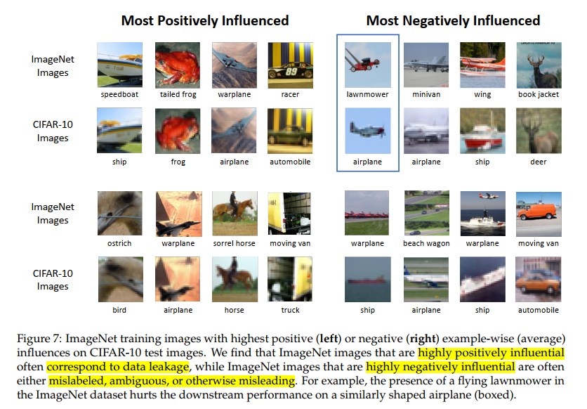
Application
Capability 3: Detecting data leakage and misleading source example

Slide 13
Research Finding
Significance of Source Dataset Composition: highlights the critical role of the source dataset's composition in influencing transfer learning performance.
Framework for Data-Based Analysis: a novel framework that automatically identifying influential data points, detecting pathologies of the dataset, the framework provides valuable insights for improving model predictions.
Conclusion
Practical Implications for Transfer Learning: mitigate transfer learning brittleness and improve model accuracy on a variety of target tasks.
Notes:
However, spatial relationship, different intensity distribution features seem to be more essential.

Slide 14
Recommendation
New Insight Finding
How to apply the framework for measuring and analyzing the role of target dataset composition?
Why we choose the paper to read? The hidden intrinsic of paper!
Saachi Jain, Hadi Salman, Alaa Khaddaj, Eric Wong, Sung Min Park, Aleksander Mądry - MIT Title: A Data-Based Perspective on Transfer Learning Proceedings of the IEEE/CVF Conference on Computer Vision and Pattern Recognition (CVPR), 2023, pp. 3613-3622 (https://openaccess.thecvf.com/content/CVPR2023/html/Jain_A_Data-Based_Perspective_on_Transfer_Learning_CVPR_2023_paper.html) Code: https://github.com/MadryLab/data-transfer
Transfer learning, Data composition, Source dataset, Downstream performance, Data leakage, Detrimental data points, Model failures, Data analysis, Source dataset composition, Transfer learning brittleness

Slide 15
Discussion
Good Question Good Answer
THANKS

