Slide 1
searching engine
presenter:
Siyuan Zhang
shu yang
Tianhao Yao

Slide 2
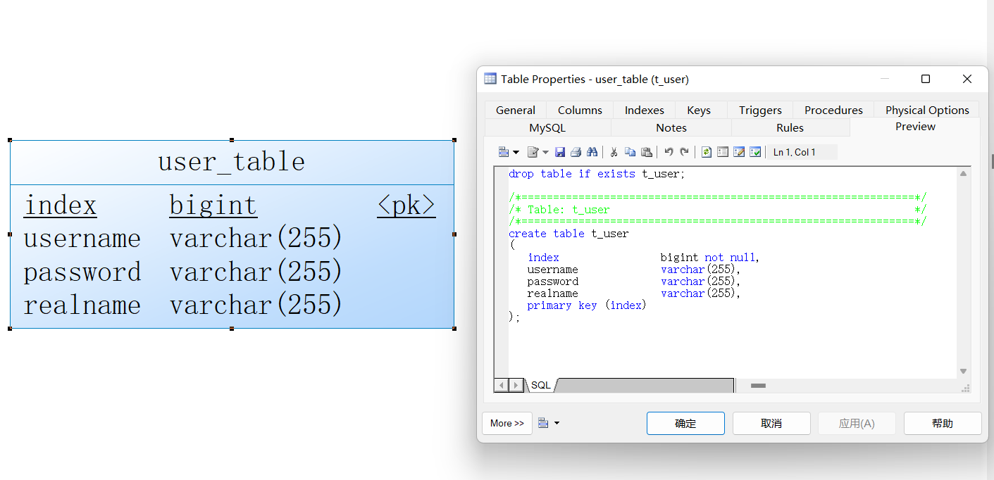
Data Base and Connection
Sprint 3
Construct Data Base(MySQL)
PowerDesigner

Slide 3
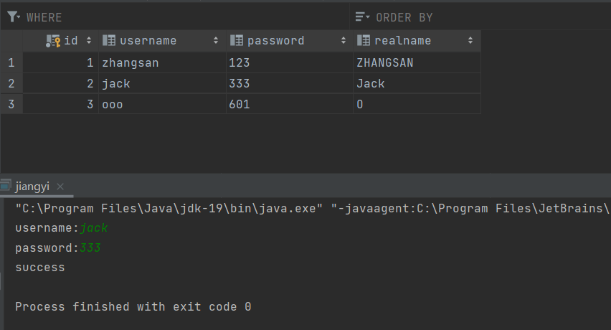
Data Base and Connection
Sprint 3
Demo: User Login System
JDBC
Java-MySQL connection

Slide 4

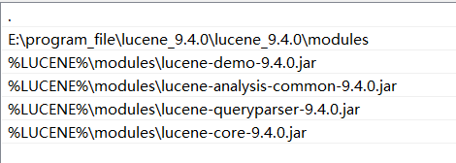
lucene
can’t find major class error

Slide 5
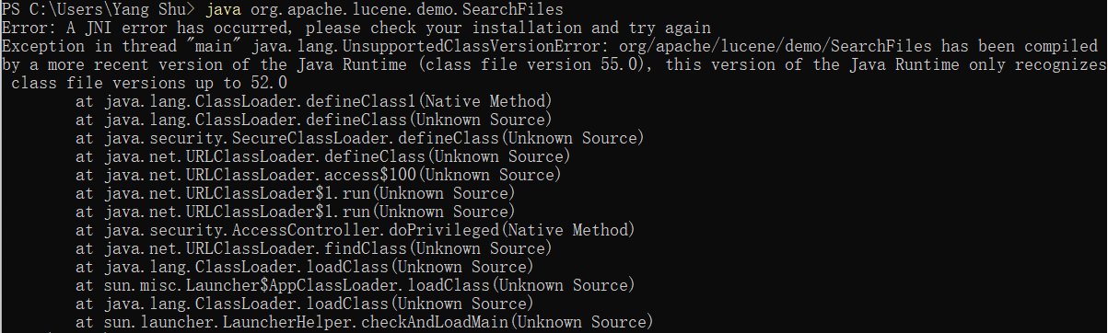
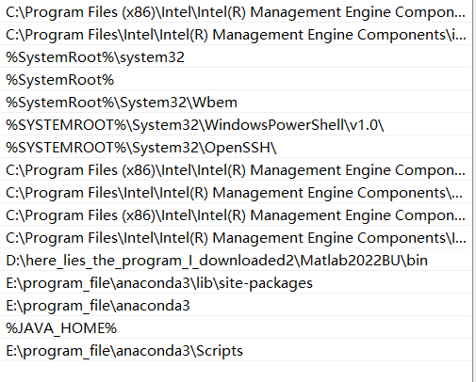
lucene

Slide 6
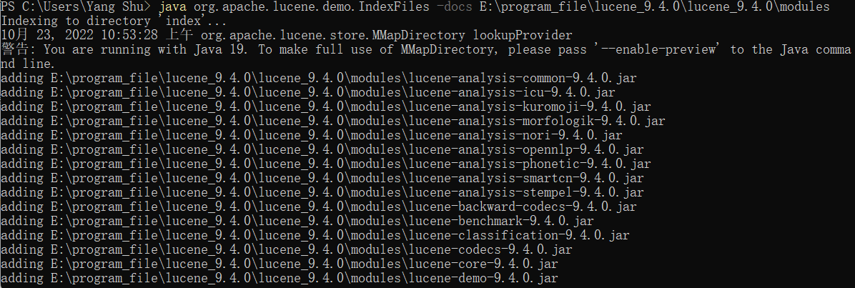
lucene

Slide 7
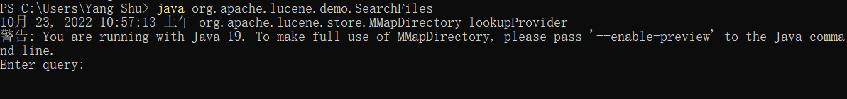
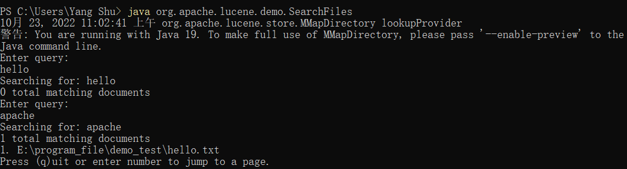
lucene

Slide 8
lucene

Slide 9
Text Pre-processing
Before searching, we need to conduct a pre-processing on the input sequence in order to get a more accurate and satisfying result.
Spell correction
Remove useless information

Slide 10
Spell correction
A basic text correction usually has 3 components:
Candidate Model
The candidate model produces a list of potential correct terms. Potential candidates are created by doing all possible permutations (add, substitute, transpose or remove a character) within a given edit distance from the original word.
Language Model
The language model is essentially a corpus of known valid language words, and the frequency of appearing these words.
Selection Criteria
The selection criteria determines the “right” word to use as the revised version of the possible candidates we have found. Calculating a score based on the edit distance (the lower the better) and how much the word appears in our language model (the higher the better) will be a potential selection criterion and selecting the candidate word with the highest score.

Slide 11
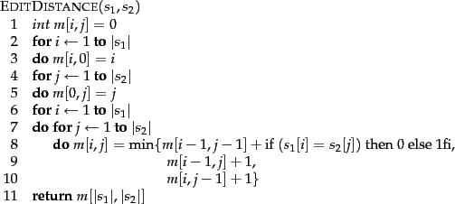

Edit distance
This edit distance is basically the measure of how many operations (adding, substituting, transposing or deleting a character) is needed to convert one word into another.
The idea is to use the dynamic programming algorithm. The (i, j) entry of the matrix holds the edit distance between the strings consisting of the first i characters of $s_{1}$ and the first j characters of $s_{2}$. The three quantities whose minimum is taken correspond to substituting a character, deleting a character and inserting a character.

