Slide 1
TF map from scratch
Practice

Slide 2
Task specification
Do not use external toolbox
In-built function in MATLAB signal processing toolbox is allowed
Borrow codes from signal analysis book is encouraged
Google solution NOT Baidu

Slide 3
Task one
Plot the third channel
Zoom in and check the pulses

Slide 4
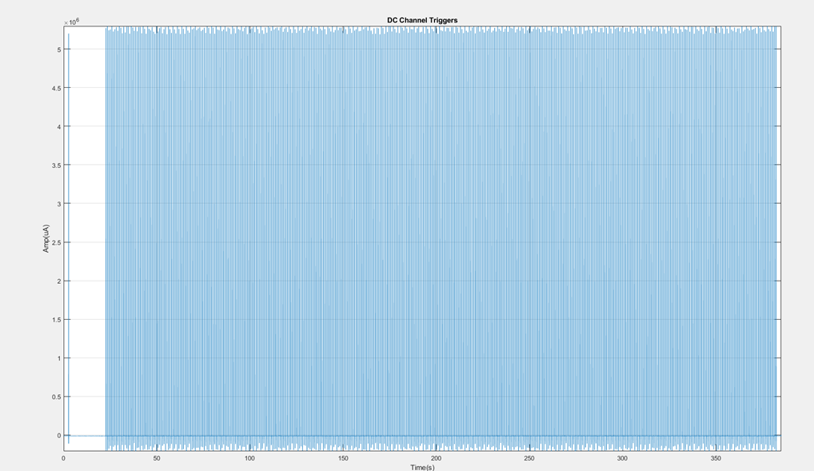

Slide 5
Task two
Rereference the first 2 channels in a bipolar manner and plot the raw and rereferenced channel like below (2-5s segment)
Don’t forget the baseline normalization of the segment

Slide 6
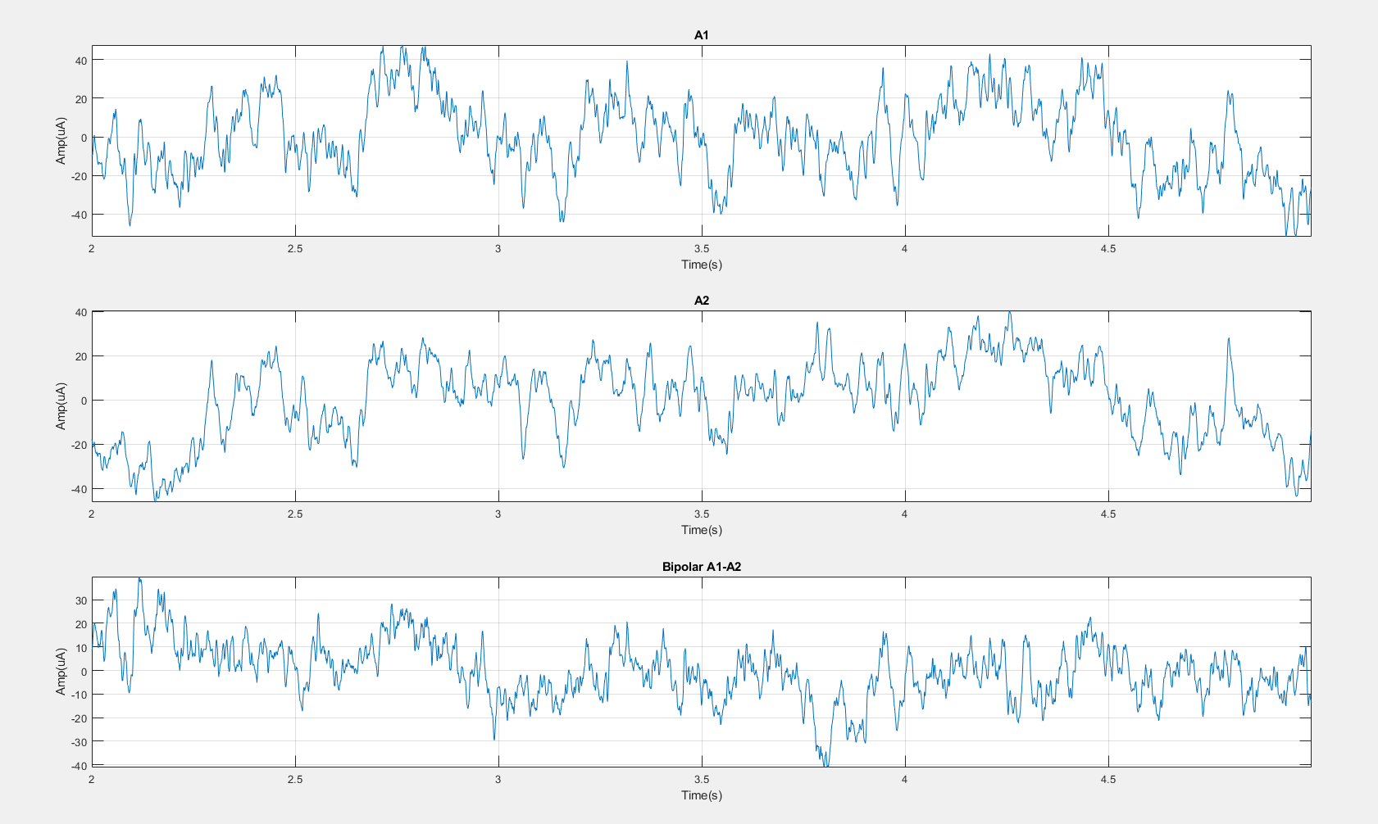

Slide 7
Task three
Filter the bipolar referenced signal to different frequency band and plot them with raw signal like below (2-5s segment)
Band:
Delta < 4Hz
Theta 4–7
Alpha 8–15
Beta 16–31
Gamma > 32
High Gamma 70-170

Slide 8
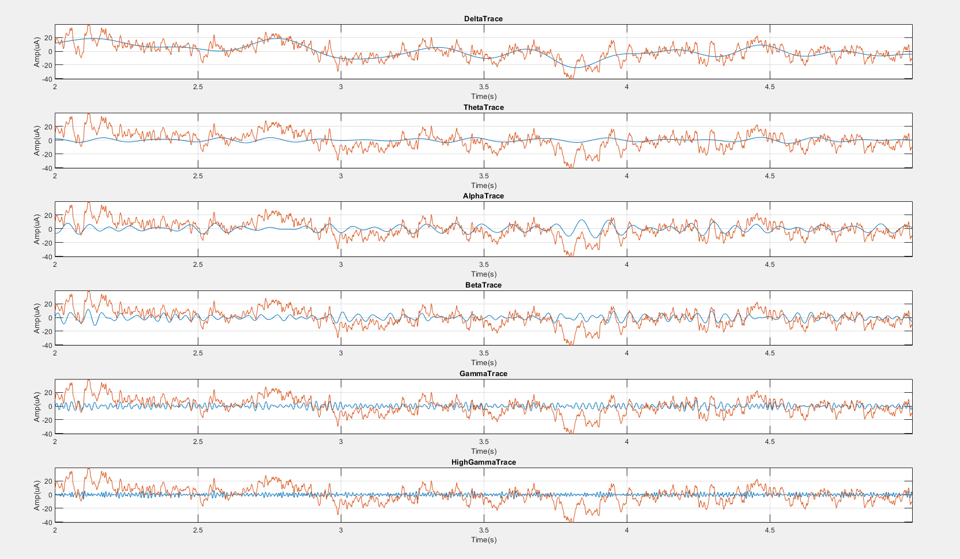

Slide 9
Task four
Extract time stamps from DC channels and epoch bipolar channel
Plot all the epoched traces together [-600ms to 1600ms]

Slide 10
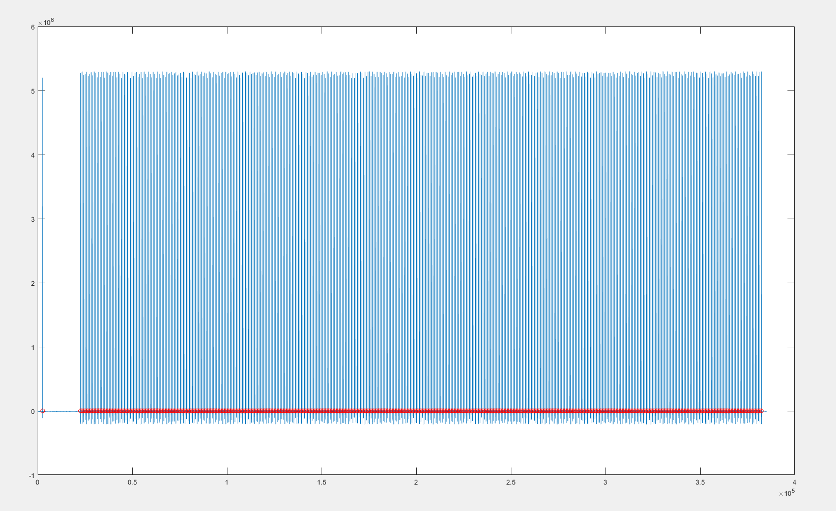
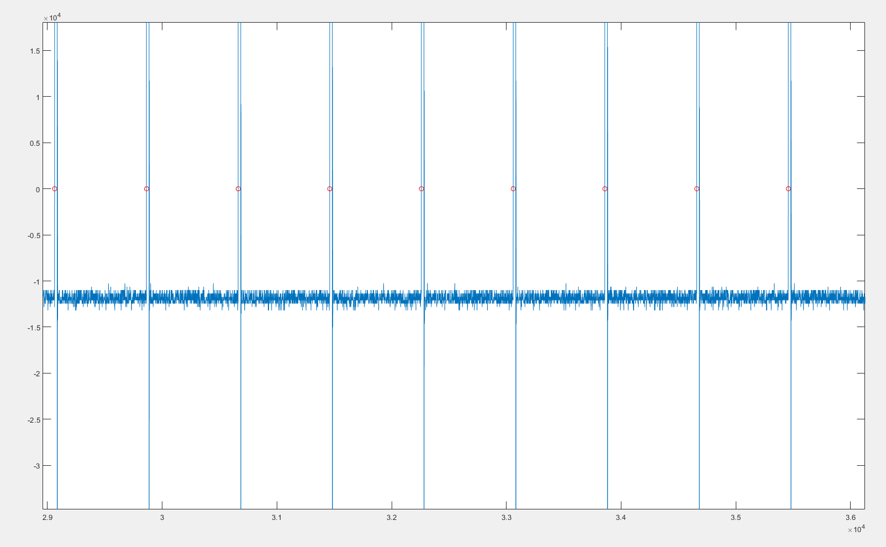

Slide 11
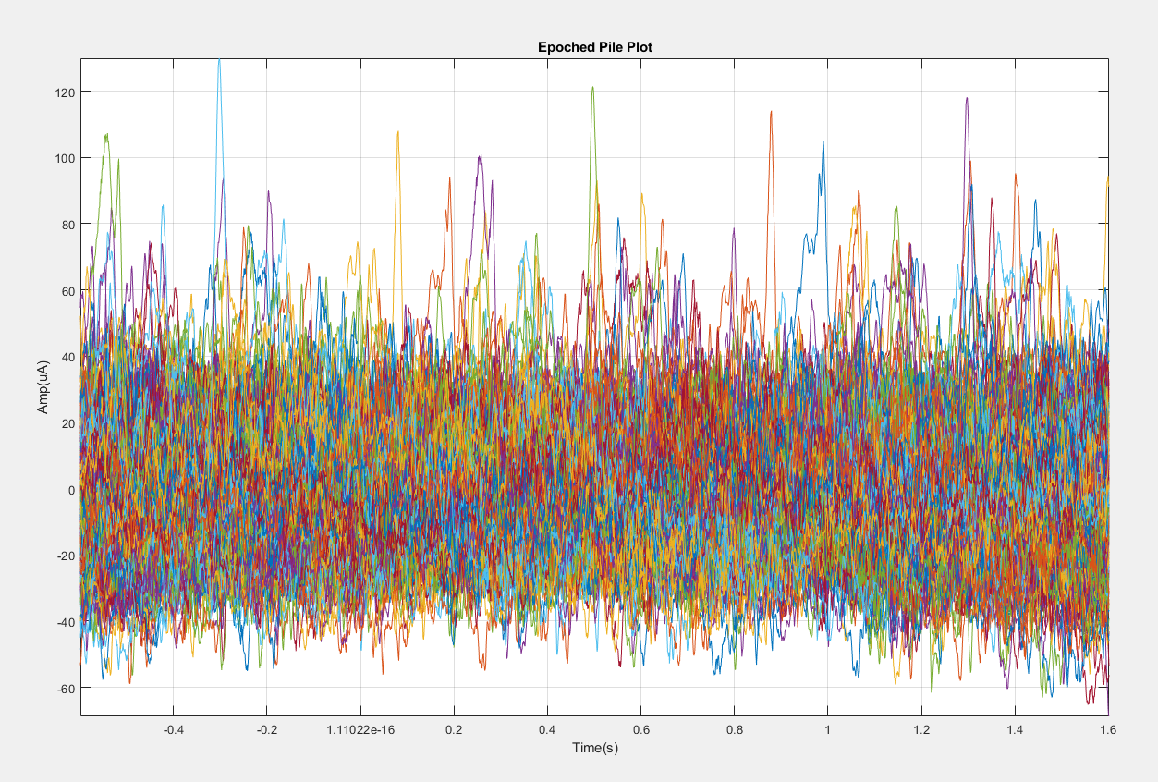

Slide 12
Task five
Time frequency transform of the epoched data.
Short time Fourier or Gabor wavelet
Frequency range: 0:1:200Hz
Baseline: [-500:0]ms; Signal: [0:1500]ms
Plot any 6 trials time frequency map in separate figures.
Plot the averaged TF map in one figure

Slide 13
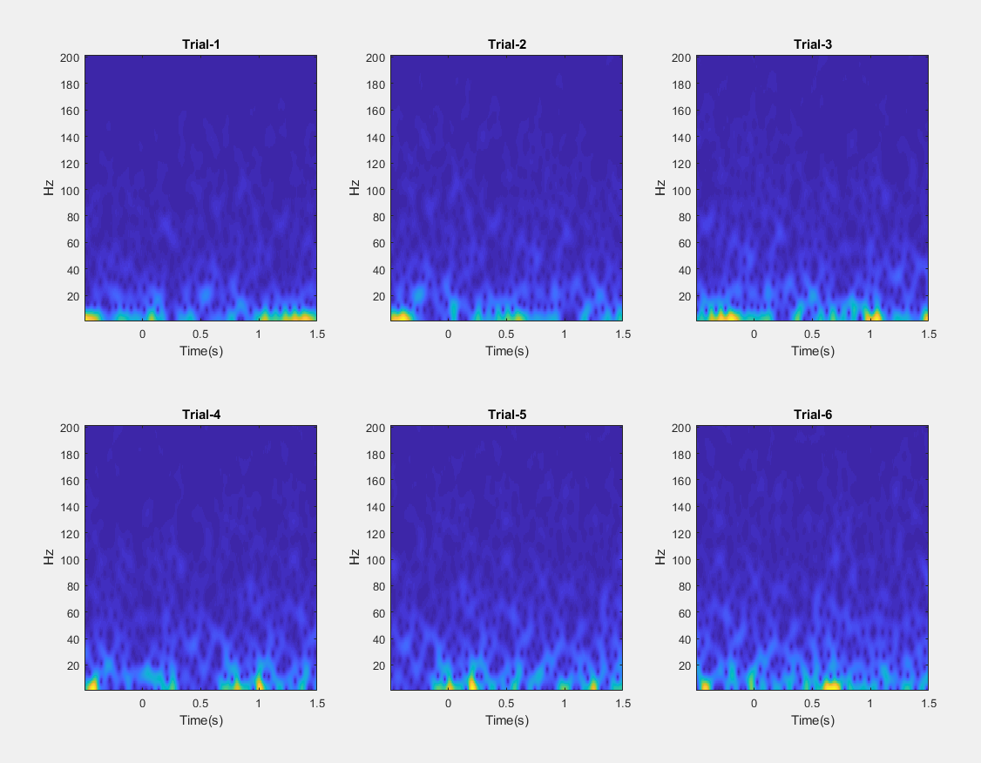

Slide 14
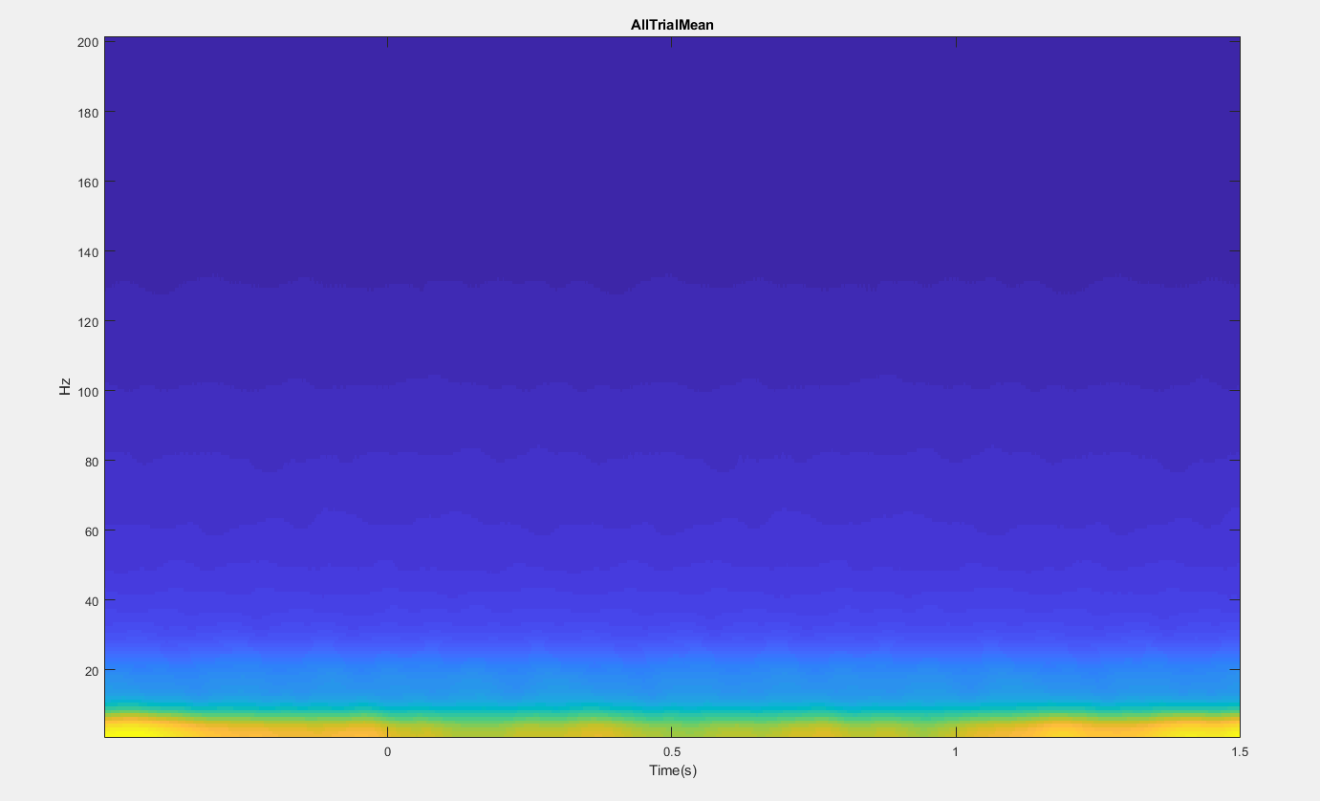

Slide 15
Task six
Baseline normalization
Use Zscore normalization and percentage normalizaiton

Slide 16
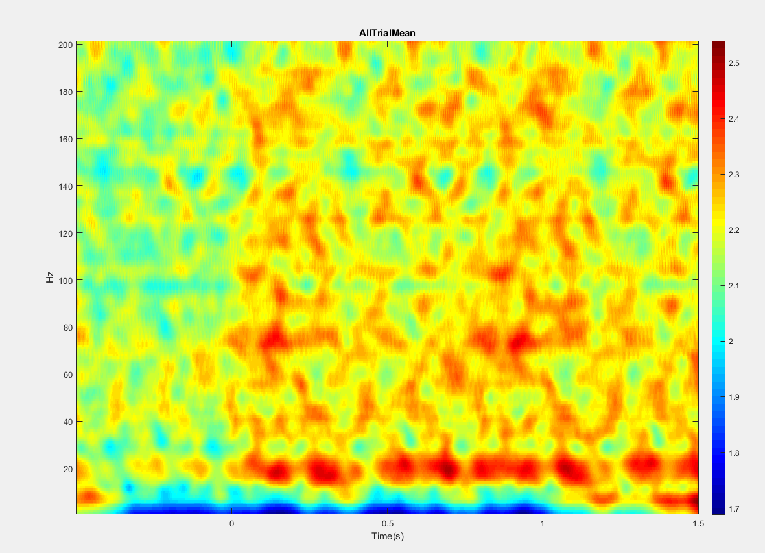

Slide 17
Task seven
Extract the power from 70 to 170Hz and plot the power traces

Slide 18
