Slide 1

From Zero to Hero - LeetCode
Mỗi Tuần Một LeetCode

Slide 2
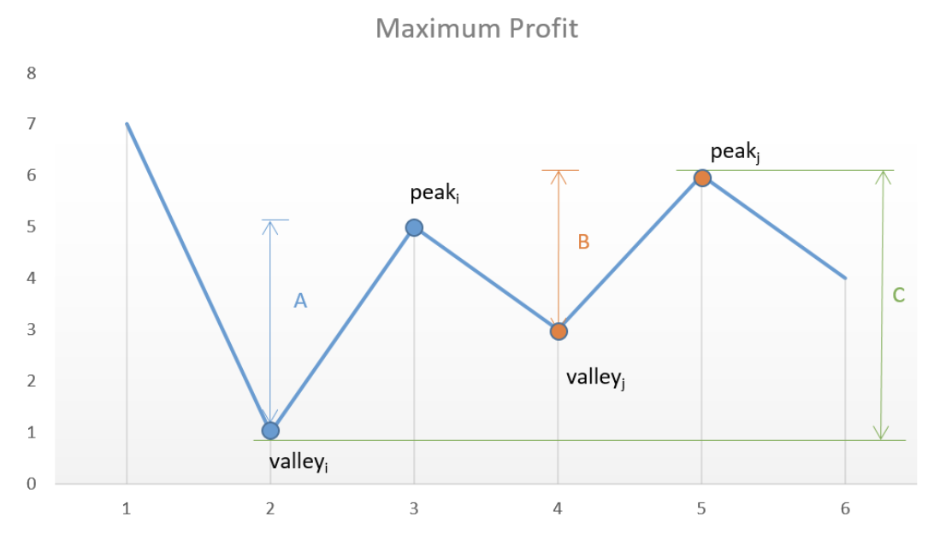
Best Time to Buy and Sell Stock II
Input: [7,1,5,3,6,4]
valley = prices[0]
peak = prices[0]
Step 1: Find valley (to buy at the lowest)
Step 2: Find peak
maxProfit = peak - valley

Slide 3
Best Time to Buy and Sell Stock II
Input: [7,1,5,3,6,4]
How to find a Valley:
while((i < len(prices)-1)and prices[i] >= prices[i+1]):
i += 1
valley = prices[i]

Slide 4
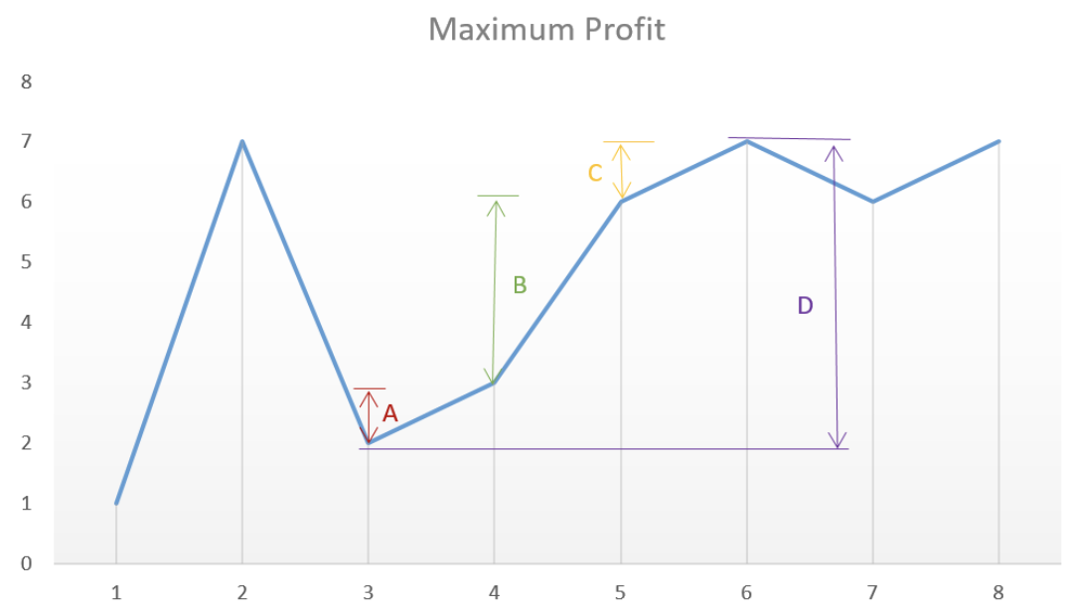
Best Time to Buy and Sell Stock II
Input: [7,1,5,3,6,4]
How to find a Peak:
while((i < len(prices)-1)and prices[i] <= prices[i+1]):
i += 1
peak = prices[i]

Slide 5
Best Time to Buy and Sell Stock II
Input: [1, 7, 2, 3, 6, 7, 6, 7]
How to find a Peak

