Slide 1

30 Days Code Challenges
LeetCode is Zero

Slide 2
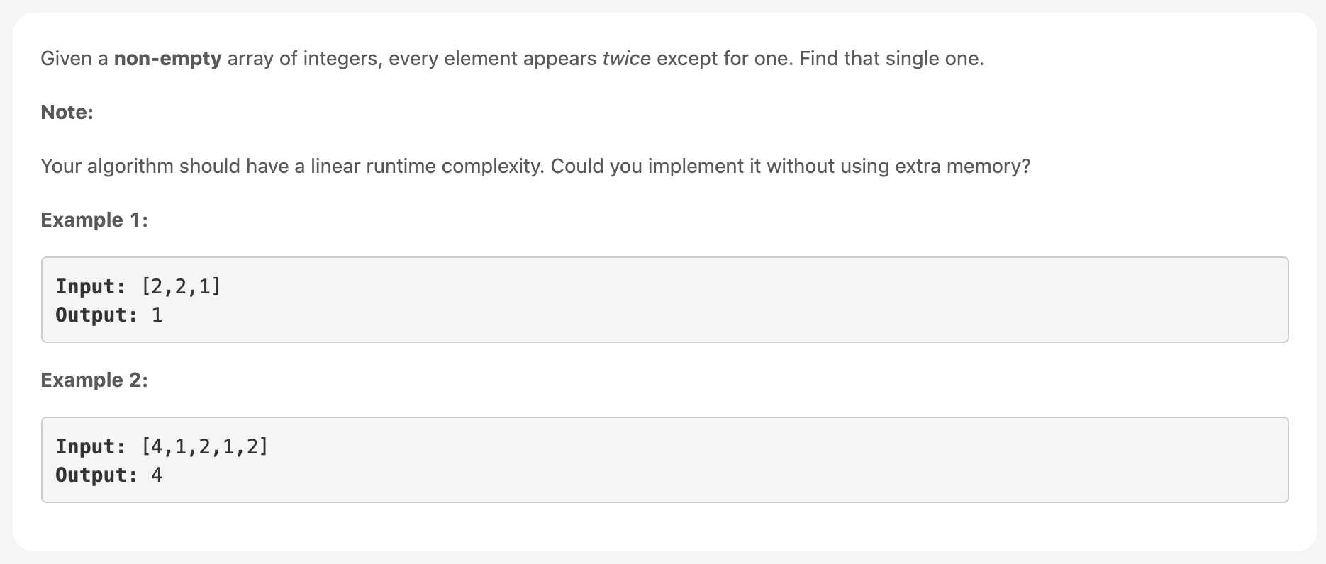
Day 1: Single Number
Notes:
Go to the Live code at array.js

Slide 3
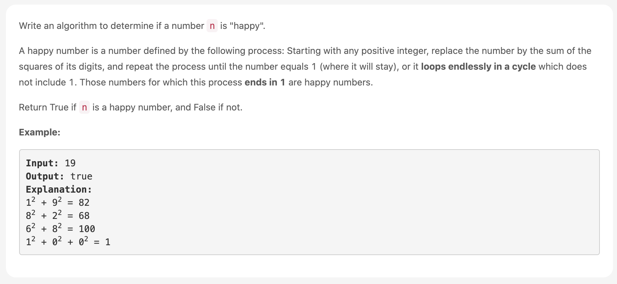
Day 2: Happy Number
Notes:
Go to the Live code at array.js

