Slide 1

From Zero to Hero - LeetCode
Mỗi Tuần Một LeetCode

Slide 2
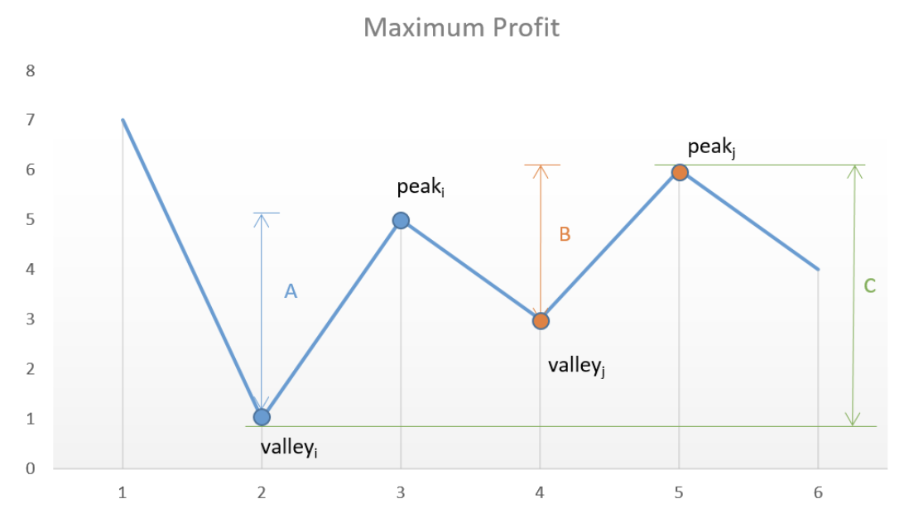
Best Time to Buy and Sell Stock II
Input: [7,1,5,3,6,4]
valley = prices[0]
peak = prices[0]
Step 1: Find valley (to buy at the lowest)
Step 2: Find peak
maxProfit = peak - valley

Slide 3
Best Time to Buy and Sell Stock II
Input: [7,1,5,3,6,4]
How to find a Valley:
while((i < len(prices)-1)and prices[i] >= prices[i+1]):
i += 1
valley = prices[i]

Slide 4
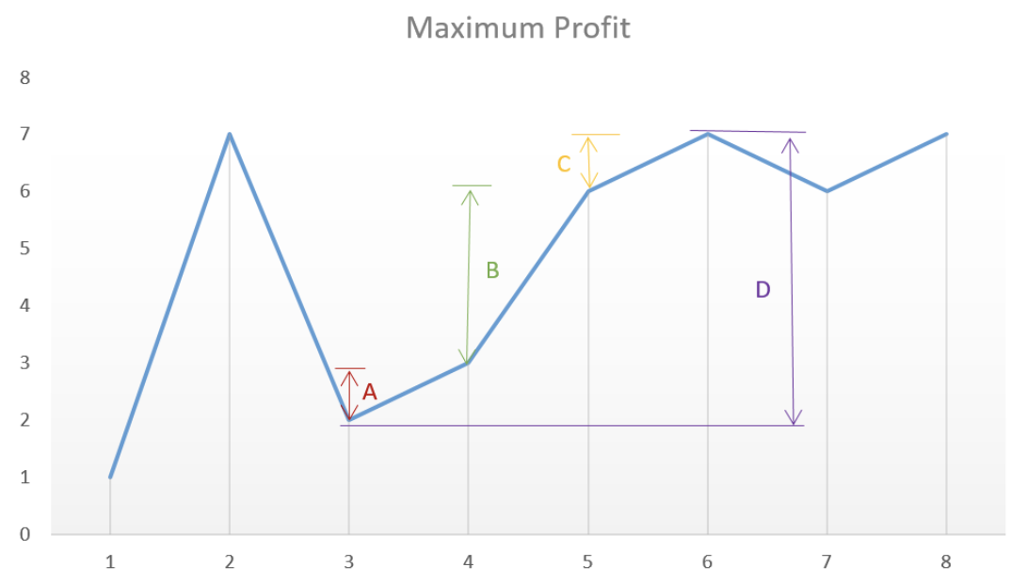
Best Time to Buy and Sell Stock II
Input: [7,1,5,3,6,4]
How to find a Peak:
while((i < len(prices)-1)and prices[i] <= prices[i+1]):
i += 1
peak = prices[i]

Slide 5
Best Time to Buy and Sell Stock II
Key Takeaways:
Valley (Local Min) Finding Algorithm
while((i < len(prices)-1)and prices[i] >= prices[i+1]):
i += 1
valley = prices[i]
Peak (Local Max) Finding Algorithm
while((i < len(prices)-1)and prices[i] <= prices[i+1]):
i += 1
peak = prices[i]

Slide 6
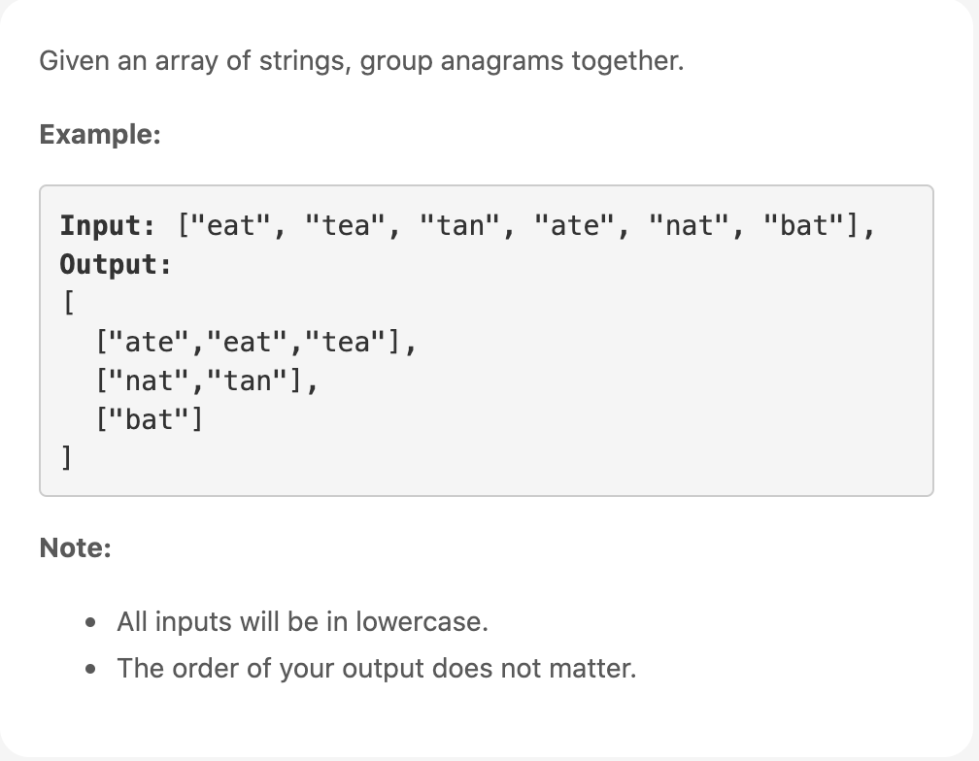
Group Anagrams
Anagrams: Phép đảo chữ là cách một từ hay cụm từ được tái sắp xếp thành các ký tự của 1 từ hay cụm từ khác

Slide 7
Group Anagrams
Approach: Categorize by Sorted String
Categorized by using Hash Table (key-value)
Key: Sorted String
Value: All anagrams
Hash Table in Python is Dictionary
Notes:
Live Code

Slide 8
Group Anagrams
Key Takeaways:
Hash Table (key-value) in Python is Dictionary
Initialize Dict with value = empty List
Hash-able and Un-Hashable key:
Hash-able Object: int, float, decimal, complex, bool, string, tuple, range, frozenset, bytes
Un-Hashable: list, dict, set, bytearray, user-defined classes
from collections import defaultdict
ans = defaultdict(list)
Notes:
Live Code

