Slide 1
CONVERSATIONAL CONSTRAINED CLUSTERING
- C3 Framework -
Project of Anh Quan Nguyen

Slide 2
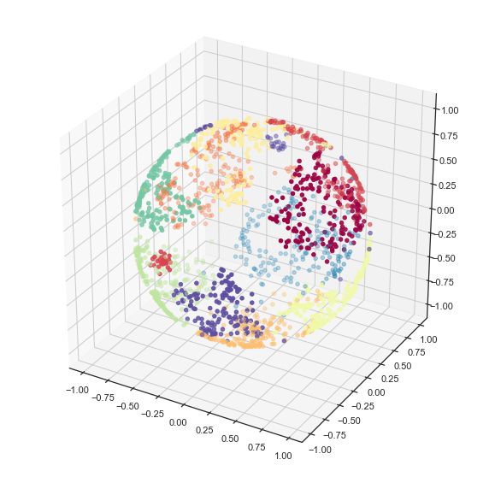
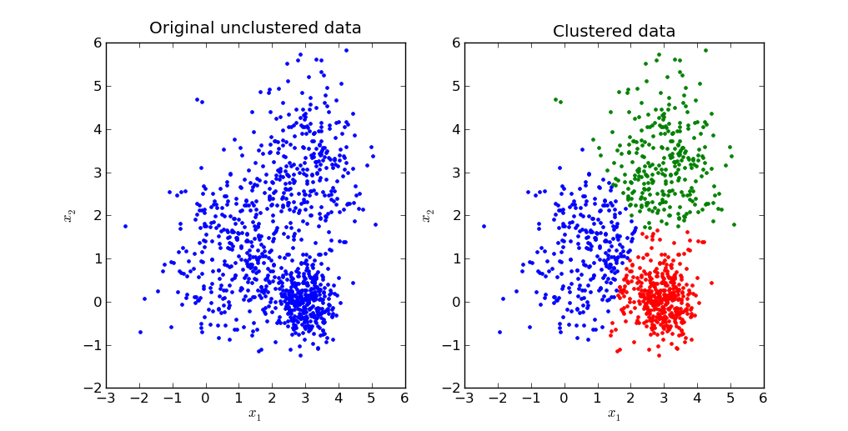
Problem Statement
Clustering is subjective: The "correct" result
depends entirely on what the user is looking for.
K-Means is inflexible: Traditional algorithms can
only group text by surface-level topics.
LLMs are unscalable: Clustering full datasets directly with LLMs is too expensive and slow.

Slide 3
Related Work
Text Embedding (all-MiniLM-L6-v2)
Anchor Sampling (FPS)
LLM (GPT-4o)
Metric Learning (ITML)
Constrained Clustering Algo (PCK-Means)

Slide 4
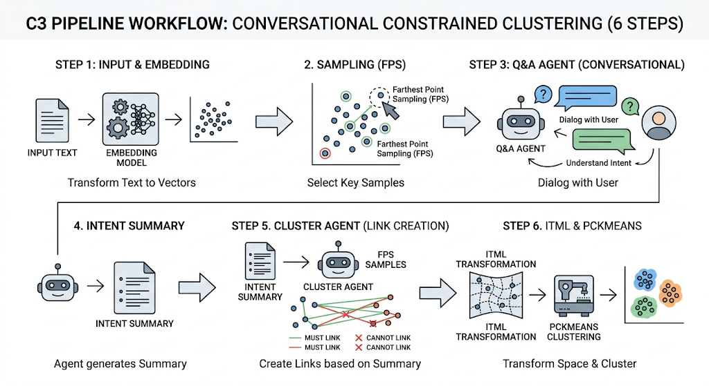

Slide 5
Research Questions
RQ1 (Multi-Aspect Capability): How effectively can C3 cluster the same dataset across different aspects compared to K-Means and LLM methods?
RQ2 (LLM Initial Purity): How accurate are the initial cluster assignments generated by the LLM based on cluster purity?
RQ3 (Sample Efficiency): What is the optimal sample size to balance clustering stability and API token costs?

Slide 6



Evaluation Metrics
NMI (Normalized Mutual Information): Measures the amount of shared information between predicted clusters and true labels (scales from 0 to 1).
ARI (Adjusted Rand Index): Evaluates clustering quality by comparing data point pairs, fully adjusted for random guessing.
ACC (Clustering Accuracy): Uses the Hungarian algorithm to map cluster IDs to true labels and computes the final classification rate.
LLM-as-a-Judge: Employs a powerful language model to qualitatively grade cluster coherence and alignment with user intent.

Slide 7
Datasets
Arxix2S2
{"task": "arxiv_fine", "input": "Caching Placement in Stochastic Wireless Caching Helper Networks:\n Channel Selection Diversity via Caching", "label": "cs.IT"}
{"task": "arxiv_fine", "input": "Efficient Bayesian hierarchical functional data analysis with basis\n function approximations using Gaussian-Wishart processes", "label": "stat.ME"}
Banking77
{"task": "banking77", "input": "What steps do I need to take to exchange currencies?", "label": "exchange via app"}
{"task": "banking77", "input": "How can I alteration my PIN?", "label": "change pin"}
Reddit
{"task": "reddit", "input": "Best M4 for under $250?", "label": "airsoft.txt"}
{"task": "reddit", "input": "A new social media campaign is drawing attention to the number of people in Illinois who say their lives would improve through the use of medical marijuana.", "label": "chicago.txt"}

Slide 8
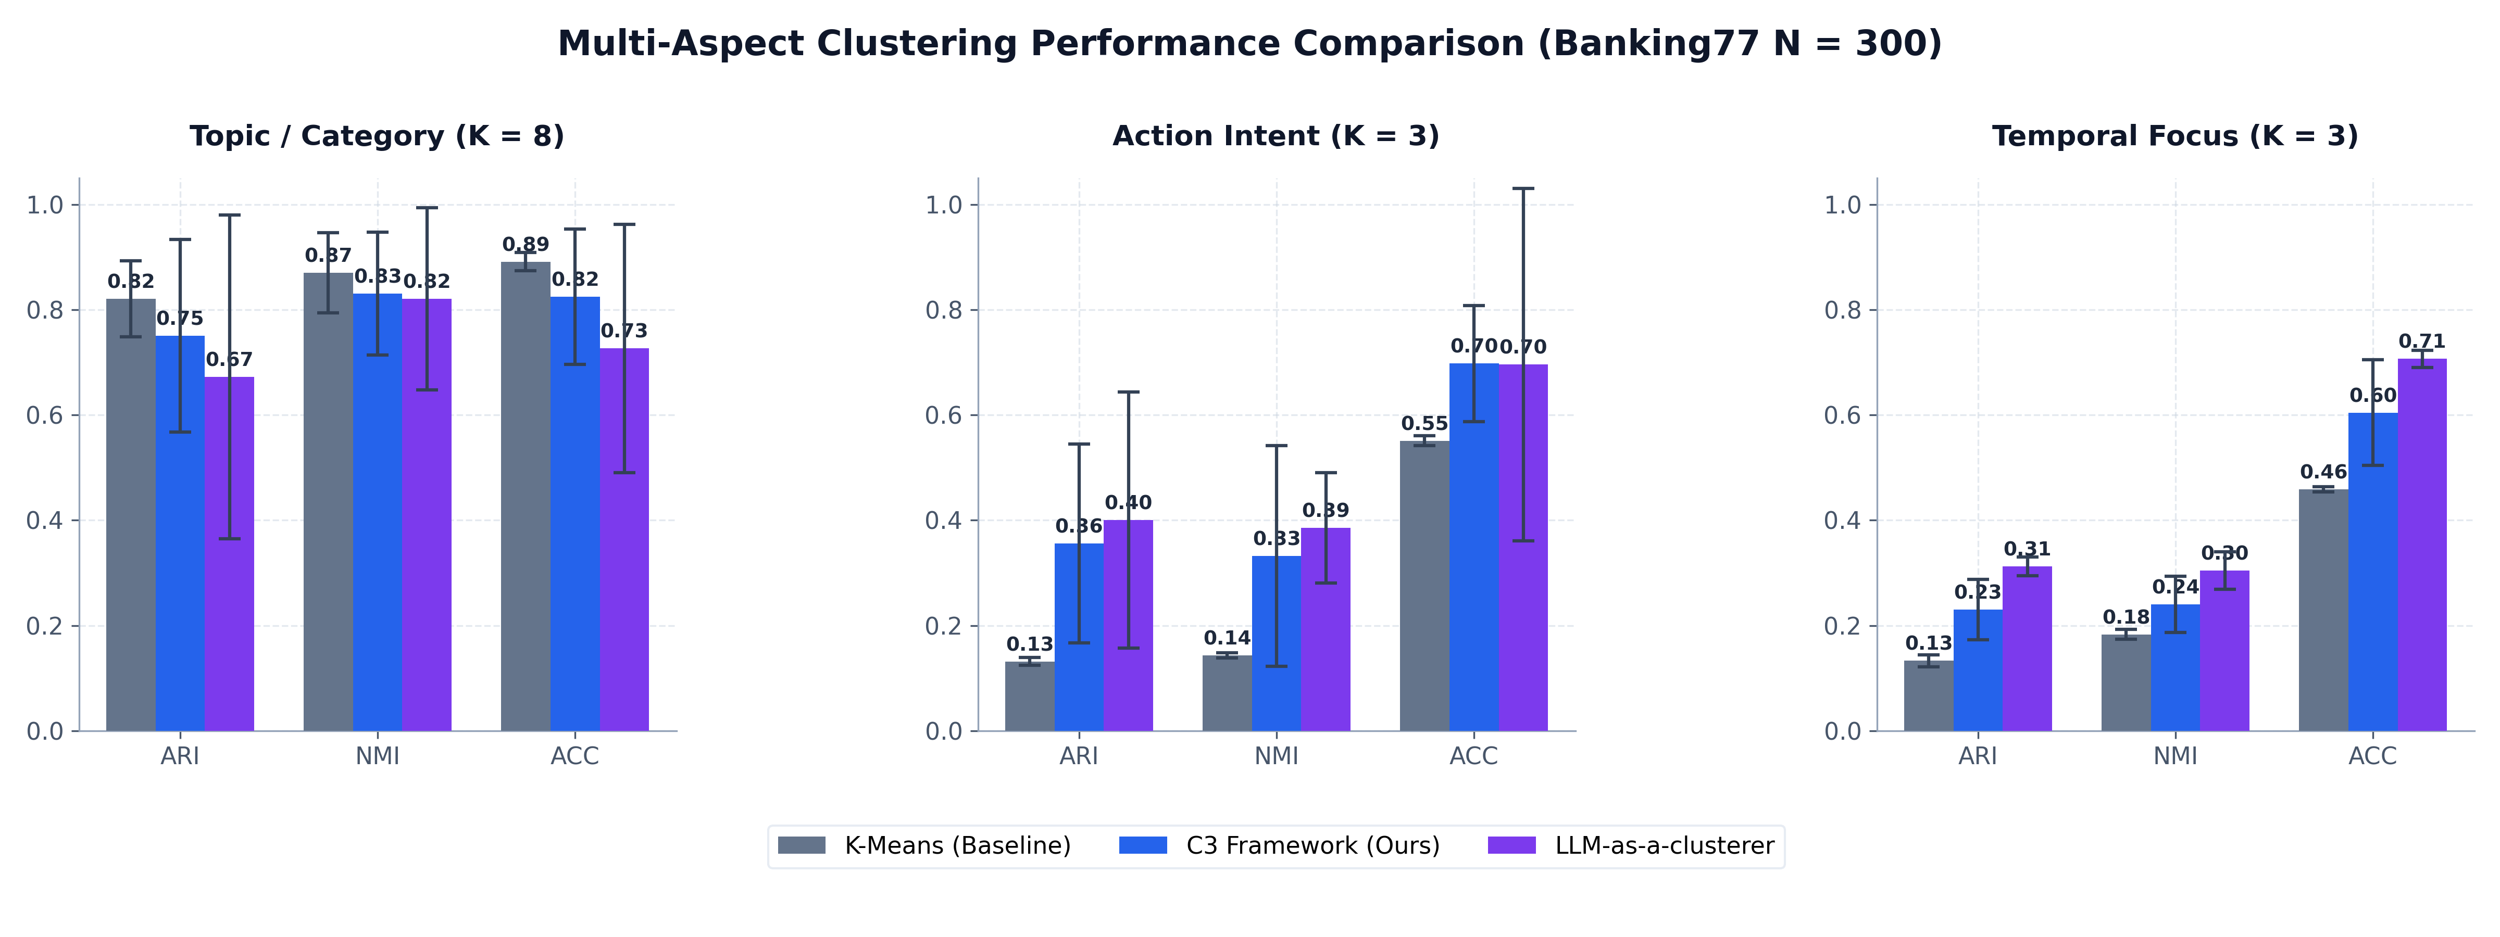
RQ1 (Multi-Aspect Capability): How effectively can C3 cluster the same dataset across different aspects compared to K-Means and LLM methods?

Slide 9
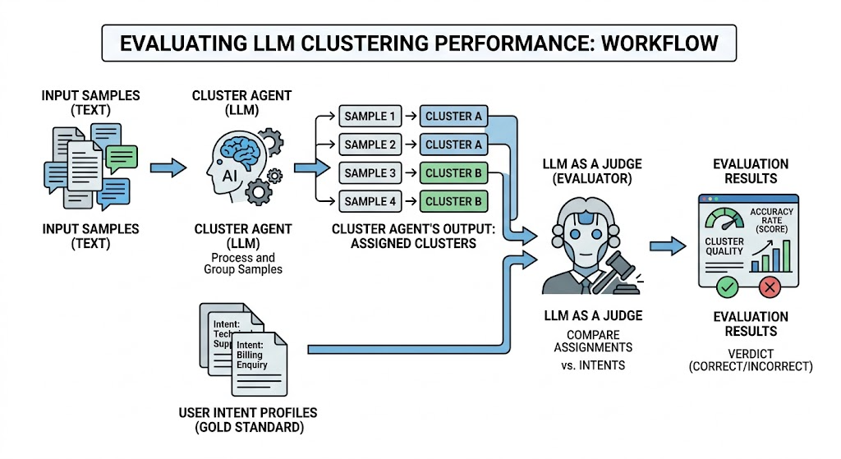
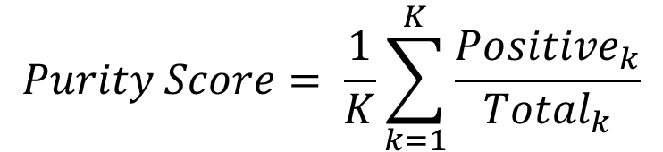
RQ2 (LLM Initial Purity): How accurate are the initial cluster assignments generated by the LLM based on cluster purity?
$$Purity Score= \frac{1}{K}\sum_{k=1}^{K}{\frac{{Positive}_{k}}{{Total}_{k}}}$$

Slide 10
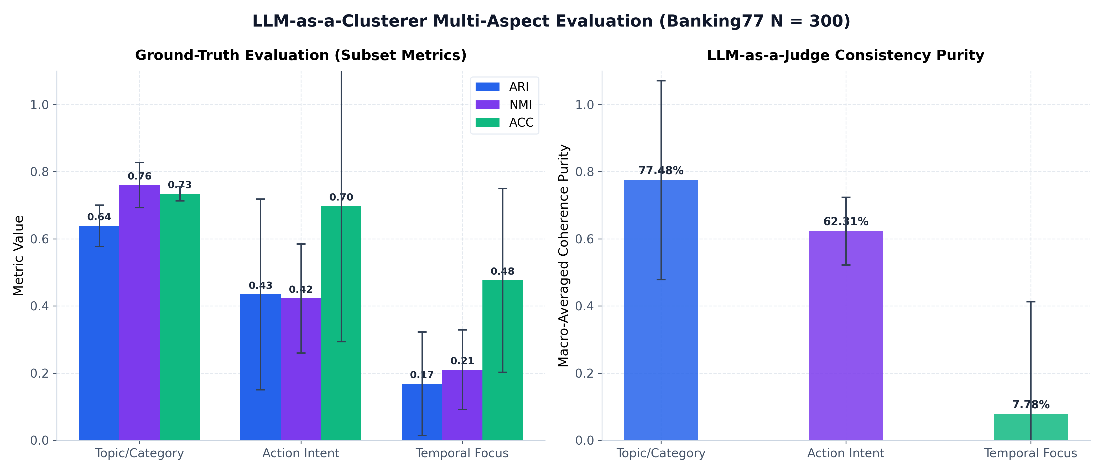
RQ2 (LLM Initial Purity): How accurate are the initial cluster assignments generated by the LLM based on cluster purity?

Slide 11
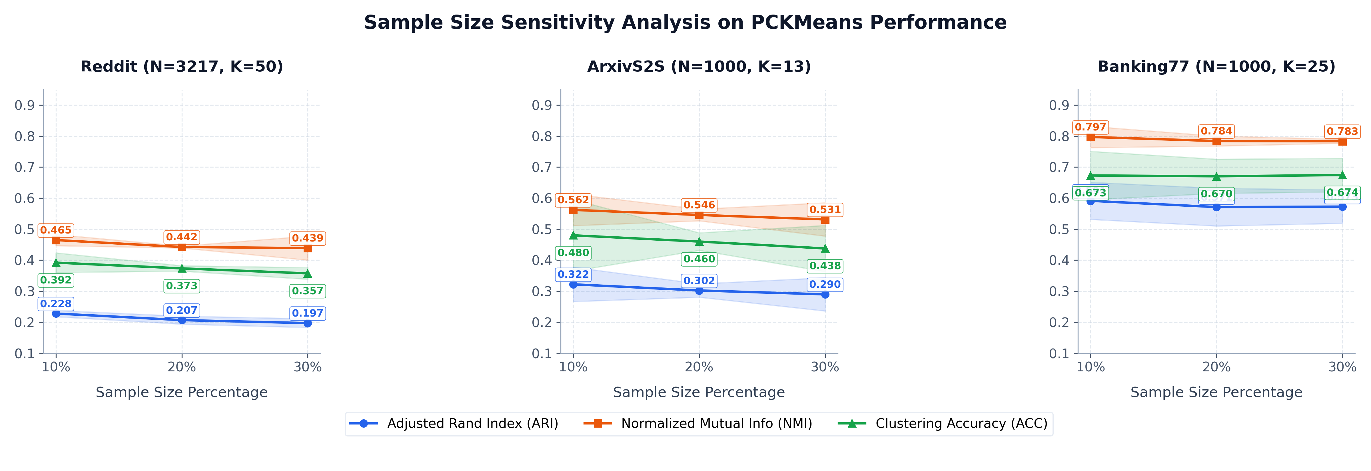
RQ3 (Sample Efficiency): What is the optimal sample size to balance clustering stability and API token costs?

Slide 12
Limitations
Granularity dependency: The system cannot auto-detect the optimal number of clusters and relies on user-provided parameters.
Metric learning latency: ITML runs on the CPU, causing significant time delays when optimizing high-dimensional embedding spaces.
Constraint complexity: Generating too many pairwise constraints increases the computational load for the partition solver.
Embedding sensitivity: System performance is heavily influenced by the initial quality of the chosen embedding model.

Slide 13
Unachieved Research Question
RQ4 (Conversational Efficiency): How many conversational turns does the LLM need to fully extract and lock in the user's clustering intent?
RQ5 (Ablation Study): What is the isolated performance impact of Metric Learning (ITML) versus pure Constrained Clustering (PCK-Means)?
RQ6 (Dynamic Intent Shifting): How robustly can C3 adapt if the user completely changes their clustering aspect mid-conversation?
RQ7 (SOTA Benchmarking): How does C3 perform on full-scale standard datasets compared to state-of-the-art clustering algorithms?

