Slide 1





















$$↖$$
$$↗$$
Detection
Alice
Basis | Bit | Polarization
 | 1
 | 0
 | 1
 | 0
Random channel selection
Waveplate
$$↑$$
$$↑$$
$$→$$
$$→$$
$$↖$$
$$→$$
$$↖$$
$$→$$
$$↑$$
$$↑$$
$$↗$$
$$↗$$
$$↖$$
$$↑$$
$$↖$$
$$↗$$
$$↗$$
Eve
Bob
$$↖$$
Polarizing
Beam Splitter
$$↑$$
Detection
$$→$$

Slide 2
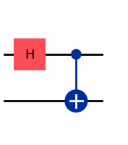
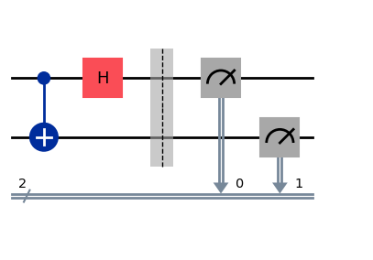


Alice
encodes message
?
$$\left|0\right\rangle$$
Third party creates Bell state
$$\left|0\right\rangle$$
Bob
decodes message

