Slide 1
Comprehensive Capital Analysis and Review (CCAR)
Quan Zhou, Xinru Wang, Jiyuan Ding

Slide 2
What is CCAR?
SCAP(Supervisory Capital Assessment Program)
The beginning, early 2009
19 large BHCs
assessed potential losses and capital shortfalls
CCAR (Comprehensive Capital Analysis and Review)
initiated in late 2010, covered same 19 BHCs
An intensive assessment of the capital adequacy
Federal Reserve supervises BHCs (bank holding companies)
November 2011, all BHCs with total assets more than $50 billion
Notes:
The genesis of current supervisory stress test and CCAR is SCAP dates back to early 2009
when supervisors conducted simultaneous stress tests of the 19 largest U.S. BHCs in the midst of the financial crisis
SCAP assessed potential losses and capital shortfalls at the 19 large BHCs. It used a wide range of inputs, including the BHCs' own estimates, supervisory model outputs, data collected from banks, and supervisory judgment to produce estimates of losses, revenues, and capital levels
The financial crisis of 2007-09 highlighted a number of deficiencies in risk measurement and management practices of large financial institutions. Building on the lessons learned from the SCAP, the Federal Reserve initiated CCAR in late 2010 to assess the capital adequacy and the internal capital planning processes of large, complex BHC
Initially, the CCAR program covered the same 19 BHCs that participated in the SCAP.⁷ In November 2011, the Board of Governors issued a rule that requires all U.S. BHCs with total consolidated assets of $50 billion or more to submit annual capital plans to the Federal Reserve.The capital plan describes the processes used by these BHCs to ensure that they have sufficient capital to continue to serve as a credit intermediaries and to provide key financial services even under very adverse economic and financial market conditions

Slide 3
Functions of CCAR
help Federal Reserve to regulate and supervise
helps promote greater resiliency at the firms
allows Federal Reserve to expand upon its firm-specific supervisory practice
help evaluate BHC’s capitalization and overall financial condition
Notes:
First, it helps Federal Reserve to regulate and supervise the financial institutions
And second, CCAR helps the firms ensure their robustness to a range of unexpected stress events. it insight into each BHC’s capital adequacy process and capital position under stressful conditions, and to ensure that the BHC’s plans for distributing capital back to its shareholders and share repurchases are consistent with the firm’s continued financial health under those conditions
CCAR also allows the Federal Reserve to expand upon its firm-specific supervisory practices by undertaking a simultaneous, horizontal assessment (of capital adequacy and capital planning processes at the largest U.S. BHCs. )
Information gathered through the CCAR assessment also serves as a key input into evaluations of a BHC’s capitalization and overall financial condition.

Slide 4
Step 1: Submission of a capital plan
An assessment of capital use/source over the planning horizon (9 quarters)
Projected revenue, losses, reserves, capital level, capital ratios
How companies will maintain regulatory ratios
Stress test results
Planned capital actions
A description of the Capital Adequacy Process (CAP)
The BHC’s capital policy
Discussion of baseline changes to business plan
Notes:
At the October of each year, the Feds will issue instruction for BHCs to do capital reviews of the upcoming 9 quarters. The reviews requires BHCs to submit their capital plan and supporting documents through a secured system. The due date is Jan 5th. The results are then published by March
#planned capital actions: dividend, share repurchase
#capital planning: The process of budgeting resources for the future of an organization's long term plans. Capital planning for a business would include budgeting for new and replacement machinery, research and development and the production of new products
#capital policy:a capital policy is the principles and guidelines used by a BHC for capital planning, capital issuance, and usage and distributions. It should be a distinct, comprehensive written document that addresses the major components of the BHC's capital planning processes and links to and is supported by other policies (risk-management, stress testing, model governance, audit, and others).

Slide 5
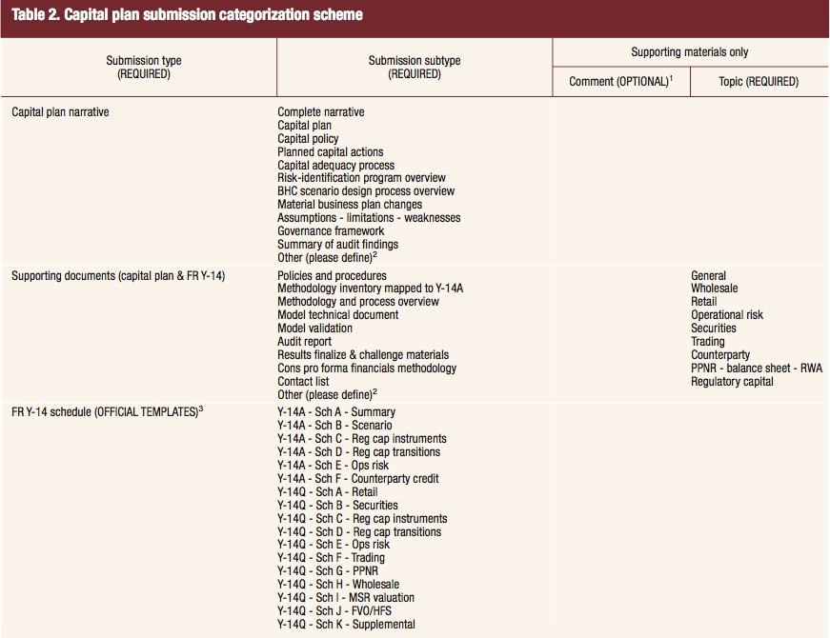
What to submit

Slide 6
What’s in the stress tests
Three supervisory stress test scenarios
Baseline
Adverse
Global market shock
Counterparty default scenario
Severely Adverse
At least one BHC stress scenario
Baseline
Adverse

Slide 7
Step 2: full review
Qualitative review of planning process by the Feds.
Involves a large number of experts.
Quantitative review of capital adequacy.
Stress test run by the Feds
Notes:
#Capital Adequacy Process: institution's internal process for assessing its capital adequacy. Sound foundational risk management. Effective loss-estimation methodologies.Solid resource-estimation methodologies . Sufcient capital adequacy impact assessment. Comprehensive capital policy and capital planning . Robust internal control. Effective governance

Slide 8
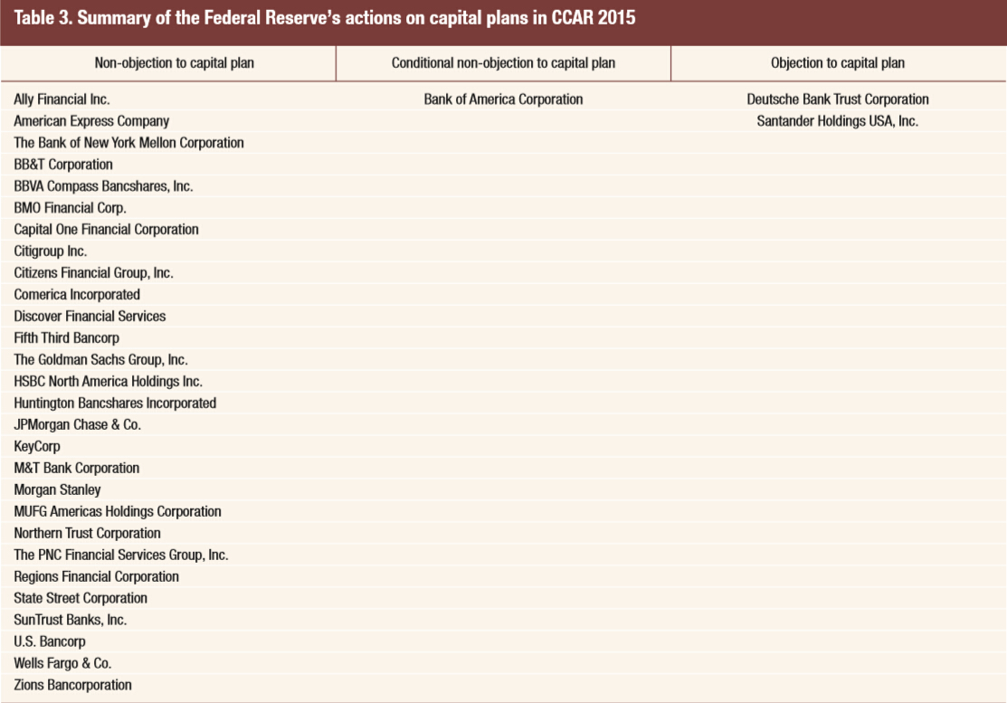
Qualitative Results of CCAR
CCAR 2015
Non-objection
28 companies
Objection
2 companies
Deutsche Bank Trust Corporation
Santander Holdings USA, Inc.
Conditional non-objection
1 company
Bank of America Corporation
Notes:
In CCAR, the qualitative results were given by a group of experts. There are three types. Non-objection, which means capital plans of these companies are good and they can execute their plans. In this year, 28 companies out of 31 got non-objection result. On the opposite, Deutsche Bank Trust Corporation and Santander Holdings were unlucky. They got objection results. This means they need to modify their capital plans and may only make capital distributions that are expressly permitted by the Federal Reserve until their new capital plans meet Fed’s requirement. The reason for objections were given in the report. For example, for Deutsche Bank Trust Corporation, the Federal Reserve said they identified numerous and significant deficiencies across Deutsche Bank Trust Corporation’s risk-identification, measurement, and aggregation processes; approaches to loss and revenue projection; and internal controls. Based on these reasons, the Fed gave them an objection. Note there is also a conditional non-objection, Bank of America Corporation. This one looks a little bit vague. This was because its capital plan had some deficiencies but they were not serious enough to undermine the quantitative results. For conditional non-objection companies, they can use their new plans to do capital distribution, but they have to resubmit a new plan by September, if their new plan does not satisfactorily address the identified weaknesses by that time, they will still get an objection and have some restrictions on capital distribution.

Slide 9
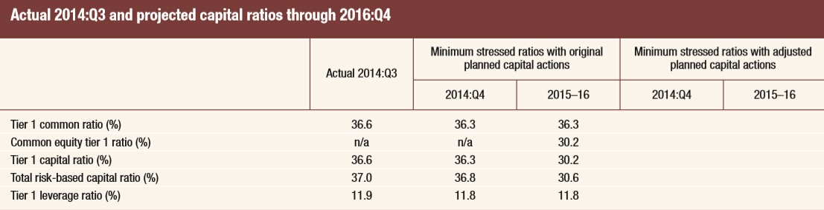
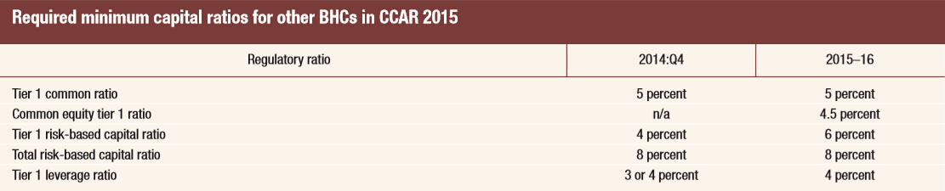
Quantitative Results of CCAR
Adverse Scenario (Severely adverse scenario)
Requirements(based on Basel III)
Notes:
Apart from qualitative result, the Fed also runs stress test to do quantitative assessment. For each company, CCAR lists detailed data on how its capital plan performed during stress tests. Here is the result of Deutsche Bank Trust Corporation under adverse scenario and the table at the bottom shows the required minimum capital ratio based on Basel Three. Here is a more intuitive view of these numbers. As we can see, all values of Deutsche Bank Trust Corporation beat the minimum requirement. In fact, this year, all companies passed the quantitative assessment. For the companies, they need to pass both qualitative and quantitative assessment to execute their capital plans.

Slide 10
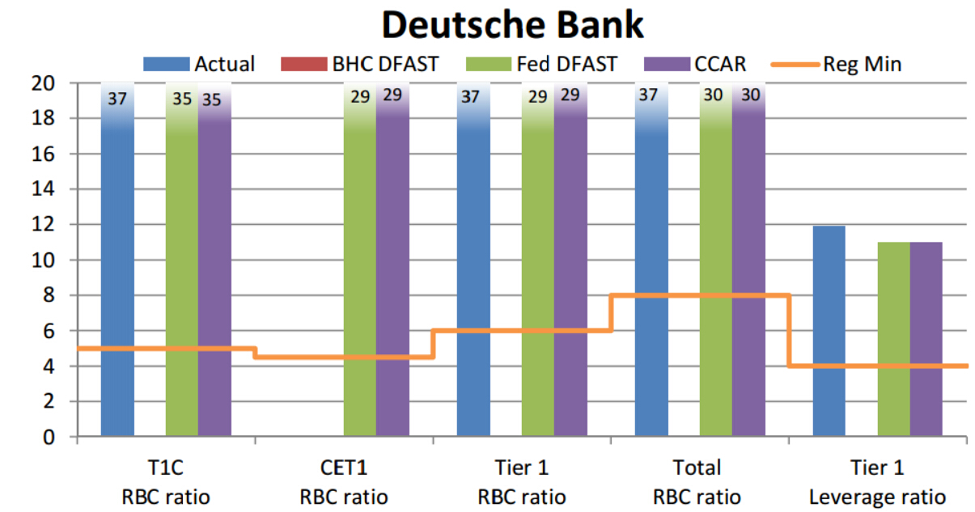
Quantitative Results of CCAR
Notes:
Apart from qualitative result, the Fed also runs stress test to do quantitative assessment. For each company, CCAR lists detailed data on how its capital plan performed during stress tests. Here is the result of Deutsche Bank Trust Corporation under adverse scenario and the table at the bottom shows the required minimum capital ratio based on Basel Three. Here is a more intuitive view of these numbers. As we can see, all values of Deutsche Bank Trust Corporation beat the minimum requirement. In fact, this year, all companies passed the quantitative assessment. For the companies, they need to pass both qualitative and quantitative assessment to execute their capital plans.

Slide 11
What we can learn from CCAR
A general idea on how BHCs’ capital plans would perform during crisis
No amount of capital can make up for deficient processes
Large banks see little downside to taking the “mulligan””
Proving comprehensive risk identification will be one of the biggest challenges for CCAR 2016
Notes:
And for the public, for us, here is some information we can learn from CCAR. First of all, the report gives us a general idea how these companies would react in an adverse scenario or severely adverse scenario. Whether they could maintain their capital at a safe level during crisis.
Another thing we can learn from CCAR is no amount of capital can make up for deficient processes. Large capital amount can bring some benefits but can not help the company avoid certain problems. In objecting to the capital plans, the Fed cited foundational risk management issues such as risk identification and modeling quality. So, risk management is crucial.
Also, three of the largest US BHCs, Goldman Sachs, JPMorgan, Morgan Stanley, adjusted their planned capital distributions downward after submission. (**) They did this after receiving DFAST results which indicated their initial plans distributed too much capital. DFAST results were released between the submission time and results release time of CCAR. The use of this “mulligan” is increasingly being taken as an attempt to pay out more to shareholders. However, the Fed may dislike this development because this is considered as a sign of weak capital planning capabilities.
The last thing I want to mention is this year’s CCAR has a new expectation for the required banks to prove, rather than simply describe, the comprehensiveness of their risk identification process and its linkage to capital planning and scenario generation. Given the experienced challenges in doing so this year, this area is expected to be an important focus for CCAR next year.

Slide 12
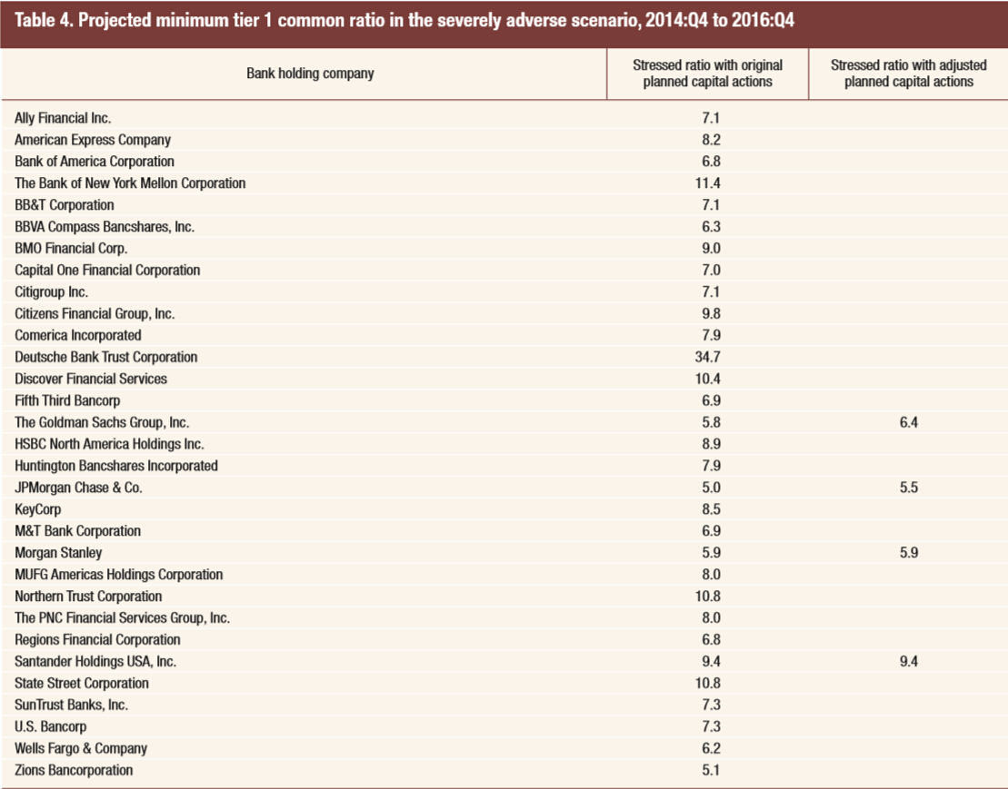
GS
5.8
6.4
JPMorgan
5.0
5.5
MS
5.9
5.9

Slide 13
CCAR and Other Regulations
Dodd-Frank Act
CCAR
DFAST
Basel III
Notes:
About the connection between CCAR and other regulations, the quantitative part of CCAR and DFAST are similar, but they use different method to evaluate BHCs. And CCAR also has qualitative assessment, which makes it more than a stress test. Basel Three gives the requirements of minimum capital ratios for stress test.

Slide 14
References
http://riskarticles.com/wp-content/uploads/2013/06/An-Introduction-to-CCAR.pdf
http://corpgov.law.harvard.edu/2015/03/22/key-points-from-the-2015-comprehensive-capital-analysis-and-review-ccar/
http://libertystreeteconomics.newyorkfed.org/2012/07/ccar-more-than-a-stress-test.html#.Vf_wJ7Fei-o
http://www.federalreserve.gov/newsevents/press/bcreg/bcreg20150311a1.pdf
https://www.federalregister.gov/articles/2014/10/27/2014-25170/capital-plan-and-stress-test-rules
http://www.federalreserve.gov/bankinforeg/ccar-and-stress-testing-as-complementary-supervisory-tools.htm
http://www.federalreserve.gov/newsevents/press/bcreg/bcreg20111122d1.pdf
http://www.federalreserve.gov/bankinforeg/bcreg20130819a1.pdf
http://blog.usbasel3.com/wp-content/uploads/2015/03/52433154v3-2015-DFAST-and-CCAR-Results-DPW-Visuals-2015.03.12.pdf

