Slide 1
CSE6230 Final Project
Topic2:
2D Jacobi Schwarz with MPI RMA and multiple threads in MKL
Quan Zhou
11/28/2016

Slide 2
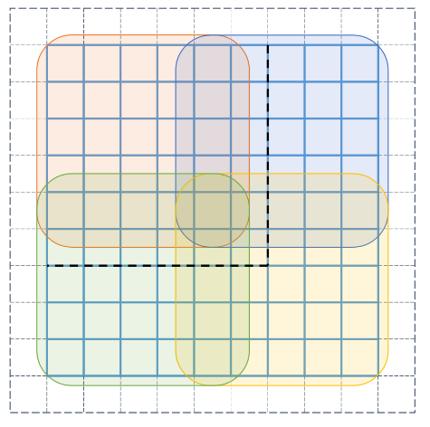
Quick Review
Grow the subdomain by k rows/columns
Each subdomain only stores its local values
Read expanded area from where it’s originally stored

Slide 3
Work Flow
Generate random initial guess
Write to local buffer
Lock
Get data from
L/R/T/B
Unlock
Solve Local Linear System with MKL
Converge?
Solution
No
Yes

Slide 4
Shared Data
In each process, 4 windows are available for remote access separately
One process only reads from one window
k
k
2
1
3
4

Slide 5
Performance
Gotham mic4 / 100 x 100 grid / 10 x 6 processes / 500 iterations
1 thread per process

Slide 6
Performance
Gotham mic4 / 100 x 100 grid / 10 x 6 processes / 500 iterations

Slide 7
Further improvement
Optimize space complexity
Eliminate unnecessary buffers
Analyze runtime and find the bottleneck

