Slide 1

Notes:
slide

Slide 2
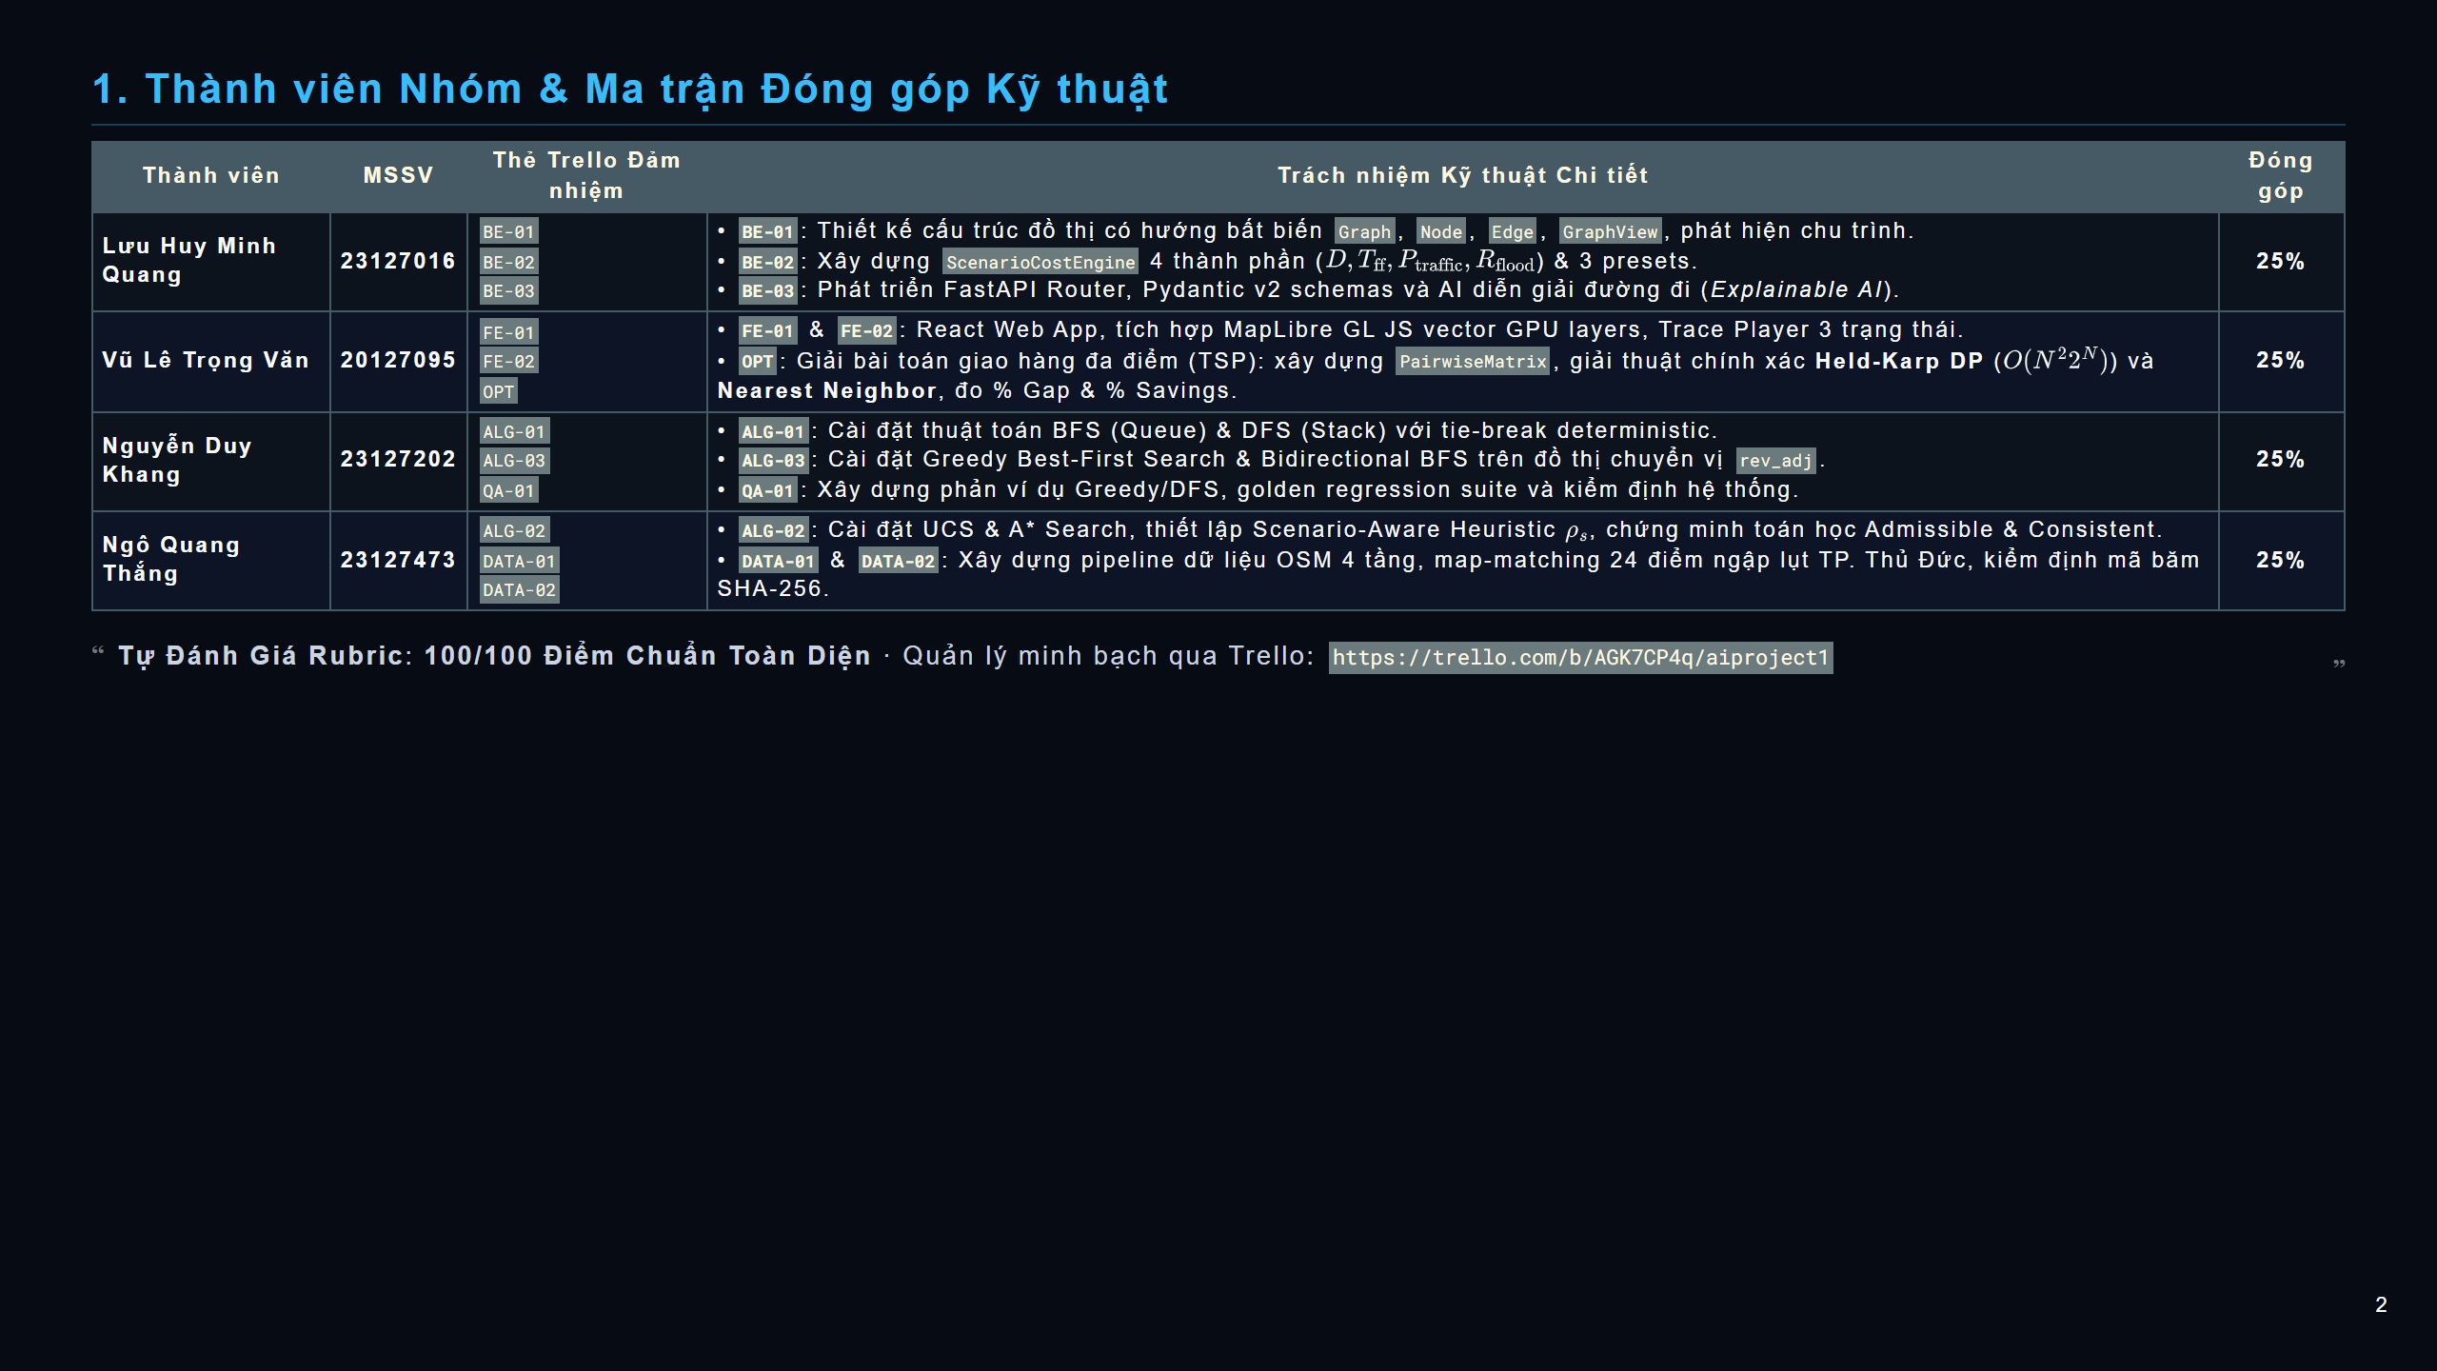
Notes:
slide

Slide 3
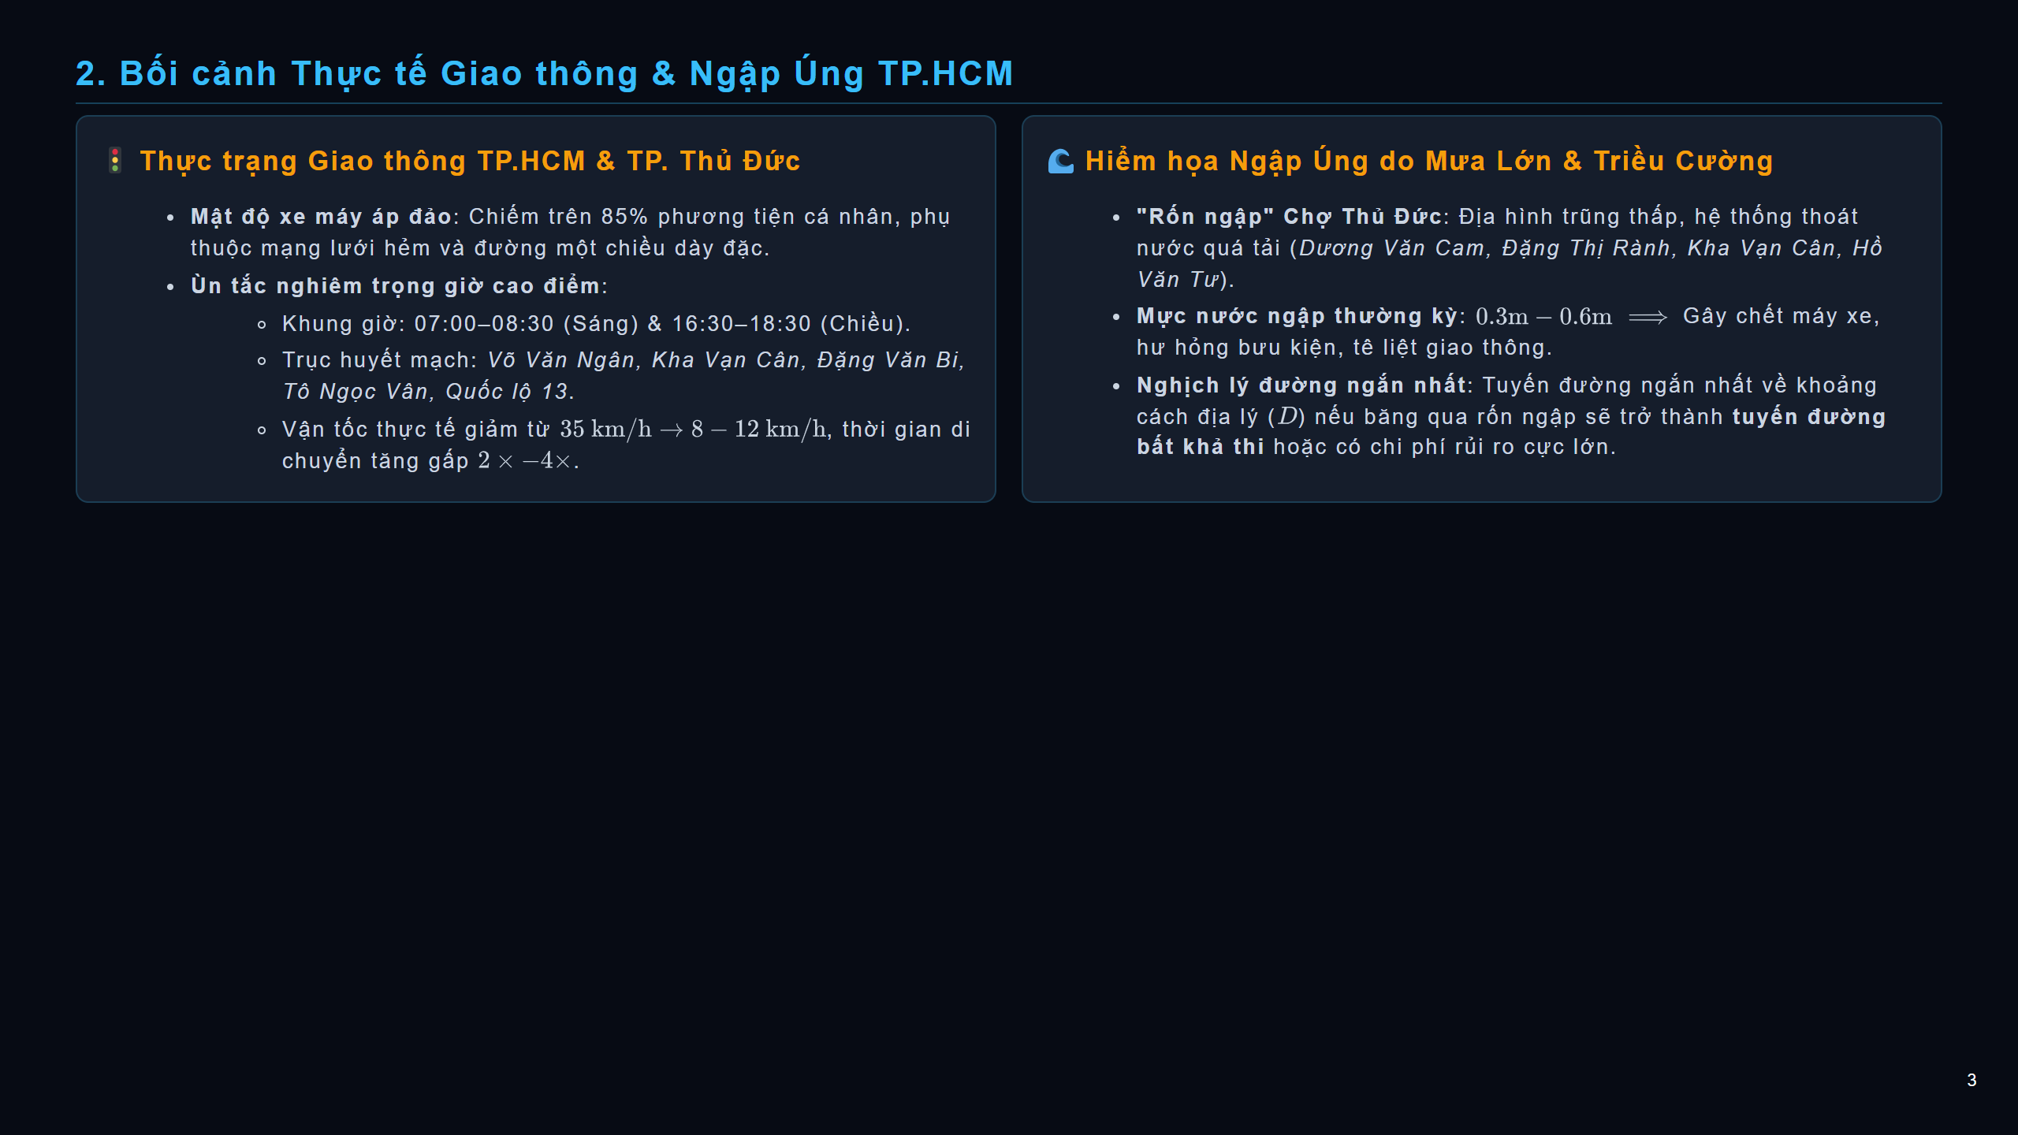
Notes:
slide

Slide 4
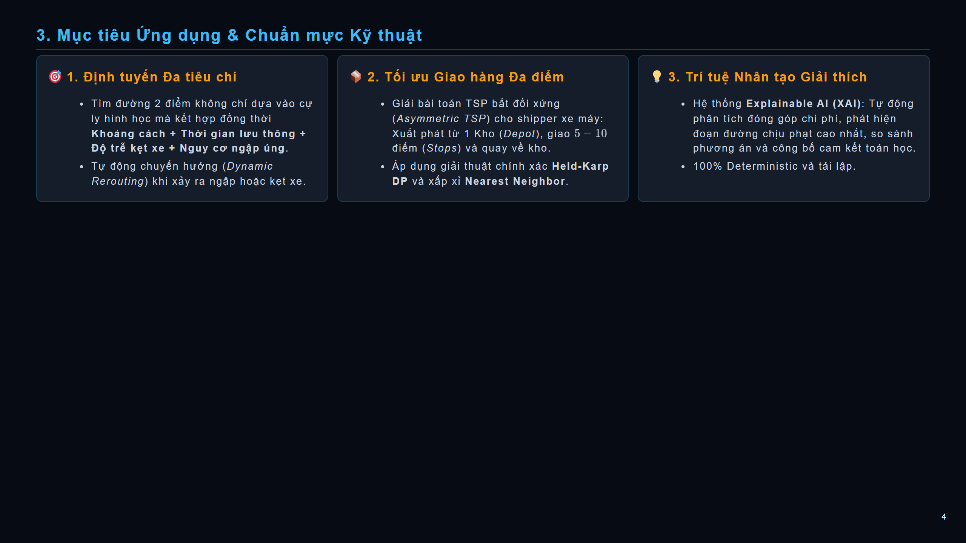
Notes:
slide

Slide 5
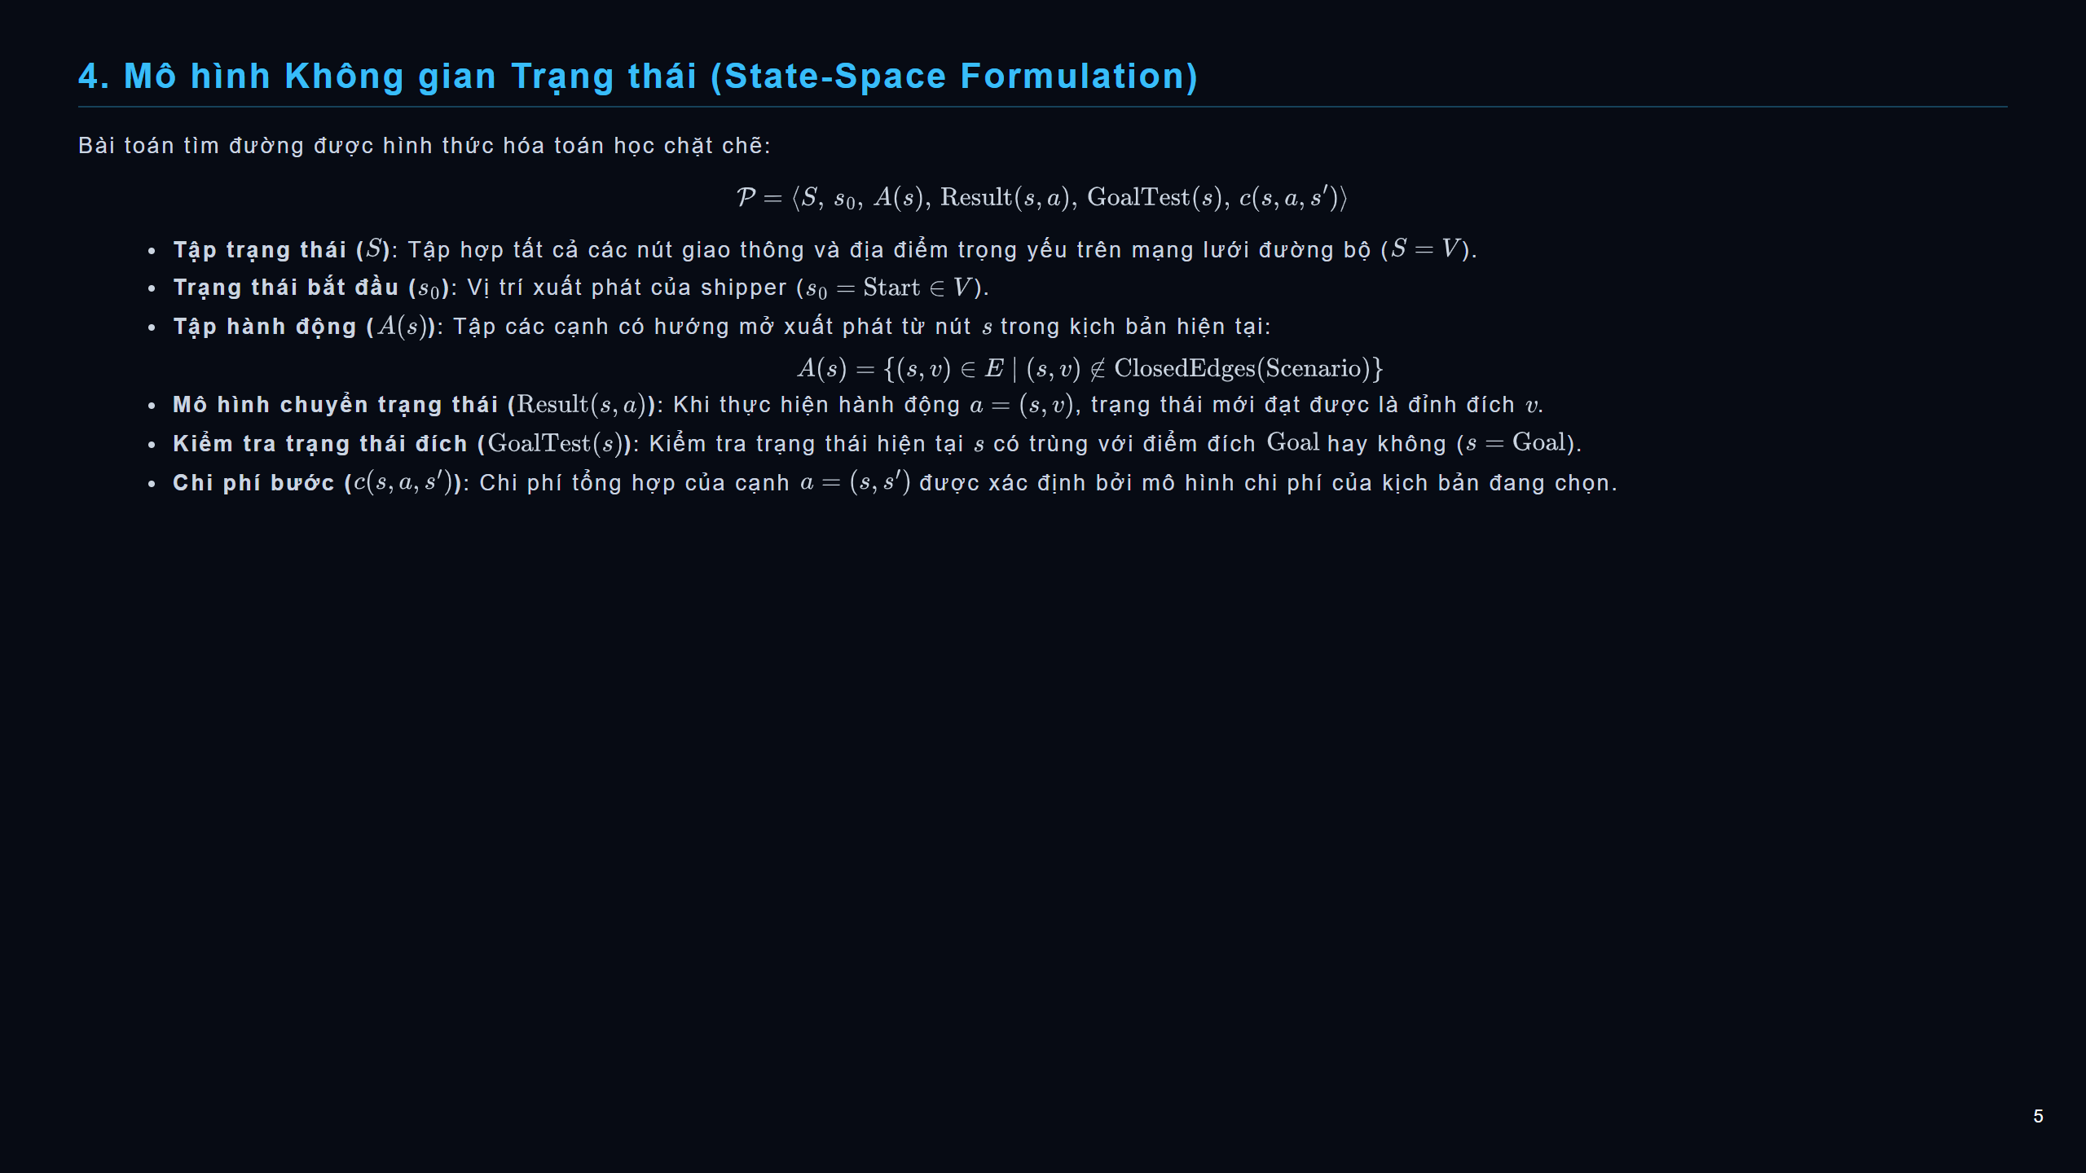
Notes:
slide

Slide 6
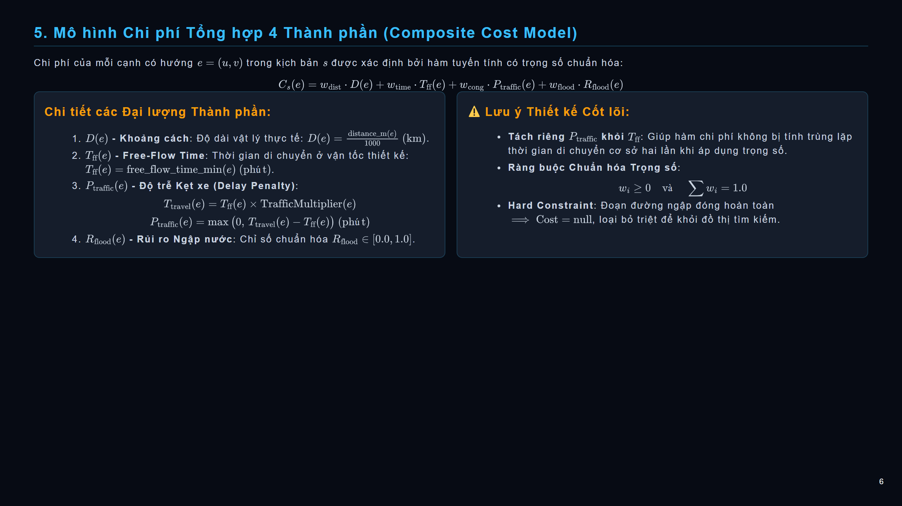
Notes:
slide

Slide 7
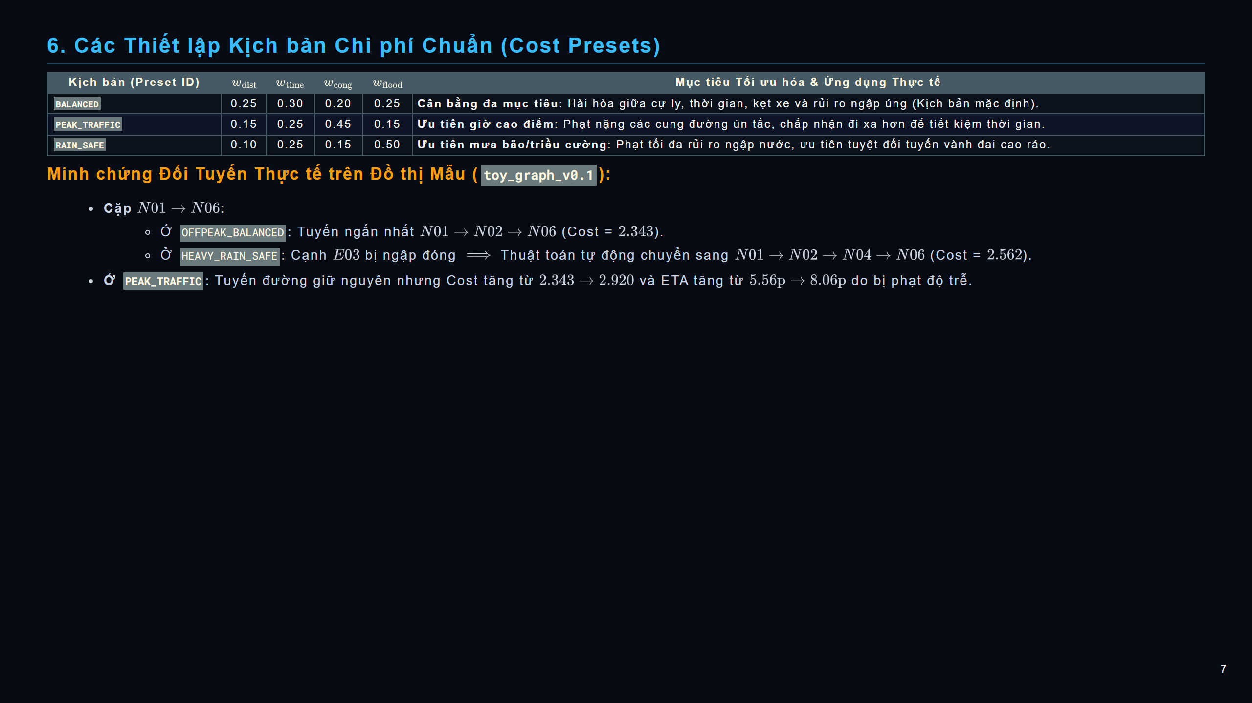
Notes:
slide

Slide 8
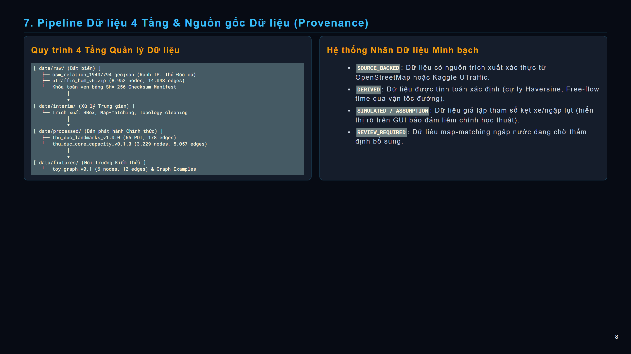
Notes:
slide

Slide 9
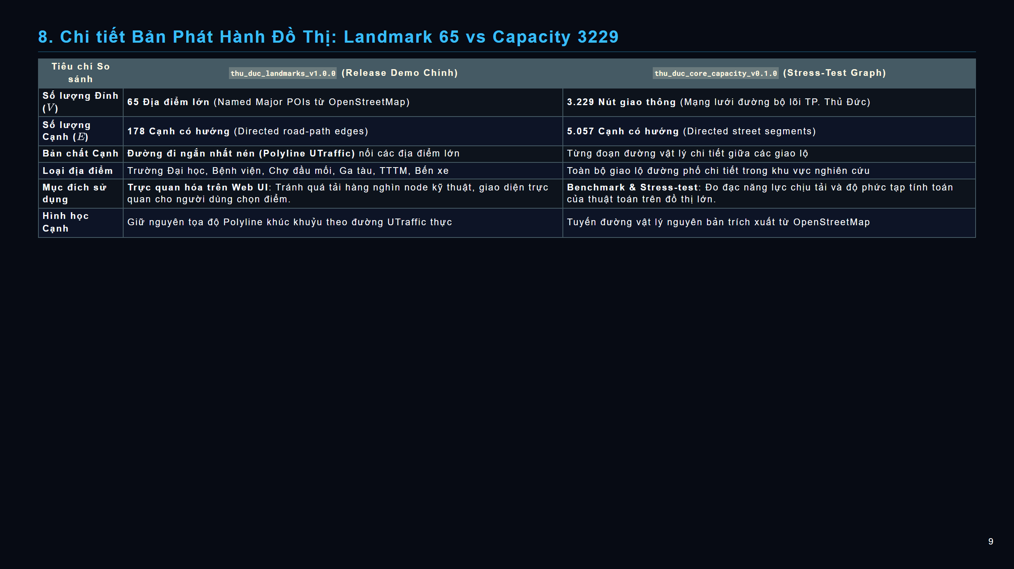
Notes:
slide

Slide 10

Notes:
slide

Slide 11
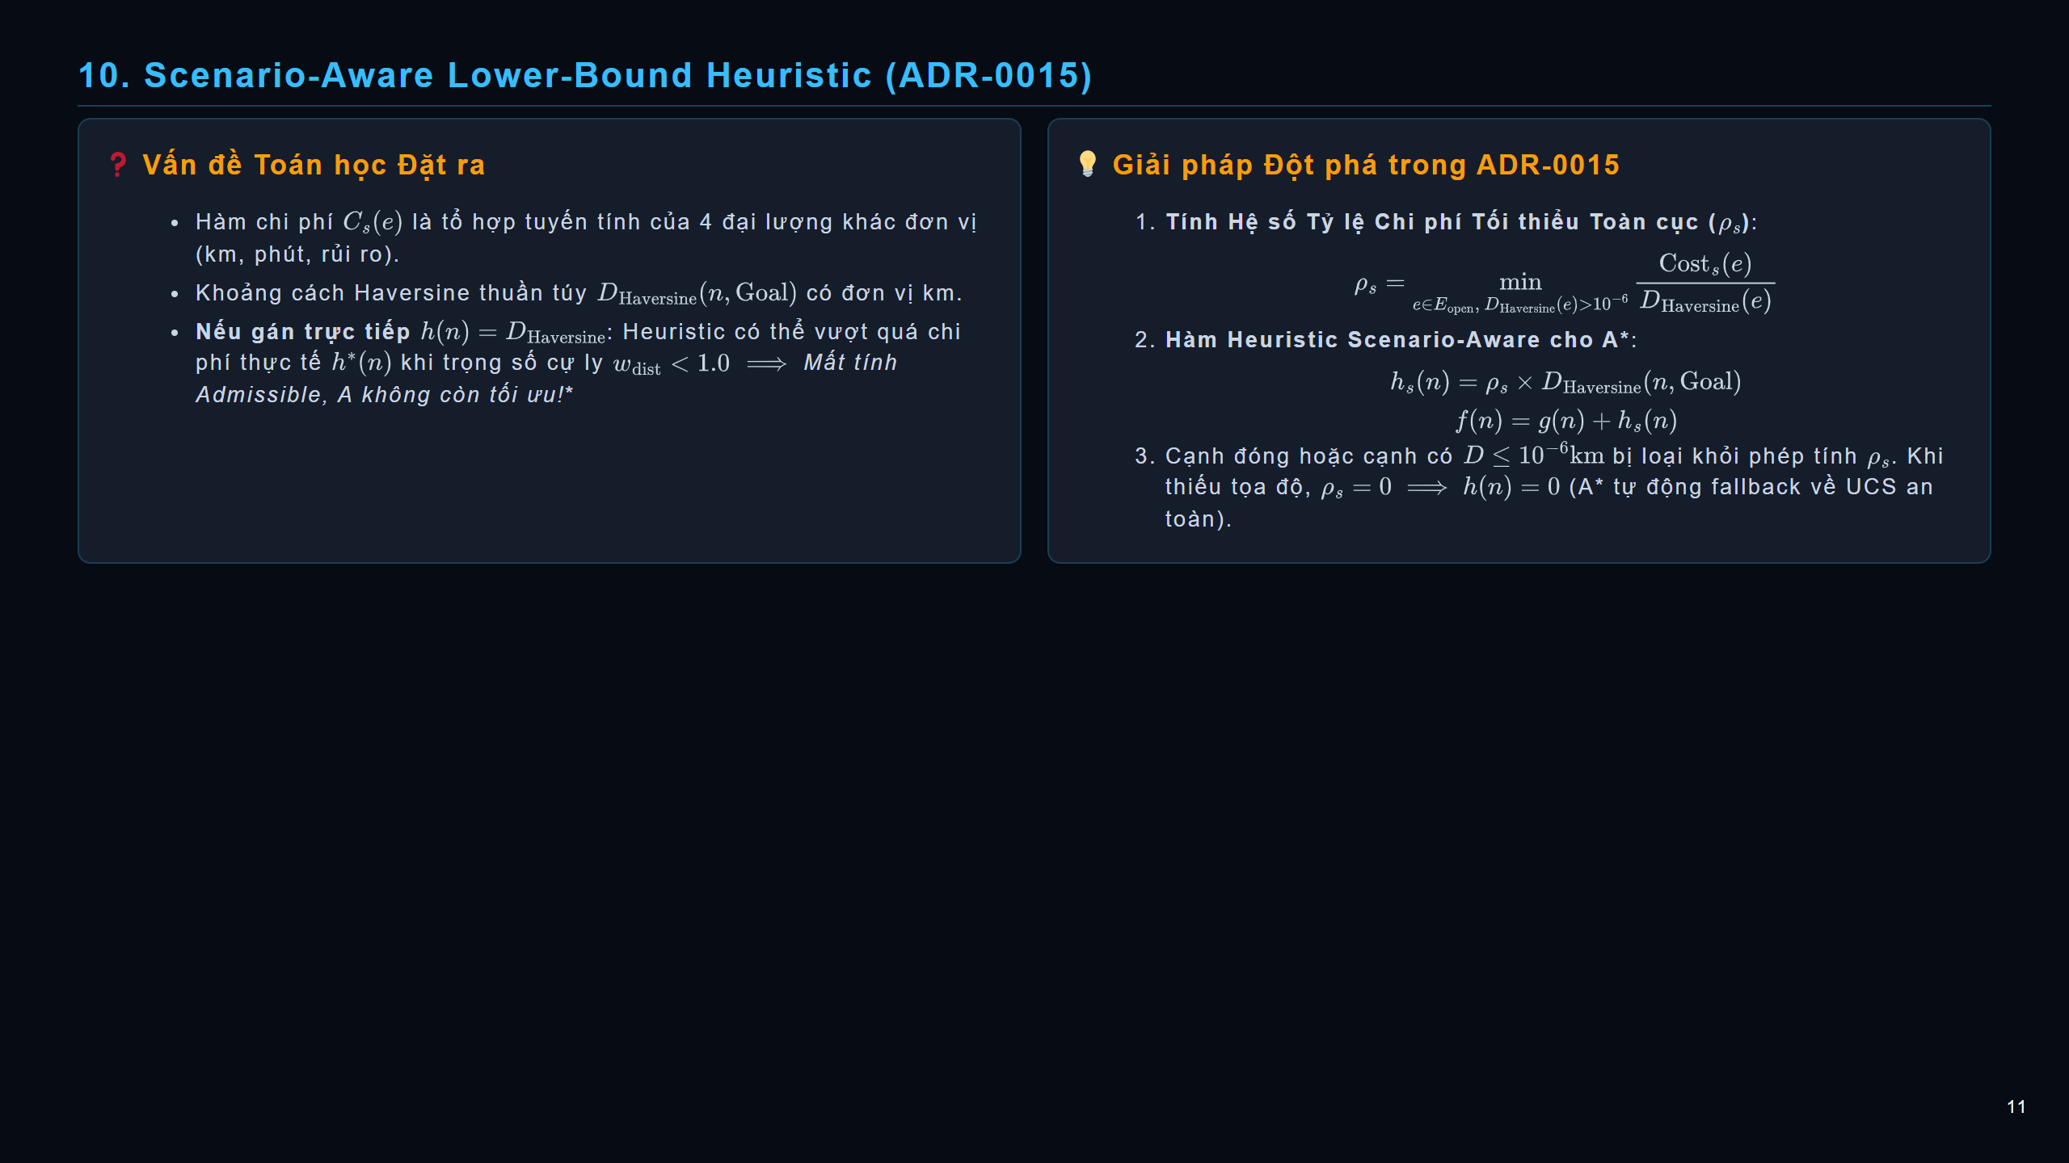
Notes:
slide

Slide 12
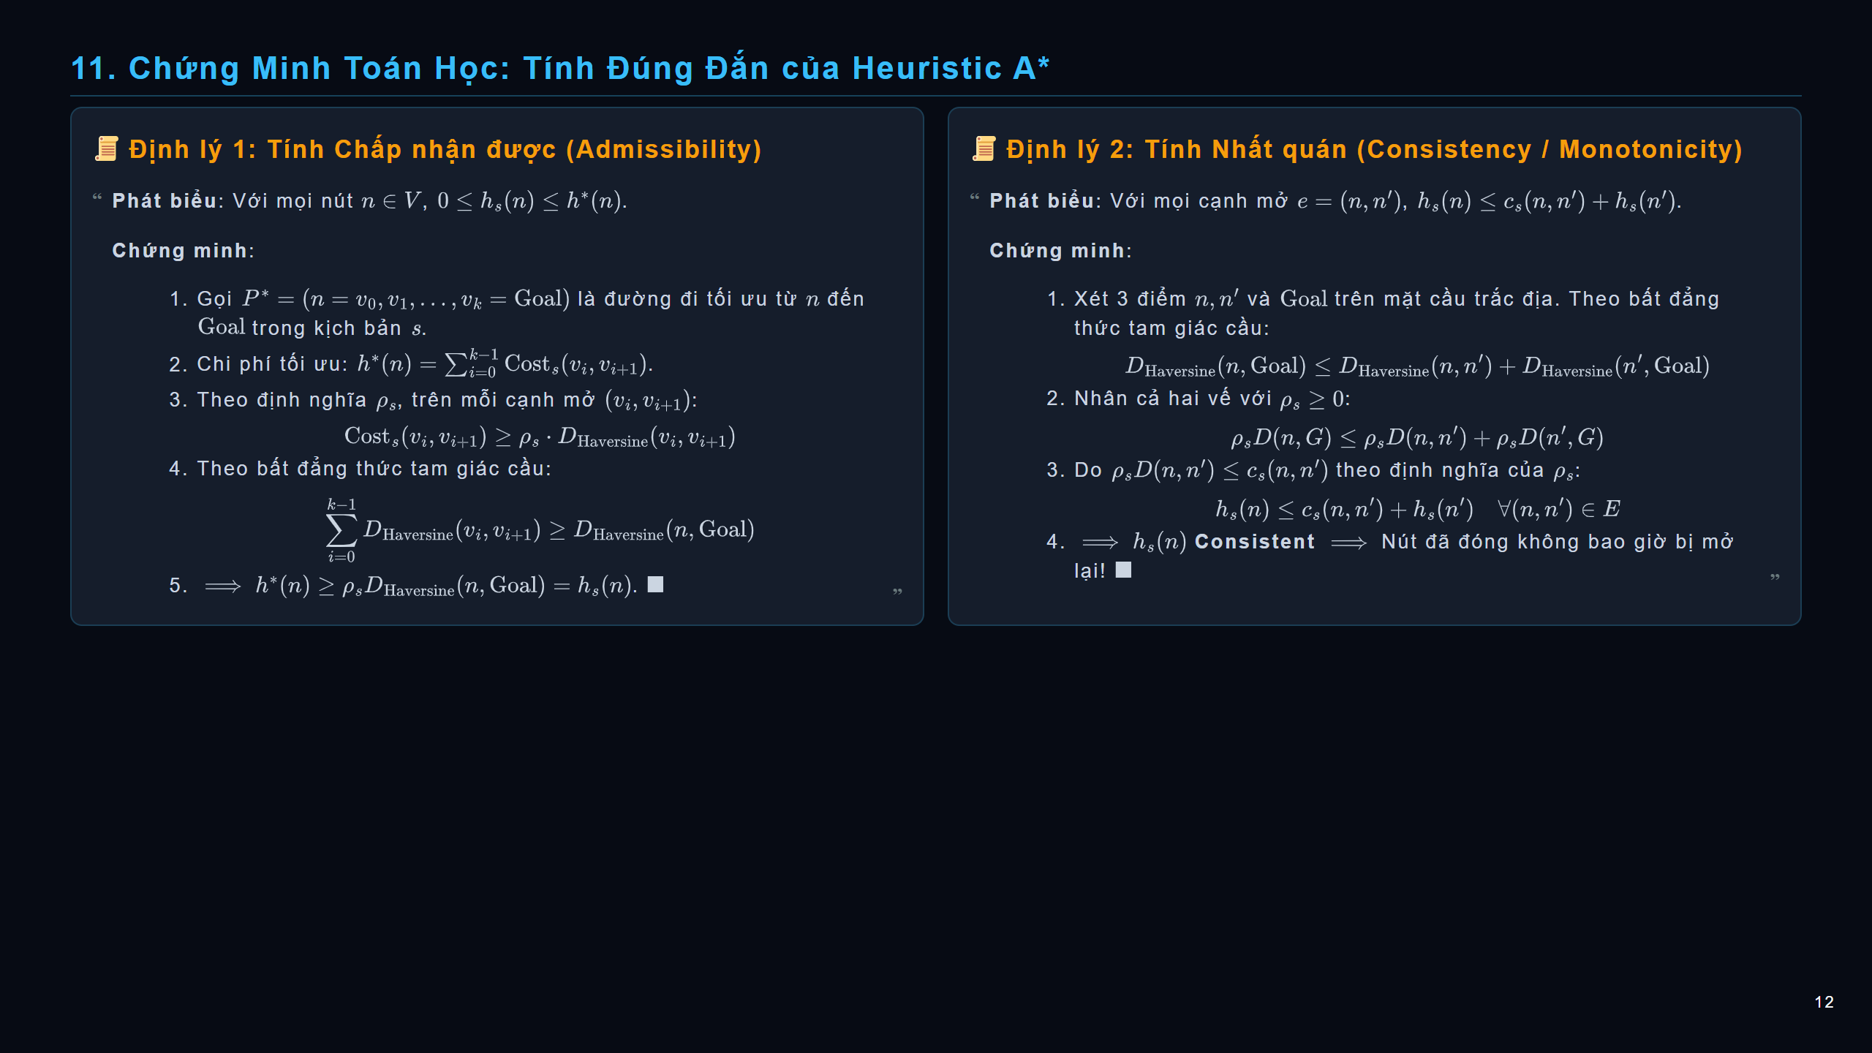
Notes:
slide

Slide 13
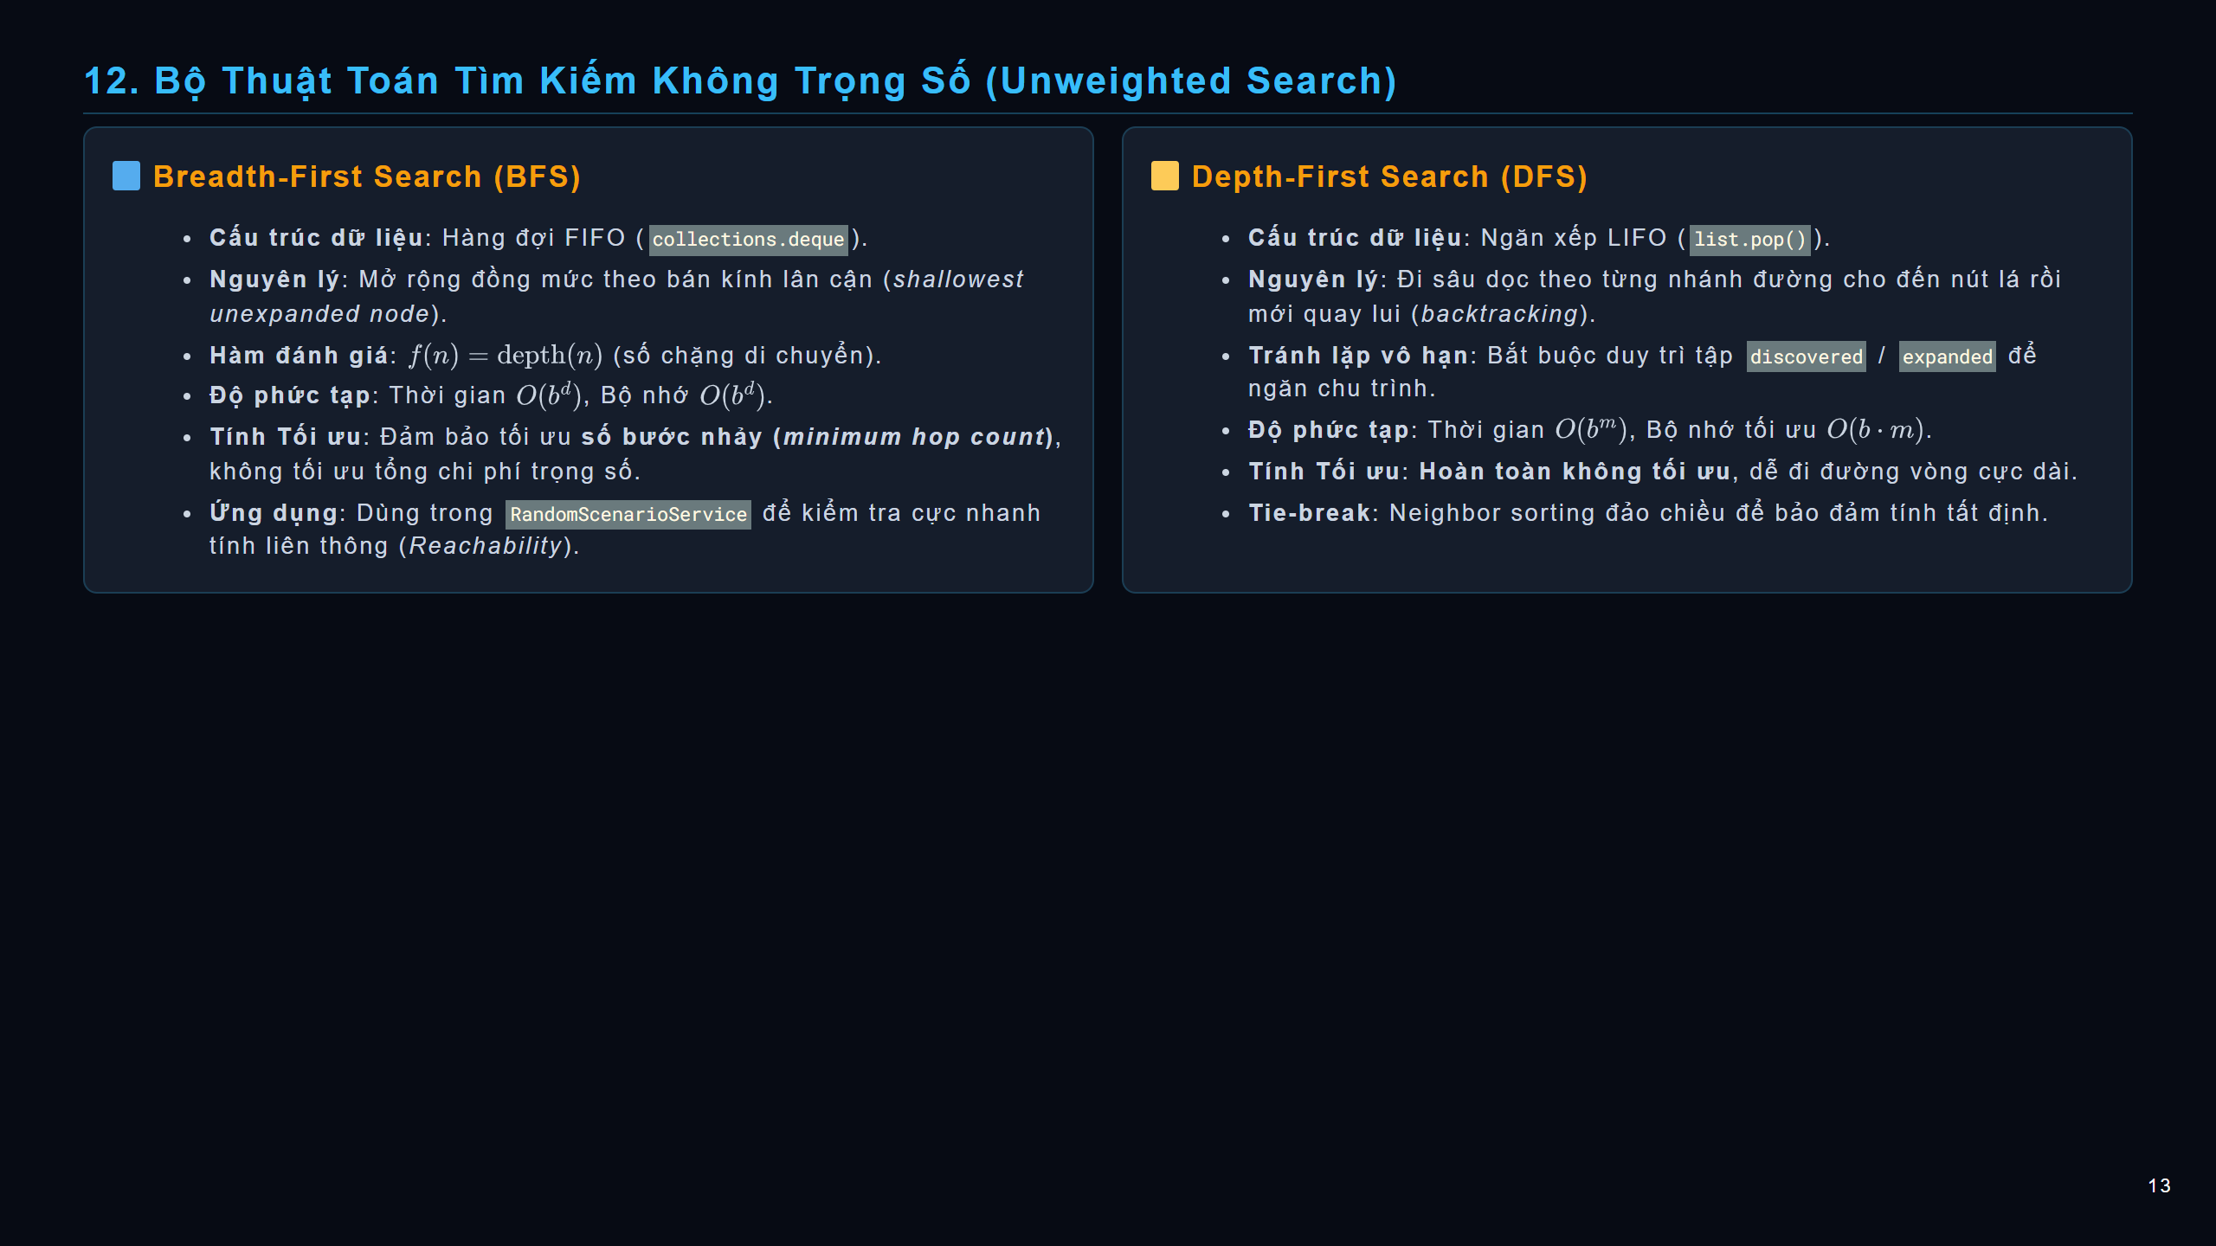
Notes:
slide

Slide 14
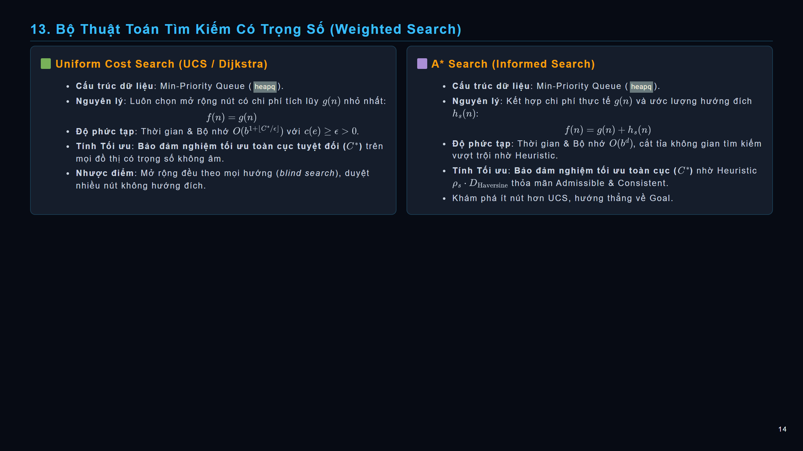
Notes:
slide

Slide 15
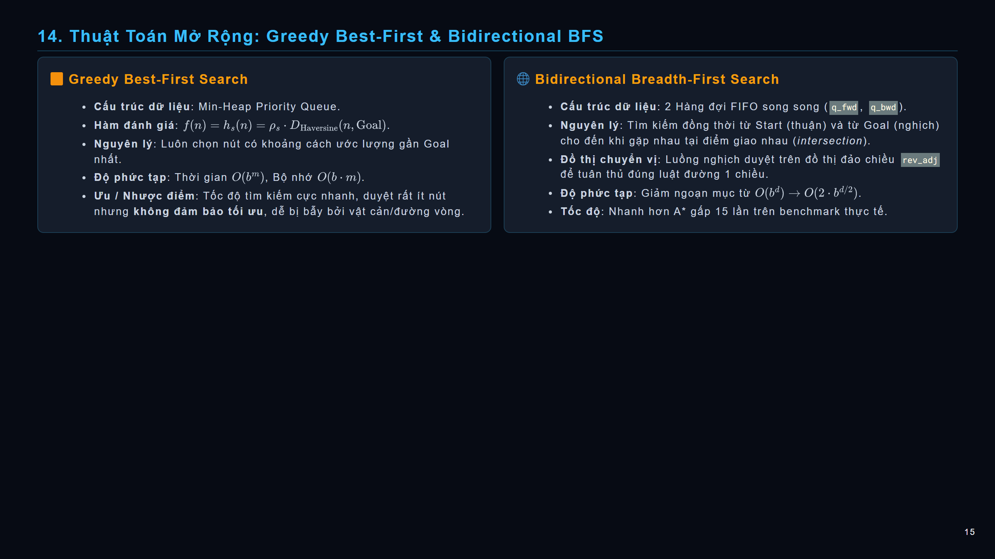
Notes:
slide

Slide 16
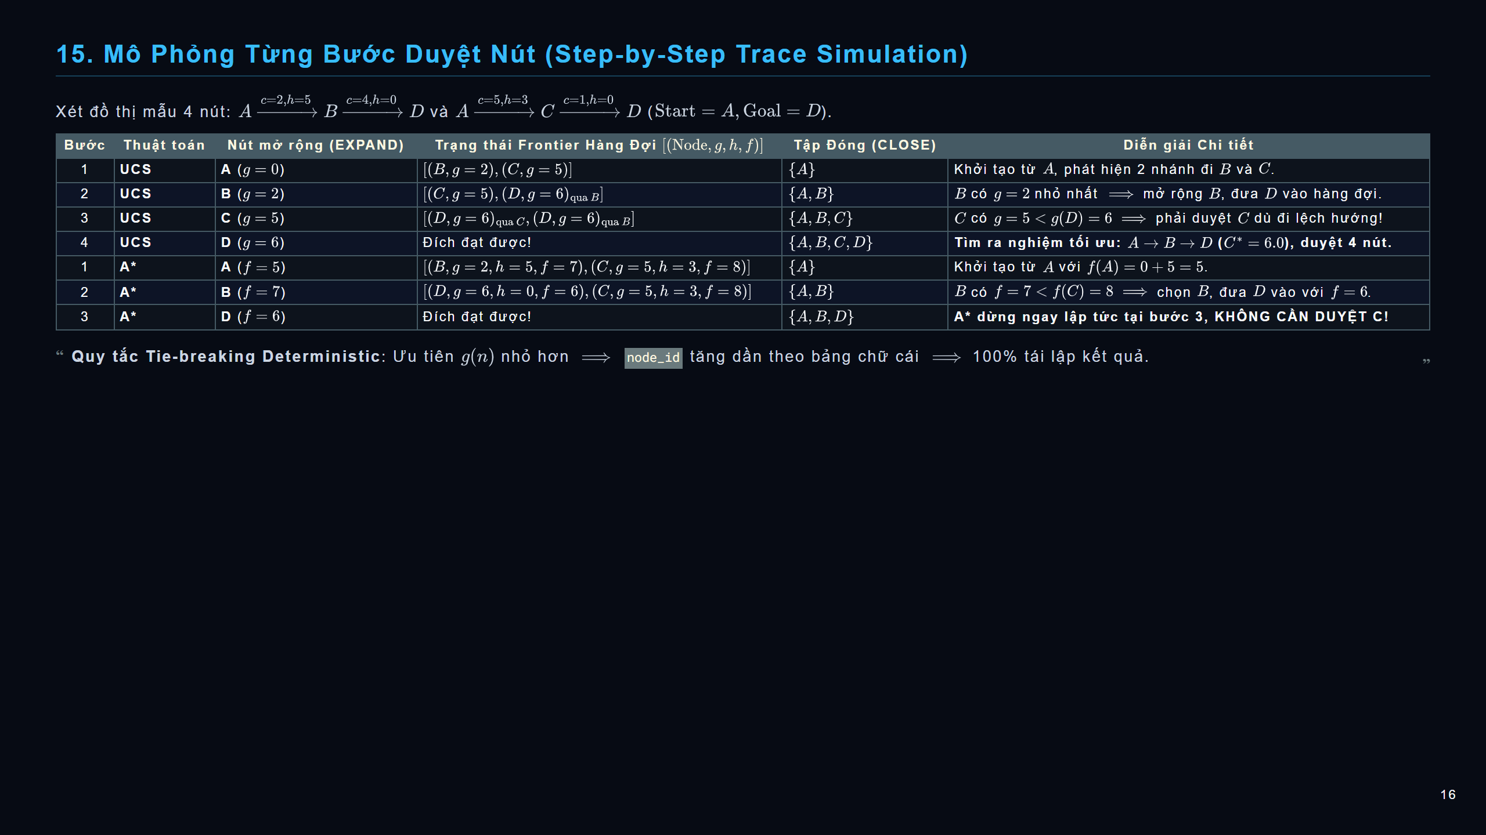
Notes:
slide

Slide 17
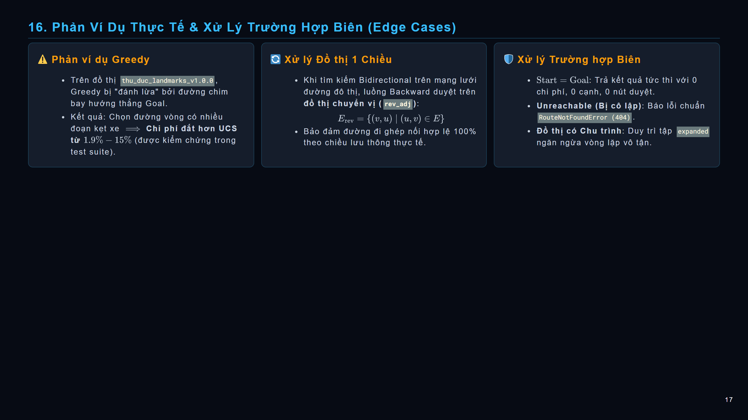
Notes:
slide

Slide 18
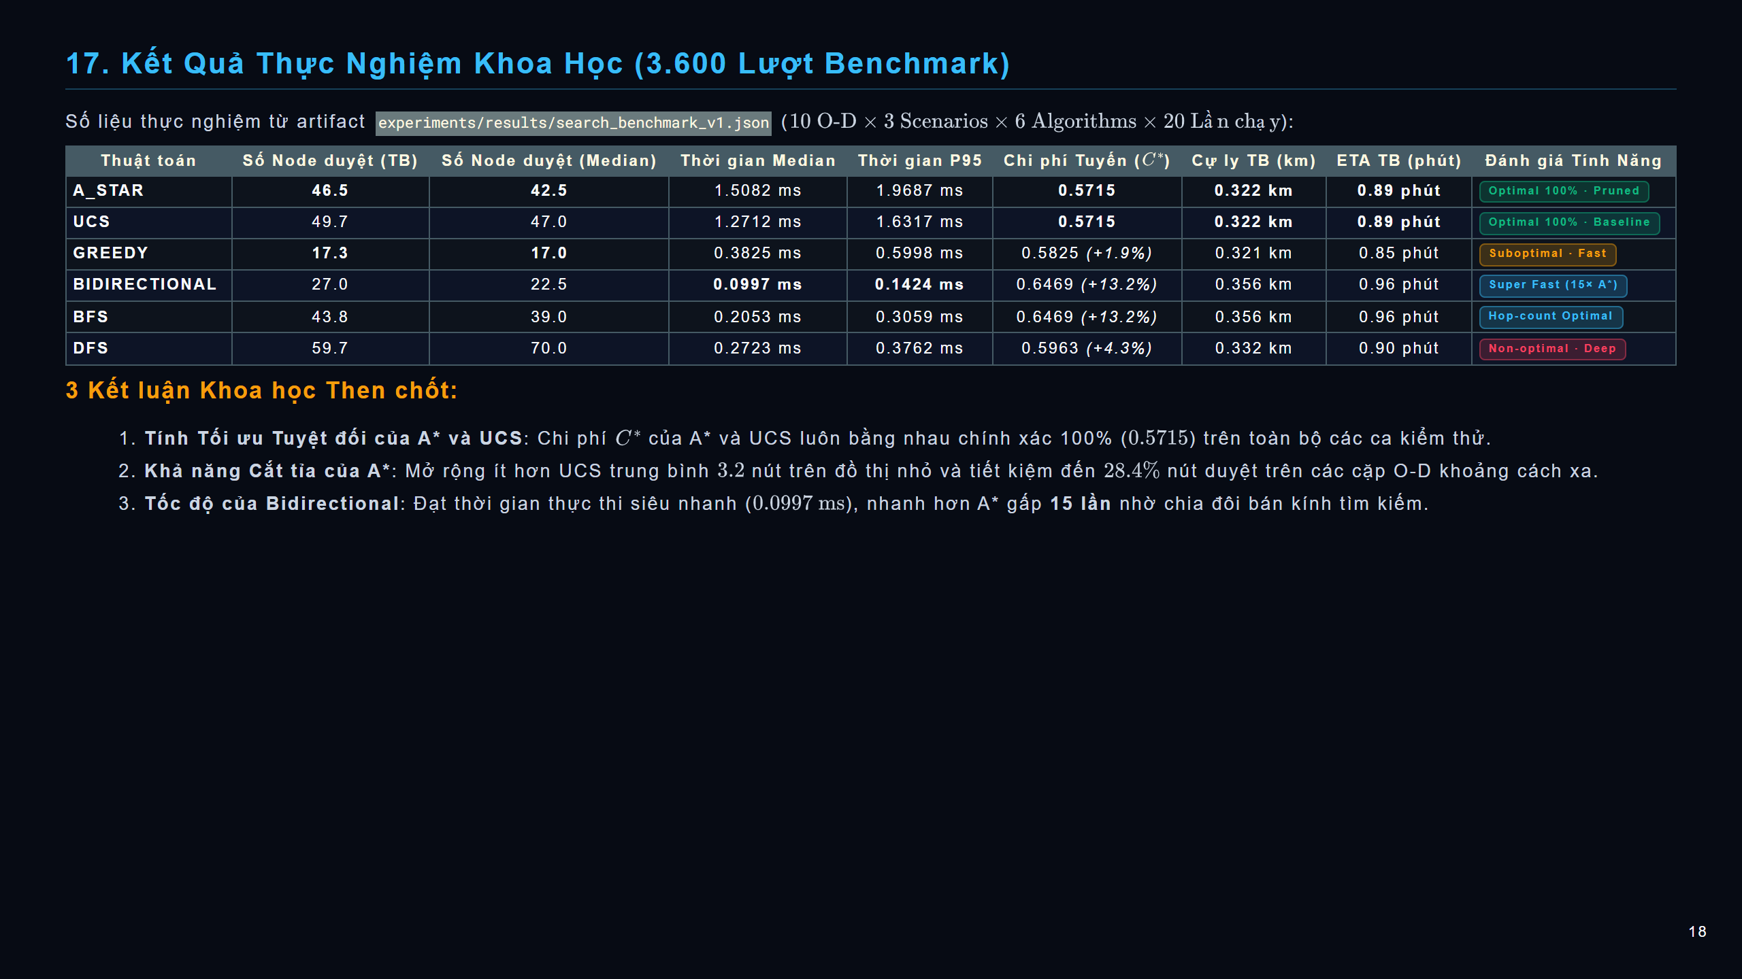
Notes:
slide

Slide 19
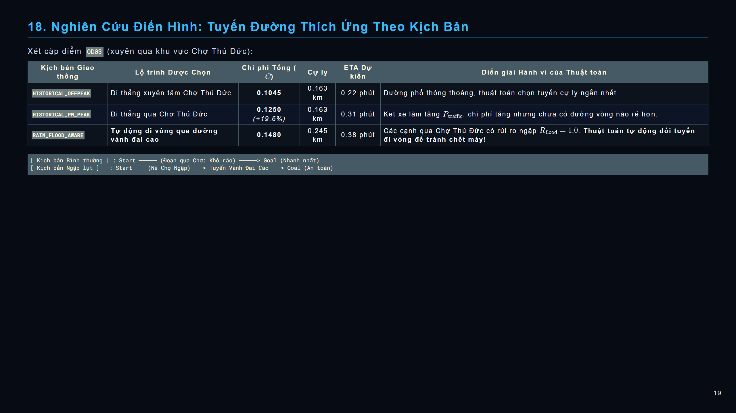
Notes:
slide

Slide 20
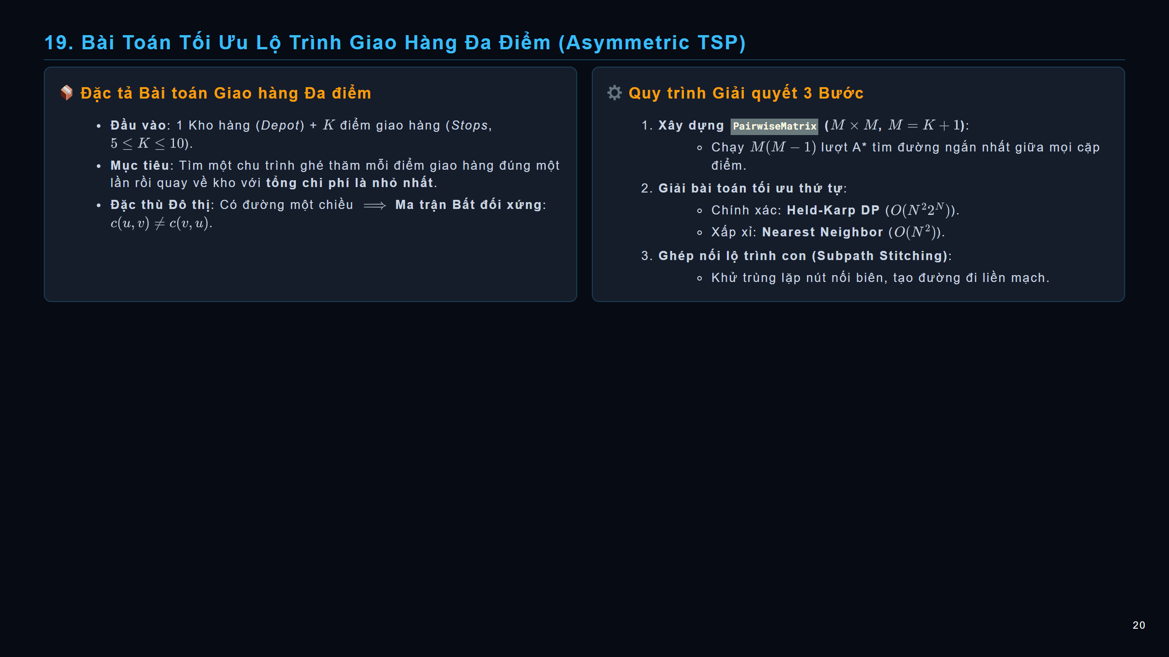
Notes:
slide

Slide 21
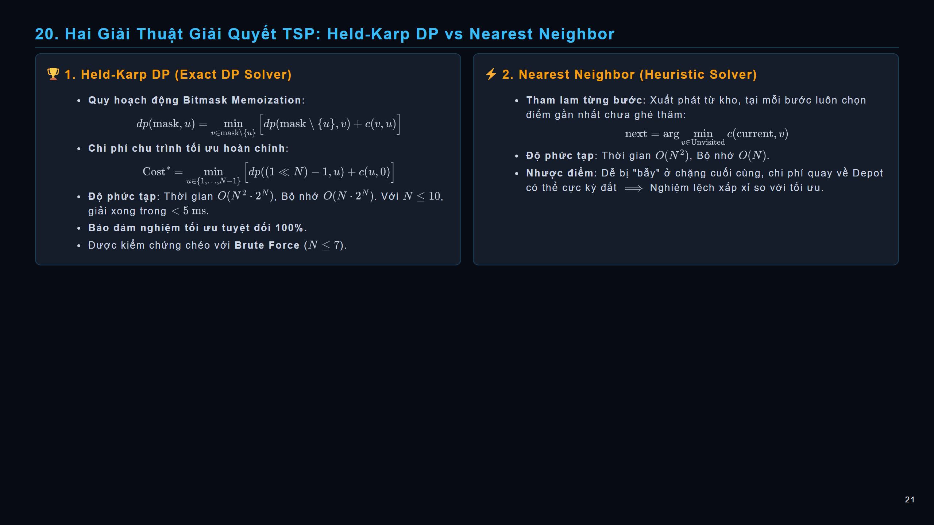
Notes:
slide

Slide 22
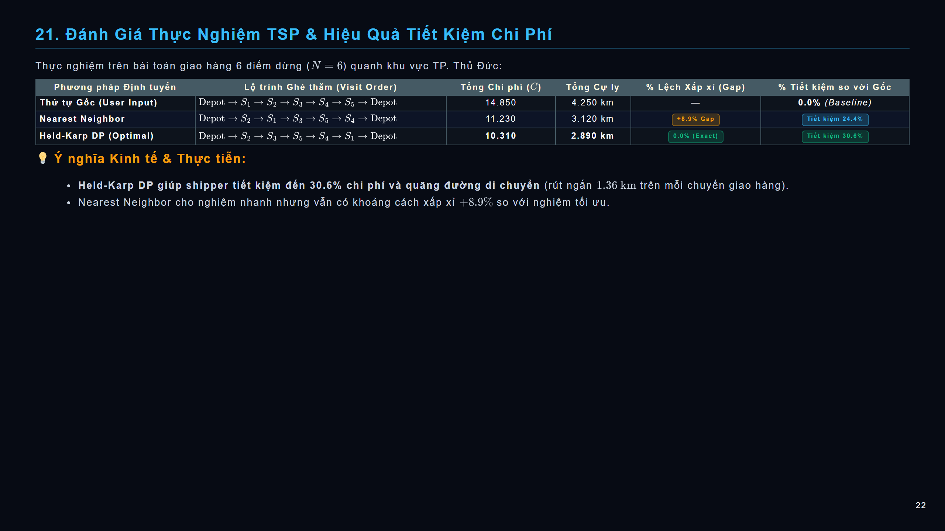
Notes:
slide

Slide 23
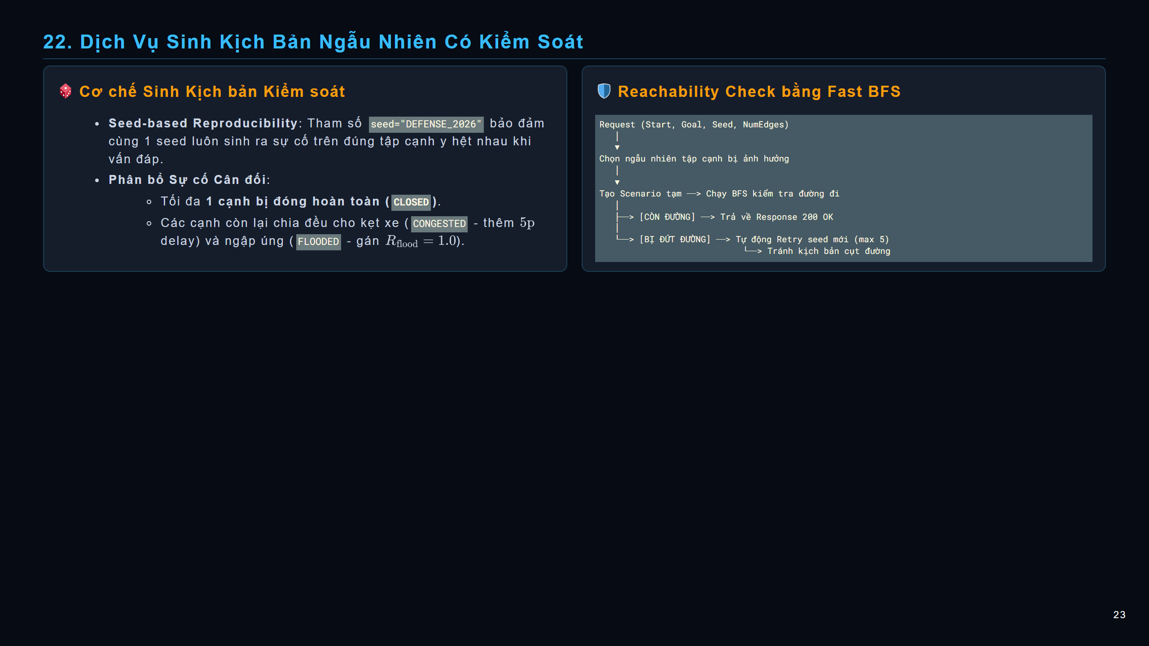
Notes:
slide

Slide 24
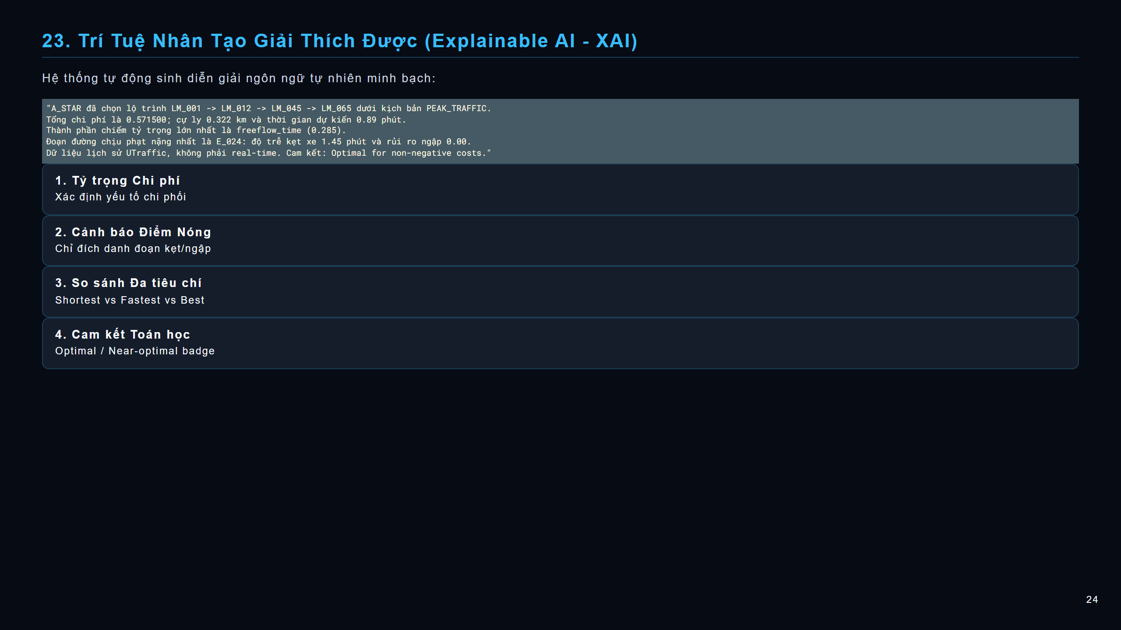
Notes:
slide

Slide 25
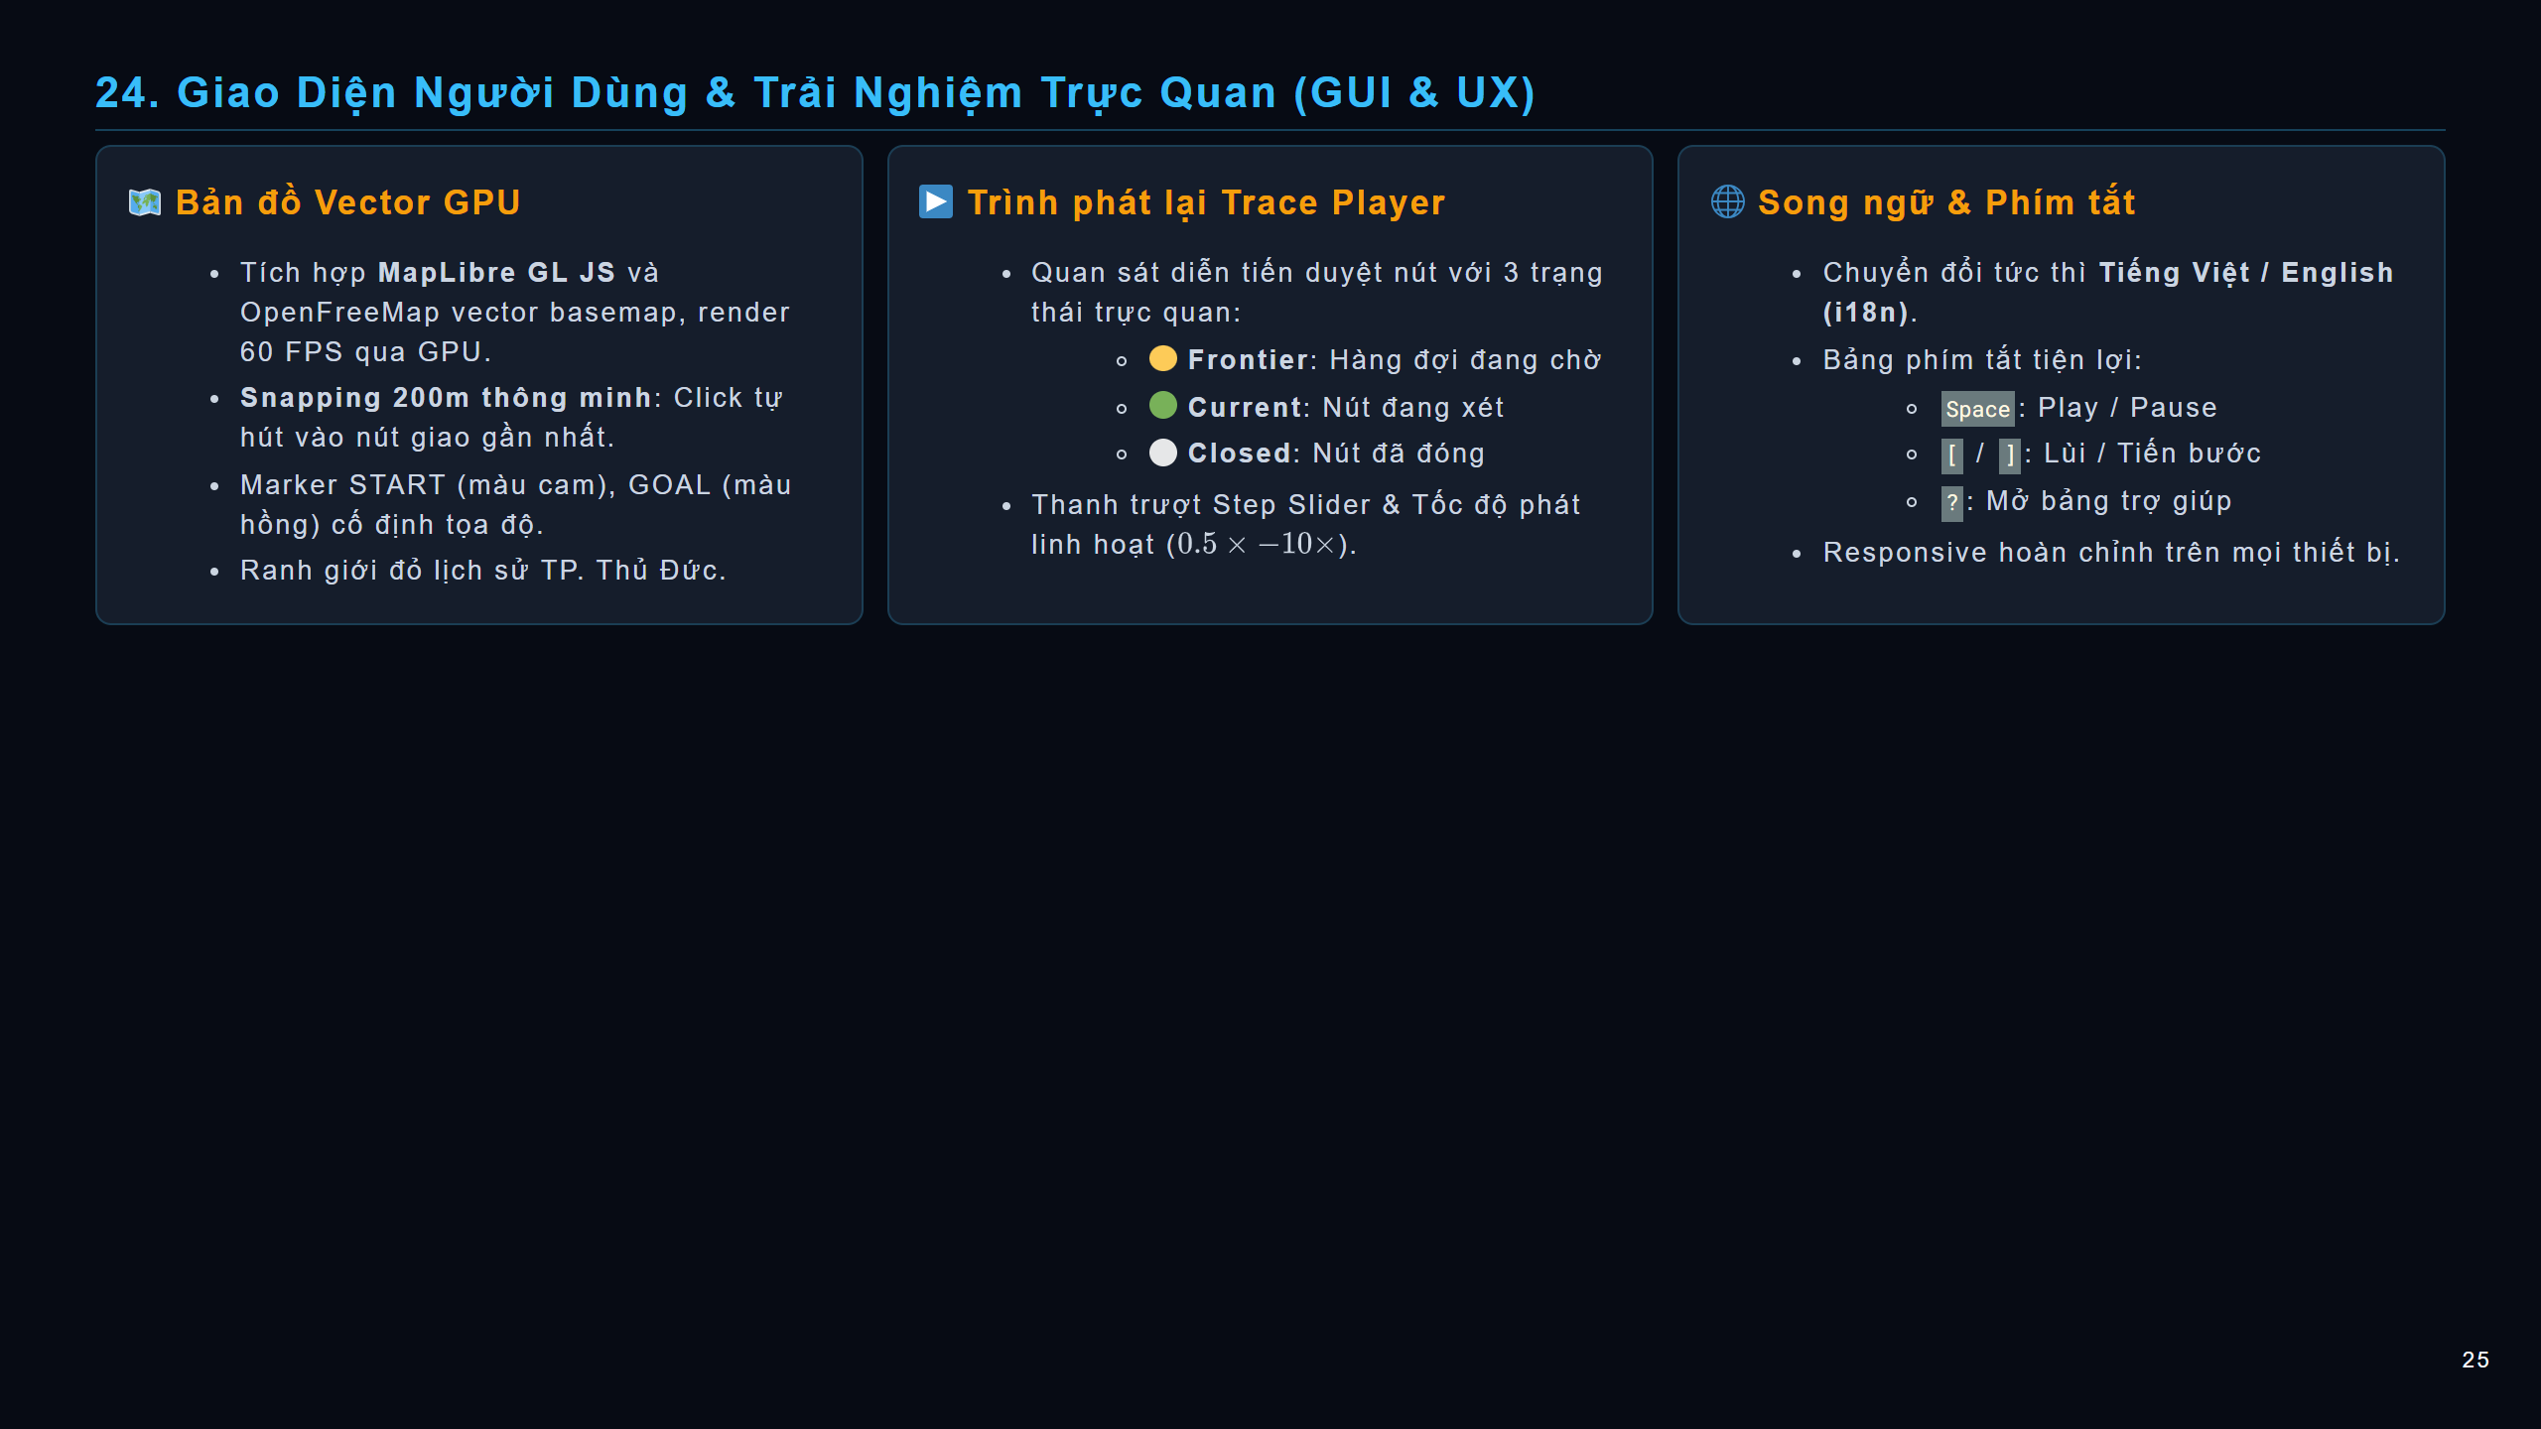
Notes:
slide

Slide 26
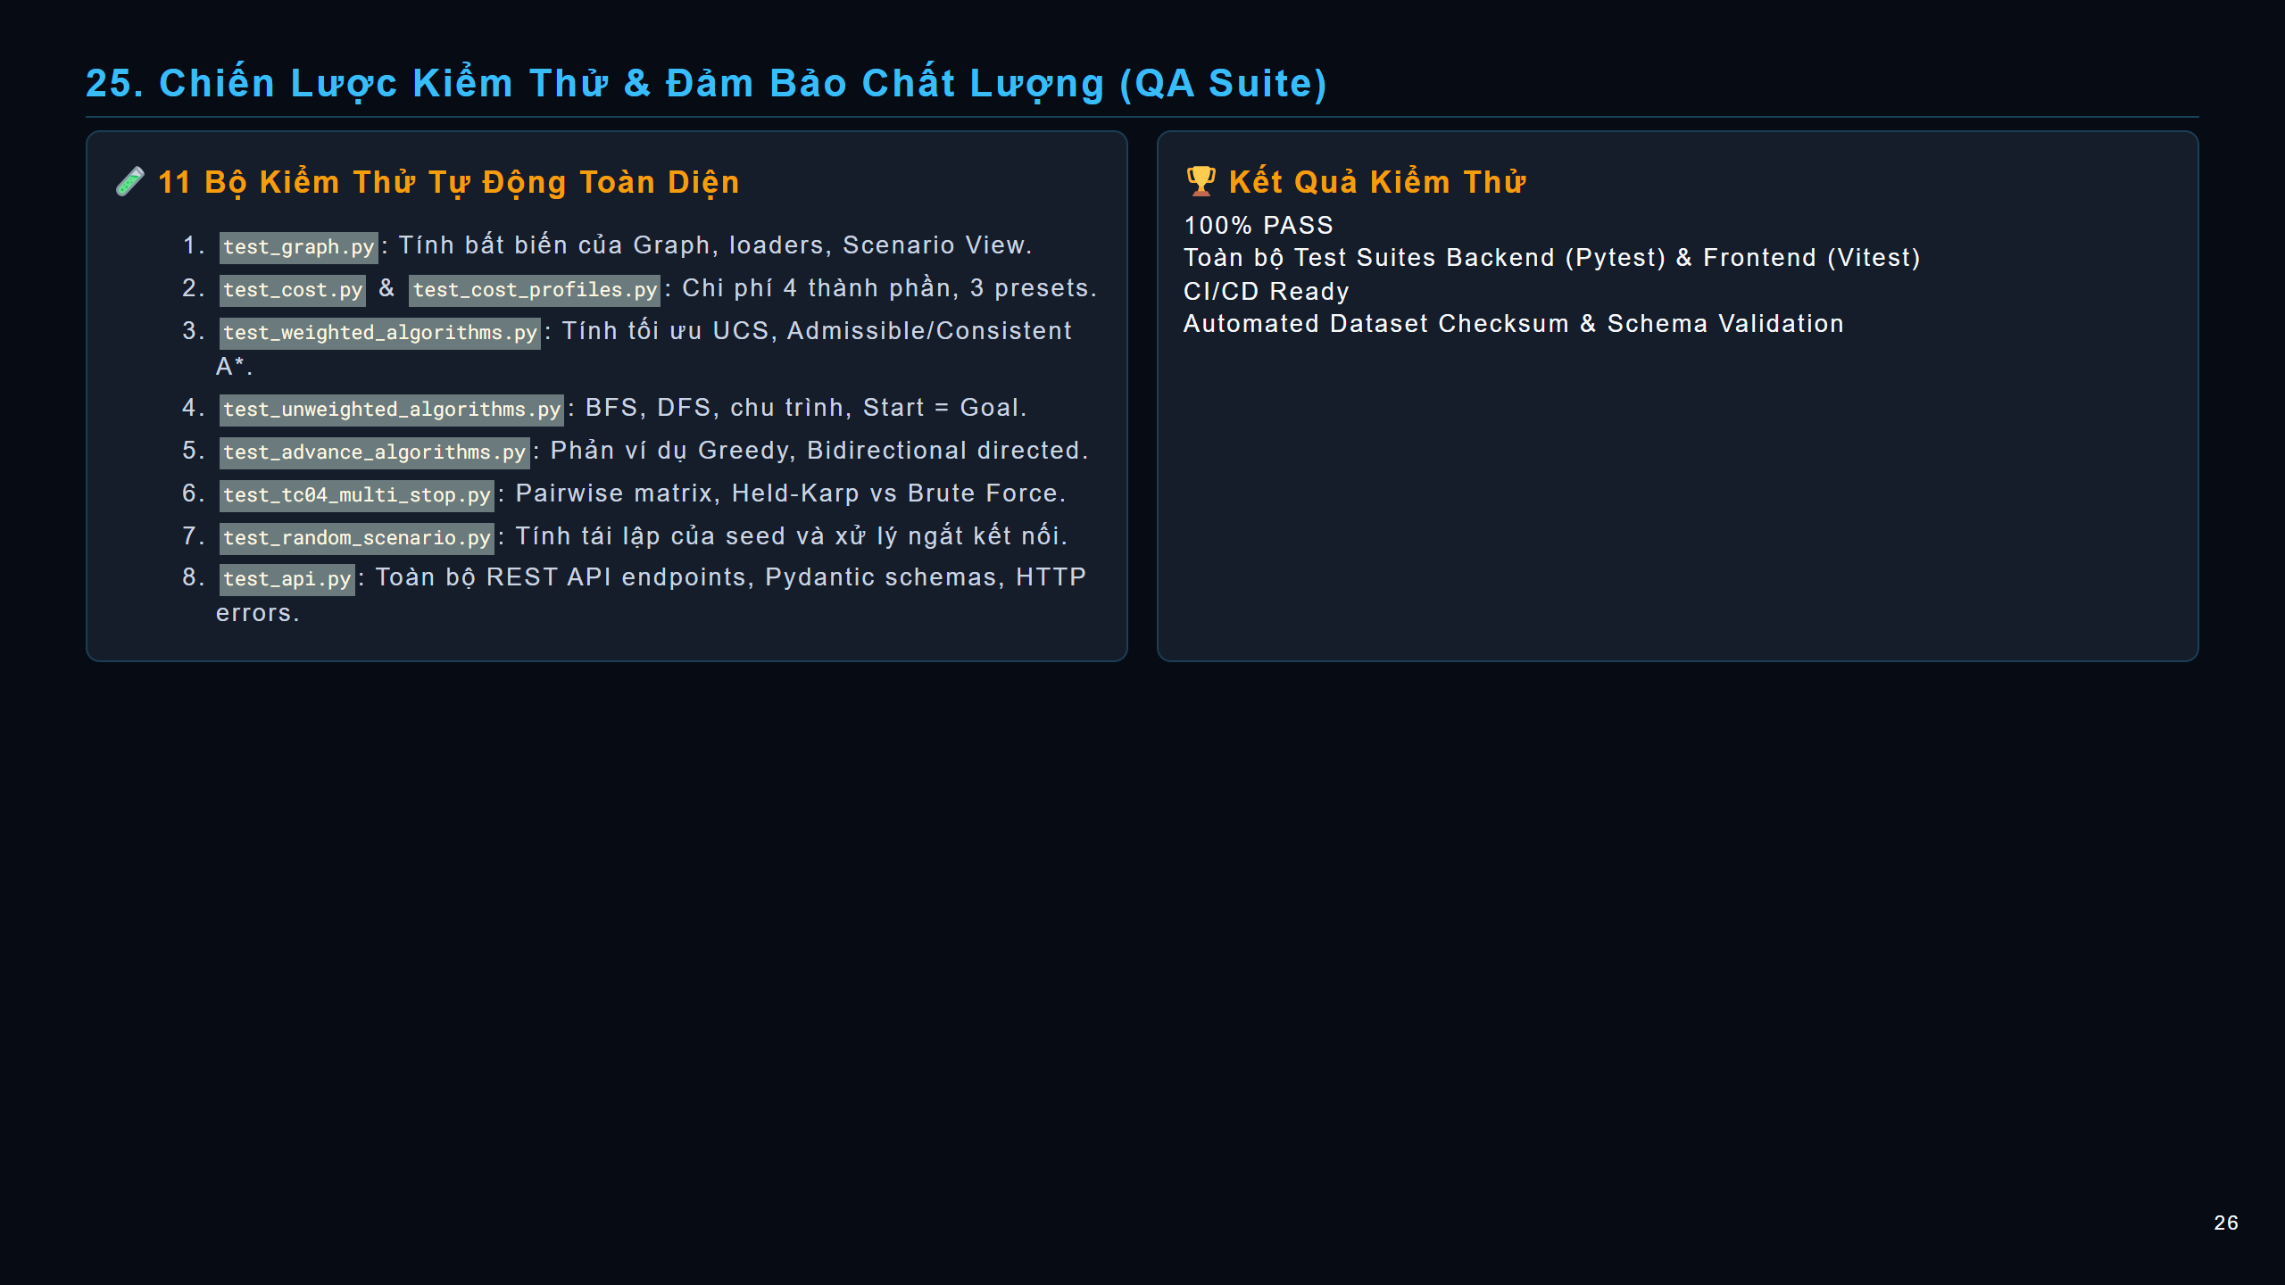
Notes:
slide

Slide 27
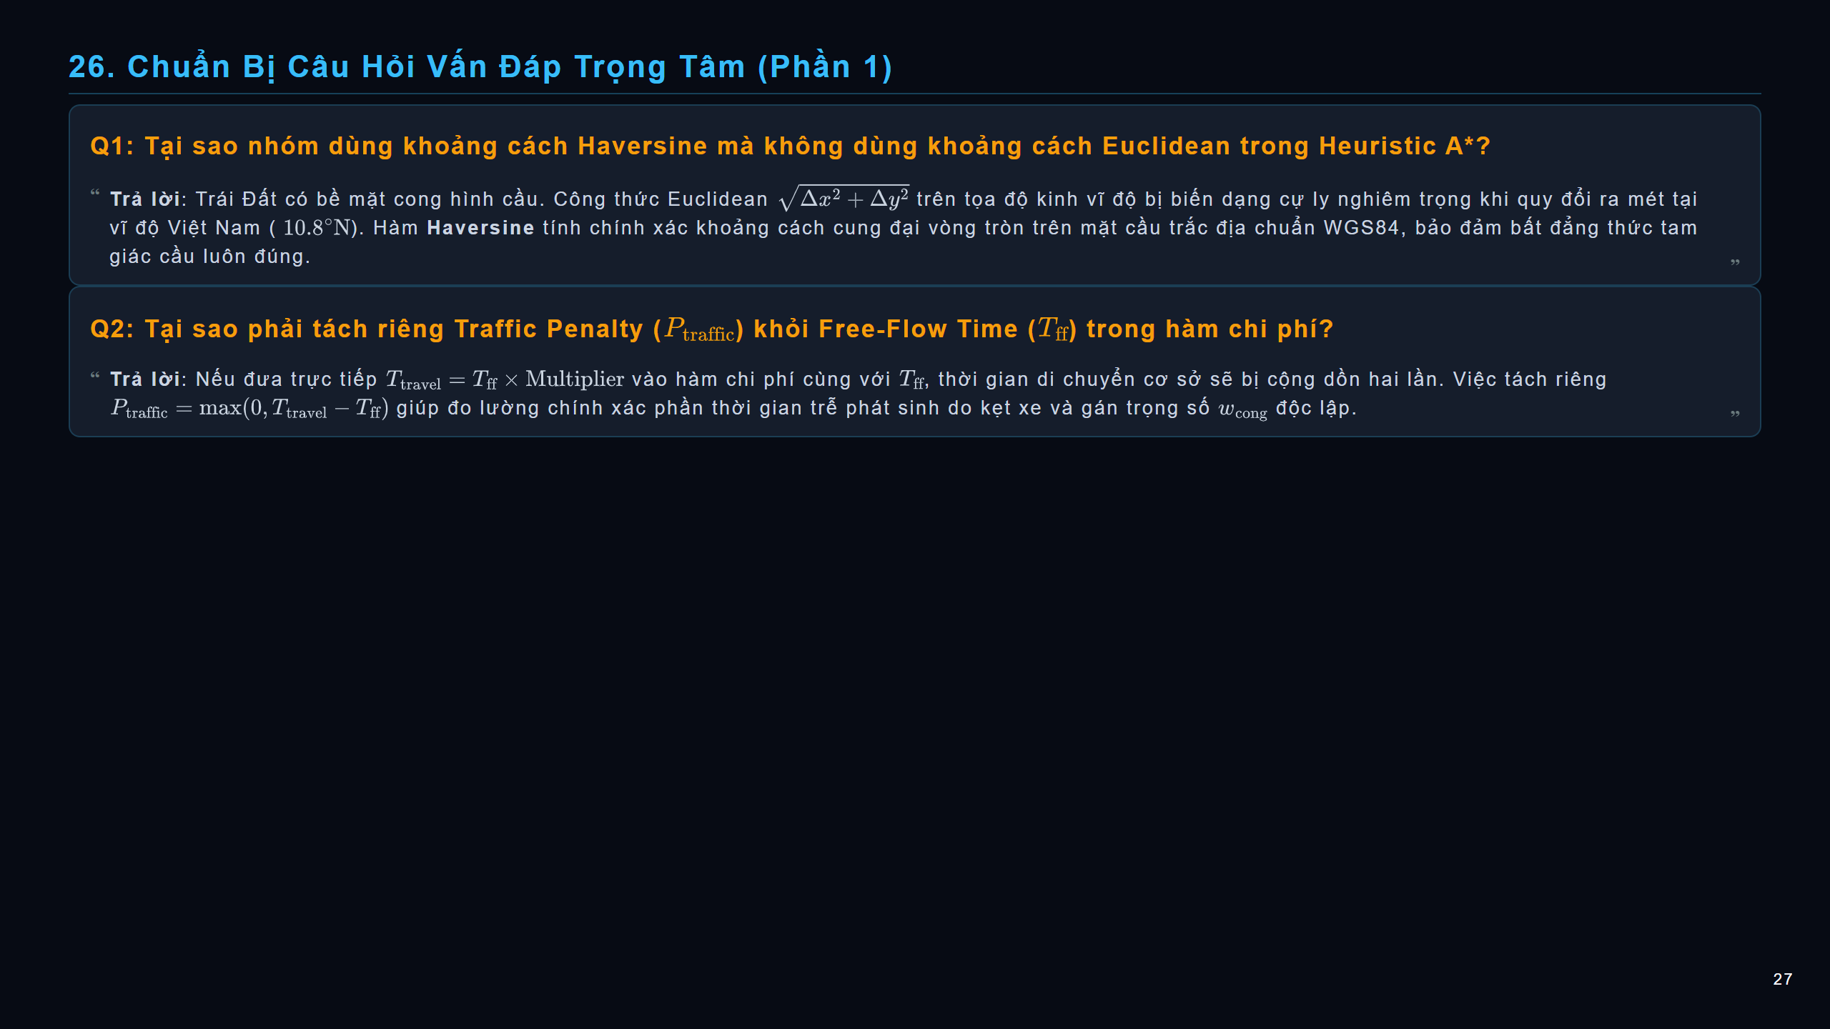
Notes:
slide

Slide 28
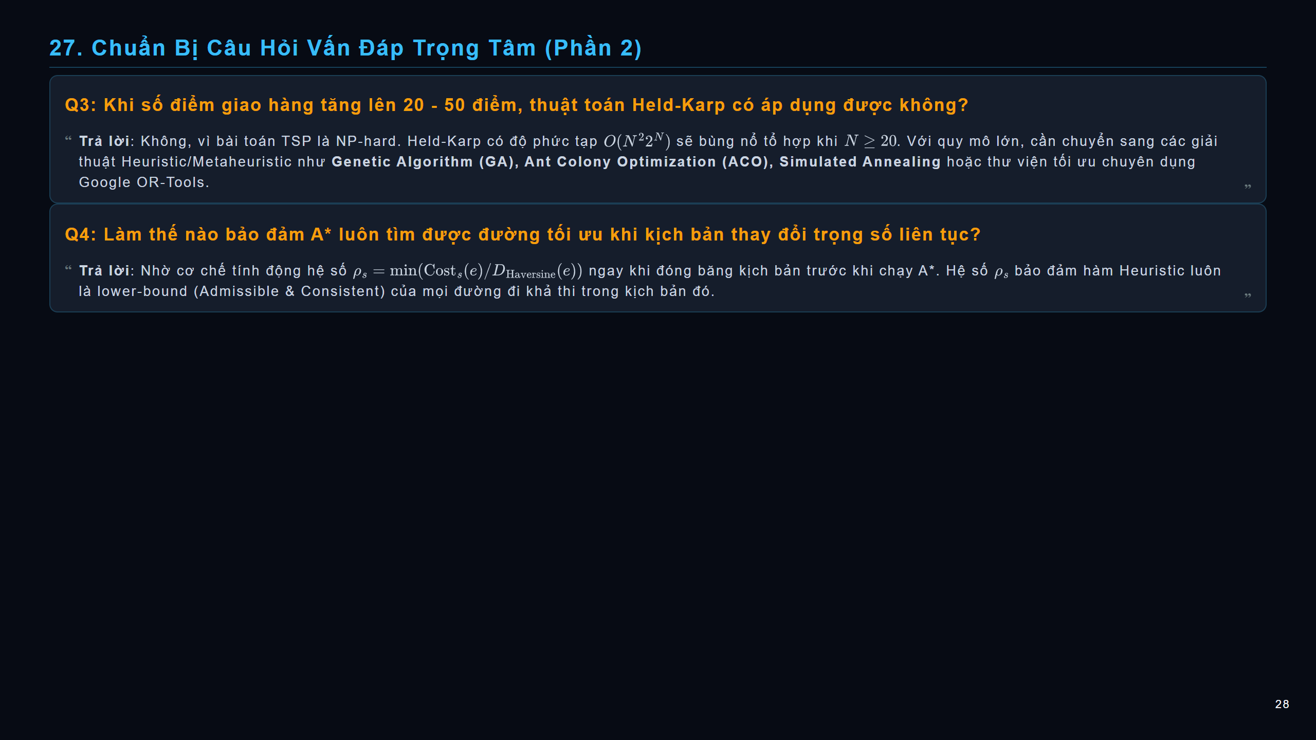
Notes:
slide

Slide 29
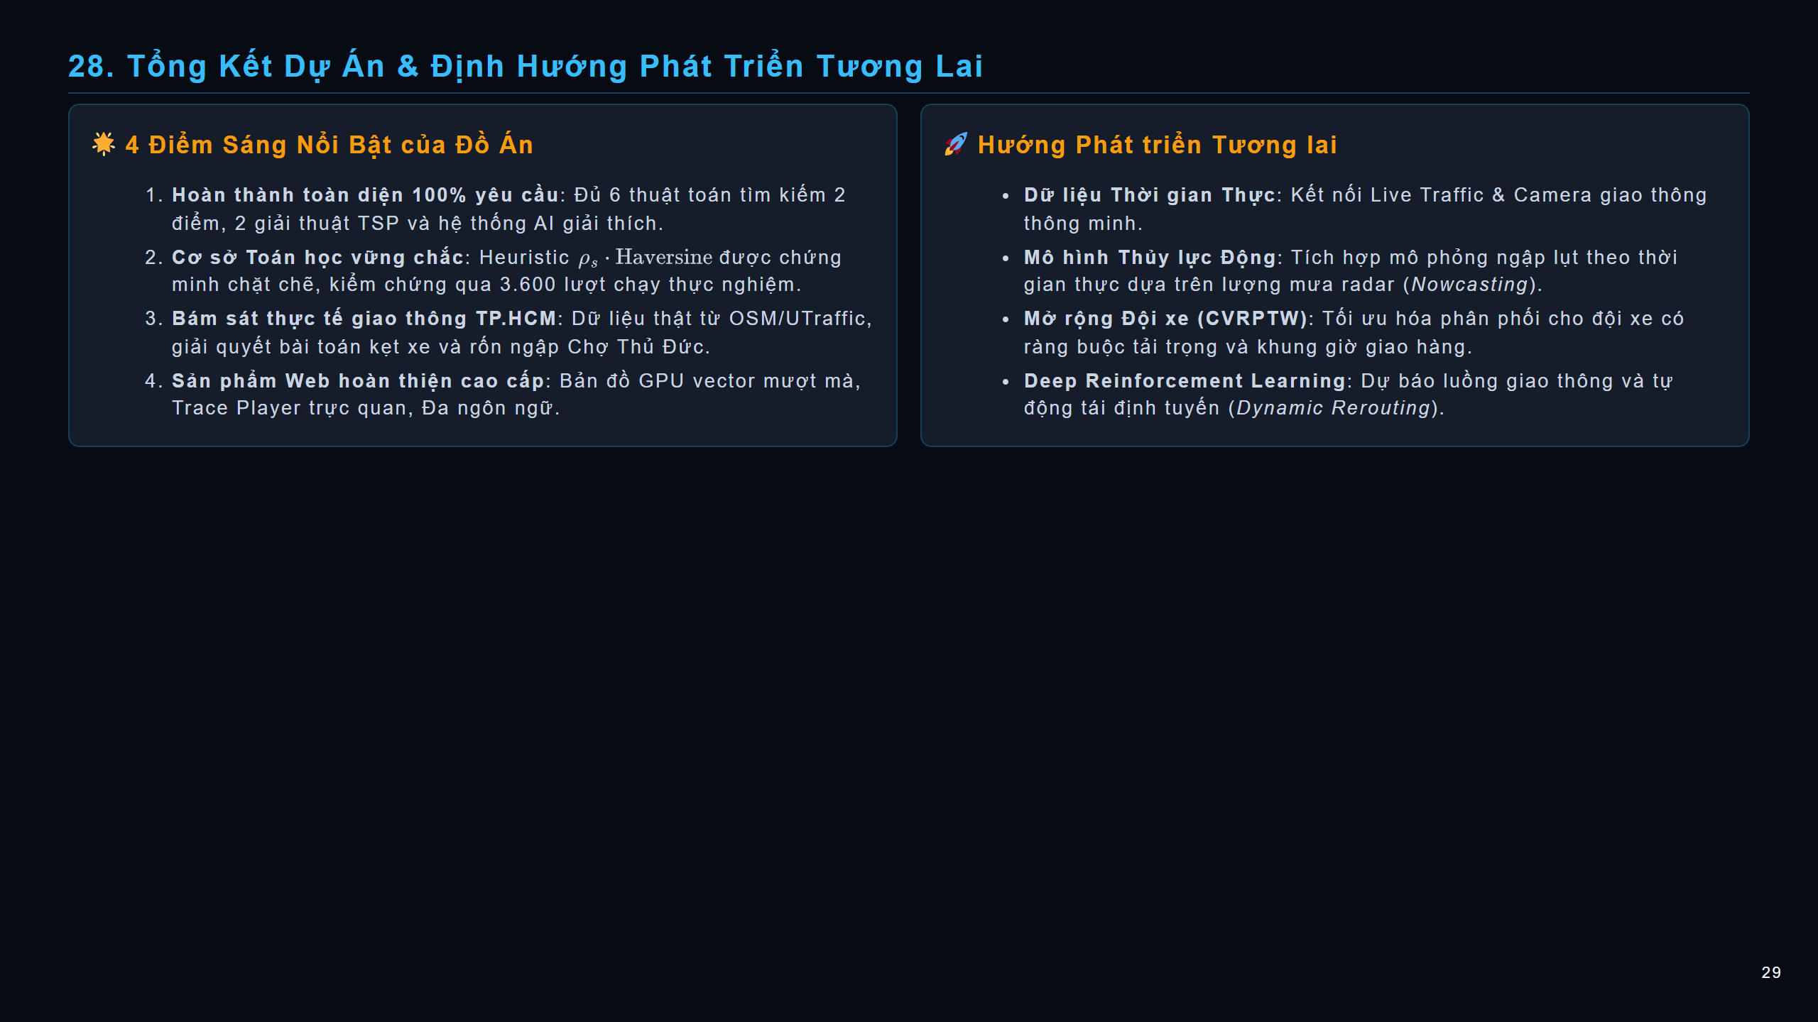
Notes:
slide

Slide 30

Notes:
slide

