Slide 1

TECHNICAL REPORT
Taekwondo Technique Scoring from Video
Technologies · Algorithms · Input & Output
Notes:
A summary of the technologies, algorithms and input/output formats of the Taekwondo technique scoring system.

Slide 2

OVERVIEW
What does the system do?
The user provides a video of a technique. The system extracts the skeleton in every frame, recognizes the kick type, finds the phases of the movement and scores it with explainable rules: per-item points, main faults and correction tips.
13
75.3%
4 + 6
joints tracked in every frame (2D + 3D)
accuracy of the LSTM model on 3 kick types
= 10 points: Accuracy 4 + Expression 6, borrowed from Poomsae scoring
Kicks: ap chagi · dollyo chagi · naeryo chagi
Punches: hook · straight
2

Slide 3






PIPELINE
From video to score
1. Read video
2. MediaPipe Pose
3. Select person & crop
4. Recognition (LSTM)
5. Phases & metrics
6. Scoring 4 + 6
OpenCV reads the frames, fps and size
33 points per frame → 13 joints, 2D + 3D
Track people, pick the performer, crop the motion
Kicks only: ap / dollyo / naeryo chagi
Start → peak → recovery; angles, speed, rotation
Per-item points, main faults, correction tips
INPUT .mp4 video, 1–3 s + command options
OUTPUT Score /10 · pipeline window · JSON · CSV · images
3
Notes:
Step 4 (LSTM recognition) is used for kicks only, to pick the right rule set. For punches, the user gives the punch type with --punch.

Slide 4






TECHNOLOGY
Technology stack
Python 3.12
MediaPipe 0.10.14
OpenCV
PyTorch
Main language, runs in a .venv virtual environment
PoseLandmarker (BlazePose full): 33 points 2D + 3D
Video reading, skeleton drawing, image export
LSTM / GCN recognition models
NumPy
Matplotlib (TkAgg)
TKD-Kick3 (Zenodo)
PowerShell / CLI
Coordinate series, signals, joint angles
Live pipeline window
765 kick pose sequences, checkpoints, original rules
Run commands, export JSON / CSV / images
4

Slide 5
INPUT
Input: video and command options
Command | Option | Meaning
infer_video.py | (none) | Kick: model recognizes the kick
infer_video.py | --kick front / roundhouse / axe | Kick: choose the kick to score
infer_punch_video.py | --punch hook / straight | Punch: punch type (required)
infer_punch_video.py | --guard chin / waist | Guard: at the chin / at the hip
Both | --window off · --out · --csv | Hide window, save JSON / CSV
Both | --keyframes · --save_dashboard | Save keyframes / dashboard image
Input video
Formats: .mp4 .mov .avi .mkv
One person, full body visible
Front view or ~45° angle
One repetition per video, 1–3 s long
Ideally ~0.3 s of guard before and ~0.5 s after the movement
5

Slide 6
INTERMEDIATE DATA
13-joint skeleton representation
Array | Shape | Meaning
kpts | (T, 13, 2) | Image coordinates (pixels)
vis | (T, 13) | Confidence 0–1 (below 0.2 = missing)
world | (T, 13, 3) | 3D coordinates (metres), origin at the hips
fps | number | Frames per second
0
2
1
4
3
6
8
7
5
Joint index: 0 nose · 1/2 shoulders · 3/4 elbows · 5/6 wrists · 7/8 hips · 9/10 knees · 11/12 ankles (odd = left, blue; even = right, red)
T = number of frames. The 13 joints are reduced from MediaPipe's 33 landmarks.
10
9
12
11
Why 3D: filmed from the front, the 2D elbow angle swings 20–150° within one punch; 3D coordinates are far more stable.
6

Slide 7

ALGORITHM 1
Pose extraction & performer selection
1
BlazePose (MediaPipe)
Parameters
Each frame → 33 2D points (x, y, visibility) and 33 3D points (metres).
2
Reduce 33 → 13 joints
Model pose_landmarker_full.task (float16)
VIDEO mode, up to 4 people
Detection / presence / tracking threshold: 0.5
Track matching: distance ≤ 15% of frame size
5-frame moving average (punch rules)
Nose, shoulders, elbows, wrists, hips, knees, ankles — enough for kicks and punches.
3
Multi-person tracking
Link people across frames by the nearest hip centre (greedy matching).
4
Select the performer
Track whose wrists / ankles move most × fraction of frames present; a near-tie raises a warning.
7

Slide 8
ALGORITHM 2
Motion window cropping
1
2
3
4
Speed signal
Smoothing
Two thresholds
Grow from peak
Ankle speed relative to the hip centre (the more active leg)
7-frame moving average, then find the speed peak
High = max(85th percentile, 2 px); low = 0.55 × high
Keep the run ≥ low threshold, clamp length to 0.6–2.0 s
Used for kick recognition
Punch rules: no cropping
The authors' own _compute_rel_speed_window function, so the LSTM sees data shaped like its training data; walking and phone handling are dropped.
The whole video is kept to see the guard before the punch and the recovery; phases come from a dedicated signal (algorithm 5).
8

Slide 9
ALGORITHM 3
Kick recognition with LSTM
1
Fill hidden joints (visibility < 0.5) with the last known value
2
Normalize: subtract the hip centre, divide by max(shoulder width, hip width)
3
Resample uniformly to T = 96 frames
4
52 features per frame = 26 positions + 26 velocities
5
BiLSTM 2 layers × 128 → temporal mean → Linear → Softmax (3 classes)
3-seed ensemble: average the probabilities of 3 models → the kick with the highest probability.
Authors' results on the validation set, mean of 3 seeds; random sample split, not person-independent.
9

Slide 10
ALGORITHM 4
Kick scoring rules (authors')
Phases from the ankle–hip distance
Item | Points
Accuracy — 4 points
A1 Kick-specific technique (chamber, swing plane, lift height) | 1.6
A2 Height & knee extension / downward speed | 1.2
A3 Leg retraction | 0.8
A4 Balance & guard | 0.4
Expression — 6 points
E1 Speed | 2.0
E2 Power (kinematic index) | 1.6
E3 Height | 1.4
E4 Smoothness | 1.0
t0
Start
t_peak
Kick peak
t1
End
Above 12% of the range → start; farthest from the hip → peak; back below 10% → end.
Metrics
Path straightness, smoothness (acceleration variation)
Stability (hip sway), leg retraction ratio
Peak knee angle, ankle height above the hip
Speed, downward speed (axe kick)
Item score = max points × map(metric, lower bound, upper bound)
10

Slide 11
ALGORITHM 5
Punch phase detection (extended rules)
1
Impact
Hook: highest elbow elevation (3D). Straight: maximum arm reach.
2
Start
Walk back from the speed peak until speed < 20% of the peak.
3
Recovery
Signal returns near guard level (≤ 30% of the range) within 1.2 s.
4
Missing data
Video cut early → that item is "not assessed" and the score is rescaled.
Start f9 → Impact f15 → Back to guard f40
11

Slide 12
ALGORITHM 5 (CONT.)
Hook punch scoring table
Code | Item | Points | Measured by (full marks)
HK_A1 | Arm shape at impact | 1.6 | Elbow angle 80–130°, elbow raised 75–135°, fist at head height
HK_A2 | Hip & shoulder rotation | 1.2 | Shoulder rotation 40–90°, hip rotation 30–90° (3D)
PU_A3 | Return to guard | 0.8 | Return to guard level ≥ 80%
PU_A4 | Guard hand & balance | 0.4 | Other hand near the chin, trunk lean ≤ 15°, little hip sway
PX_E1 | Speed | 2.0 | Wrist speed ≥ 8 torso lengths / s
PX_E2 | Power (trunk rotation) | 1.6 | Shoulder rotation speed ≥ 300 °/s
PX_E3 | Snap | 1.4 | Execution time ≤ 0.35 s
PX_E4 | Smoothness | 1.0 | One continuous speed-up / slow-down
Blue codes = Accuracy (4 points) · green codes = Expression (6 points). The straight punch replaces HK_A1/A2 with ST_A1 (arm extension, straight path) and ST_A2 (shoulder rotation, target height) — not yet tested on real video.
12

Slide 13




OUTPUT
Output types
Terminal output
Pipeline window
JSON
Score /10, per-item points, phases, main faults & tips, warnings
6 live steps, video + skeleton, phase chart, score table
--out: full result and raw metrics for one video
CSV
Keyframe image
Dashboard image
--csv: score table for many videos, opens in Excel
--keyframes: start / peak / recovery frames with skeleton
--save_dashboard: PNG of the pipeline window
13

Slide 14
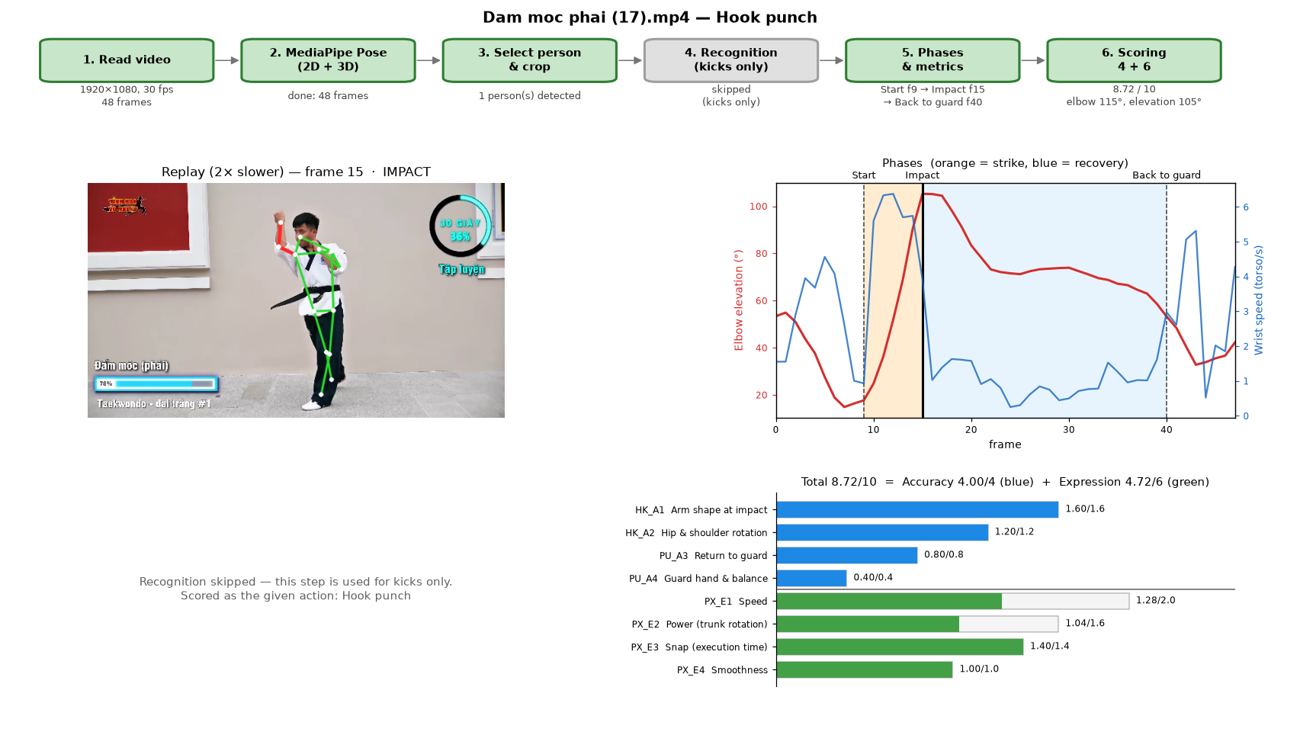
OUTPUT EXAMPLE
Pipeline window & result structure
{
"action": "hook",
"result": {
"valid": true,
"total": 8.72,
"acc": 4.00,
"expr": 4.72,
"acc_items": [{
"code": "HK_A1",
"maxi": 1.6, "got": 1.6,
"reason": "...",
"tip": "..." }, ...],
"phases": {"t0": 9,
"t_peak": 15, "t_end": 40},
"warnings": []
}
}
Clip 17 — right hook: 8.72 / 10
14

Slide 15
RESULTS
Test results
24/24
hook clips scored · median 8.57
75.3%
3-kick recognition (LSTM, val set, 3 seeds)
MAE 0.60
kick rules vs. experts (30 videos, r = 0.61)
Punch-rule thresholds were set from one person's data and have not been compared with judges.
15

Slide 16

Limitations & future work
Limitations
Future work
Punch thresholds set from one person, not checked against judges
Straight punch not yet tested on real video
Kick model not evaluated person-independently
3D from a single camera: sensitive to side-on or back views
"Power" is a kinematic index, not measured force
Collect videos from more people and skill levels
Have ≥ 2 experts score videos to calibrate thresholds (MAE, correlation)
Add new actions with train_actions.py + scoring-rule plugins
Test the straight punch and side kick on real video

