Slide 1
Movie Recommendation Nguyen Quang Anh – ID: c3005993
Notes:
Hi everybody, my name is qa and today I gonna talk about my aai final assessment –movie recommendation
Nowaday, most Internet users have come across a recommendation system in one way or another.

Slide 2
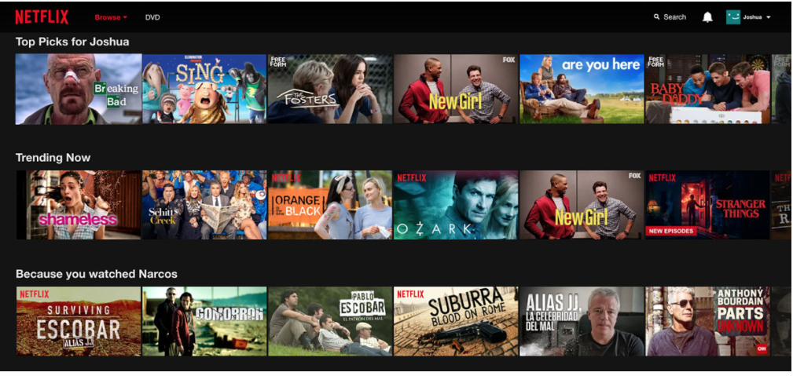
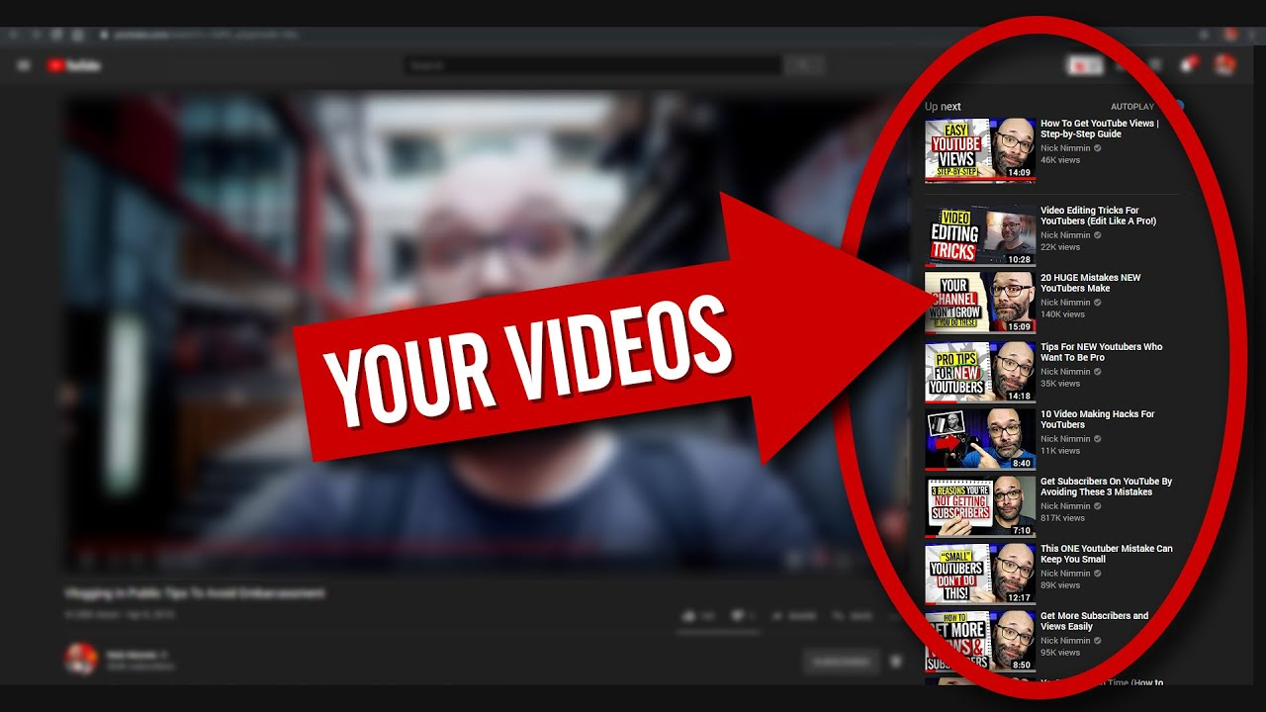
Notes:
For entertainment service companies like YouTube or Netflix, they have abundant data, so recommendation systems are crucial as they can increase the user experiment.
And in this presentation, I will introduce some methods, including collaborative filtering, content-based filtering, and NN approaches.

Slide 3
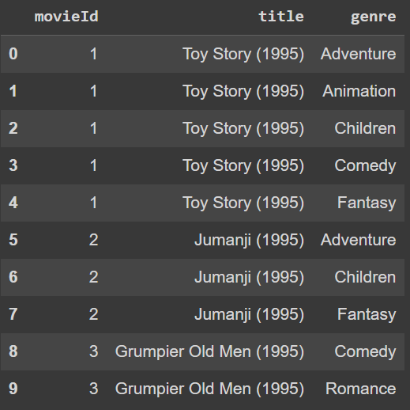
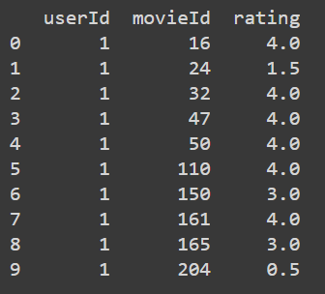
DATASET
Movie
Rating
movieID: key
title: name
genre: total 22 different genre
Total 10325 movies
movieID: key - 10325 movies
userID – 668 users
rating: on scale 5
Total 105339 ratings

Slide 4
Approach
Content-based Filtering
Collaborative Filtering
Base on content of item
Using content of movie (genre)
Find similarity of movies
Advantage: Doesn’t require user data
Disadvantage: Miss out new interests
Base on rating of user
Using rating
Find similarity of users
Advantage: Can recommend new items
Disadvantage: Need sufficient data to be effective

Slide 5
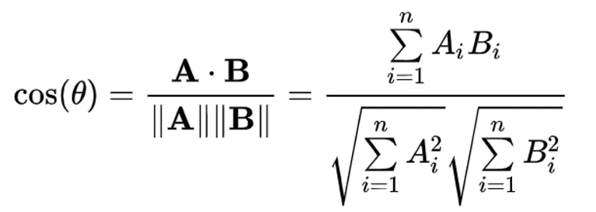
SIMIlARITY
COSINE SIMILARITY
Formula
Cosine similarity is a similarity rate obtained from the cosine angle multiplication of two vectors being compared
Result:
Close to 1: High similarity
Close to 0: Low similarity
Close to -1: High dissimilarity

Slide 6
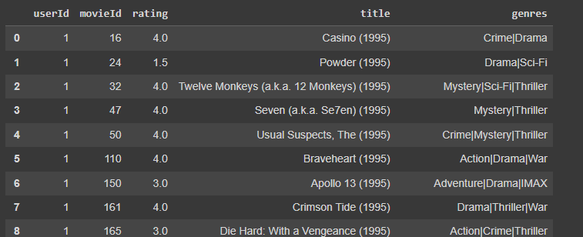
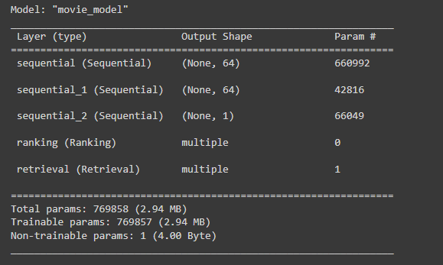
Neural NetWork
Using NN approach to use both content and rating data
Concatenate both dataframe into a new feature space
Neural Network Structure
Train/Test split: 95339/10000
Evaluation: RMSE: 0.987

Slide 7
Demo

