Slide 1

HUNG YEN UNIVERSITY OF TECHNOLOGY AND EDUCATION
DEPARTMENT OF INFORMATION SYSTEMA
STUDYING AND DESIGNING A SMART PARKING SYSTEM
Student: Dang Xuan Quang
Instructor: DR Vu Huy The
Contact us: quangdx.iot@gmail.com

Slide 2
Introduction
Design system
Outline
Evaluation
Conclusion
Notes:
Today I'd like to give you an overview of cache memory
This presentation(prez.ənˈteɪ.ʃən) is structured(strʌk.tʃəd) as follow
part 1 Introducing cache memory
part 2 Tranformation of cache memory
part 3 Organization(ɔː.ɡən.aɪˈzeɪ.ʃən) of cache

Slide 3
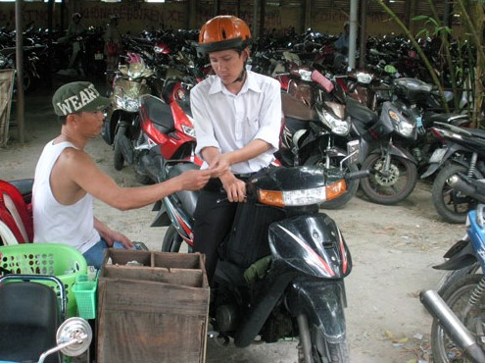
Introduction
Traditional parking lots use manual labor by recording the license plate numbers. When customers leave, the staff will check the ticket to verify the information.
Construction and Maintenance Costs High investment costs, hiring attendants, paper for tickets, etc.
Vehicle Entry and Exit Time Takes around 10 seconds to issue a ticket, which is slow.
Security Concerns Tickets can be damaged, swapped, or counterfeited.
Convenience, Safety, and Aesthetics Poor aesthetics, long-lasting congestion.
Notes:
Construction and Maintenance Costs High investment costs, hiring attendants, paper for tickets, etc.
Vehicle Entry and Exit Time Takes around 10 seconds to issue a ticket, which is slow.
Security Concerns Tickets can be damaged, swapped, or counterfeited.
Convenience, Safety, and Aesthetics Poor aesthetics, long-lasting congestion.

Slide 4
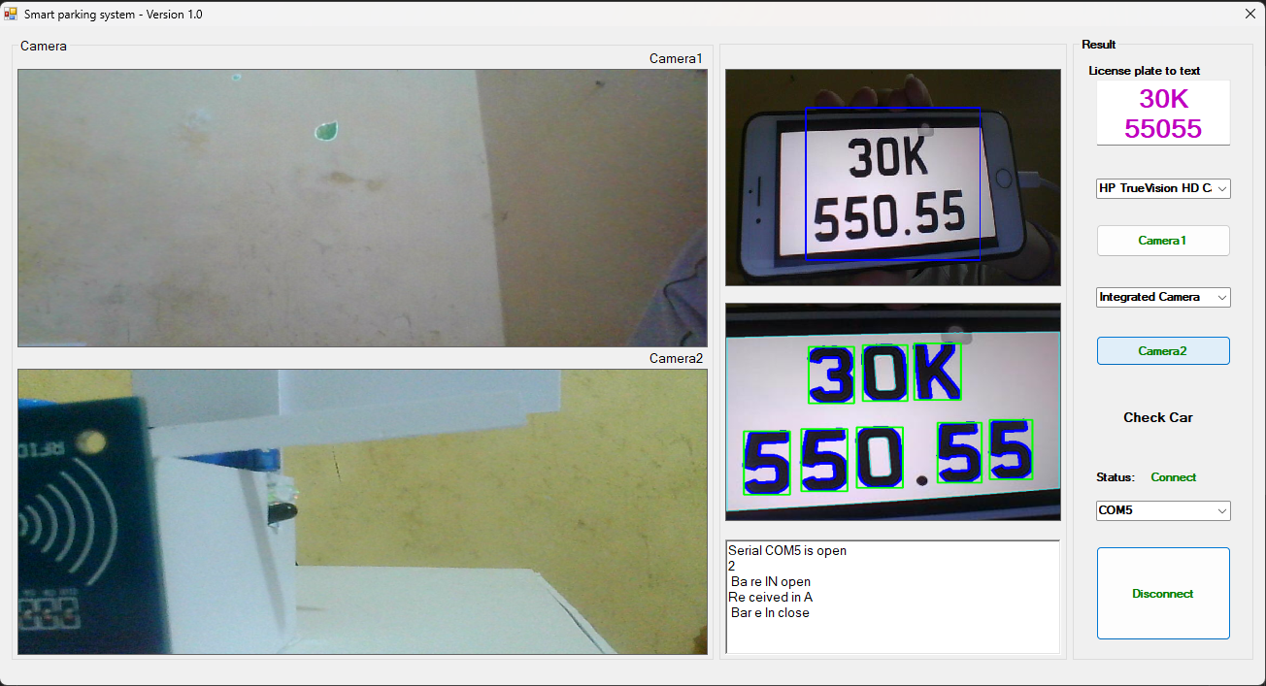
Introduction
Features of vehicle license plate image
Color.
Size and aspect ratio.
Format ( XX-XXX.XX)
Notes:
Color: License plates background color, commonly white or yellow. The characters and numbers on the plate have a contrasting color, usually black or red.
Size and Aspect Ratio car license plates in Vietnam have a size of width 16.5cm x length 33cm and an aspect ratio of 1:2.
car license plates in Vietnam have the format "XX-XXXX.XX" (e.g., 51A-123.45).

Slide 5
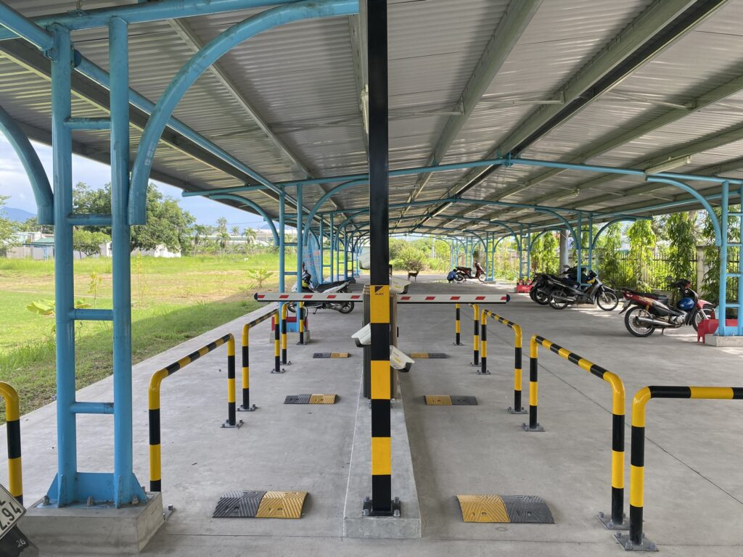
Introduction
Utilizing license plate recognition technology and storing information in a database. Managers will use specialized software to monitor vehicles entering and exiting the parking lot.
Construction and Maintenance Costs Higher than traditional parking lots, but reduces labor costs by 70% monthly.
Vehicle Entry and Exit Time 3-5 seconds for license plate recognition.
Security Concerns No damaged tickets, and card information cannot identify vehicles, so counterfeiting is not possible.
Convenience, Safety, and Aesthetics Enhanced safety and reduced pressure during peak hours.
Notes:
Construction and Maintenance Costs Higher than traditional parking lots, but reduces labor costs by 70% monthly.
Vehicle Entry and Exit Time 3-5 seconds for license plate recognition.
Security Concerns No damaged tickets, and card information cannot identify vehicles, so counterfeiting is not possible.
Convenience, Safety, and Aesthetics Enhanced safety and reduced pressure during peak hours.

Slide 6
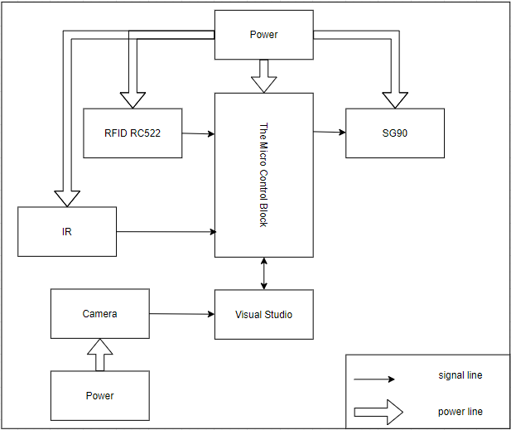
Design system
Notes:
This is block diagram

Slide 7
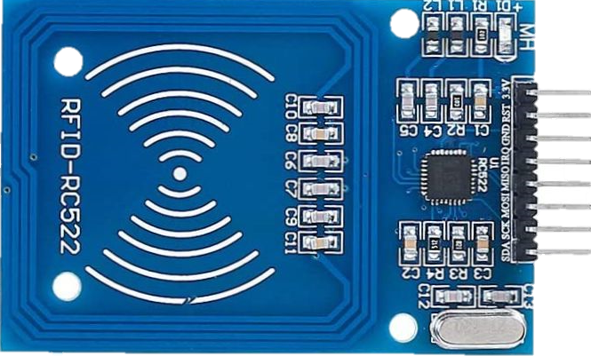
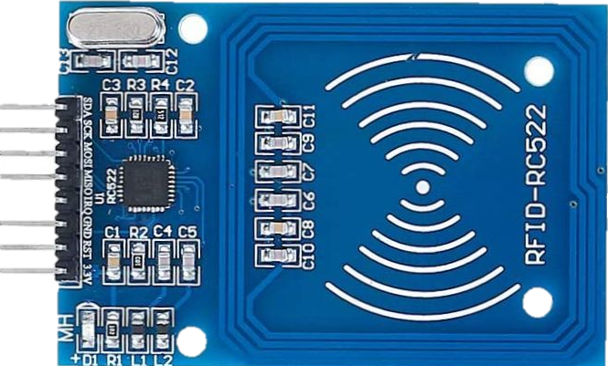
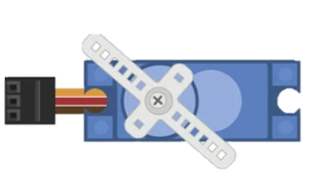
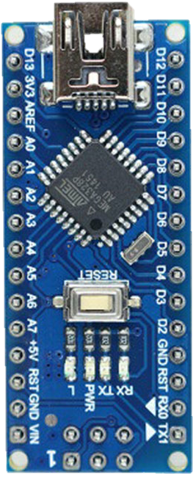
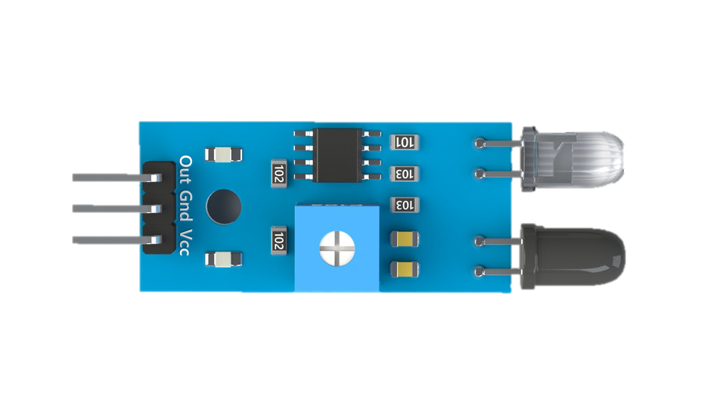
Design system
VCC
SDA
RST
SCK
GND
MOSI
MISO
MISO
MOSI
GND
SCK
RST
SDA
VCC
SCK
MOSI
VCC
MISO
SDA
RST
D3
D2
D5
D4
D3
D2
GND
D4
D5
Notes:
This is the hardware connectivity diagram.

Slide 8
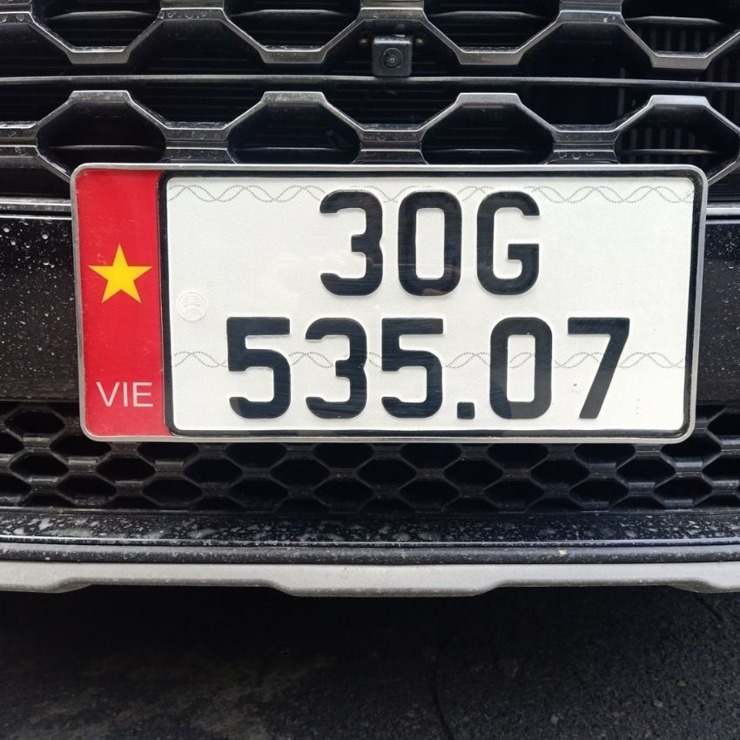
Design system
Convert the input image to a BGR color image and a grayscale image.
Use a Cascade Classifier to detect license plates in the grayscale image.
If no license plate is found, display an error message on the user interface.
If a license plate is found, crop the license plate image from the BGR color image and add it to the list of license plates.
Resize the images to display them on a PictureBox and ImageBox.
Notes:
Today I'd like to give you an overview of cache memory
This presentation(prez.ənˈteɪ.ʃən) is structured(strʌk.tʃəd) as follow
part 1 Introducing cache memory
part 2 Tranformation of cache memory
part 3 Organization(ɔː.ɡən.aɪˈzeɪ.ʃən) of cache

Slide 9
Design system
Convert the input image to a BGR color image and a grayscale image.
Use a Cascade Classifier to detect license plates in the grayscale image.
If no license plate is found, display an error message on the user interface.
If a license plate is found, crop the license plate image from the BGR color image and add it to the list of license plates.
Resize the images to display them on a PictureBox and ImageBox.
Notes:
Today I'd like to give you an overview of cache memory
This presentation(prez.ənˈteɪ.ʃən) is structured(strʌk.tʃəd) as follow
part 1 Introducing cache memory
part 2 Tranformation of cache memory
part 3 Organization(ɔː.ɡən.aɪˈzeɪ.ʃən) of cache

Slide 10
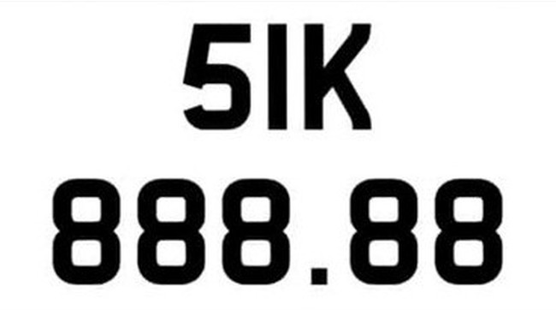



1 2 3 4
RFID
1 2 3 4
RFID
Notes:
Today I'd like to give you an overview of cache memory
This presentation(prez.ənˈteɪ.ʃən) is structured(strʌk.tʃəd) as follow
part 1 Introducing cache memory
part 2 Tranformation of cache memory
part 3 Organization(ɔː.ɡən.aɪˈzeɪ.ʃən) of cache

Slide 11
Evaluation
The model has high accuracy
system performance
The system achieves an 85% license plate recognition rate
The system operates stably, functioning as intended
Potential of system
The system can be integrated into security and fire alarm systems, providing a comprehensive solution.

Slide 12
Conclusion
Automation of the parking entry and exit process, saving time and increasing convenience for users.
Enhanced management and control of the parking lot, reducing the issue of vehicles parked in unauthorized areas.
Improved security and theft prevention, thanks to the accurate identification of incoming and outgoing vehicles.
Detailed data collection on the number of vehicles entering and leaving, helping to better manage and plan the use of the parking lot

Slide 13
Thank you for your attention

Slide 14
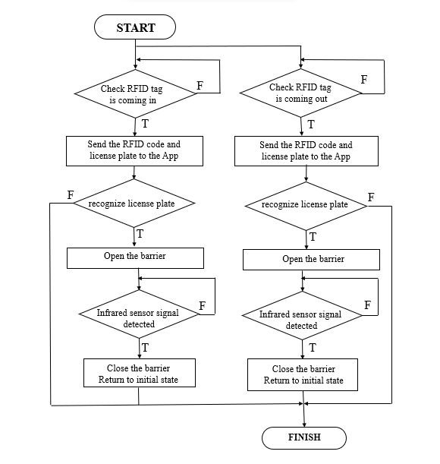
Design system
Notes:
Today I'd like to give you an overview of cache memory
This presentation(prez.ənˈteɪ.ʃən) is structured(strʌk.tʃəd) as follow
part 1 Introducing cache memory
part 2 Tranformation of cache memory
part 3 Organization(ɔː.ɡən.aɪˈzeɪ.ʃən) of cache

