Slide 1
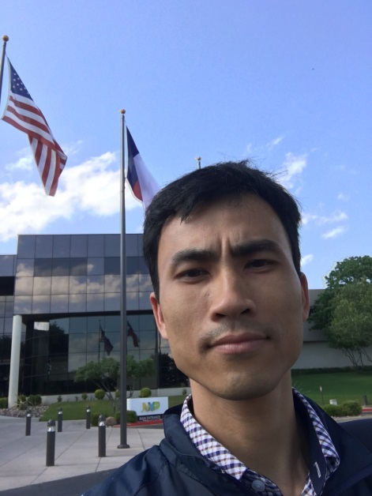
Presentation introduce about myself
PERSONAL INFORMATION
First name : TRUNG QUANG
Surname : NGUYEN
Date of birth : February 10, 1982
Gender/Status : Male / Married
Address : P610, No3T5 building, Diplomatic Delegation, Xuan Tao ward, North Tu Liem District, Hanoi
Mobile : +84975861910
E-Contact : nguyentrungquang102@gmail.com

Slide 2


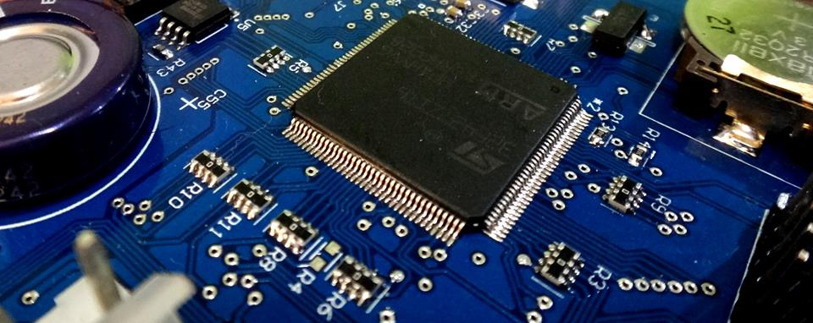

Education
Electronic Telecommunication Engineer from Dong Do University: From 2001 to 2006
Good Practice online course : JavaScript on codecademy.com
Sam Sung Test software certificates

Slide 3





Work Experience
2009
2014
2016
2017
Now
2006 - 2009
2009 - 2014
2014 - 2016
2016 - 2017
2017 - Now
Electronic Specialist
Lead Engineer
Senior Developer
Team Leader
Lead Engineer

Slide 4


Work Experience
Main tasks:
Development Firmware for Toys ROBOT on PIC microcontroller by C.
Design Driver of Step Motor, DC Motor for Industrial ROBOT, Production Lines…
Main tasks:
Development firmware for Embedded System by C, C++ programming language.
Write design documents, user manual
Testing & Debug the design.
Assign task for other members of team - Making Report to Manager
Main tasks:
Handle issue relate to Power Consumption, Audio, SIM, of sea projects
Assign task for other members of team
Making Report to Manager
Analysis the issue in the Software of CP (Communication Processor) layer
Contacting Vendor
Main tasks: (development software for embedded system in Automotive).
Development Driver for Embedded system in C (GPT, ICU, CAN, SCI)
Development bootloader in C for Secure download system Projects
Main tasks:
(development firmware for embedded system of smarthome project).
Development firmware for MCU by C++ on the QT Creator

Slide 5
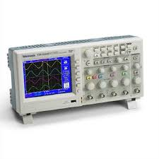



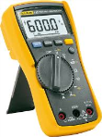

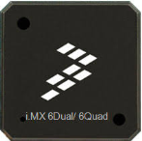




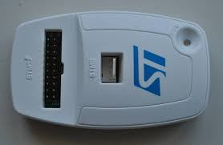
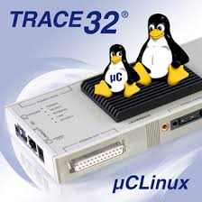
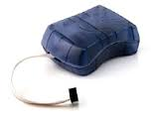
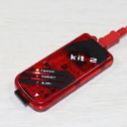
Technical skills
Microcontroller:
ARM, Power PC, 8051, AVR, PIC
Others:
Electronic (analysis schematic of circuit)
Measurement equipment (oscilloscope, logic analyzer…)
Analysis equipment (Can vector, flexray vector)
Microsoft Office
Programming languages
C,C++, ASM, JavaScript
Debuging tool:
Trace32 Lauterpach
St-link for STM32
Pickit2
AVRISP

Slide 6



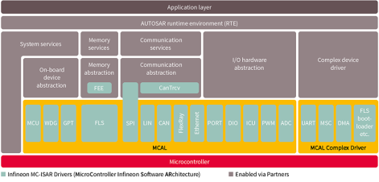
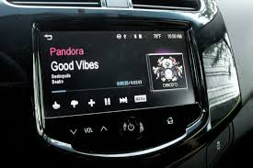




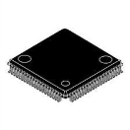

The Projects is Joined
1
2
3
CMA Project
( Media Player Application for Automotive )
Secure Download system . (bootloader for download system )
MCAL Driver
Elf files
GPT
ICU
CAN

Slide 7
The Projects is Joined
Other
Drink Vending Machine
Developing software for Toy robot
Developing software for Data Transferring via Optical system.
Developing software for Sensor Data Collection Systems

Slide 8







Tool, Environment used for developing
Git, Jira, Harmony
Mplab, CCS for PIC, AVR Studio, Ardruino, Eclipse, QT
Compilers: GCC, Diab, Green hill.
Altium PCB Designer

Slide 9
Thank You !

