Slide 1
STARBUCKS OFFER PERSONALIZATION
COSC2789 -Practical Data Science
Group 12

Slide 2

INTRODUCTION
Starbucks is being well known as the largest coffeehouse company in the world at the moment. However, it is also being famous as a world-leading data-driven company that utilizes the use of data to elevate their business. One of the most famous business data-driven business approaches of Starbucks is personalization promotion. Starbuck uses the data gathered from the Starbucks reward mobile app and performs analysis to send the most suitable offer to a customer. In the final assignment of the course Practical Data Science, a group of four students will try to simulate the analysis process to build a model that can predict which type of offer is effective for the customer.

Slide 3
TABLE OF CONTENTS
01
02
03
RESULT AND DISCUSSION
BUSINESS OBJECTIVE AND HYPOTHESIS
DATA SCIENCE PROCESS

Slide 4
01
BUSINESS OBJECTIVE AND HYPOTHESIS

Slide 5
PROBLEM STATEMENTS
What is the most effective offer that customer is most likely to use?

Slide 6
BUSINESS UNDERSTANDING
The process of an offer are:
For BOGO and discount:
offer_recieved ---> offer_viewed ---> offer_completed ---> transaction
For informational offer:
offer_recieved ---> offer_viewed ---> transaction
=> An offer is considered success if the offer status is viewed

Slide 7
02
DATA SCIENCE PROCESS

Slide 8
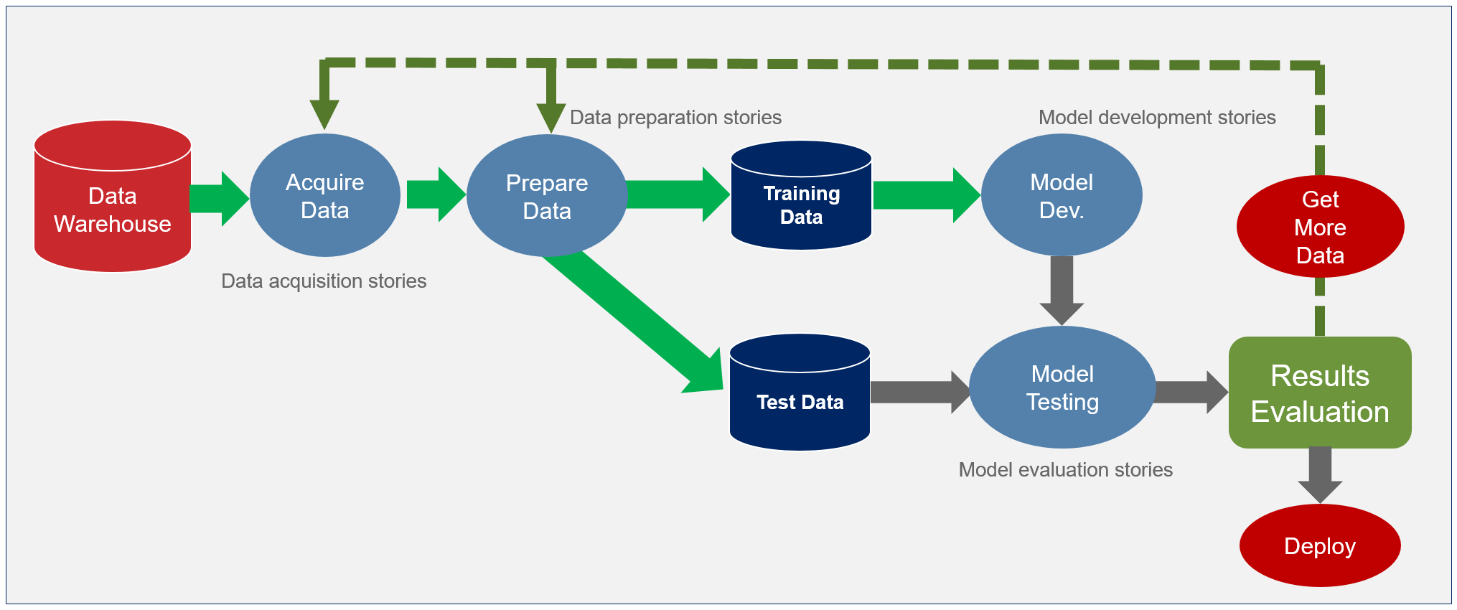
ROADMAP
Source: Agile Data Science – Addendum – The Burndown

Slide 9
DATA SET
portfolio.json: offer id and its relevant data
profile.json: customer demographic data
transcript.json: record for transactions, offers received, offers viewed, and offers completed

Slide 10
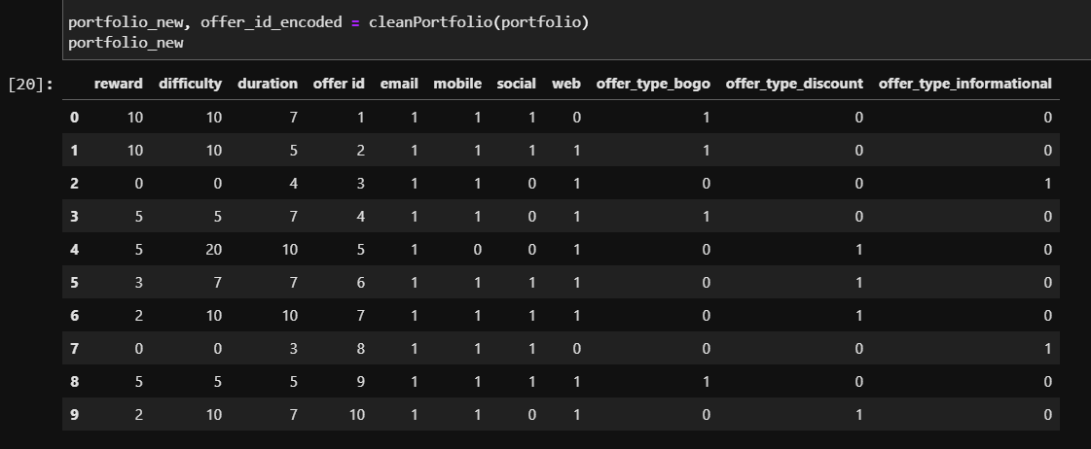
DATA PREPARATION
Portfolio.json cleaning steps:
Change the offer_id to integer value
One hot encoded the channel and offer type column
Drop unnecessary columns

Slide 11
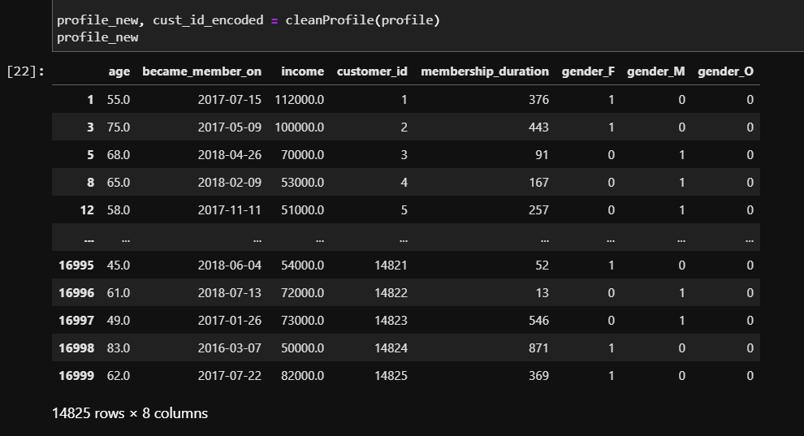
DATA PREPARATION
Profile.json cleaning steps:
Normalize the customer id
Drop columns with missing gender and age
Format the date in became_member_on column
Create the member duration columns
One hot encoded gender
Change the age over 100 to NaN

Slide 12
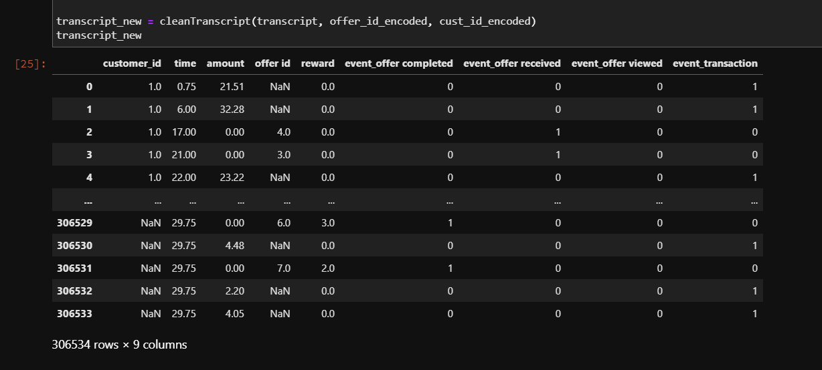
DATA PREPARATION
Transcript.json cleaning step:
Map the customer and offer id
Sort the data by customer and time
Split the “value” collumn
Fill the N/A value in amount and reward column
Split the event column
Change the time to hours to days

Slide 13
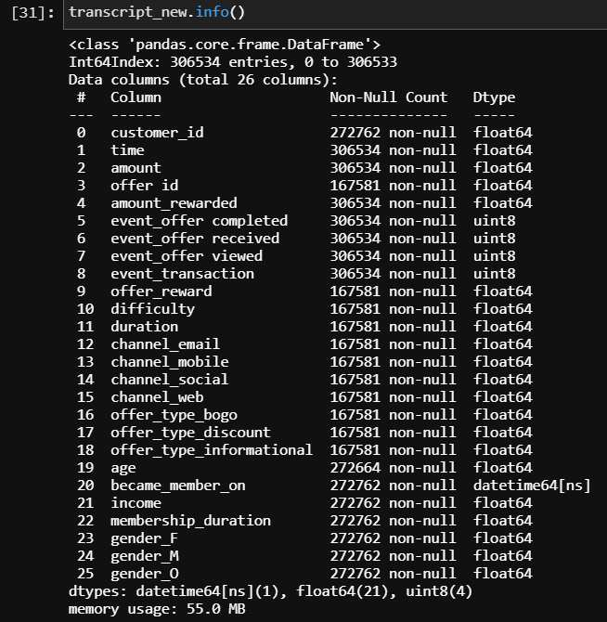
BUSINESS UNDERSTANDING
Merge the portfolio and profile data to transcript

Slide 14
DATA MODELLING
Feature engineering
Model evaluation
02
04
01
03
Deployment
Parameter tuning & Model training

Slide 15
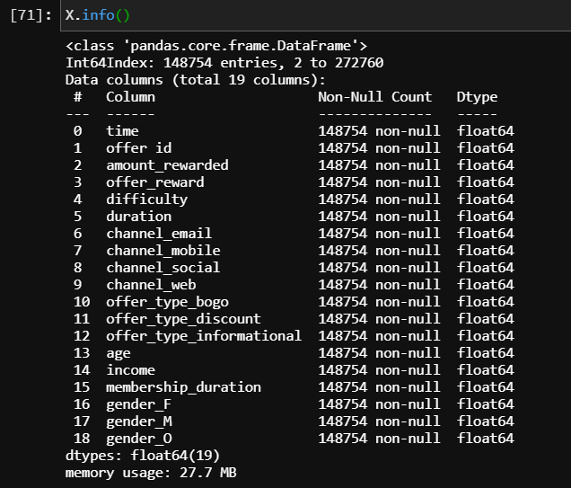
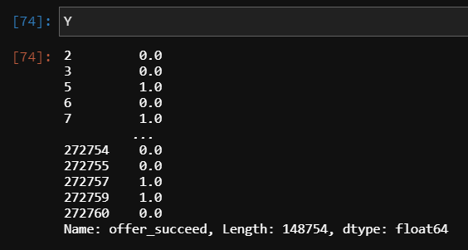
FEATURES ENGINEERING
Drop all the column with nulls value
Drop duplicate
Make target column “offer_succeed”
Select the feature

Slide 16
Model training
Logistic Regression
Random Forest Classifier
AdaBoost Classifier
LightBGM Classigier

Slide 17
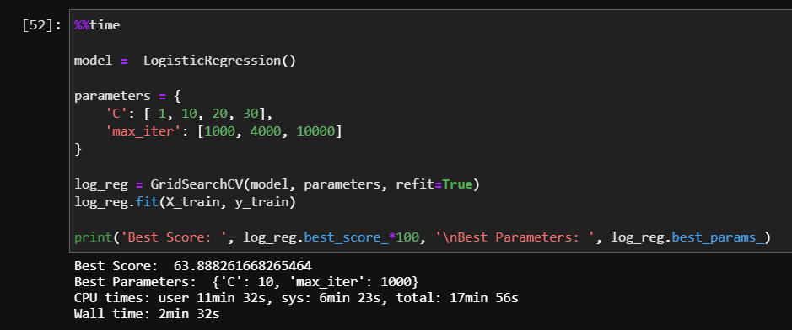
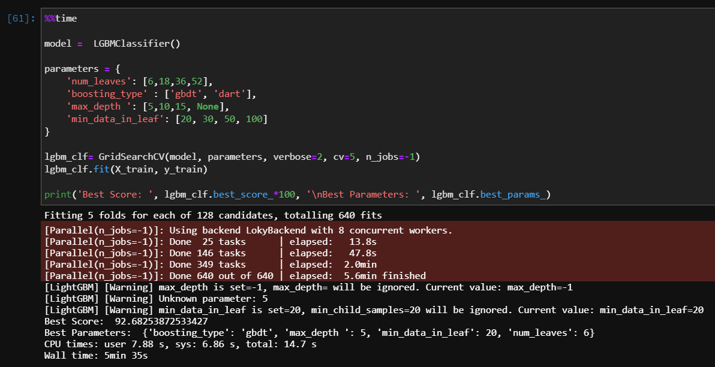
Parameter Tunning
Research about each model to chose the most important parameters
Create a list of possible value for each parameter
Using GridSearchCV to train model and select the best params

Slide 18
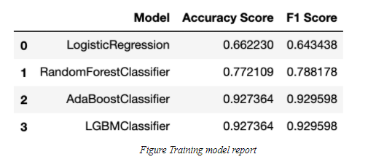
Model Evaluation – models’ score

Slide 19
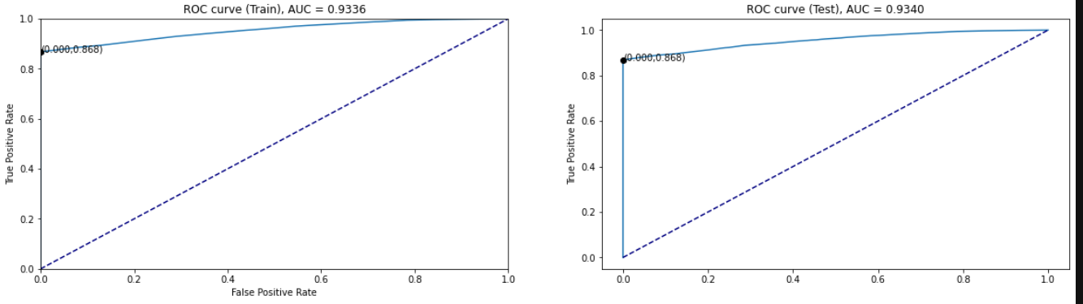
Model Evaluation – ROC graph

Slide 20
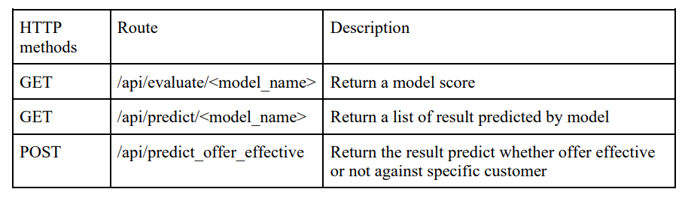
Deployment - API

Slide 21
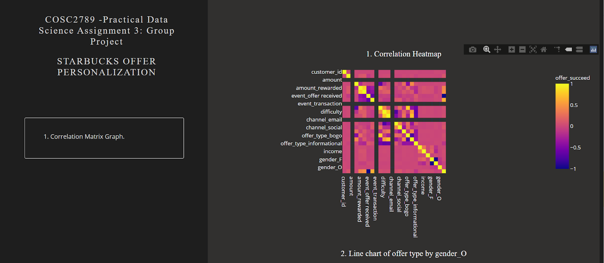
Deployment - Dashboard

Slide 22
03
RESULT & DISCUSSION

Slide 23
Conclusion
In conclusion, from the data of customer behavior of Starbucks application, we have applied the process of data science to draw some insights and build a predictive model to evaluate the effectiveness of an offer based on the customer profile. The first part of this process is data cleaning which is one of the most challenging parts in this project, because the raw data is in JSON type with dictionary structure. Thus a tremendous amount of work has to be done when dealing with data such as one hot encoding categorical features, drop null value, merge the data sets. After finished cleaning, in the EDA part we have analyzed the data to acquire some insights about the customer spending trend with different offer types and customer membership duration over time. Finally, we have performed parameter tuning with 4 different binary classification models and found out that the LightGBMClassifier is the most effective model with the accuracy and f1 score over 0.9. In the future, some improvement can be done with this project. From the information, we can make more features to increase the accuracy of the model, other high performance models such as XGBoost or CatBoost could be taken into account and the project can be taken to a further step which is to predict the best offer type for a specific customer.

Slide 24
Q&A

