Slide 1

Principles of Package Design
Software Engineer
Ta Quang Tung

Slide 2


Packages
Classes are not enough for organizing large applications.
Packages partition the classes according to some criteria.
Packages have dependency relationships with each other.
What criteria to put classes into packages?

Slide 3

Principles of Software Package Design
Granularity: The Principles of Package Cohesion
  The Reuse-Release Equivalent Principle (REP)
  The Common-Reuse Principle (CRP)
  The Common-Closure Principle (CCP)
Stability: The Principles of Package Coupling
  The Acyclic-Dependencies Principle (ADP)
  The Stable-Dependencies Principle (SDP)
  The Stable-Abstraction Principle (SAP)

Slide 4
The Reuse-Release Equivalent Principle (REP)
The granule of reuse is granule of release.
Any thing that reuse must also be released and tracked.
Reusability comes only after there is a tracking system take place.
Reusabilty is based on packages.
Reusable packages must contain reusable classes.

Slide 5
The Common-Reuse Principle (CRP)
The classes in a package are reused together. If you reuse one of the classes in a package, you reuse them all.
Classes are seldom reused in isolation.
In one package, we would expect to see classes that have a lots of dependencies on each other.

Slide 6
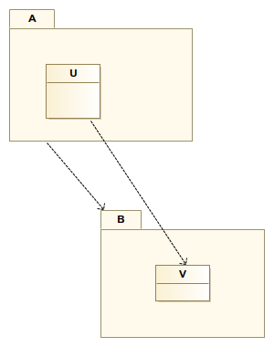
The Common-Reuse Principle (CRP)
It tell us what classes should put together in a package, and what shouldn’t put in the same package.

Slide 7
The Common-Reuse Principle (CRP)
It is common for packages to become a shared libraries, DLLs, JARs.
We want to make sure that classes we put in a package are inseperable.
Classes are not tightly bound to each other should not be in the same package.

Slide 8
The Common-Closure Principle (CCP)
The classes in a package should be closed together against the same kinds of changes. A change that affects a package affects all the classes in that package and no other packages.
This is Single-Responsibility Principle restated for packages.
Changes should occur all in one package.

Slide 9
The Common-Closure Principle (CCP)
Prompts us to gather in one place all classes that are likely to change for the same reasons.
Closely associated with Open-Closed Principle.
Changes are restricted to a minimal number of packages.

Slide 10
The Acyclic-Dependencies Principle (ADP)
Allow no cycles in the package-dependency graph.
The “morning-after syndrome”
  In a large project, developers modify the same source files.
  Isn’t a big problem in a small project.
  Can become a nightmare in a large project.
  ADP is solution for that problem.

Slide 11
ADP solution for morning-after syndrome
Partition the development environment into release packages.
Packages become unit of work.
When a package work, devopers release it for use by the others.
Everyone else use the released version.
Other teams can decide accept immediately the new release or not.
No direct interference.
This method is widely used.
But it requires no cycles in dependency graph.

Slide 12
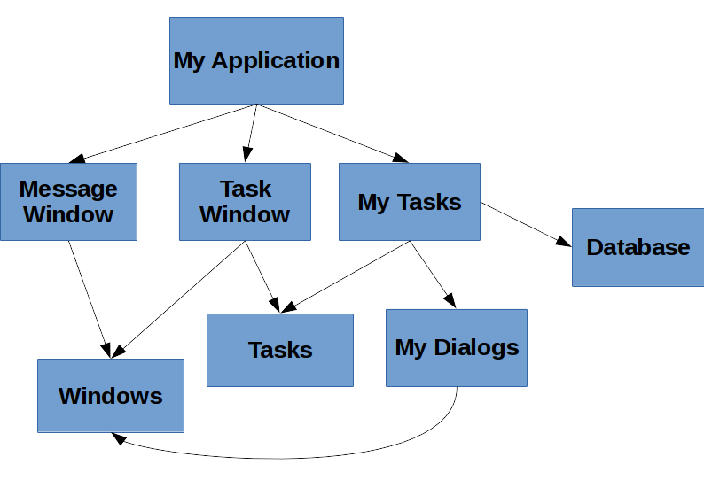
ADP solution for morning-after syndrome

Slide 13

The Effect of a Cycle in the Package Dependency Graph

Slide 14
Breaking the Cycle
Apply the Dependency-Inversion Principle (DIP).
Create a new package, move the class(es) that both packages depend on into the new package.

Slide 15
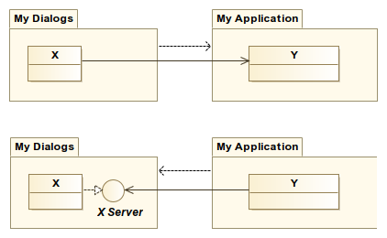
Apply the DIP

Slide 16
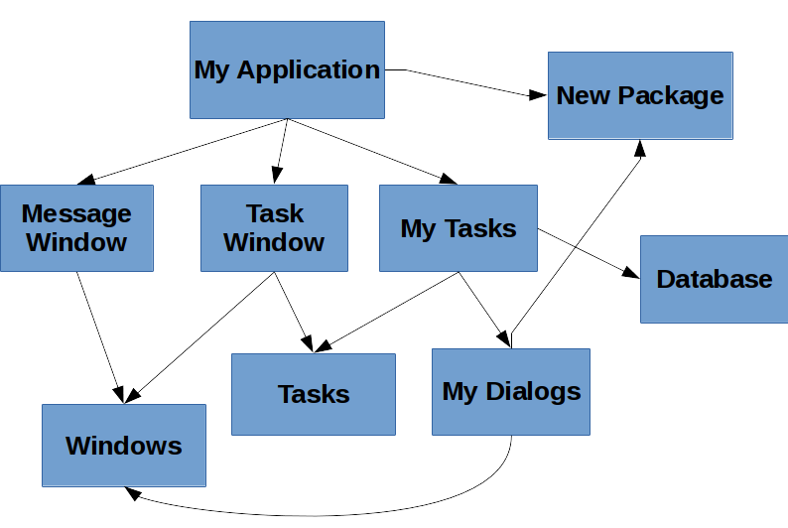
Create a new package

Slide 17
Top-Down Design
The package structure cannot be designed from top-down.
It evolves as the system grows and changes.
Package dependency diagrams have very little to do with describing the function of the system.
It is a map to buildability of the application.

Slide 18
The Stable-Dependencies Principle (SDP)
Depend in the direction of stability.
Design cannot be completely static.
Any package that we expect to be volatile should not be depended on a package that is difficult to change.

Slide 19
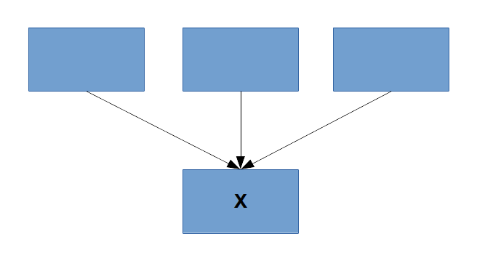
Stability
There are many factors make a software package hard to change.
One immedate factor is dependency of other packages.
X is a stable package.

Slide 20
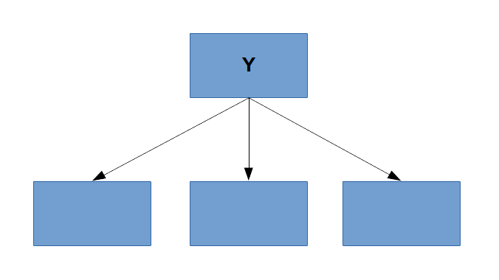
Stability
Y is an instable package.

Slide 21
Not all packages should be stable
If all packages are maximally stable, the system would unchangeable.
Should have packages that some are stable and the others are instable.
A stable package should not depend on instable packages.

Slide 22
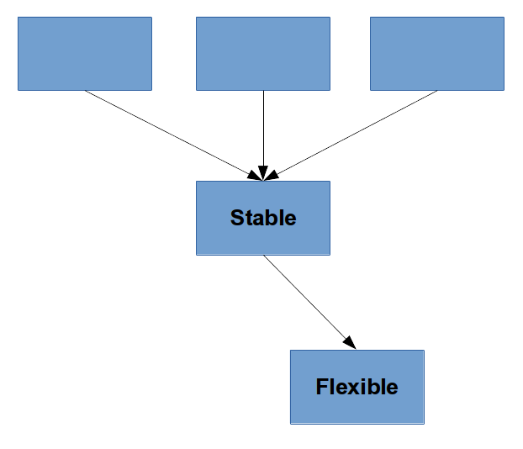
Violation of SDP

Slide 23
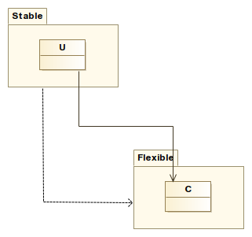
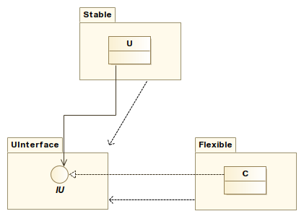
Fixing the violation of SDP

Slide 24
The Stable-Abstraction Principle (SAP)
A package should be as abstract as it is stable.
Sets up a relationship between stability and abstractness.
The abstractness make stable packages can be extended.
Instable packages should consist of concrete classes.
Stable packages that are extensible are flexible and do not make many constrains for the design.
Dependencies run in the direction of abstraction.

Slide 25
Thanks for Listening

